Slide 1
Will I Stay or Will I Go Now? A report on Attrition
By:
Stacy Bowler
and
Derrik Miller

Slide 2
Business Problem
Employee turnover is an expensive problem for a company.
We assume there’s a cost incurred of $40,000 every time an employee leaves due to lost productivity as well as time spent to find, hire, and train a new employee.
With that in mind, should we adopt a retention program using this predictive model and how much financial value does it create?
The primary objective is to accurately determine which employees are likely to quit before they do.

Slide 3
Executive Summary
Based on the assumptions:
Cost of employee turnover: $40,000
Cost of retention intervention: $8,000
This could be given as one-time bonuses, annual pay increases, or other career growth opportunities; depending on the needs of the employee.
Retention intervention success rate: 60%
Using this model to intervene would save the company $1,592,000 in expected costs. It is worth having a retention program.
For a company of 1470 employees, the program would cost $1,552,000, having invested $8k into 194 total employees.
This resulted in ~ 79 employees being retained for a total savings of $3,160,000.

Slide 4
Data Summary
Data source: kaggle.com
The data is a fictional dataset created by IBM data scientists.
The dataset contains 1470 rows of data with 35 columns each.
All identified ideal data was in dataset.
Main Columns
Age
Attrition
Job Role
Job Satisfaction
Marital Status
Monthly Income
Number of Companies Worked
Overtime

Slide 5
Data Preparation
The dataset required little cleaning.
For this project, we converted ‘Attrition’ to a binary outcome where Yes = 1 - meaning the employee left the company
Removed from data: Attrition, Department, EmployeeNumber, DailyRate, MonthlyIncome, EmployeeCount, Over18, PerformanceRating, StandardHours
Removed due to the similarities shared with other predictors, and thus they were just adding more noise.

Slide 6
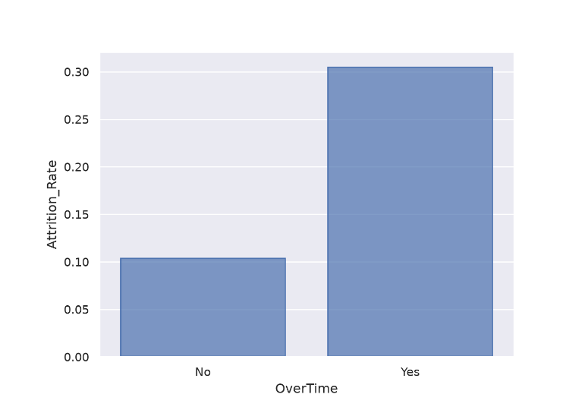
Overtime vs Attrition
Employees who work overtime are much more likely to leave.

Slide 7
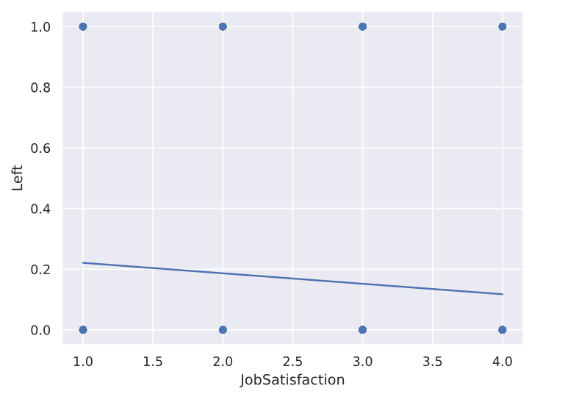
Satisfaction vs Attrition
4 = Very Satisfied, 1 = Not Satisfied.
More satisfied employees are more likely to stay.

Slide 8
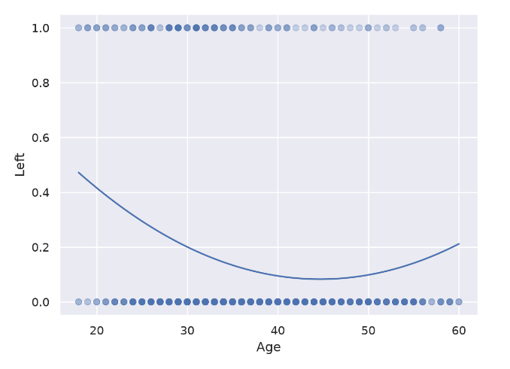
Age vs Attrition
Younger employees are more likely to leave, but levels off, then reverses around age 45.
Younger employees may be more mobile and able to accept jobs elsewhere.
Middle-aged workers are more likely to have families and opt for more stable employment.
Older employees could be leaving for more senior level positions or retirement.

Slide 9
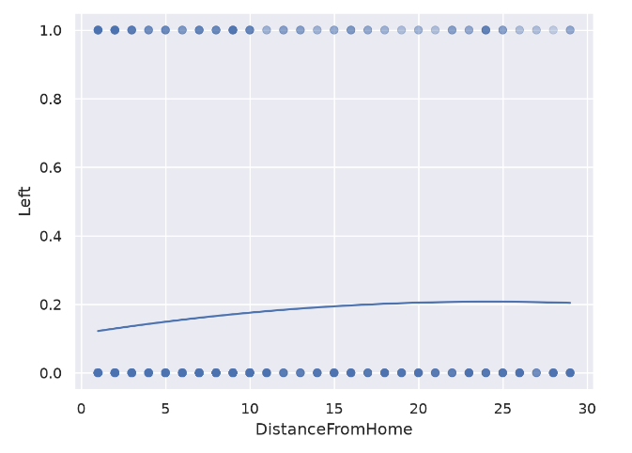
Commute Vs Attrition
Commute distance impacts attrition, but the effect wanes around 15-20 miles.

Slide 10
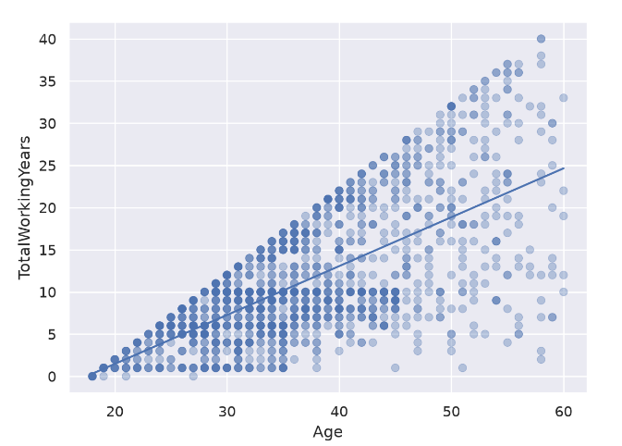
Age vs Total Working Years
Age is somewhat correlated with total working years, but not as much as expected.

Slide 11
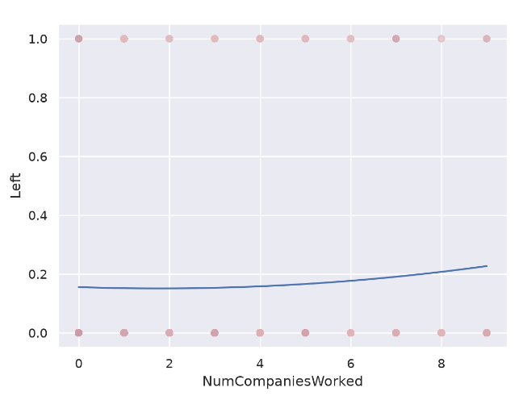
Number of Companies and Attrition
Employees that have worked at more companies are more likely to leave.
Notes:
This may be due to employees that have worked at more companies are more likely to be looking for new opportunities
Could also be retirees or other senior employees

Slide 12
Model Introduction
Elastic Net was chosen for the final model.
We ran the dataset against an Elastic Net, Ridge, and LASSO models. We also considered interactions, but ultimately the added complexity didn’t provide any additional value.
Elastic Net was selected because it achieved comparable utility to the other models while providing better accuracy and precision.
Precision was important, because each false positive costs the company $8,000.

Slide 13
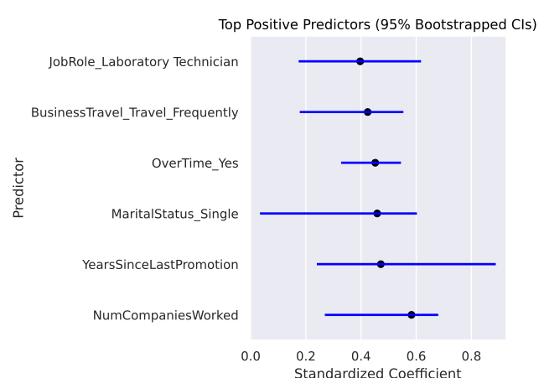
Top Positive Predictors
Notes:
Positive meaning more likely to leave

Slide 14
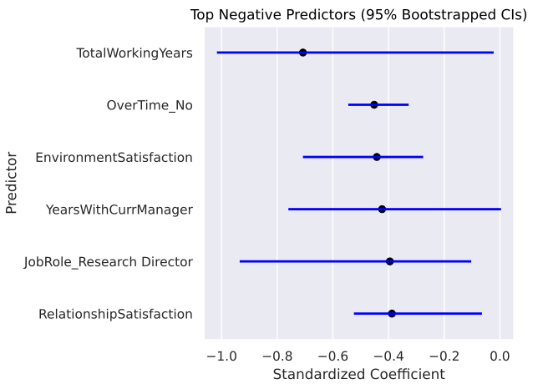
Top Negative Predictors
Notes:
Negative meaning more likely to cause employees to stay

Slide 15
Important Continuous Predictors
Overtime
Employees working overtime have roughly 8 times the odds of attrition compared with employees who do not, holding the other variables constant:
E^2.07 ≈ 7.95
Marital Status
Single employees have roughly 5 times the odds of attrition compared to divorced employees, holding the over variables constant:
E^1.60 ≈ 5

Slide 16
Important Continuous Predictors (continued)
Business Travel
Employees traveling frequently have roughly 7.5 times the odds of attrition compared to employees who do not travel, holding the other variables constant:
E^2.02 ≈ 7.5
Employees traveling rarely also have roughly 2.9 times the odds of attrition compared to employees who do not travel, holding the other variables constant:
E^1.05 ≈ 2.9

Slide 17
Recommendations
Monitor employees with sustained overtime requirements.
Reviewing workload and travel expectations for frequently traveling employees.
Provide career development opportunities for employees experiencing perceived stalled progression.
Use satisfaction measures as early indicators of disengagement.

Slide 18
Conclusion
Based on our assumptions and the data available, a retention program is well worth the investment as it results in significant cost savings from having to replace an employee.
Monetary benefits can be one-time installments, a more permanent yearly raise, or an investment into career growth opportunities.
Money invested into employees as false positives is still likely to improve moral, productivity, and possibly other benefits.
Over time and with more data, the model may be improved resulting in even more savings.

Slide 19
Closing Thoughts
In this example:
Targeted 194 high-risk employees with an $8,000 intervention ($1,552,000 total investment)
Successfully retains 79 employees who otherwise would have left.
63 employees were false positives
52 employees left the company even after the intervention attempt.
At $40,000 saved per retained employee ($3,160,000 gross savings), the program yields a net ROI of $1,608,000.
In other words, for every $1 invested, $2.04 in turnover costs are avoided.

Slide 20
What’s Next?
Identify ideal data.
Since this data was simulated, it’s possible we could build a stronger model if we had real data.
Track and add employee hiring cost to the data.
Add additional employee engagement and compensation variables.
Try to measure whether targeted interventions actually reduce attrition after identification over the long term.

Slide 21
Questions?

