Slide 1

Architecture & Overview
Smart UML – Sketch enabled multiuser UML Diagram designer
Presented By
Omar Al Zabir
Shahedul Huq Khandkar
Mehfuz Hossain
Awnik Raihan

Slide 2

Smart UML Application
Notes:
<footer>© 2003-2004 Microsoft Corporation. All rights reserved.
This presentation is for informational purposes only. Microsoft makes no warranties, express or implied, in this summary.

Slide 3
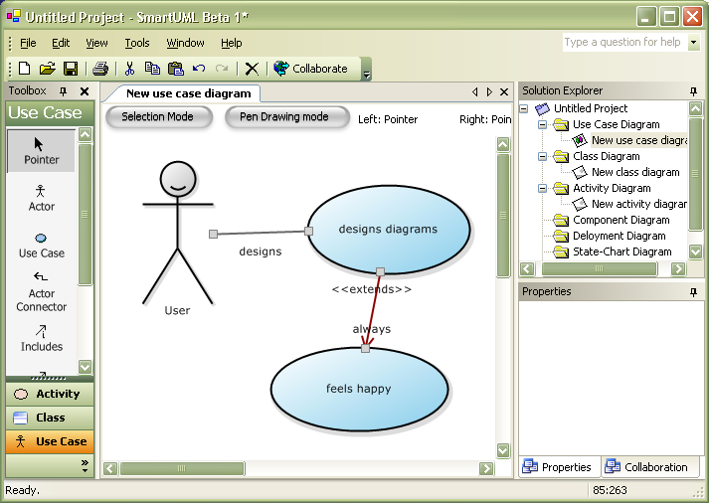
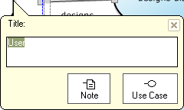
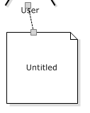
Innovative User Interface
In-place convenient editor with full pen support
Design shorthand, create connected symbols from one click
Create colorful lively symbols and great looking diagrams!

Slide 4
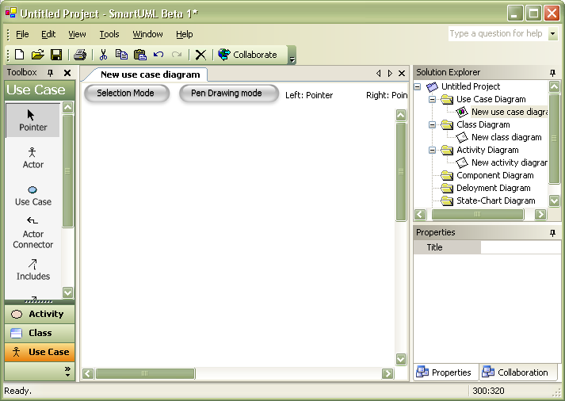
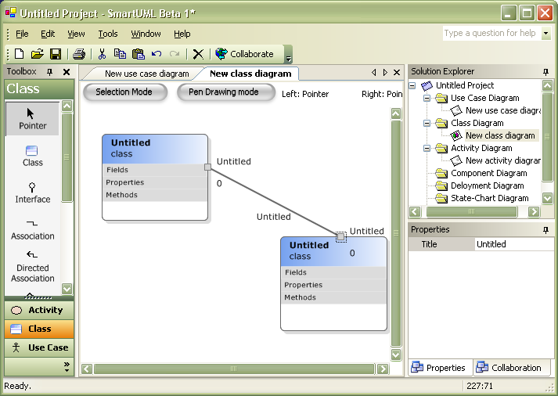


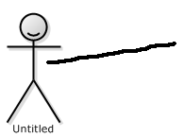










Ink support
Seamless drawing and editing with pen
Draw on existing diagrams with ink to make simple changes
Freehand natural drawing using Microsoft Tablet PC SDK
Arrow Head
Diamond

Slide 5
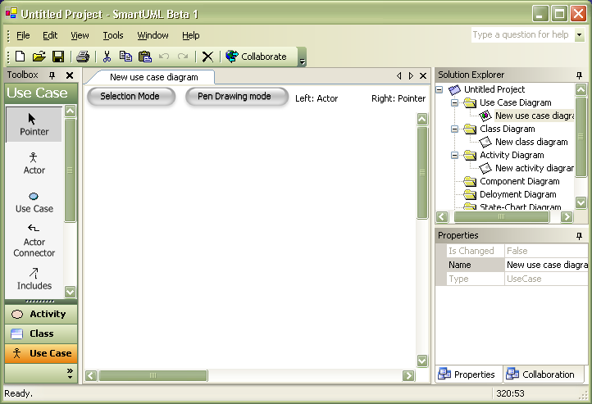




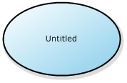



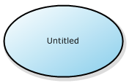


Enhanced Mouse support
Faster drawing using the “Design prediction” feature.
It predicts what you will draw next and automatically selects the right tool for you
Auto introduce design elements whenever its necessary.
Draw a connector, it automatically adds the right symbol
Drawing and editing at the same time. Right mouse button is always the handy pointer. Never select the pointer tool again

Slide 6
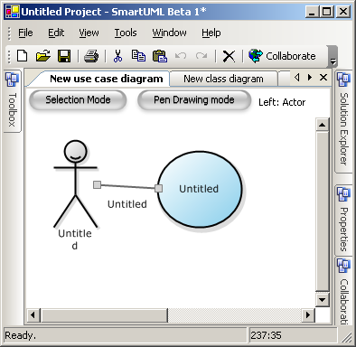
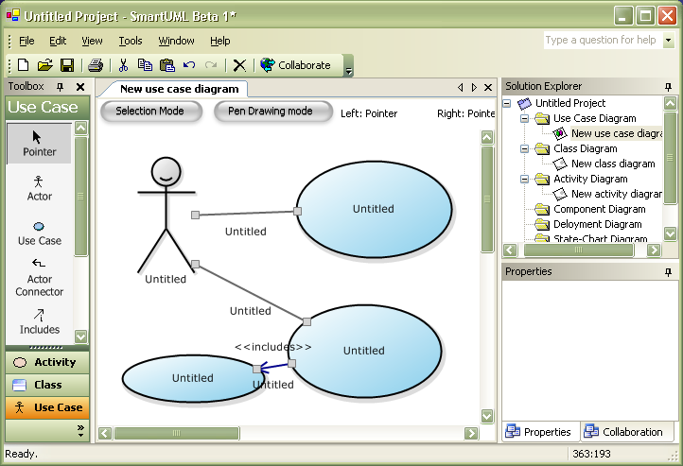
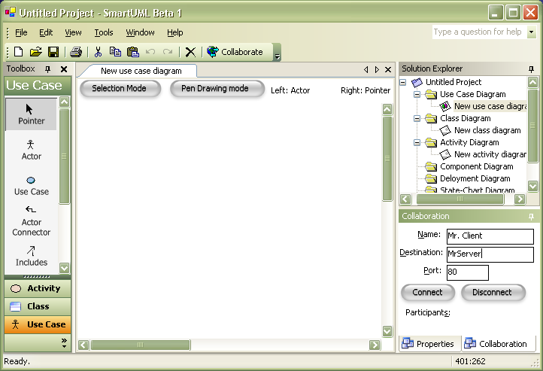
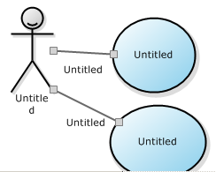
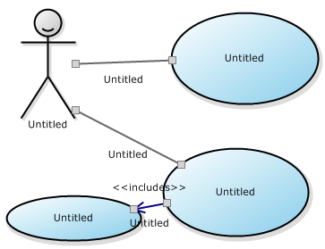
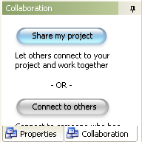
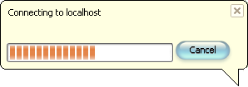
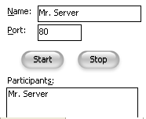
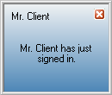
Collaboration
Draw diagrams in a team using the network drawing feature. It’s an electronic whiteboard!
Transfer/Share diagrams with team mates quickly over LAN, WAN and Internet
Firewall friendly plain English (HTTP) communication (Windows XP SP2 - No problem)

Slide 7
Sketch Recognition
Notes:
<footer>© 2003-2004 Microsoft Corporation. All rights reserved.
This presentation is for informational purposes only. Microsoft makes no warranties, express or implied, in this summary.

Slide 8
Basic Architecture
Drawing Board
This layer works with UI. It collect strokes in buffer and pass to parser layer
Sketch Recognition
Parser
A parser can have input strokes in UI dependant format and convert it to a generic stroke format
Generic
Geometric Shape Recognizer
A Shape Recognizer recognize the basic geometric shape from input strokes (i.e. Line, triangle ... )
Context specific
Symbol Recognizer
A Symbol Recognizer detects a context specific symbol from a collection of basic geometric shape. For ex: a UML Symbol Recognizer will detect ‘Note’ if the basic shape is Rectangle and context is Use Case.
Object Model

Slide 9
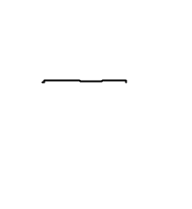
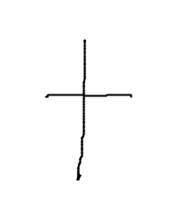
Drawing Board
A drawing board is a place where user can draw freehand diagrams using pen interface.
The drawing board collects the user strokes using Microsoft Table PC ‘s Ink interface. After a certain interval it passes the collected strokes for detection. For use case diagram, it passes the collection when ever a stroke is generated.

Slide 10
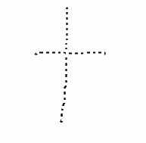
Parser
This is the first layer of sketch recognition. It converts the input data (i.e. strokes) to a common format ( Point array ) which is compatible with other layers.
By replacing only this Parser layer the recognition layer can be reused in any other purpose.
UI
Parser
Shape Recognizer
Array of Microsoft.Ink.Stroke
Common data format (Point array)

Slide 11
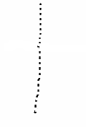
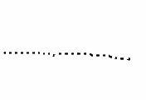

Detecting a Symbol
This layer detects the basic geometric shapes from Point array. For multiple strokes, it will be an array of Point array
Iteration 1
Shape Recognizer
Symbol Recognizer
Common data format (Point array)
Shape.Line
No match found
No symbol found for shape in current context, so save in stake
Iteration 2
Shape Recognizer
Symbol Recognizer
Common data format (Point array)
Shape.Line
Object of ObjectModel.Actor
No symbol found for shape in current context so match combinations with stack value

Slide 12
Generic Geometric Shape Recognizer
IsLine
IsDiamond
IsRectangle
IsAngle
IsCircle
IsEllipse
IsTriangle
IsZigzag
No
Yes
Create Object with values

Slide 13
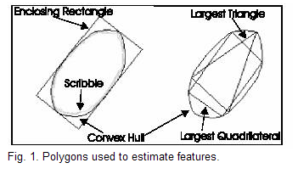
Recognizing basic Shapes
Basic Calculations:
Length of a stroke = sum of distance between every two points
Length of enclosed rectangle [(height + width) x 2] = L_{ER}
Ratio of ( lengthOfStroke / lengthOfConvexHull ) = L_{sc}
Ratio of ( Area of Convex Hull and Enclosing Rectangle) = A_{CE}
PerimeterOfEnclosingRectangle = P_{ER}

Slide 14
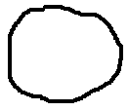
Recognizing basic Shapes
ZigZag:
Ratio of ( lengthOfStroke / lengthOfConvexHull ) should be between 1.6 and 4.2
Circle:
Two end met
false
Yes
Lsc > 1.3
false
Yes
.7<Ace<.8
false
Yes
true

Slide 15
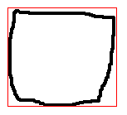
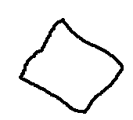
Recognizing basic Shapes
Rectangle:
Two end met
false
Yes
Ace>=.8
false
Yes
true
Diamond:
Two end met
false
Yes
P_{ER}/L_{ER} >1.3
false
Yes
.7<Ace<.8
false
Yes
true

Slide 16

Recognizing basic Shapes
Line:
Two end met
A = distanceBetween2End / LengthOfStroke
B = EnclosingRecHeight>EnclosingRecWidth
C = height / width > 6
D = convexHullArea / enclosingRecArea
E = AverageSlopeVariation
false
Yes
X < 0.8
false
Yes
B
false
Yes
C
false
Yes
D < 0.3
E < 5
false
Yes
Yes
True
True

Slide 17
XUML Persistence
Notes:
<footer>© 2003-2004 Microsoft Corporation. All rights reserved.
This presentation is for informational purposes only. Microsoft makes no warranties, express or implied, in this summary.

Slide 18

XUML Overview
  XUML = XML for UML
  New human readable application independent generic format named “XUML”
  Easier for XML Transformation using XSL in order to build custom import/export to other formats. For ex, Rose XMI
  Supports first ever “XSD” validation technique for dynamic UML syntax and semantics checking.

Slide 19
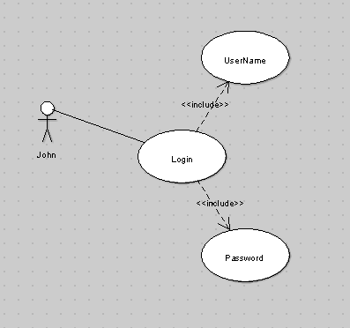
Simple Diagram
A simple use case diagram( using a well-known UML tool )
*John Logs in , he requires to have an user name and a password

Slide 20
XMI – Unreadable, too complex
Generate tones of unreadable xml
<?xml version="1.0" encoding="UTF-8"?>
<XMI xmi.version="1.0">
<XMI.header>
<XMI.documentation>
<XMI.exporter>Novosoft UML Library</XMI.exporter>
<XMI.exporterVersion>0.4.20</XMI.exporterVersion>
</XMI.documentation>
<XMI.metamodel xmi.name="UML" xmi.version="1.3"/>
</XMI.header>
<XMI.content>
<Model_Management.Model xmi.id="xmi.1" xmi.uuid="-84-16-2-12-1e1be92:10122353358:-7ffe">
<Foundation.Core.ModelElement.name>untitledModel</Foundation.Core.ModelElement.name>
<Foundation.Core.ModelElement.isSpecification xmi.value="false"/>
<Foundation.Core.GeneralizableElement.isRoot xmi.value="false"/>
<Foundation.Core.GeneralizableElement.isLeaf xmi.value="false"/>
<Foundation.Core.GeneralizableElement.isAbstract xmi.value="false"/>
<Foundation.Core.ModelElement.name>Login</Foundation.Core.ModelElement.name>
<Foundation.Core.ModelElement.isSpecification xmi.value="false"/>
<Foundation.Core.GeneralizableElement.isRoot xmi.value="false"/>
<Foundation.Core.GeneralizableElement.isLeaf xmi.value="false"/>
<Foundation.Core.GeneralizableElement.isAbstract xmi.value="false"/>
<Foundation.Core.ModelElement.namespace>
<Foundation.Core.Namespace xmi.idref="xmi.1"/>
</Foundation.Core.ModelElement.namespace>
//---------- More to Continue------------------------------------------------------

Slide 21
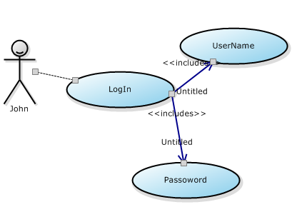
XUML Format
Use Case Diagram ( Smart UML )
<Project>
<UseCaseDiagram>
<actor id=“actor1”>
<label>John</label>
<associatedWith id=“usecase1” />
</actor>
<useCase id=“useCase1”>
<includes id=“useCase2” />
<includes id=“useCase3” />
</useCase>
<useCase id=“useCase2” >
<label>Password</label>
</useCase>
<useCase id=“useCase3” >
<label>UserName</label>
</useCase>
</UseCaseDiagram>
</Project>

Slide 22
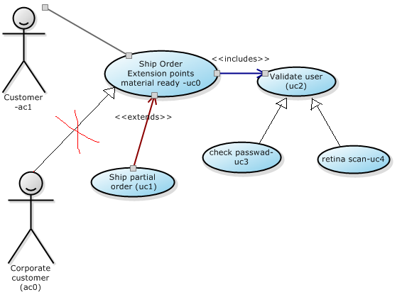
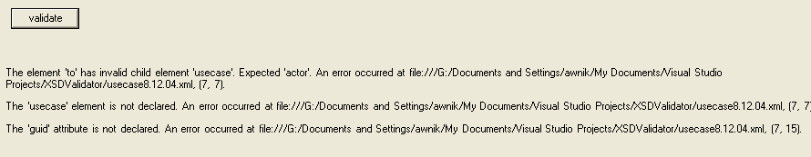
XSD Validation for XUML
Actor- Use case association validation
<actor guid="aco">
<label>corporate customer</label>
<generalization>
<to>
<usecase guid="uc0"></usecase>
</to>
</actor>

Slide 23
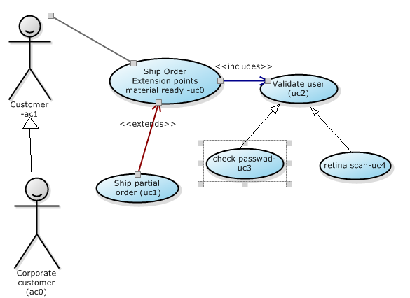
Valid Diagram using XUML
Final Diagram after “XSD” validation

Slide 24
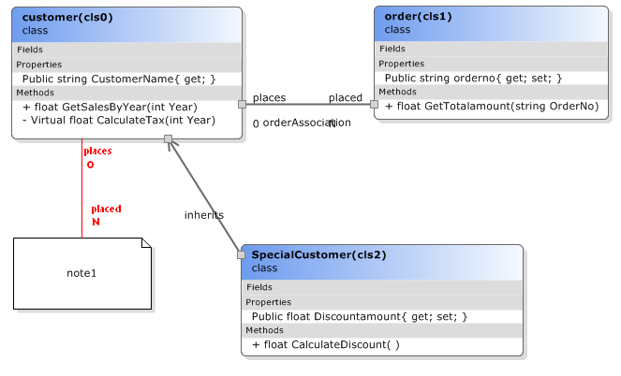
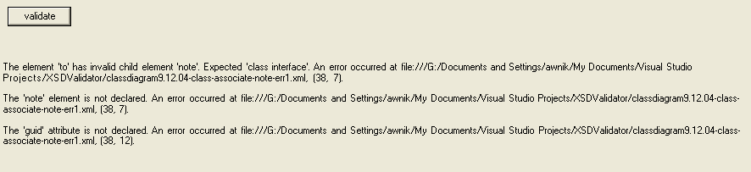
Class Diagram validation
Class – Note Association
<association>
<label>orderAssociation</label>
<from multiplicity="1" fromLabel="places">
</from>
<to multiplicity="n" toLabel="placed">
<note guid="cls1"></note>
</to>
</association>

Slide 25
Distributed Command Pattern
Notes:
<footer>© 2003-2004 Microsoft Corporation. All rights reserved.
This presentation is for informational purposes only. Microsoft makes no warranties, express or implied, in this summary.

Slide 26
Distributed Command Pattern
Executing same command in same process, out-of-process, and over the network in another running process
It is used to perform the same action on multiple running application producing the same result in each application
For example, in a chat server, if one client sends a message, it shows the message on its own screen and also on all the clients connected to the same server

Slide 27






Overview of Command Pattern
Invokes
ICommand
Invoker
Implements
Concrete
Command
Target
Action
Sample Code:
ICommand command = new FileSaveCommand( FileContent );
Command.execute();

Slide 28

Another variant of Command Pattern
Creates
CommandContext
Invoker
Calls
Execute
Target
CommandFacade
ICommand
Make
Executes
Implements
CommandFactory
Concrete
Command
CommandContext context = new FileSaveContext( FileData );
CommandFactory.Execute( context );
Instantiate

Slide 29
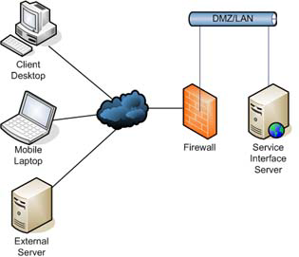
Distributed Command Pattern
Command needs to be executed on the same process and also on other processes simultaneously
Hi
FileSaveCommand
FileSaveCommand
Hi
Hi
FileSaveCommand
FileSaveCommand
Hi

Slide 30
Architecture
Message Bus
Invoker
Execute
CommandBus
Creates
Context
ICommandExecutor
Distributed
Command
Executor
Local
Command
Executor
Serialize Context and Send
Distributed
Command
Executor
Receive
Action
Network
Execute Locally
Target
CommandContext context = new FileSaveContext( FileData );
CommandBus.Execute( context );
Target

Slide 31
Interfaces
CommandBus
  Execute( CommandContext )
ICommandExecutor
  Execute( CommandContext )
  ExecuteLocally( CommandContext )
CommandPipeline
  Add( ICommandExecutor )
  Remove( ICommandExecutor )

Slide 32
Distributed Command Executor
Abstract transportation layer
RemotingTransporter
Send
ITransporter
Distributed
Command
Executor
TCPTransporter
Receive
HTTPTransporter
SMTPTransporter

Slide 33
Collaboration in Smart UML
Draw diagrams in a team using the network drawing feature. It’s an electronic whiteboard!
Transfer/Share diagrams with team mates quickly over LAN, WAN and Internet
Firewall friendly plain English (HTTP) communication (Windows XP SP2 - No problem)

Slide 34
The End
Notes:
<footer>© 2003-2004 Microsoft Corporation. All rights reserved.
This presentation is for informational purposes only. Microsoft makes no warranties, express or implied, in this summary.

