Slide 1

Bank Marketing (Campaign)
DataWizz
LISUM21
21-05-2023

Slide 2
Team Members
Akhil Abraham
Pravallika Sheshabhatter
Shiva Ramezani

Slide 3
Problem Statement
The objective of this analysis is to provide actionable insights and recommendations to XYZ, a private firm planning to invest in the Cab Industry. By examining multiple data sets and conducting exploratory data analysis (EDA), we aim to identify the right cab company for investment based on various factors such as customer segments, company performance, and market trends.

Slide 4
Business Understanding
The business objective of this project is to increase the effectiveness and efficiency of the bank’s marketing campaigns for its term deposit product. By utilizing a machine learning model, the bank aims to identify customers who are more likely to subscribe to the product, enabling targeted marketing efforts. The project seeks to optimize the allocation of marketing resources and improve the overall success rate of the marketing campaigns.

Slide 5
Data Understanding
Column | Type | Description
Age | Numeric data | Age of the customer
Job | Categorical data | Customer’s Job
Marital | Categorical data | Customer’s marital status
Education | Categorical data | Customer’s educational background
Default | Categorical data | Credit in default(Yes/No)
Housing | Categorical data | Customer Housing loan(Yes/No)
Loan | Categorical data | Customer personal loan(Yes/no)
Contact | Categorical data | Preferred contact type
Month | Categorical data | Customer’s last month of contact
Day of week | Categorical | Customer’s Last weekday of contact

Slide 6
Data Understanding
Column | Type | Description
Duration | Numeric data | Customer’s last contact duration
Campaign | Numeric data | No. of contacts made during last campaign
Pdays | Numeric data | No. of days after the client was previously contacted.
Previous | Numeric data | No. of contacts before the campaign
Poutcome | Categorical data | Outcome of previous campaign
Emp.var.rate | Numeric data | Employment variation rate
Cons.price.idx | Numeric data | Consumer price index
Cons.conf.idx | Numeric data | Consumer confidence index
Euribor3m | Numeric data | Euribor 3-month rate
Nr.employed | Numeric data | No. of employees employed

Slide 7
Exploratory Data Analysis
There are a few main issues to address while exploring the data:
Missing values: The absence of values can impact analysis and modeling.
Outliers: Need to address outliers for reliable model training.
Skewed Data: Uneven distribution can affect model assumptions and classifications.
Imbalanced data: Leads to a biased model favoring majority class.

Slide 8
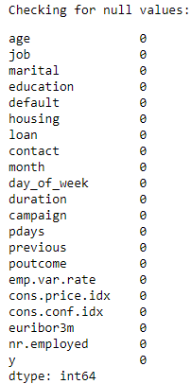
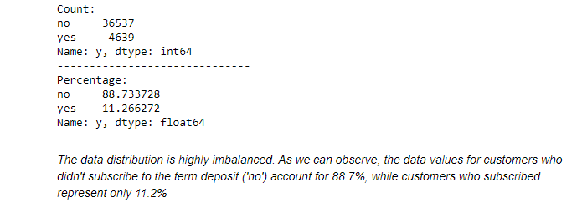
Target variable

Slide 9
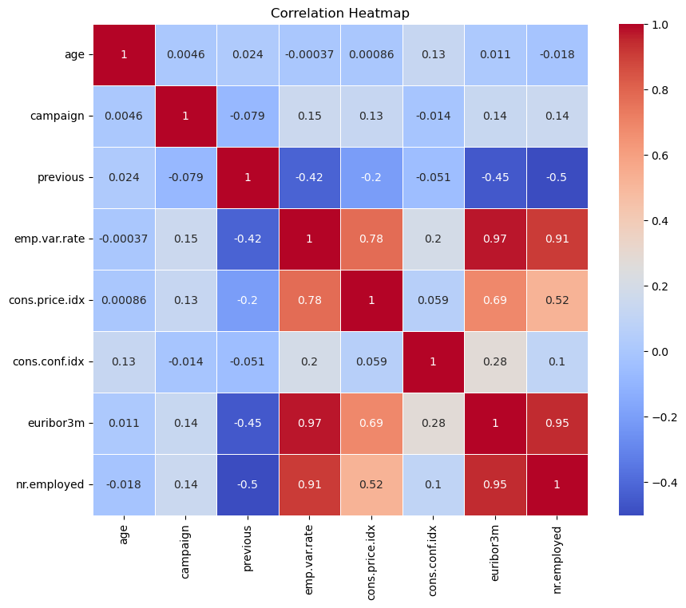
Heatmap
This heatmap shows the correlation between numerical features in the dataset. Most features have low correlation, but 'nr.employed' and 'emp.var.rate,' 'emp.var.rate' and 'euribor3m,' and 'nr.employed' and 'euribor3m' show higher correlations. Additionally, 'cons.price.idx' correlates notably with 'euribor3m' and 'nr.employed.' Further exploration is needed to understand these correlations better

Slide 10
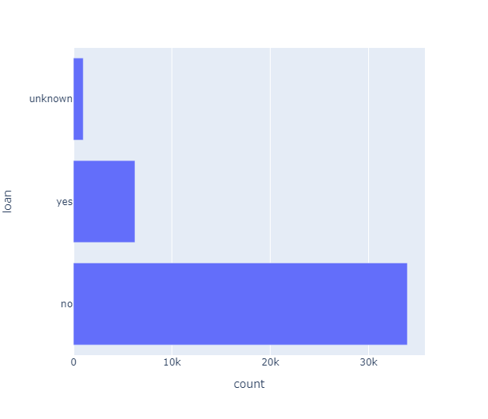
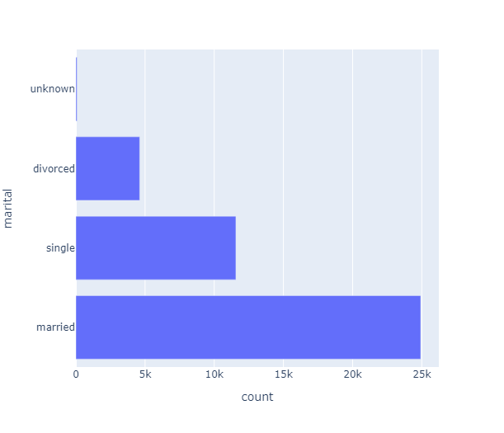
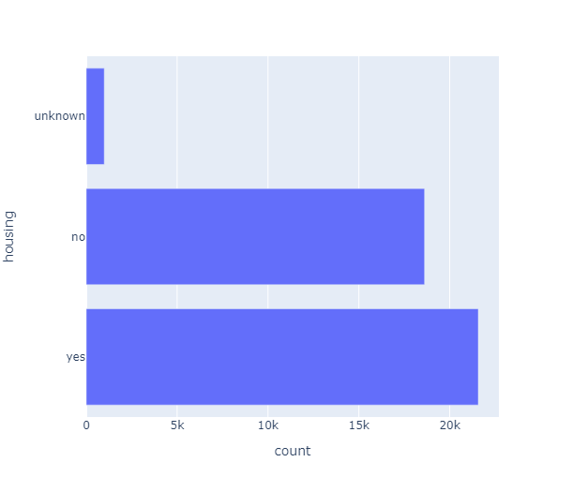
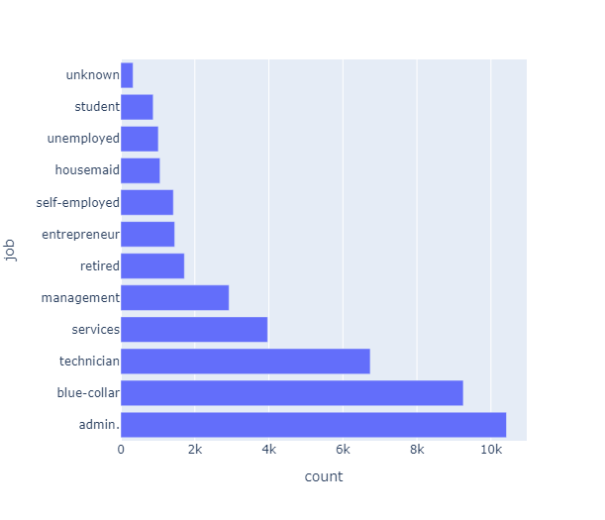
Categorical data
We are individually examining histograms for categorical data to gain insights for data analysis. We observed that customers with administrative jobs or married customers were contacted the most. Similar insights were noticed during the univariate analysis.

Slide 11
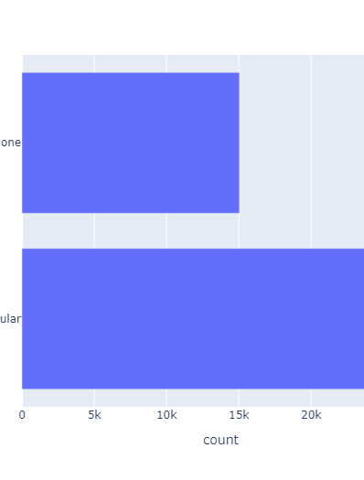
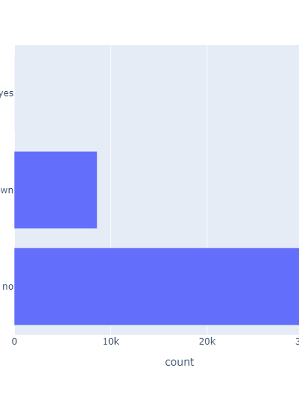
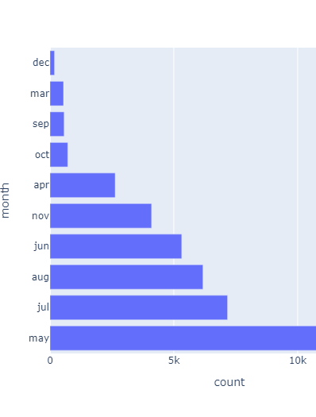
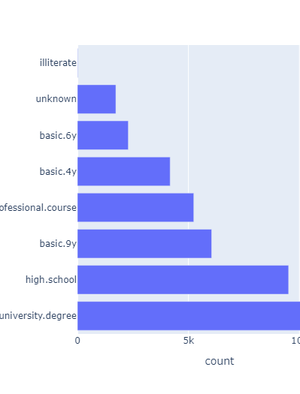
Categorical data

Slide 12
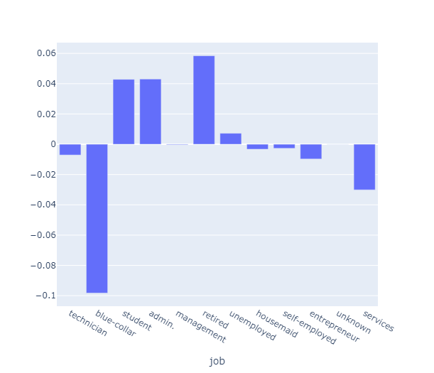
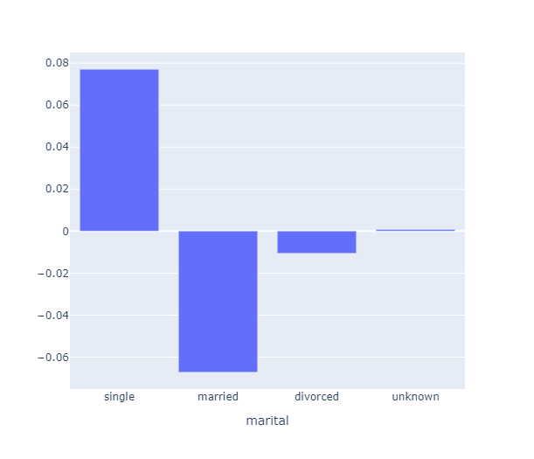
Categorical data (Where client subscribed vs not)

Slide 13
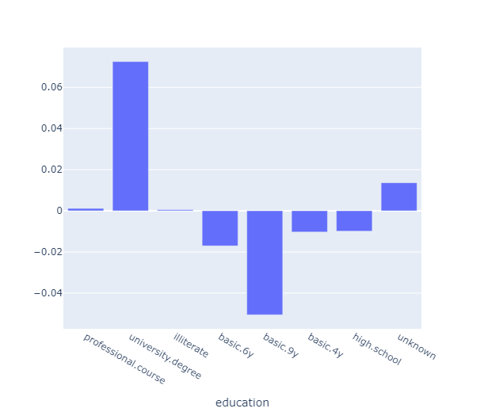
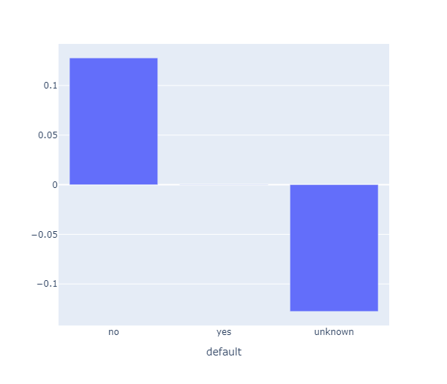
Categorical data (Where client subscribed vs not)

Slide 14
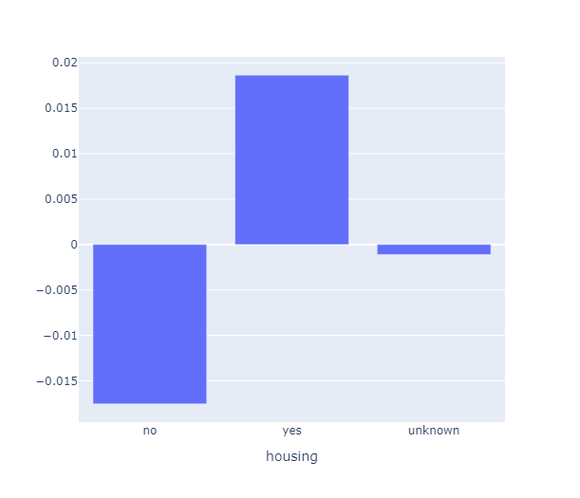
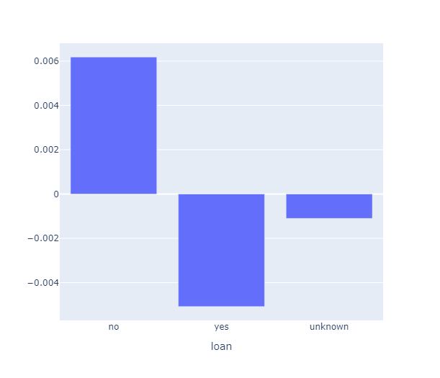
Categorical data (Where client subscribed vs not)

Slide 15
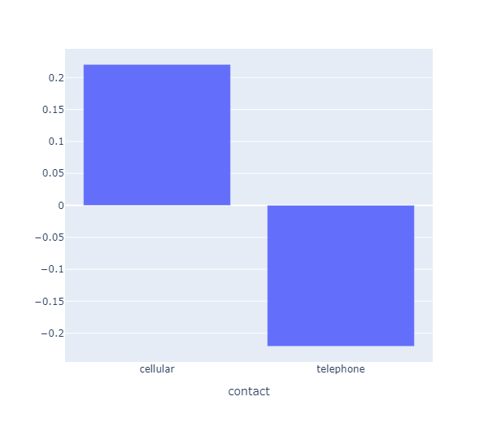
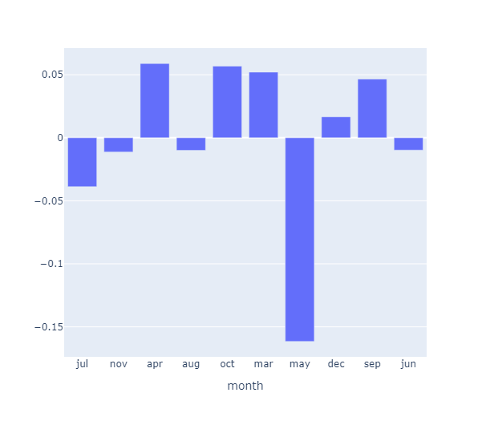
Categorical data (Where client subscribed vs not)

Slide 16
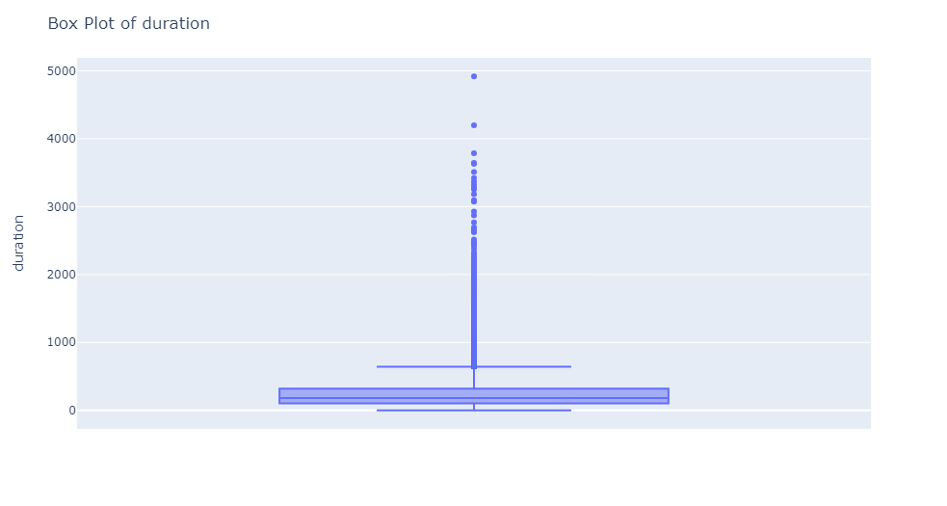
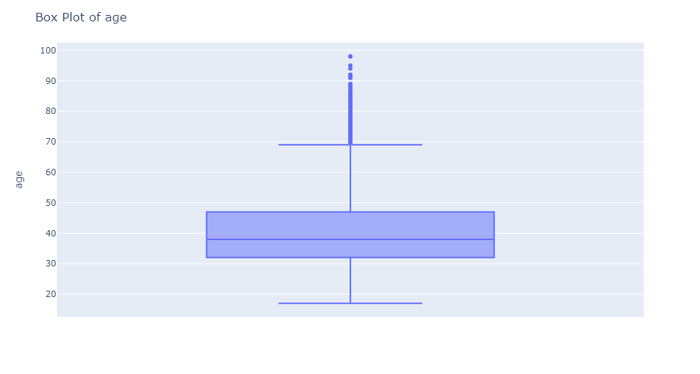
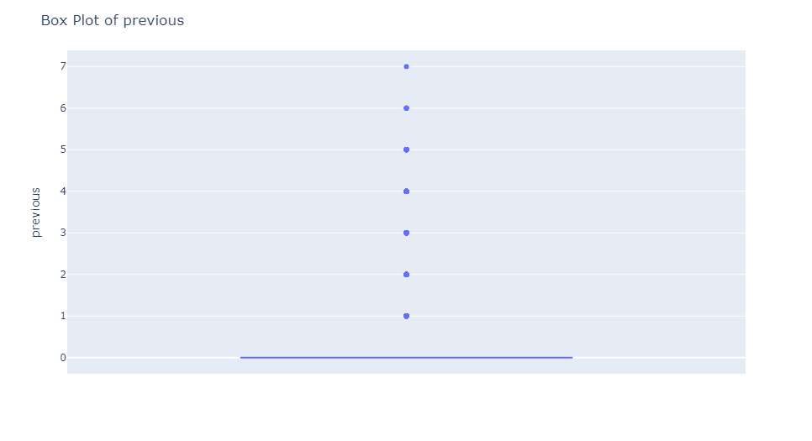
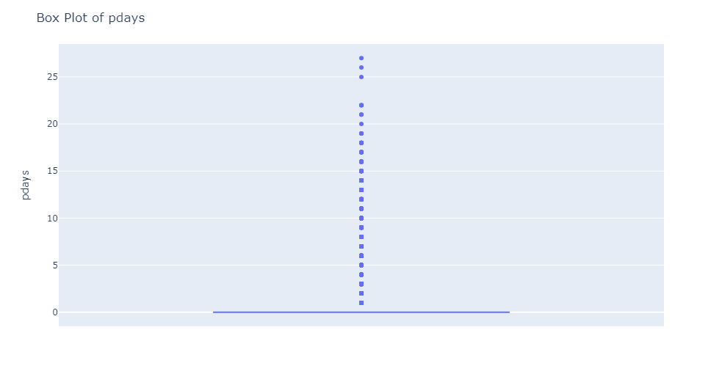
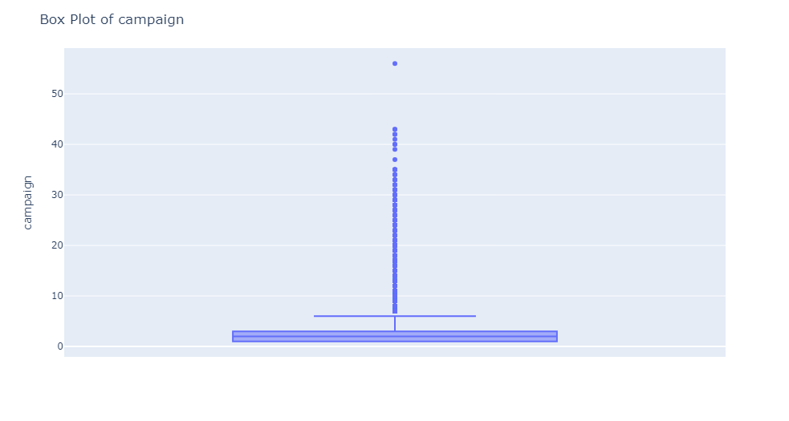
Numeric data
Numerical data needs a boxplot because it provides a concise and informative visual representation of the data's distribution, including measures of central tendency, variability, and potential outliers, making it easier to understand the data's key characteristics at a glance.

Slide 17
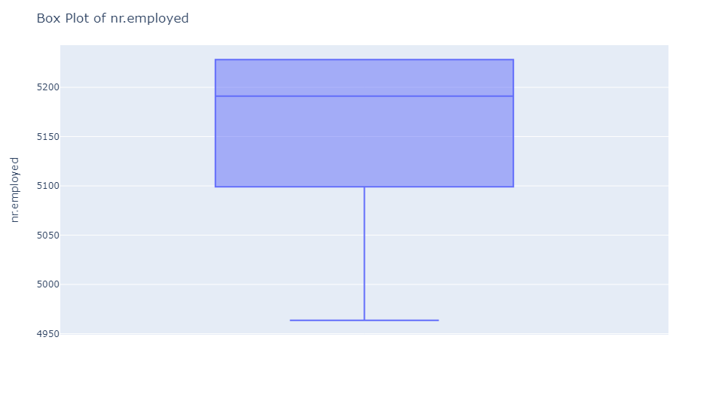
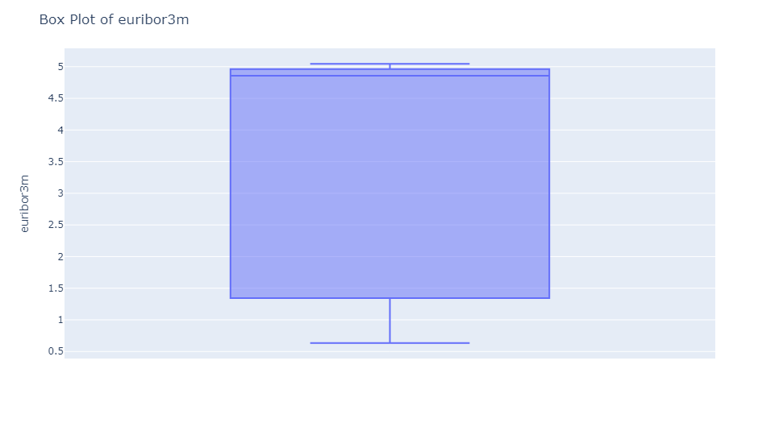
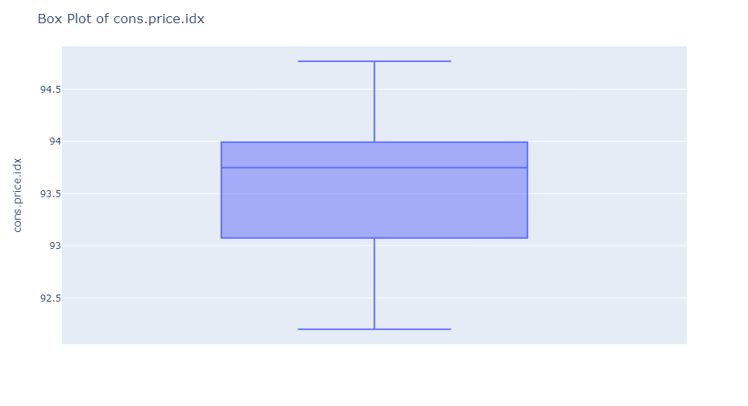
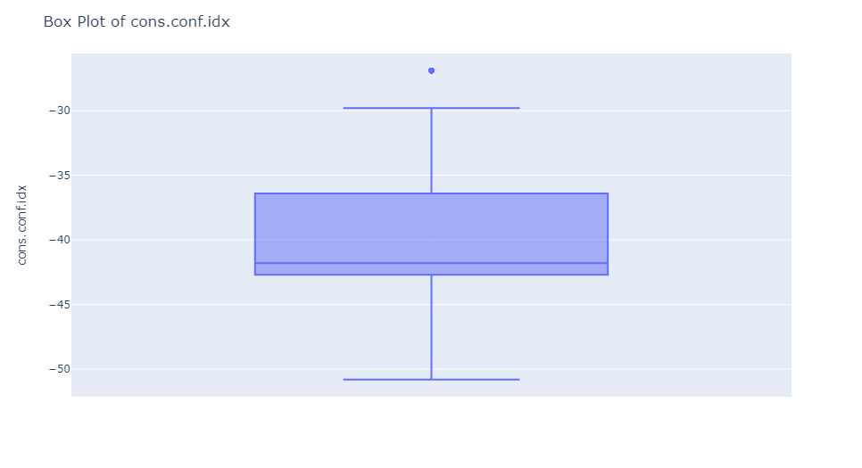
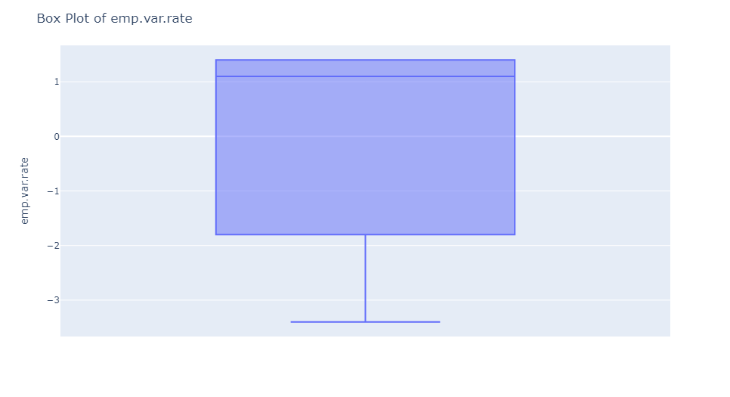
Numeric data

Slide 18
Observations
Some relevant observations found were:
No null values but “unknown” and “nonexistent” values are present which can be considered as missing values.
Major customers fall under the age of 17-54.
Longer duration of the call, higher chances of success in campaigns.
Outliers were found in numeric data and using the OLS model we removed all the outliers
Some values were not relevant, we might need to change them so we could change them to meaningful data (e.g. ‘999’ meant the customers’ were not contacted previously to ‘0’).
More insight can be found by performing bivariate or multivariate analysis.
Imbalanced data can be solved by sampling the data.

Slide 19
Recommendation
We need to predict whether the customers are likely to subscribe to the term deposit or not. To accomplish this, we could develop binary classification models such as:
Logistic Regression: This model is easy to understand, can be trained rapidly, and offers highly interpretable results. Nonetheless, it presupposes a linear association between features and the log-odds of the target variable, which may not always be accurate.
Random forest: An ensemble technique that improves decision tree performance, exhibits reduced overfitting tendencies, and excels in handling non-linear associations. Nevertheless, comprehending them could be somewhat more difficult, and their training duration might be longer.
XGBoost: These models exhibit high accuracy, effective handling of non-linear relationships, and the ability to manage missing data. Nevertheless, they necessitate lengthier training periods, boast higher complexity in interpretation, and demand meticulous parameter tuning.
Feedforward Neural Networks: Suitable for tabular data where features are independent of each other, like in traditional classification or regression problems.

Slide 20

Thank You

