Slide 1
Hands-On:
Solidity for beginners
M2 MFCA Lille 2020
santiago.bragagnolo@inria.fr
https://github.com/sbragagnolo/hands-on-solidity

Slide 2
Solidity
Ethereum’s smart contract main language
High level language inspired in Go, C, Javascript
Statically typed (Java, C, C++, C#, Go, etc)

Slide 3
Solidity Web-IDE: Remix
https://remix.ethereum.org/

Slide 4
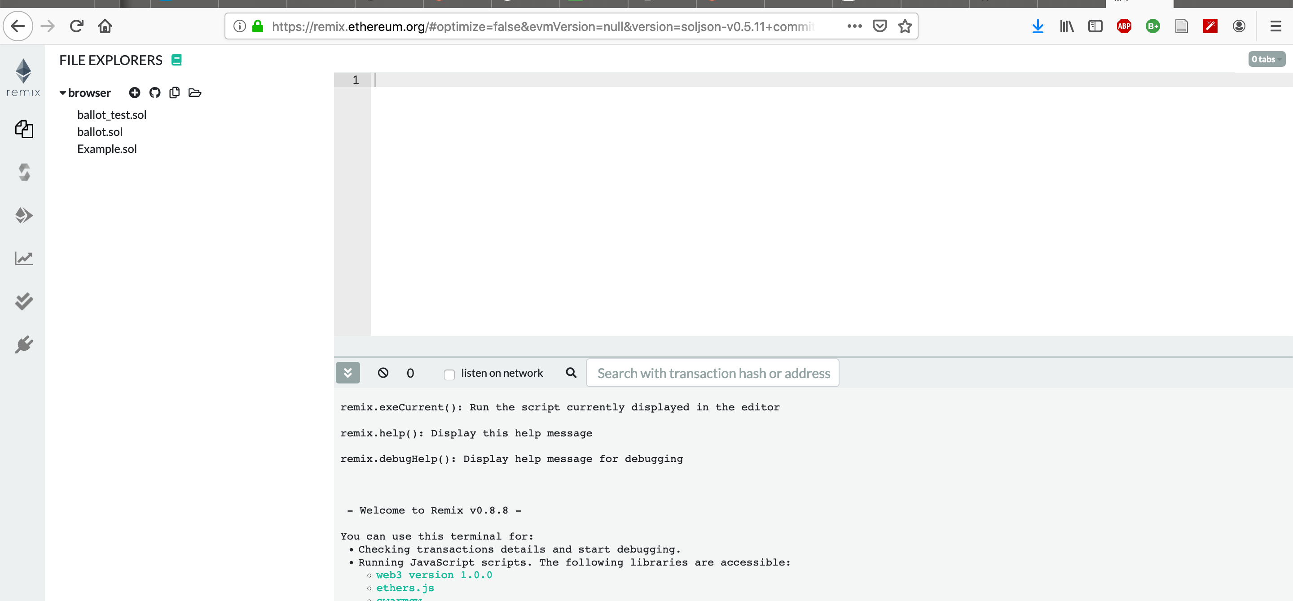
Solidity Web-IDE: Remix

Slide 5
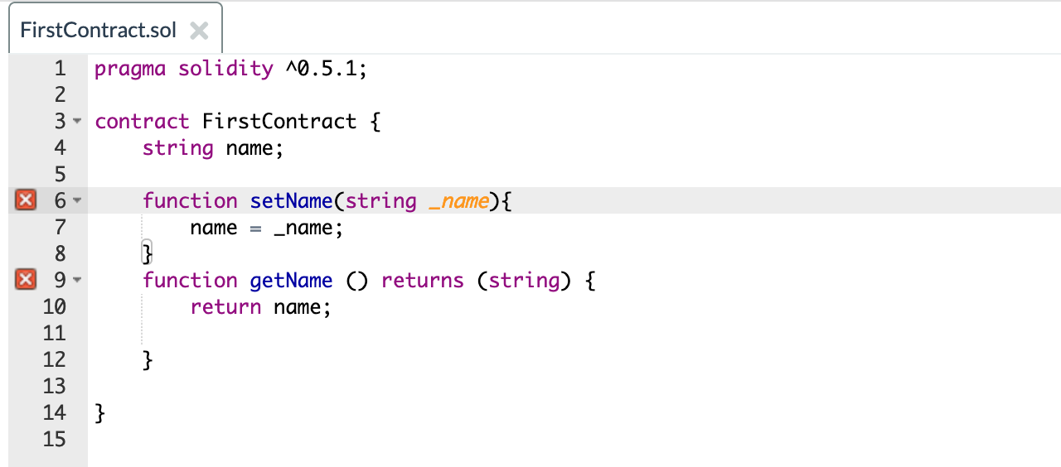
First contract

Slide 6
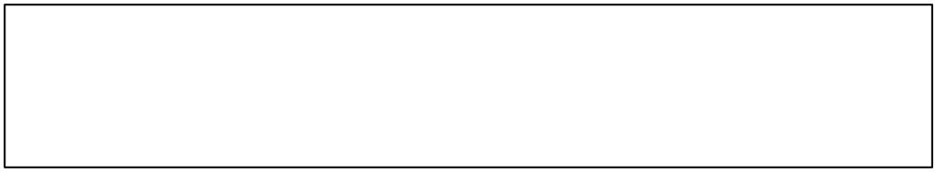
Primitive types

Slide 7
Primitive types
bool
int / uint ... int8 / uint8 ... int256 / uint256
string
byte / bytes / bytes1... bytes32
address

Slide 8
Functions

Slide 9
Functions
The “rules” enforced by a contract is defined by its functions
It can return more than one value (or none at all)
Functions can be overloaded

Slide 10
First compiling errors :)

Slide 11
Built-in method modifiers
Visibility Modifiers: private, public, internal, external
Mutability Modifiers: view, pure
Cryptocurrency Modifiers: payable

Slide 12
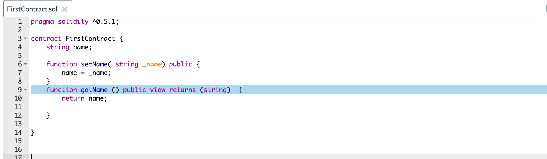
Built-in method modifiers

Slide 13
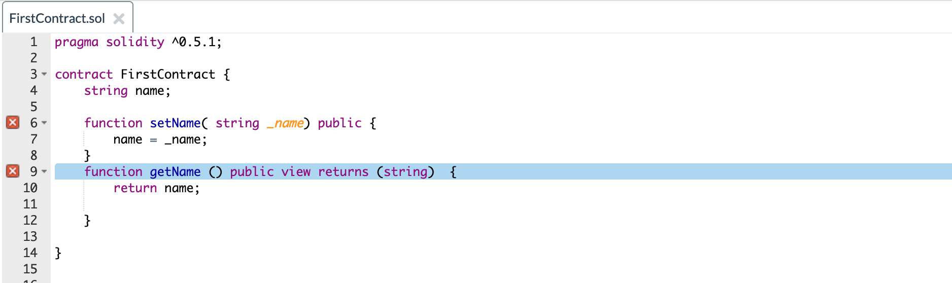
More compiling errors :(

Slide 14
More compiling errors :(

Slide 15
Built-in parameter modifiers
Memory
Storage

Slide 16
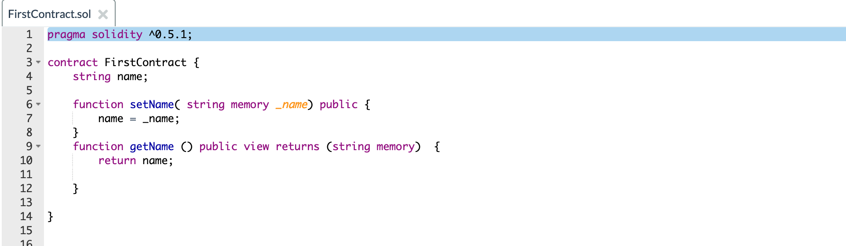
Built-in parameter modifiers

Slide 17
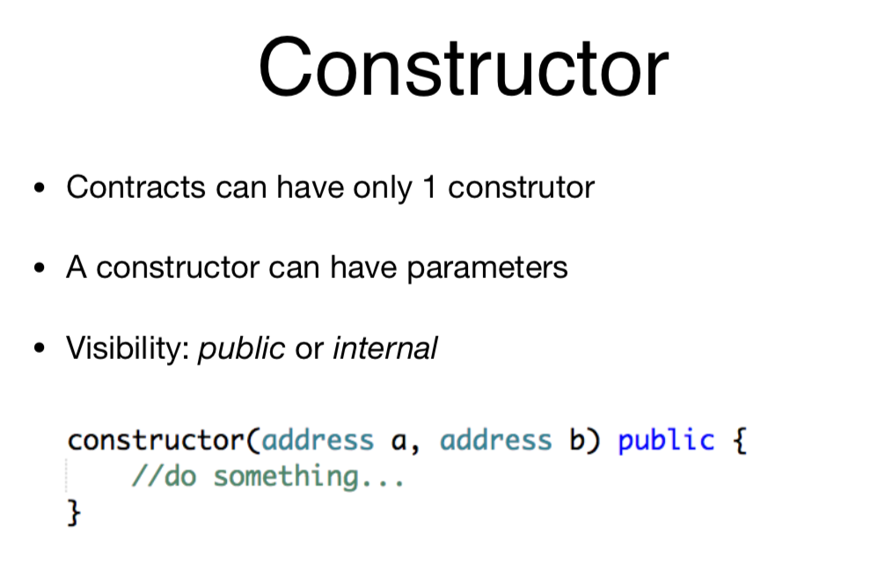

Slide 18
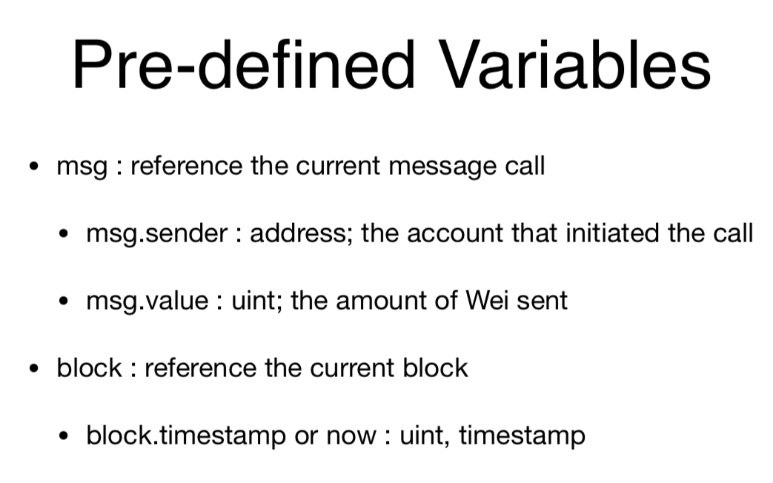

Slide 19
Exceptions
An exception undo all changes and propagates through the call and sub-calls
assert(bool condition): abort execution and revert state changes if condition is false (use for internal error)
require(bool condition, string memory message): abort execution and revert state changes if condition is false (use for malformed input or error in external component). Also provide error message.
revert(string memory message): abort execution and revert state changes providing an explanatory string

Slide 20
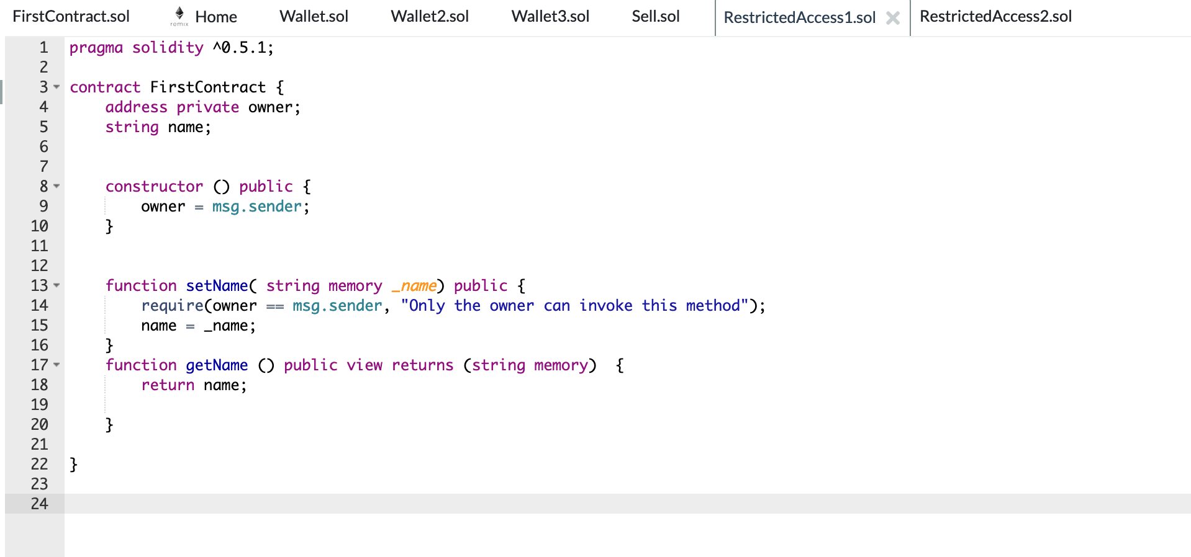
Restricted access V1

Slide 21
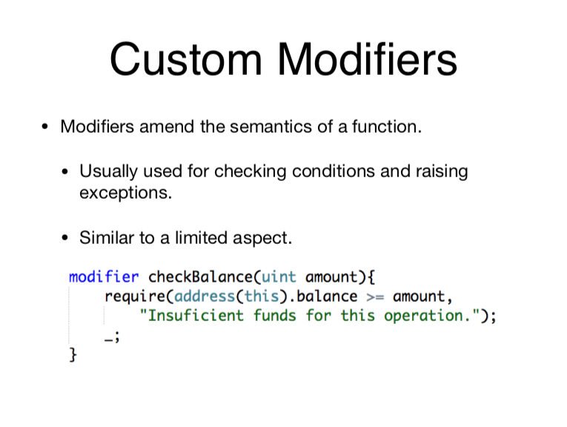

Slide 22
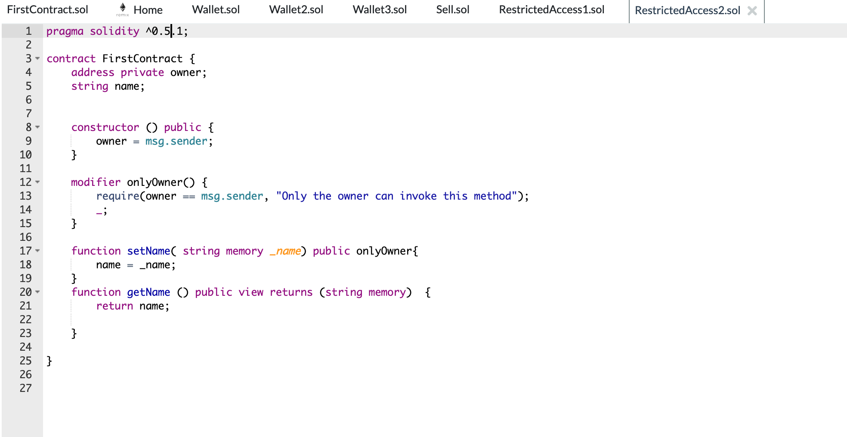
Restricted access V2

Slide 23
Dealing with money
payable addresses implements money transfer methods
send
transfer
only payable functions can handle money

Slide 24
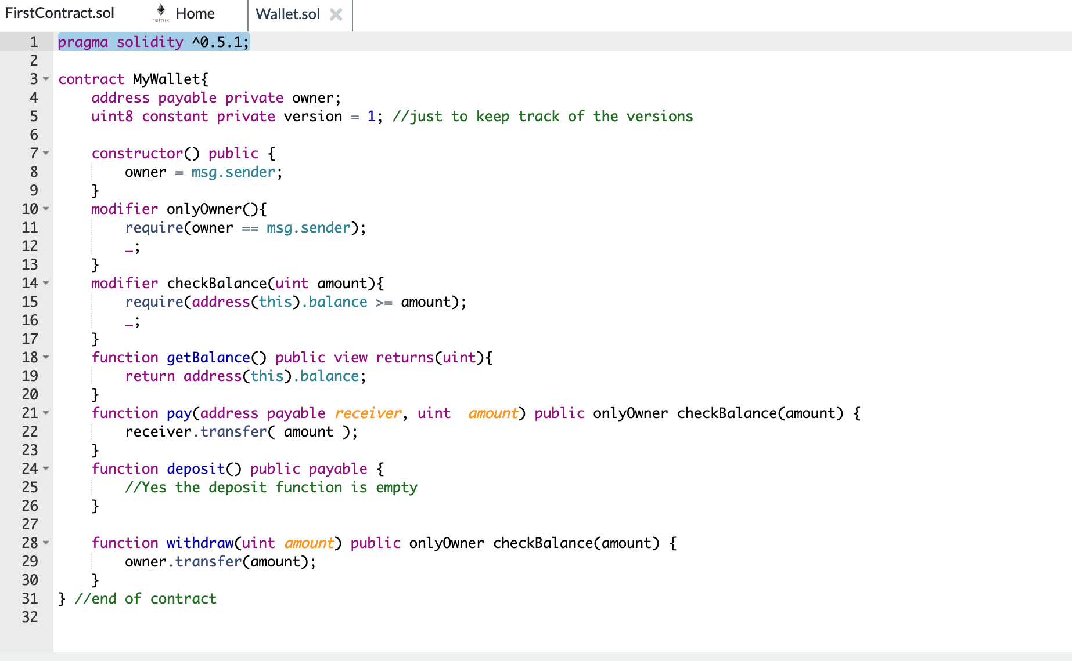
Wallet v1

Slide 25
Events
Client notification
Allows clients to note a change
Allows clients to articulate their business
Logging
Debugging
Easy auditory

Slide 26
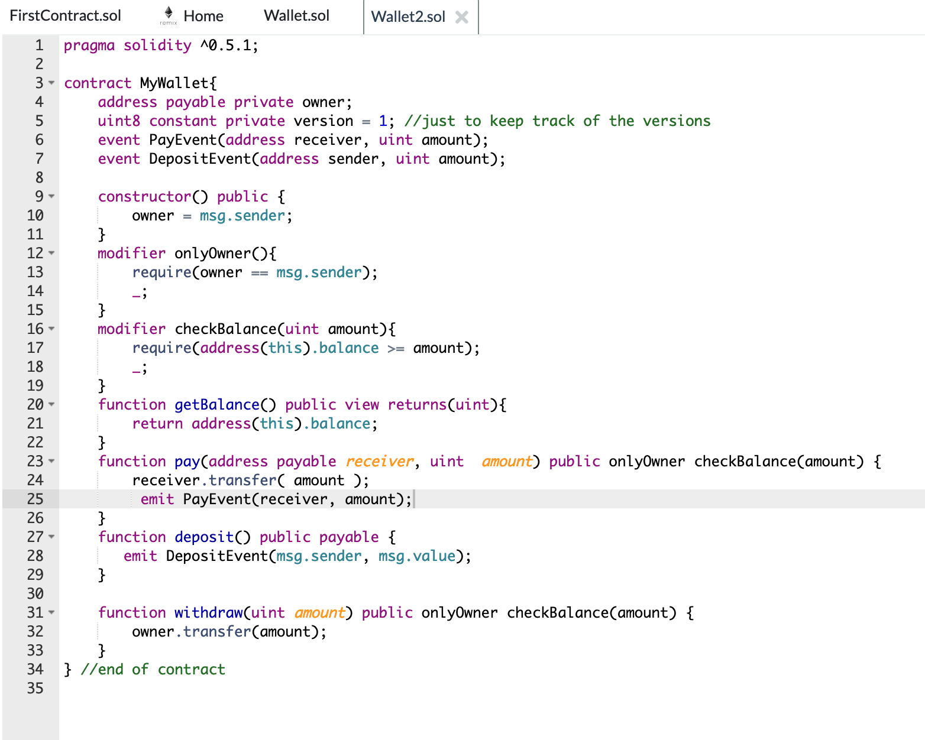
Wallet v2

Slide 27
Fallback Function
Un-named function
Cannot have any parameter, cannot return any value
must be external
could be payable
Executed when a method name is not found
Executed (if payable) when transferring money to this contract

Slide 28
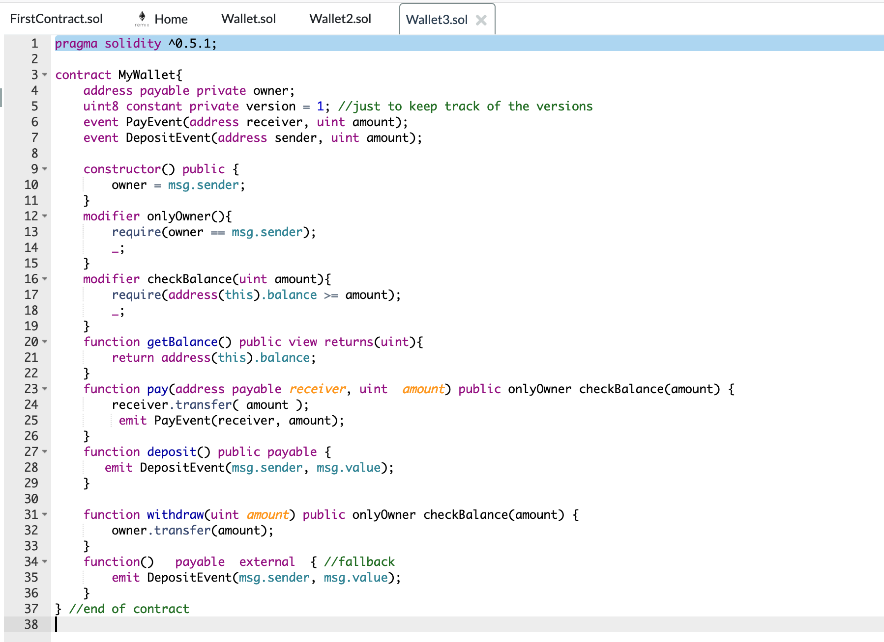
Wallet v3

Slide 29
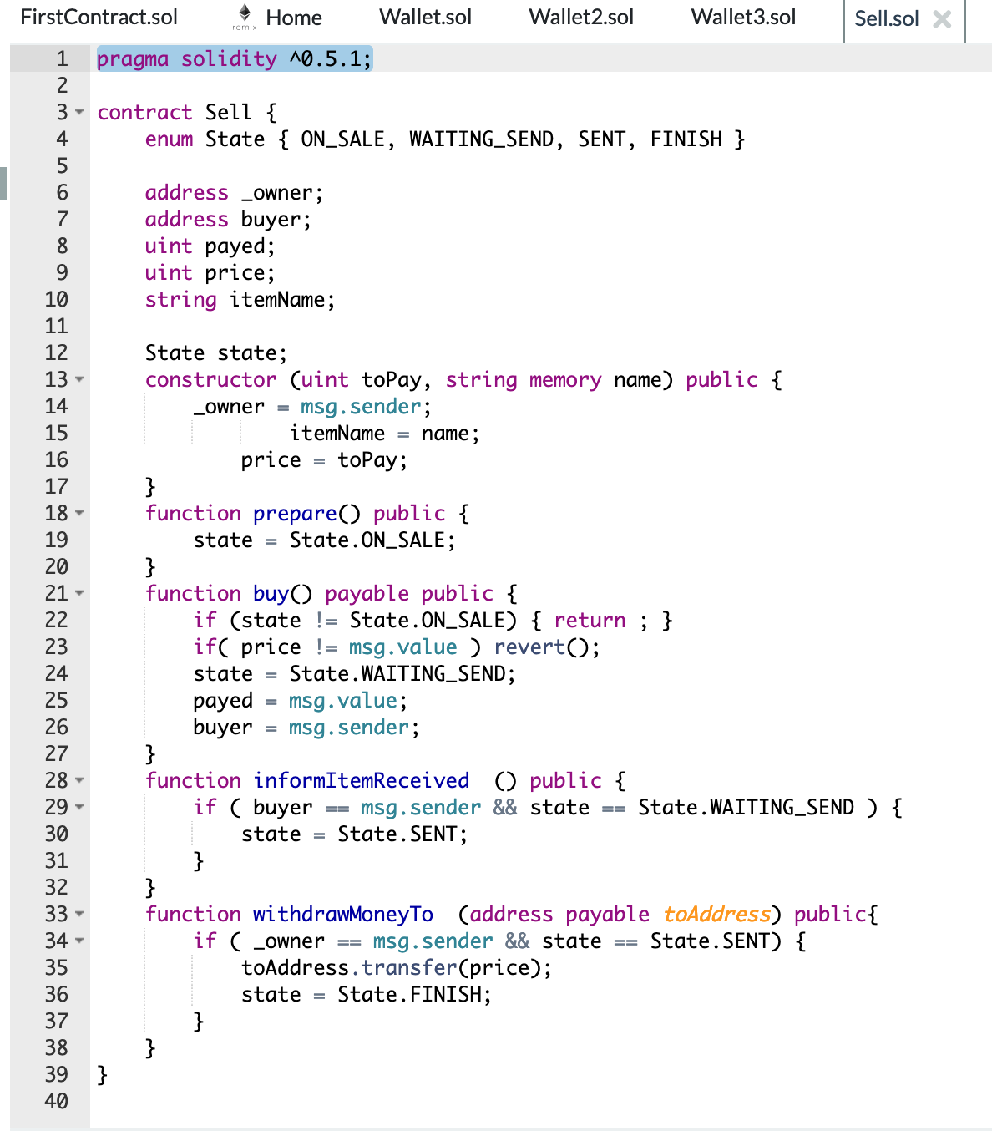
State machine

Slide 30
Tasks
Explain what this State machine tries to guarantee
Refactor the contract by using modifiers for the method requirements (such as ensuring the owner)
How it would be an external application that uses such a contract?

