Slide 1
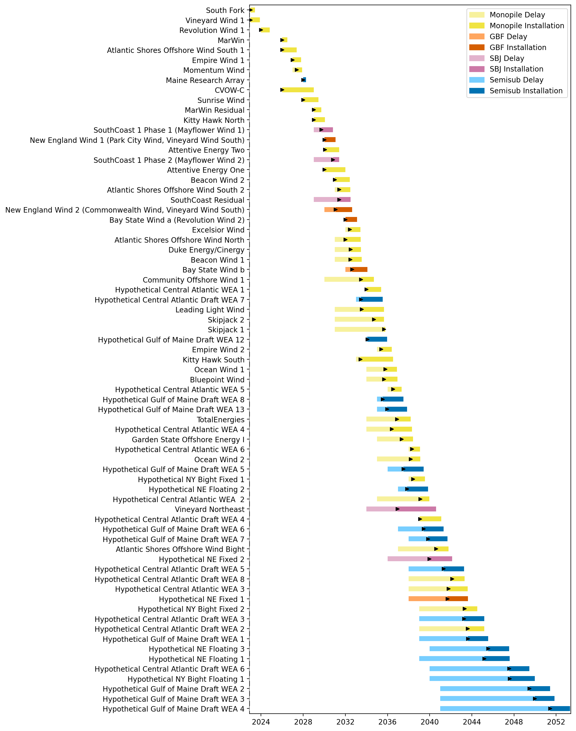
Full Gantt

Slide 2
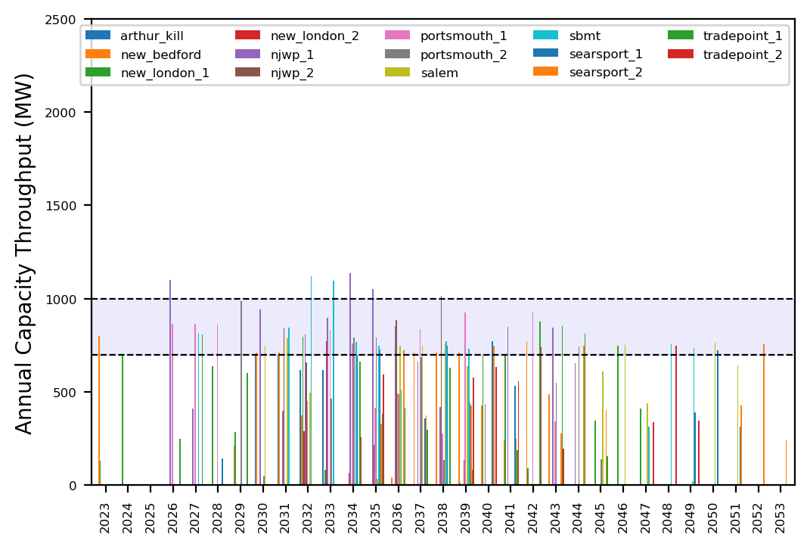
Port Throughput

Slide 3
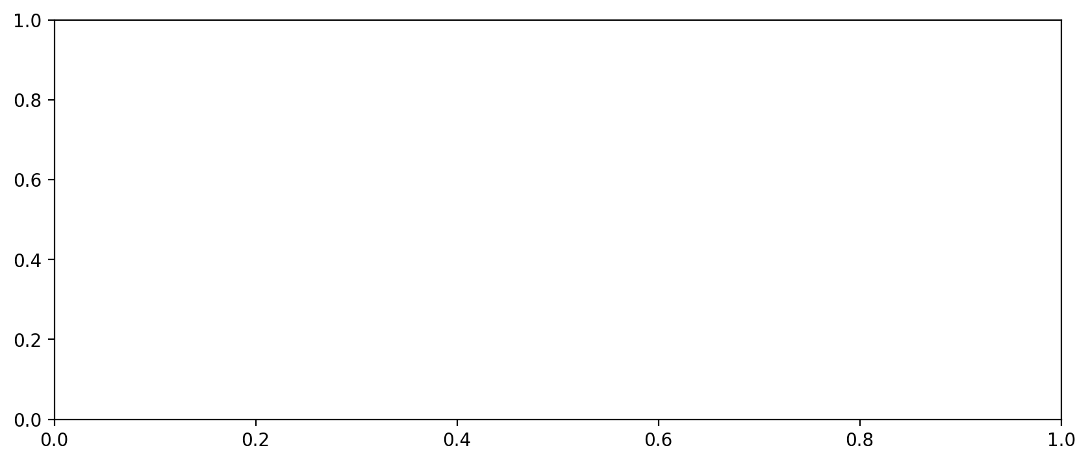
Vessel Utilization

Slide 4
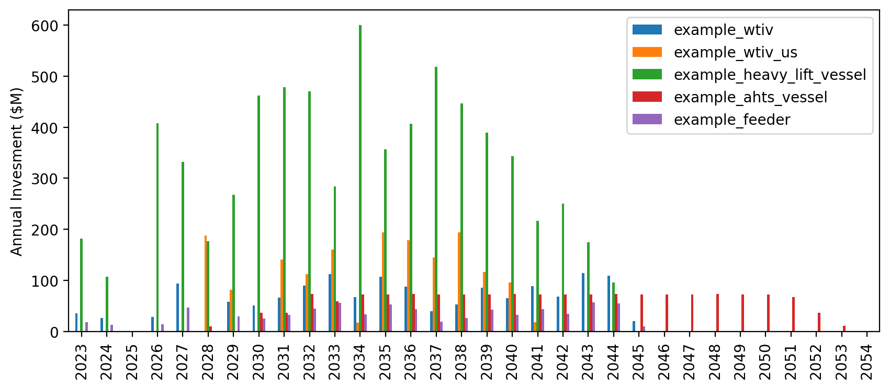
Vessel Investment

Slide 5

Full Gantt

Slide 6
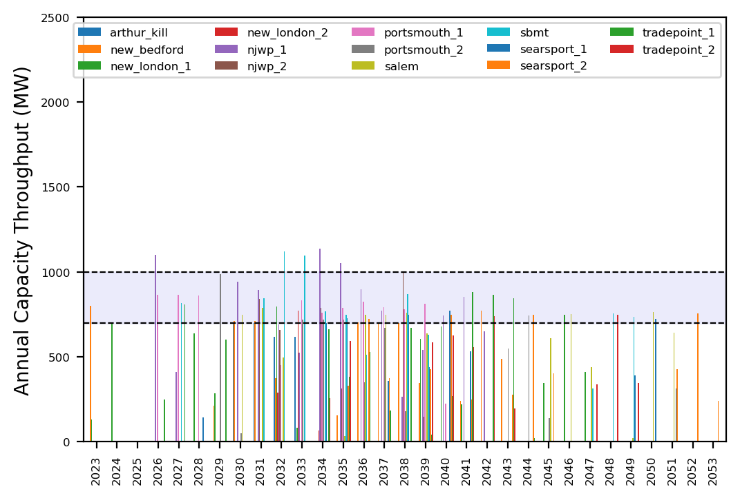
Port Throughput

Slide 7
Vessel Utilization

Slide 8
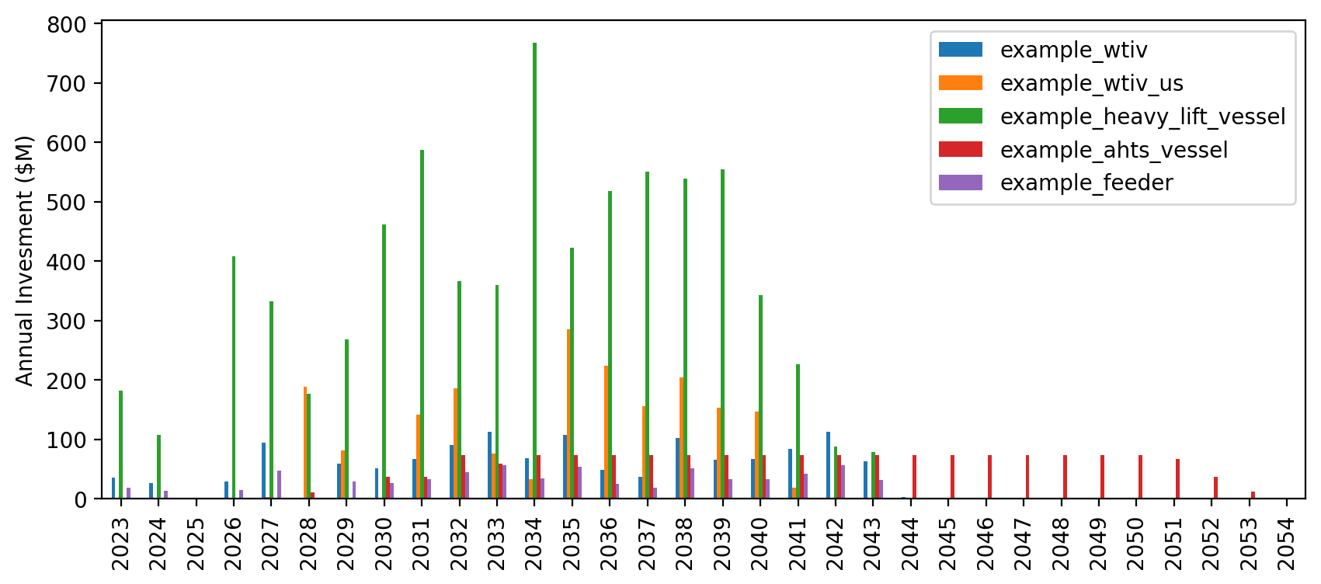
Vessel Investment

Slide 9
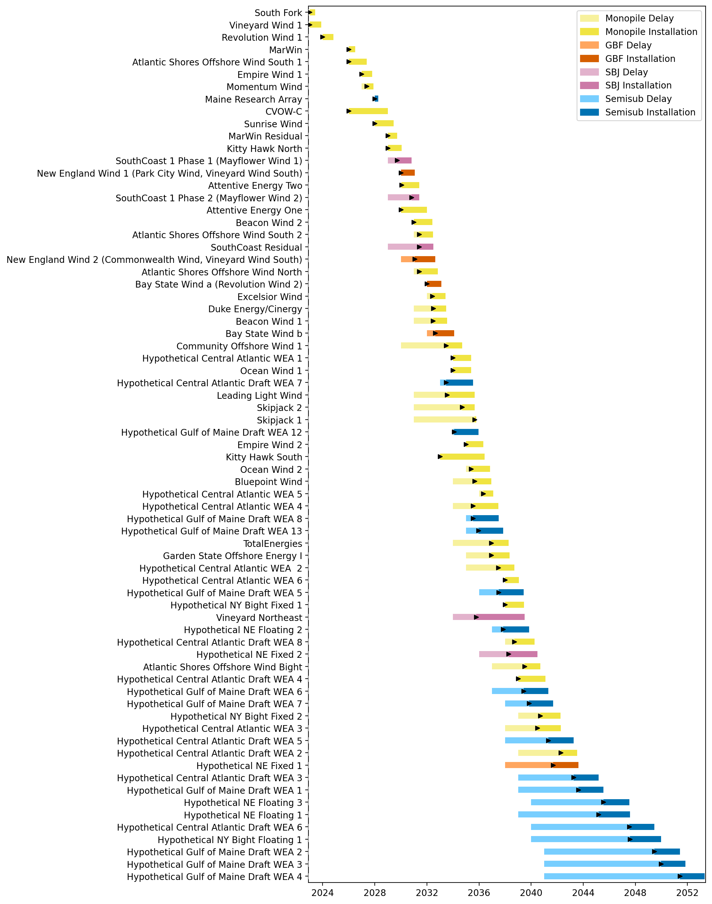
Full Gantt

Slide 10
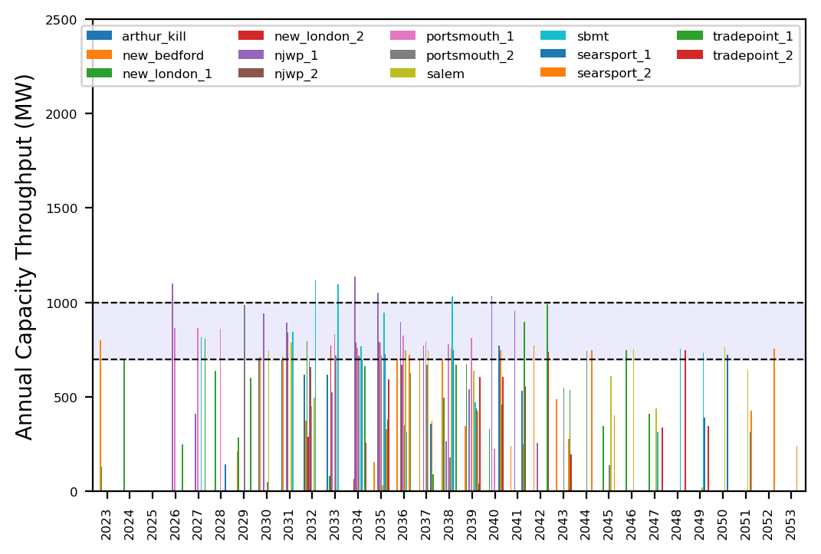
Port Throughput

Slide 11
Vessel Utilization

Slide 12

Vessel Investment

Slide 13
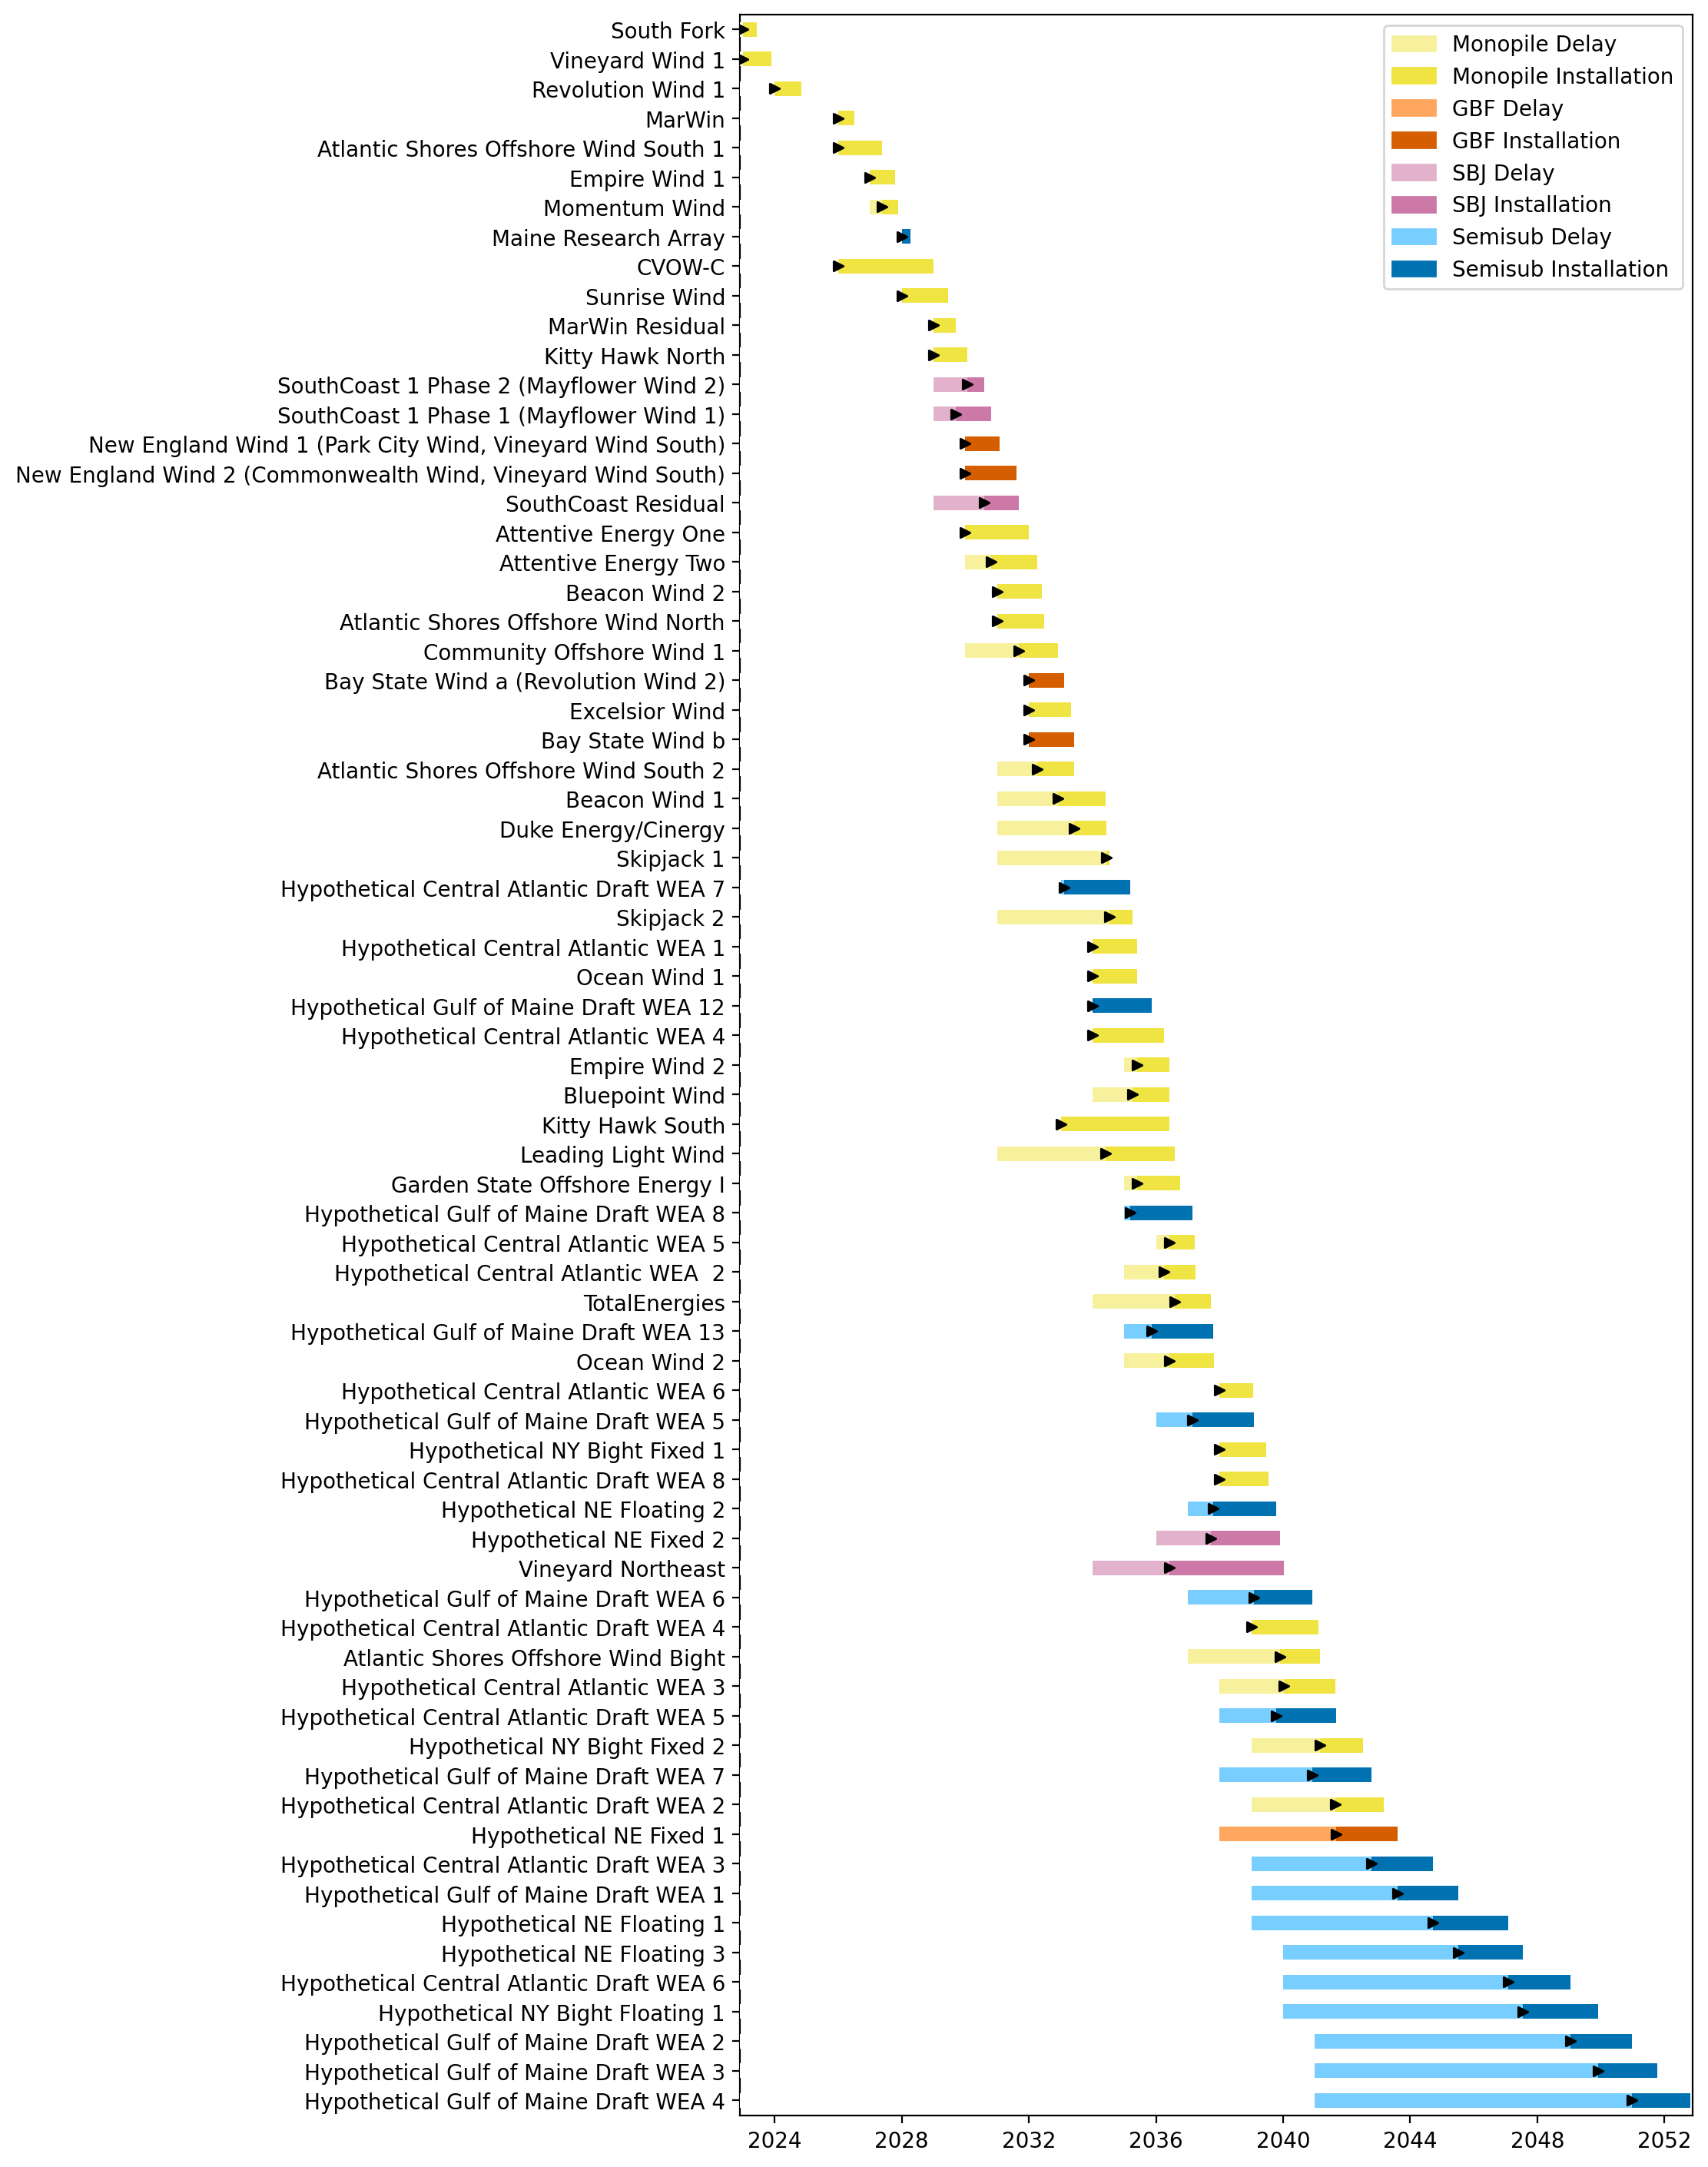
Full Gantt

Slide 14
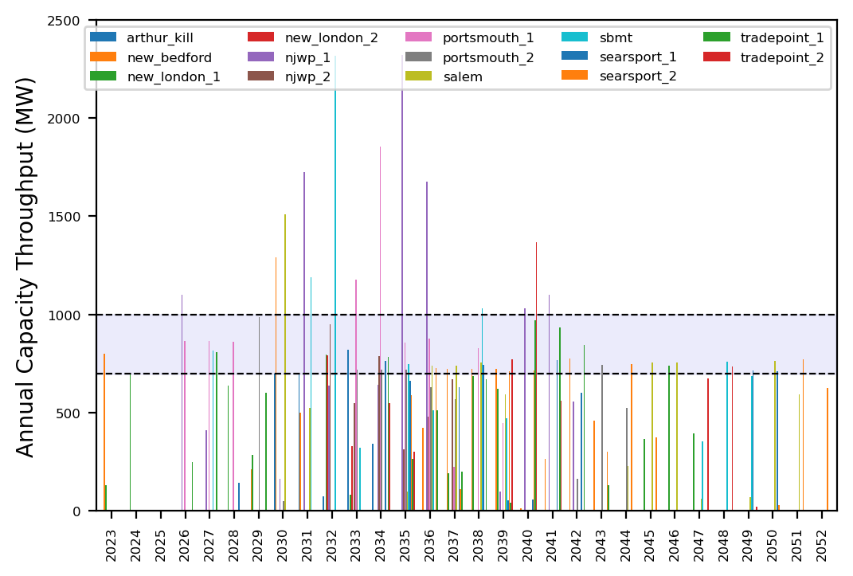
Port Throughput

Slide 15
Vessel Utilization

Slide 16
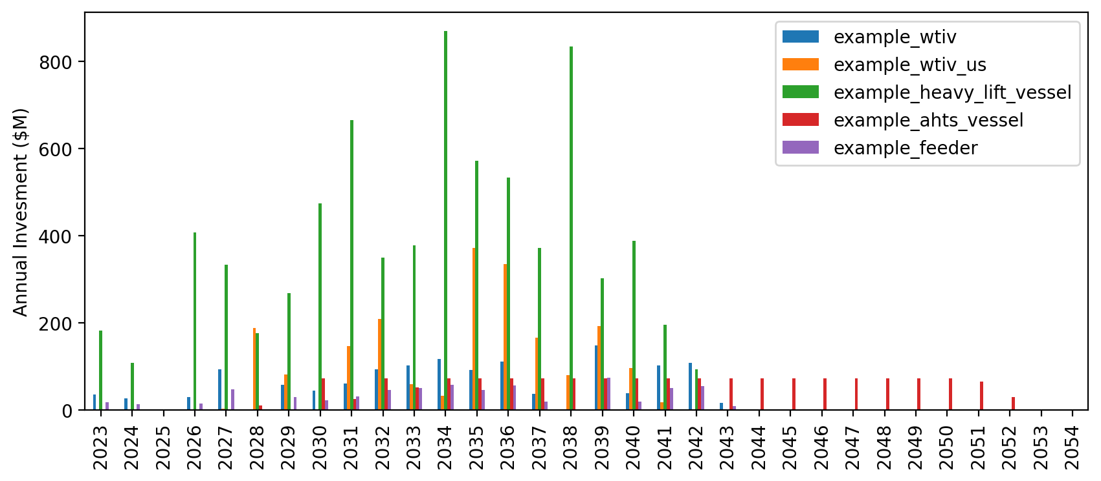
Vessel Investment

Slide 17
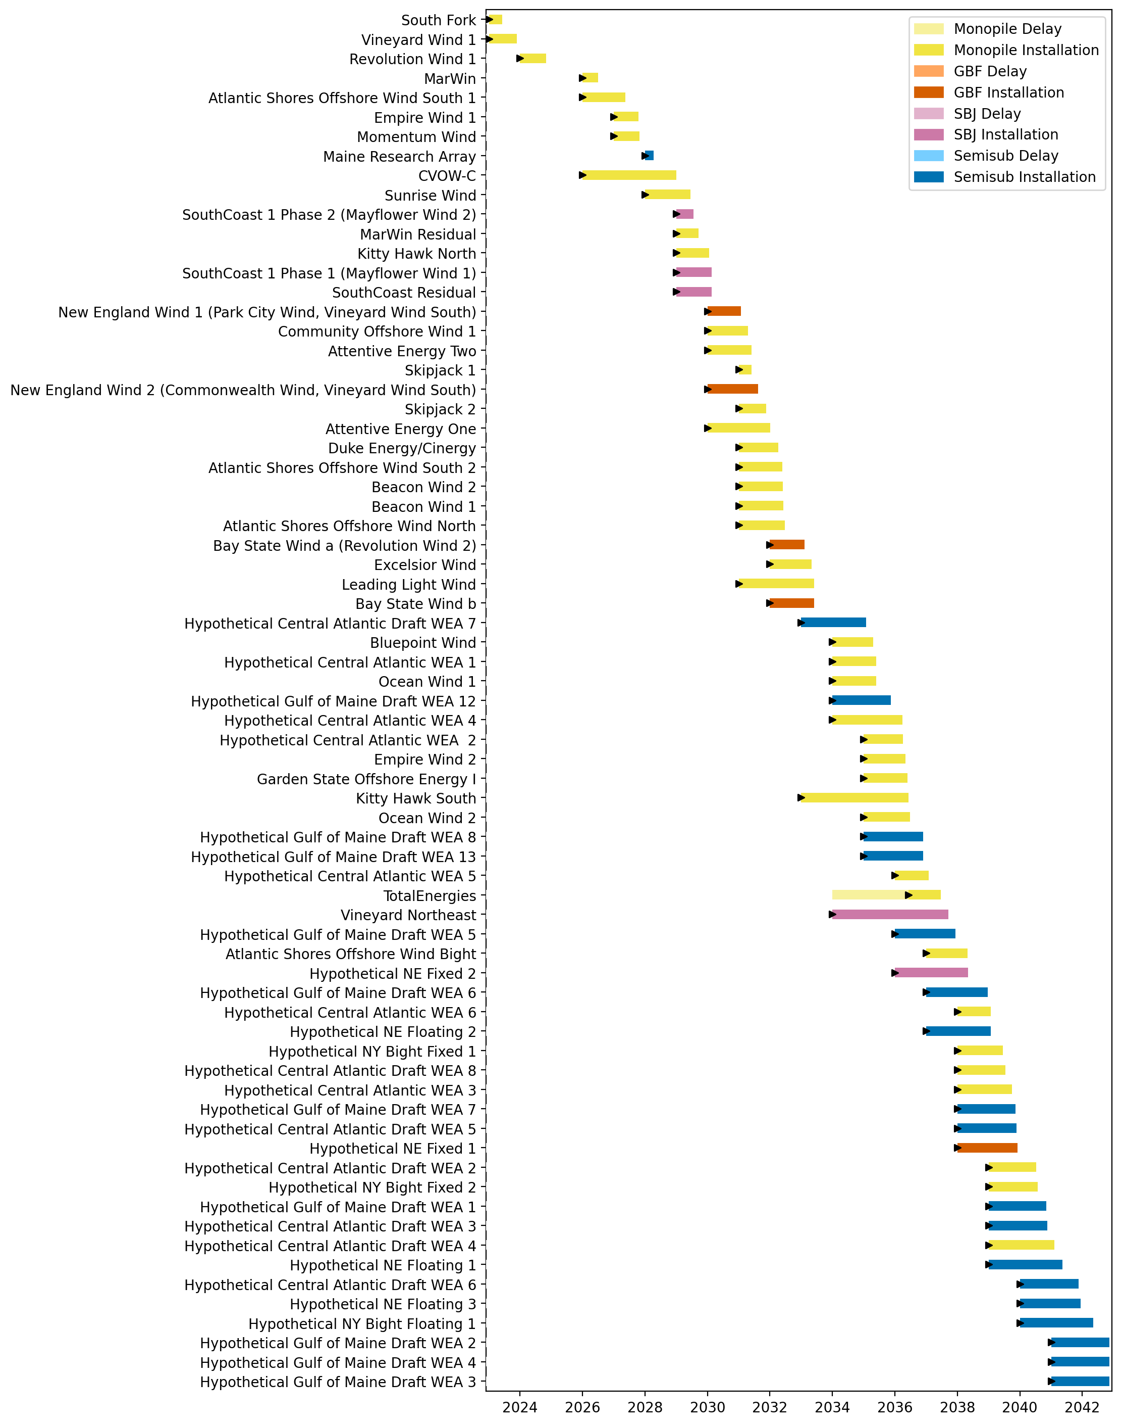
Full Gantt

Slide 18
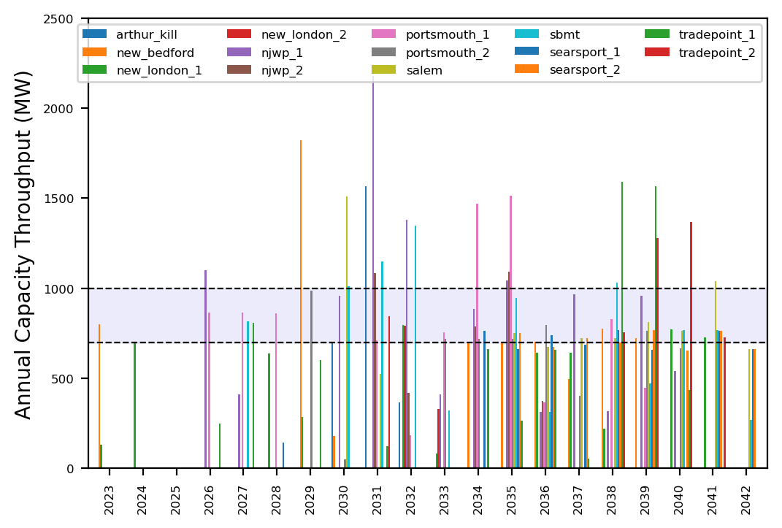
Port Throughput

Slide 19
Vessel Utilization

Slide 20
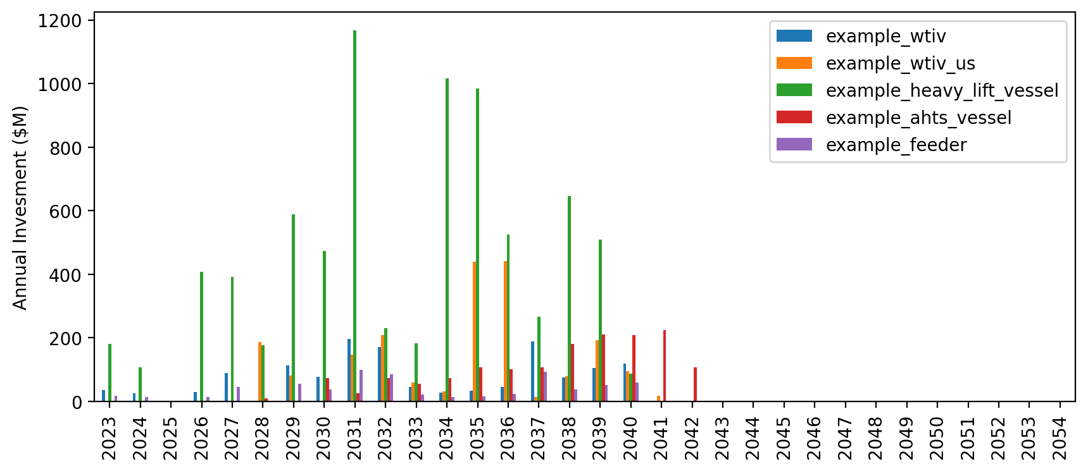
Vessel Investment

Slide 21
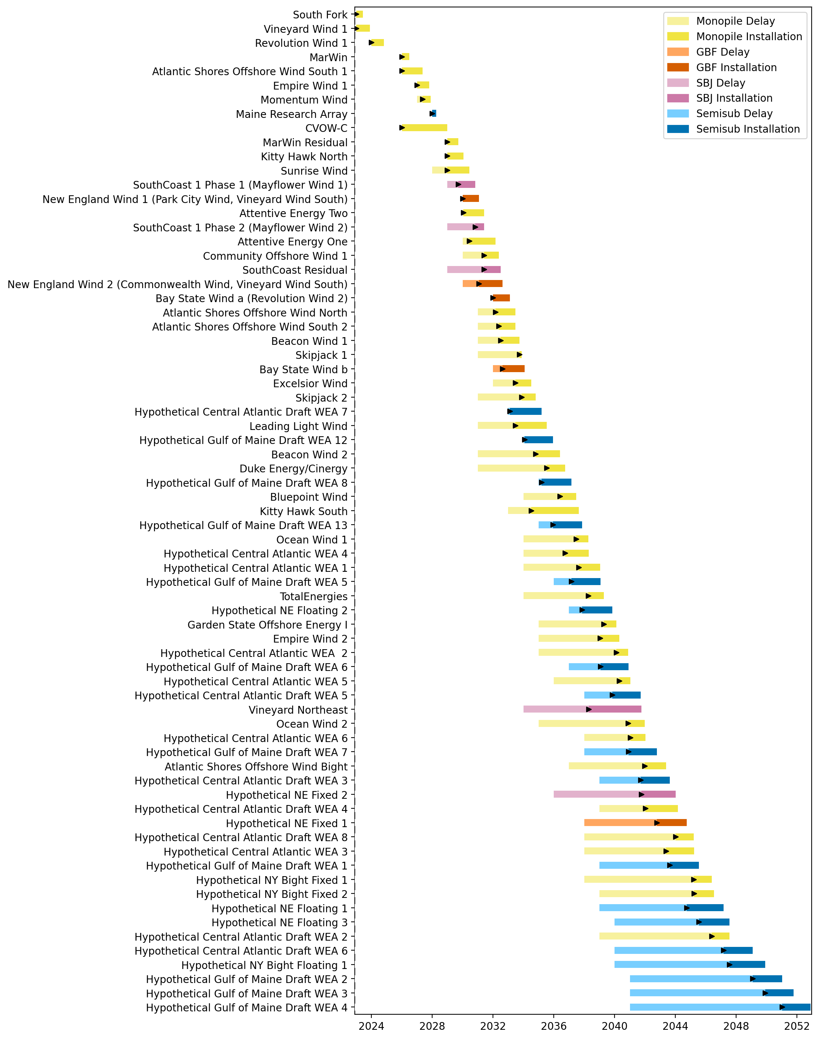
Full Gantt

Slide 22
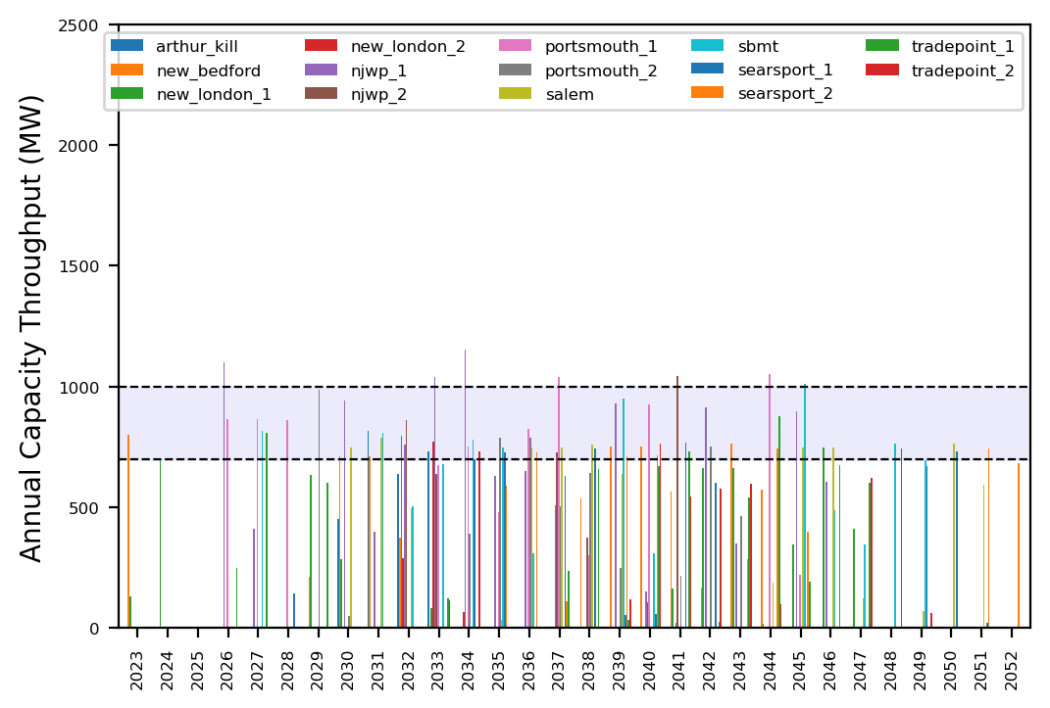
Port Throughput

Slide 23
Vessel Utilization

Slide 24
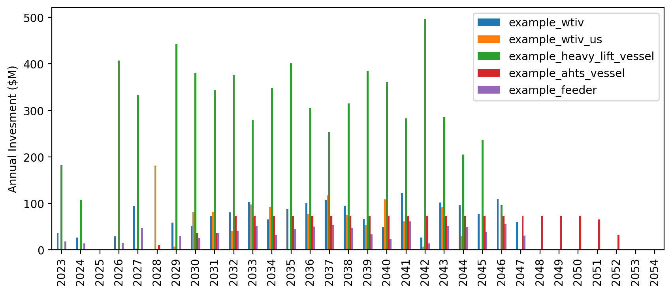
Vessel Investment

Slide 25
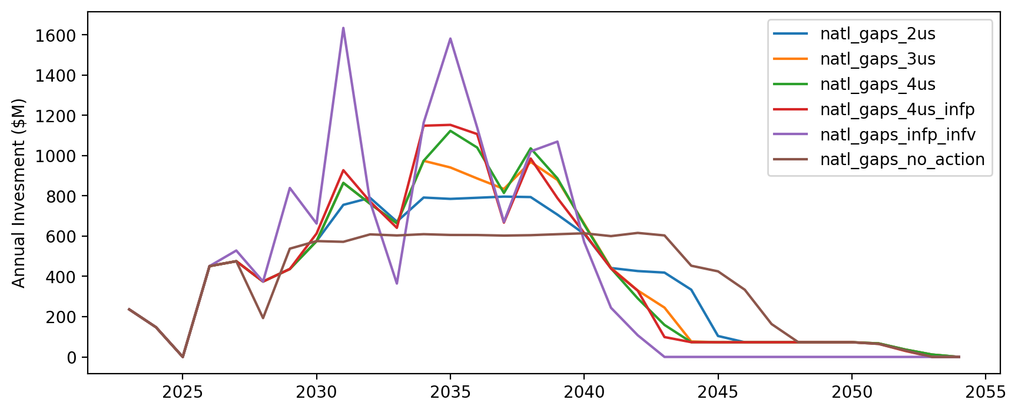
Vessel Investment by Scenario

Slide 26
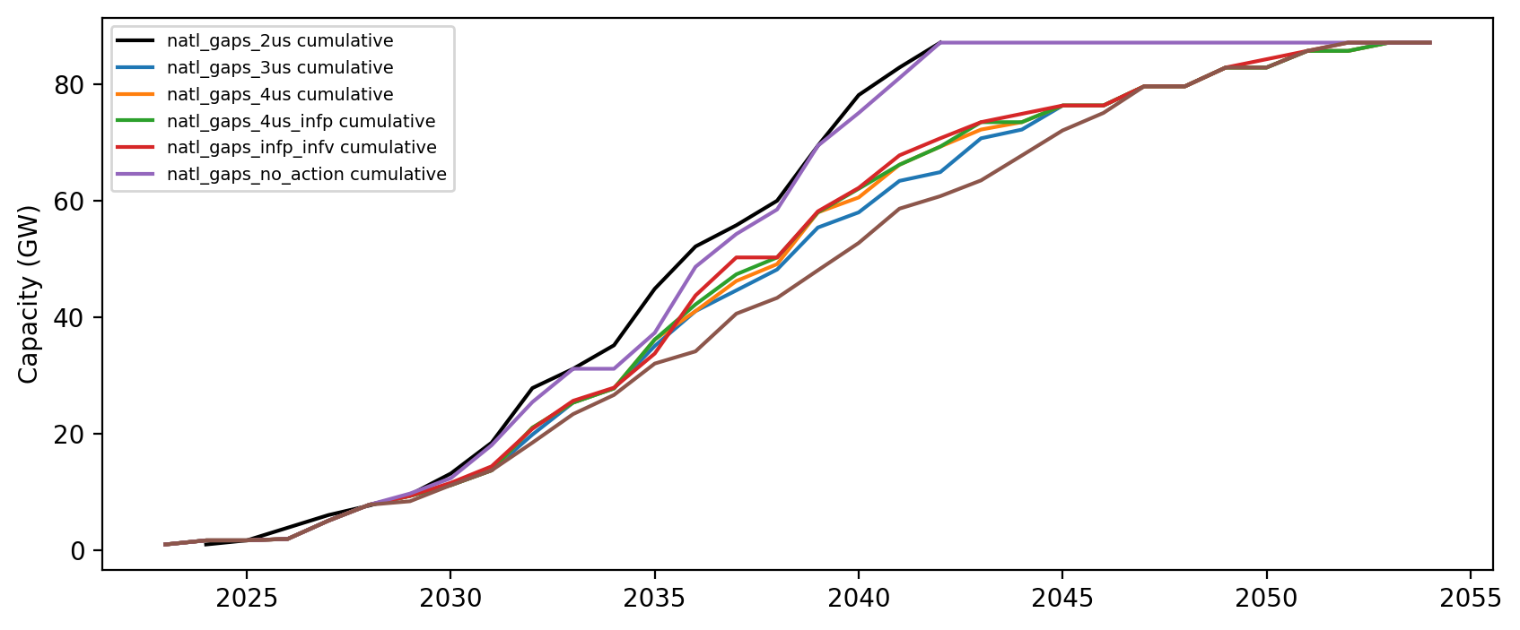
Installed Capacity

Slide 27
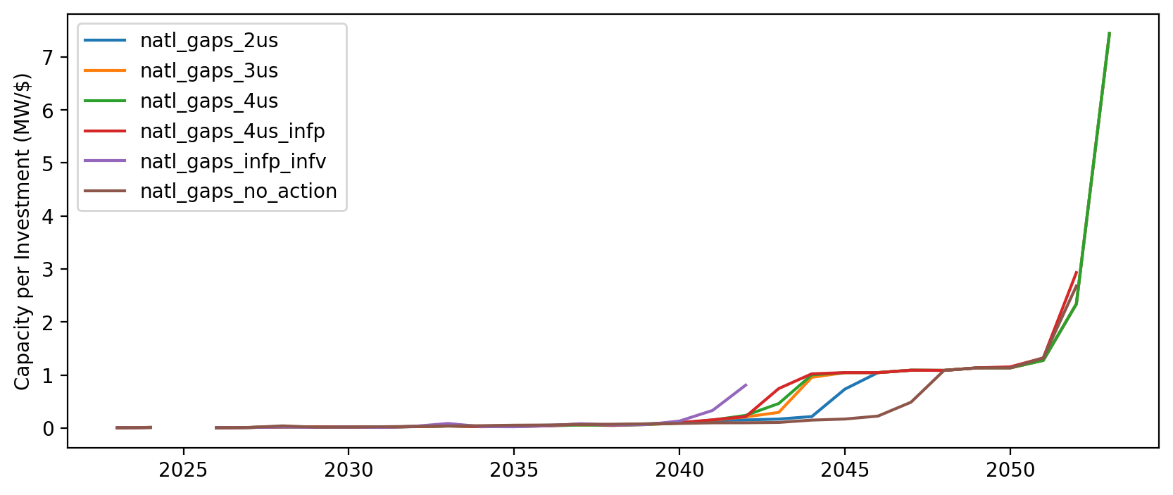
Capacity per Investment (MW/$)

