Slide 1
example_atlantic_3

Slide 2
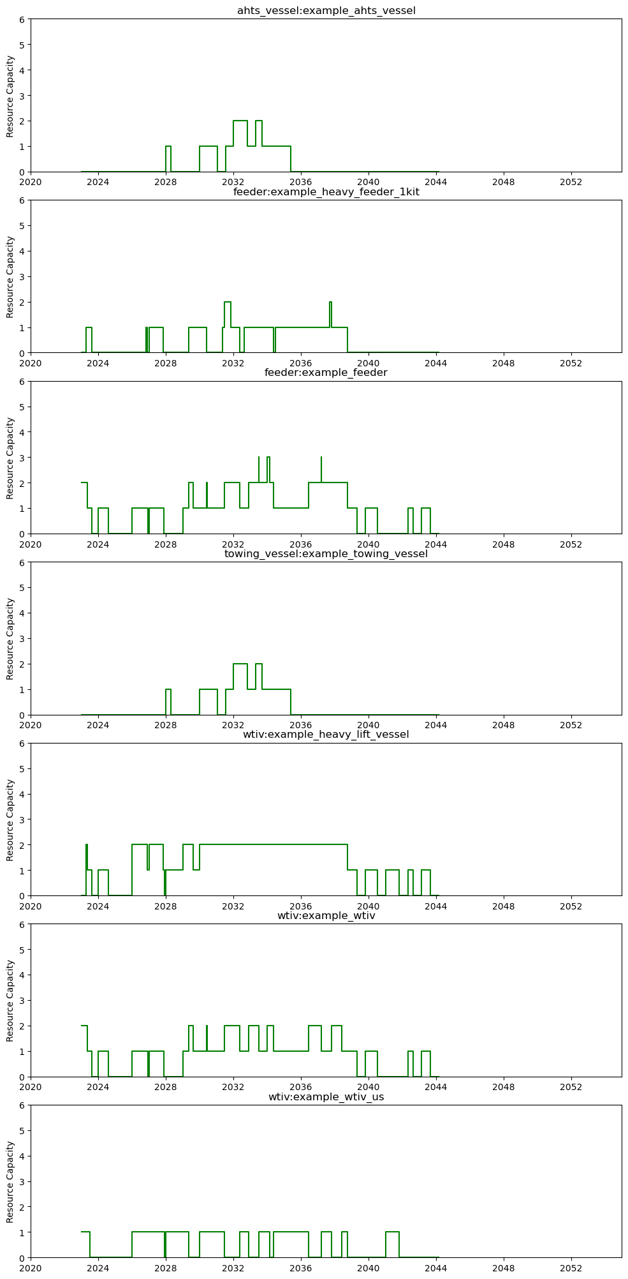
Shared Resource Capacity - Vessels

Slide 3
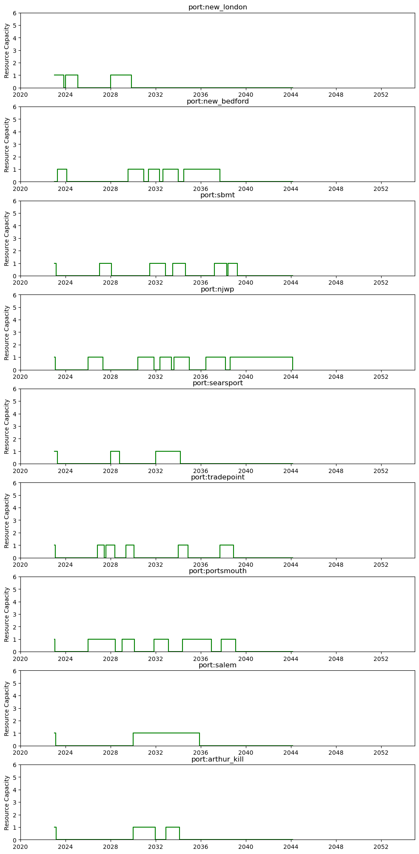
Shared Resource Capacity - Ports

Slide 4
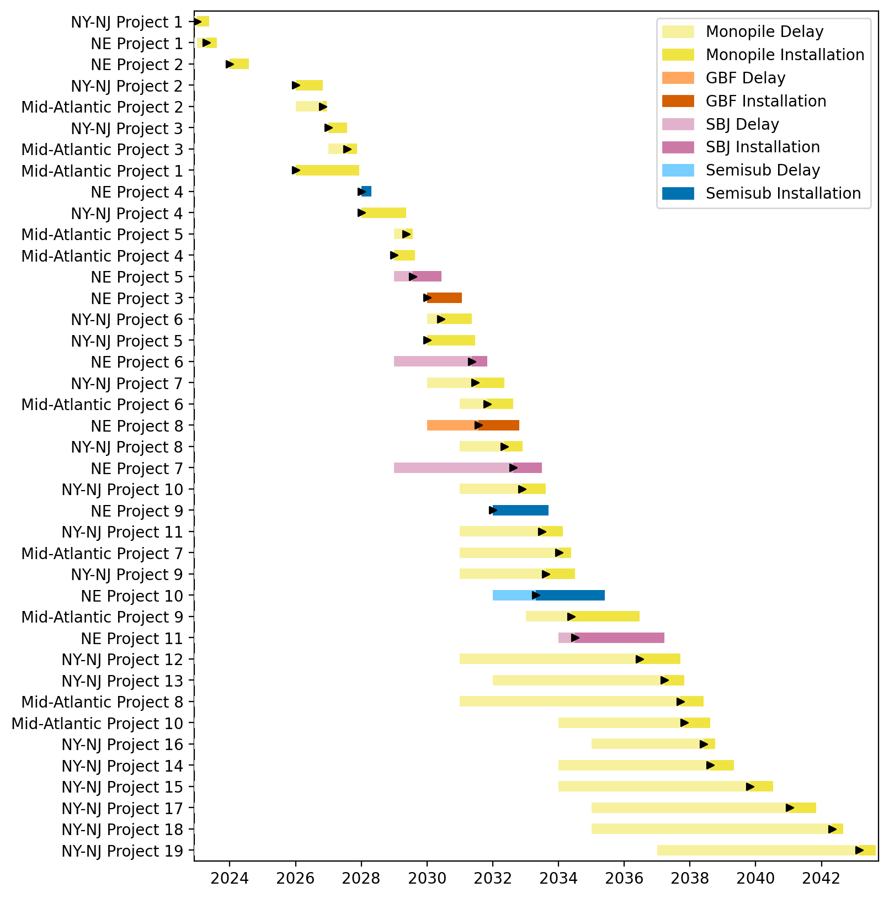
Full Gantt

Slide 5
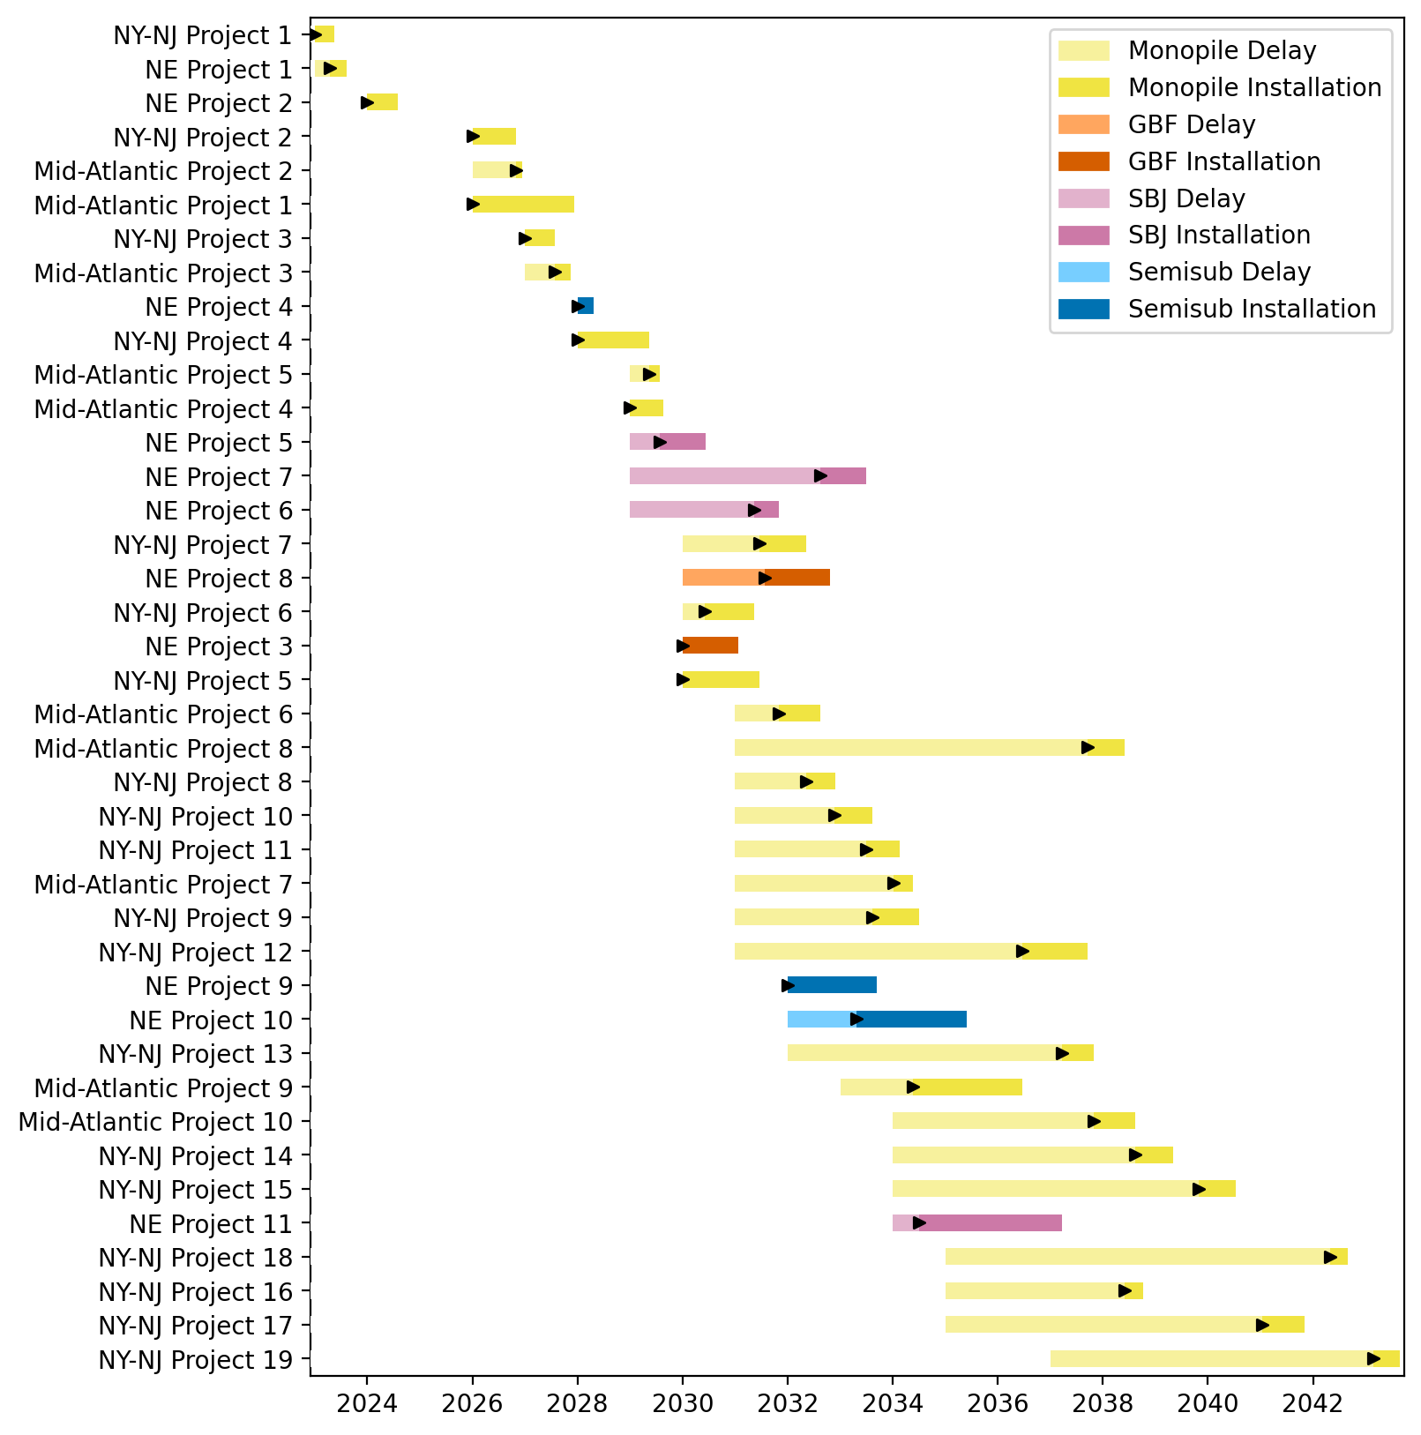
Sorted Full Gantt

Slide 6
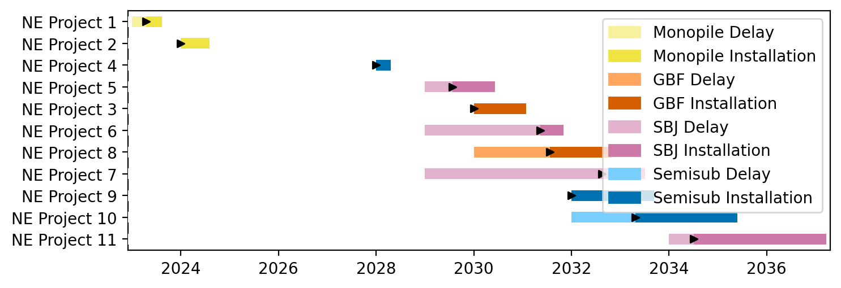
New England Gantt

Slide 7
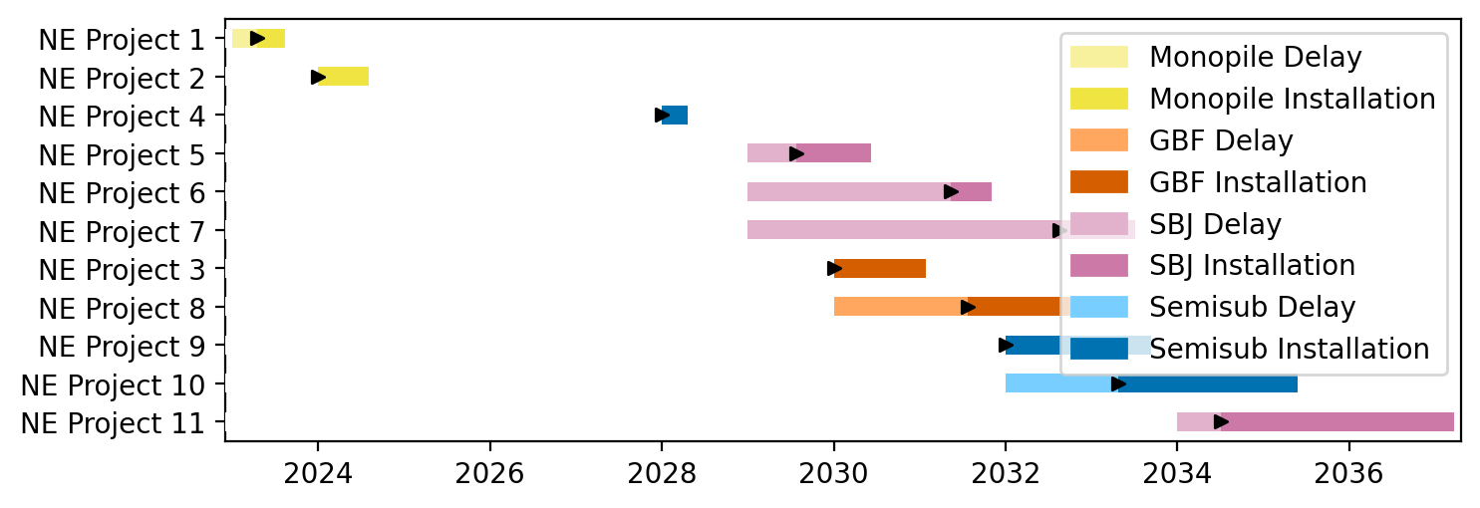
Sorted New England Gantt

Slide 8
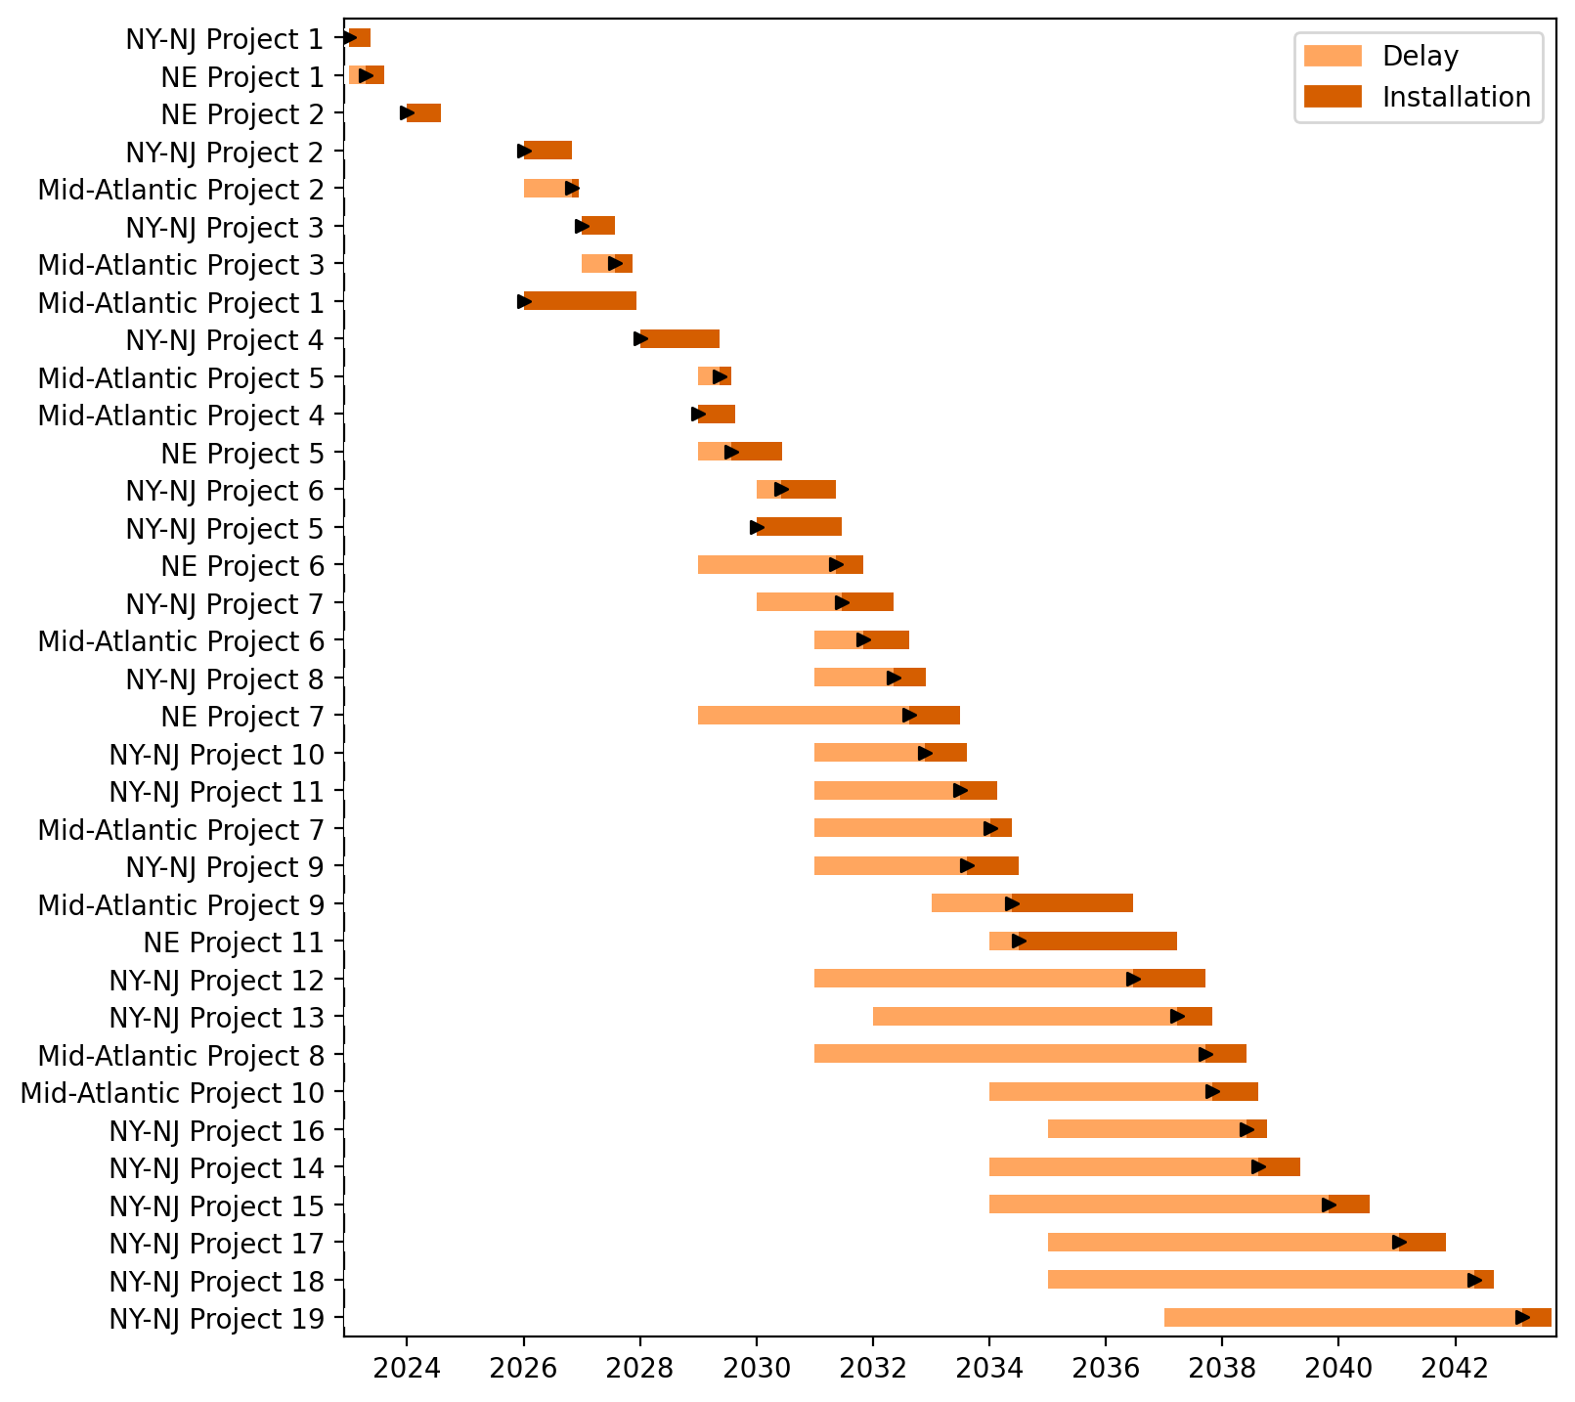
Fixed Gantt

Slide 9
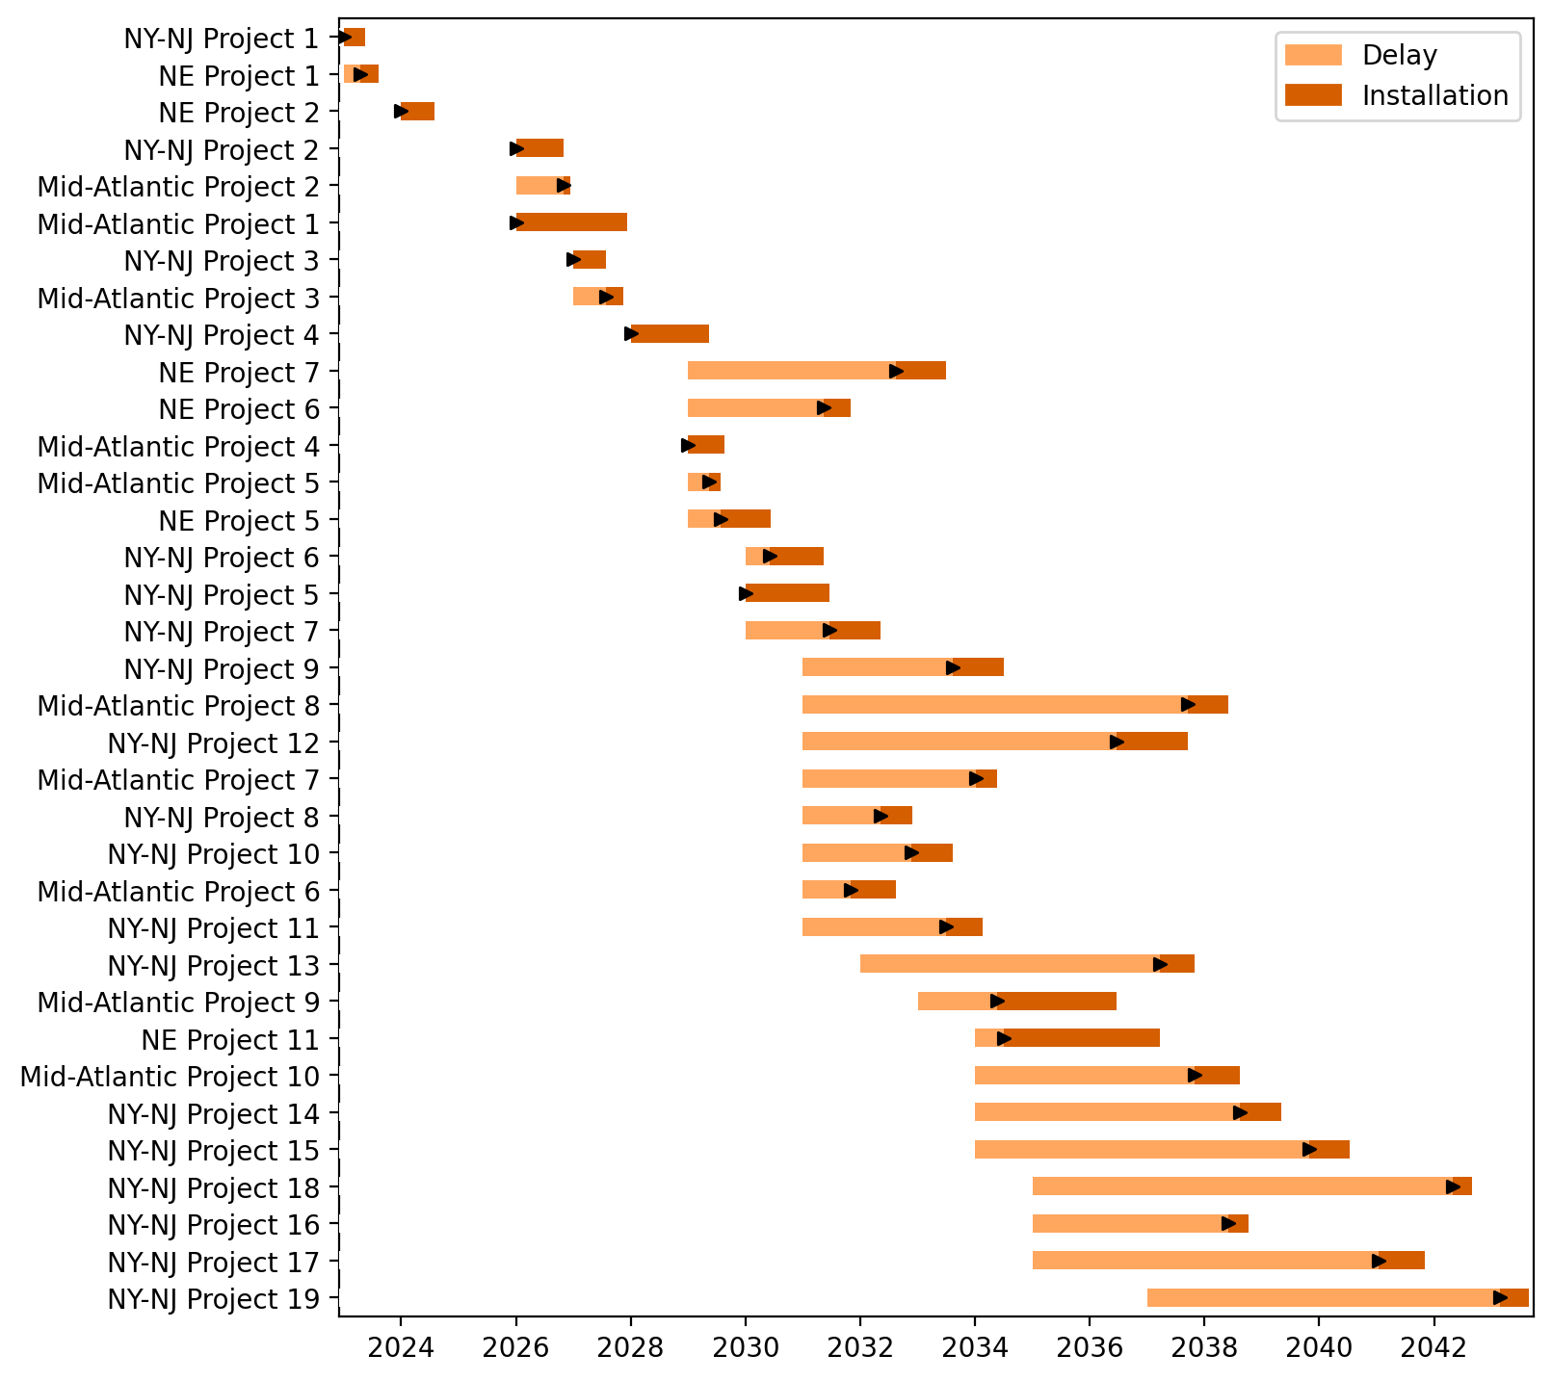
Sorted Fixed Gantt

Slide 10
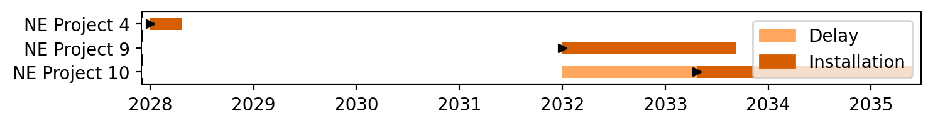
Floating Gantt

Slide 11
Sorted Floating Gantt

Slide 12
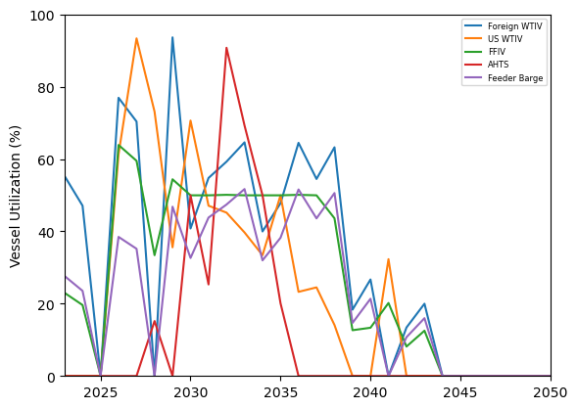
Vessel Utilization

Slide 13
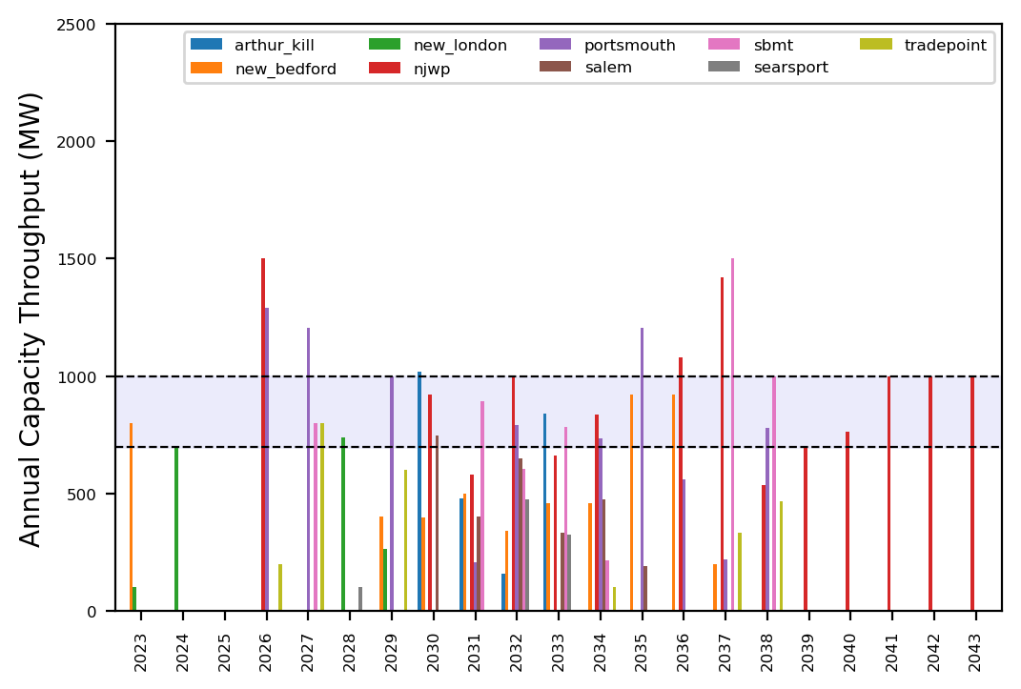
Port Throughput

Slide 14
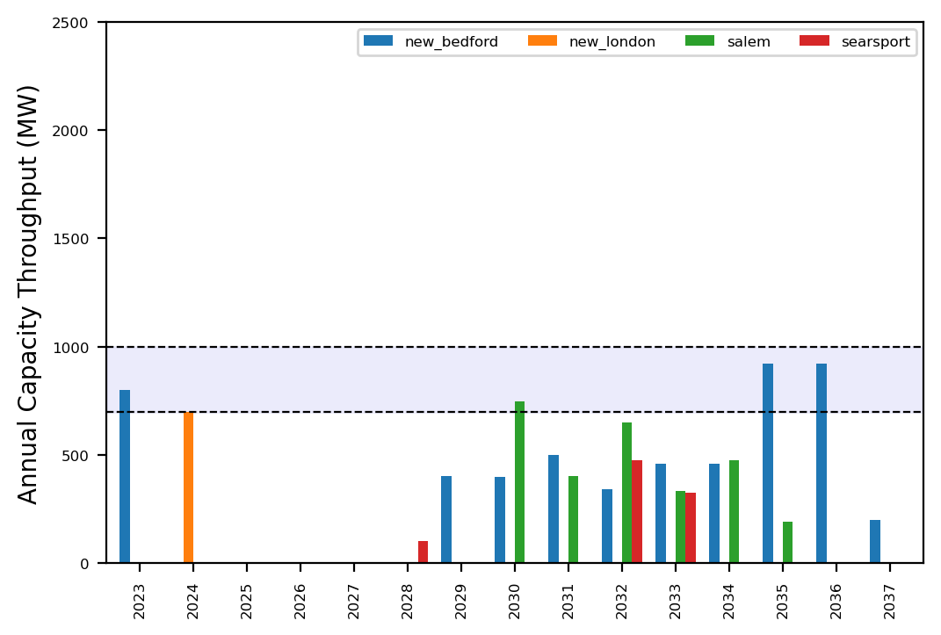
Port Throughput

Slide 15
example_atlantic_2

Slide 16
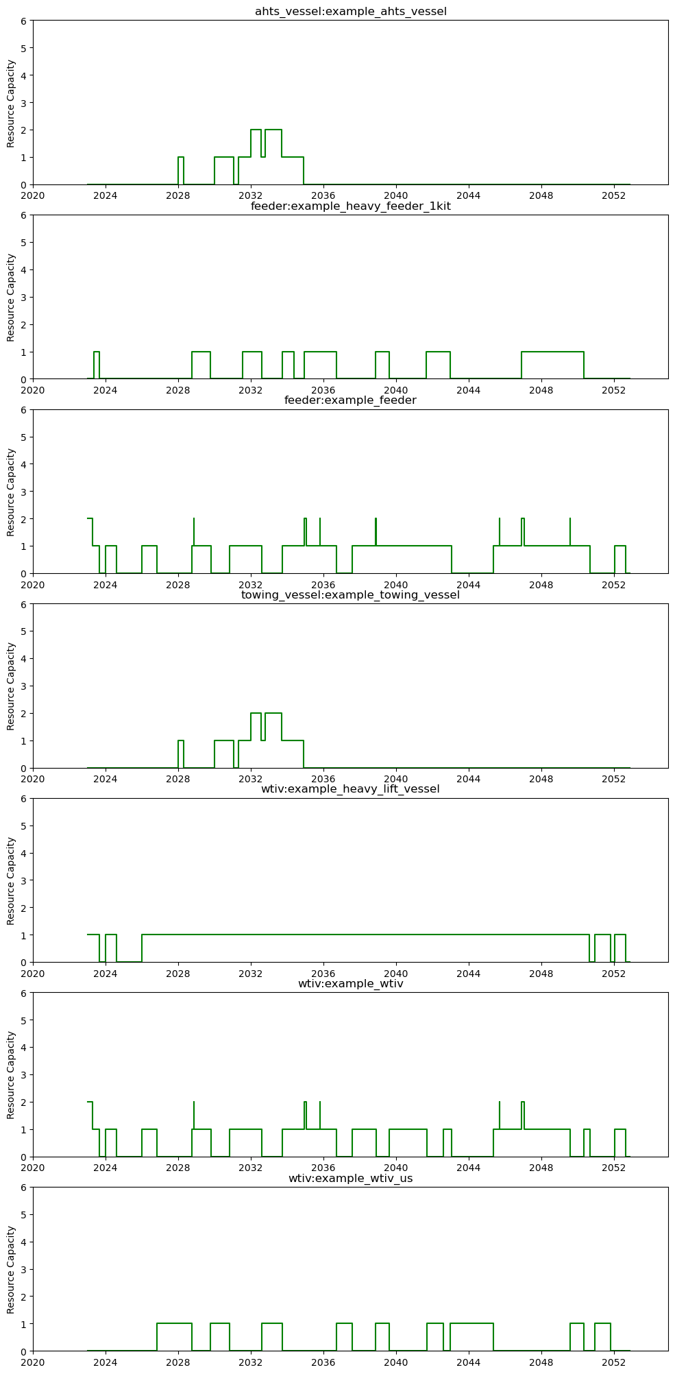
Shared Resource Capacity - Vessels

Slide 17
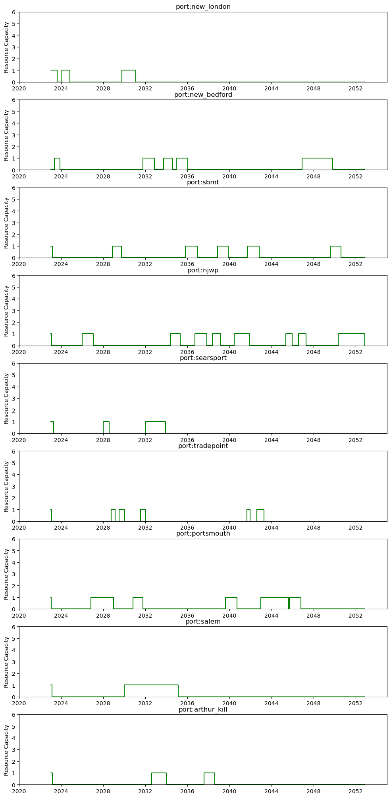
Shared Resource Capacity - Ports

Slide 18
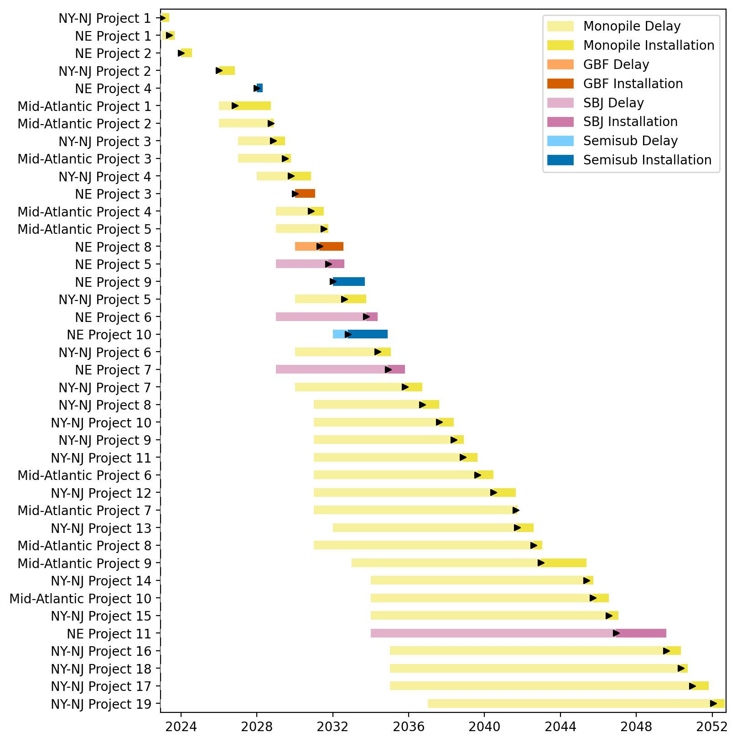
Full Gantt

Slide 19
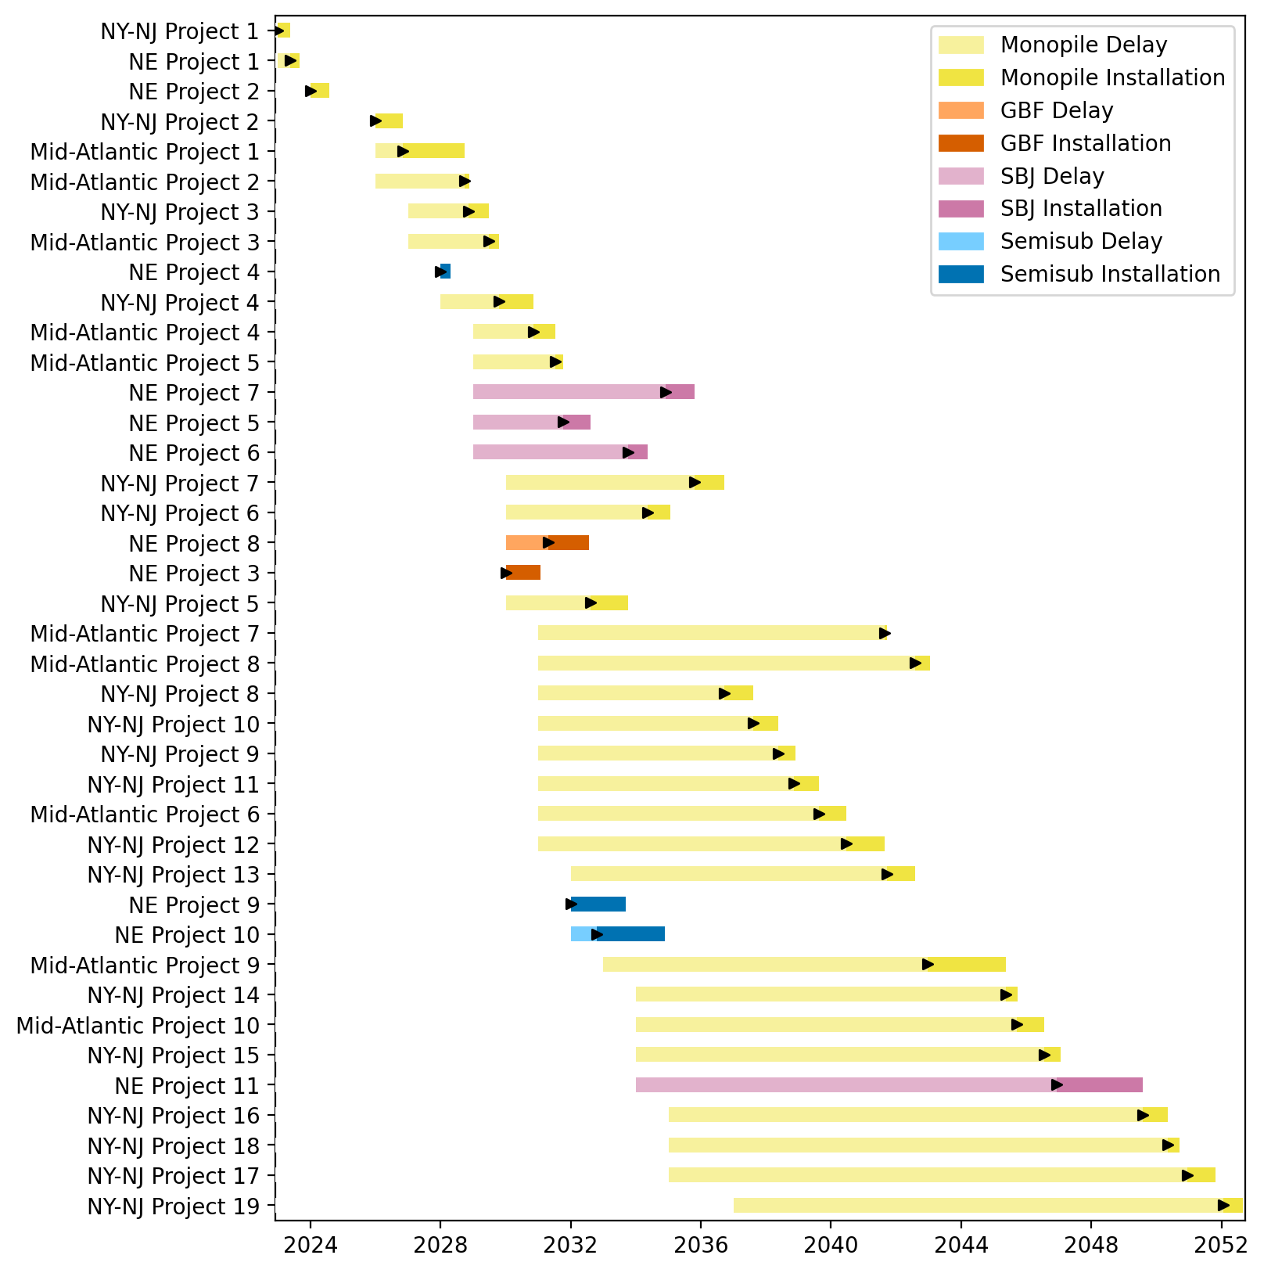
Sorted Full Gantt

Slide 20
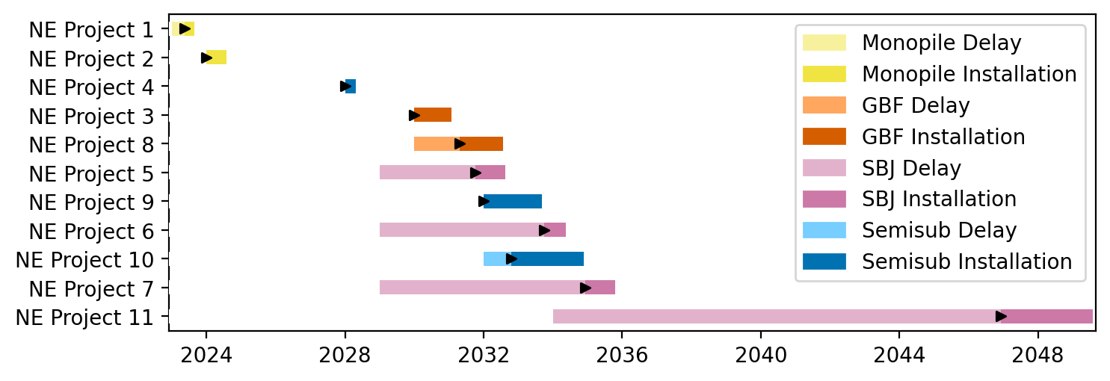
New England Gantt

Slide 21
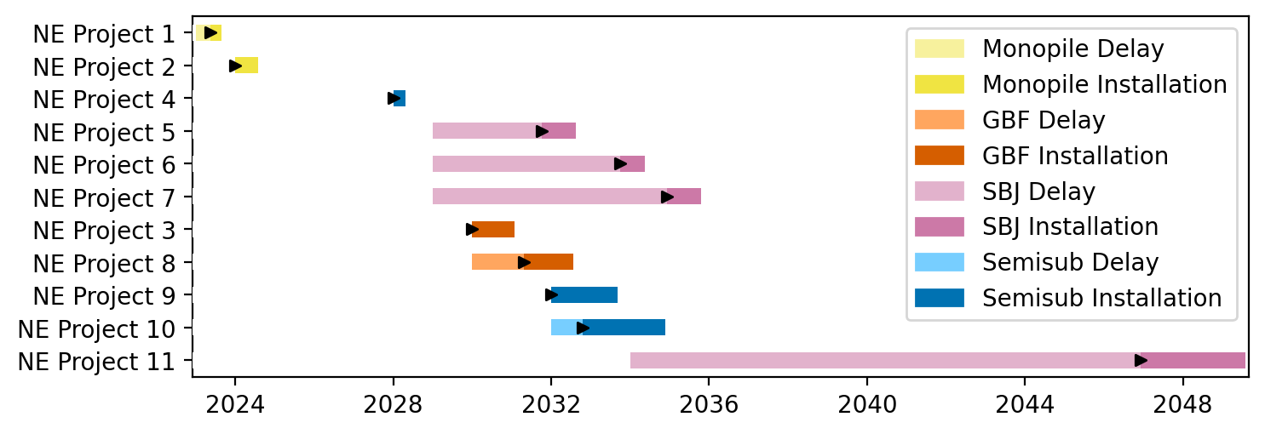
Sorted New England Gantt

Slide 22
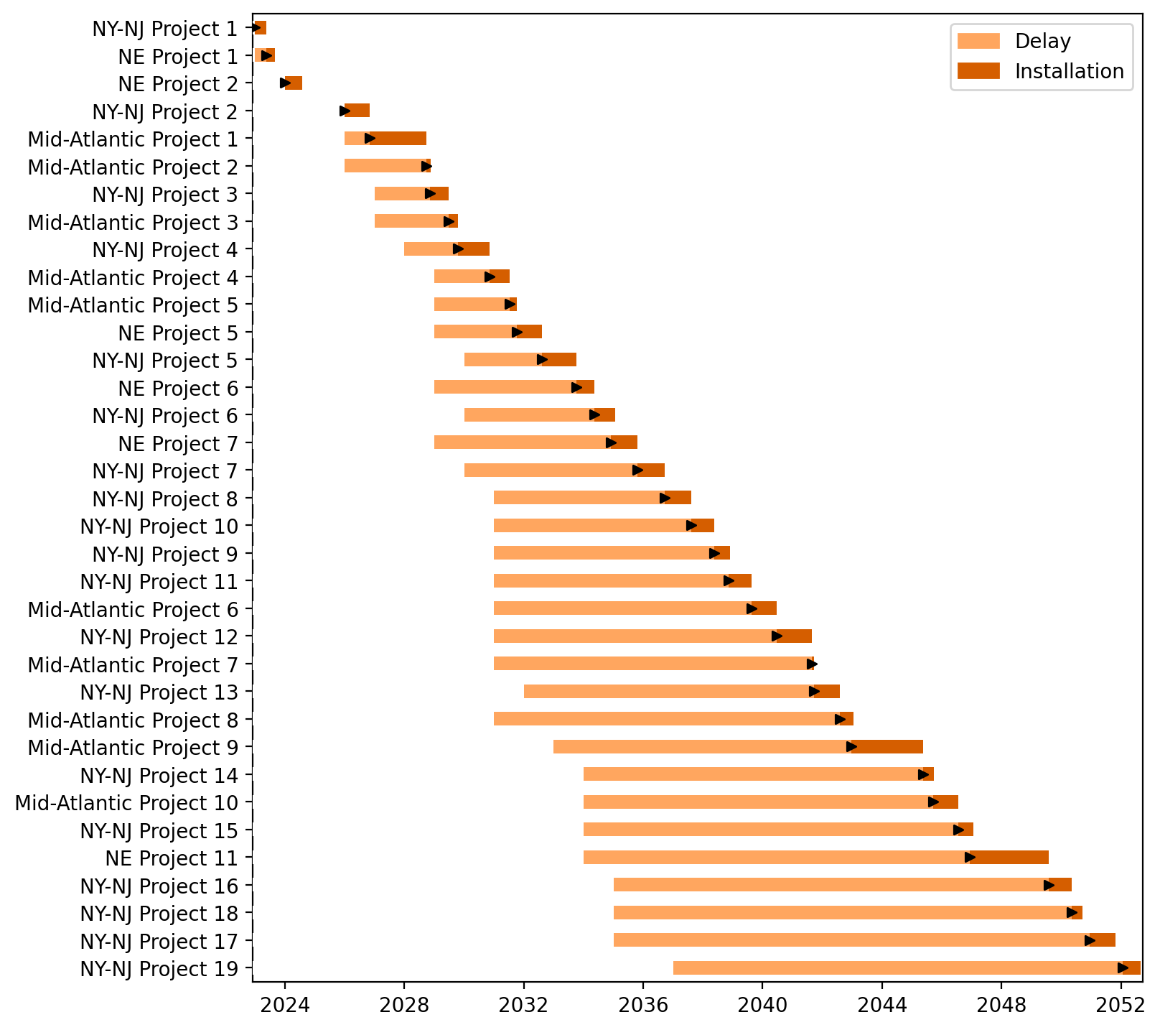
Fixed Gantt

Slide 23
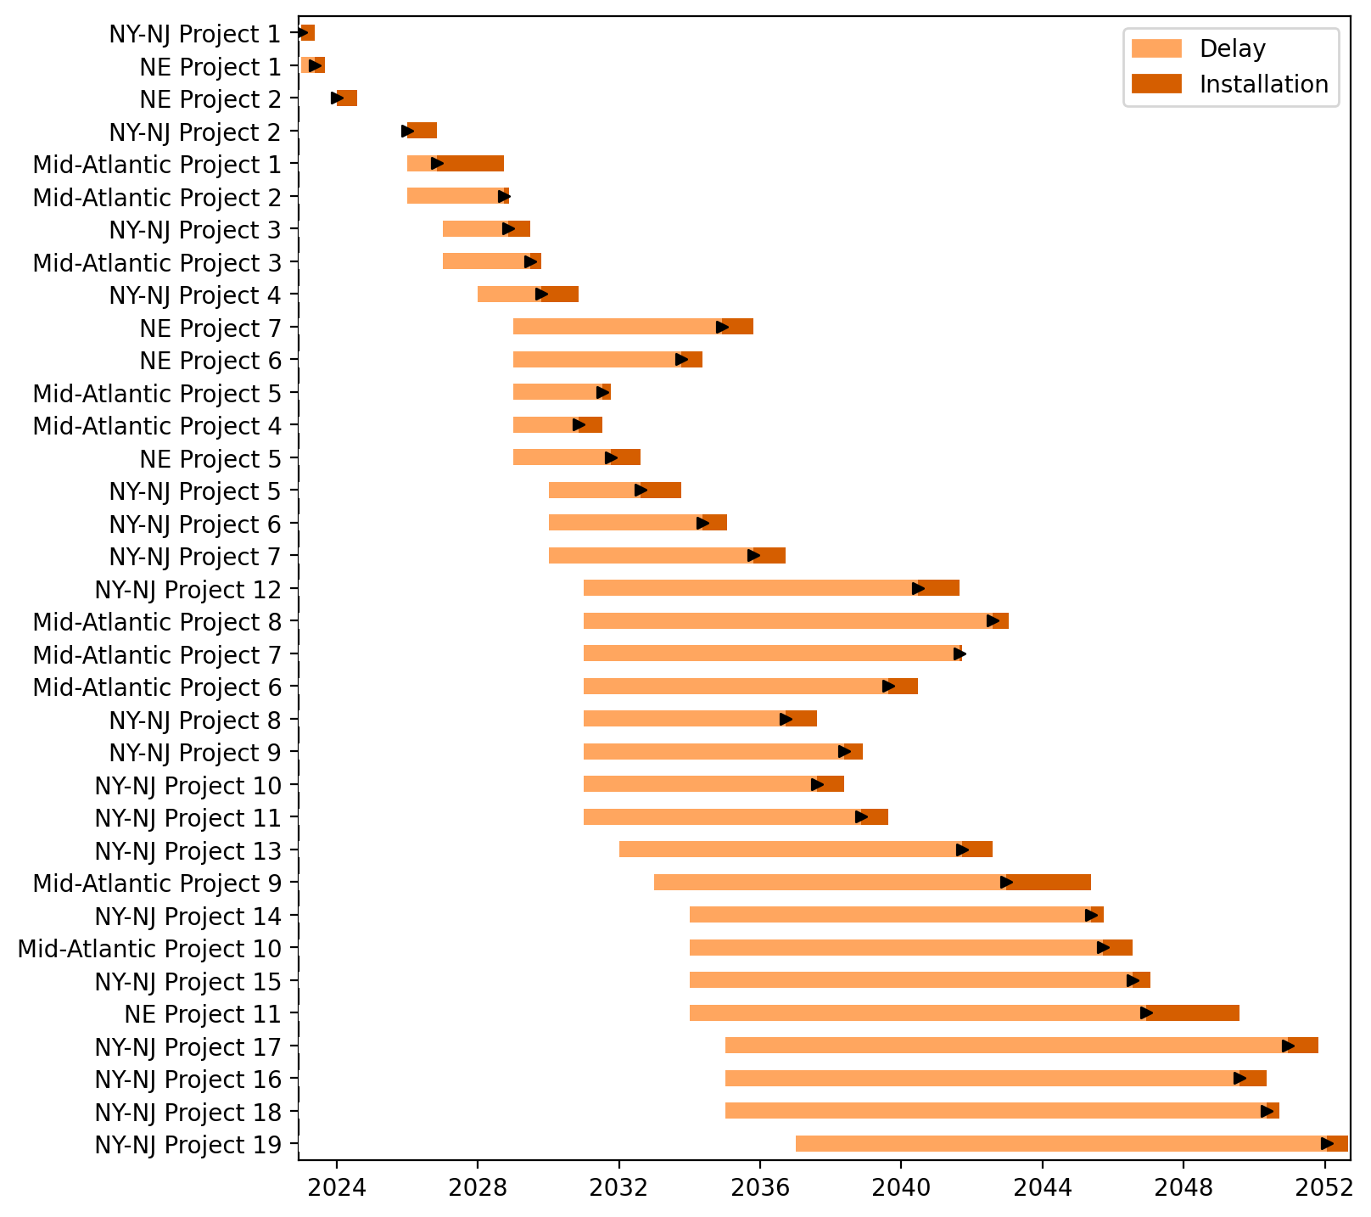
Sorted Fixed Gantt

Slide 24
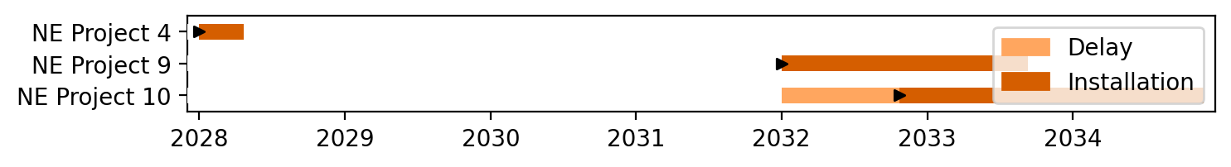
Floating Gantt

Slide 25
Sorted Floating Gantt

Slide 26
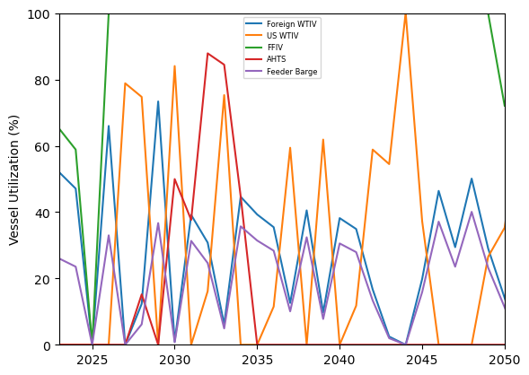
Vessel Utilization

Slide 27
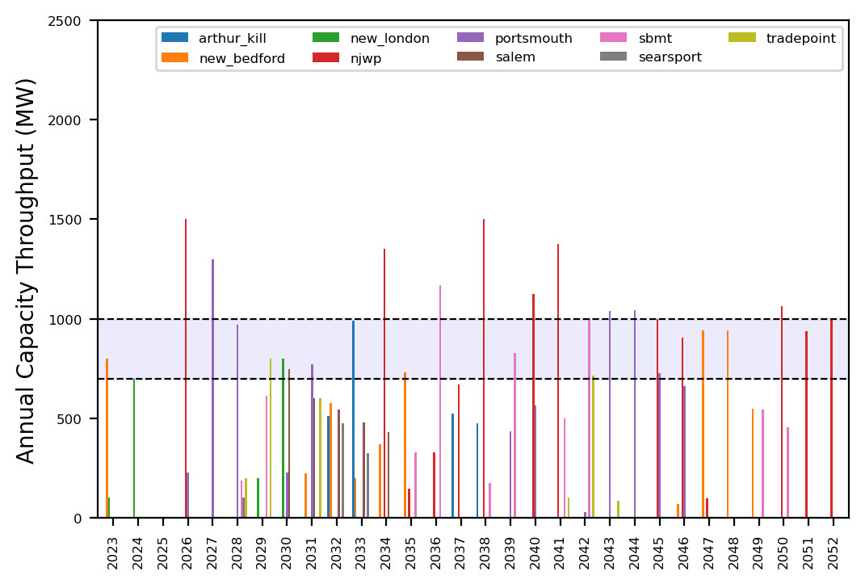
Port Throughput

Slide 28
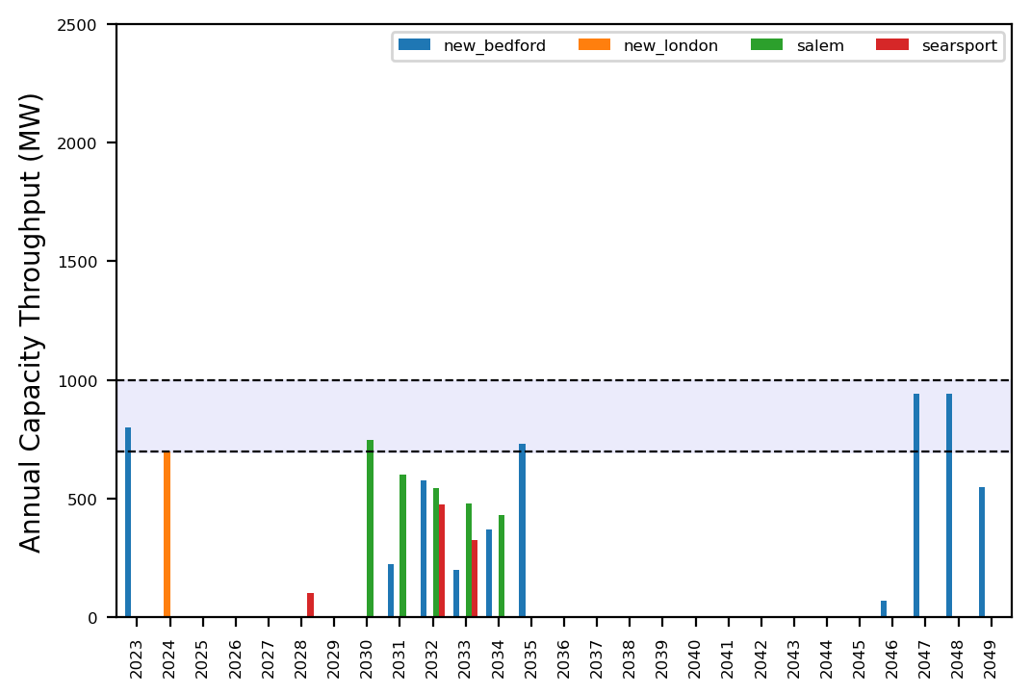
Port Throughput

Slide 29
example_atlantic_1

Slide 30
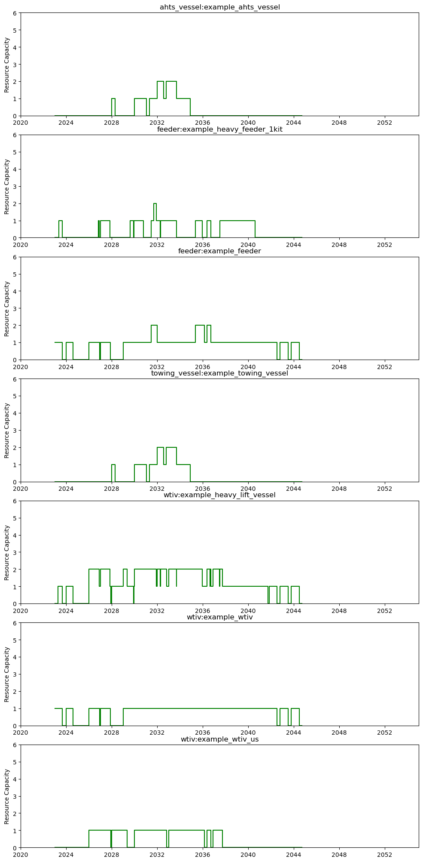
Shared Resource Capacity - Vessels

Slide 31
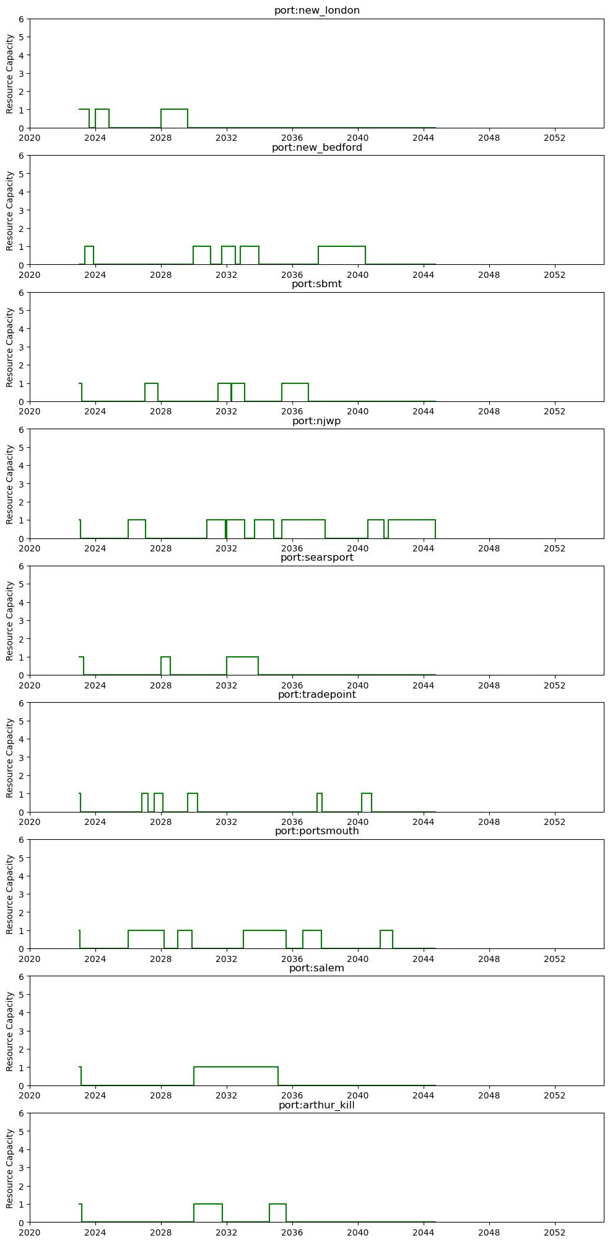
Shared Resource Capacity - Ports

Slide 32
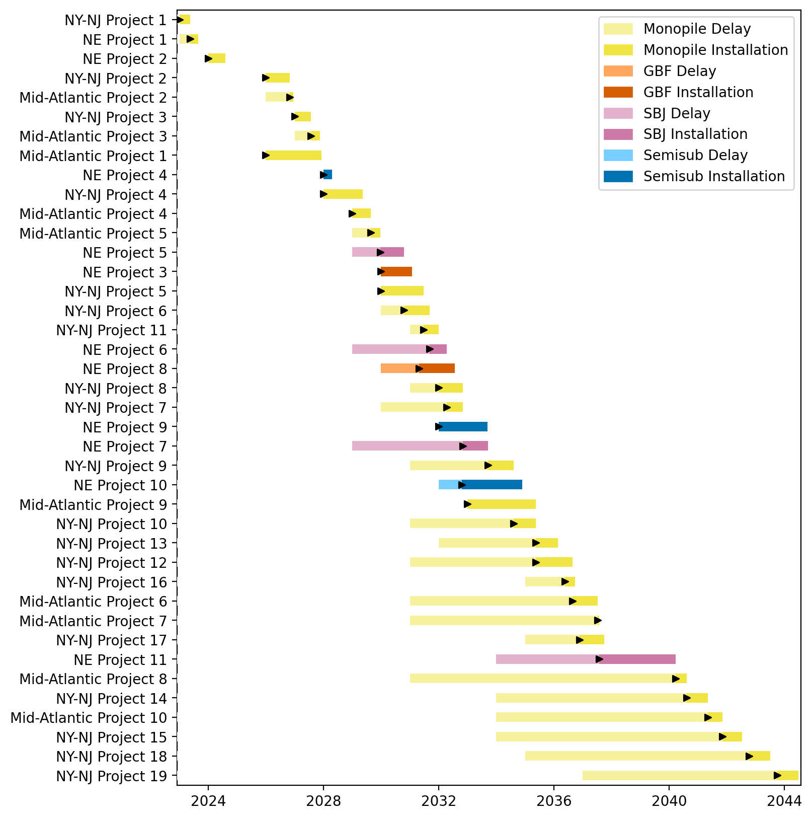
Full Gantt

Slide 33
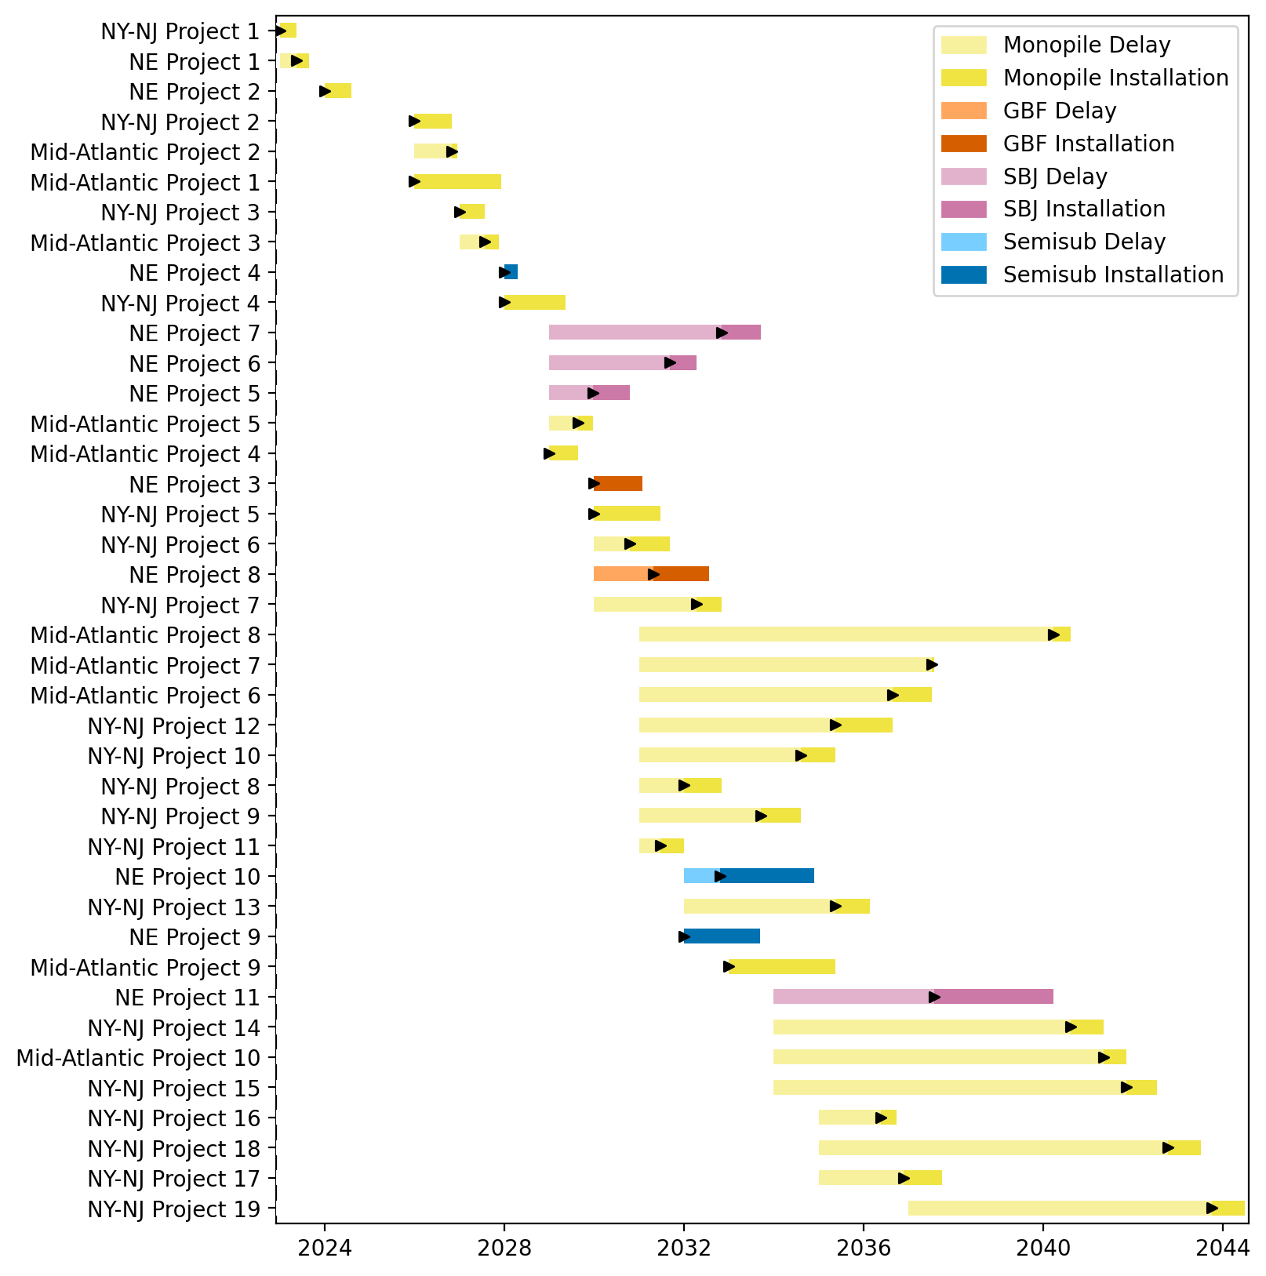
Sorted Full Gantt

Slide 34
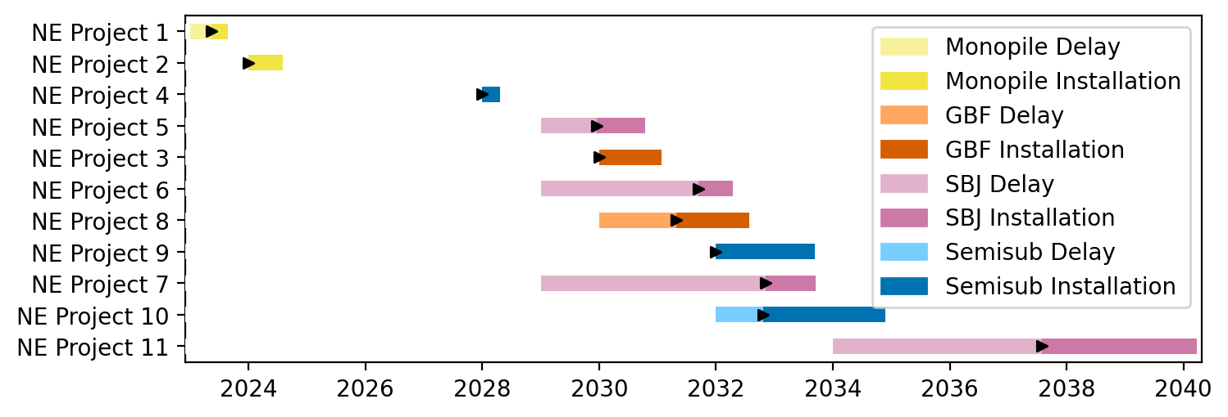
New England Gantt

Slide 35
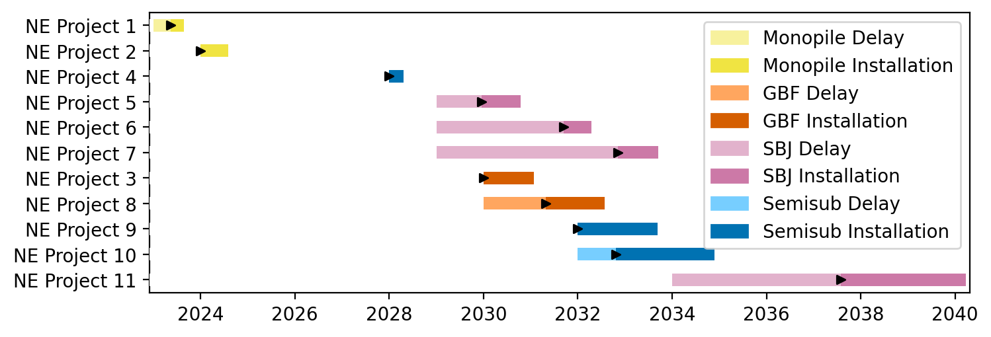
Sorted New England Gantt

Slide 36
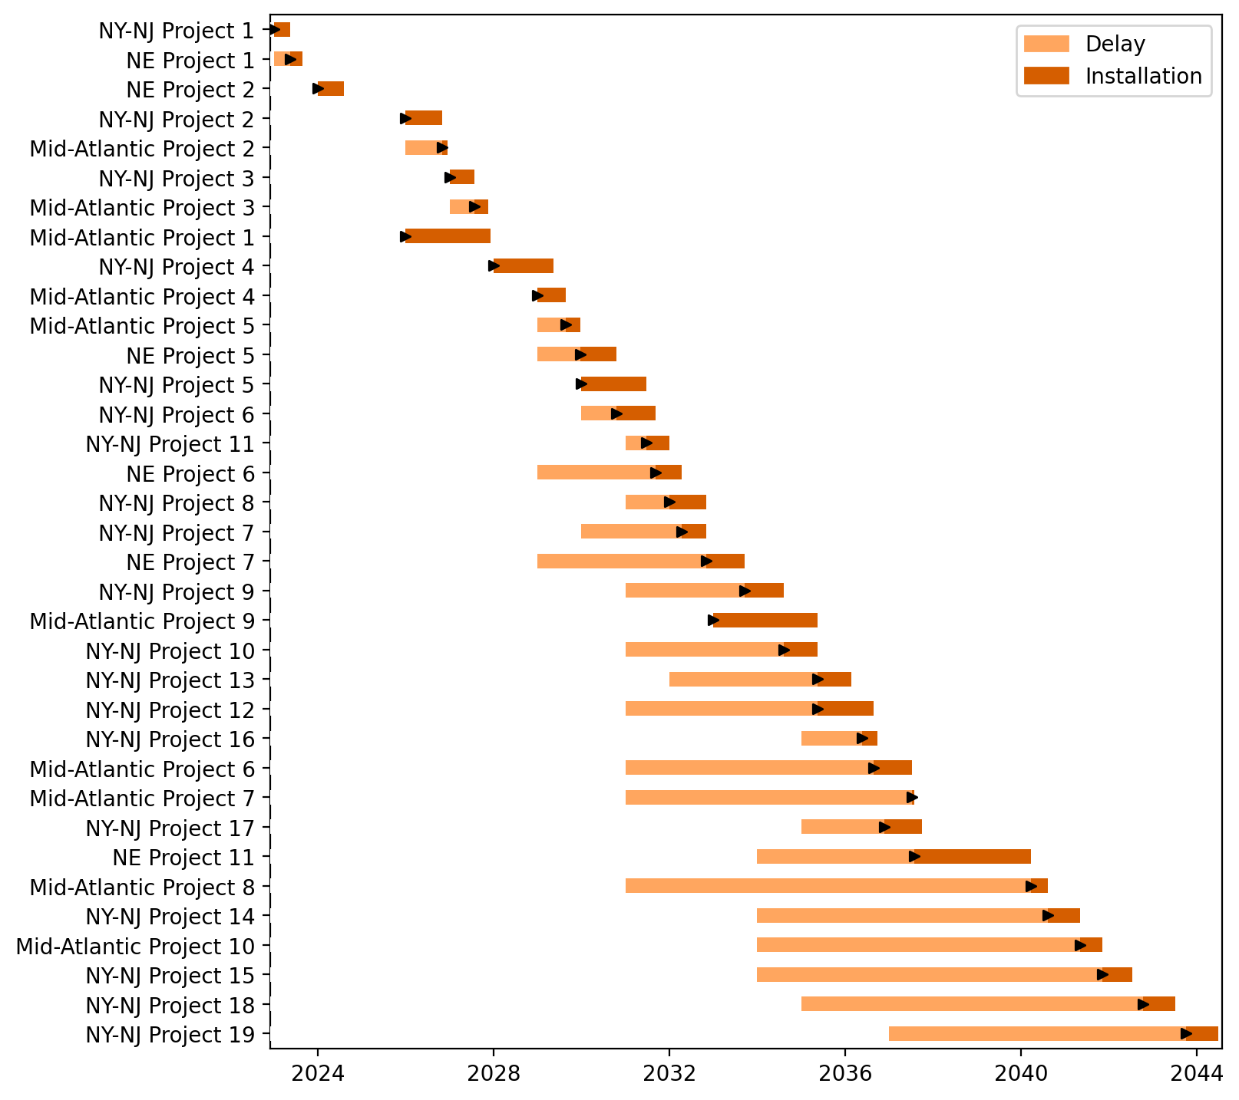
Fixed Gantt

Slide 37
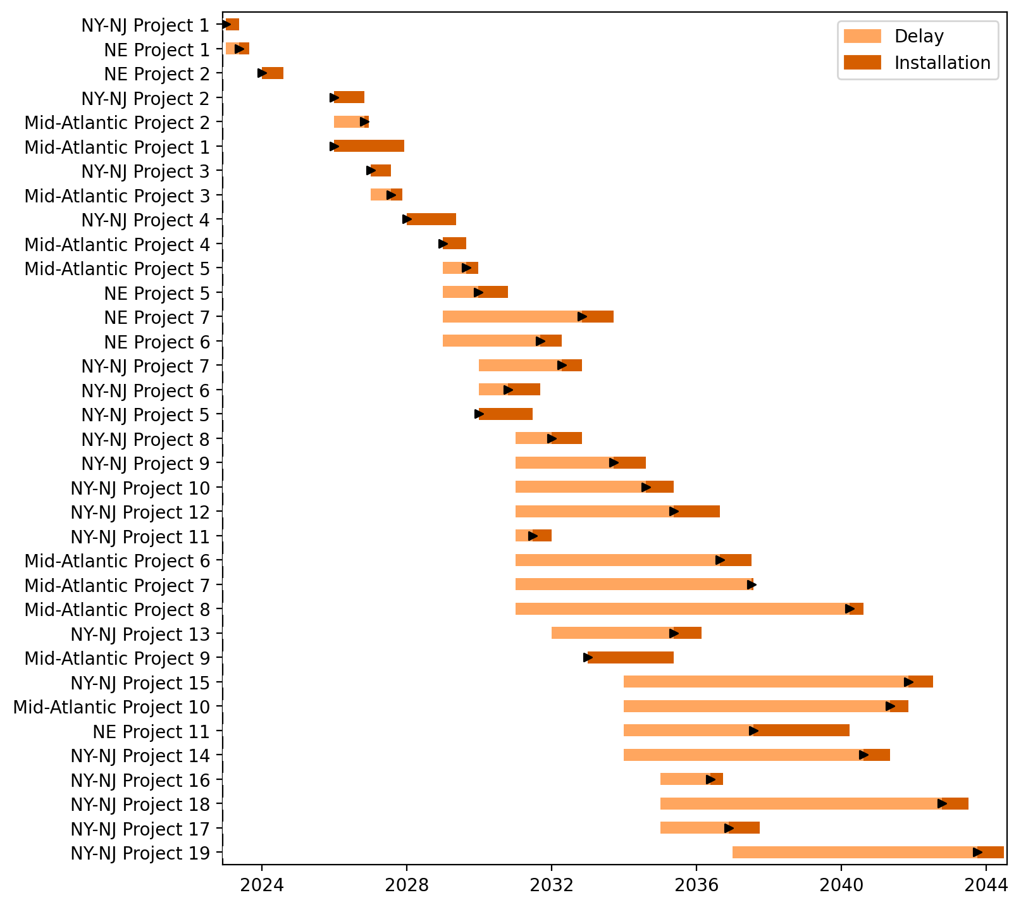
Sorted Fixed Gantt

Slide 38
Floating Gantt

Slide 39
Sorted Floating Gantt

Slide 40
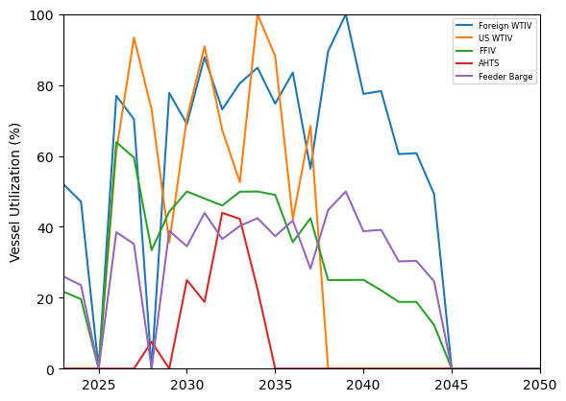
Vessel Utilization

Slide 41
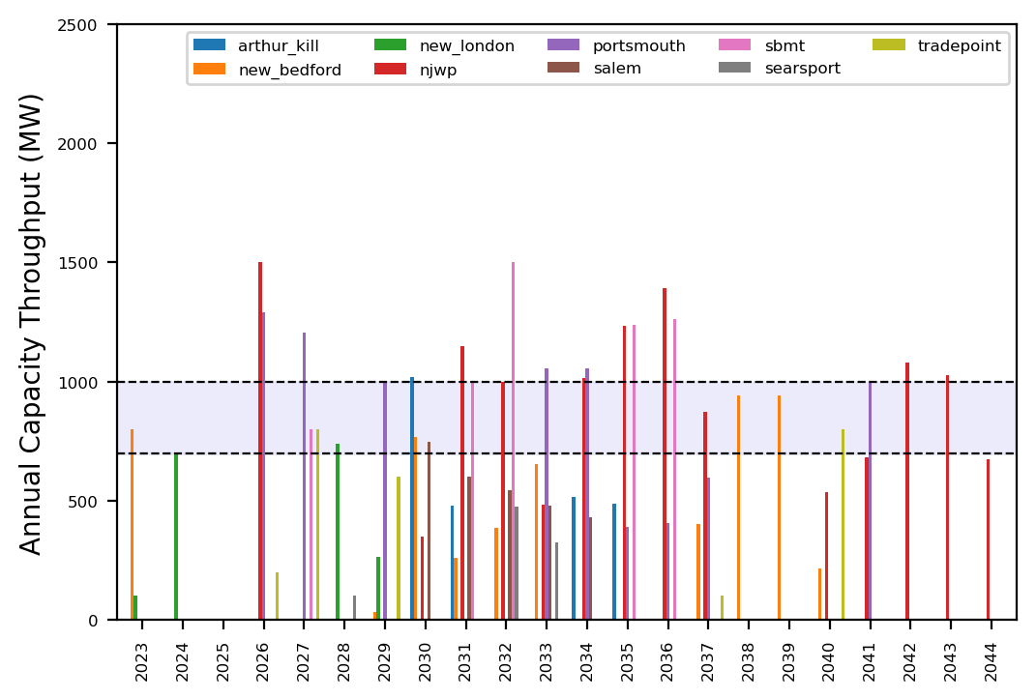
Port Throughput

Slide 42
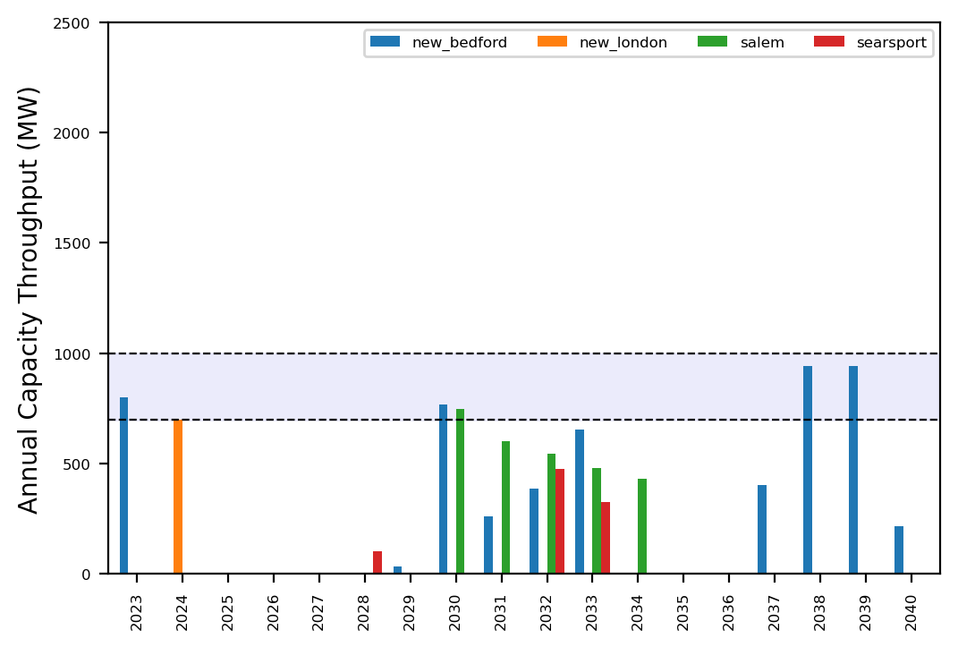
Port Throughput

Slide 43
Summary Plots

Slide 44
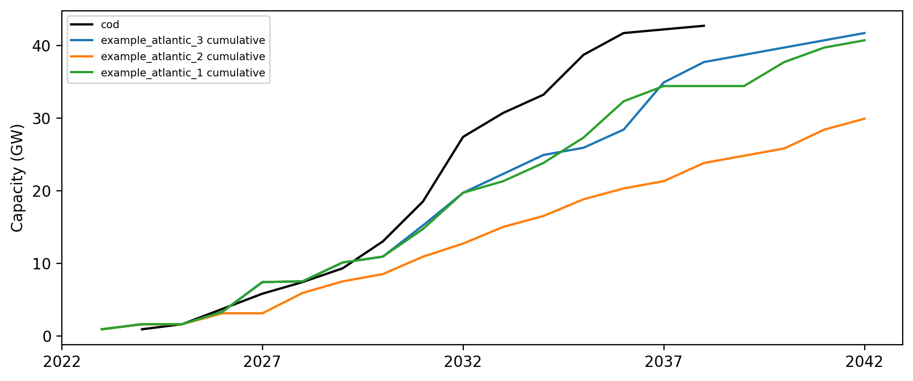
Cumulative Installed Capacity

Slide 45
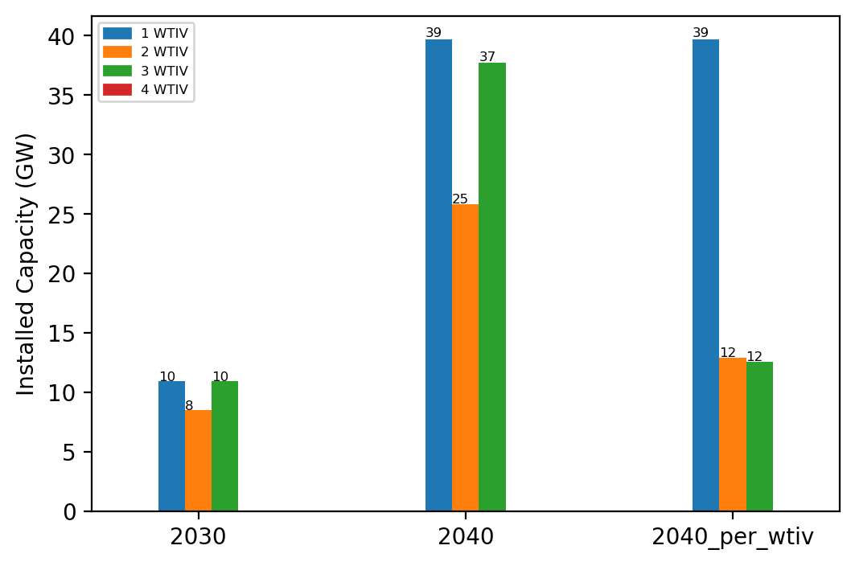
Summary Installed Capacity

Slide 46
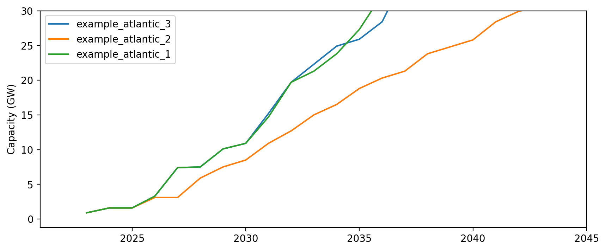
Installed Capacity - All Regions

Slide 47
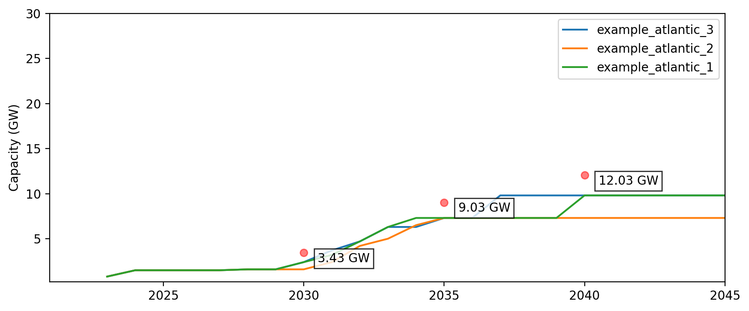
Installed Capacity - NE

Slide 48
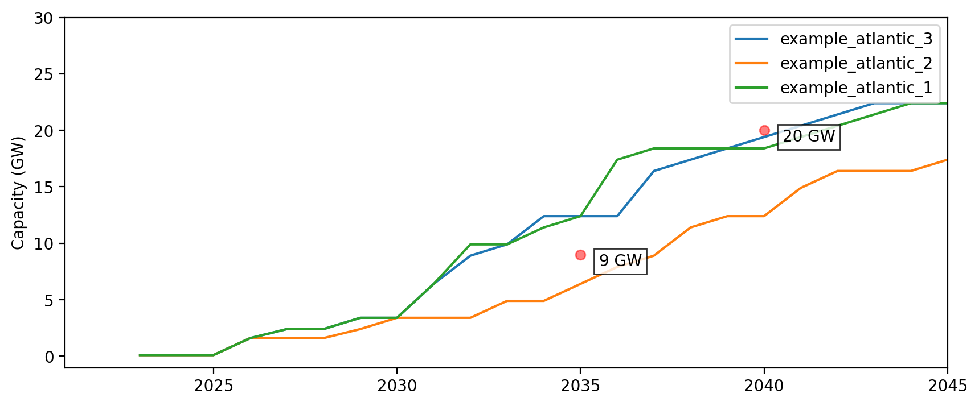
Installed Capacity - NY/NJ

Slide 49
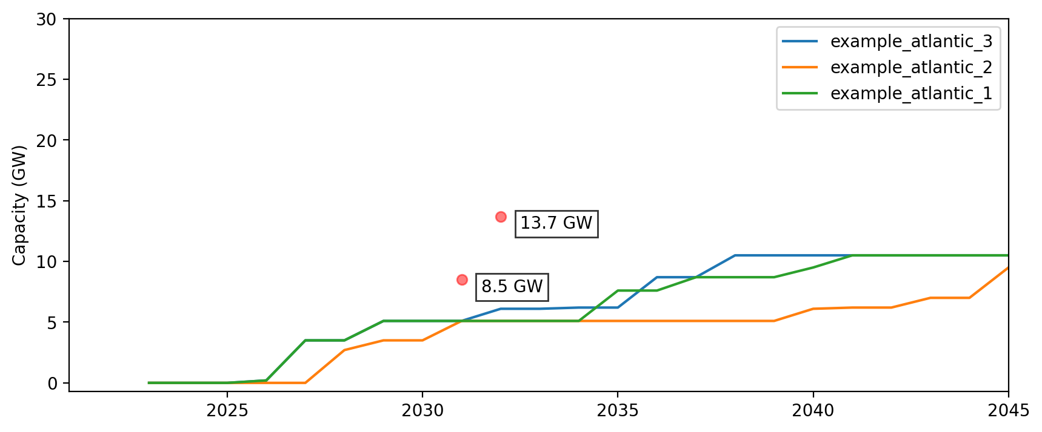
Installed Capacity - Central Atlantic

Slide 50
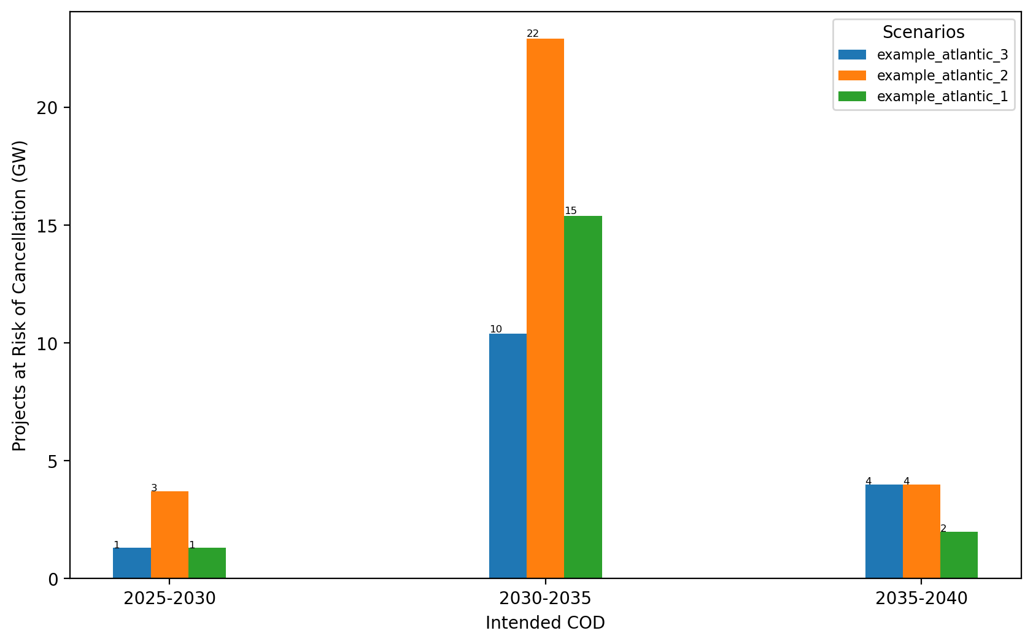
Total Capacity at Risk by COD - All Regions

Slide 51
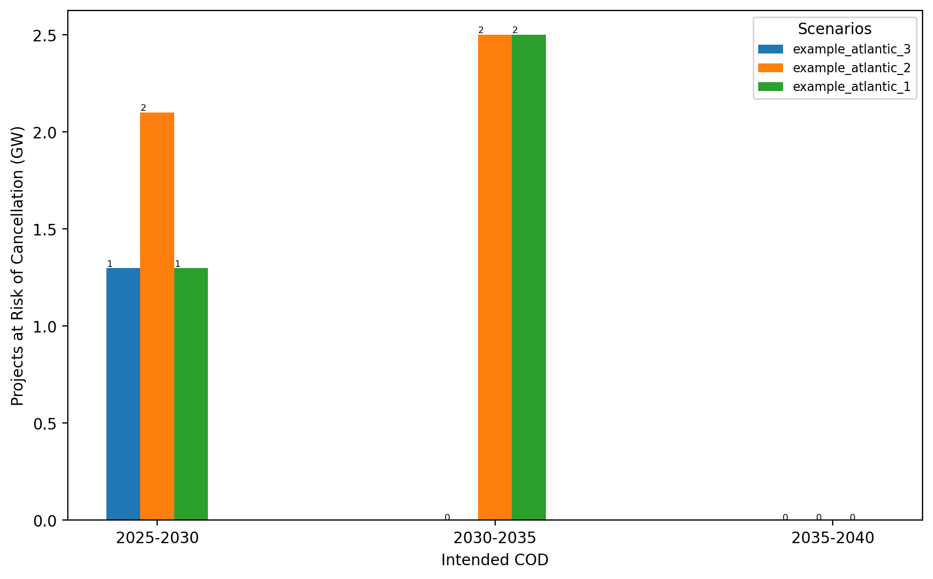
Total Capacity at Risk by COD - NE

Slide 52
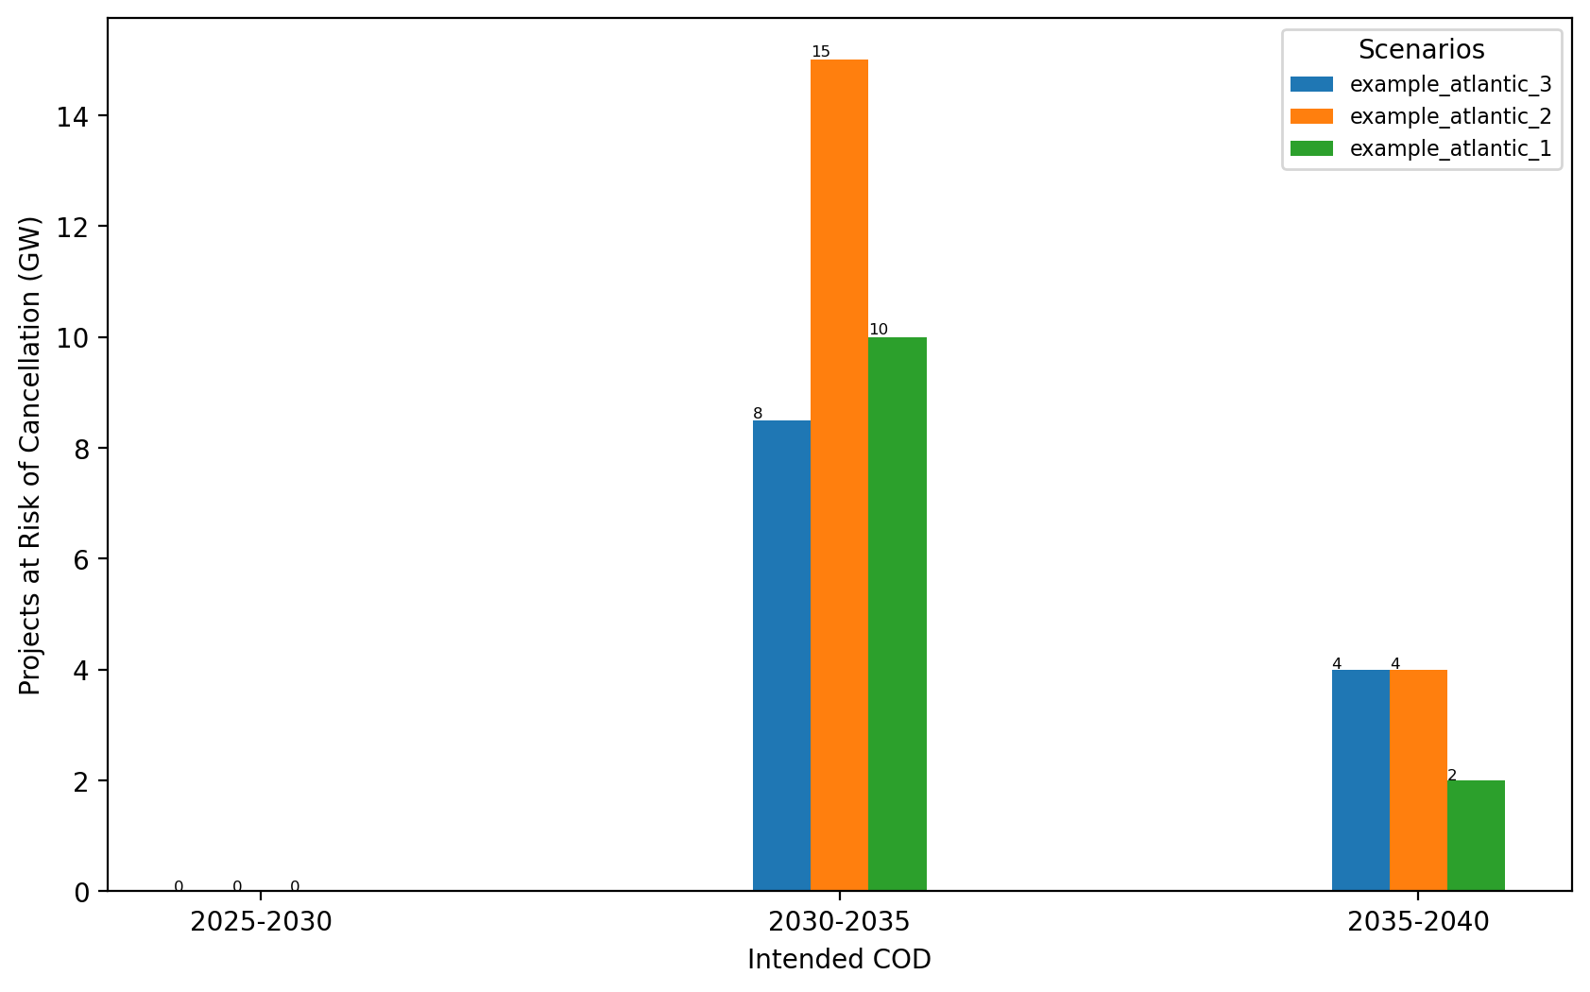
Total Capacity at Risk by COD - NY/NJ

Slide 53
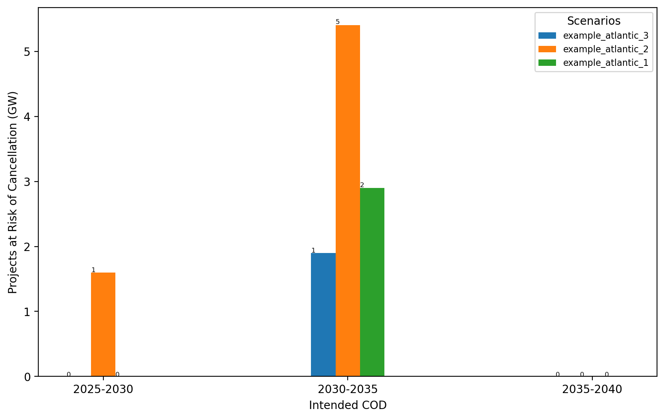
Total Capacity at Risk by COD - Mid-Atlantic

Slide 54
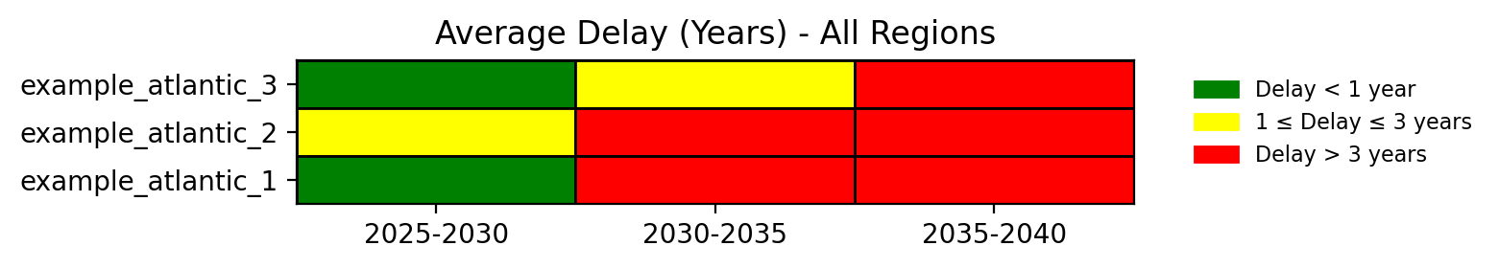
Average Delay Heat Map - All Regions

Slide 55
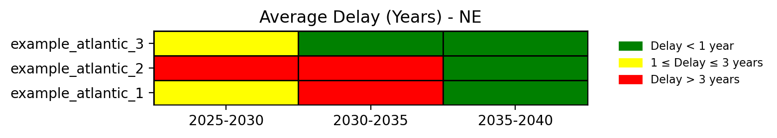
Average Delay Heat Map - NE

Slide 56
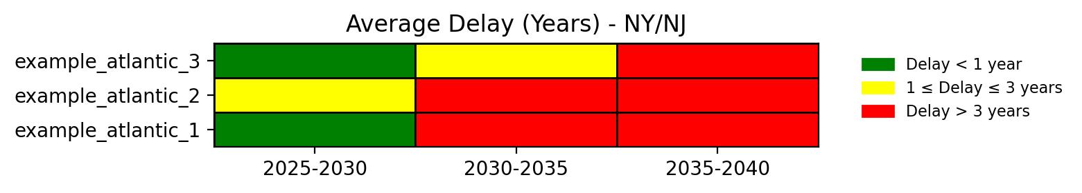
Average Delay Heat Map - NY/NJ

Slide 57
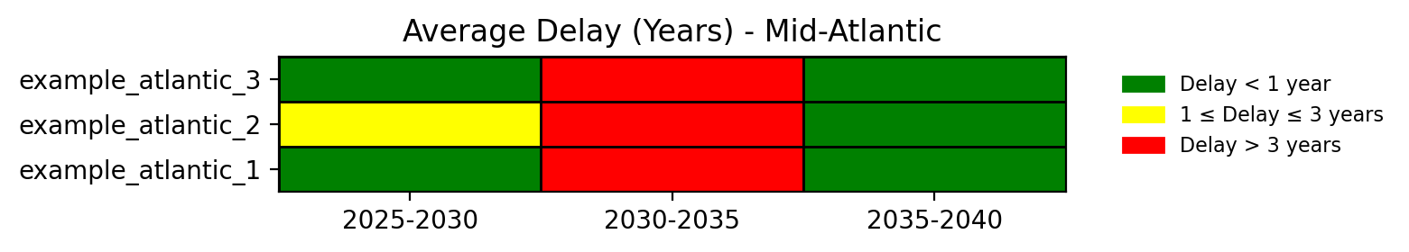
Average Delay Heat Map - Mid-Atlantic

