Slide 1
natl_gaps_1AHTS_2_1
1 additional AHTS built in 2030

Slide 2
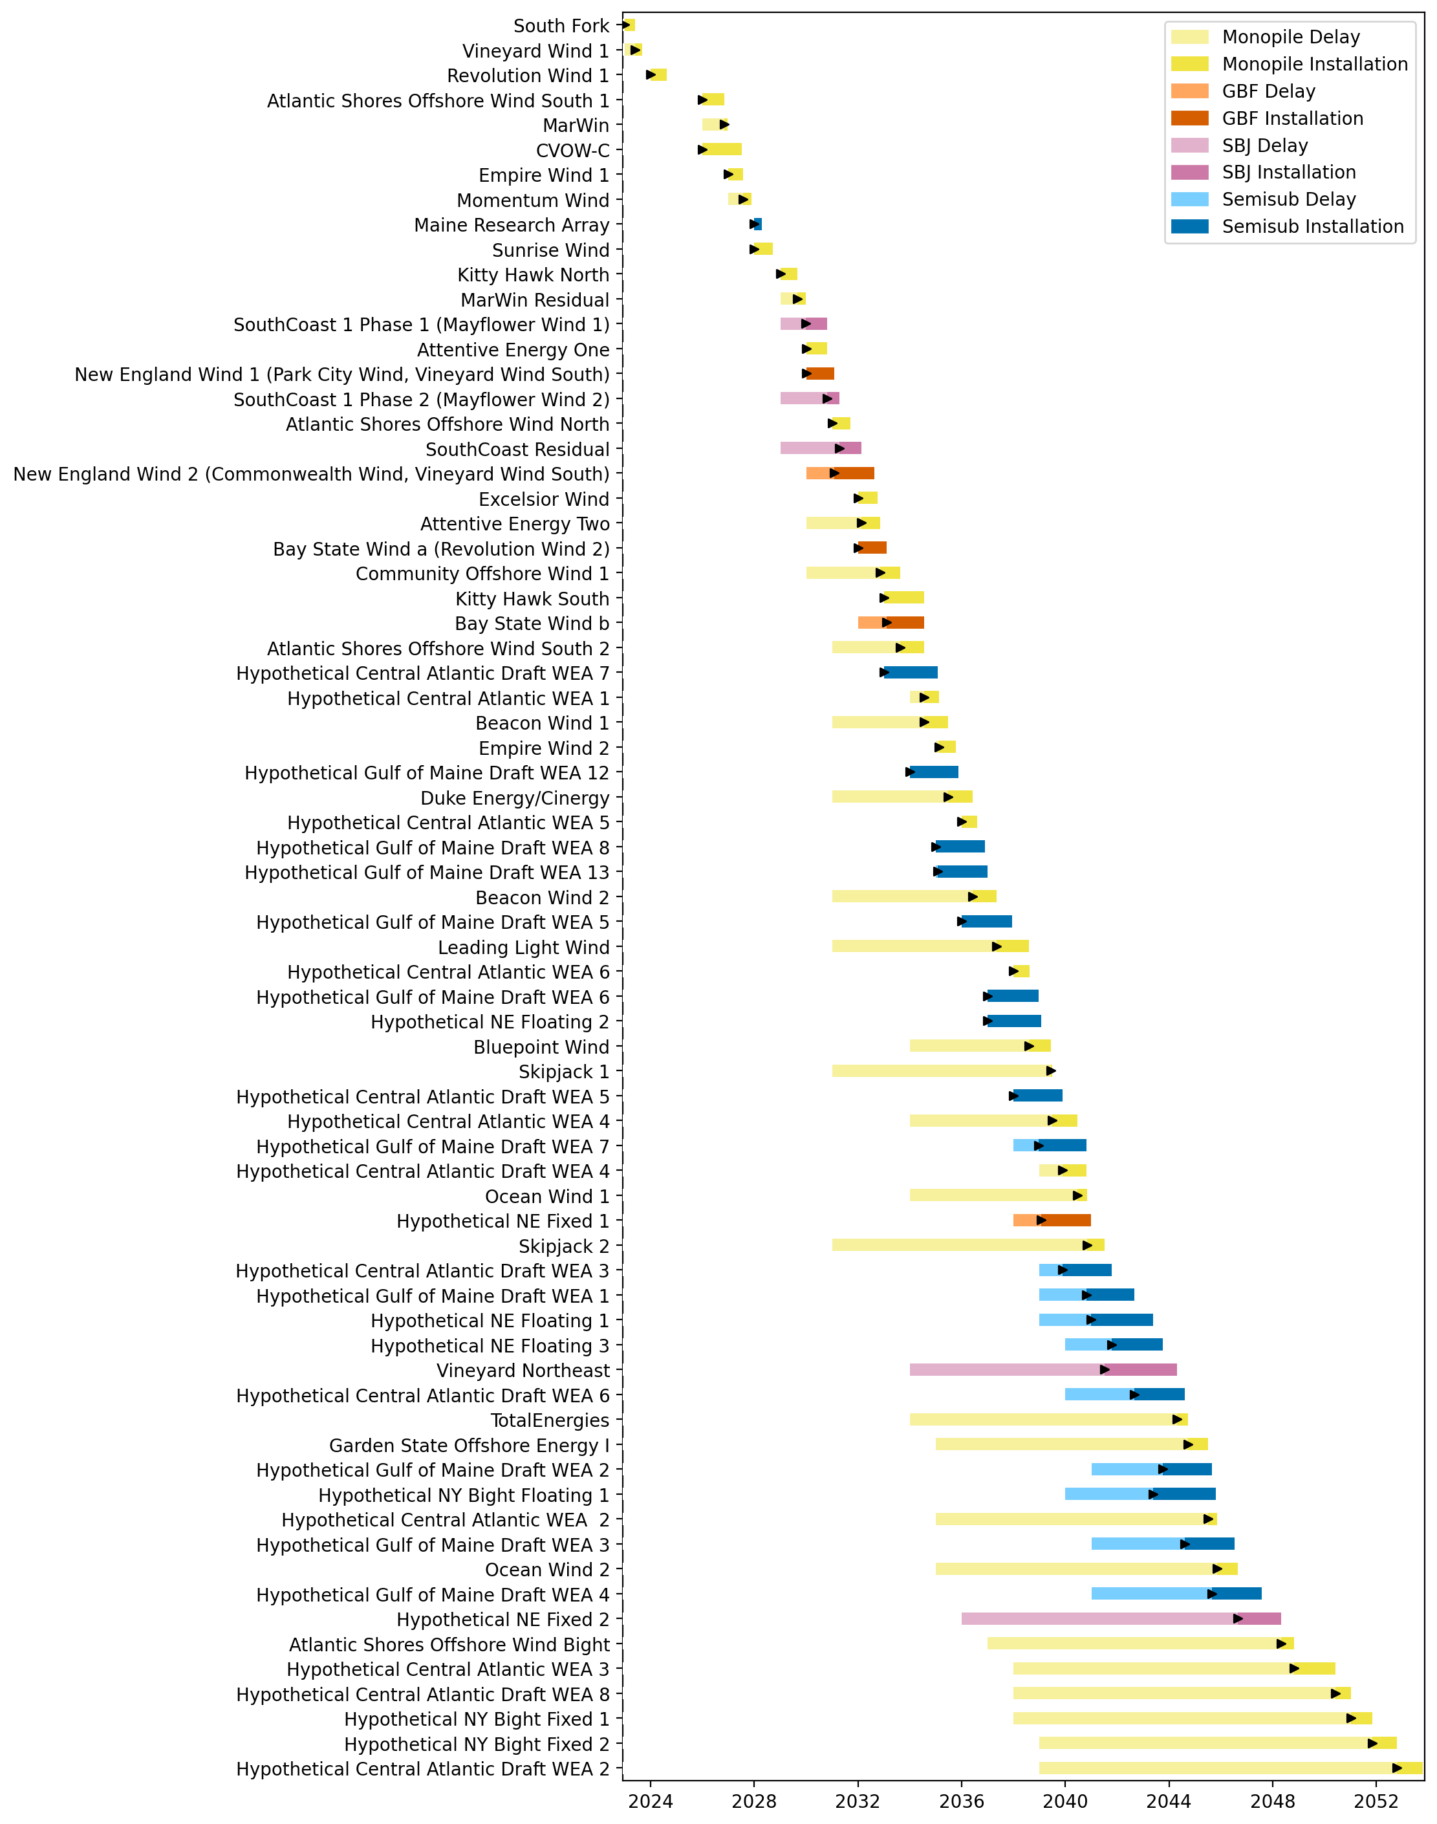
Full Gantt

Slide 3
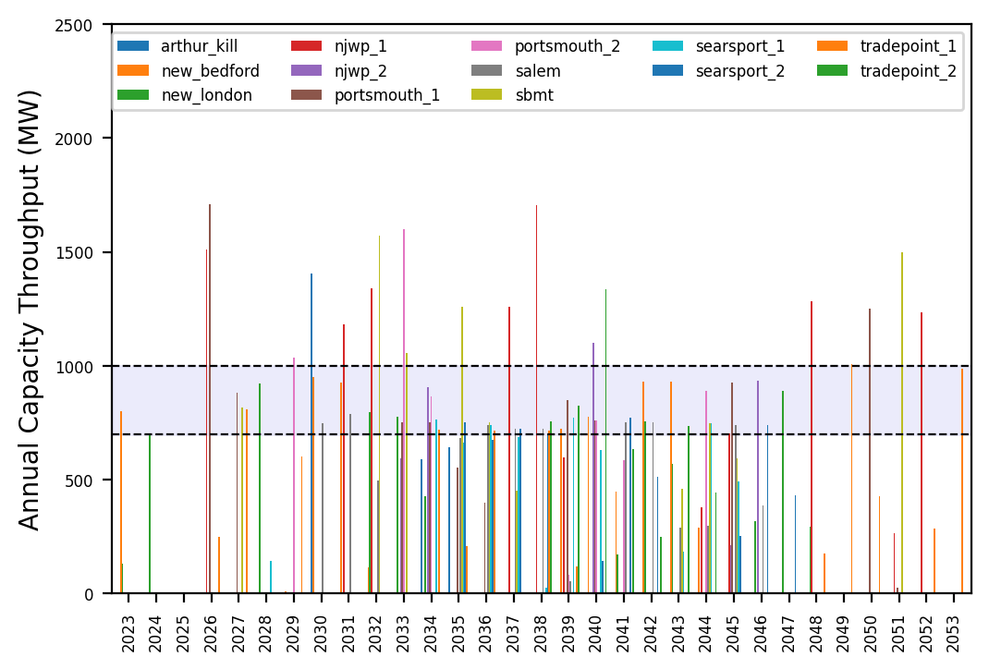
Port Throughput

Slide 4
natl_gaps_2AHTS_2_1
2 additional AHTS vessels, built every 3 years starting in 2030

Slide 5
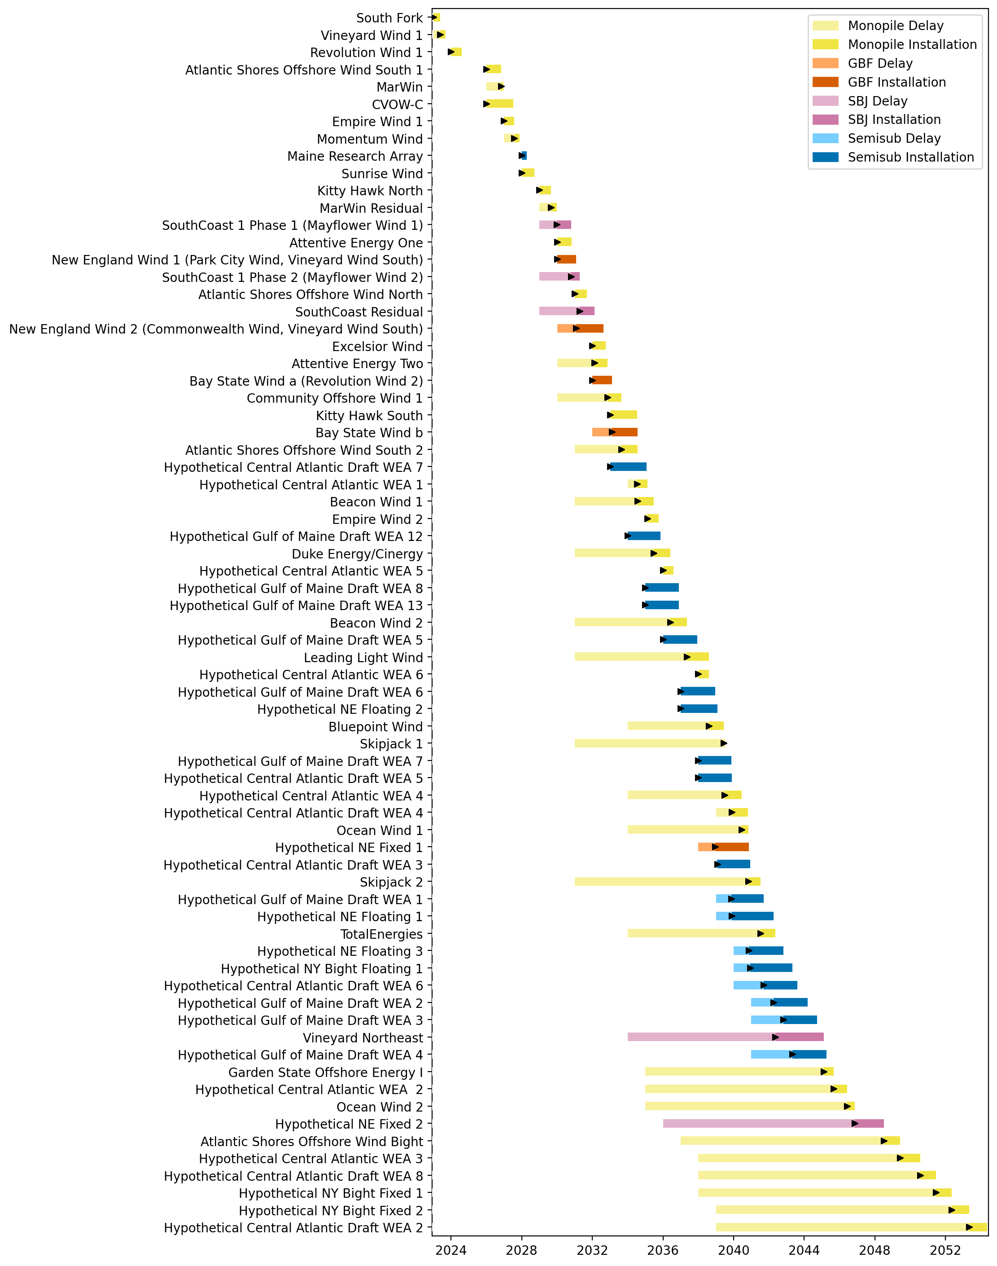
Full Gantt

Slide 6
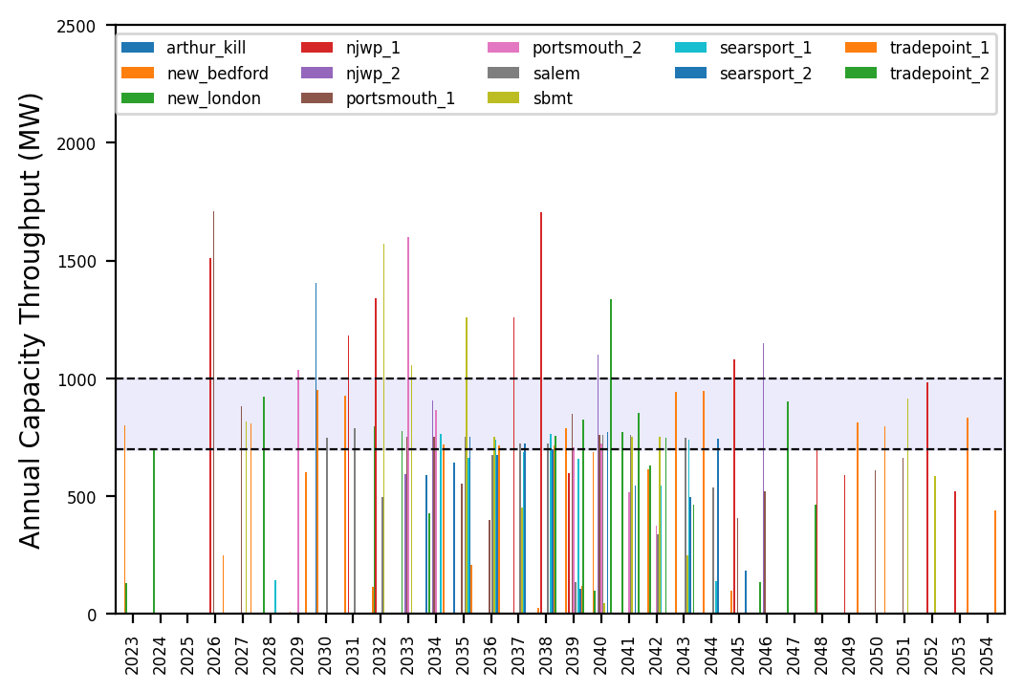
Port Throughput

Slide 7
natl_gaps_4AHTS_2_1
4 additional AHTS vessels, built every 3 years starting in 2030

Slide 8
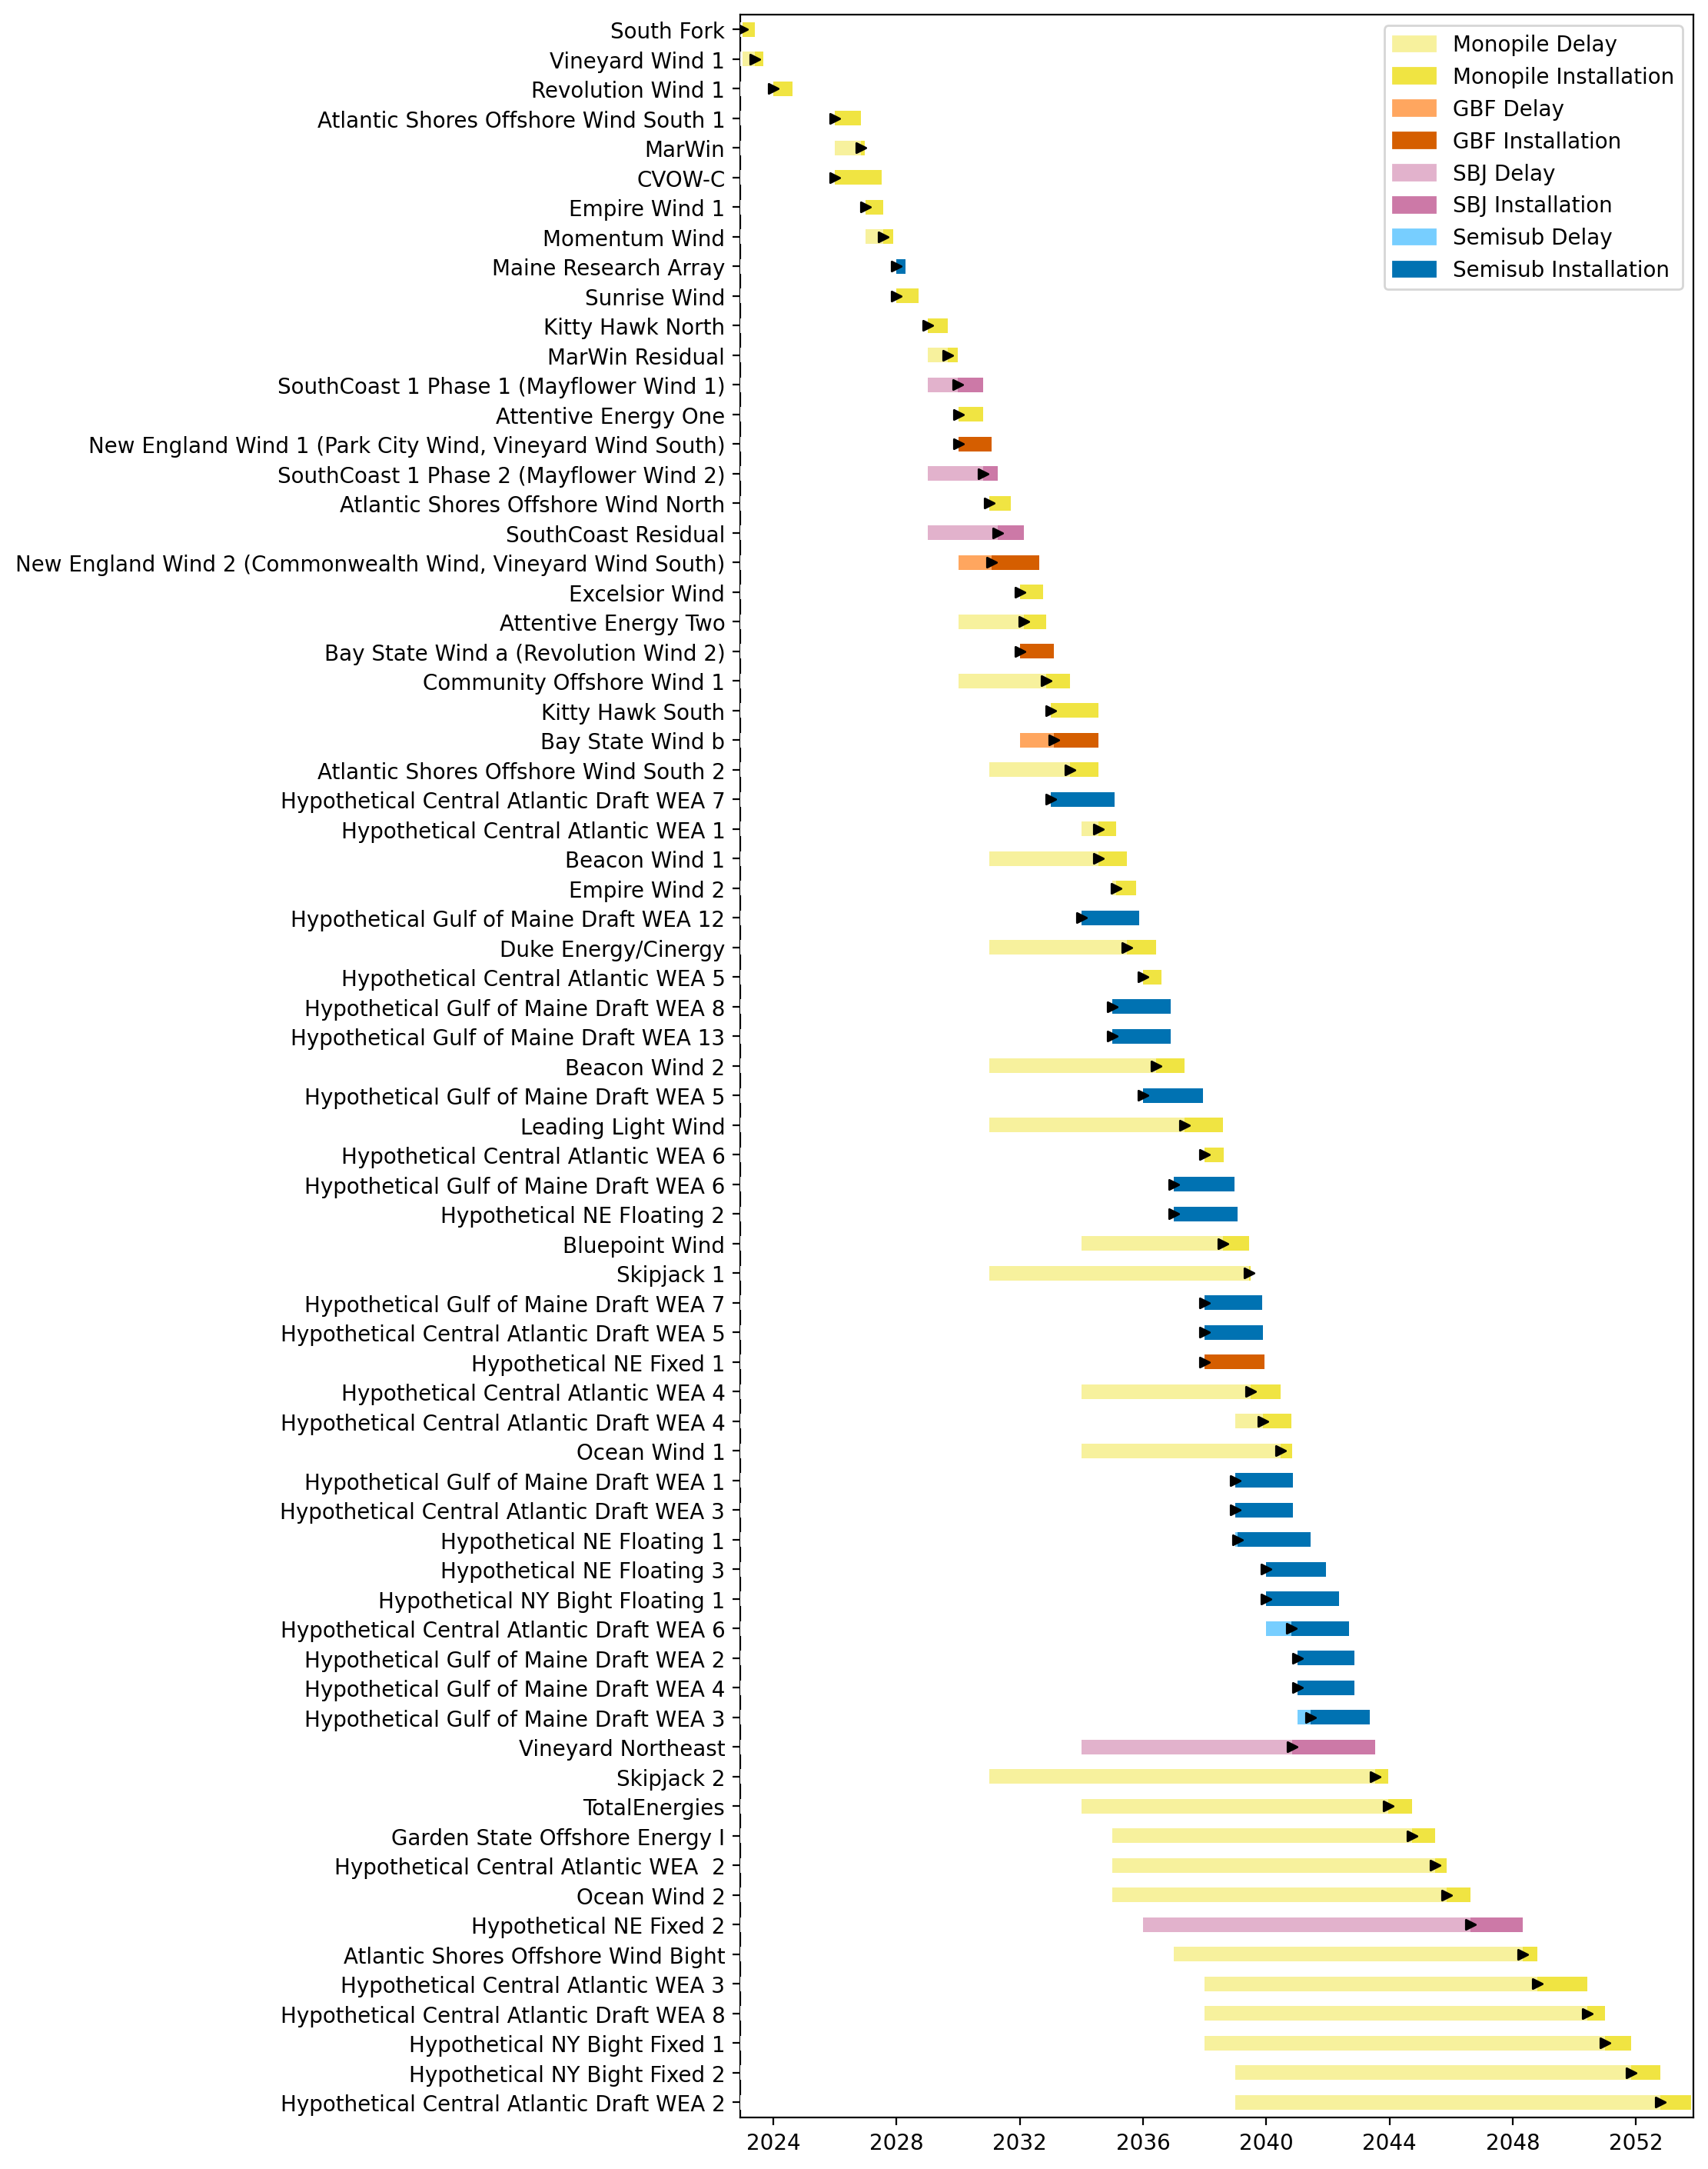
Full Gantt

Slide 9
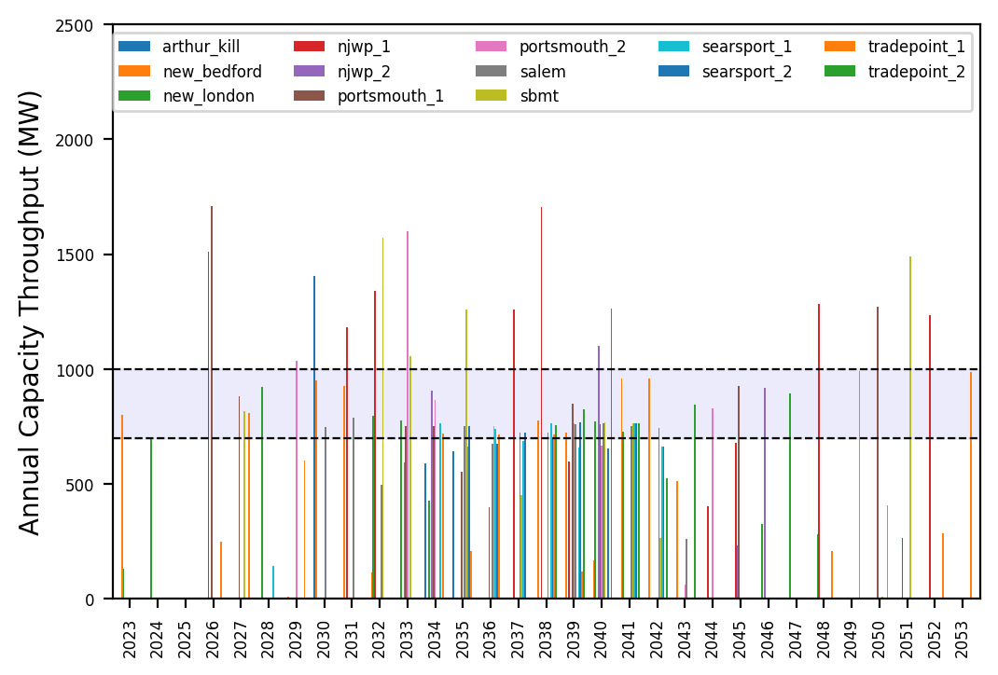
Port Throughput

Slide 10
natl_gaps_6AHTS_2_1
6 additional AHTS vessels, built every 3 years starting in 2030

Slide 11
Full Gantt

Slide 12
Port Throughput

Slide 13
natl_gaps_6AHTS_2_1_infp
4 additional AHTS vessels, built every 3 years starting in 2030

Slide 14
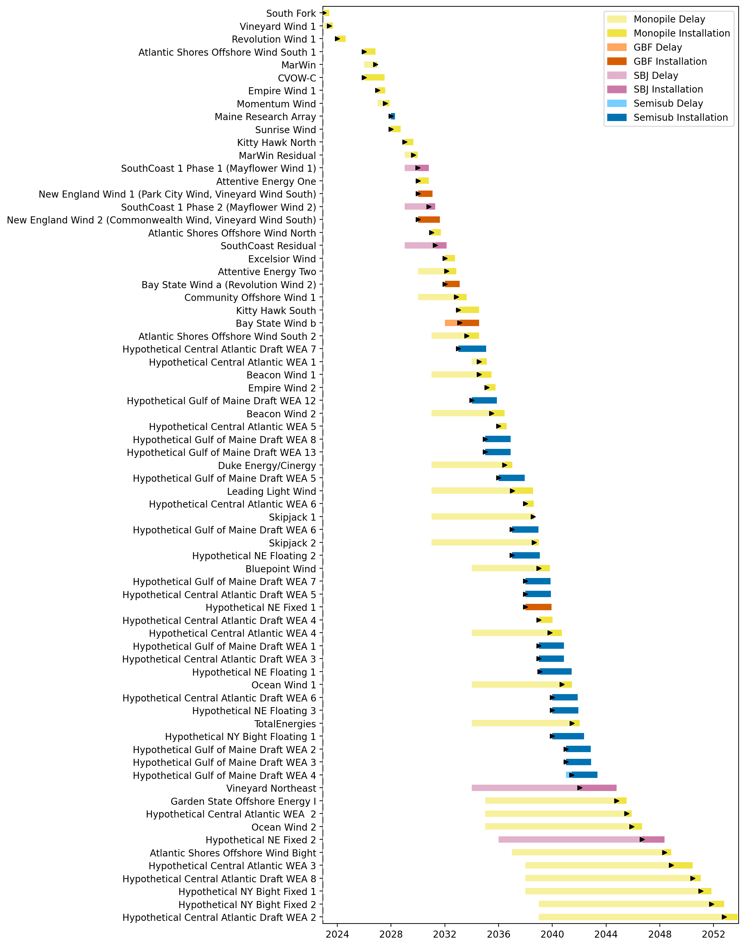
Full Gantt

Slide 15
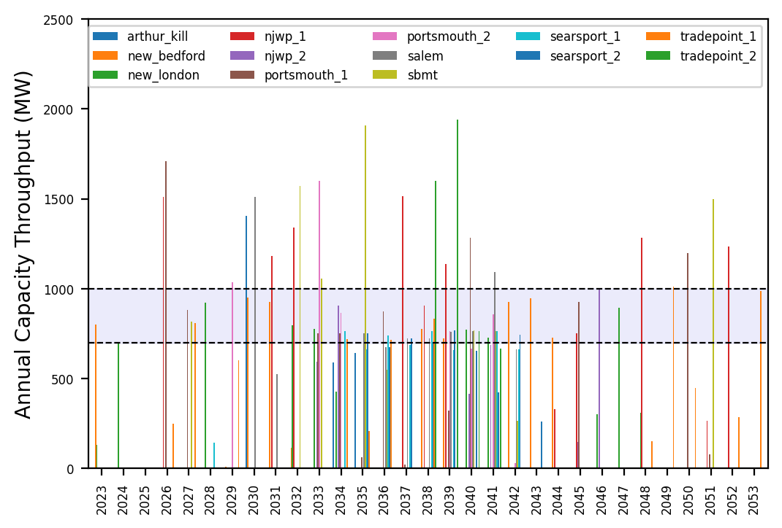
Port Throughput

Slide 16
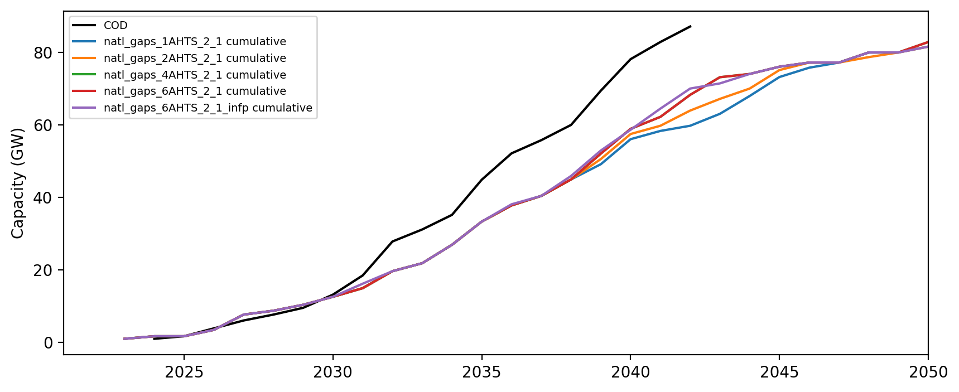
Installed Capacity

