Slide 1
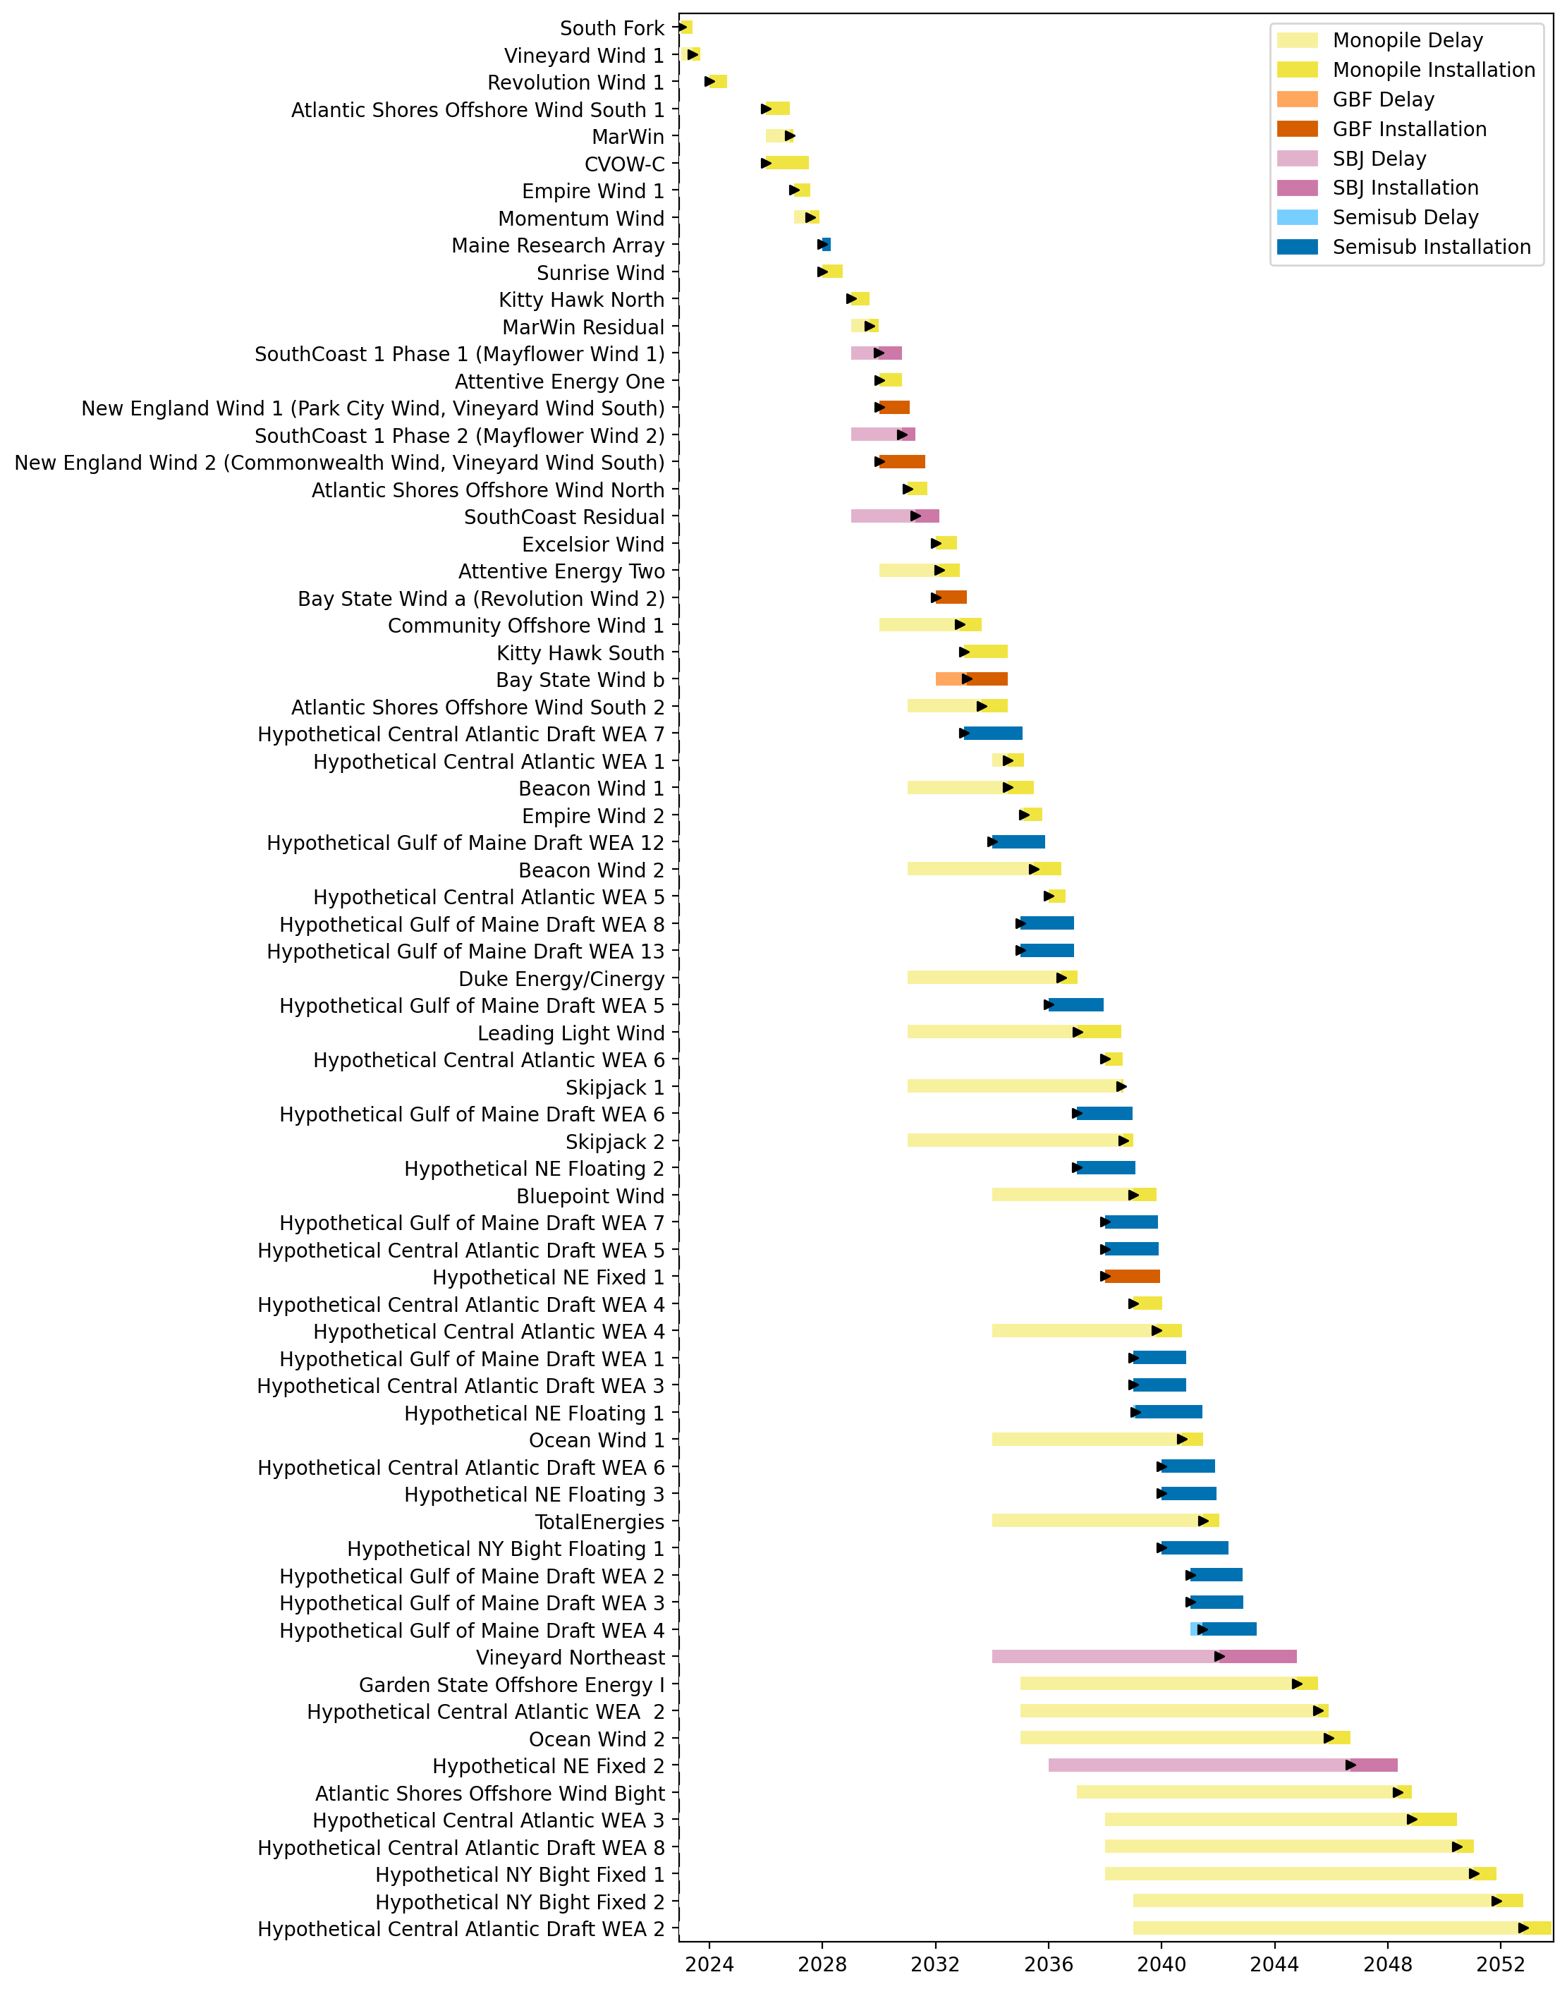
Full Gantt

Slide 2
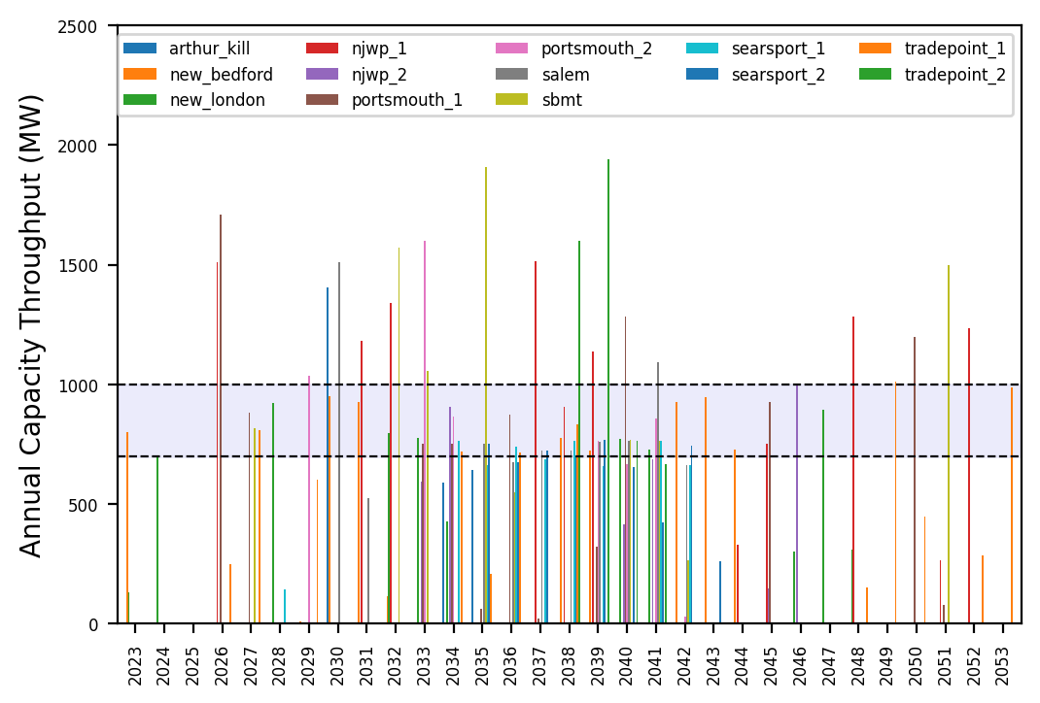
Port Throughput

Slide 3
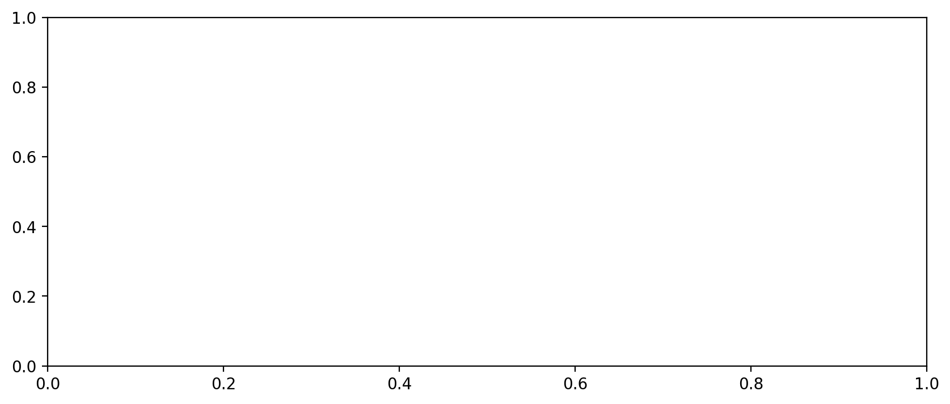
Vessel Utilization

Slide 4
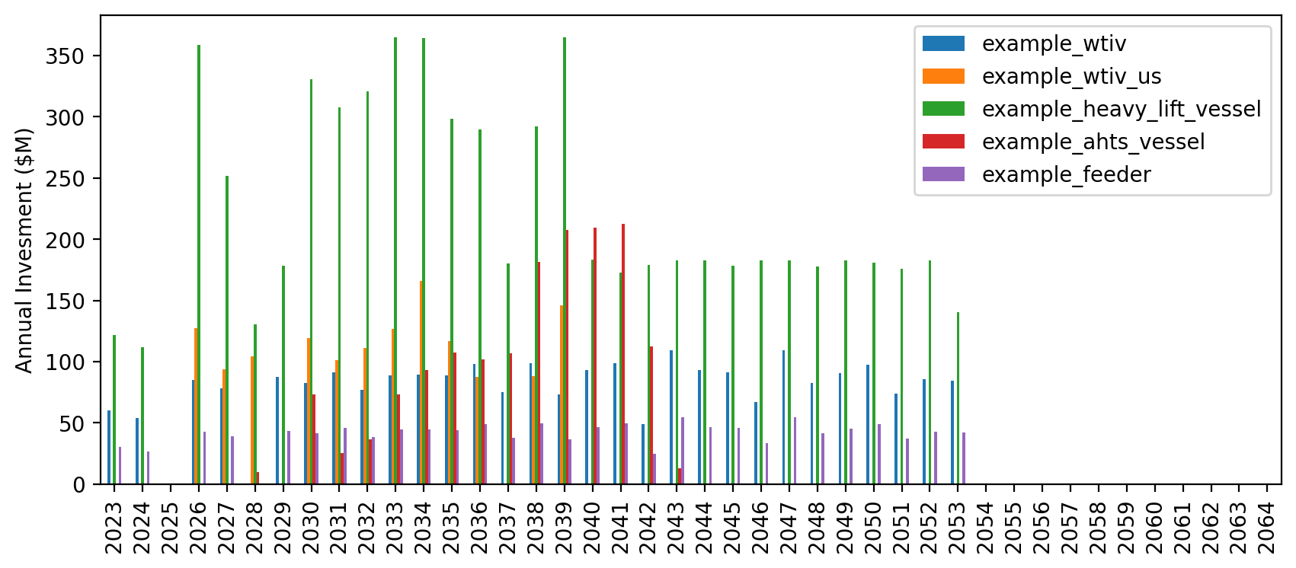
Vessel Investment

Slide 5
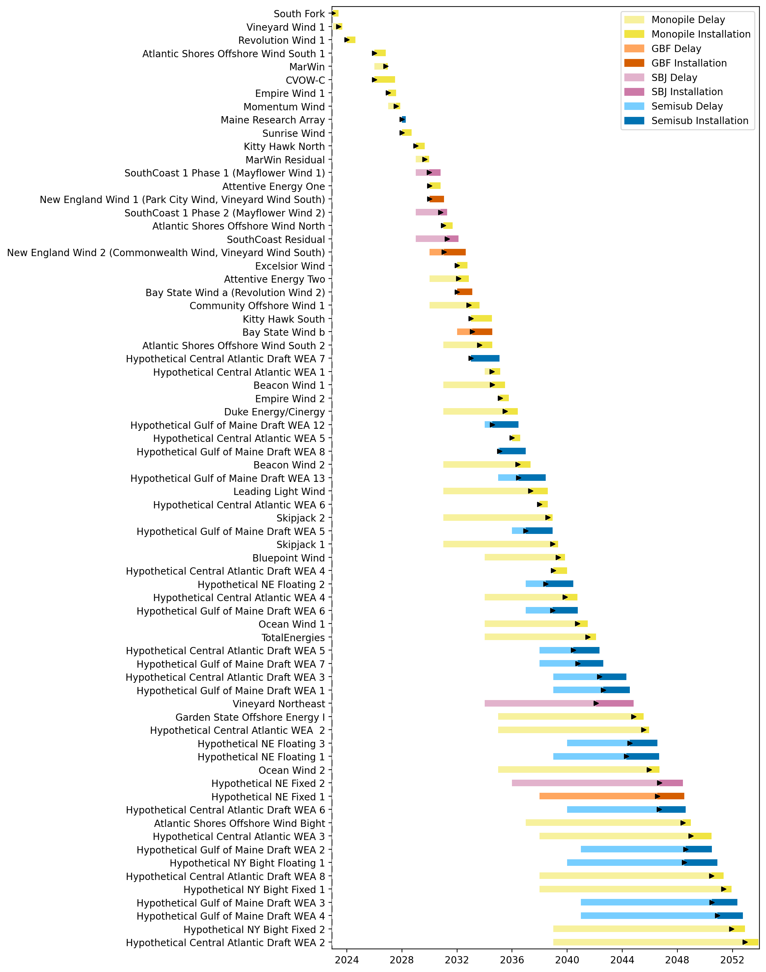
Full Gantt

Slide 6
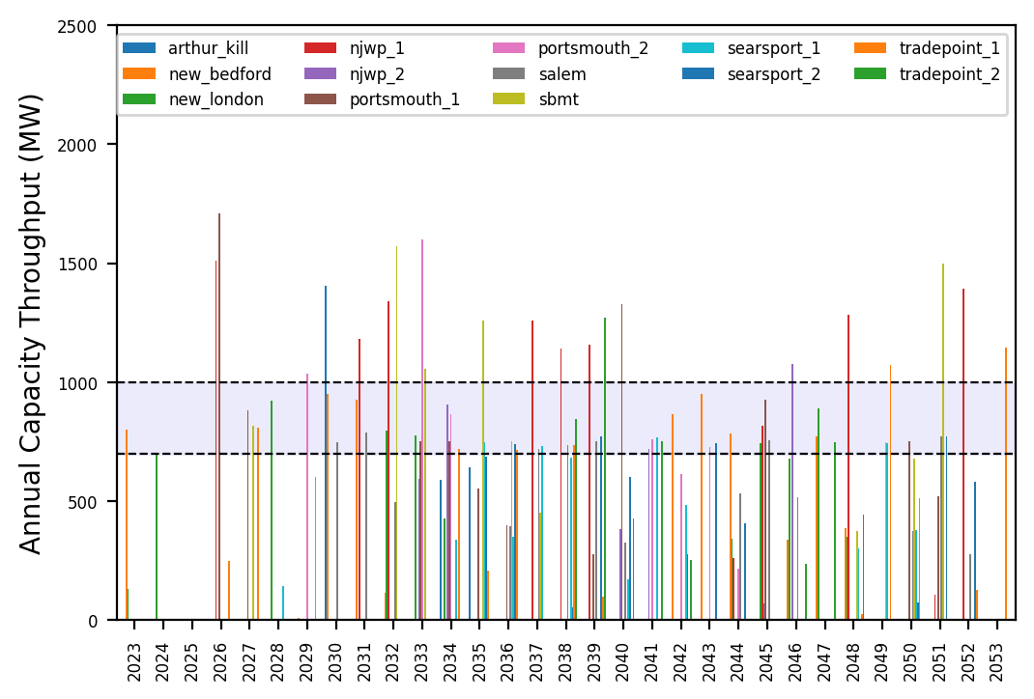
Port Throughput

Slide 7
Vessel Utilization

Slide 8
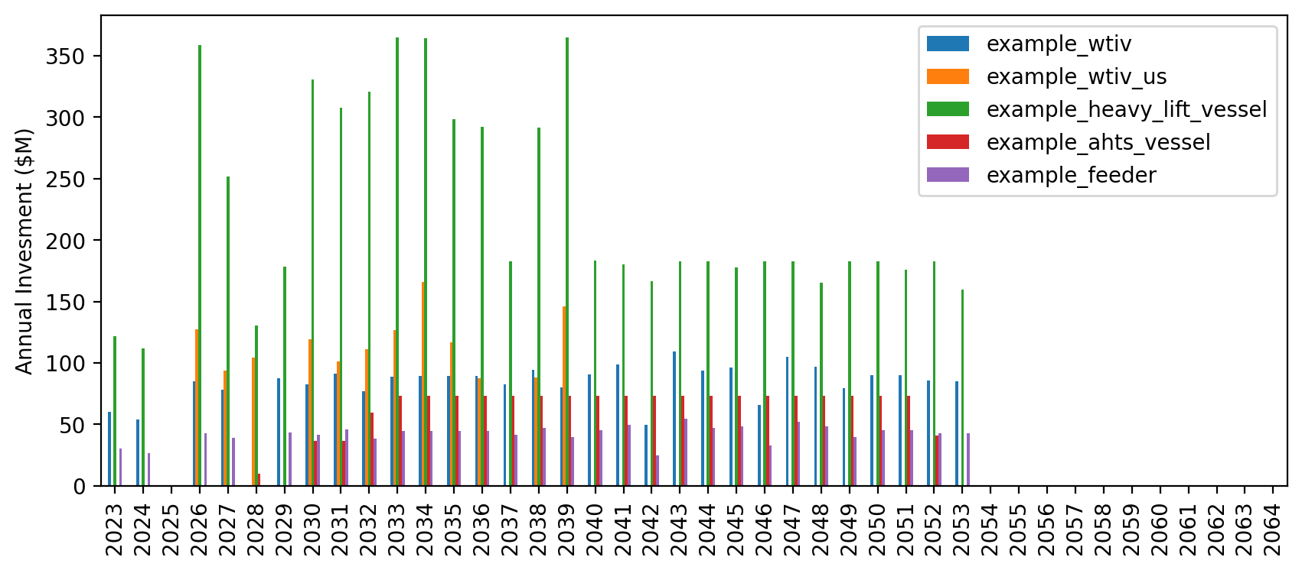
Vessel Investment

Slide 9
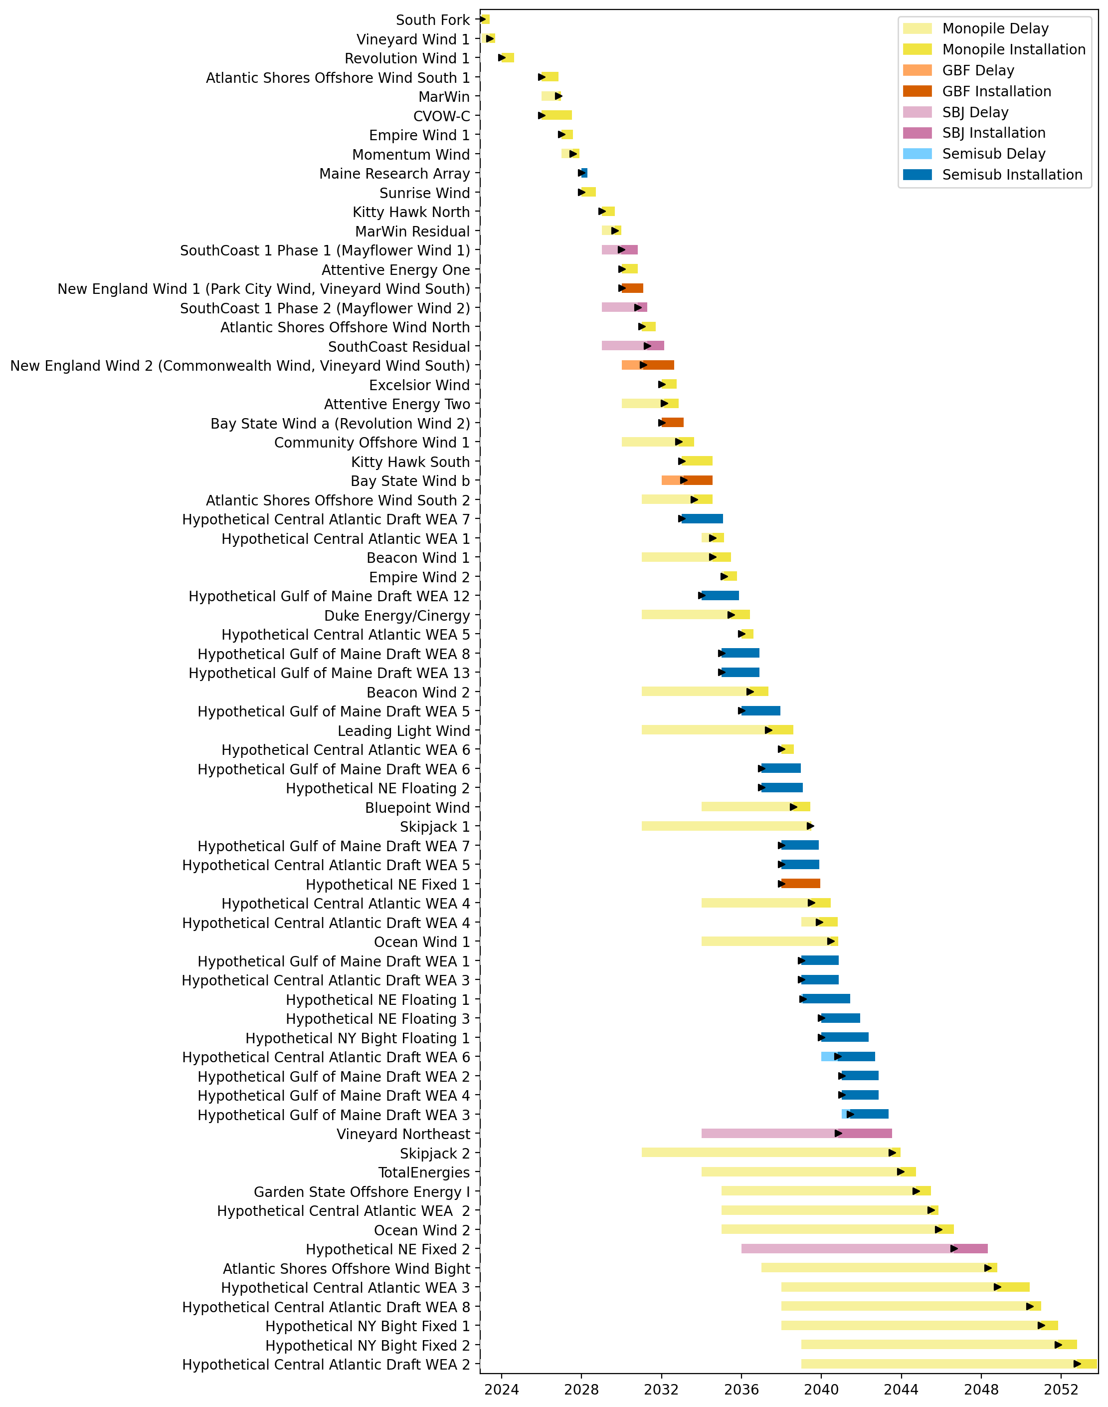
Full Gantt

Slide 10
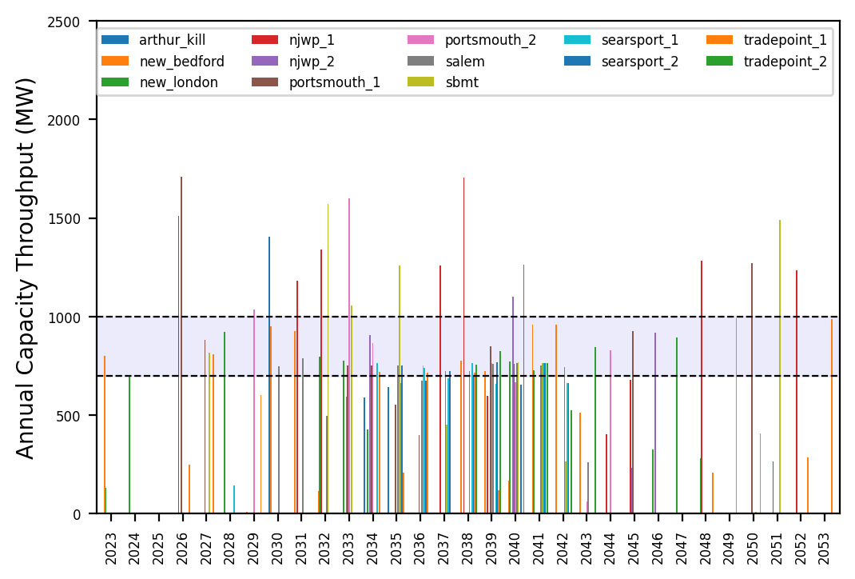
Port Throughput

Slide 11
Vessel Utilization

Slide 12
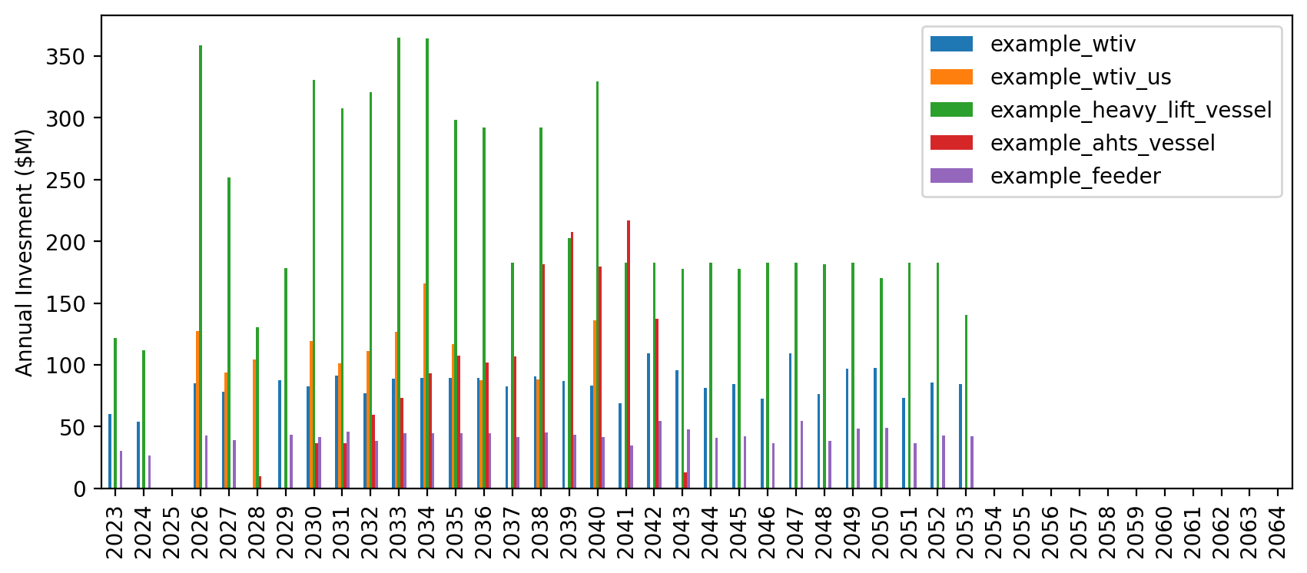
Vessel Investment

Slide 13
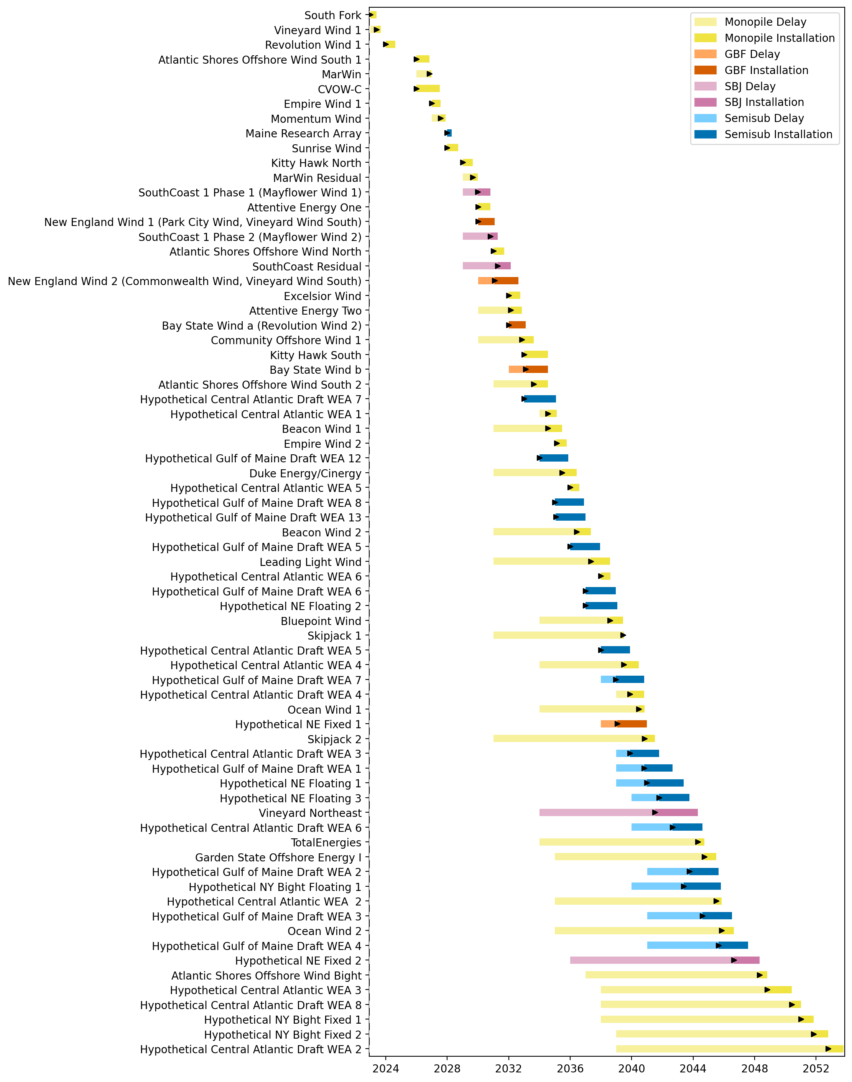
Full Gantt

Slide 14
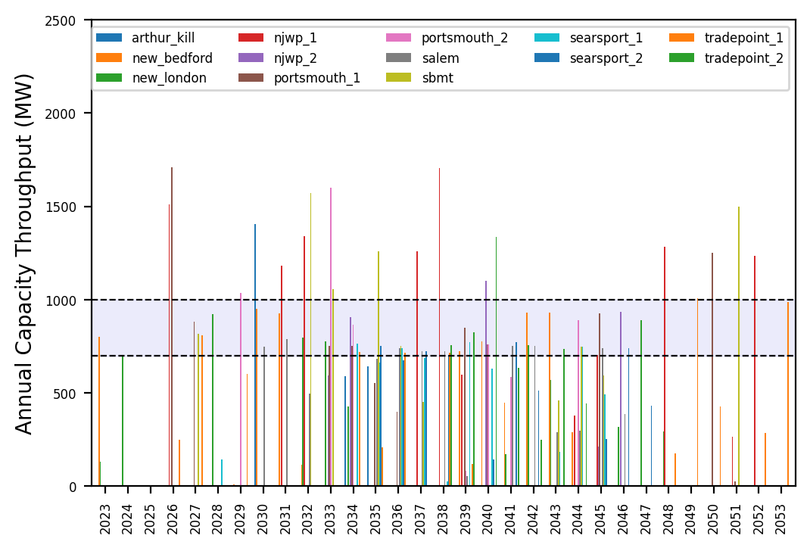
Port Throughput

Slide 15
Vessel Utilization

Slide 16
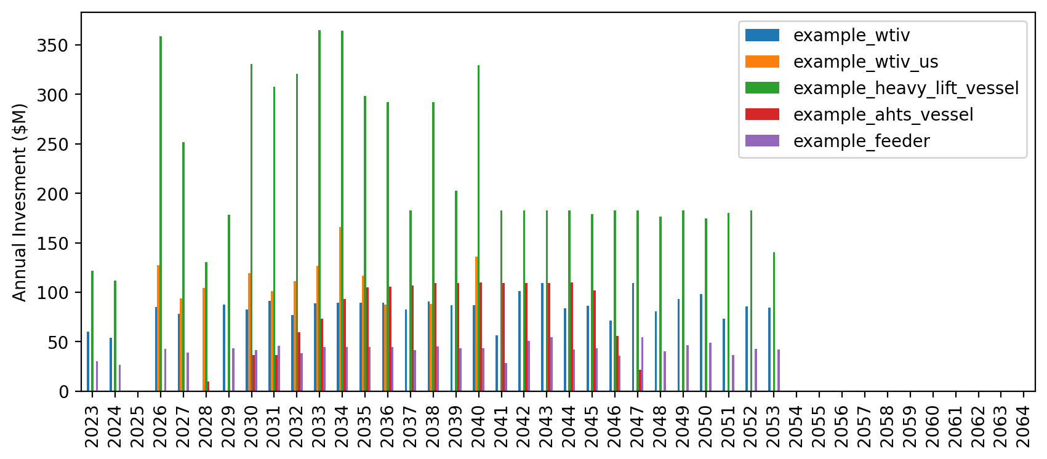
Vessel Investment

Slide 17
Full Gantt

Slide 18
Port Throughput

Slide 19
Vessel Utilization

Slide 20
Vessel Investment

Slide 21
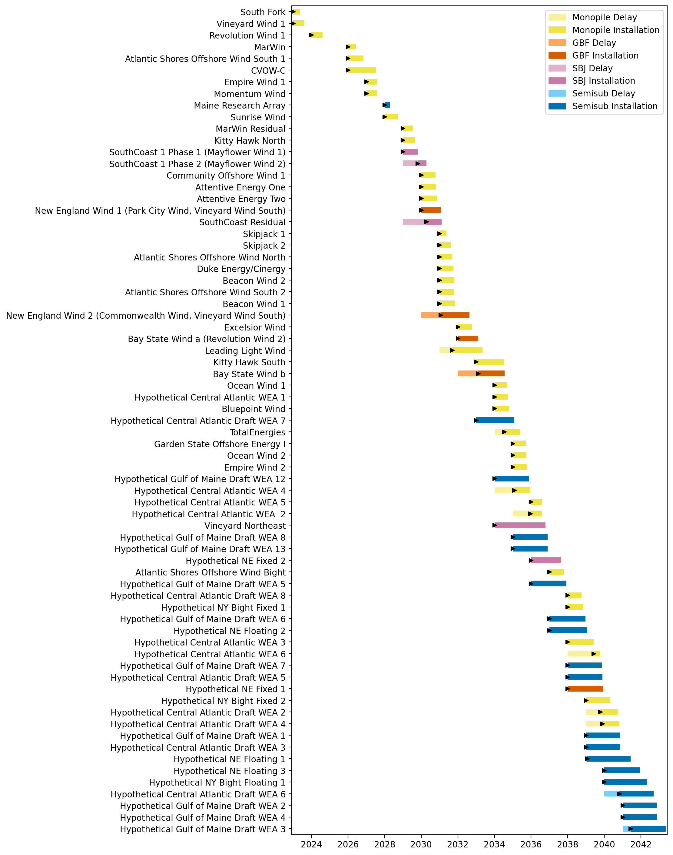
Full Gantt

Slide 22
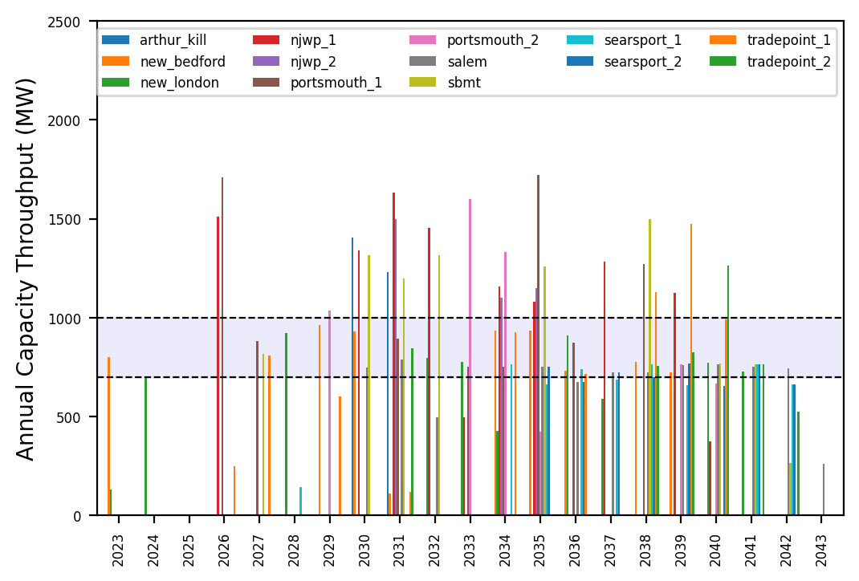
Port Throughput

Slide 23
Vessel Utilization

Slide 24
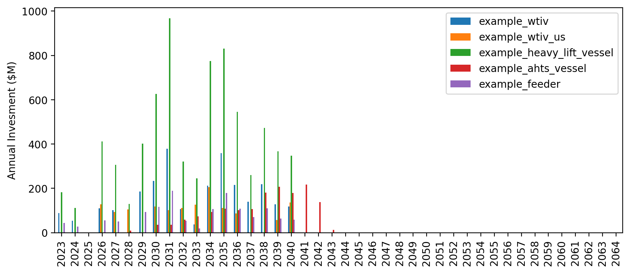
Vessel Investment

Slide 25
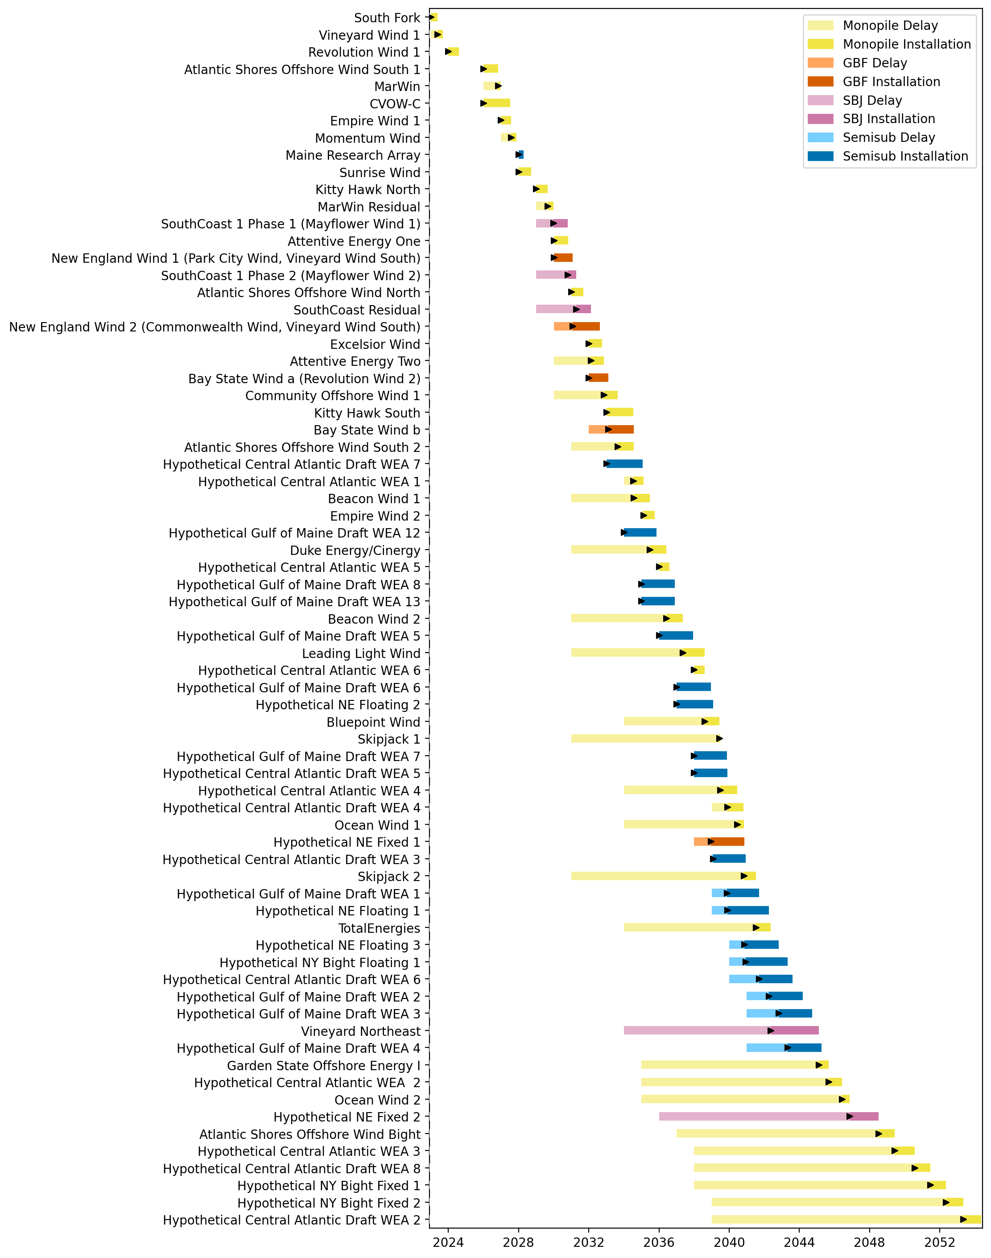
Full Gantt

Slide 26
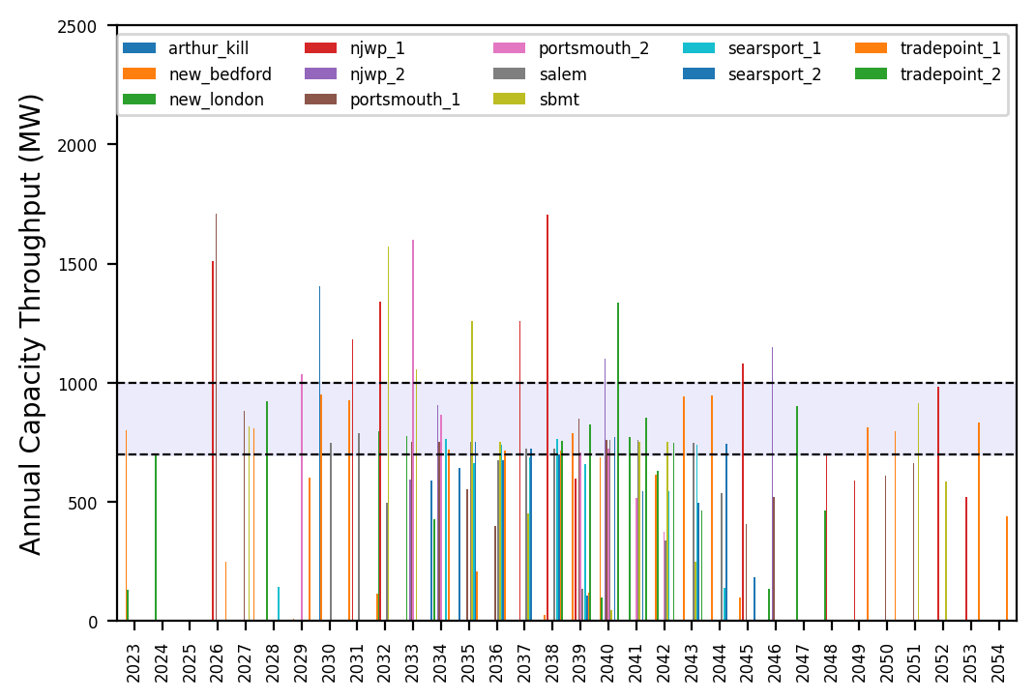
Port Throughput

Slide 27
Vessel Utilization

Slide 28
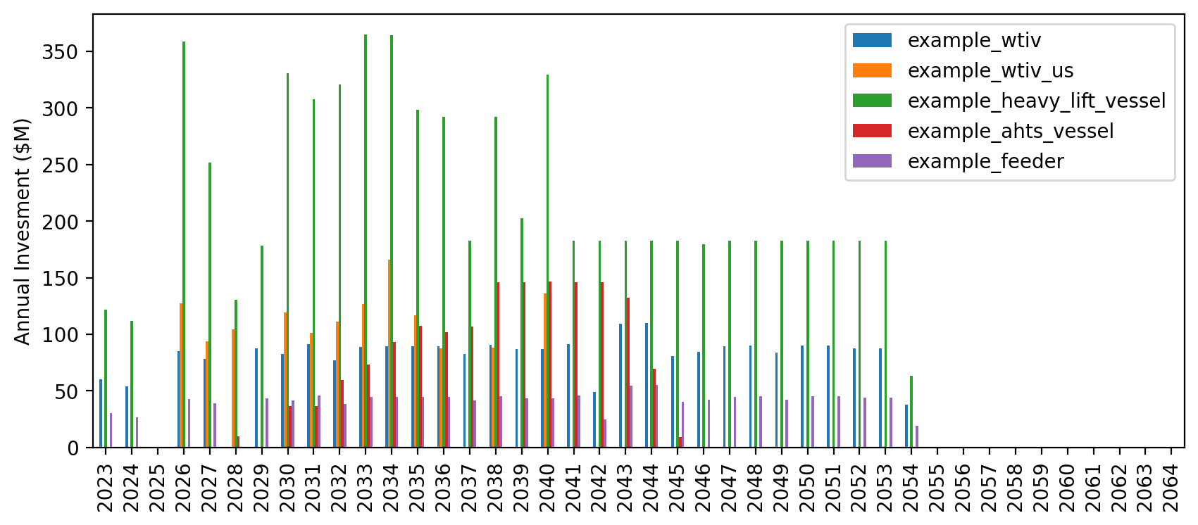
Vessel Investment

Slide 29
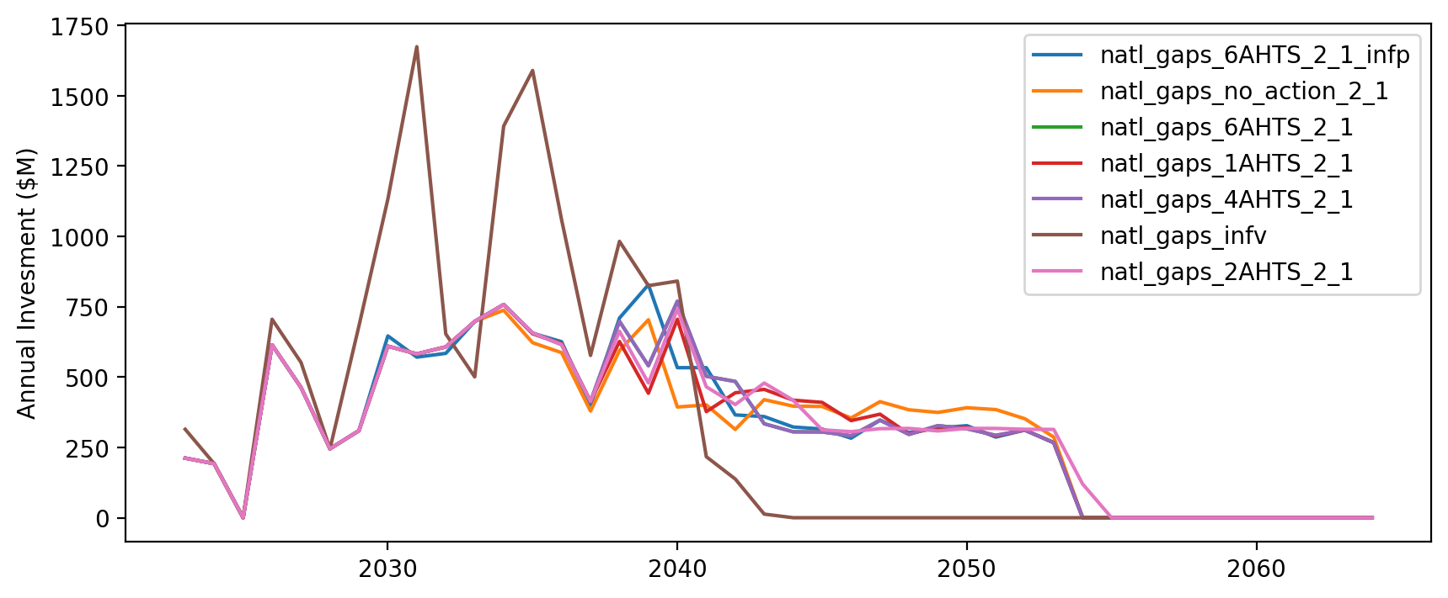
Vessel Investment by Scenario

Slide 30
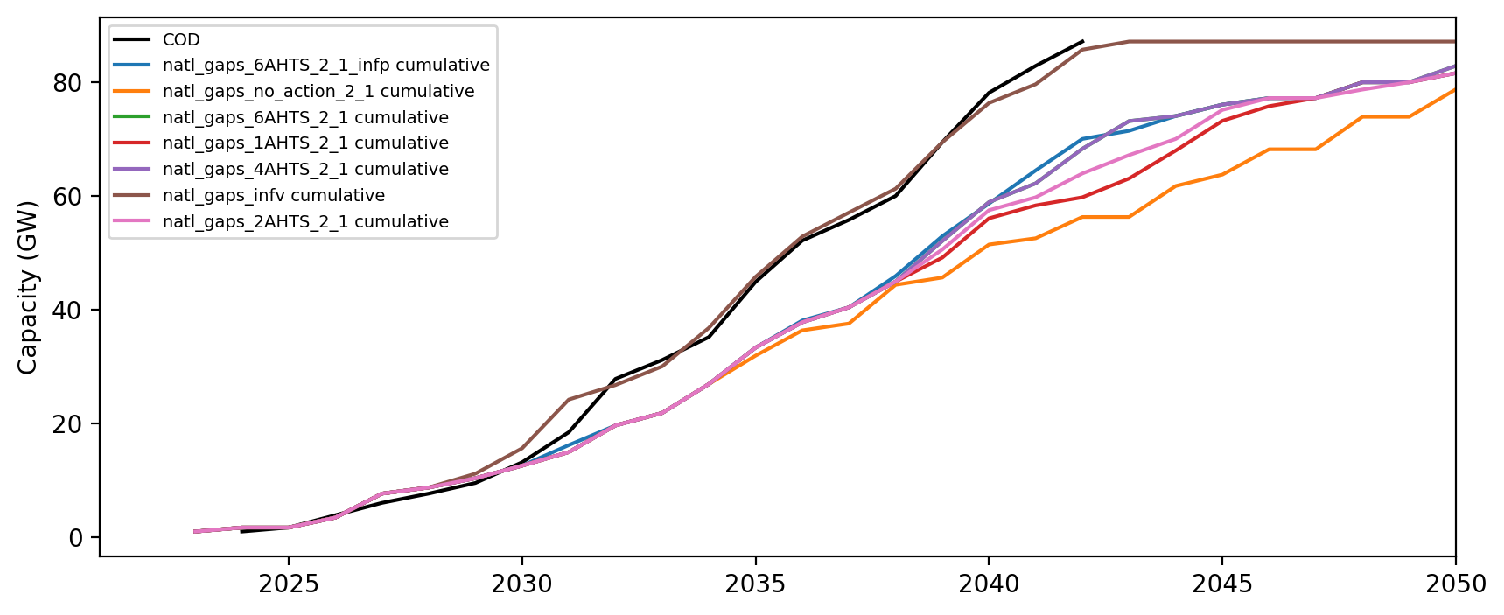
Installed Capacity

