Slide 1
natl_gaps_no_action
1 US WTIV starting with CVOW

Slide 2
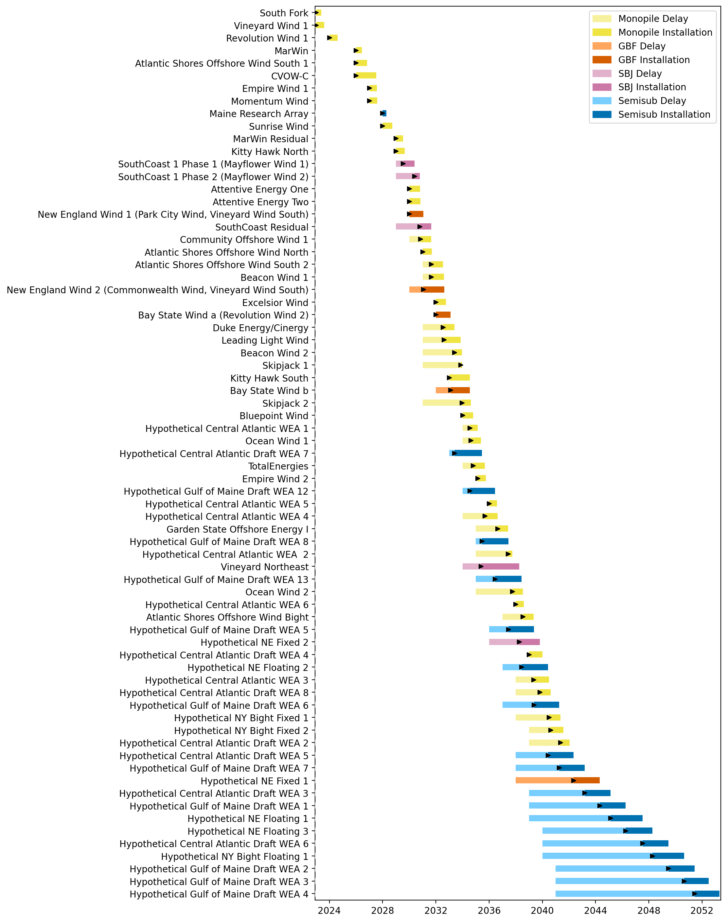
Full Gantt

Slide 3
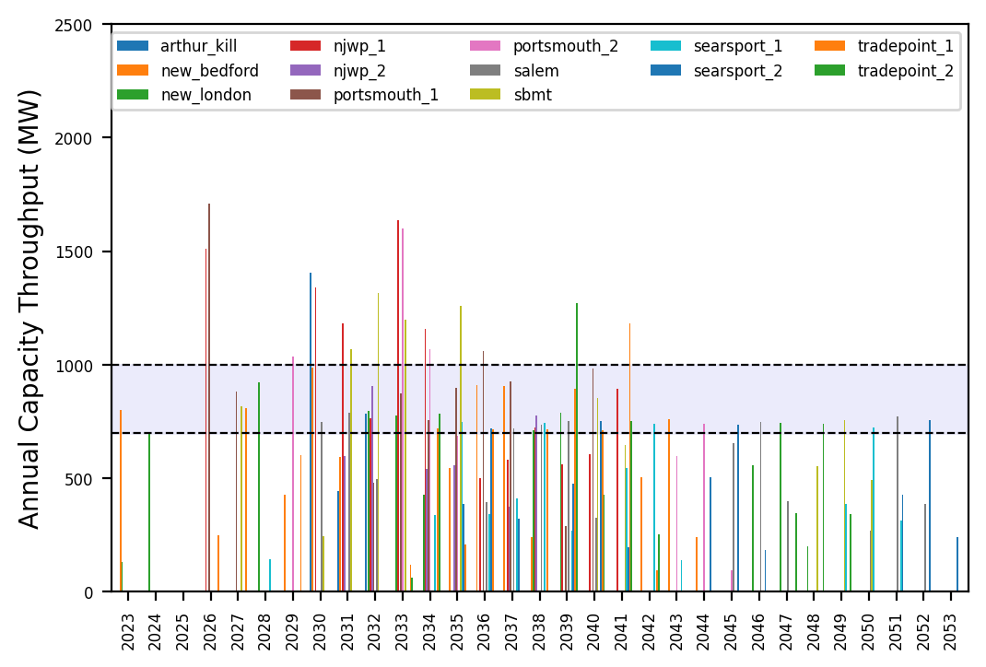
Port Throughput

Slide 4
natl_gaps_1AHTS
1 additional AHTS built in 2030

Slide 5
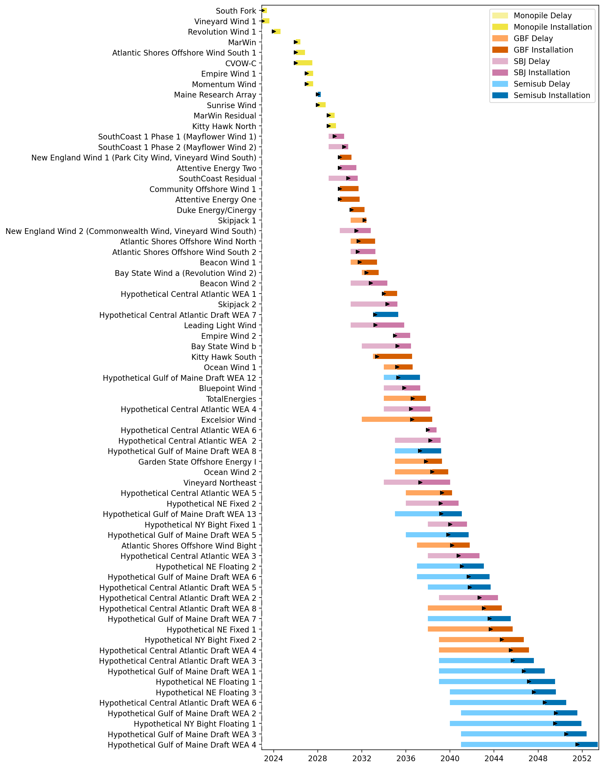
Full Gantt

Slide 6
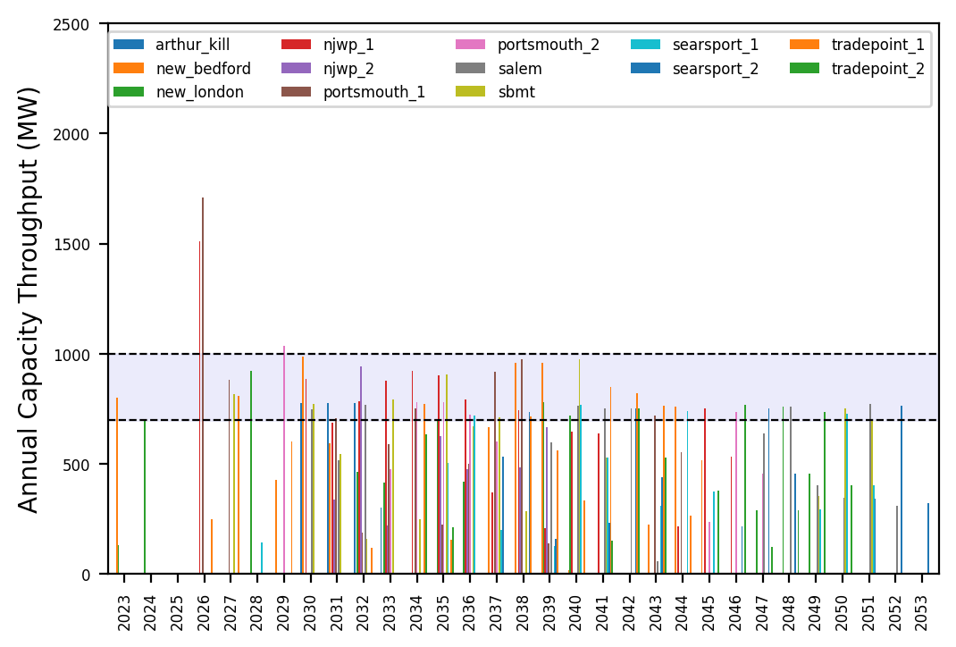
Port Throughput

Slide 7
natl_gaps_2AHTS
2 additional AHTS vessels, built every 3 years starting in 2030

Slide 8
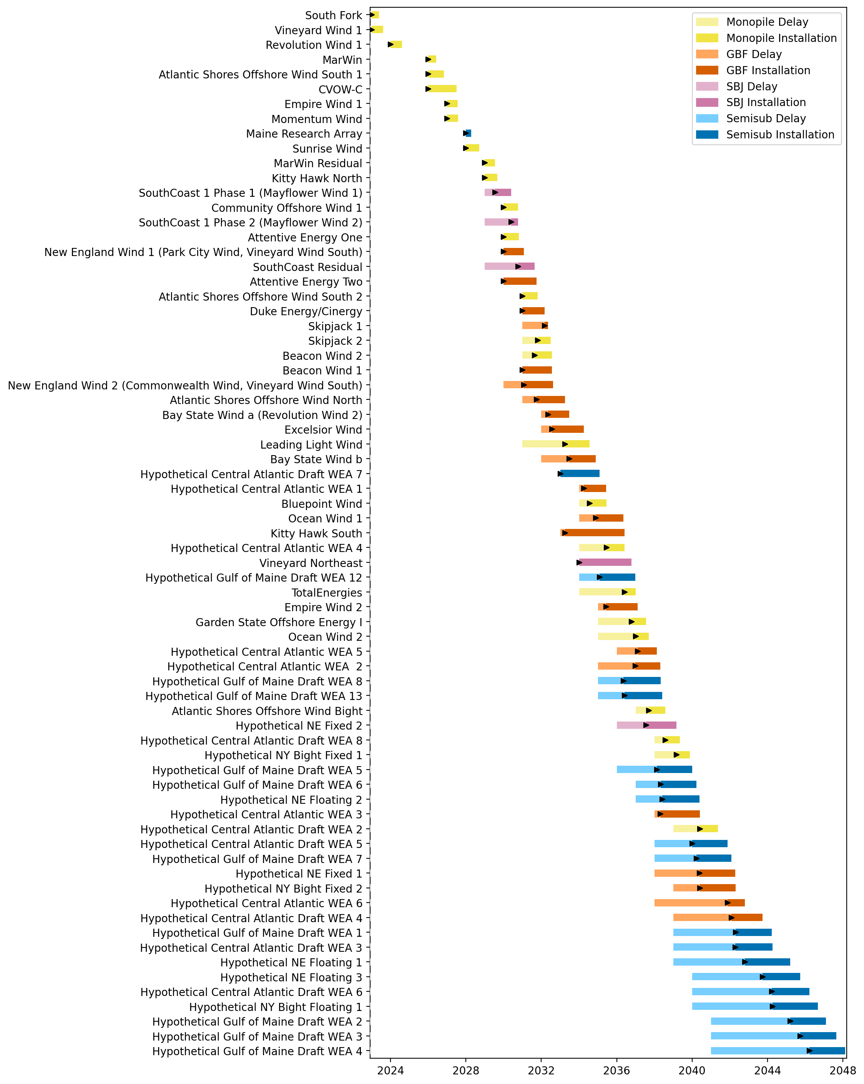
Full Gantt

Slide 9
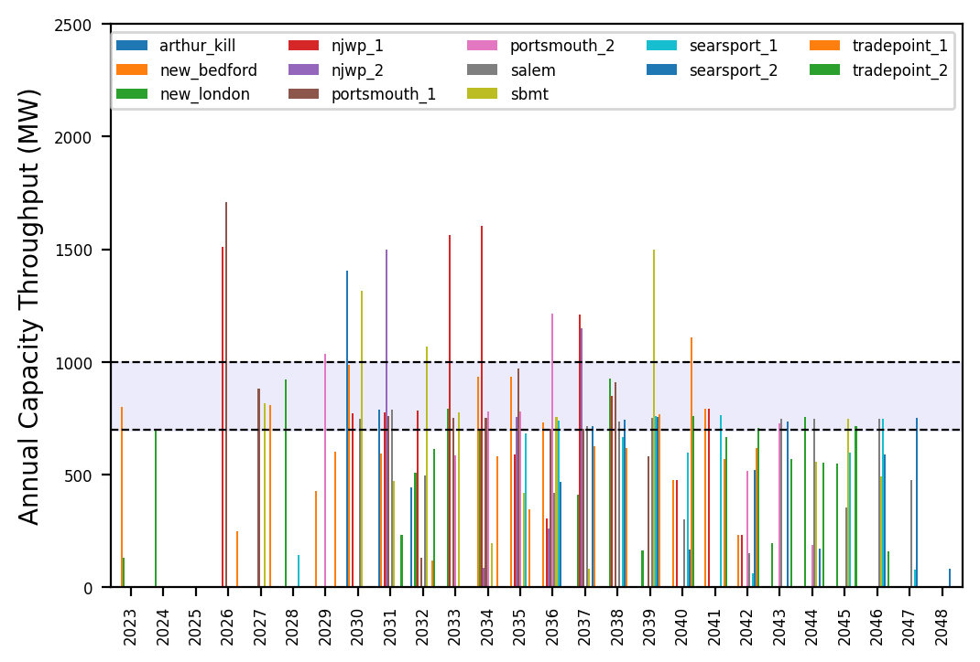
Port Throughput

Slide 10
natl_gaps_3AHTS
3 additional AHTS vessels, built every 3 years starting in 2030

Slide 11
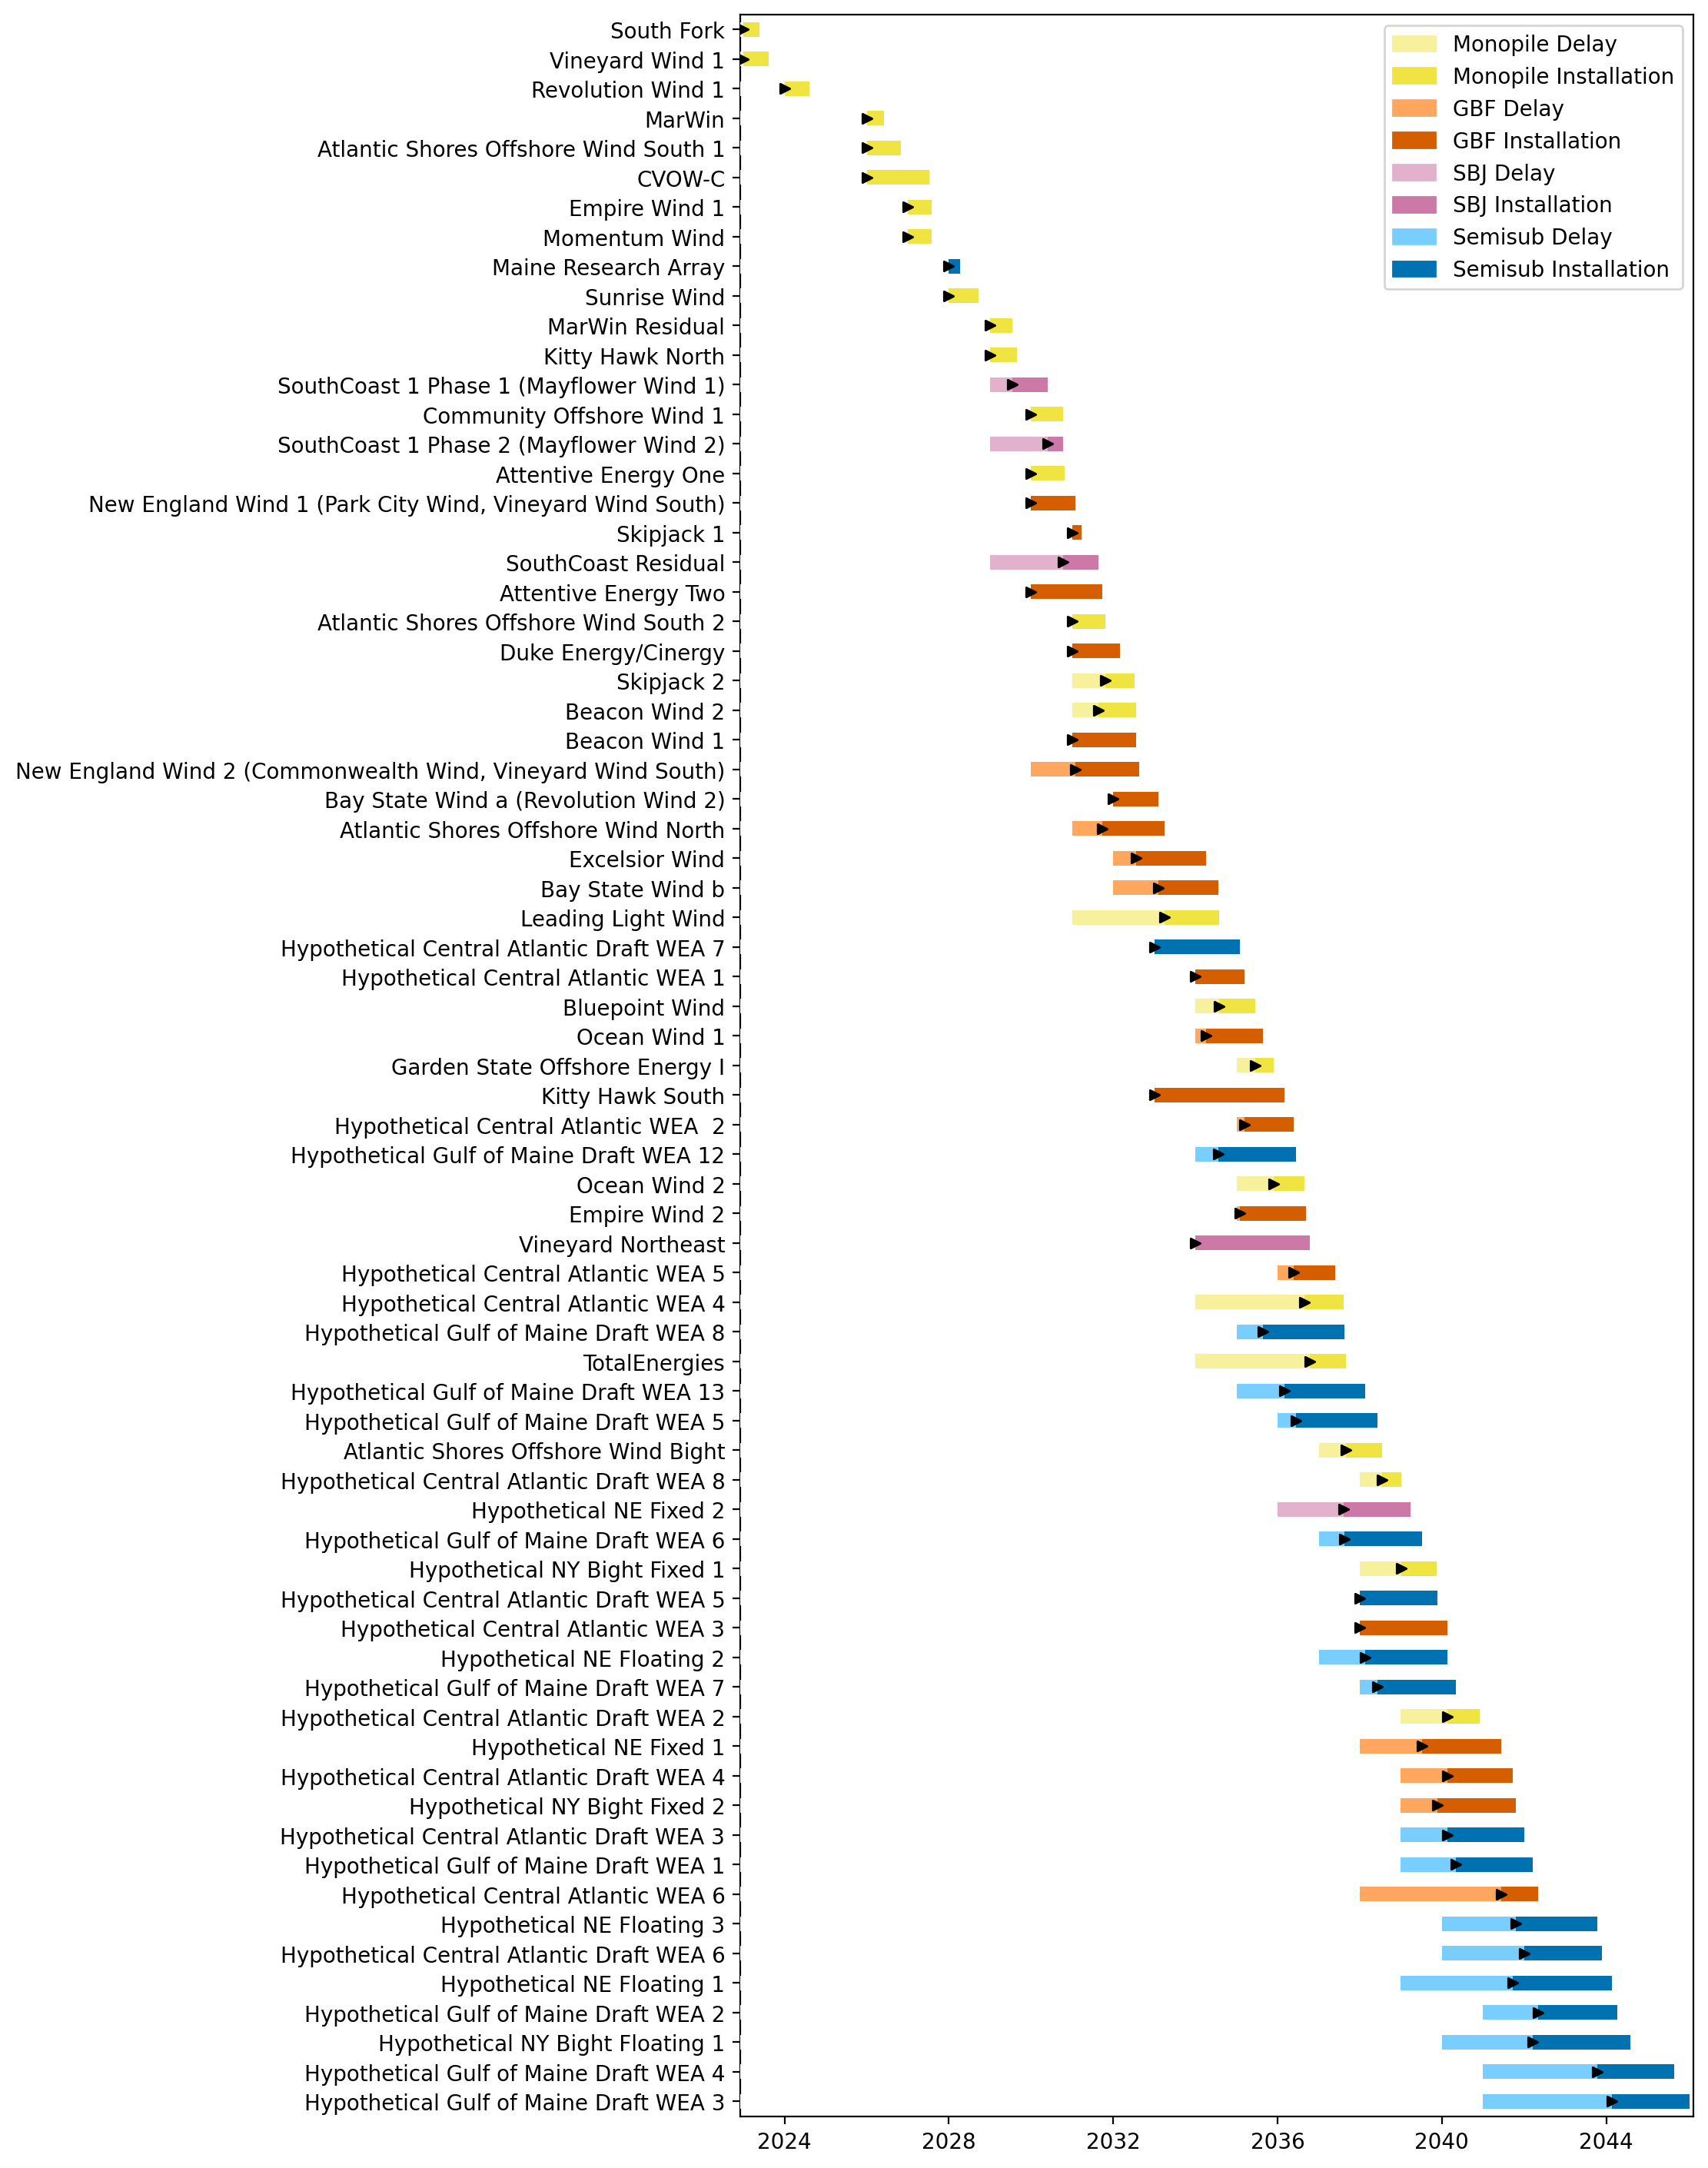
Full Gantt

Slide 12
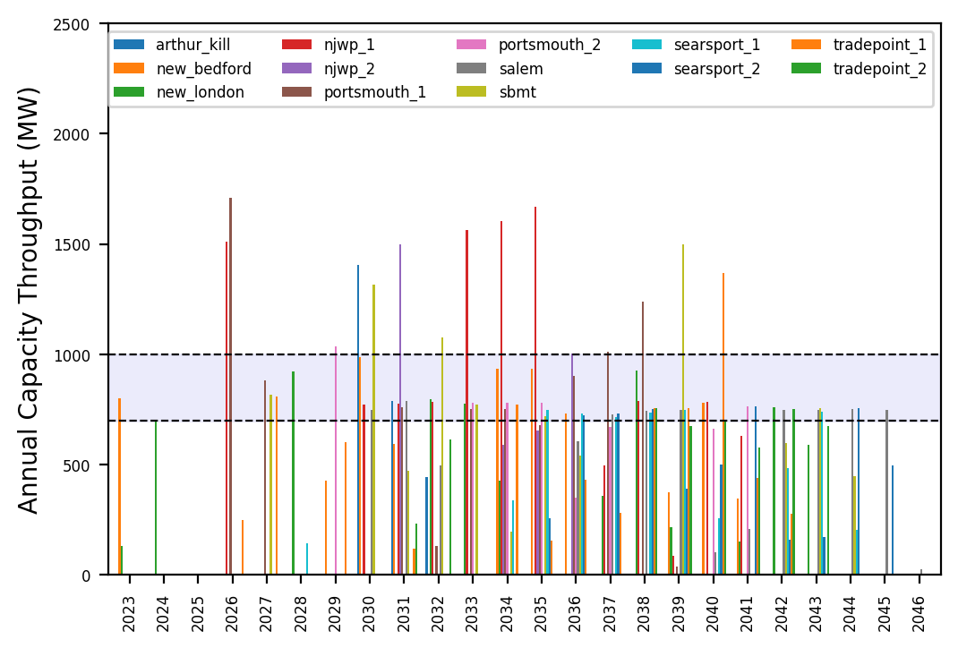
Port Throughput

Slide 13
natl_gaps_4AHTS
4 additional AHTS vessels, built every 3 years starting in 2030

Slide 14
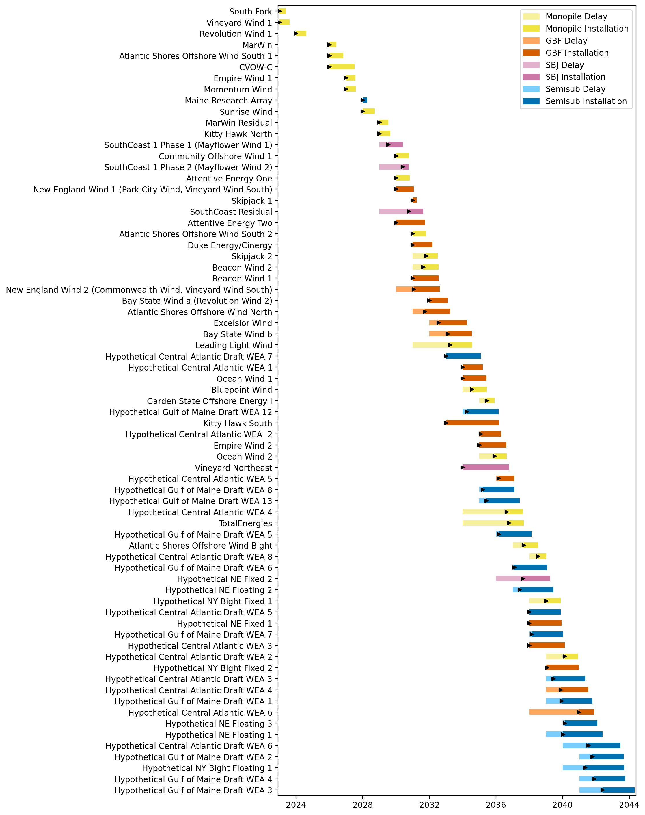
Full Gantt

Slide 15
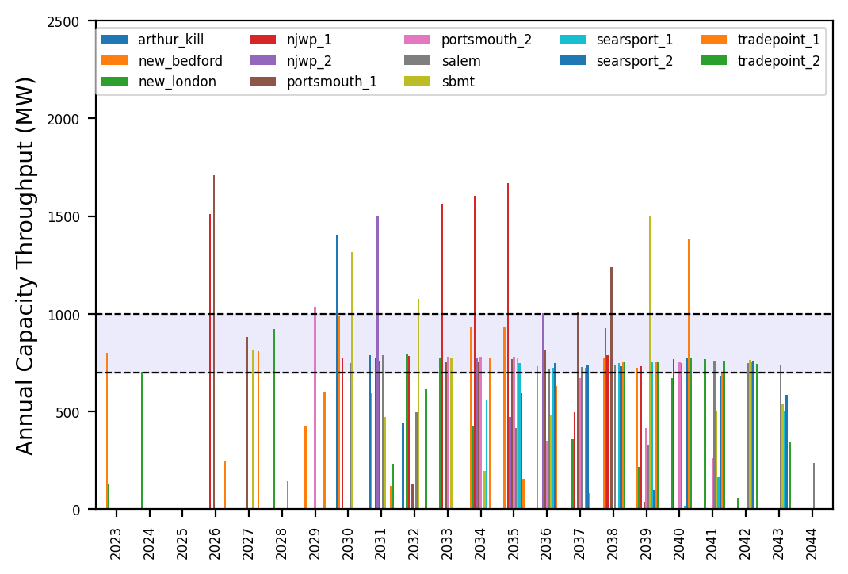
Port Throughput

Slide 16
natl_gaps_4AHTS_infp
4 additional AHTS vessels, built every 3 years starting in 2030

Slide 17
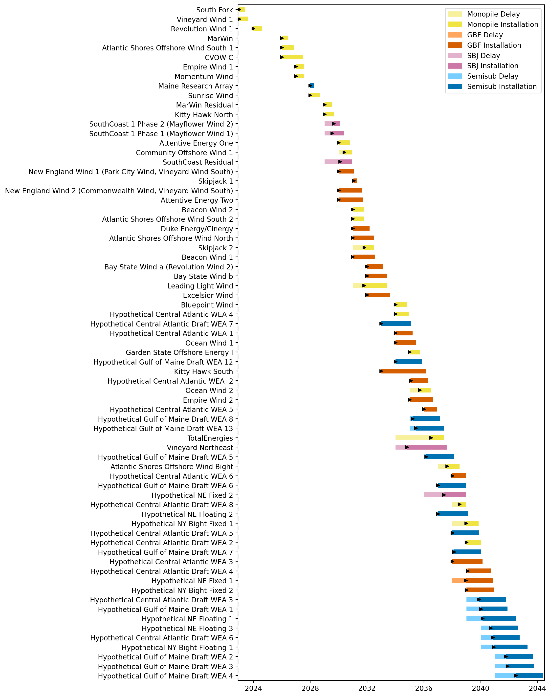
Full Gantt

Slide 18
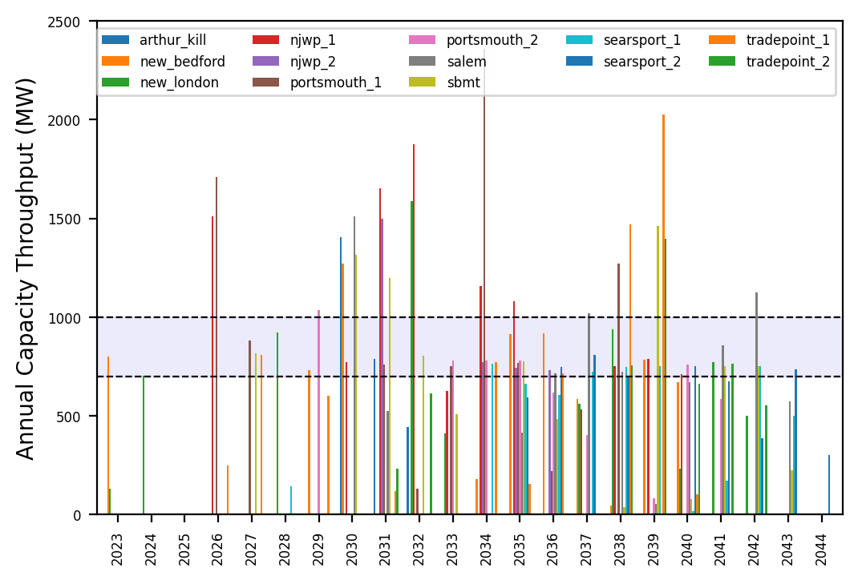
Port Throughput

Slide 19
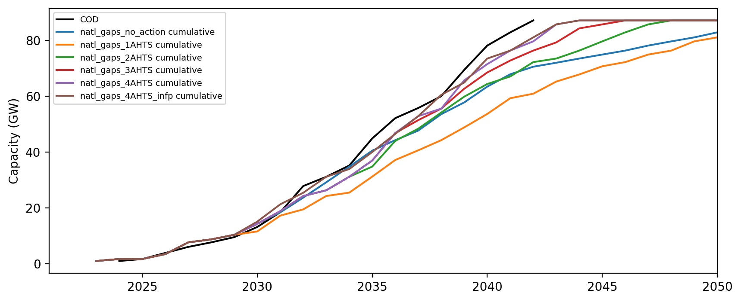
Installed Capacity

