Slide 1
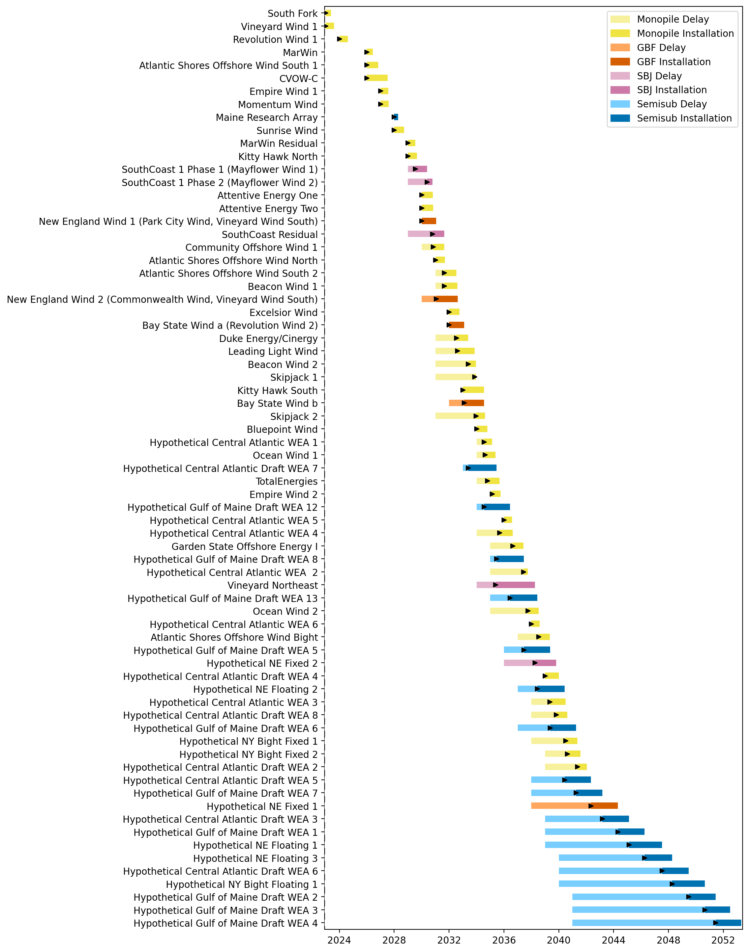
Full Gantt

Slide 2
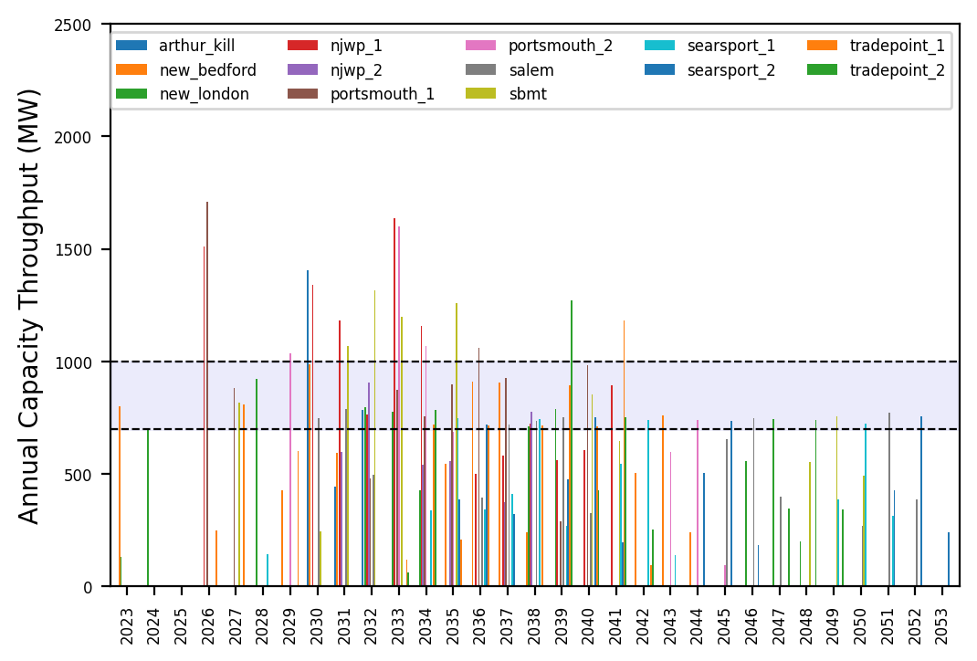
Port Throughput

Slide 3
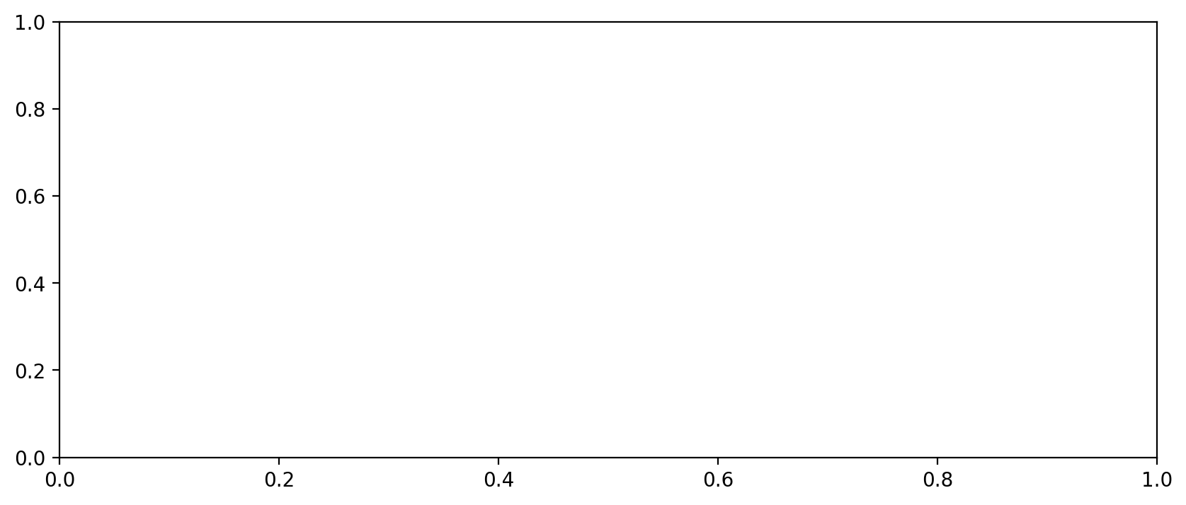
Vessel Utilization

Slide 4
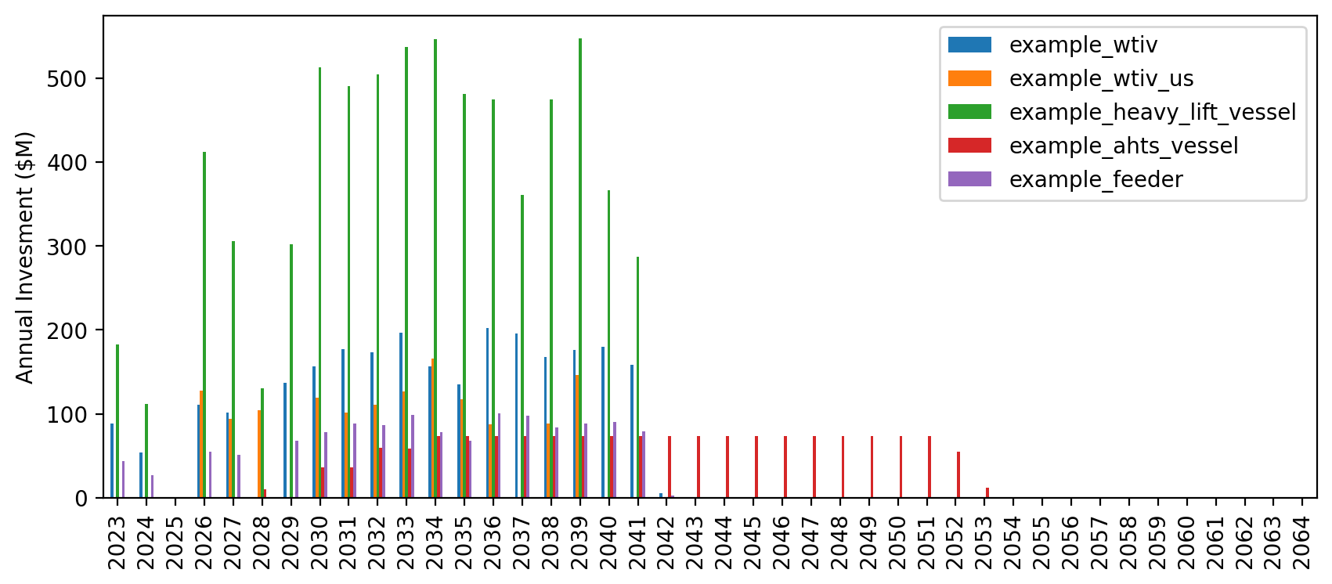
Vessel Investment

Slide 5
Full Gantt

Slide 6
Port Throughput

Slide 7
Vessel Utilization

Slide 8
Vessel Investment

Slide 9
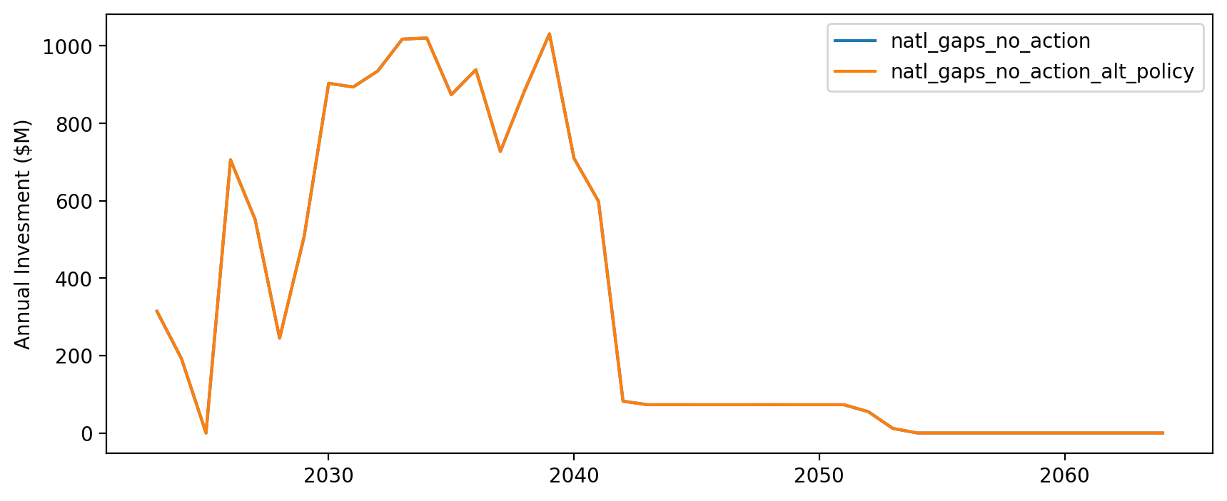
Vessel Investment by Scenario

Slide 10
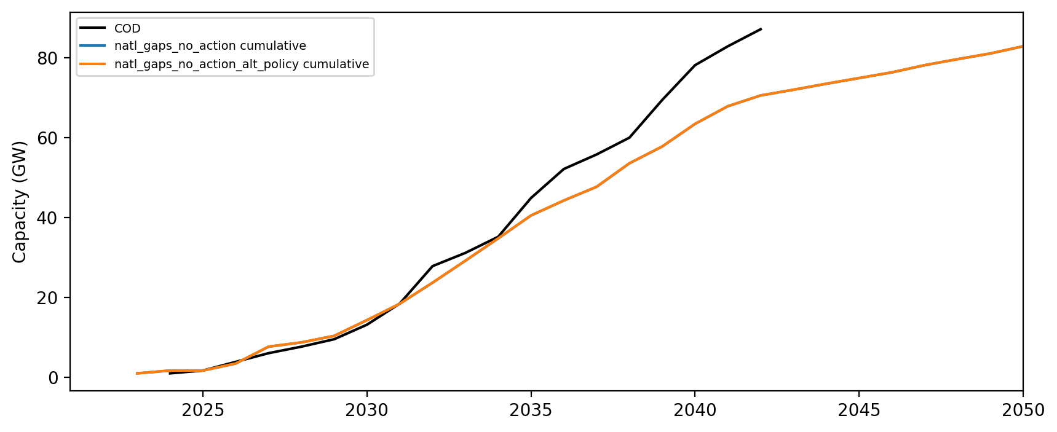
Installed Capacity

