Slide 1
natl_gaps_no_action_1_1
1 US WTIV starting with CVOW

Slide 2
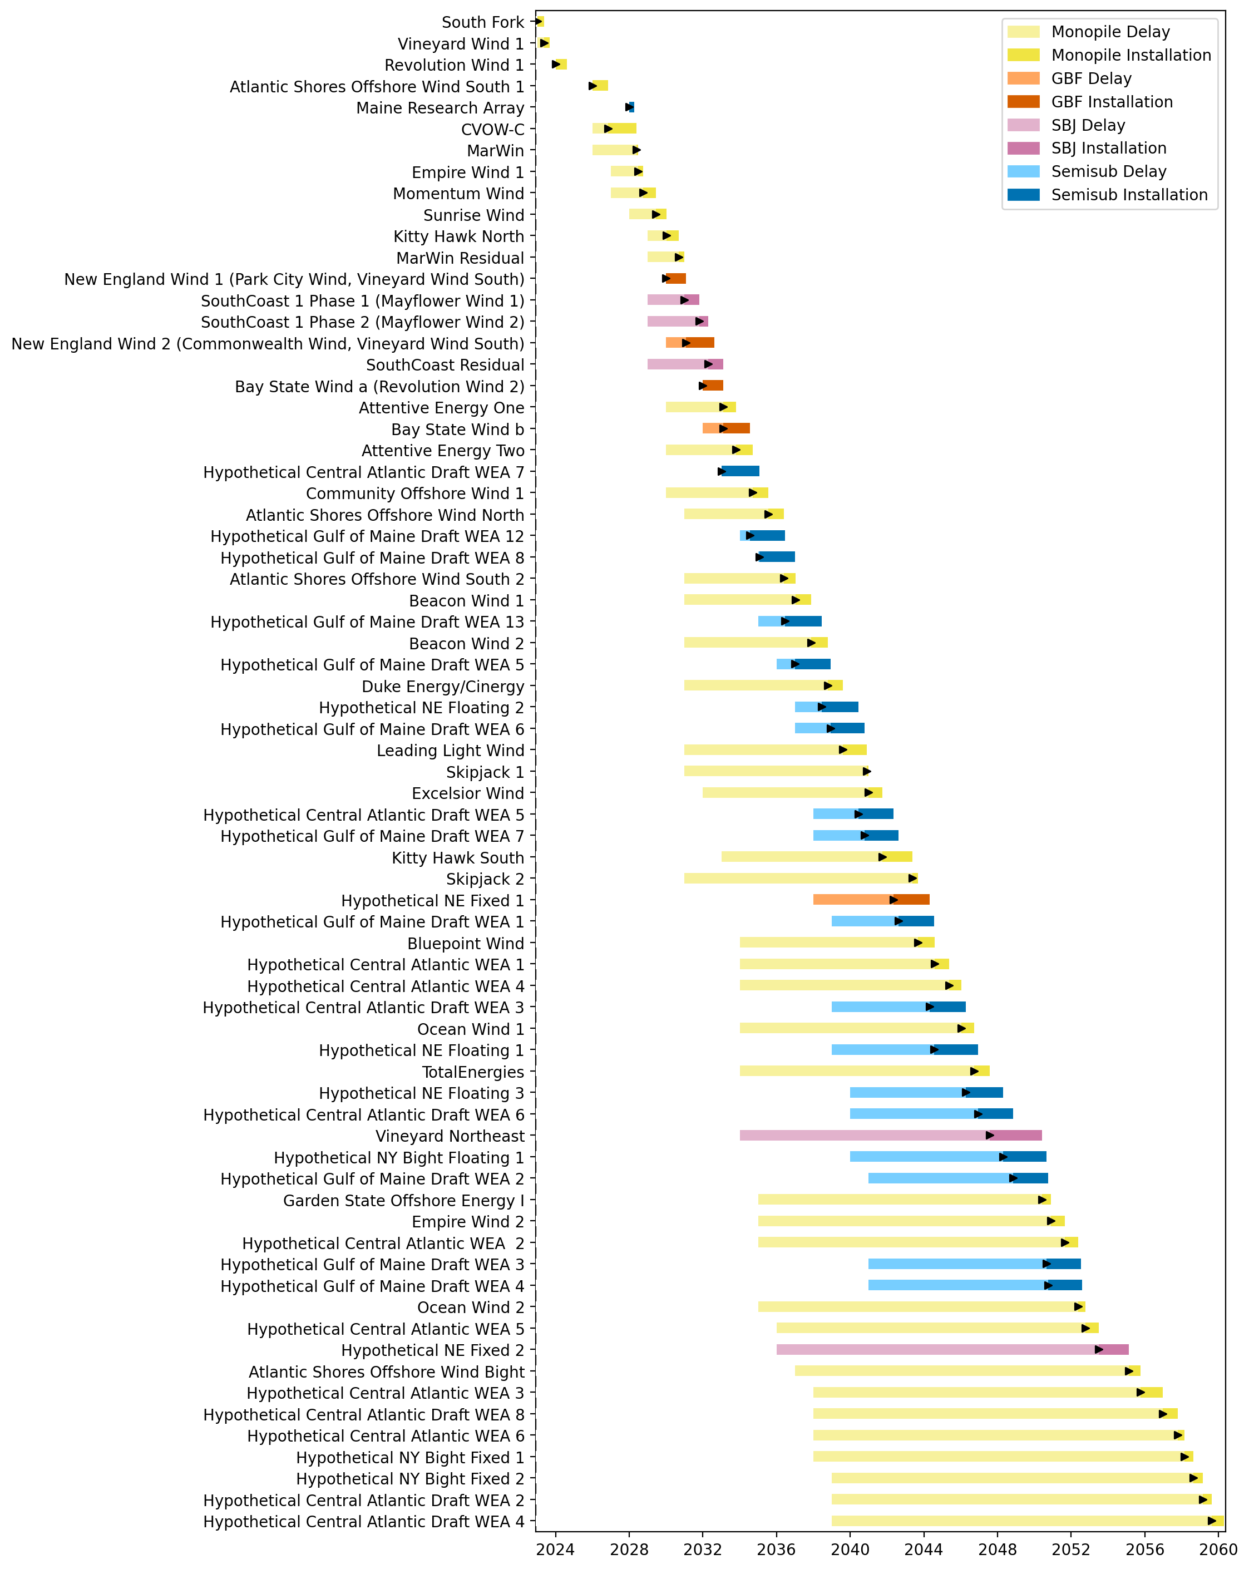
Full Gantt

Slide 3
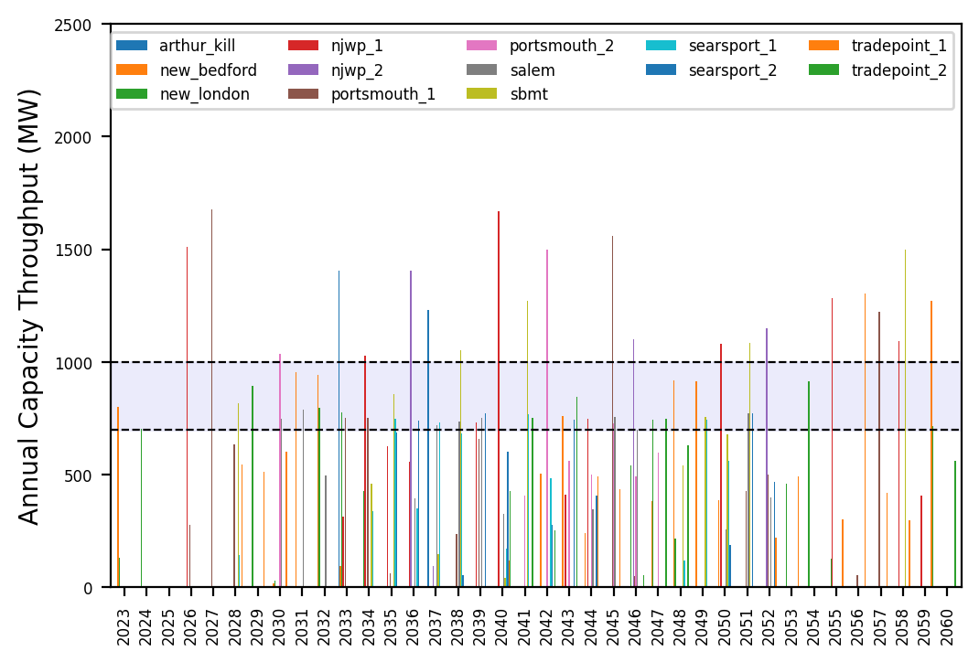
Port Throughput

Slide 4
natl_gaps_no_action_2_1
1 US WTIV starting with CVOW

Slide 5
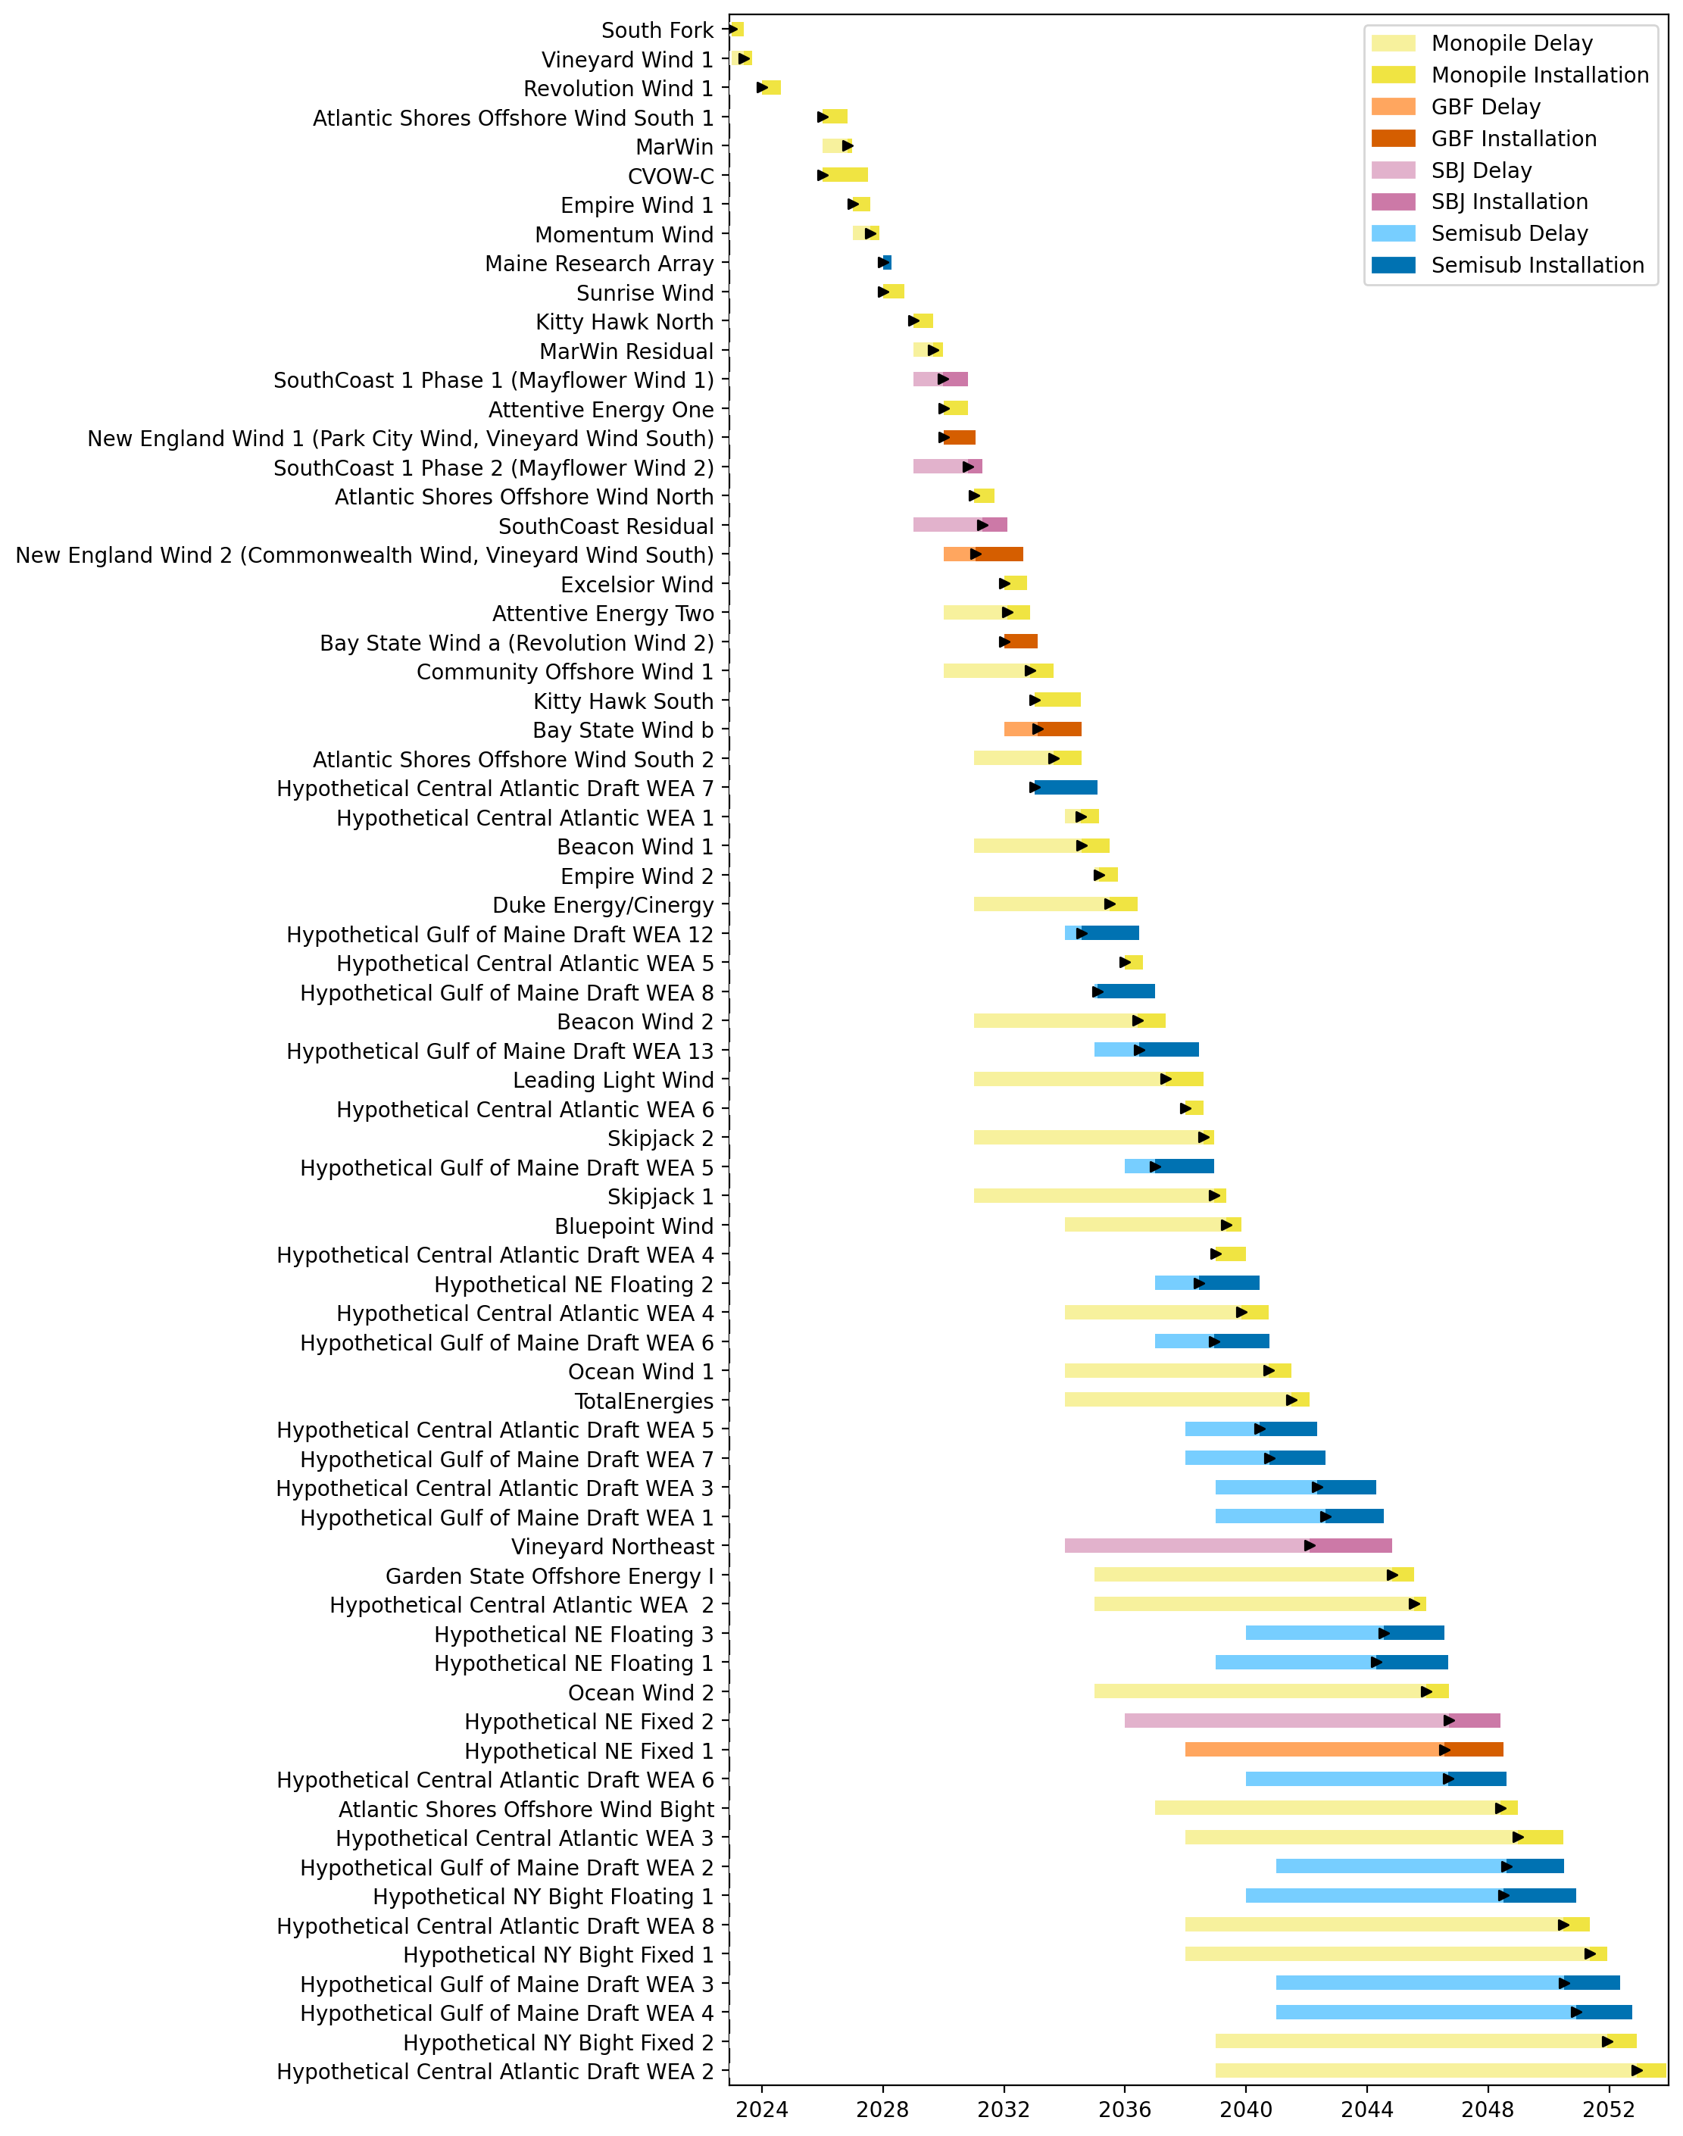
Full Gantt

Slide 6
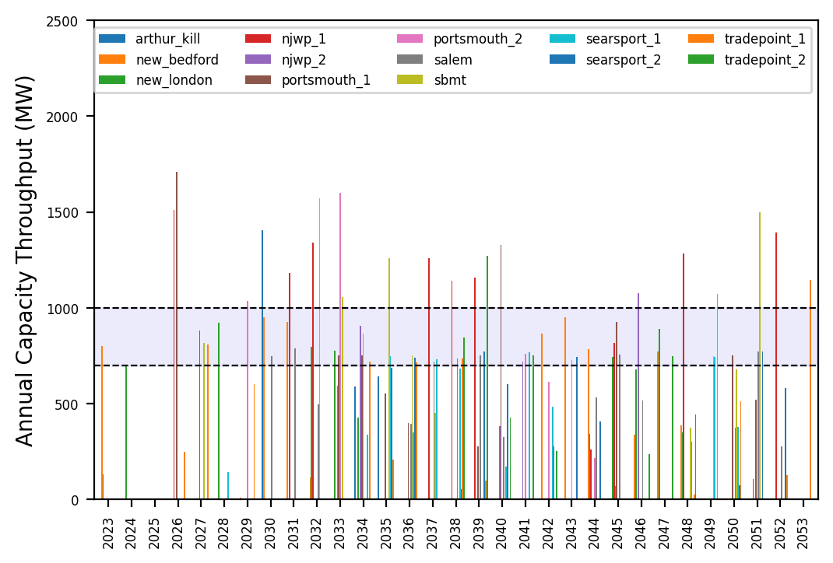
Port Throughput

Slide 7
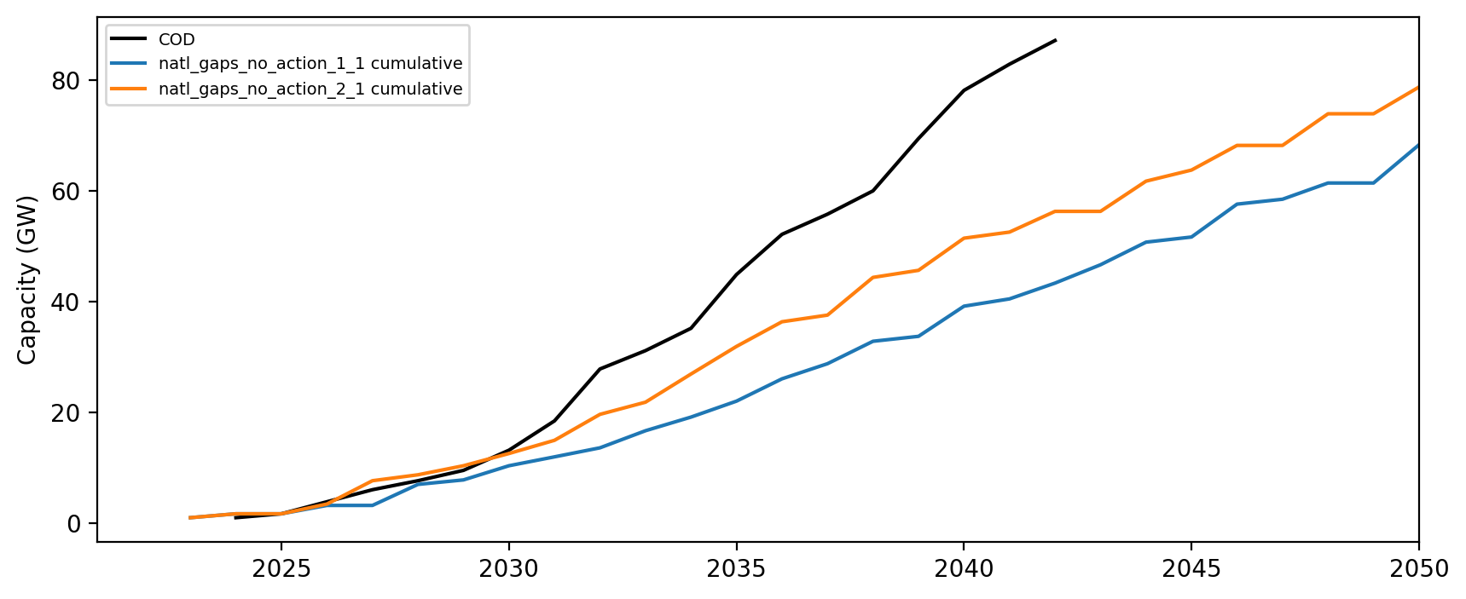
Installed Capacity

