Slide 1
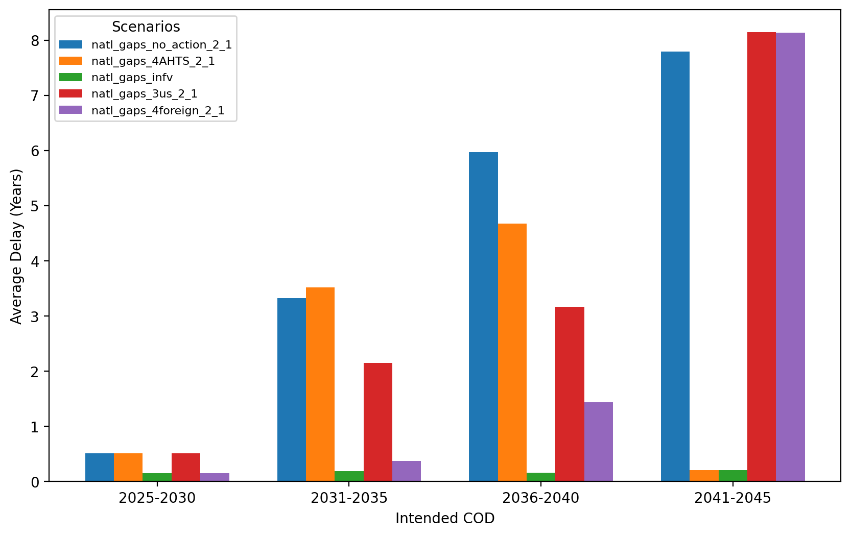
Average Delay Per Project by COD - All Regions

Slide 2
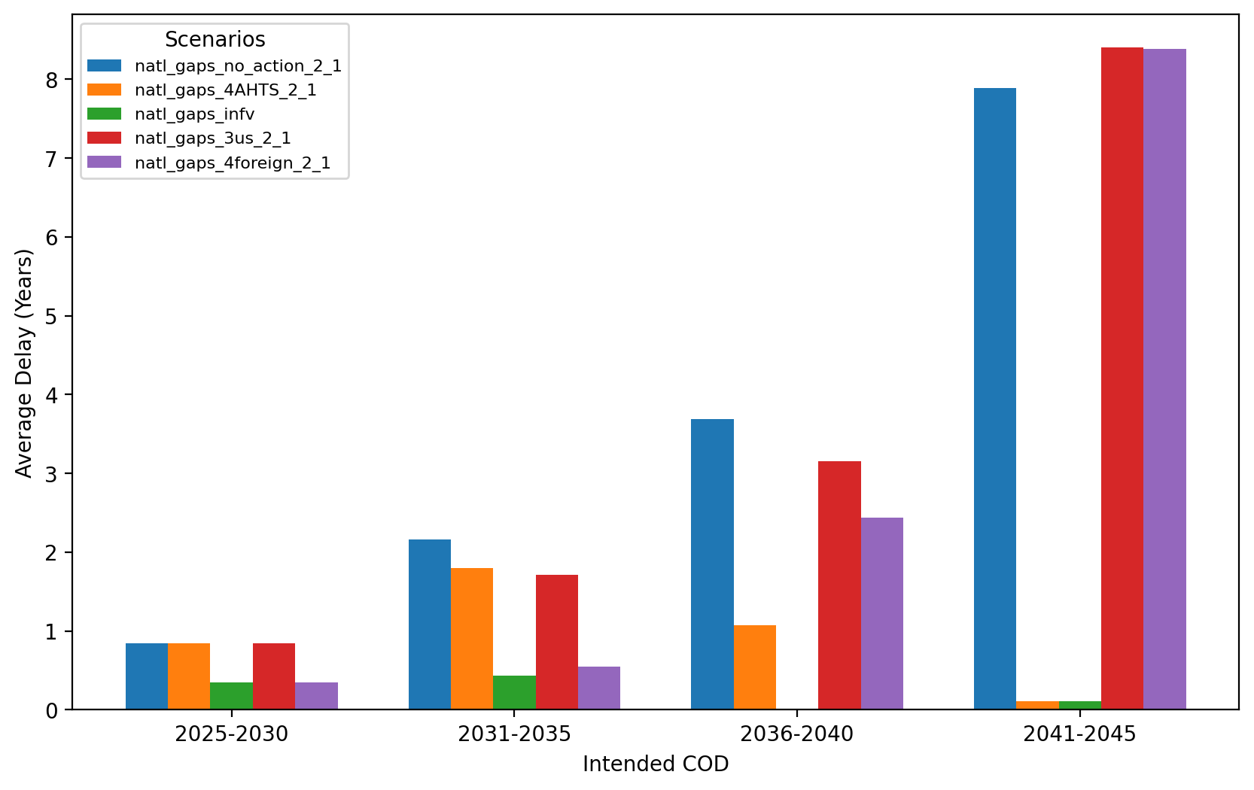
Average Delay Per Project by COD - NE

Slide 3
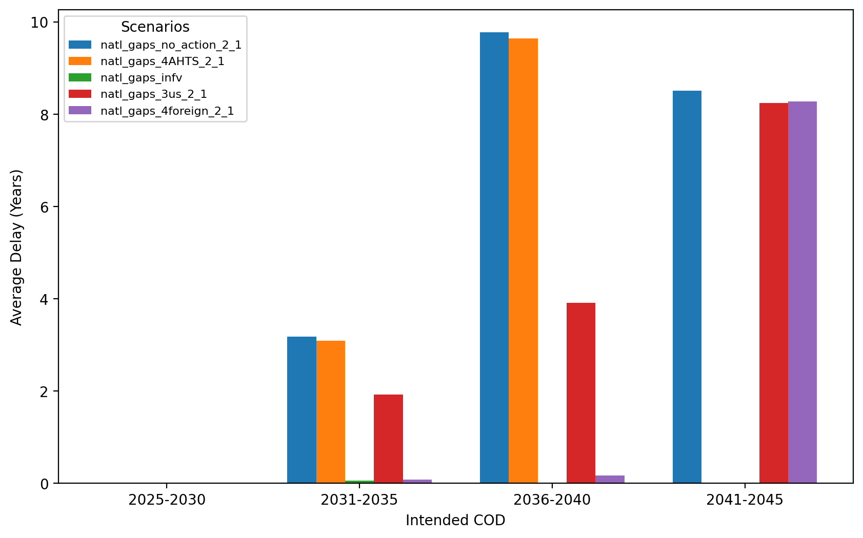
Average Delay Per Project by COD - NYNJ

Slide 4
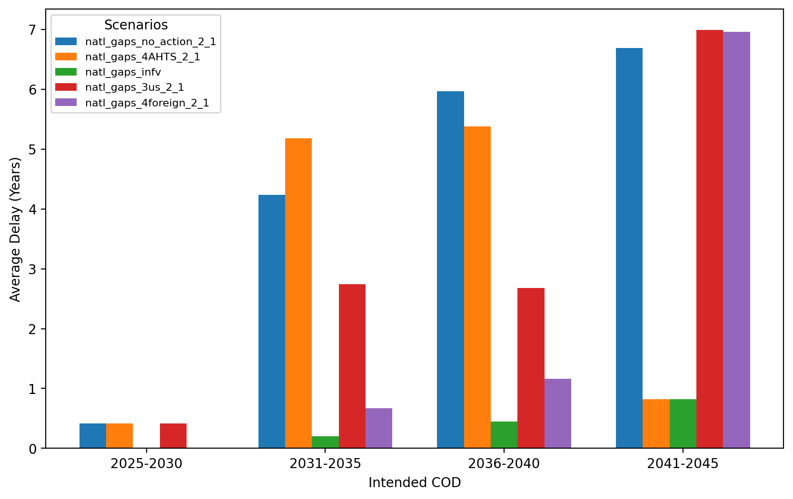
Average Delay Per Project by COD - Mid-Atlantic

