Slide 1
natl_gaps_no_action_2_1
t
e
x
t

Slide 2
natl_gaps_4AHTS_2_1
t
e
x
t

Slide 3
natl_gaps_3us_2_1
t
e
x
t

Slide 4
natl_gaps_4foreign_2_1
t
e
x
t

Slide 5
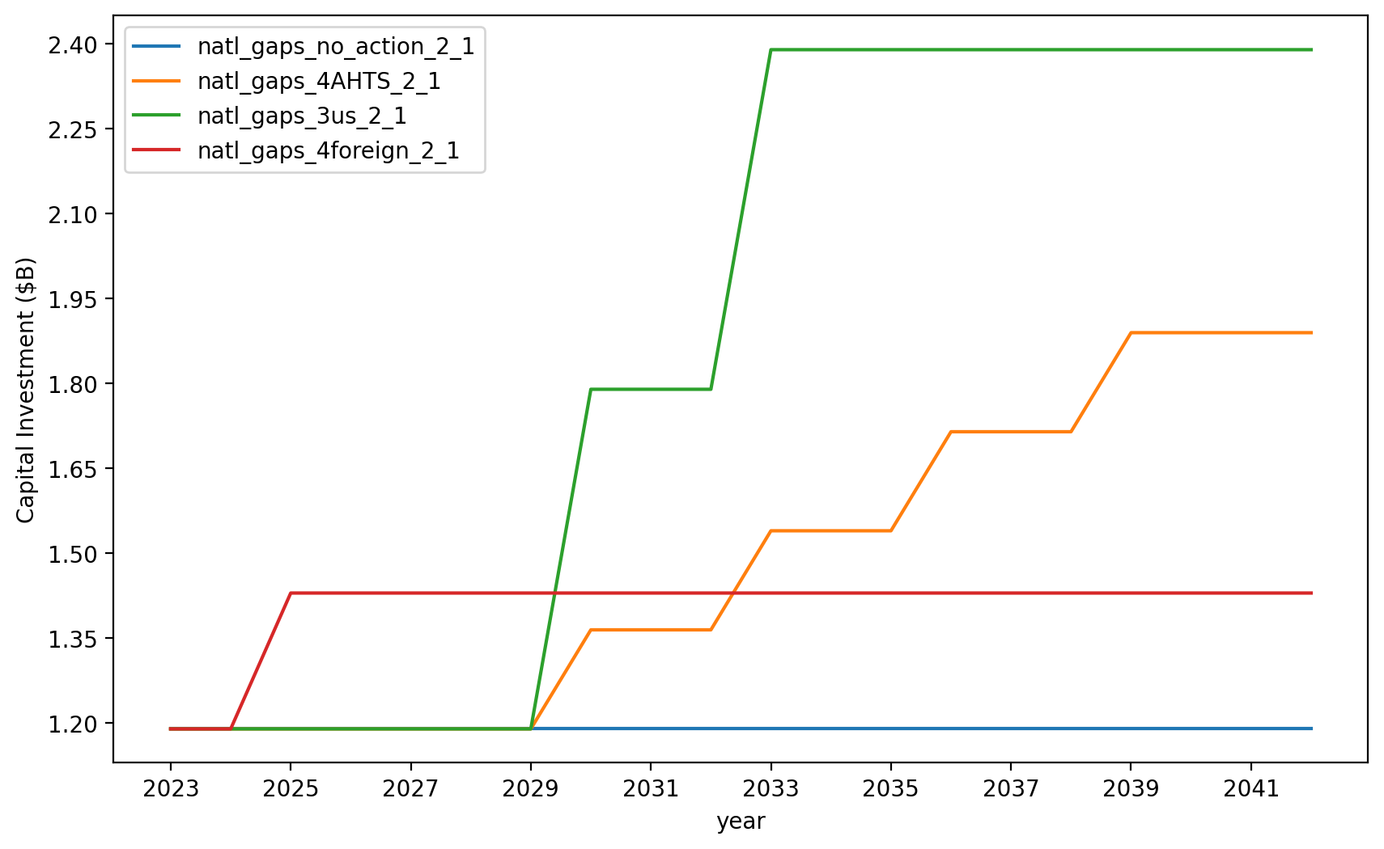
Vessel Investment

Slide 6
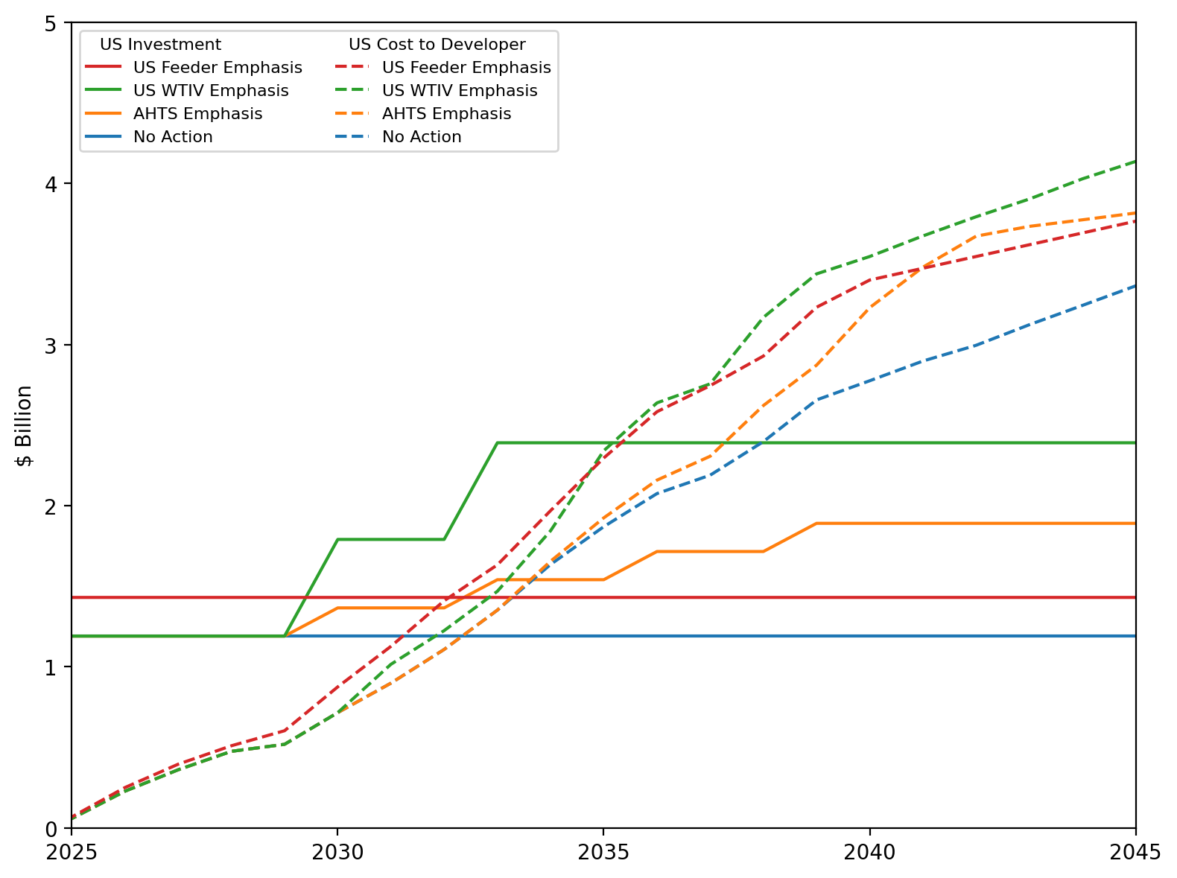
US Investment Summary

Slide 7
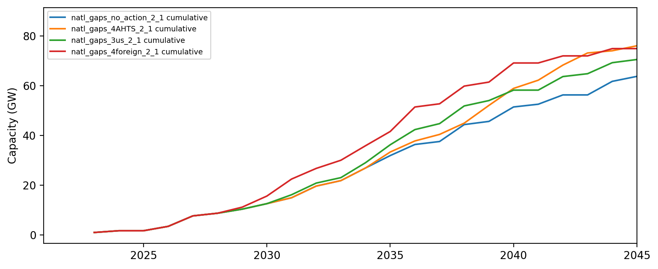
Installed Capacity

Slide 8
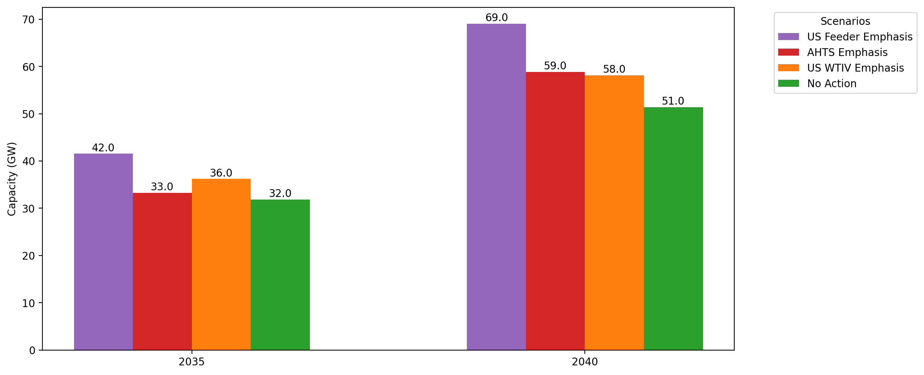
Cumulative Capacity by 2035 and 2040

Slide 9
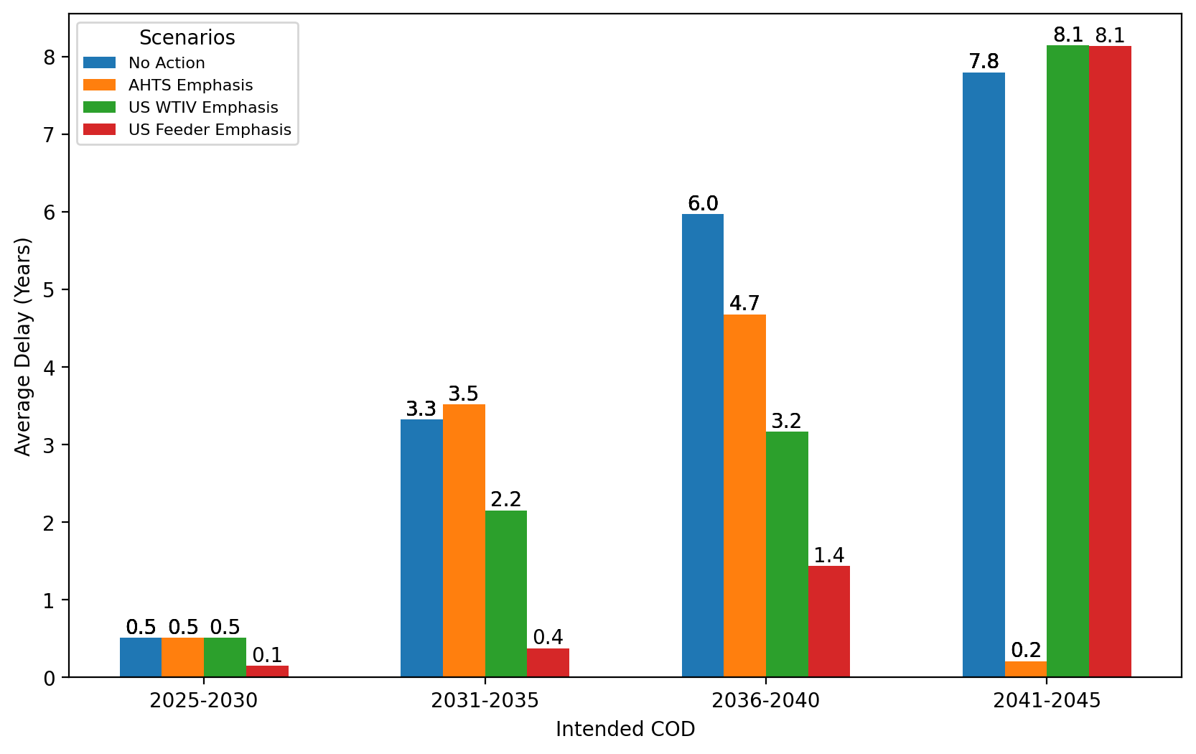
Average Delay Per Project by COD - All Regions

Slide 10
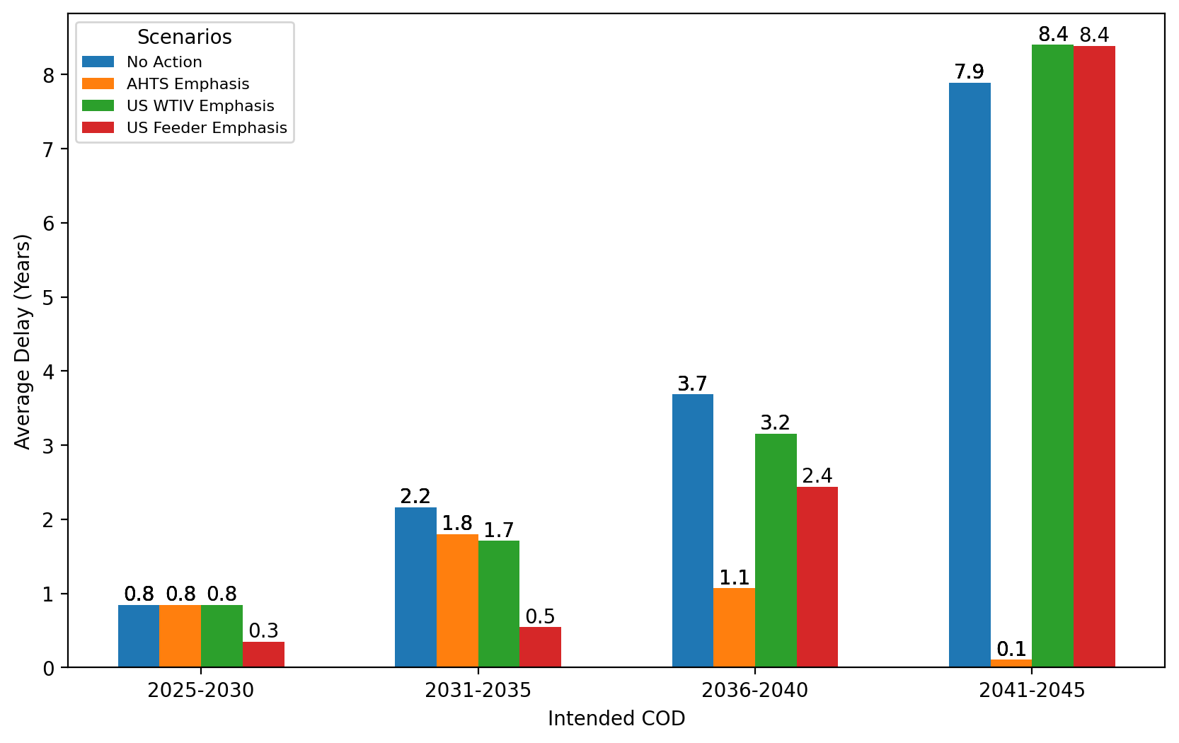
Average Delay Per Project by COD - NE

Slide 11
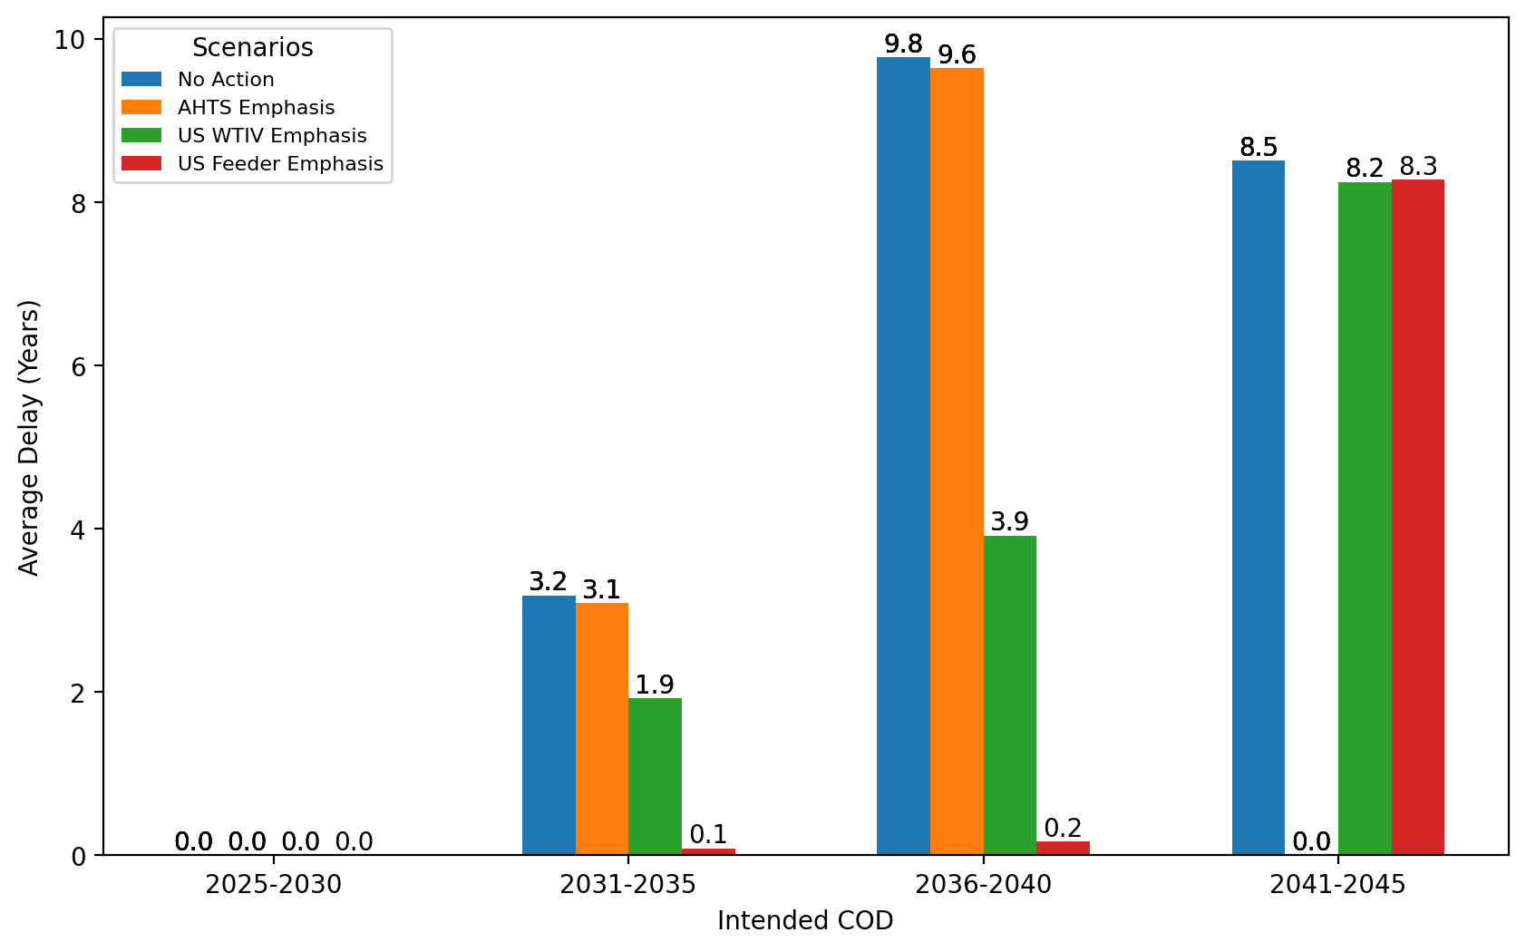
Average Delay Per Project by COD - NYNJ

Slide 12
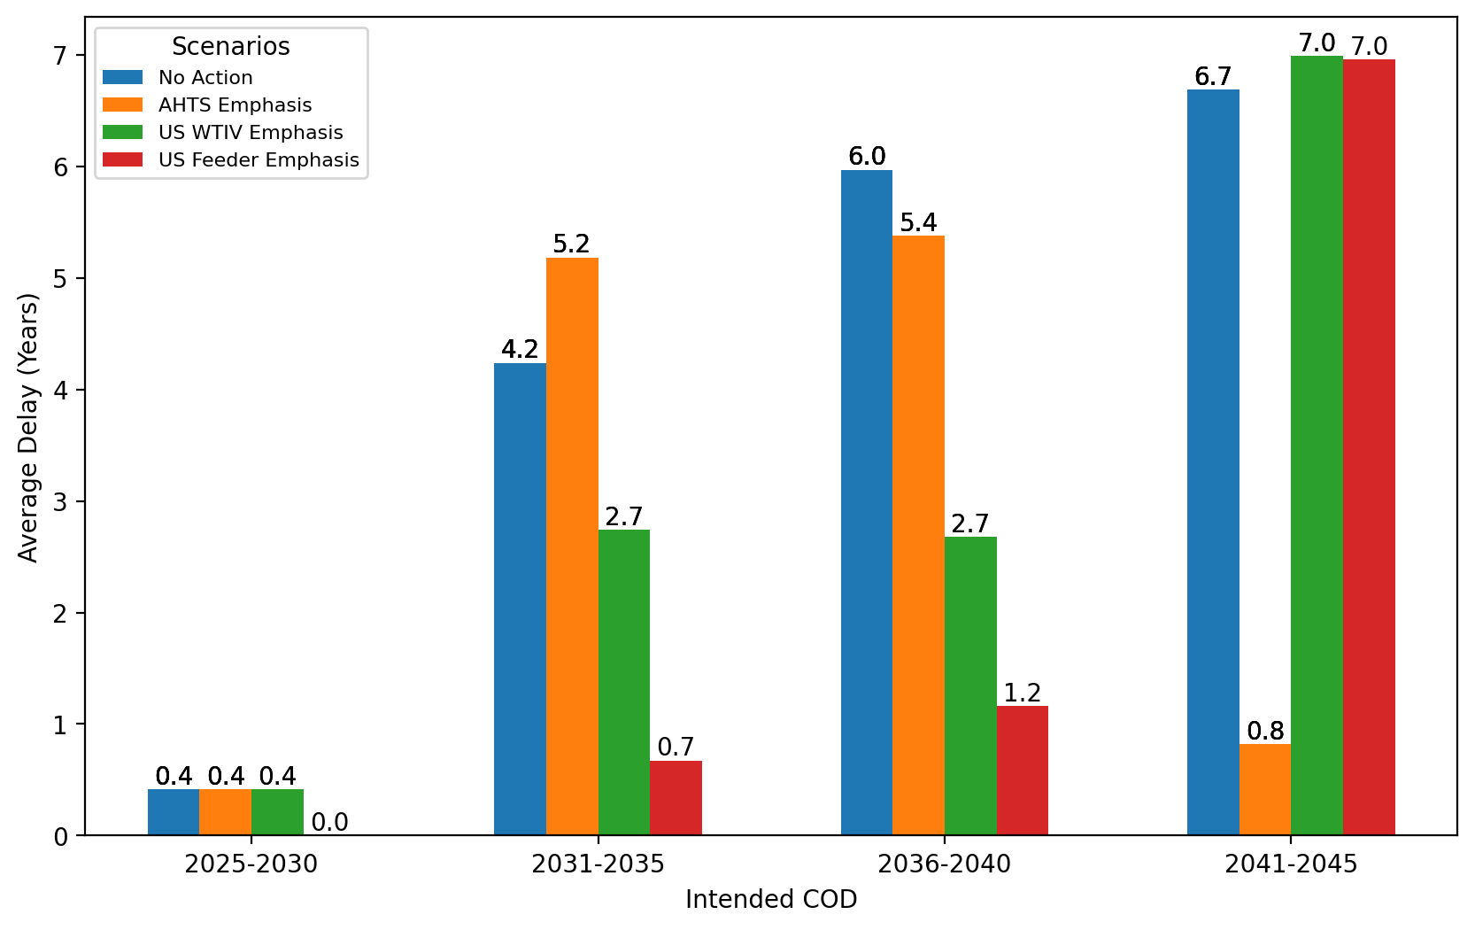
Average Delay Per Project by COD - Mid-Atlantic

