Slide 1
ne_infv
NE Core Scenario
Unconstrained Vessels

Slide 2
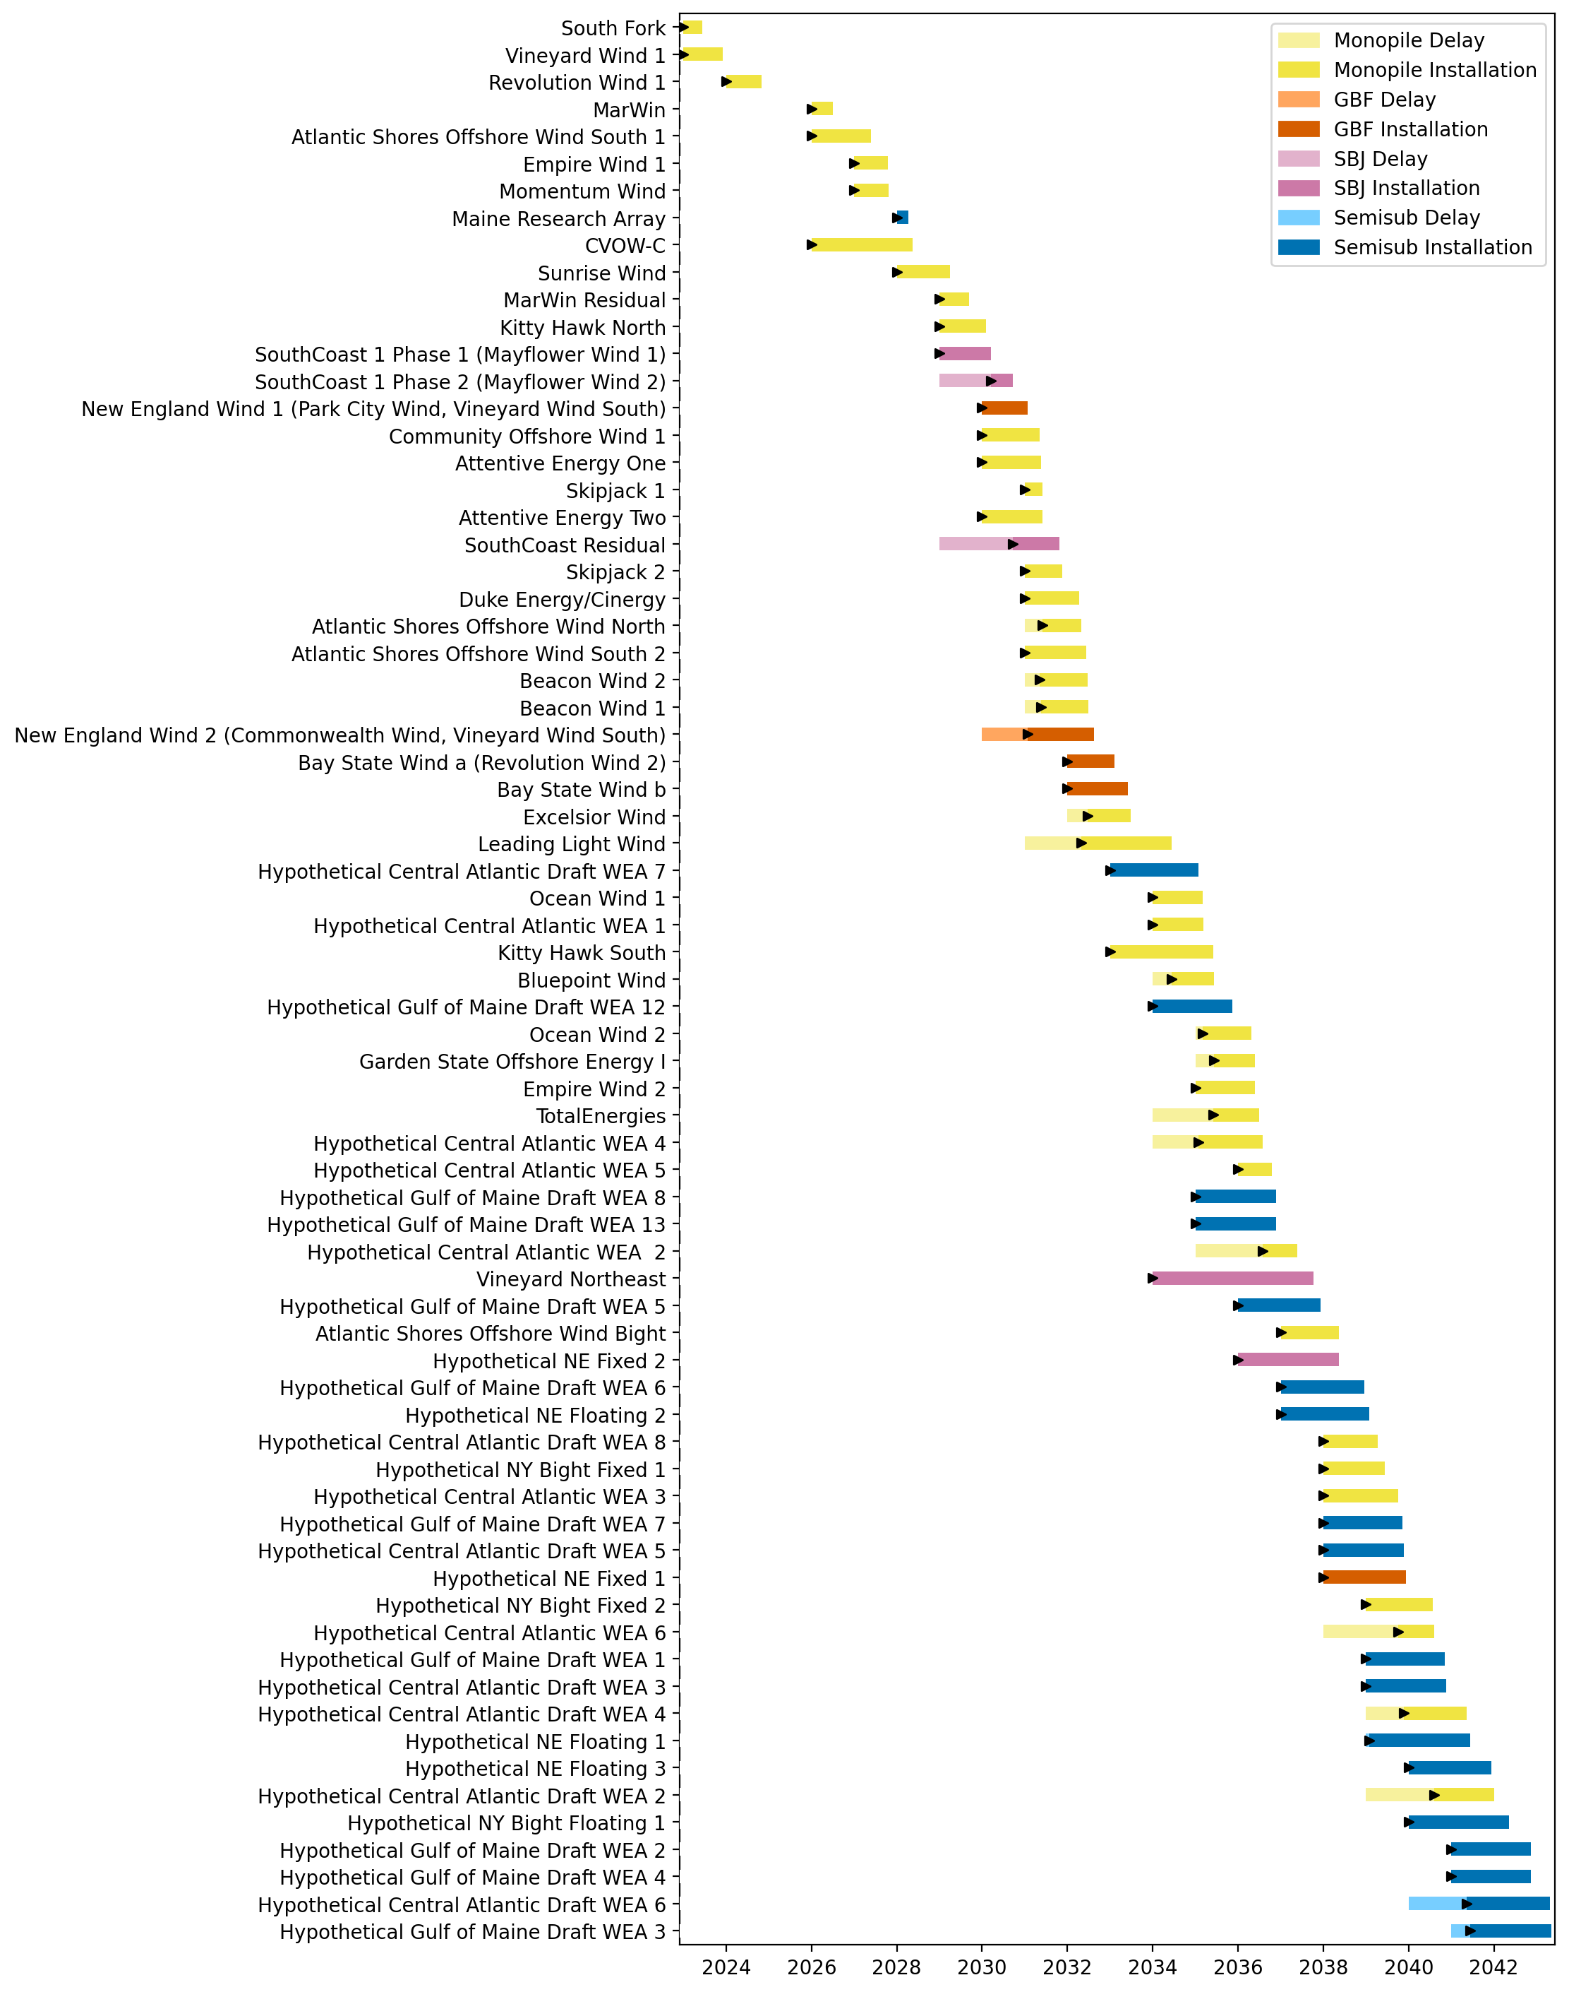
Full Gantt

Slide 3
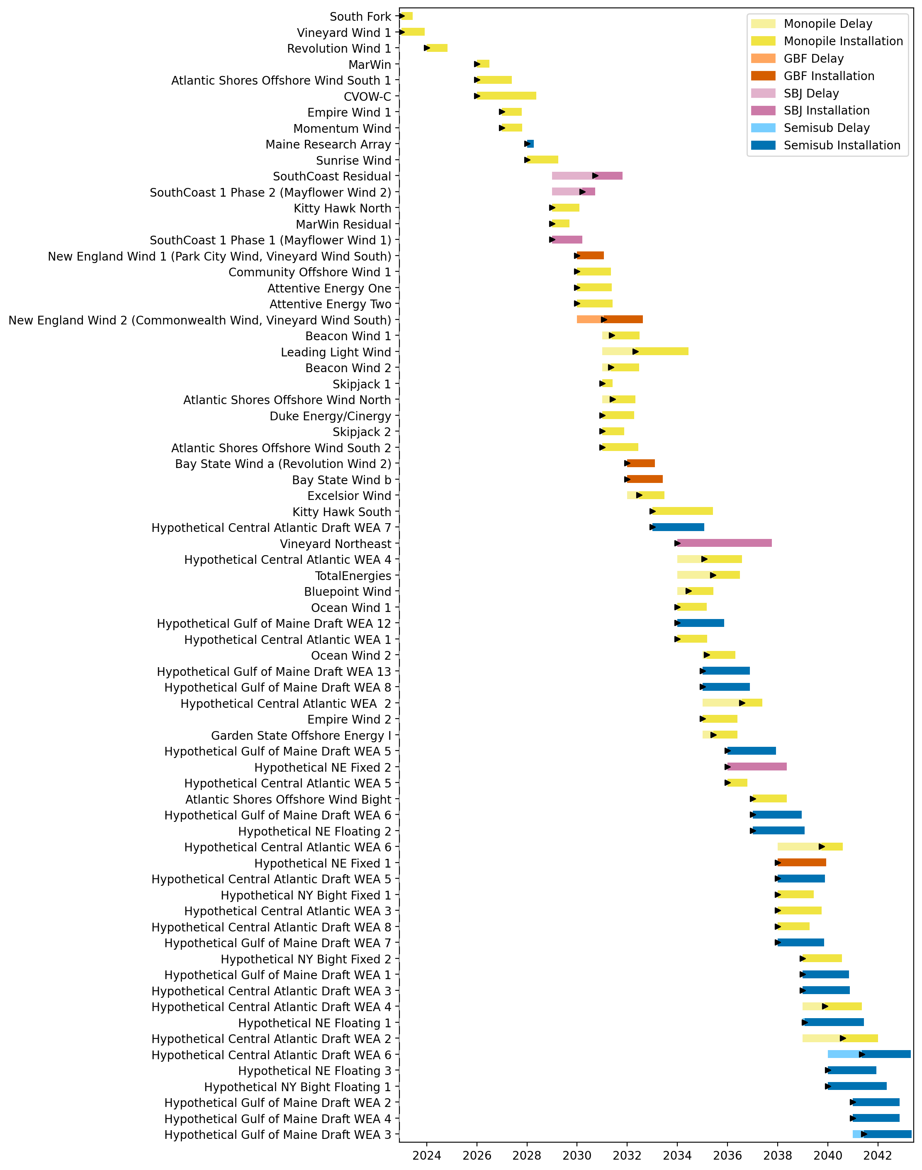
Sorted Full Gantt

Slide 4
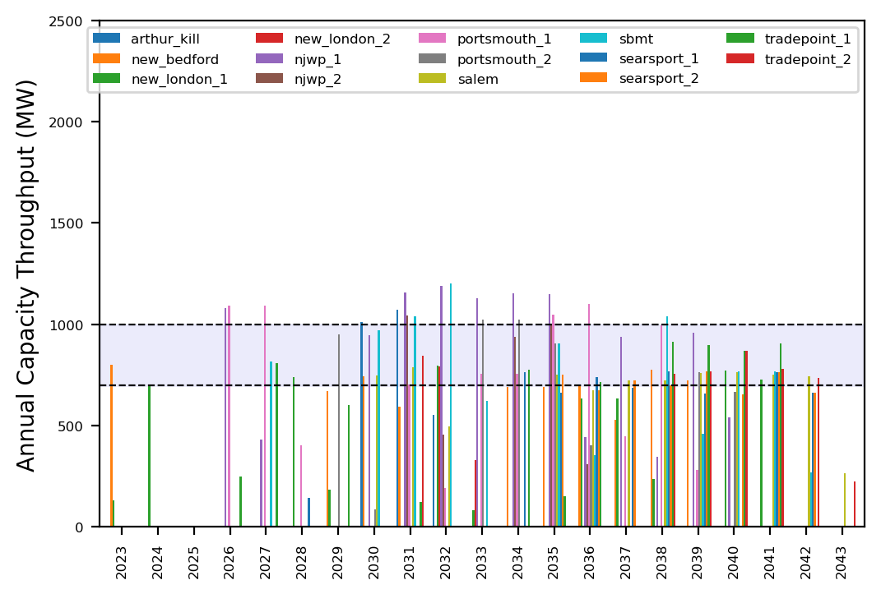
Port Throughput

Slide 5
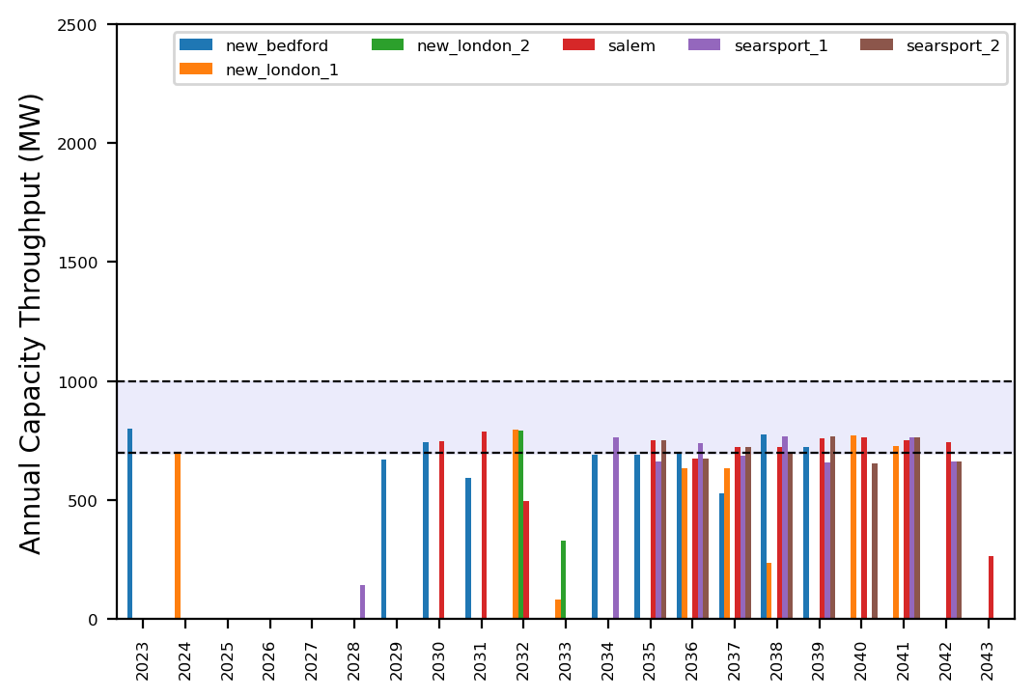
Port Throughput

Slide 6
ne_infv_infp
NE Core Scenario
Unconstrained Vessels

Slide 7
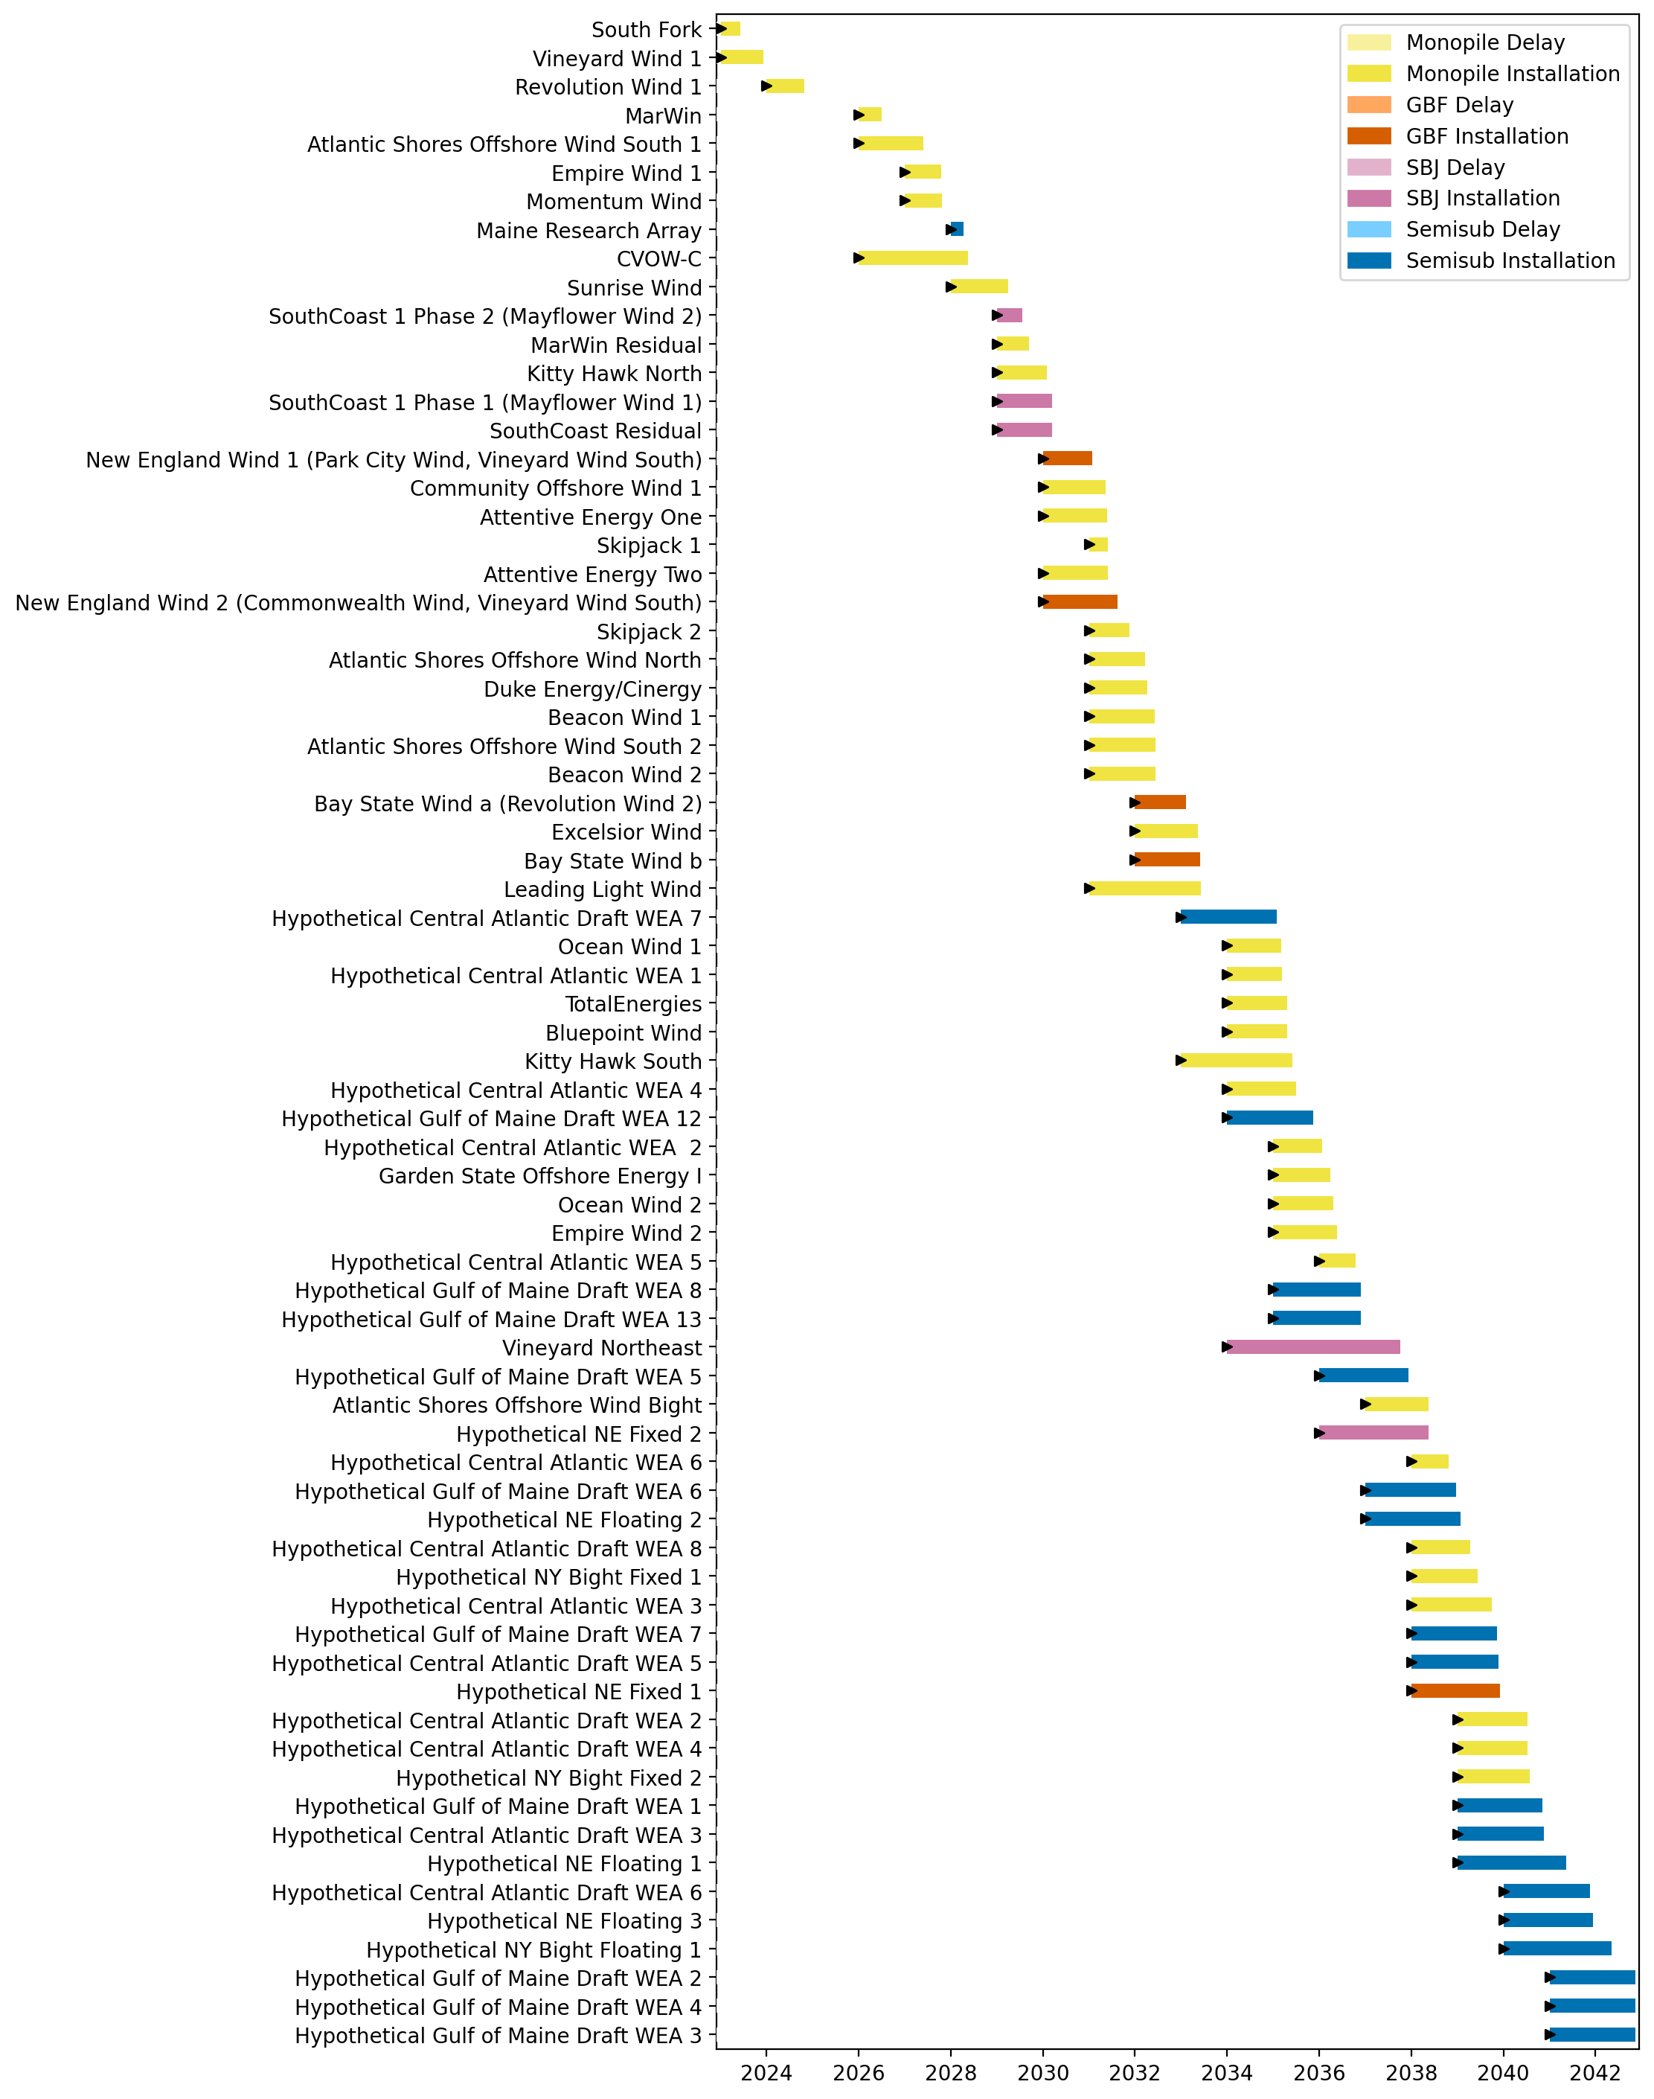
Full Gantt

Slide 8
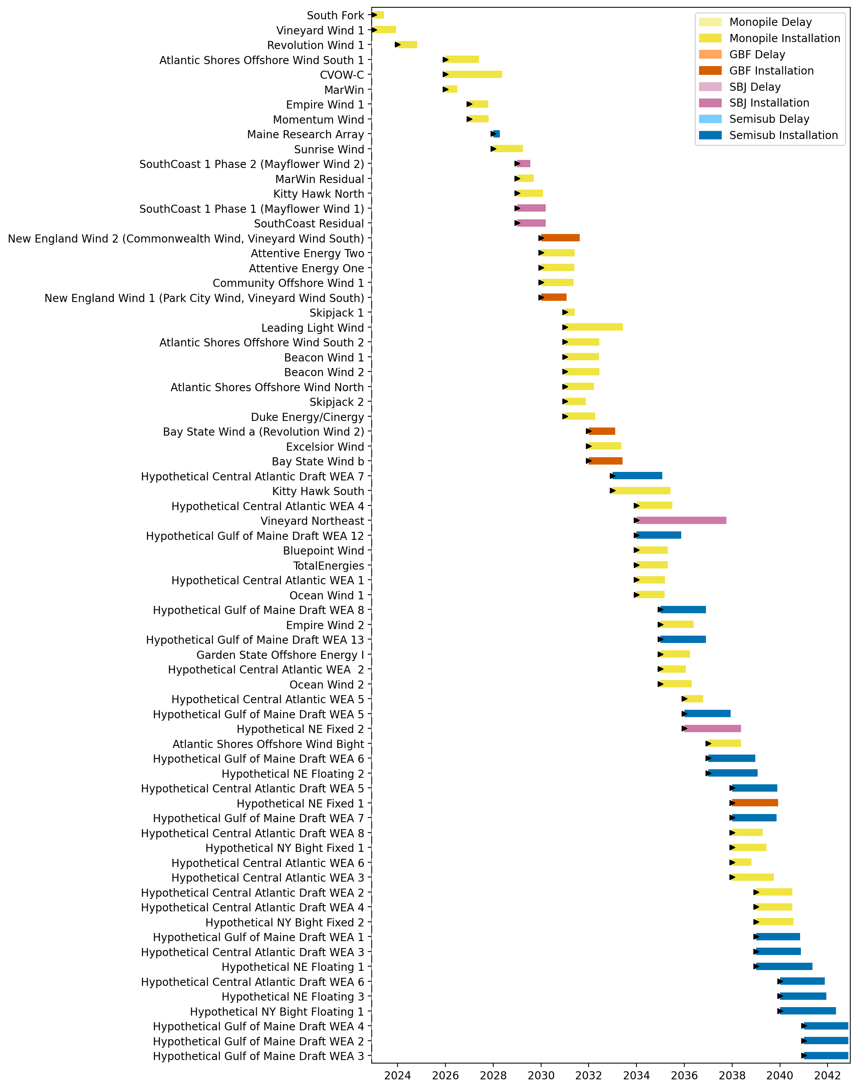
Sorted Full Gantt

Slide 9
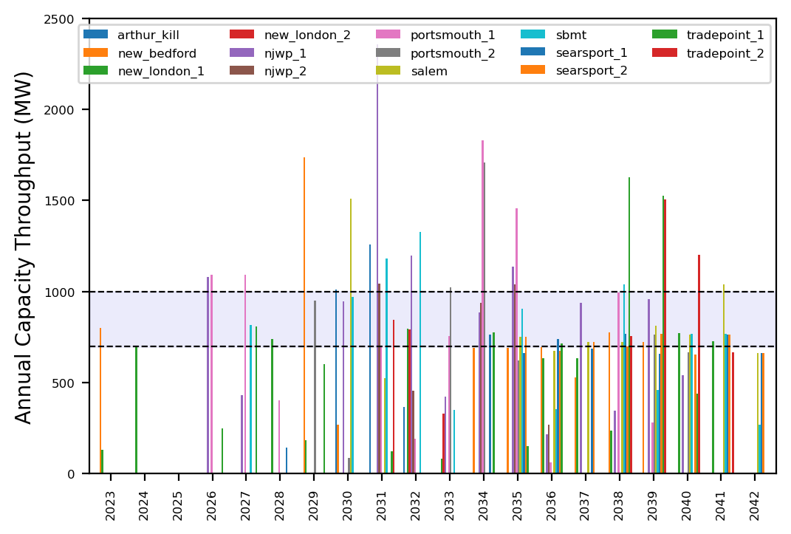
Port Throughput

Slide 10
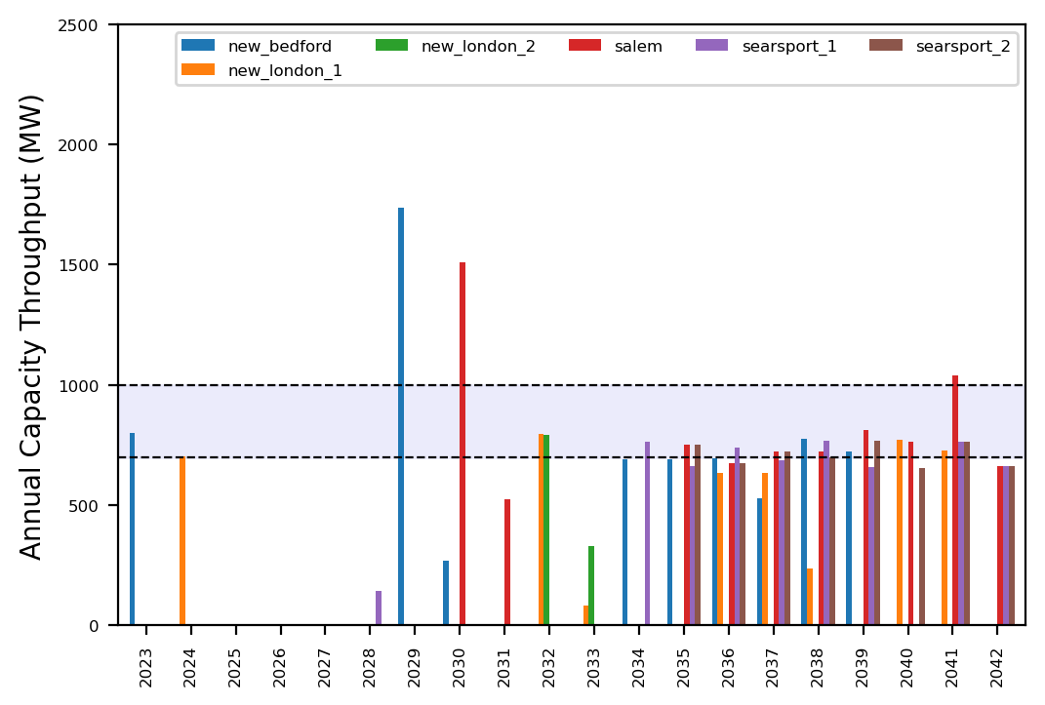
Port Throughput

Slide 11
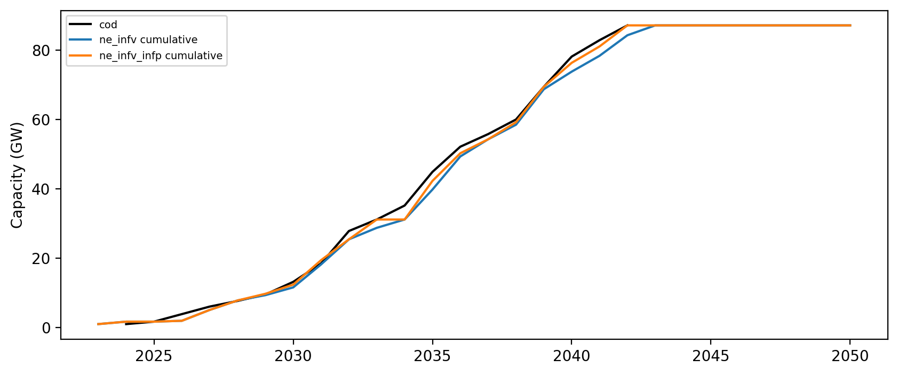
Installed Capacity

