Slide 1
ne_core_4wtiv_add_3_ahts
NE Core Scenario
Add 3 WTIV
Add 3 AHTS

Slide 2
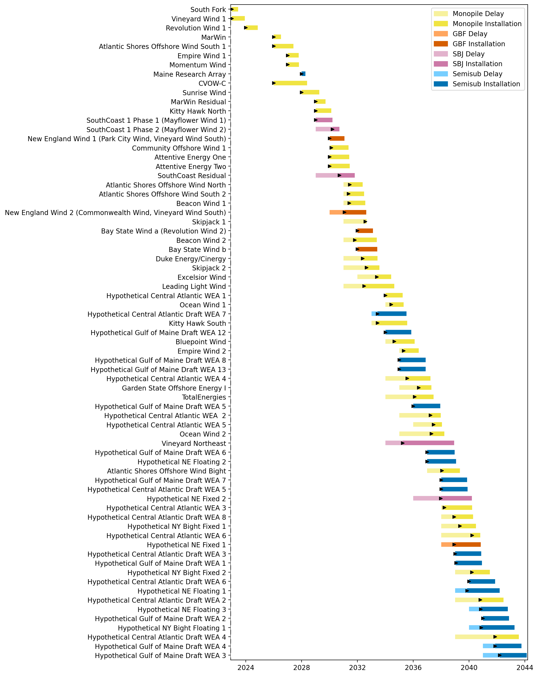
Full Gantt

Slide 3
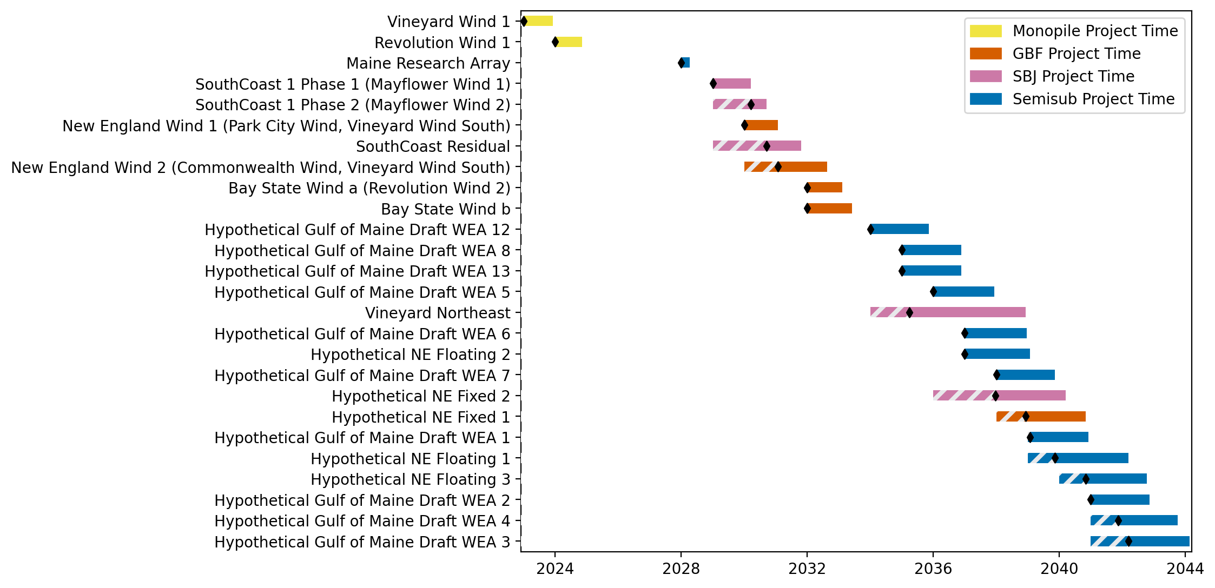
New England Gantt

Slide 4
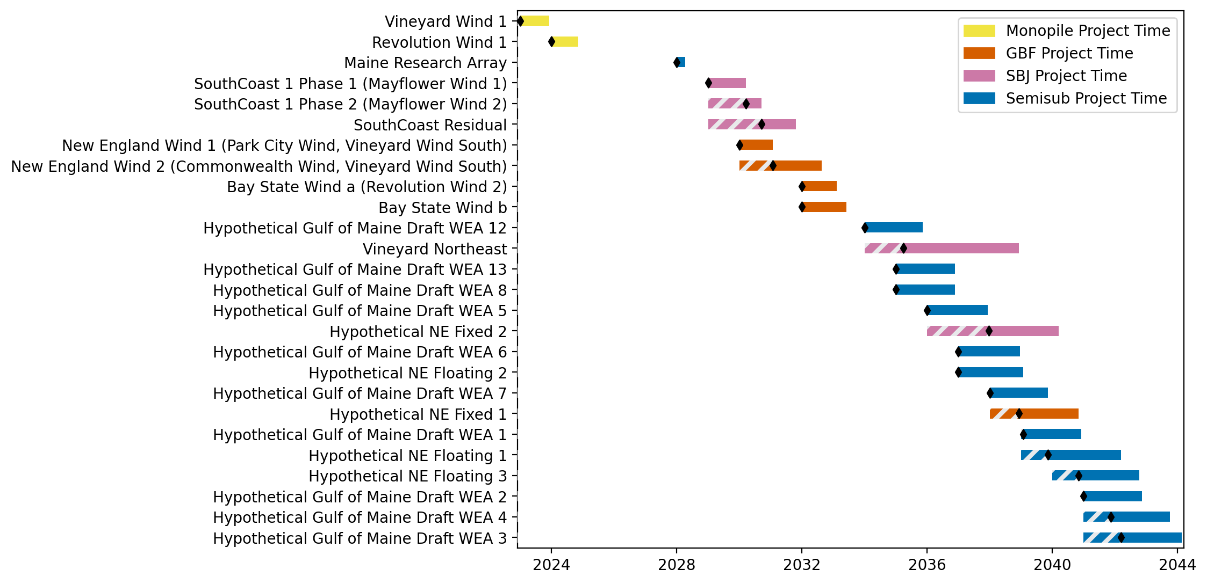
Sorted New England Gantt

Slide 5
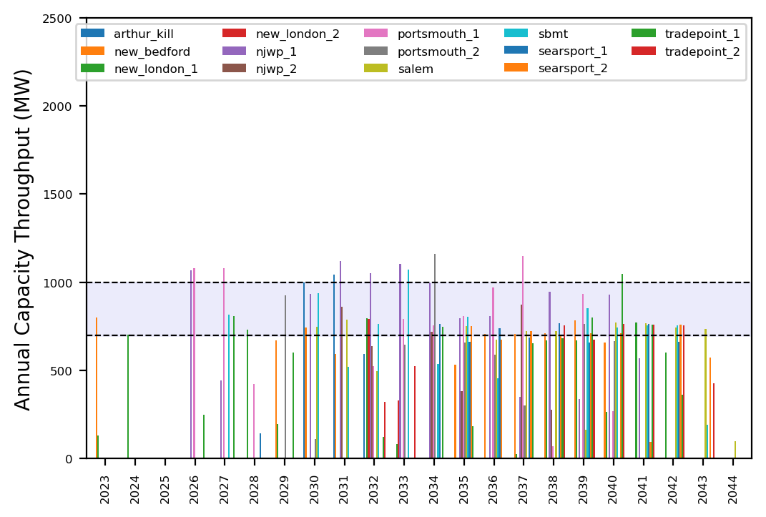
Port Throughput

Slide 6
ne_delayed_ports_w_vessels
Delayed Port Scenario

Slide 7
Full Gantt

Slide 8
New England Gantt

Slide 9
Sorted New England Gantt

Slide 10
Port Throughput

Slide 11
ne_gbf_add_4_ahts
All GBF Pipeline
Add 4 AHTS

Slide 12
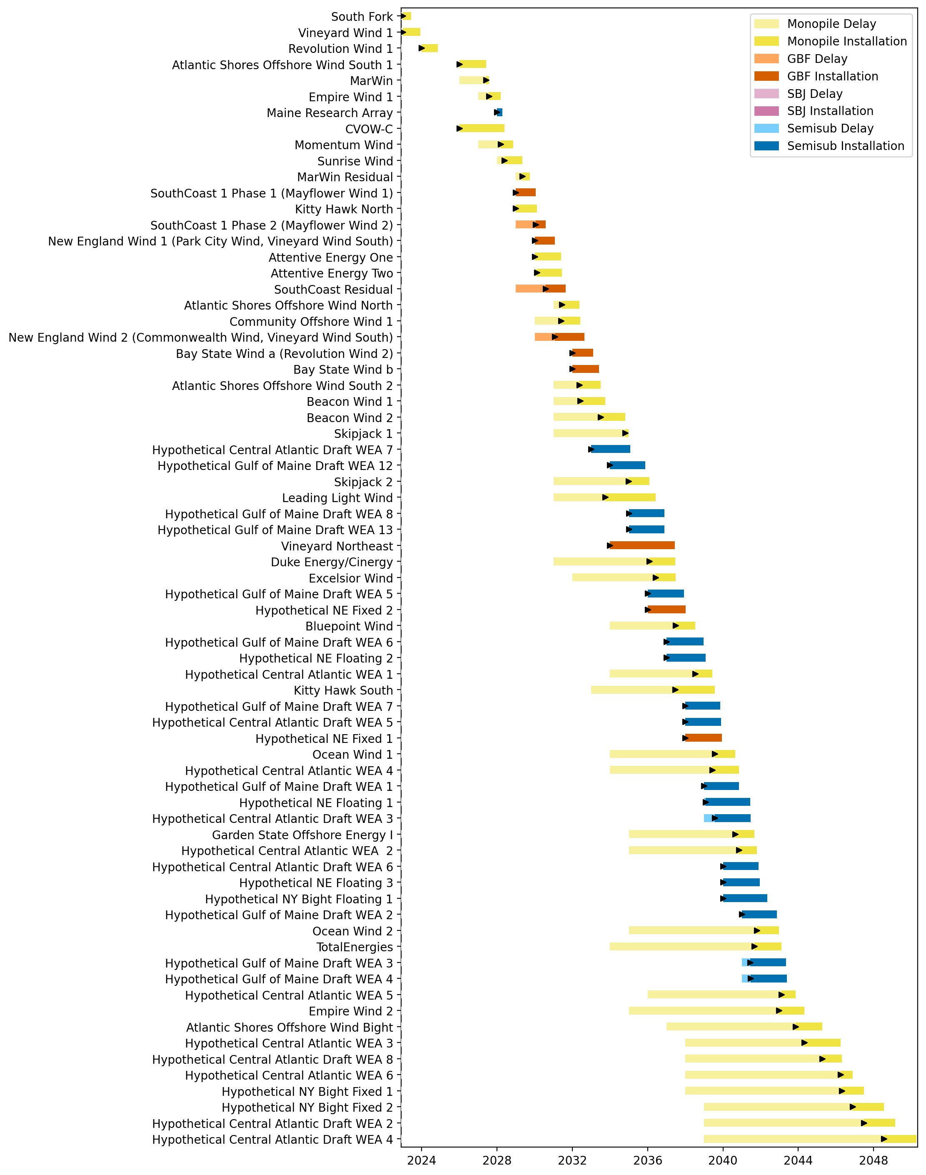
Full Gantt

Slide 13
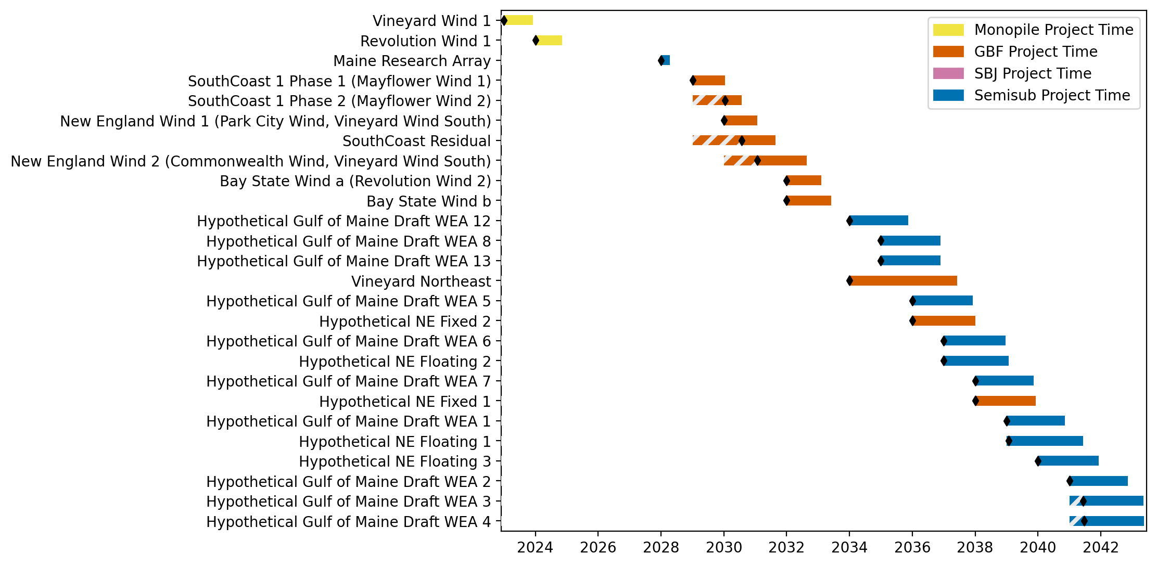
New England Gantt

Slide 14
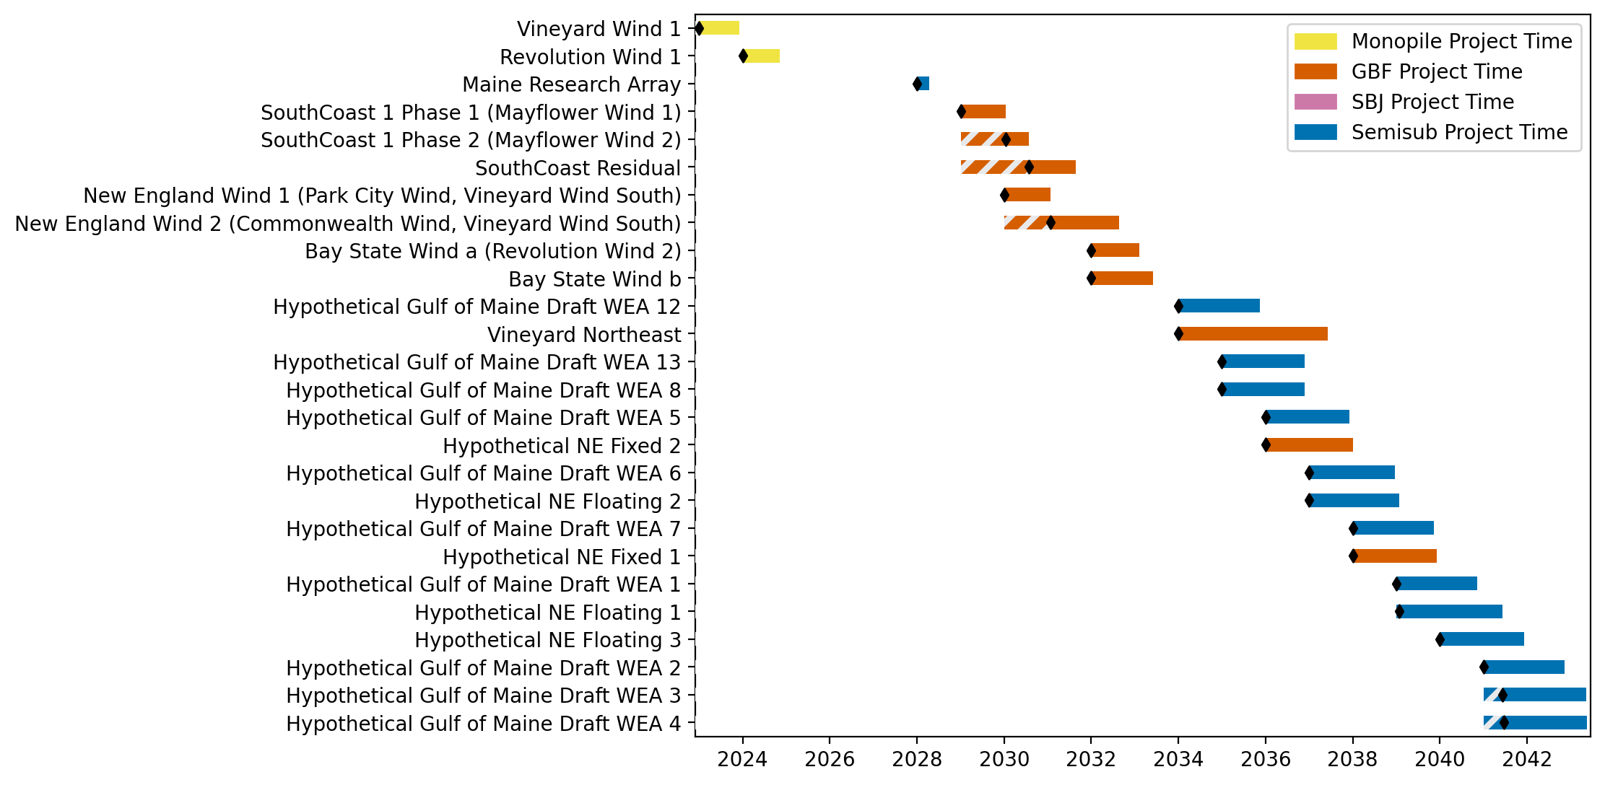
Sorted New England Gantt

Slide 15
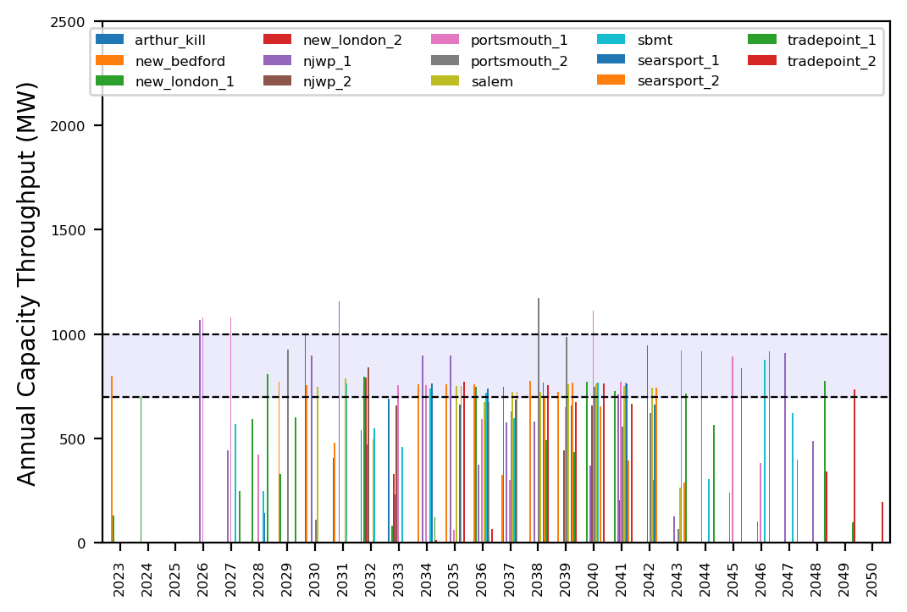
Port Throughput

Slide 16
ne_high_4wtiv_6ahts
High Deployment Scenario

Slide 17
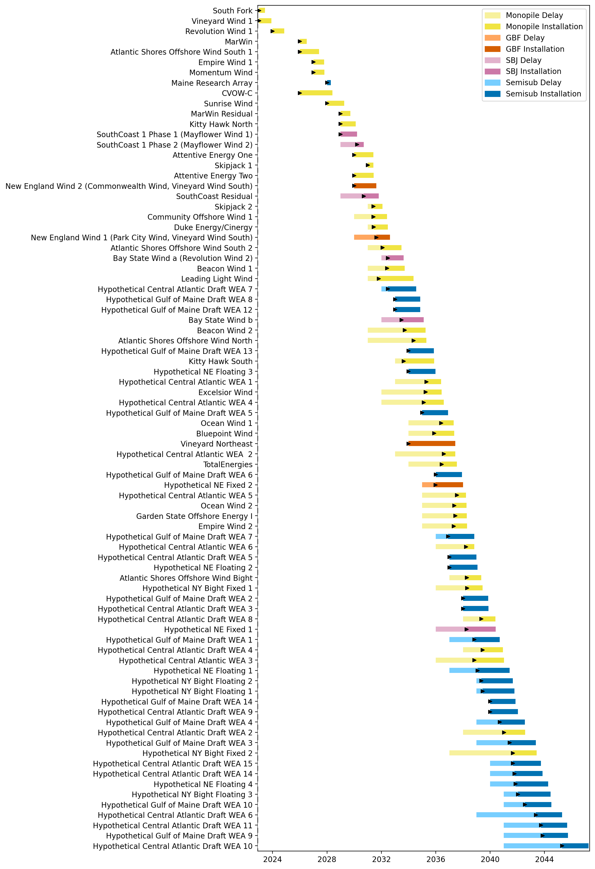
Full Gantt

Slide 18
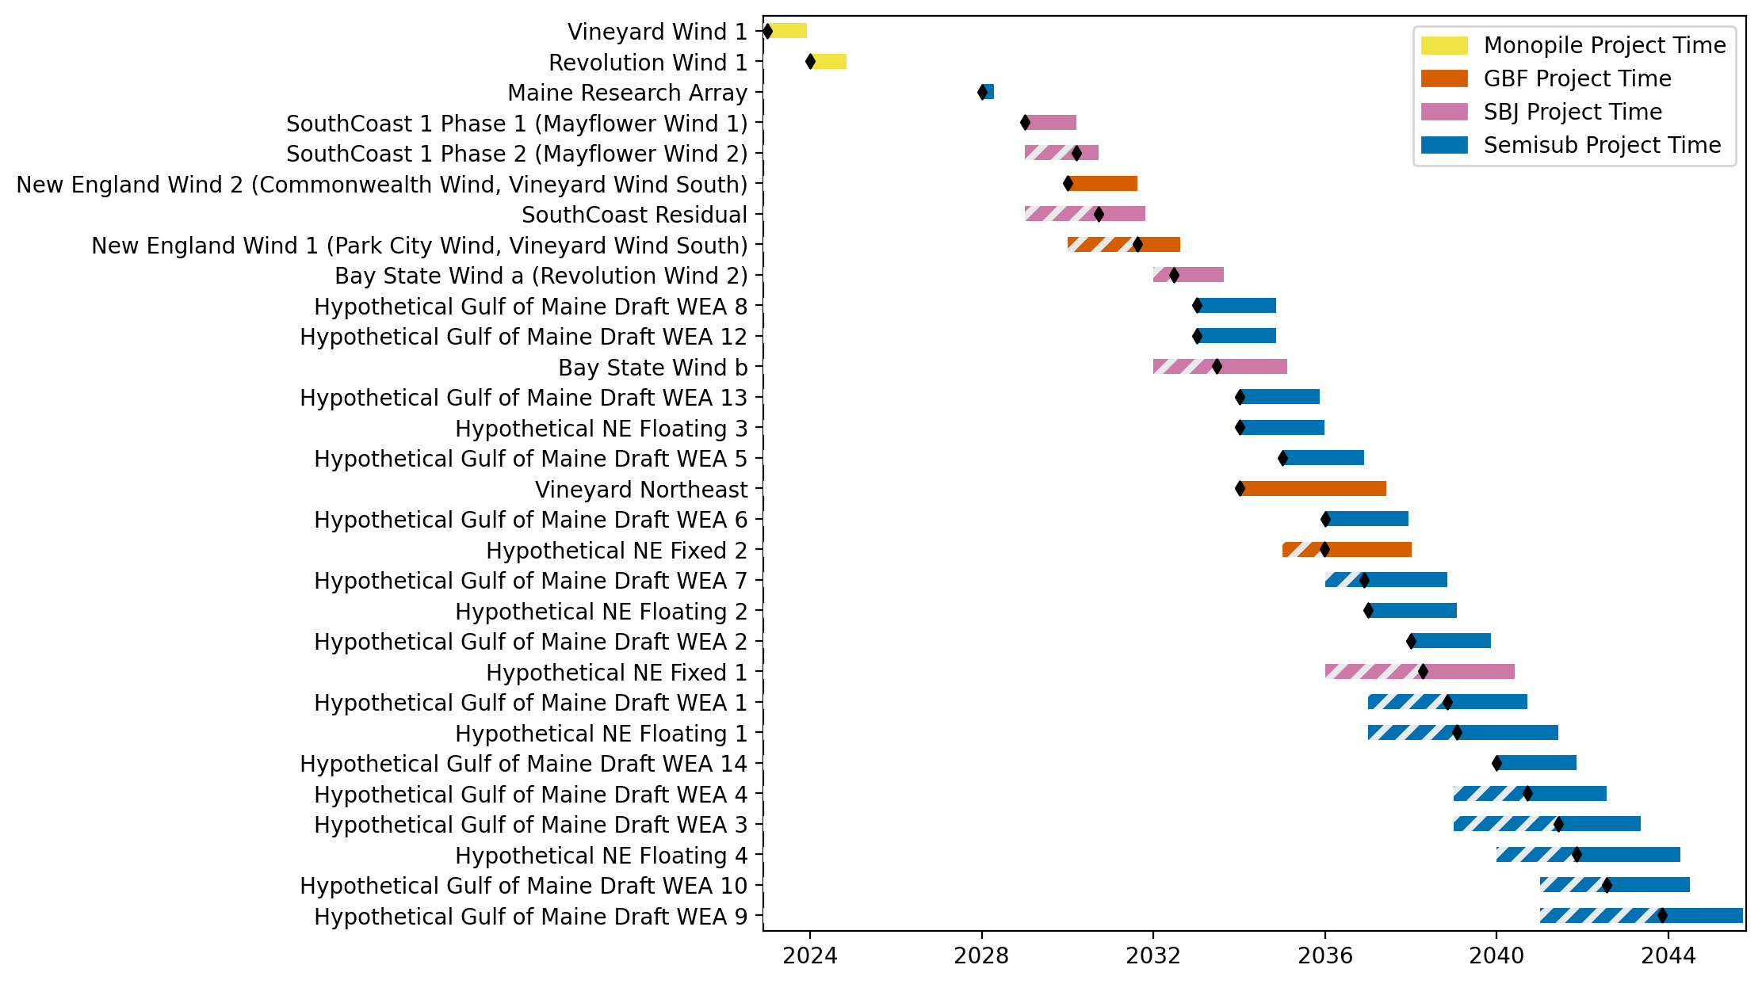
New England Gantt

Slide 19
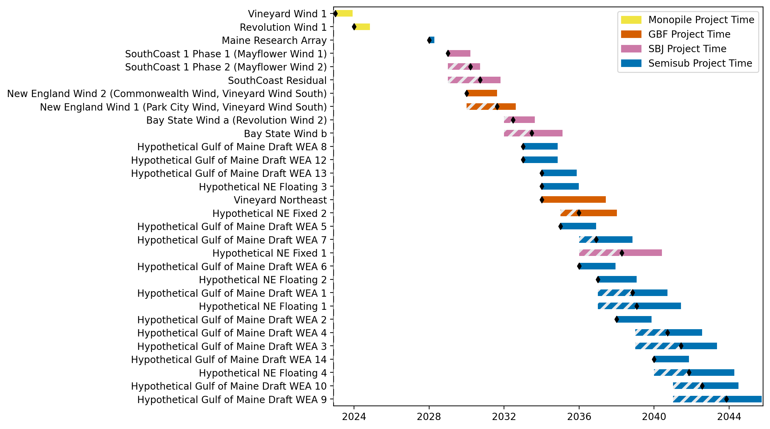
Sorted New England Gantt

Slide 20
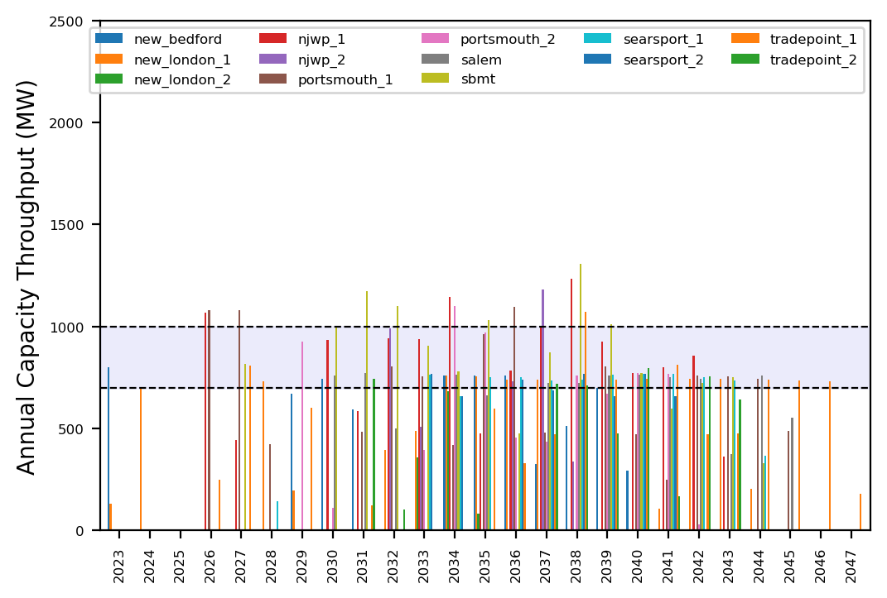
Port Throughput

Slide 21
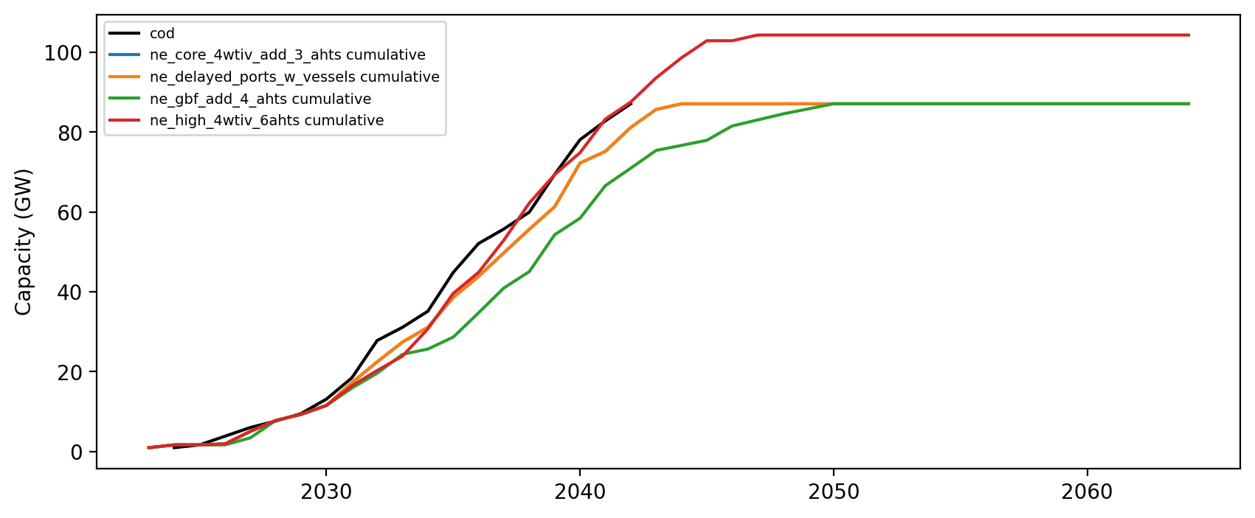
Installed Capacity

