Slide 1
moderate_limited_port
NE Core Scenario
Add 3 WTIV
Add 3 AHTS

Slide 2
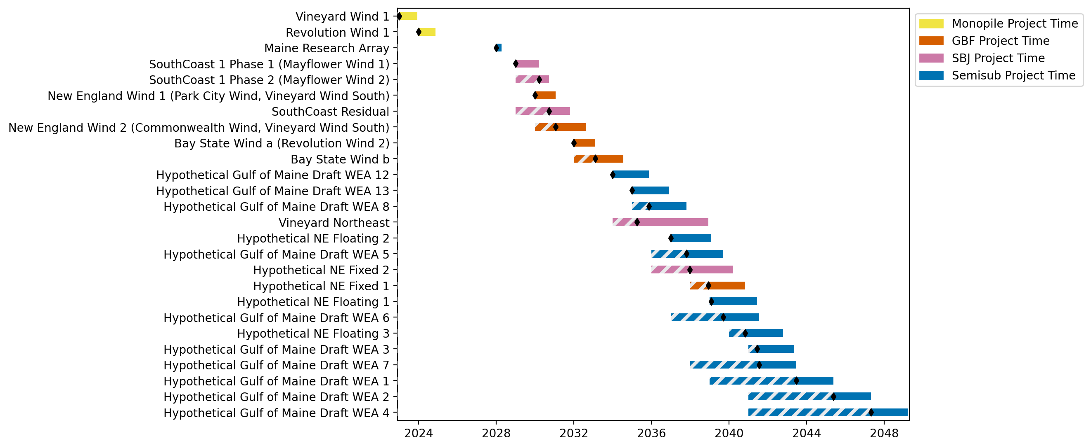
New England Gantt

Slide 3
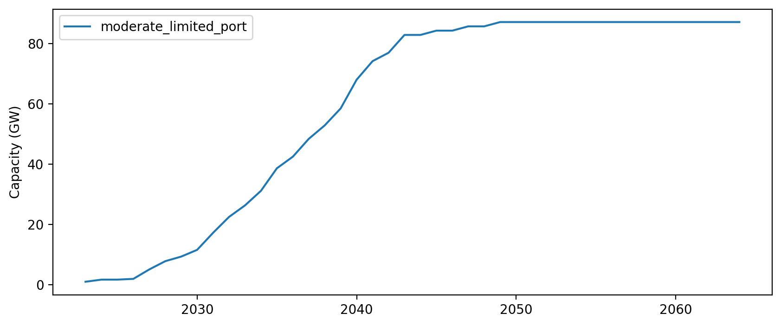
Installed Capacity

