Slide 1
low
Low Deployment Scenario

Slide 2
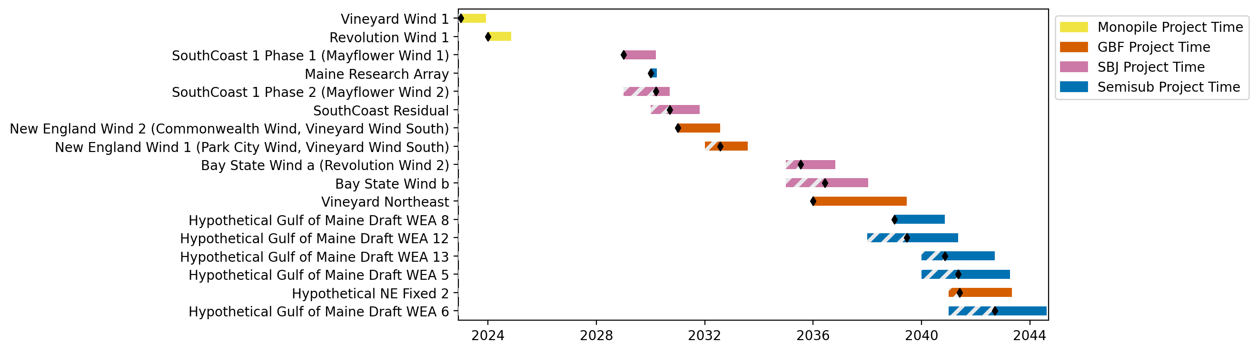
New England Gantt

Slide 3
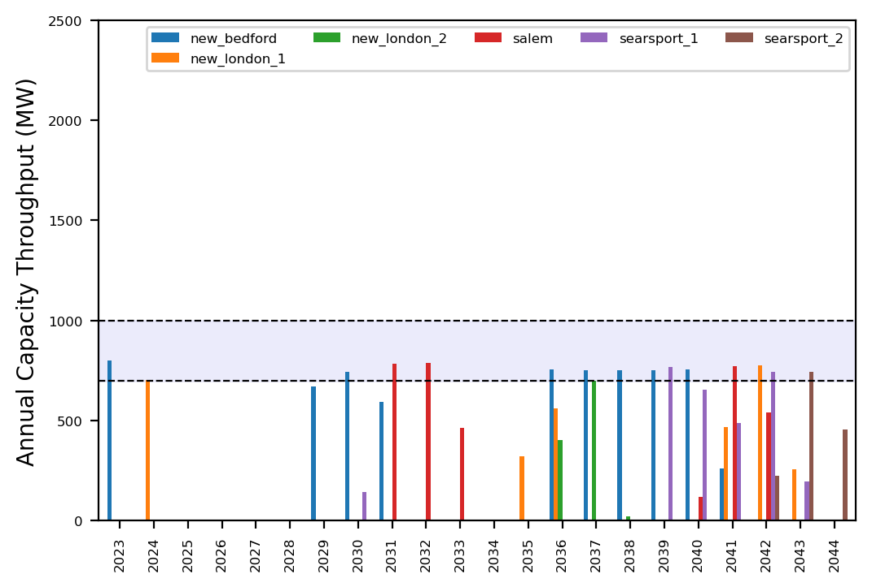
Port Throughput

Slide 4
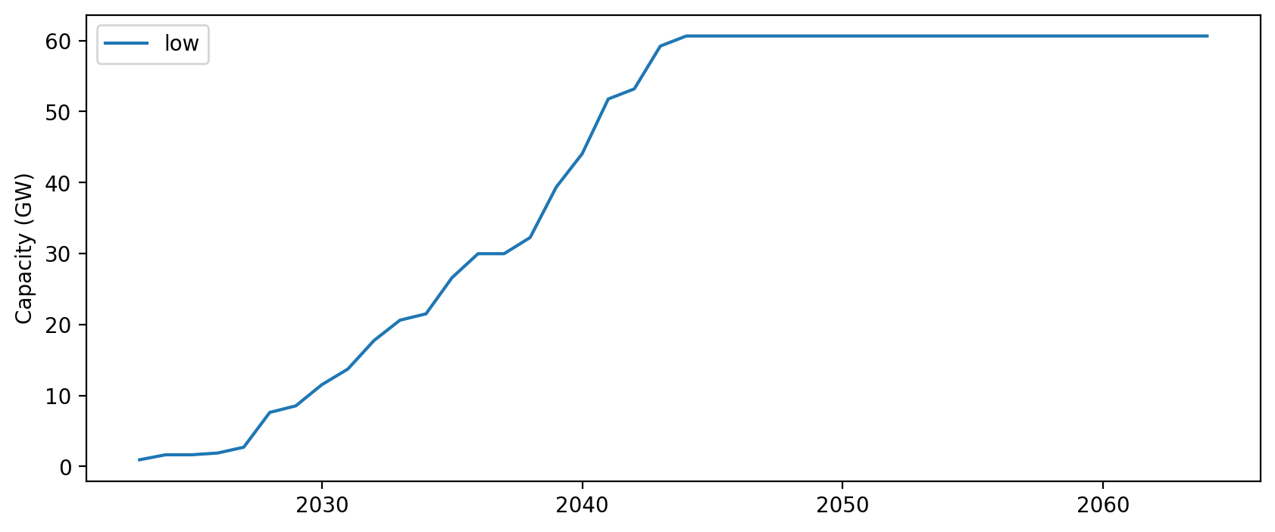
Installed Capacity

