Slide 1
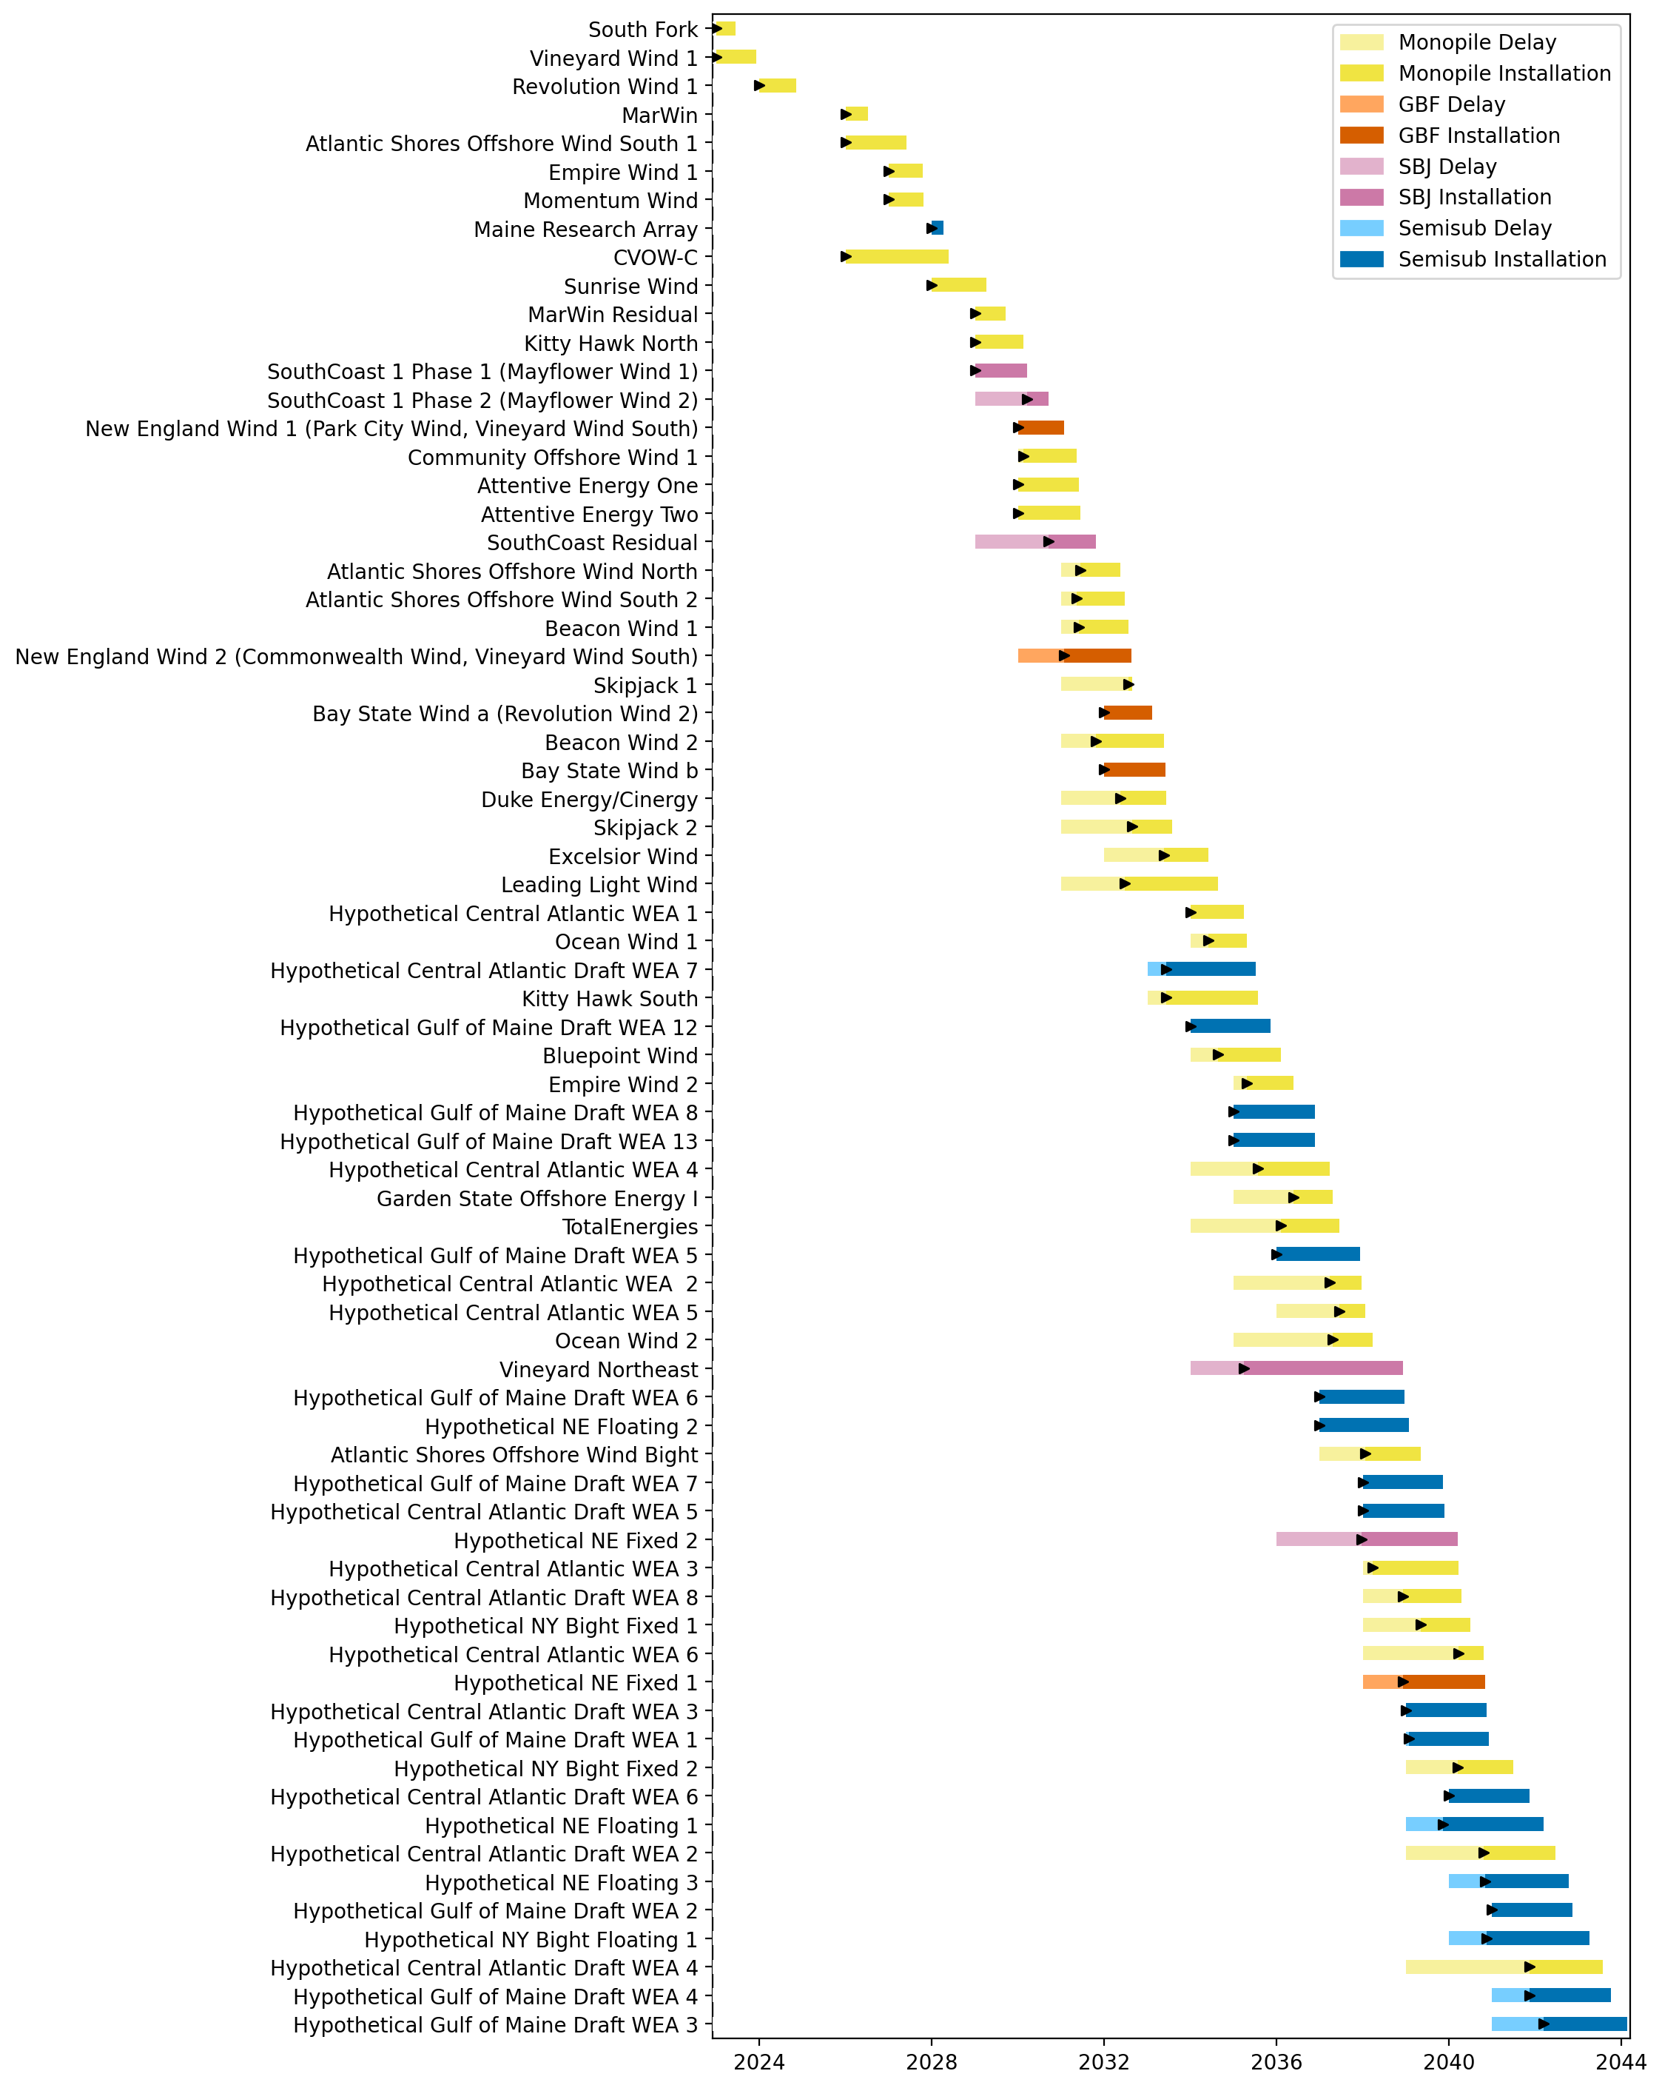
Full Gantt

Slide 2
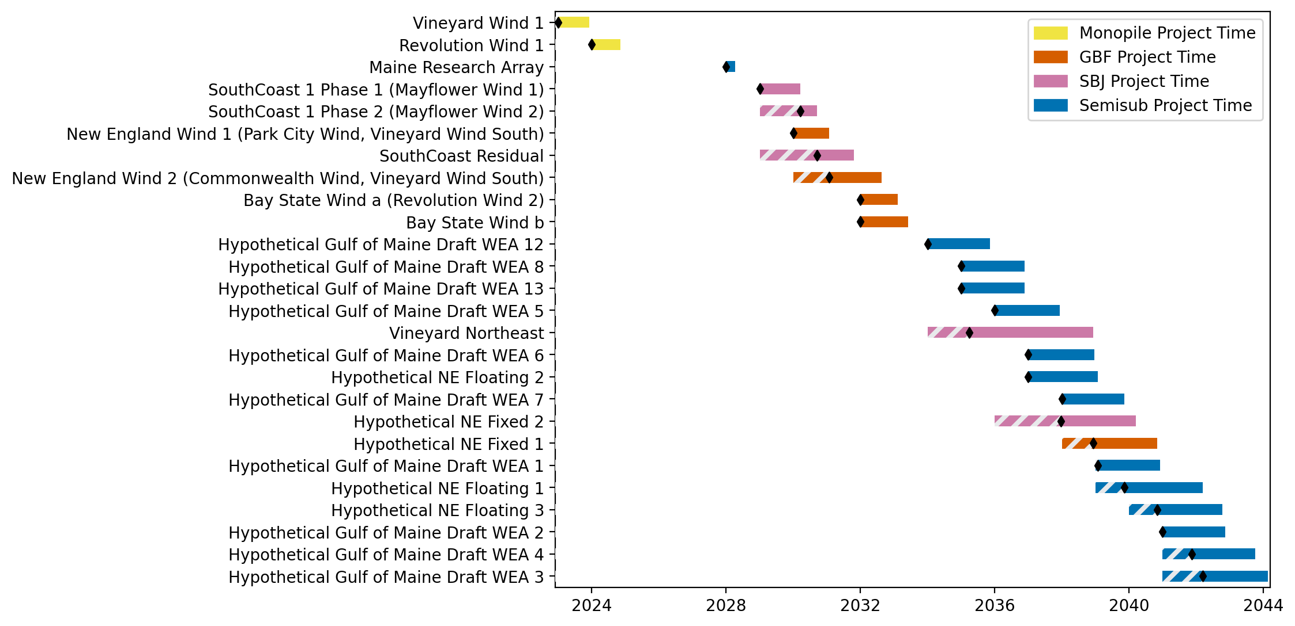
New England Gantt

Slide 3
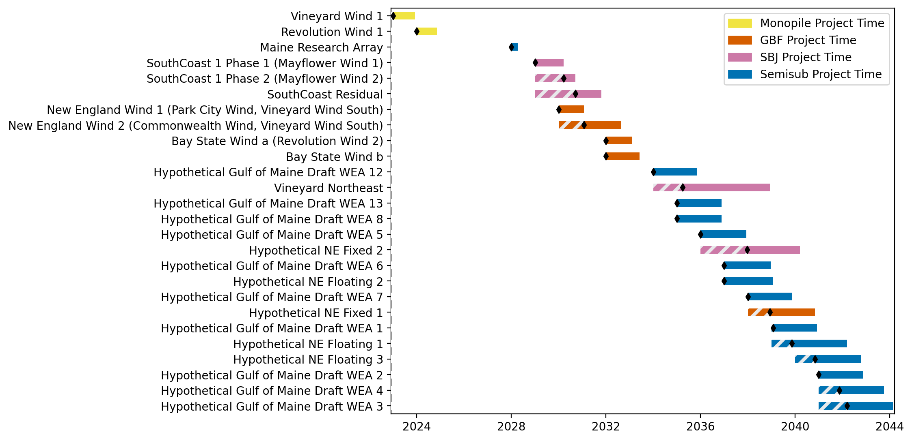
Sorted New England Gantt

Slide 4
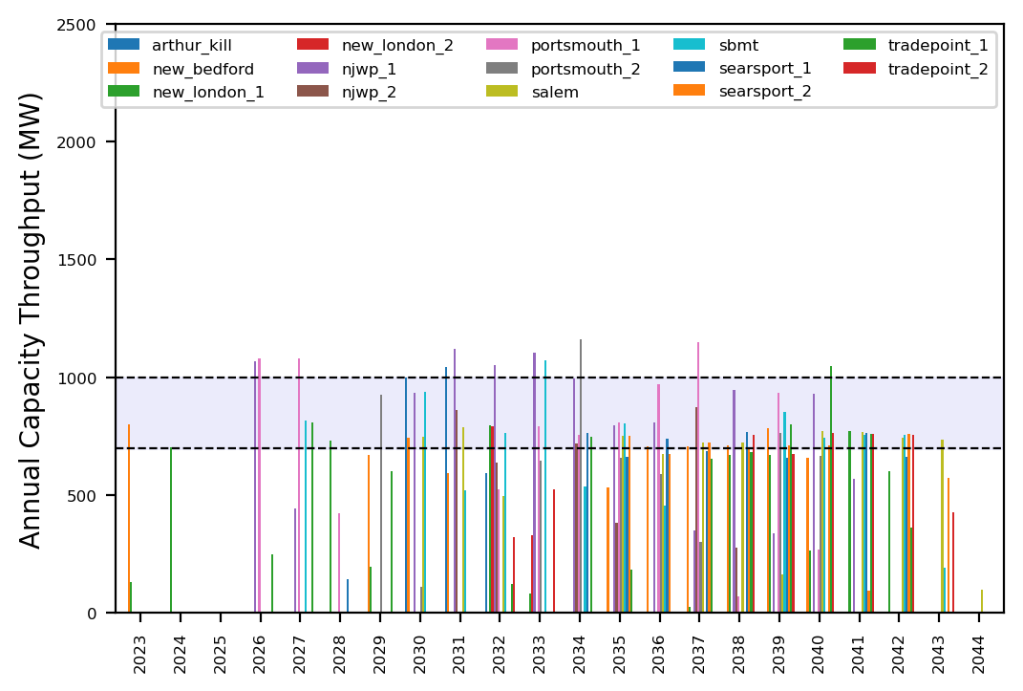
Port Throughput

Slide 5
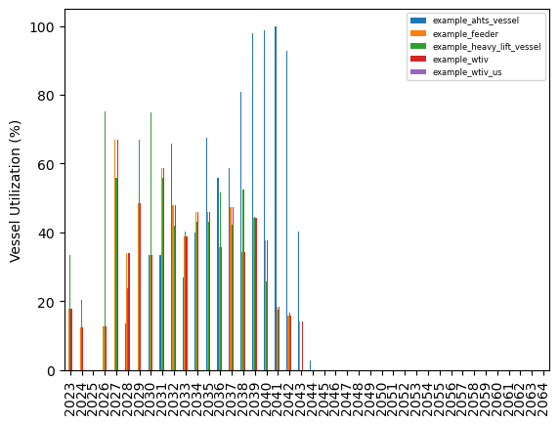
Vessel Utilization

Slide 6
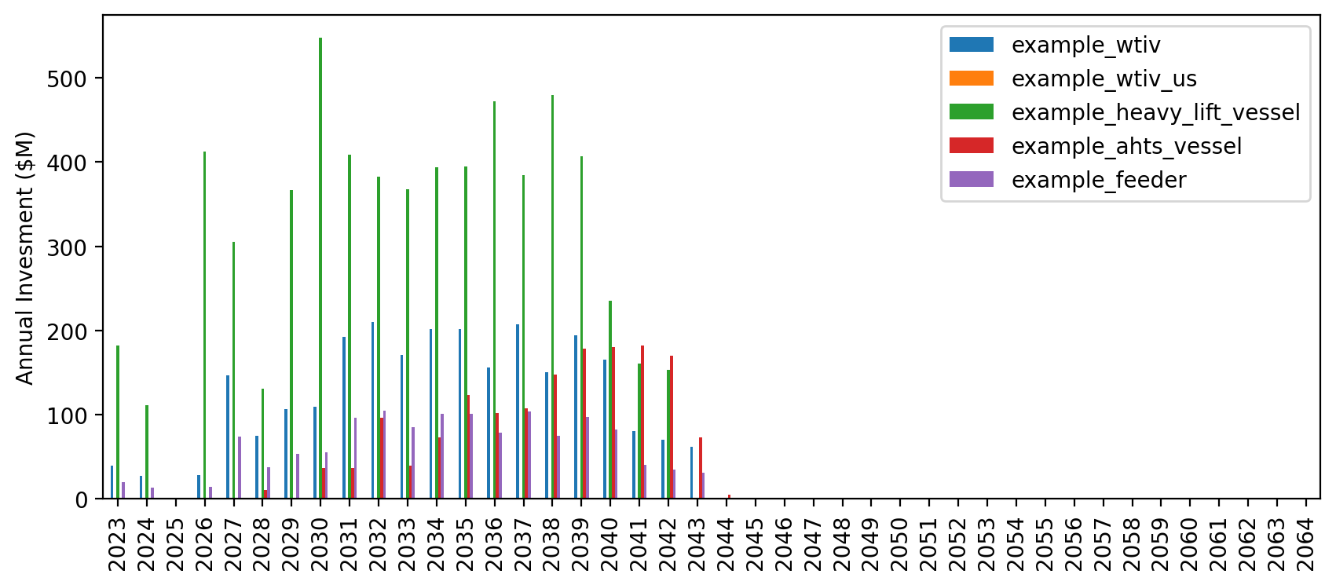
Vessel Revenue

Slide 7
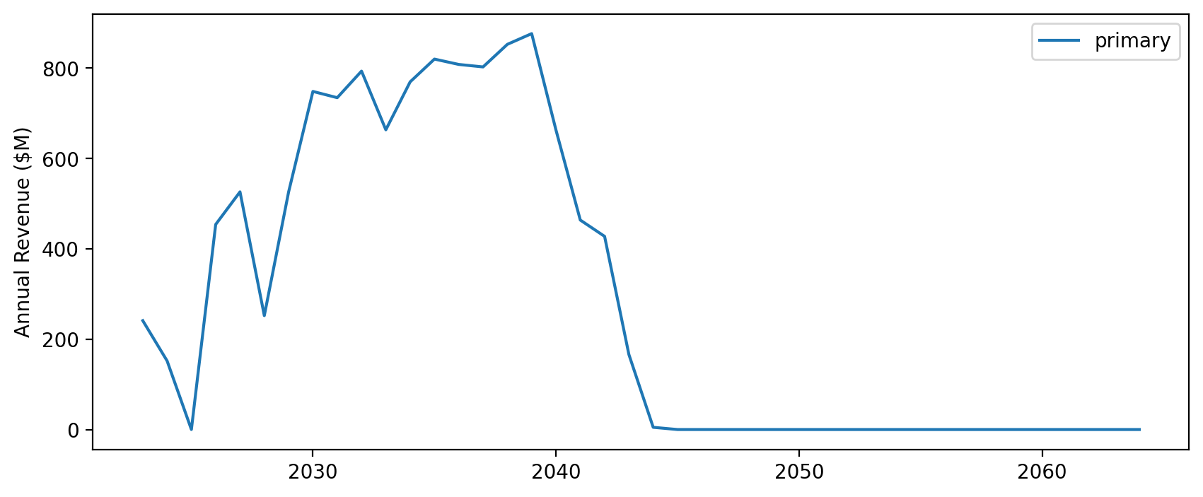
Vessel Revenue by Scenario

Slide 8
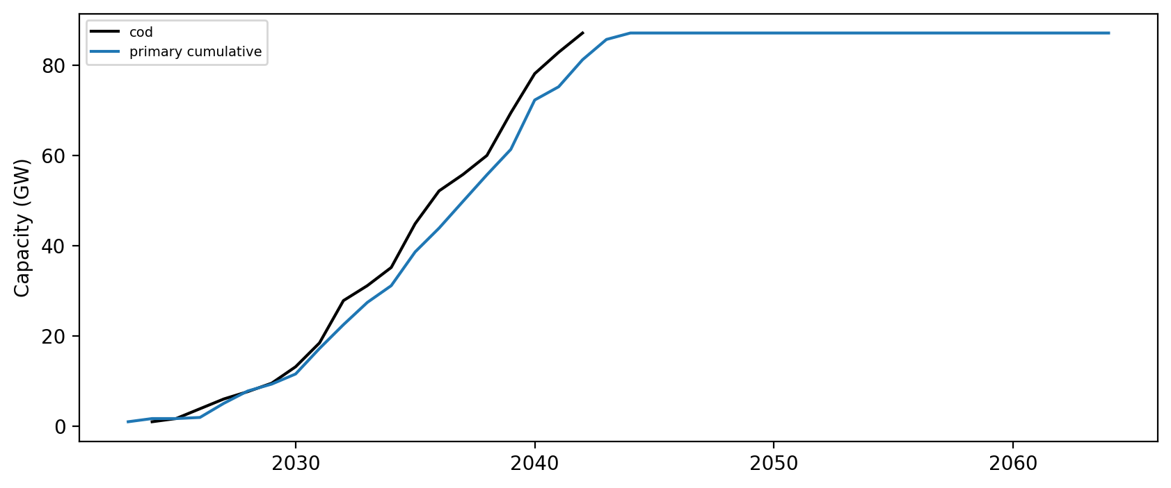
Installed Capacity

Slide 9
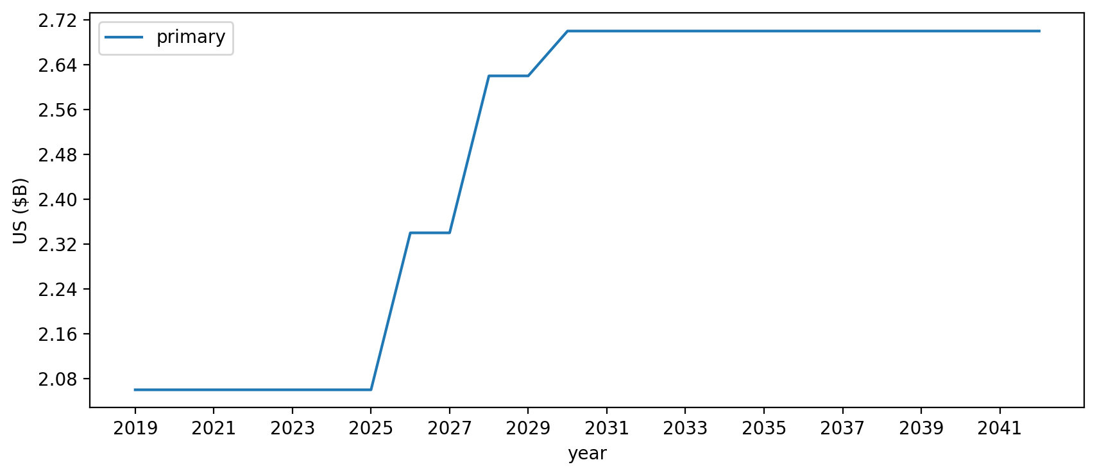
Vessel investment

Slide 10
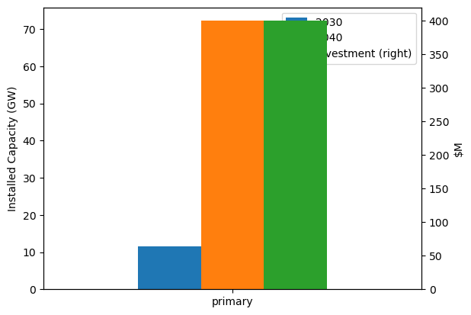
Summary Installed Cap/Investment

