Slide 1
natl_gaps_infv_test
t
e
x
t

Slide 2
natl_gaps_infv
t
e
x
t

Slide 3
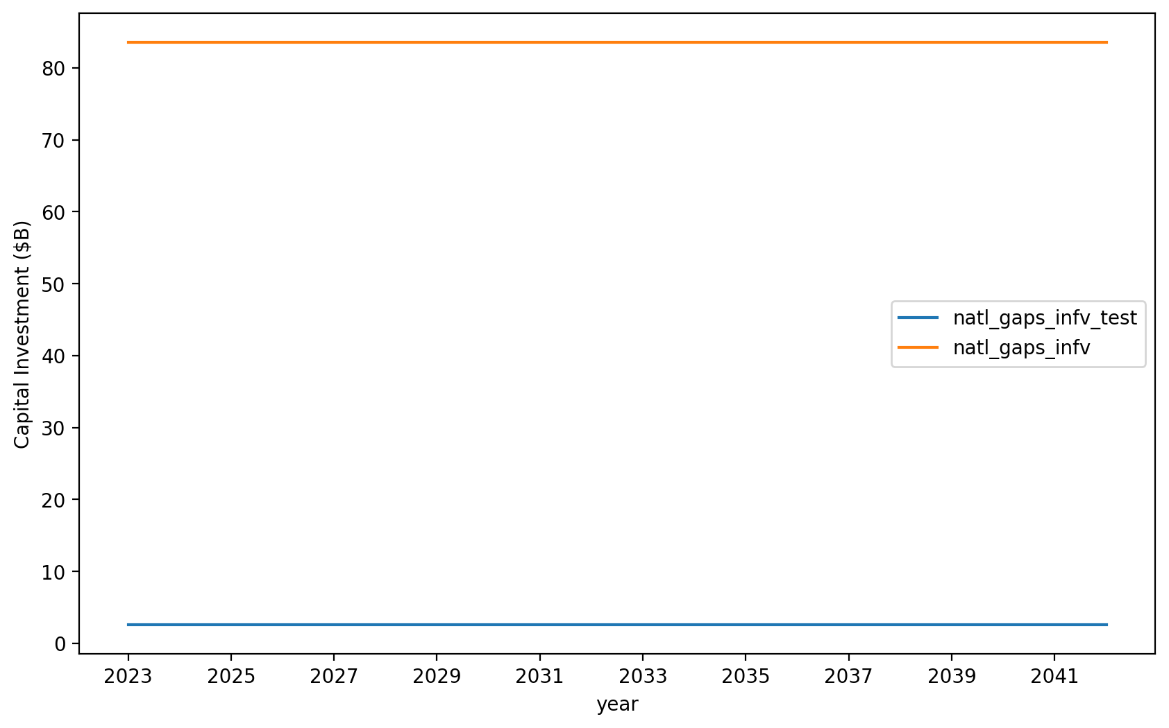
Vessel Investment

Slide 4
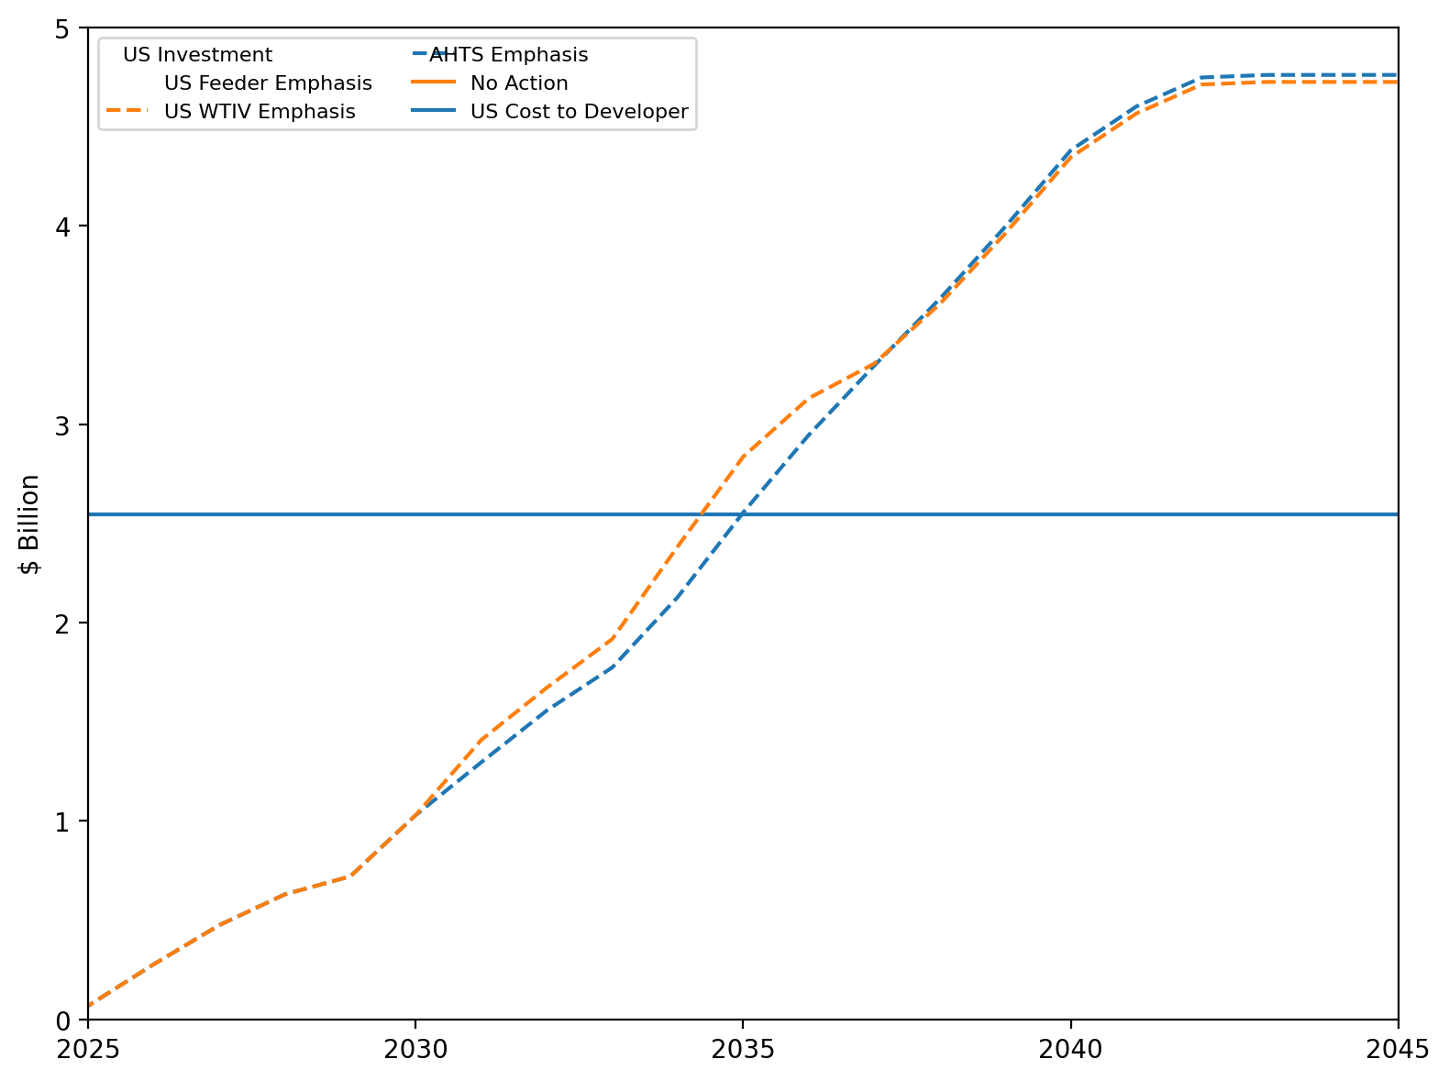
US Investment Summary

Slide 5
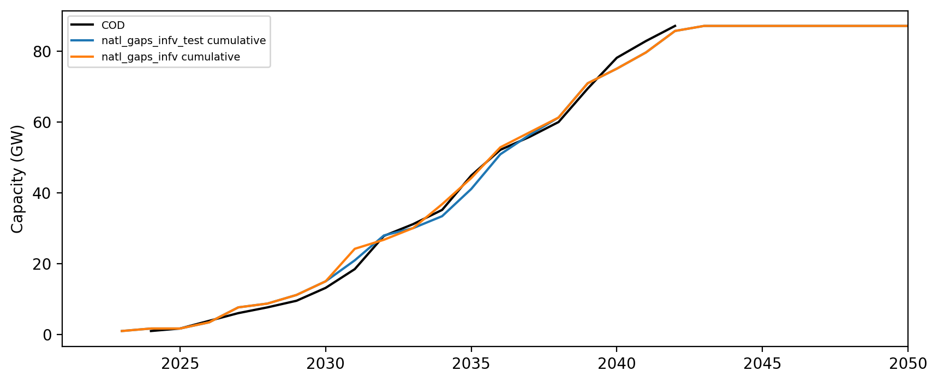
Installed Capacity

Slide 6
Installed Capacity

Slide 7
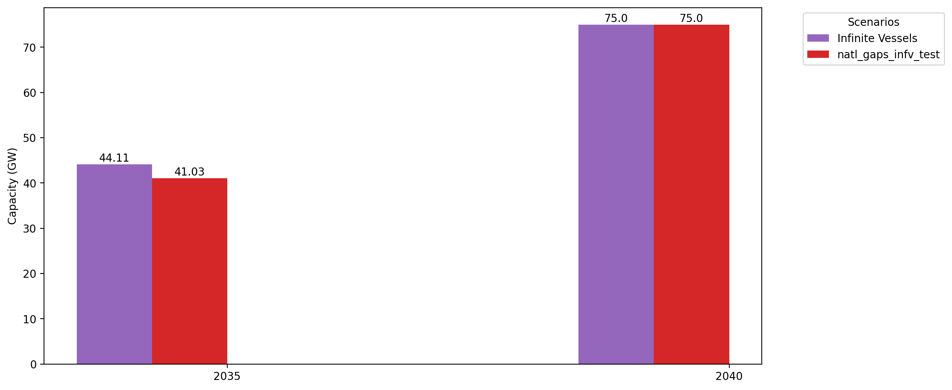
Cumulative Capacity by 2035 and 2040

