Slide 1
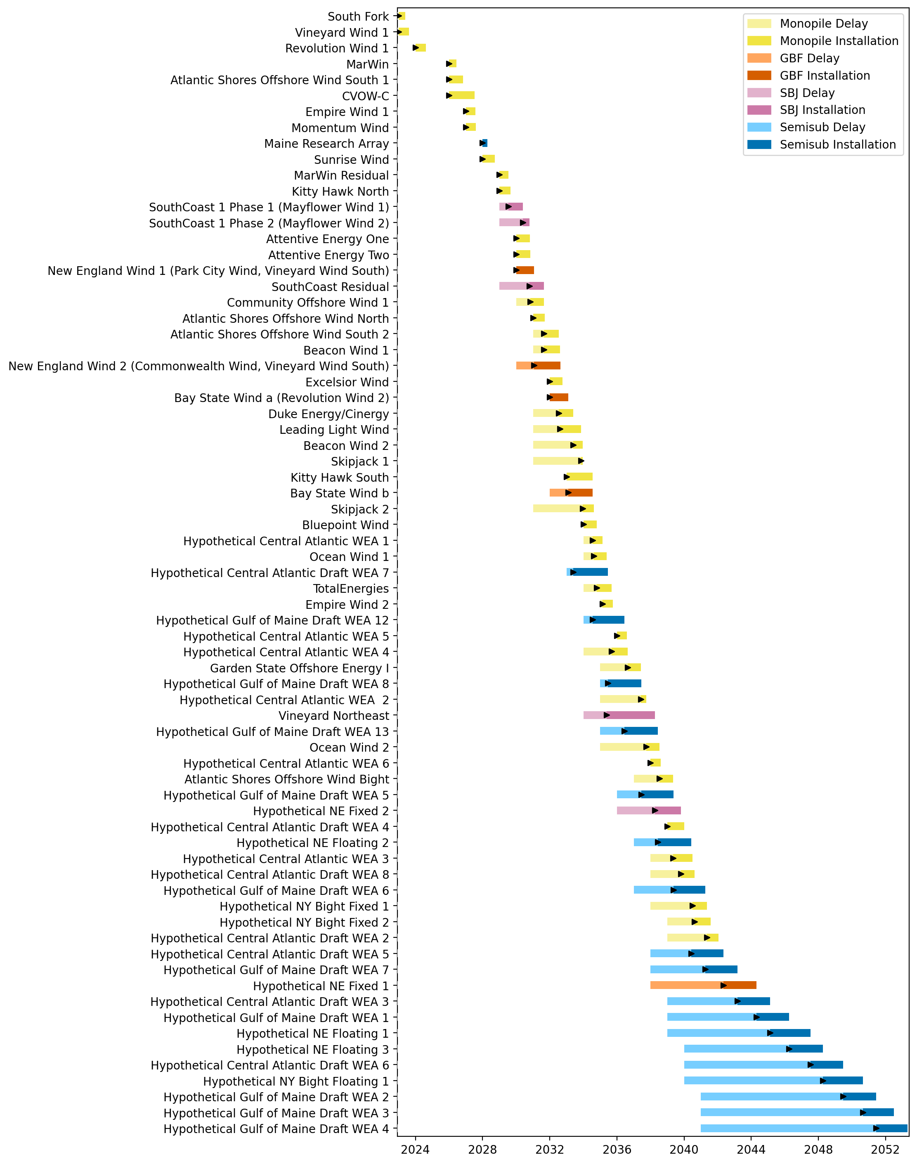
Full Gantt

Slide 2
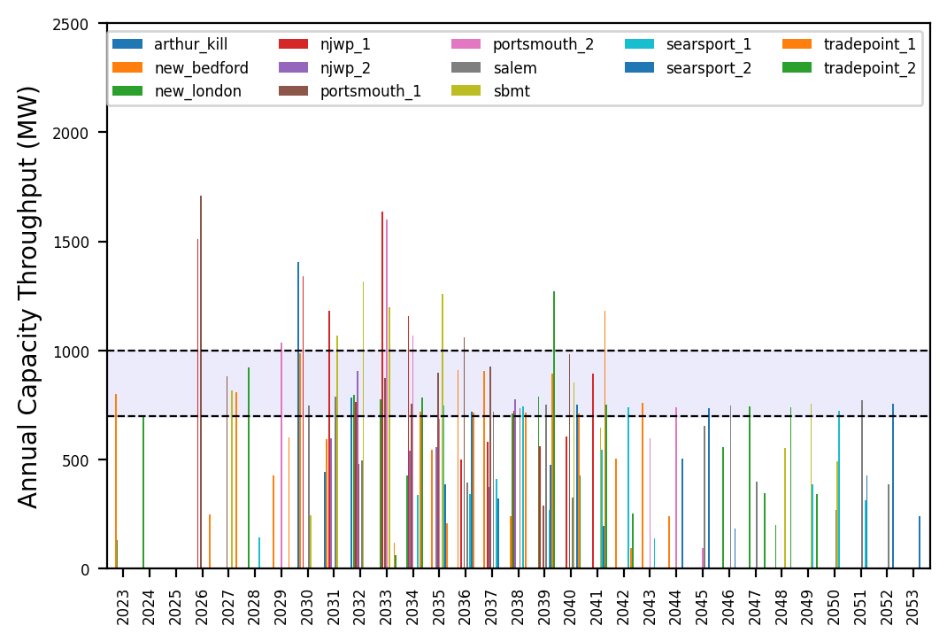
Port Throughput

Slide 3
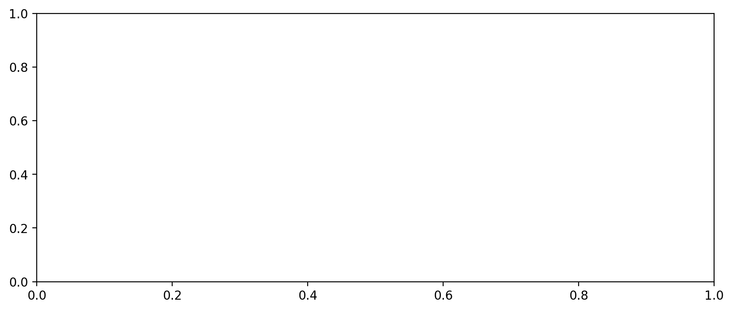
Vessel Utilization

Slide 4
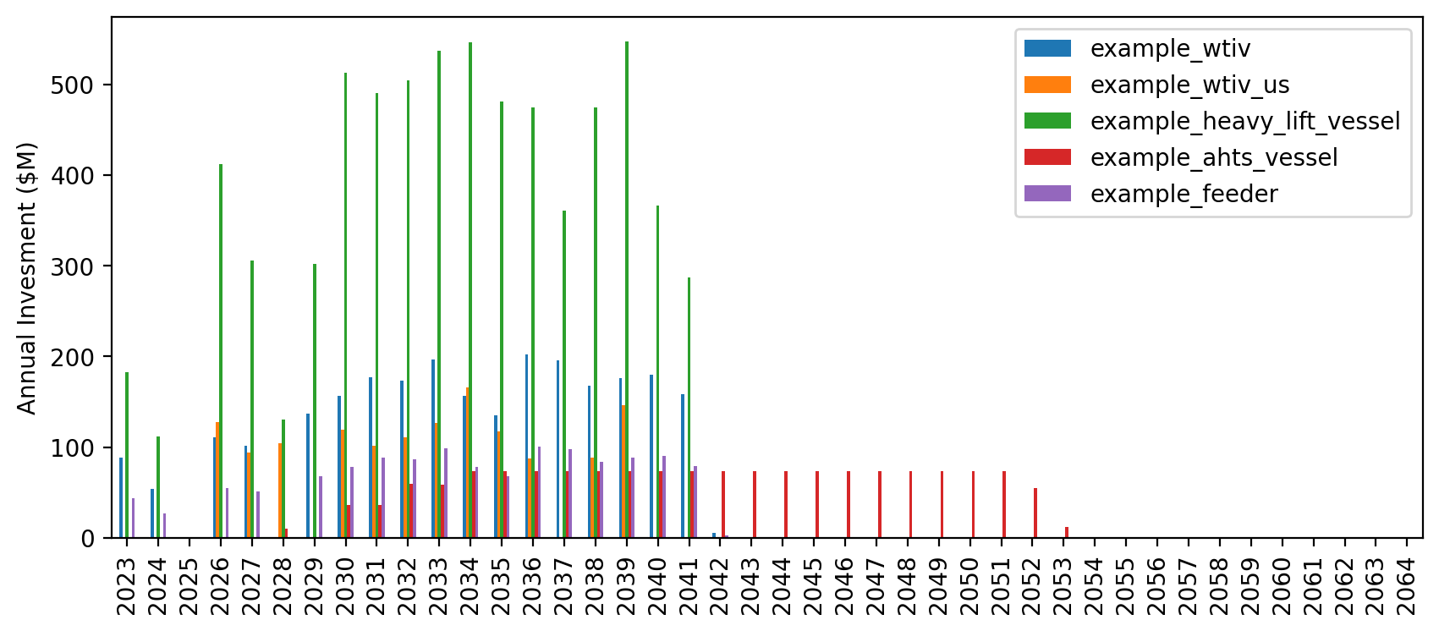
Vessel Investment

Slide 5
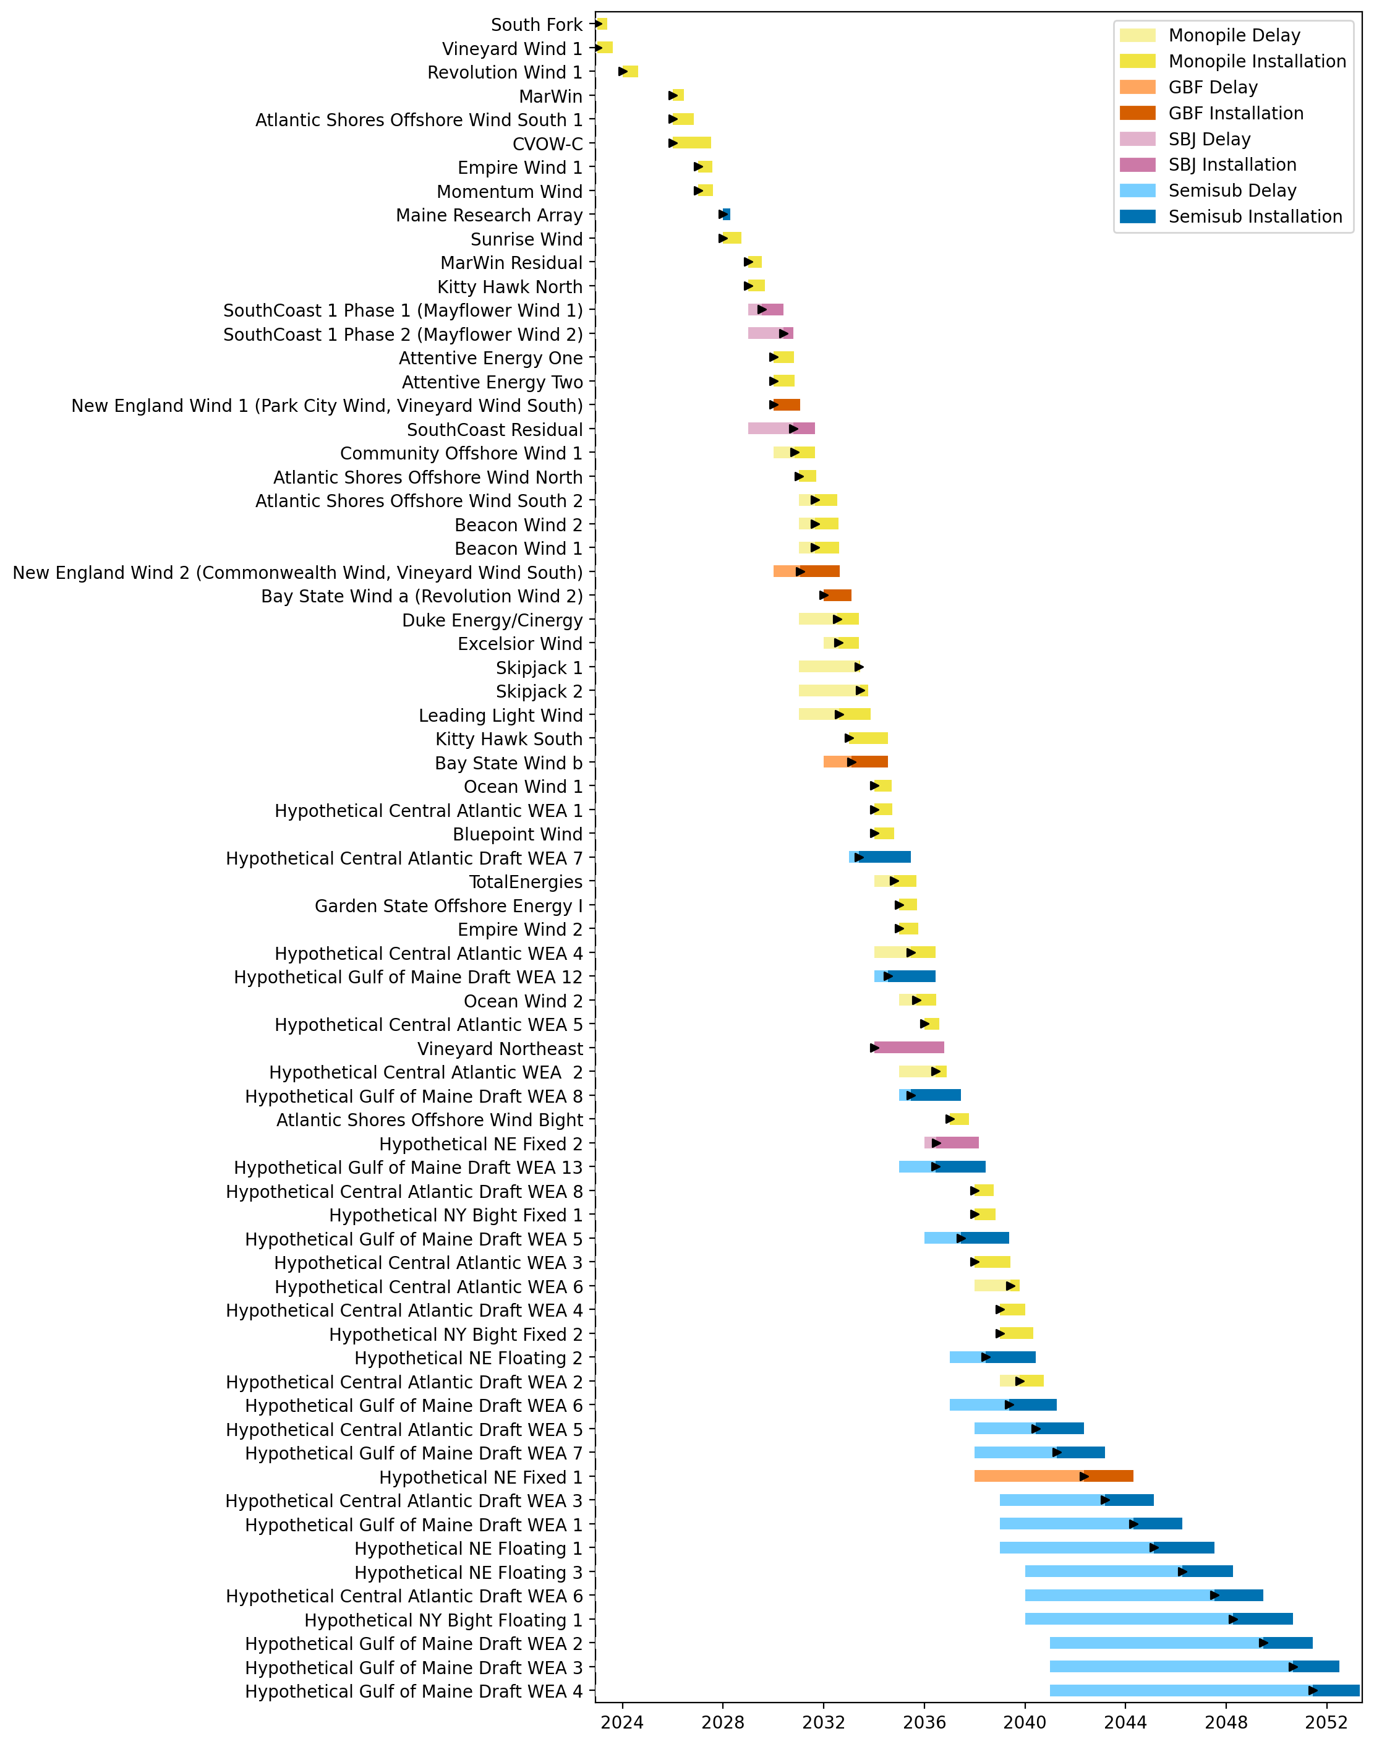
Full Gantt

Slide 6
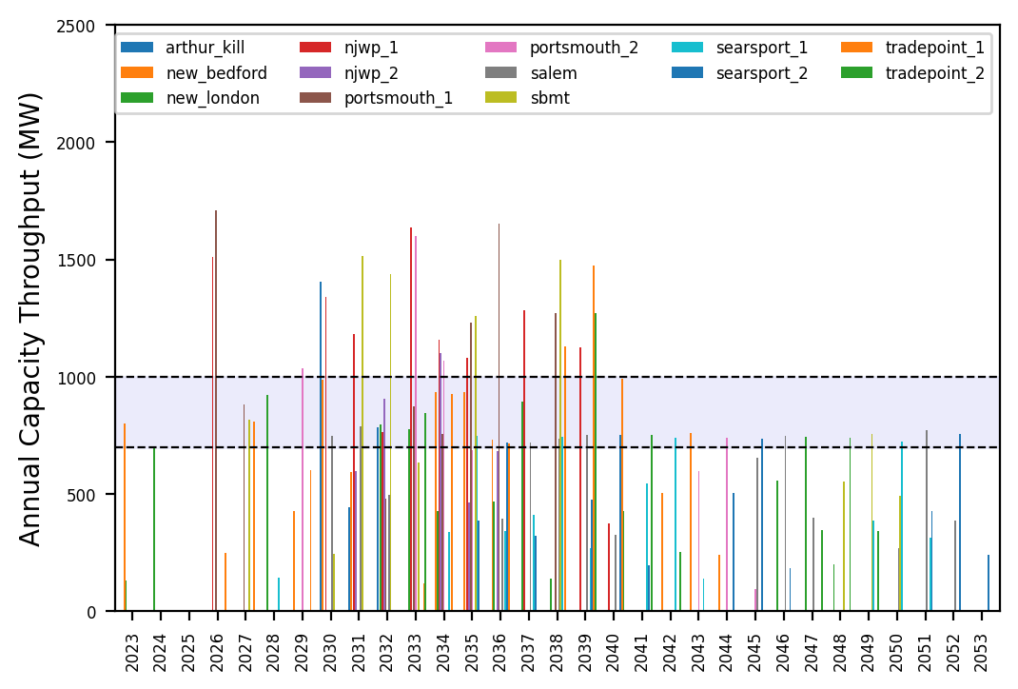
Port Throughput

Slide 7
Vessel Utilization

Slide 8
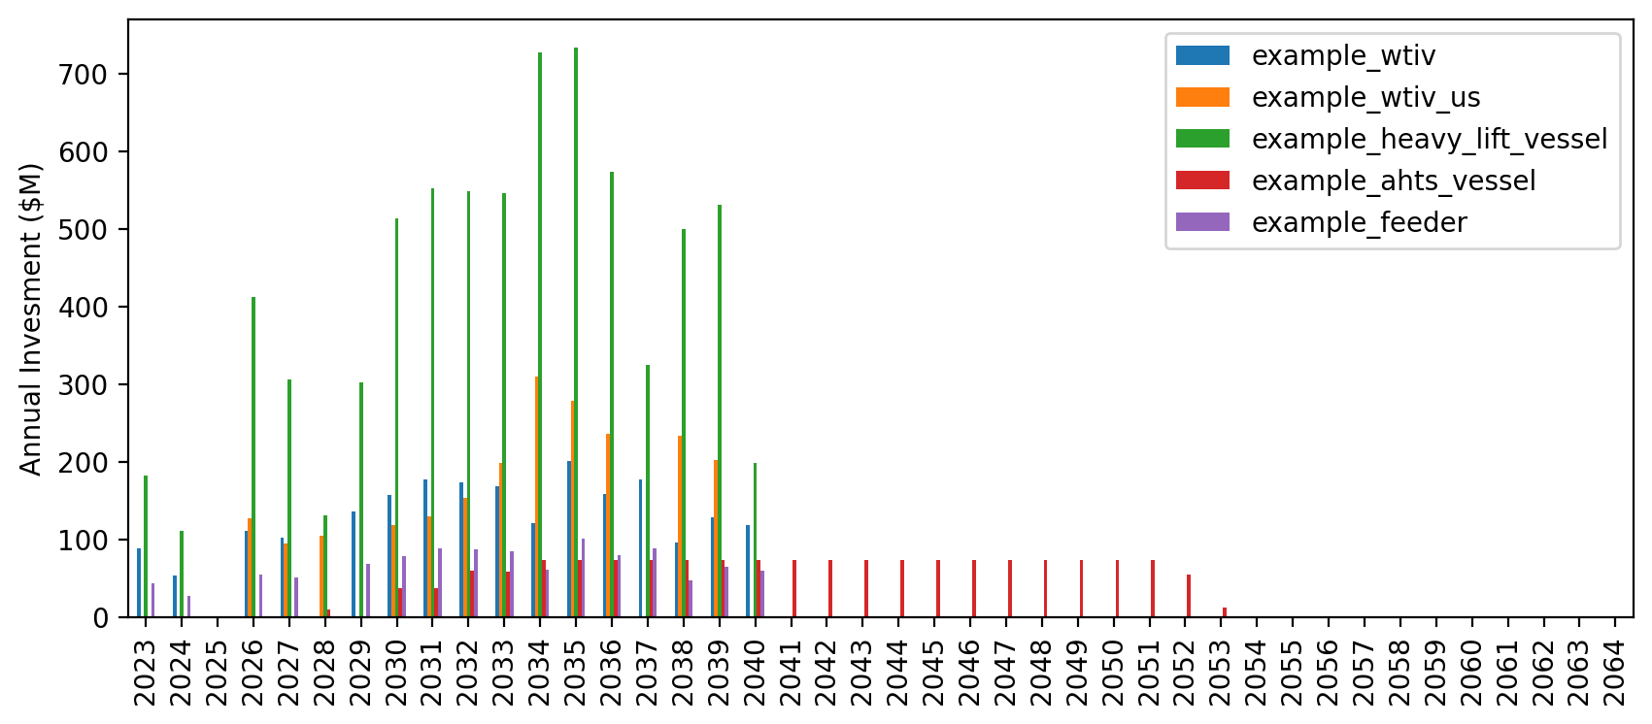
Vessel Investment

Slide 9

Full Gantt

Slide 10
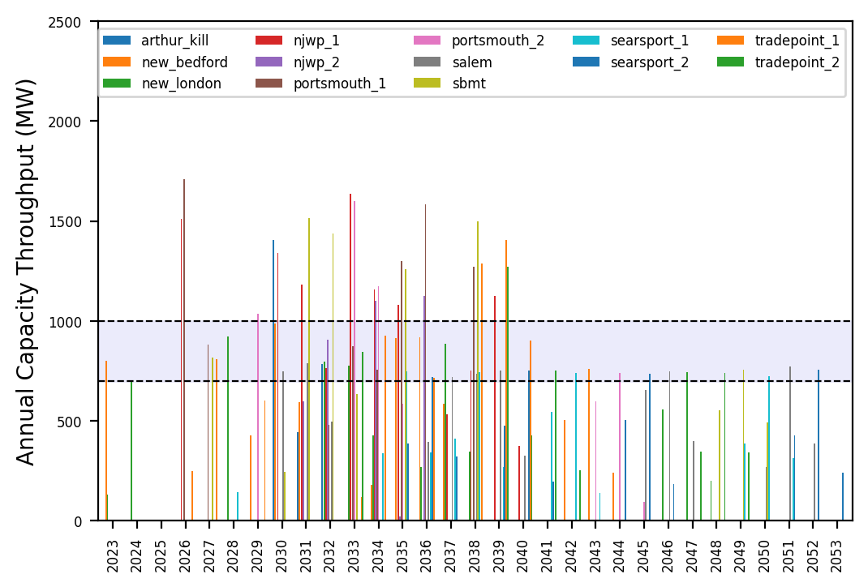
Port Throughput

Slide 11
Vessel Utilization

Slide 12
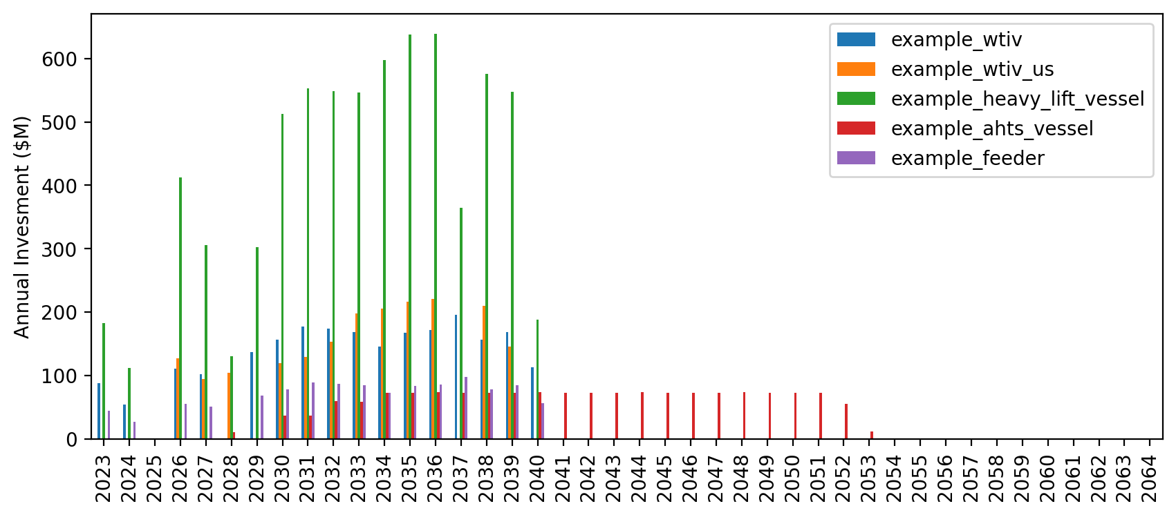
Vessel Investment

Slide 13
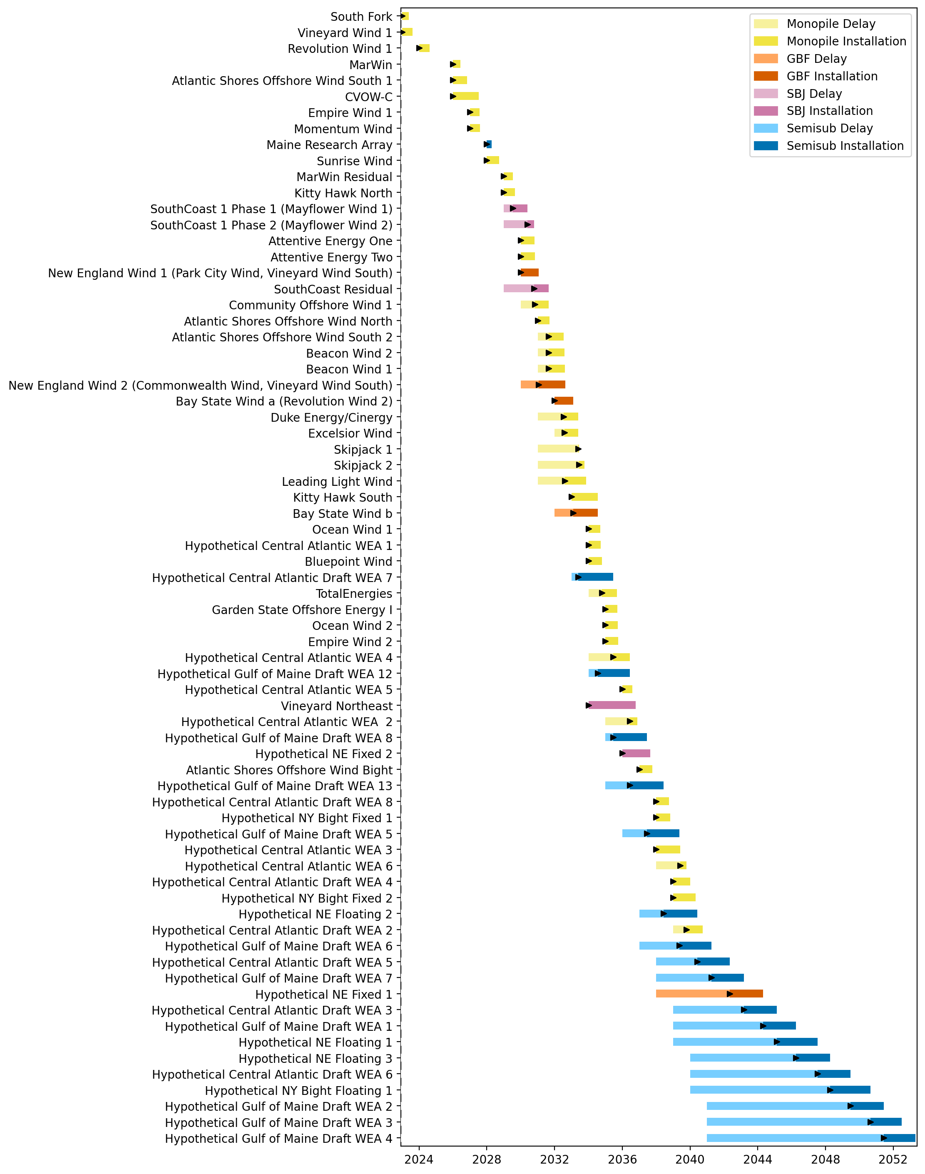
Full Gantt

Slide 14

Port Throughput

Slide 15
Vessel Utilization

Slide 16
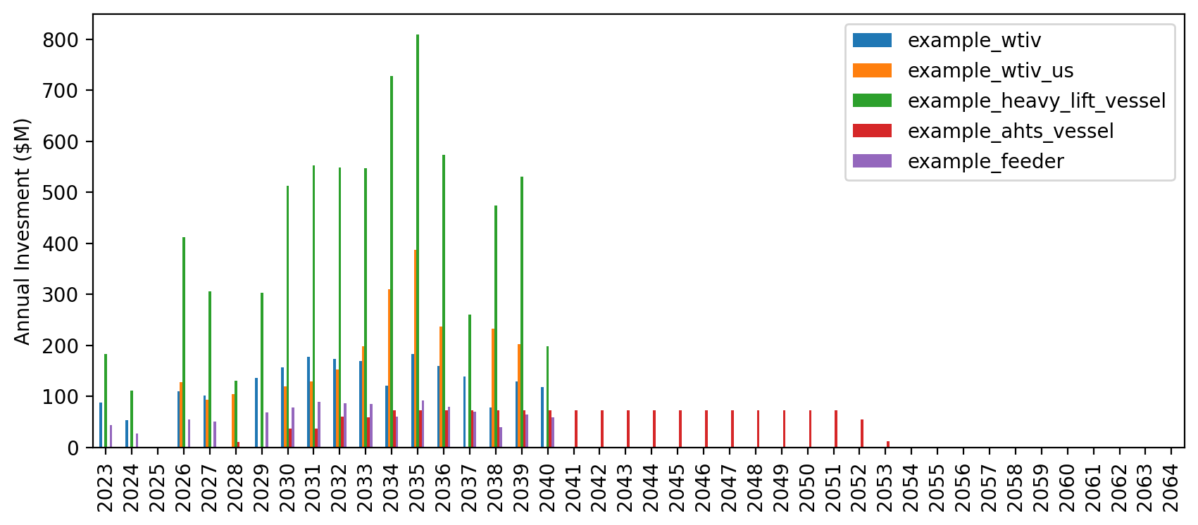
Vessel Investment

Slide 17
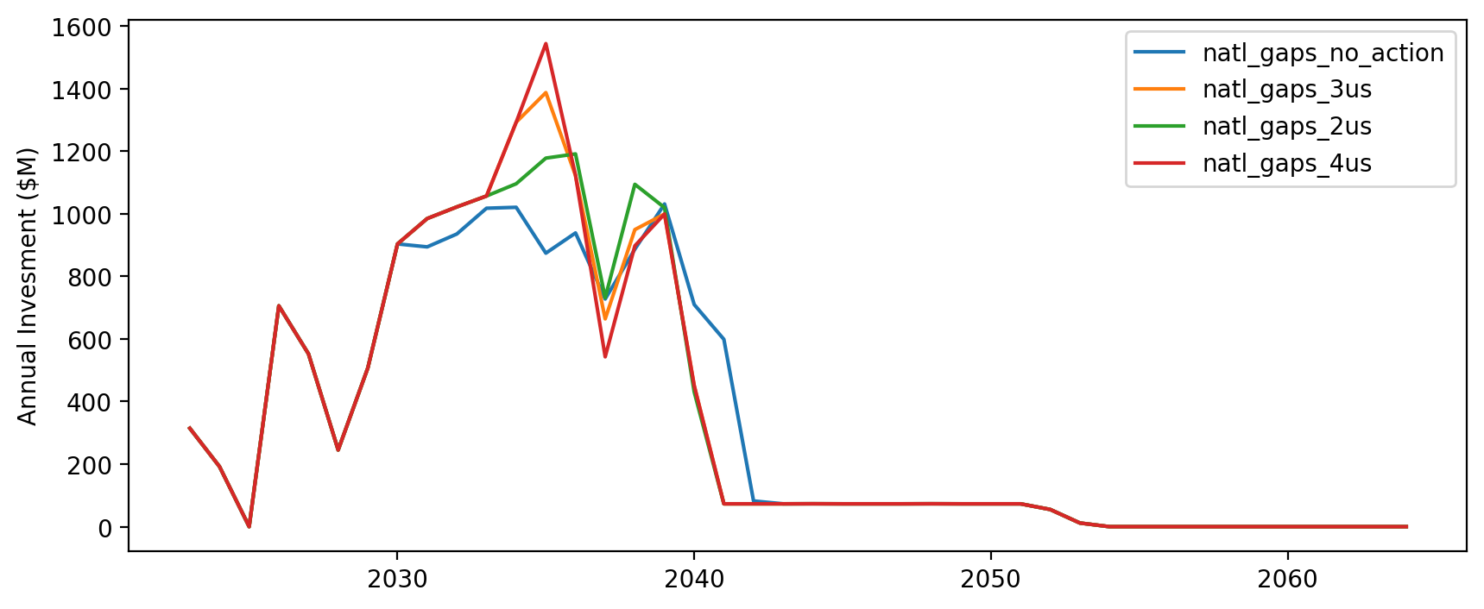
Vessel Investment by Scenario

Slide 18
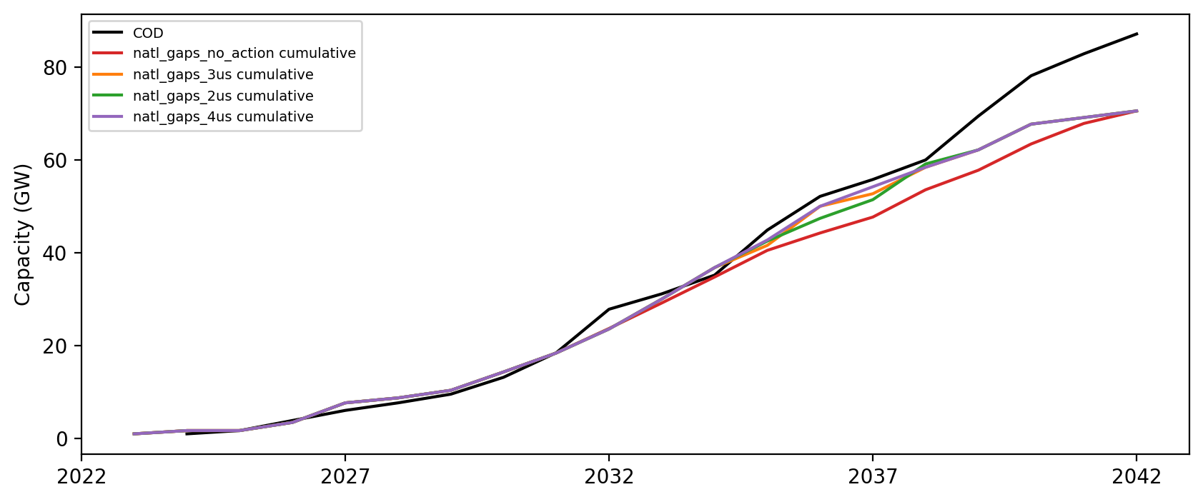
Installed Capacity

