Slide 1
infv_test
1 US WTIV starting with CVOW

Slide 2
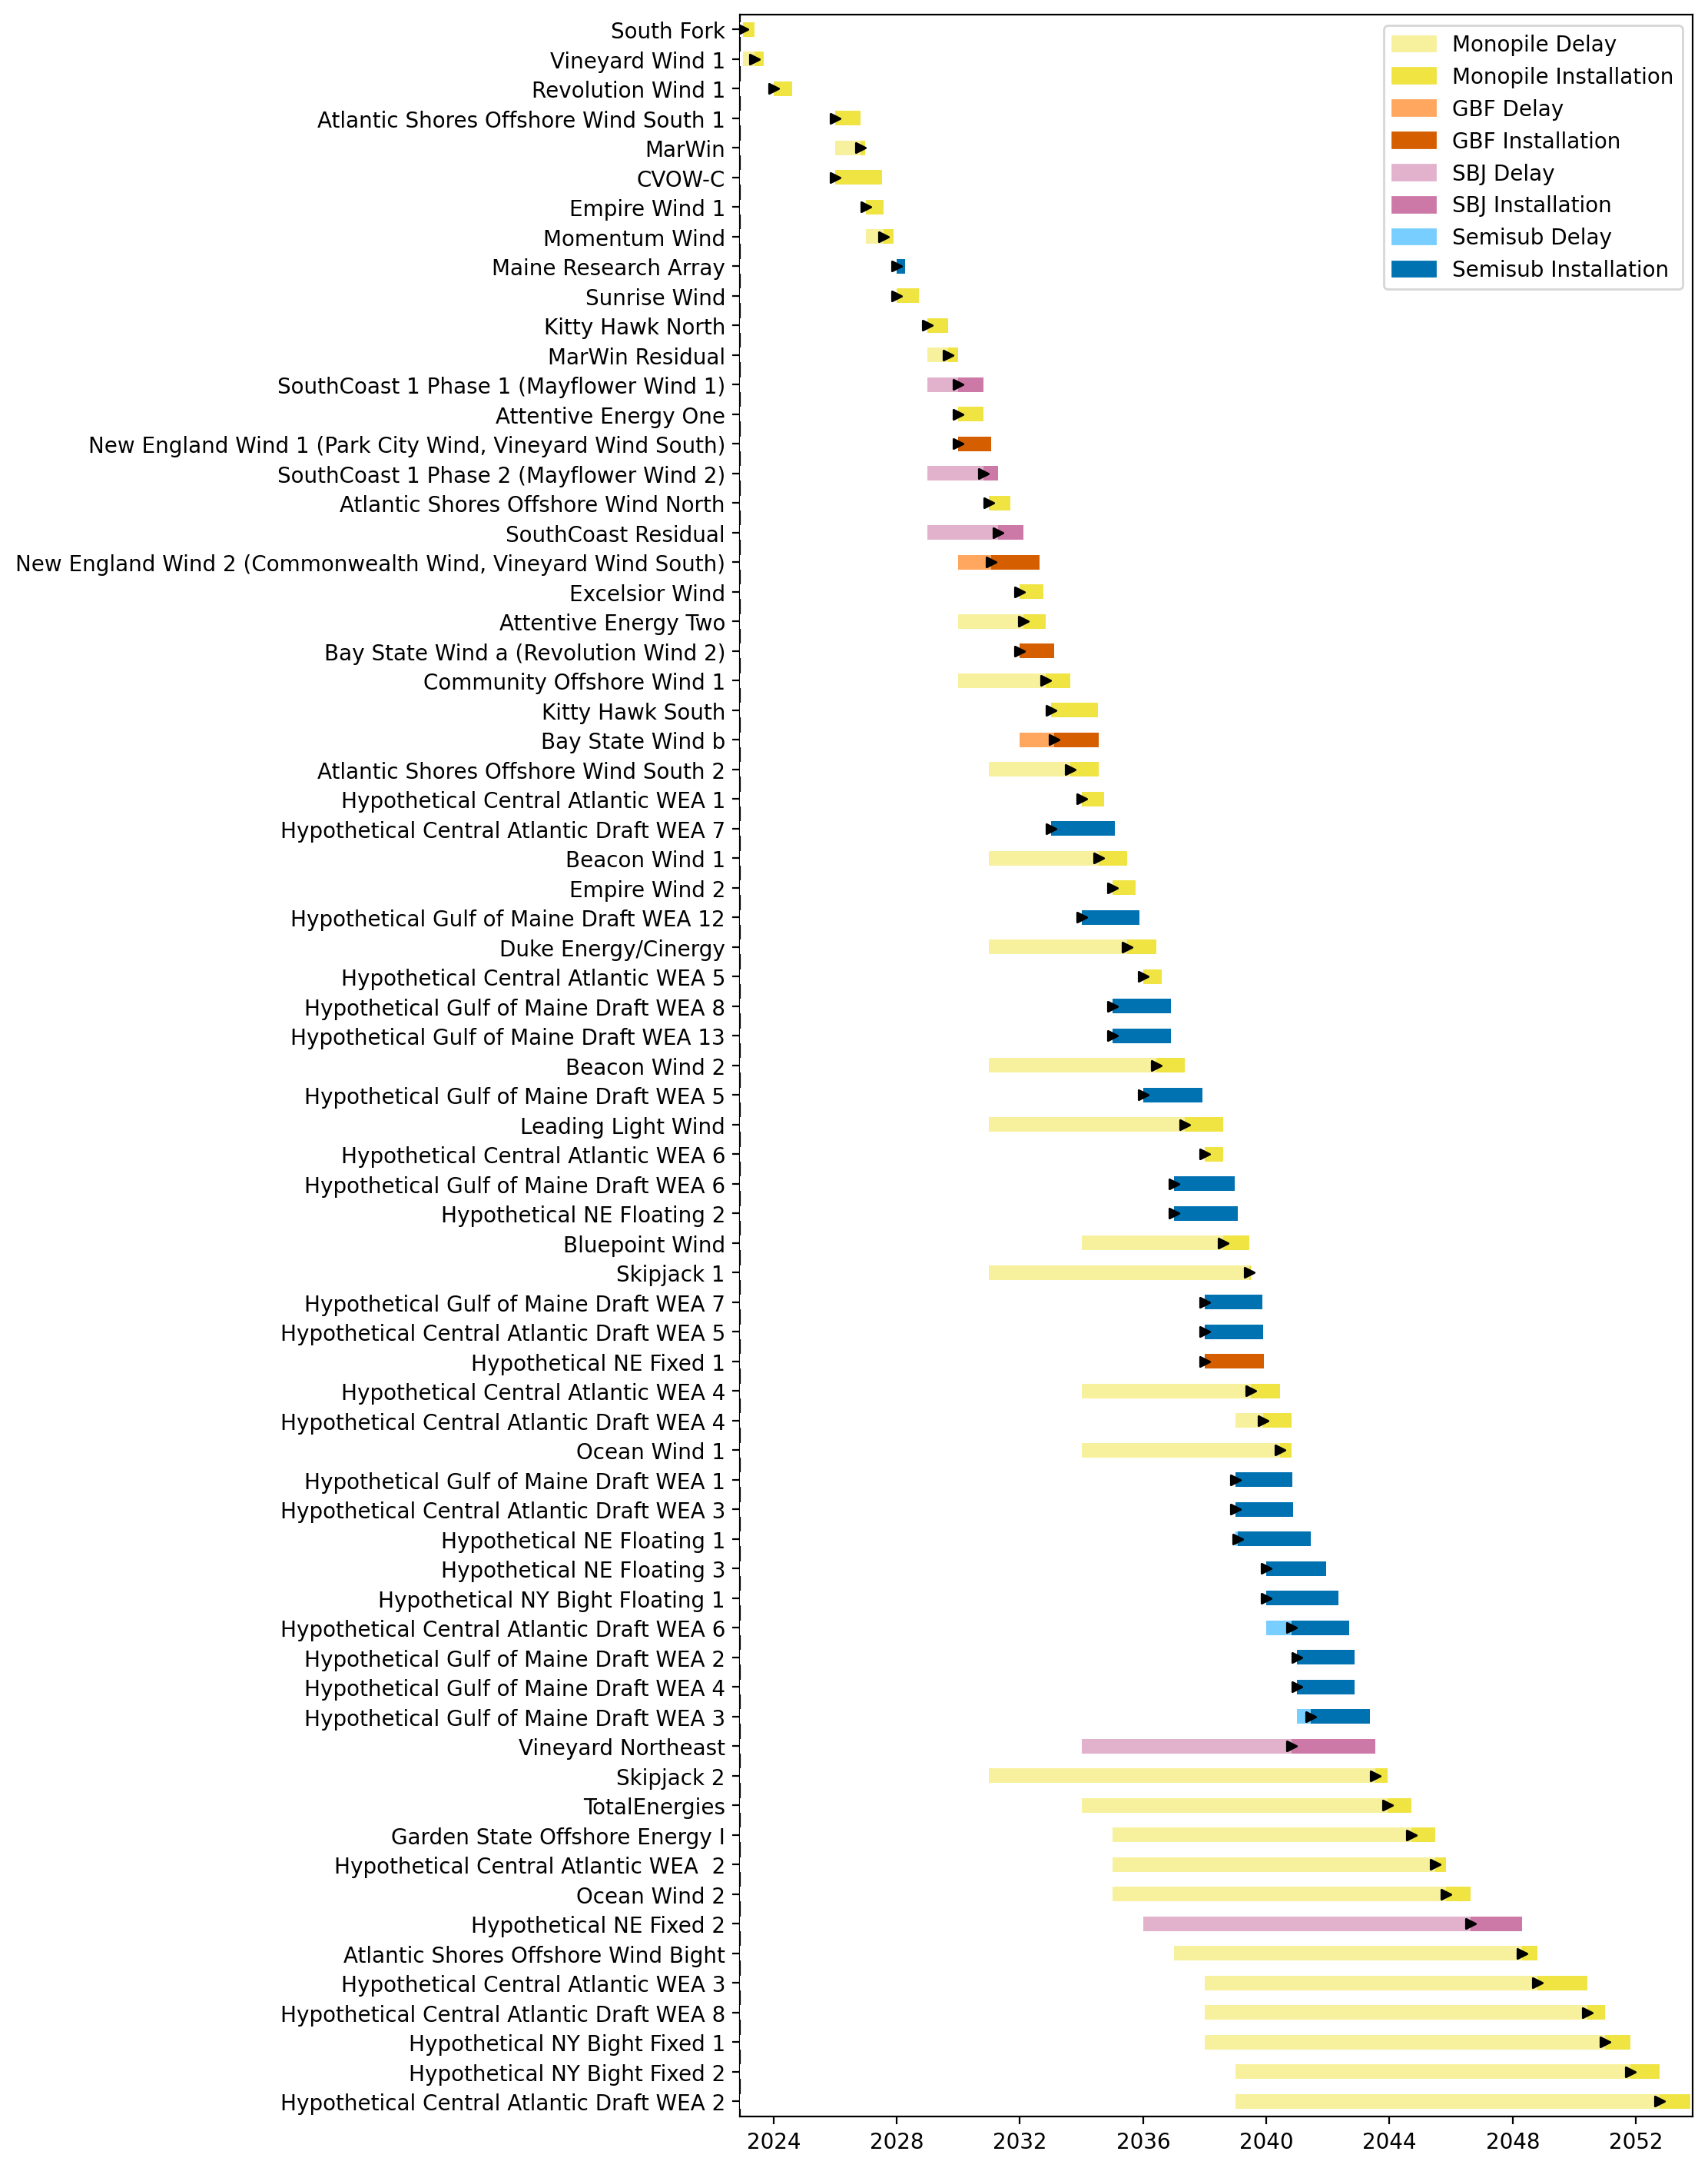
Full Gantt

Slide 3
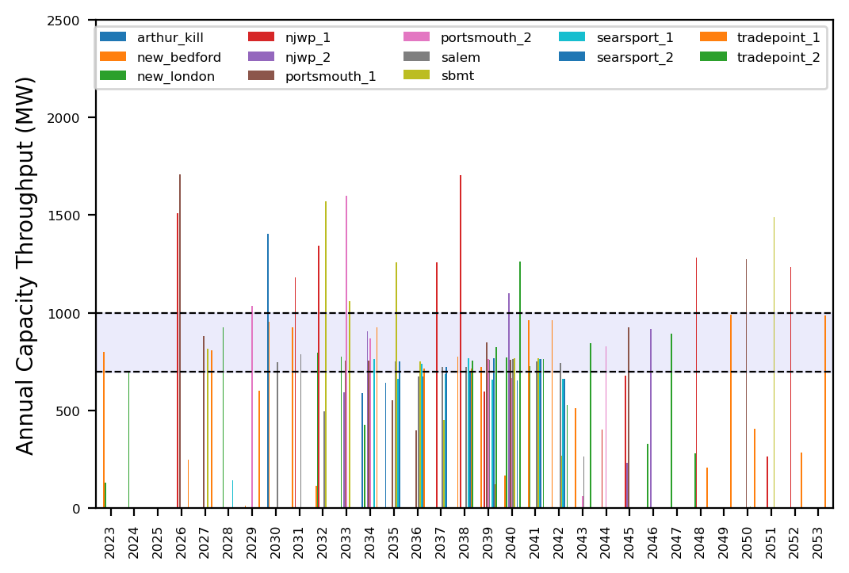
Port Throughput

Slide 4
natl_gaps_infv
Default ports, unconstrained vessels

Slide 5
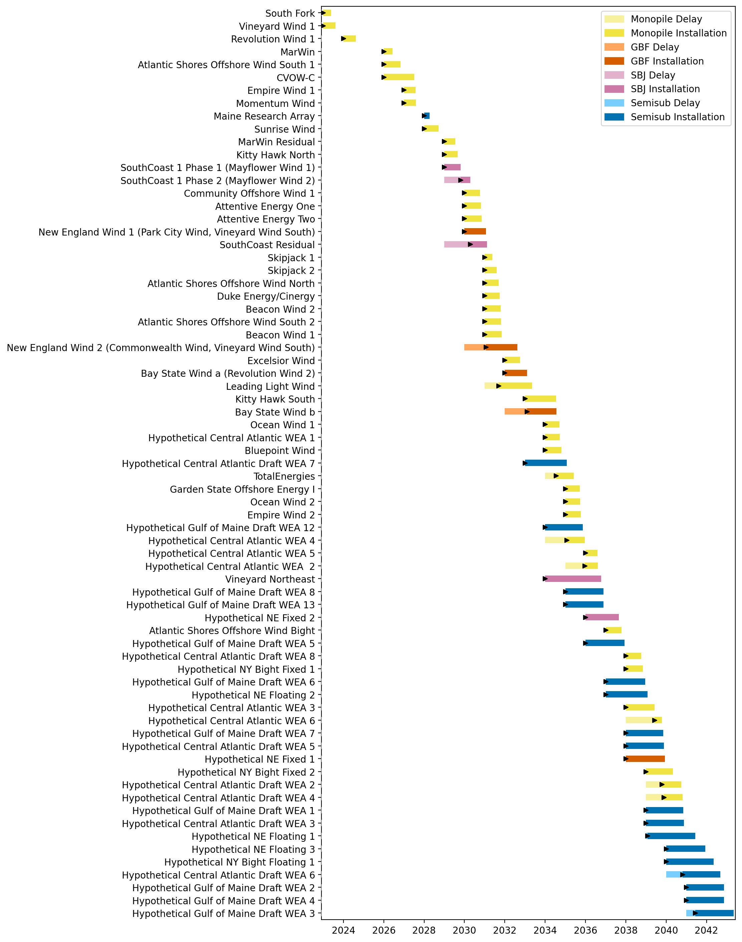
Full Gantt

Slide 6
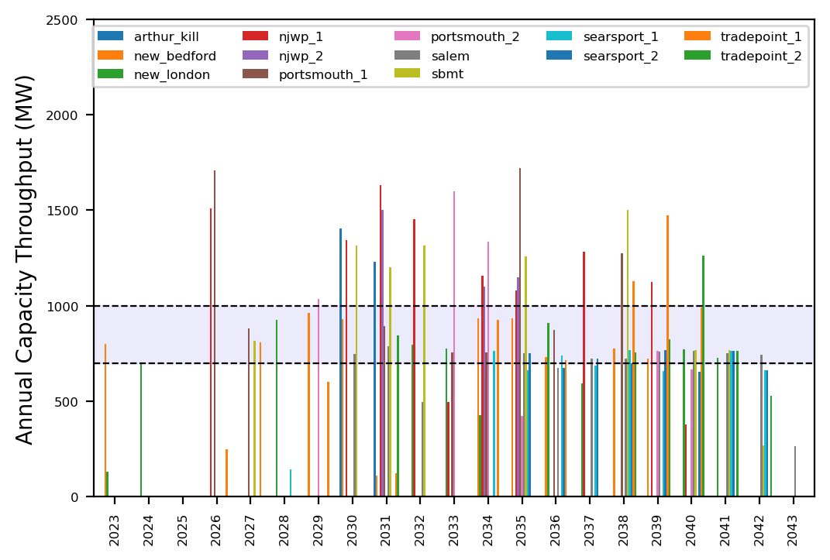
Port Throughput

Slide 7
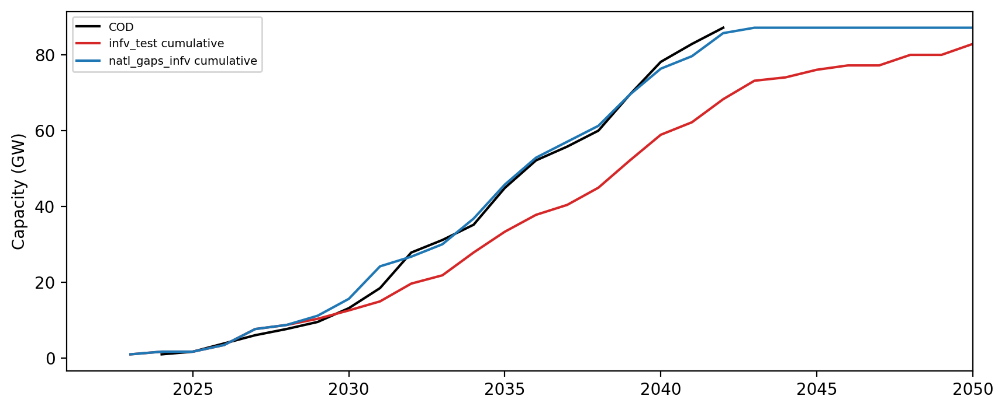
Installed Capacity

