Slide 1
low_deployment
Pipeline: Low Deployment
Vessel Pathway: Common
Port Pathway: Common

Slide 2
best_path_forward
Pipeline: Best Path Foward
Vessel Pathway: Common
Port Pathway: Common

Slide 3
high_deployment
Pipeline: High Deployment
Vessel Pathway: Common
Port Pathway: Common

Slide 4
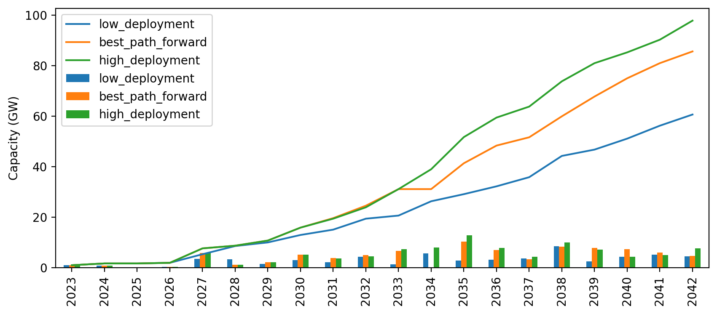
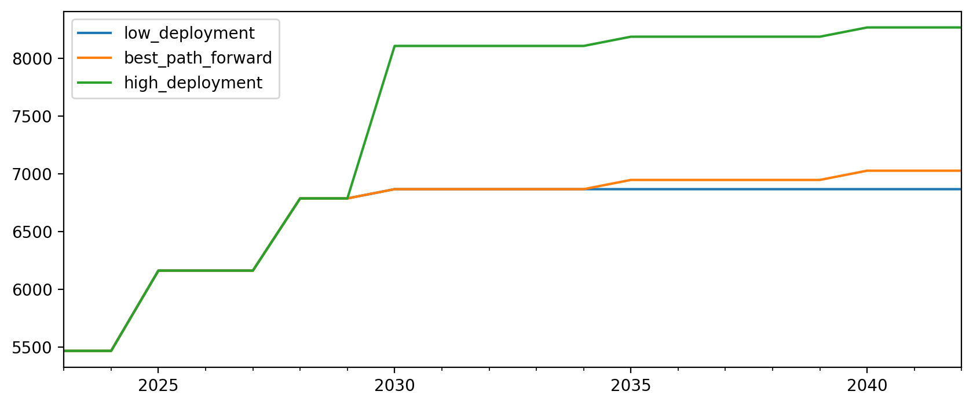
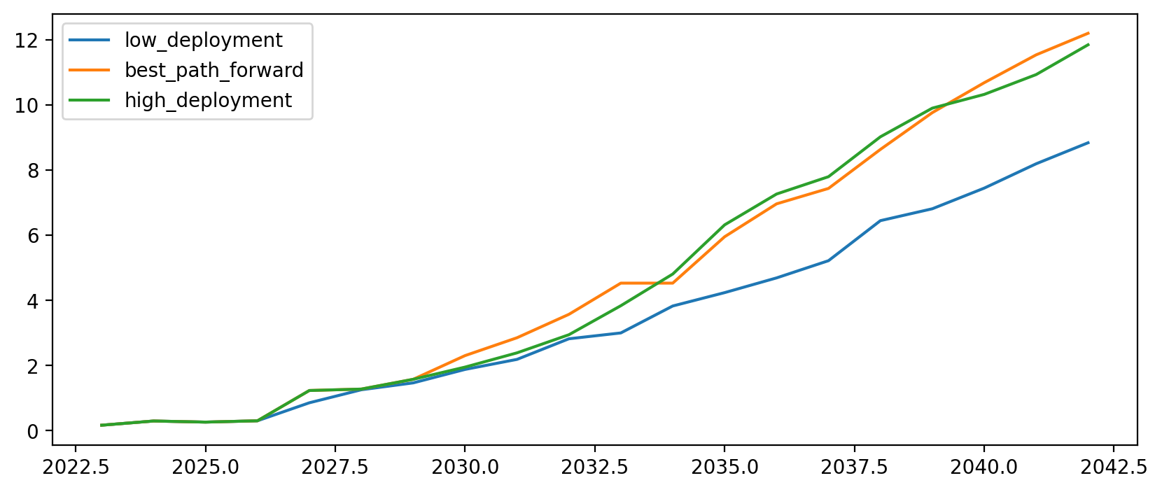
Cumulative Installed Capacity

Slide 5
Vessel Investment Plot

Slide 6
Capacity per $ Invested (MW/$)

