Slide 1
low_deployment
Pipeline: Low Deployment
Vessel Pathway: Common
Port Pathway: Common

Slide 2
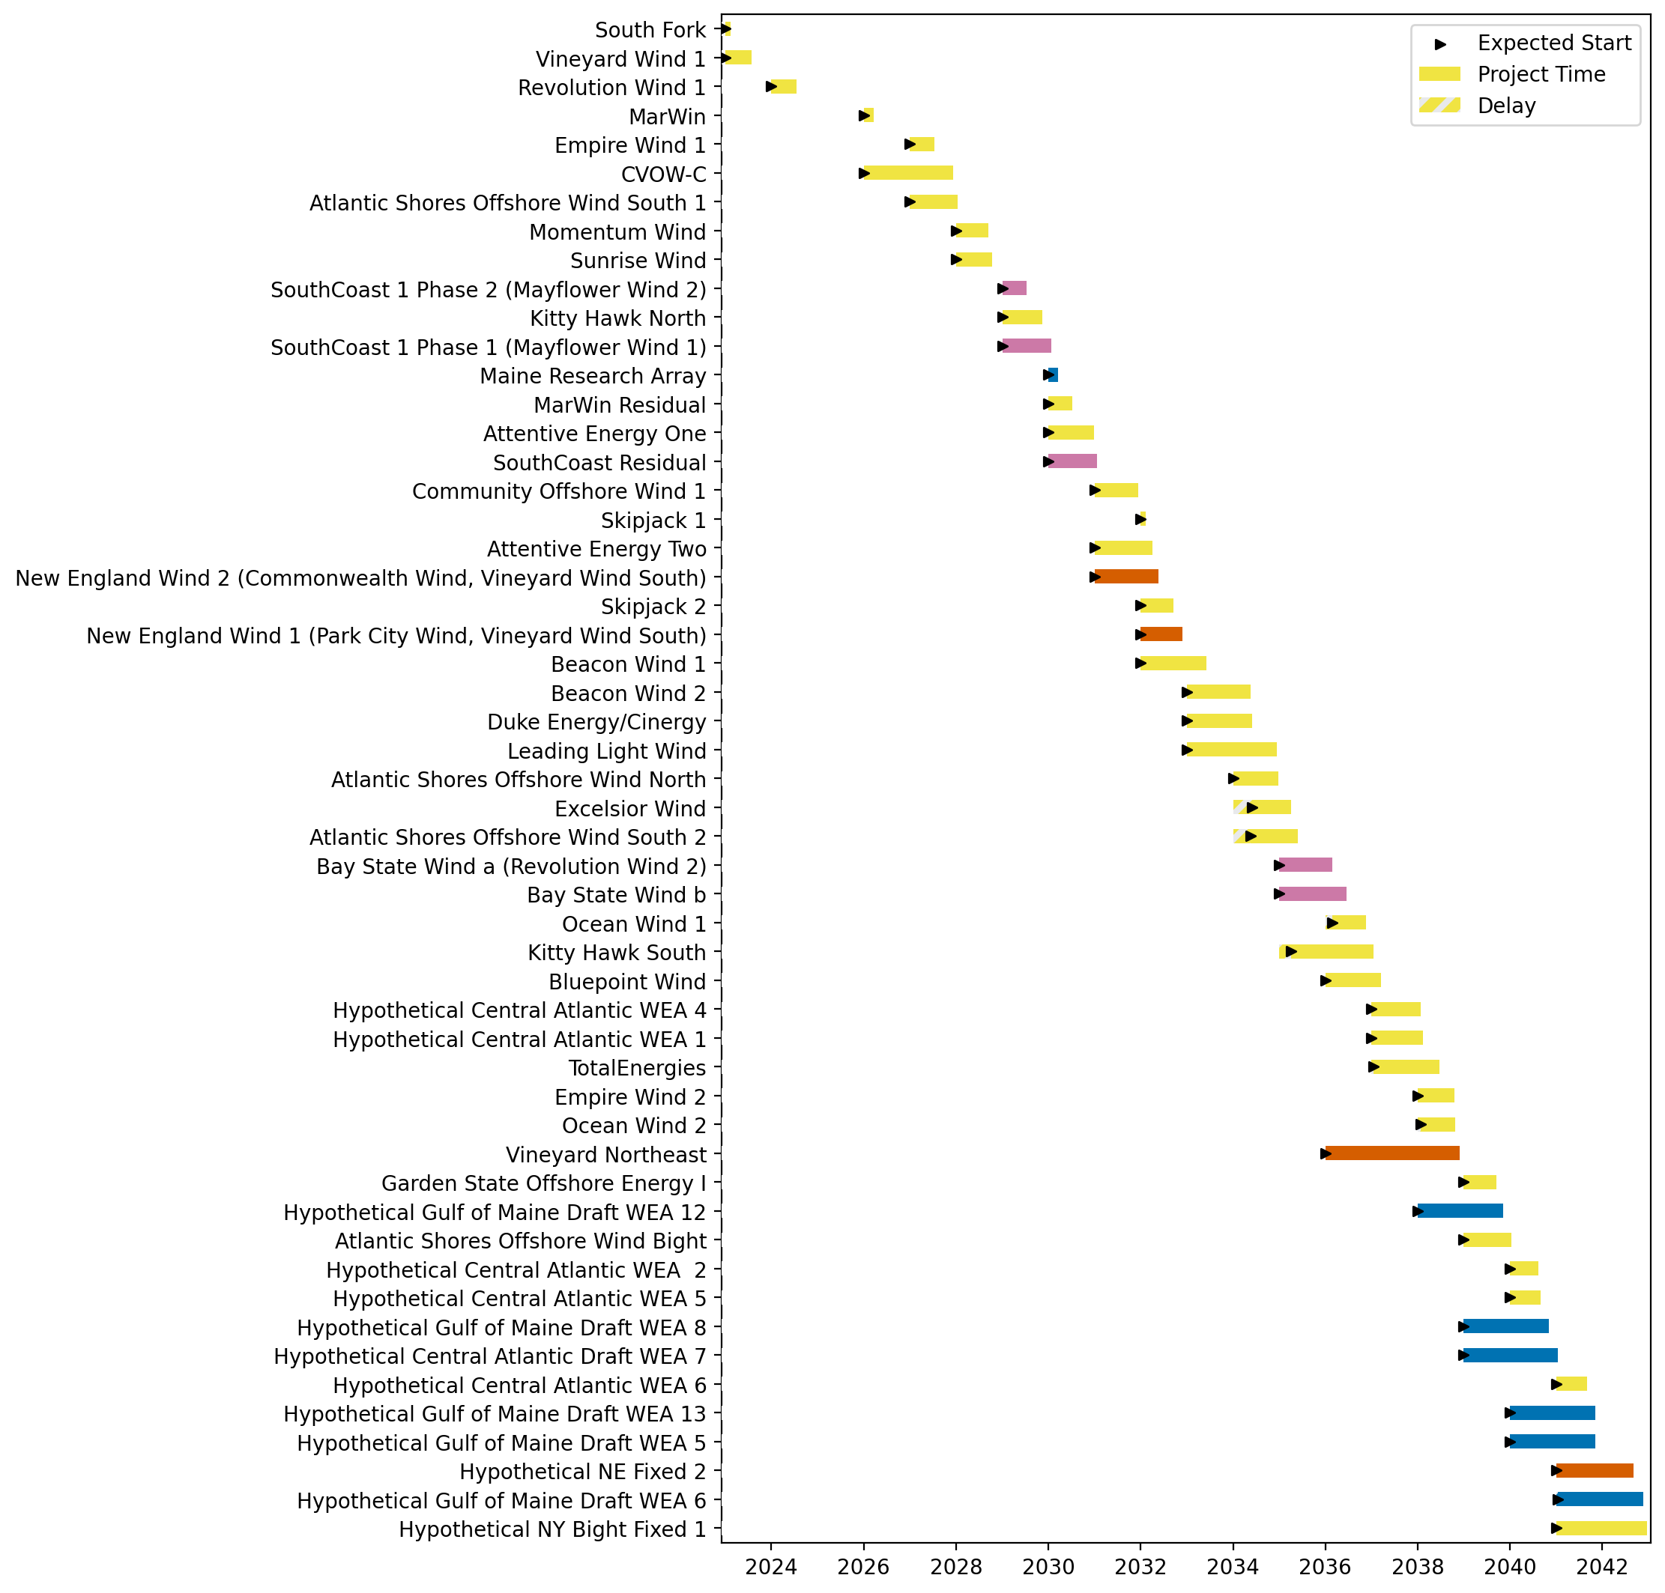
Full Gantt

Slide 3
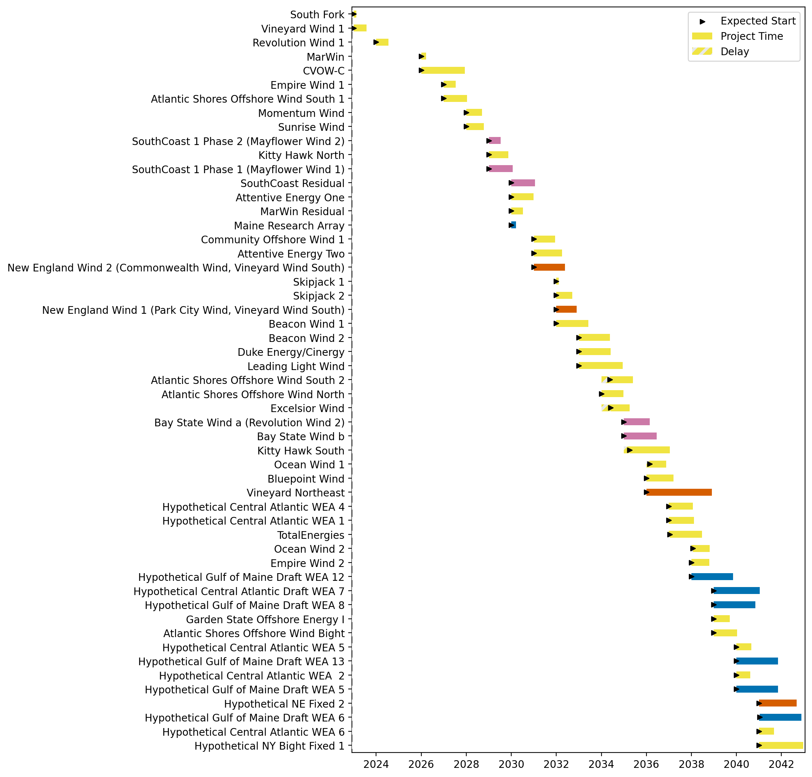
Sorted Full Gantt

Slide 4
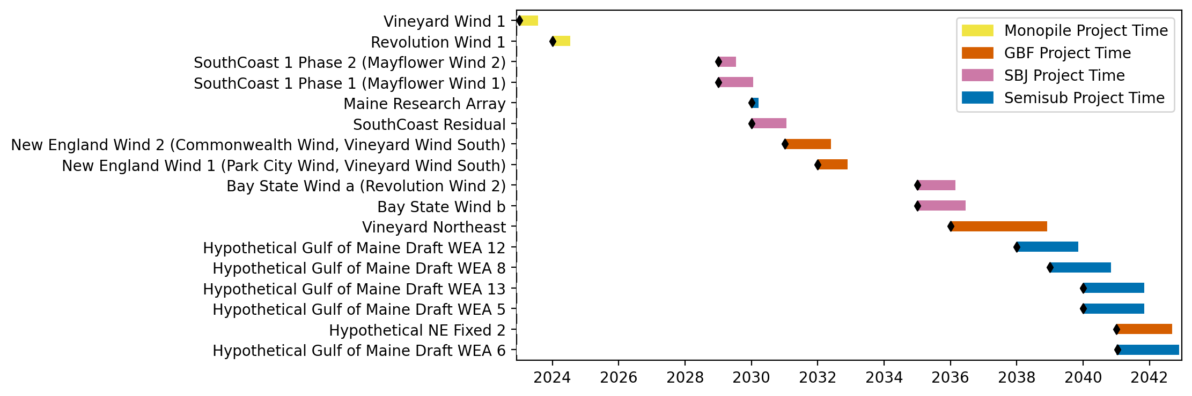
New England Gantt

Slide 5
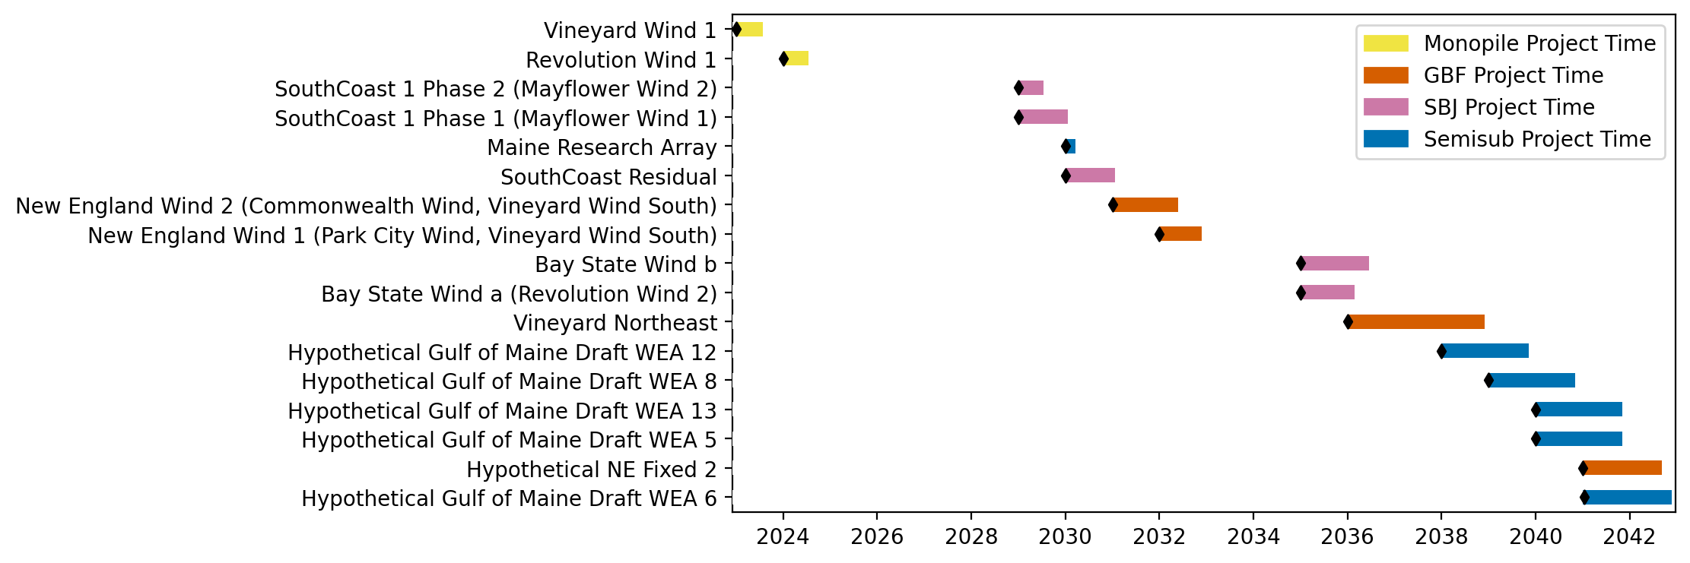
Sorted New England Gantt

Slide 6
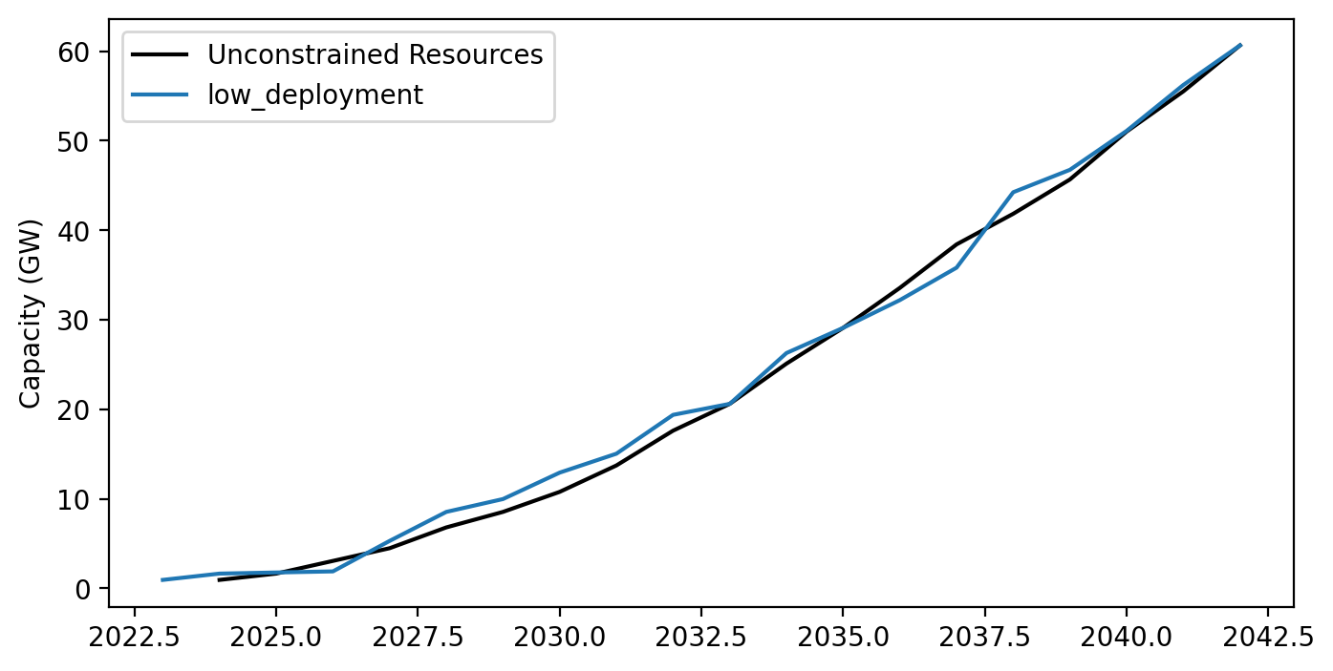
Cummulative Installed Capacity

