Slide 1
base_ne_baseline
Pipeline: Baseline - NE
Vessel Pathway: Base
Port Pathway: Base

Slide 2
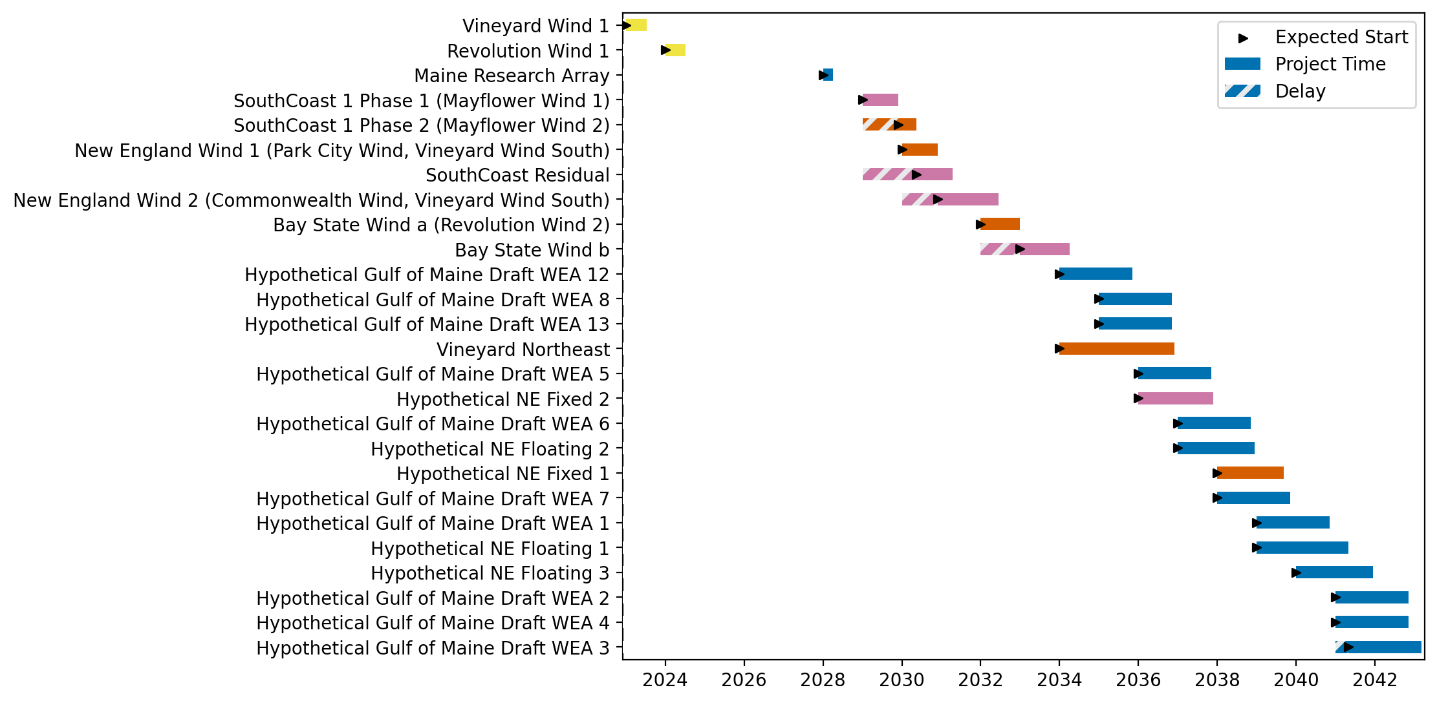
Full Gantt

Slide 3
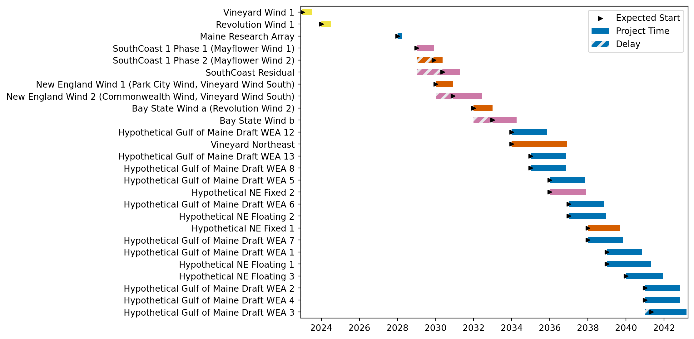
Sorted Full Gantt

Slide 4

New England Gantt

Slide 5

Sorted New England Gantt

Slide 6
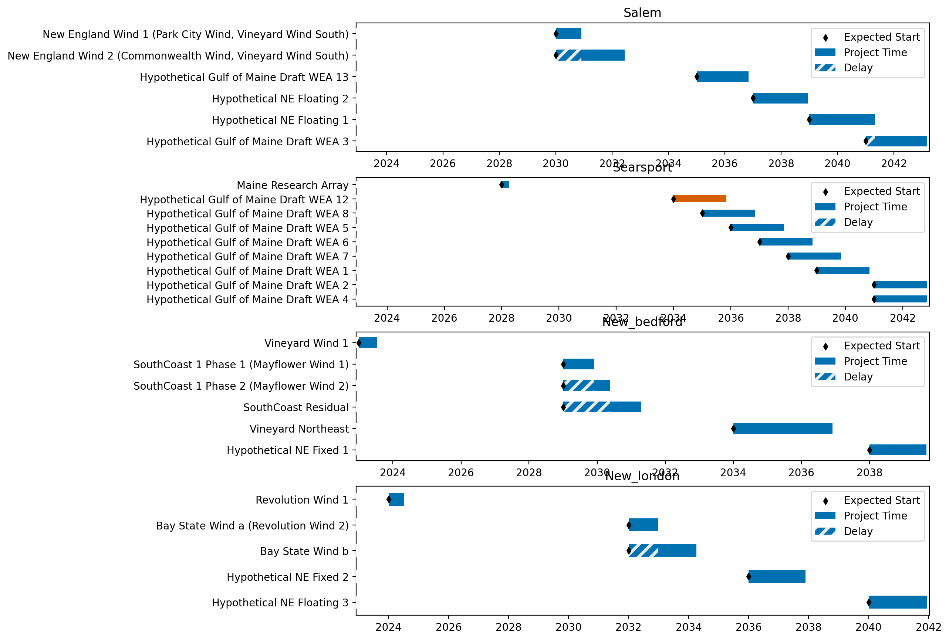
Port Gantts

Slide 7
Sorted Port Gantts

Slide 8
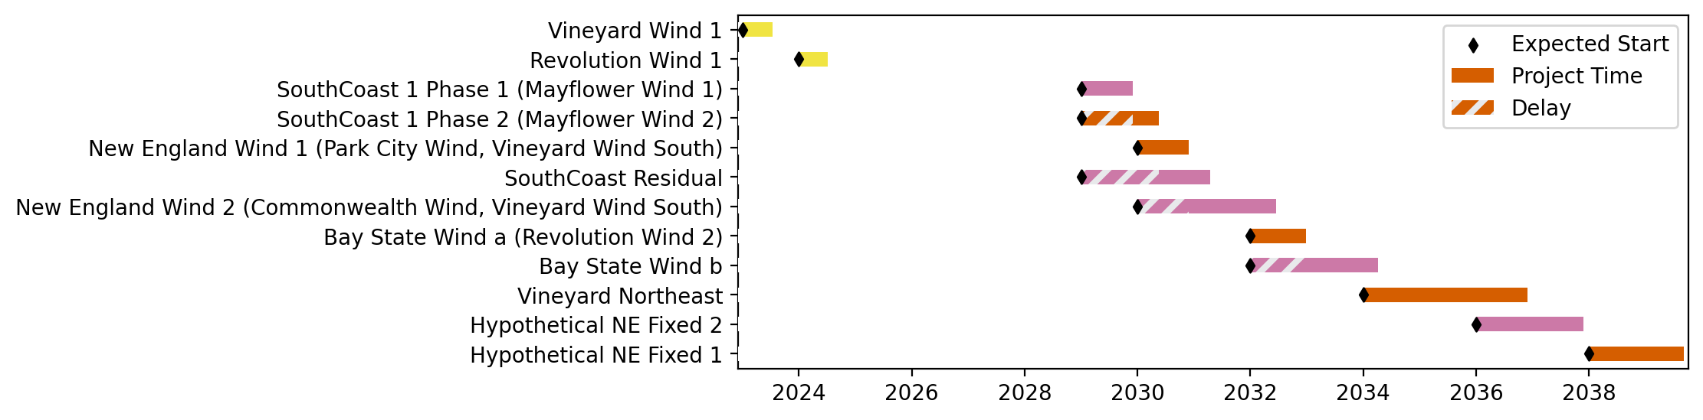
Fixed Gantt

Slide 9
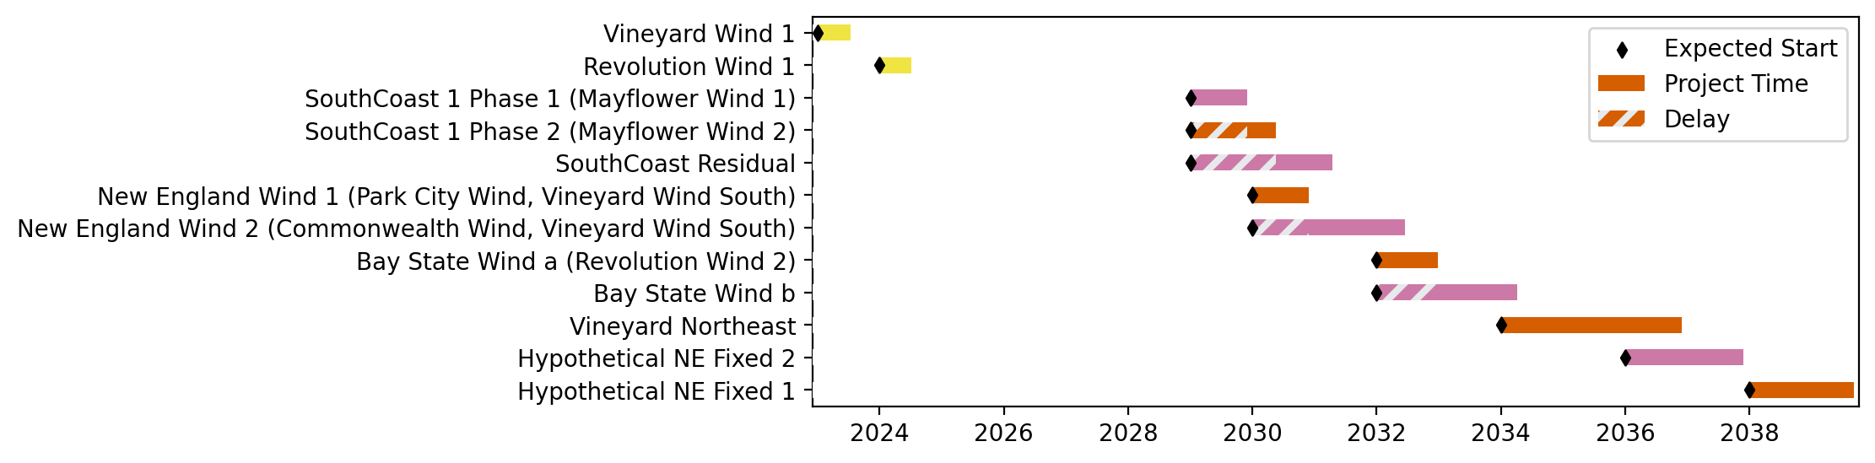
Sorted Fixed Gantt

Slide 10
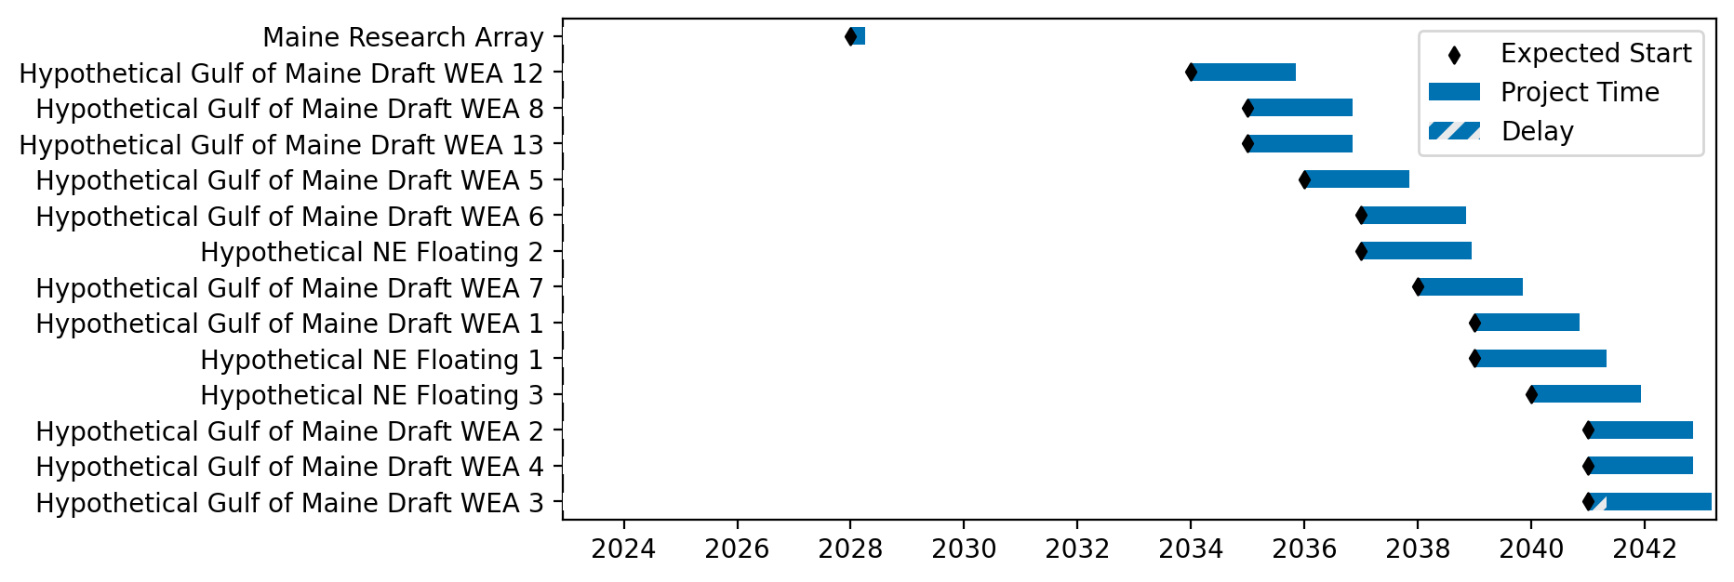
Floating Gantt

Slide 11
Sorted Floating Gantt

Slide 12
base_ne_mono_baseline
Pipeline: Baseline - NE, Monopiles
Vessel Pathway: Base
Port Pathway: Base

Slide 13
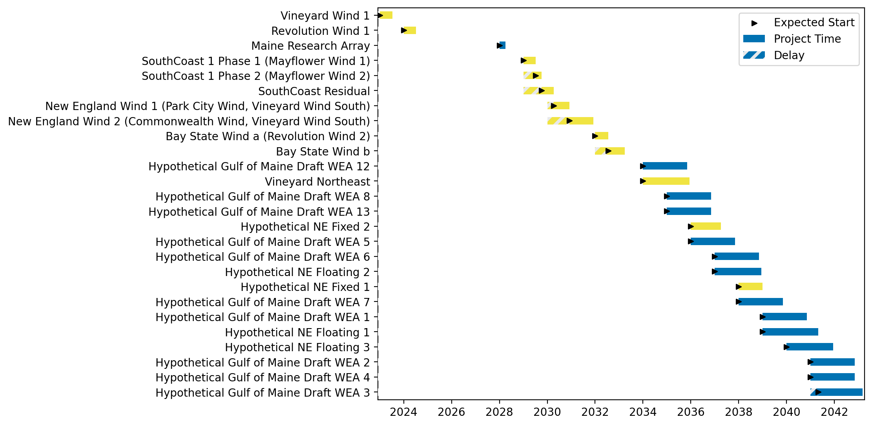
Full Gantt

Slide 14

Sorted Full Gantt

Slide 15

New England Gantt

Slide 16

Sorted New England Gantt

Slide 17
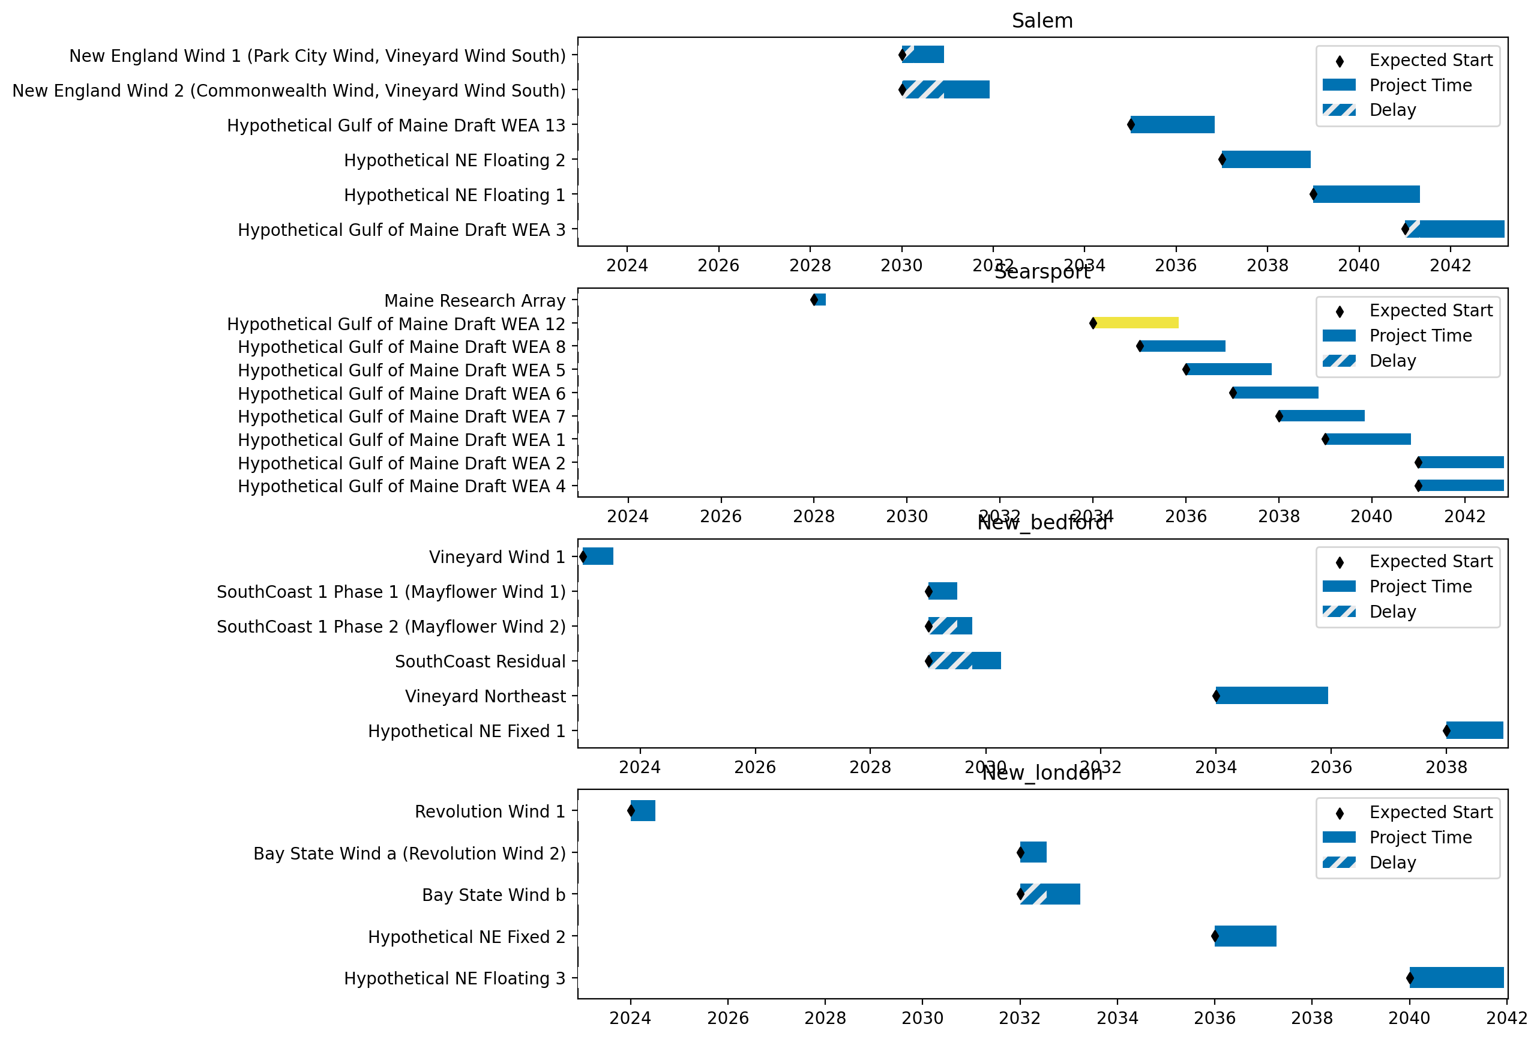
Port Gantts

Slide 18
Sorted Port Gantts

Slide 19
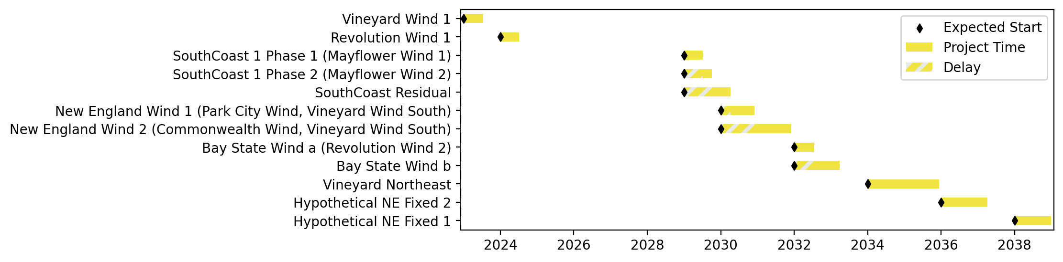
Fixed Gantt

Slide 20
Sorted Fixed Gantt

Slide 21
Floating Gantt

Slide 22
Sorted Floating Gantt

Slide 23
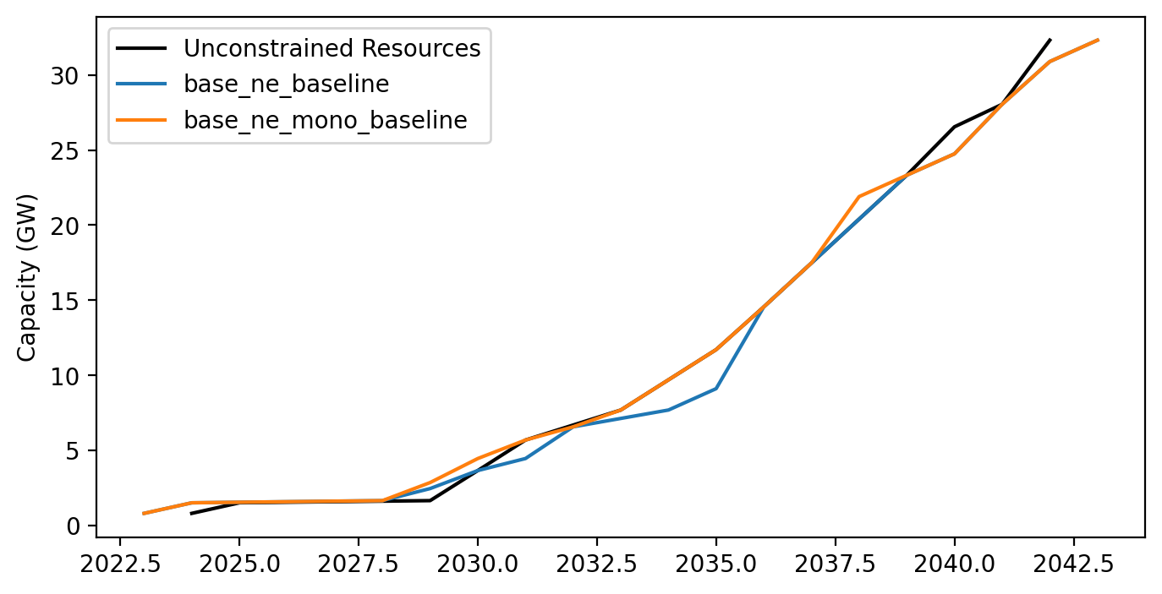
Cummulative Installed Capacity

