Slide 1
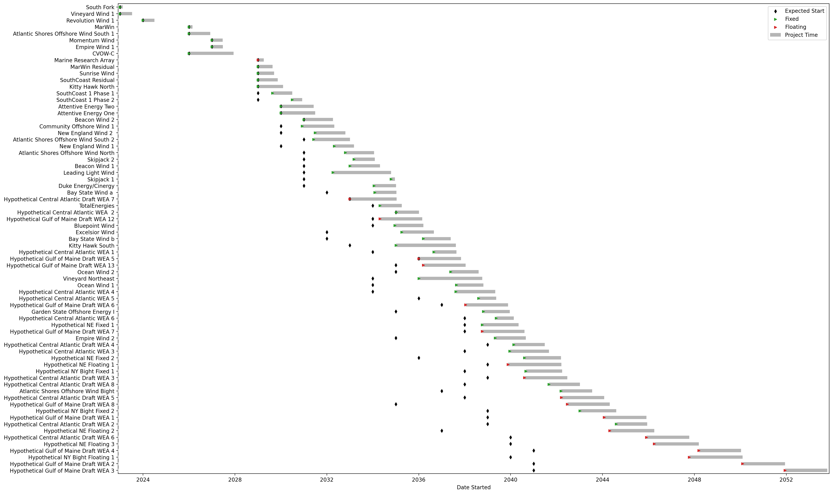
Full Gantt

Slide 2
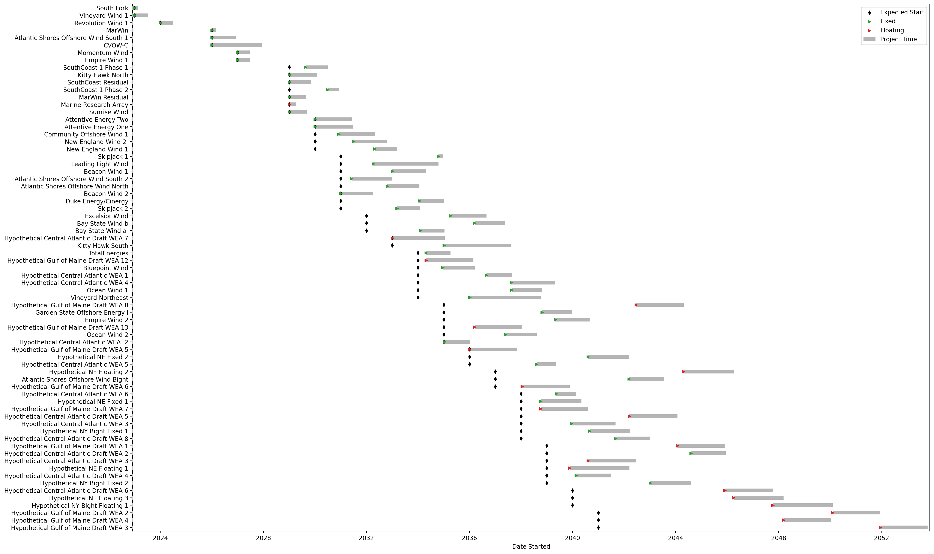
Sorted Full Gantt

