Slide 1
natl_gaps_2us
1 US WTIV starting with CVOW, then 1 in 2027

Slide 2
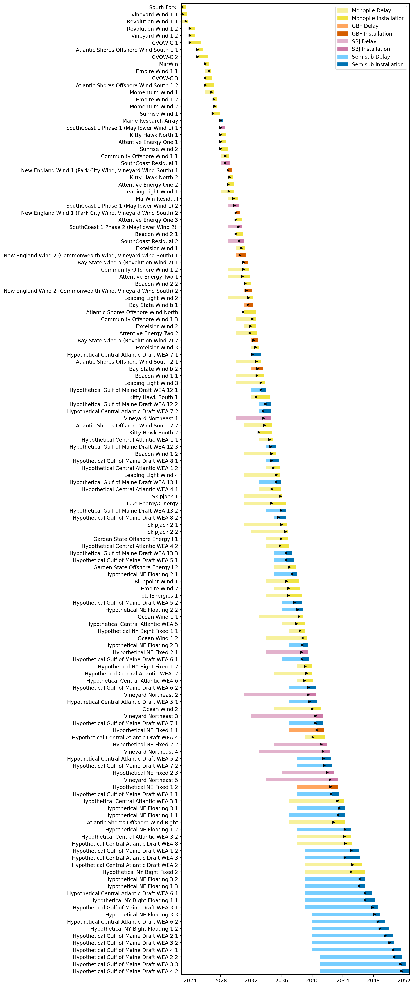
Full Gantt

Slide 3
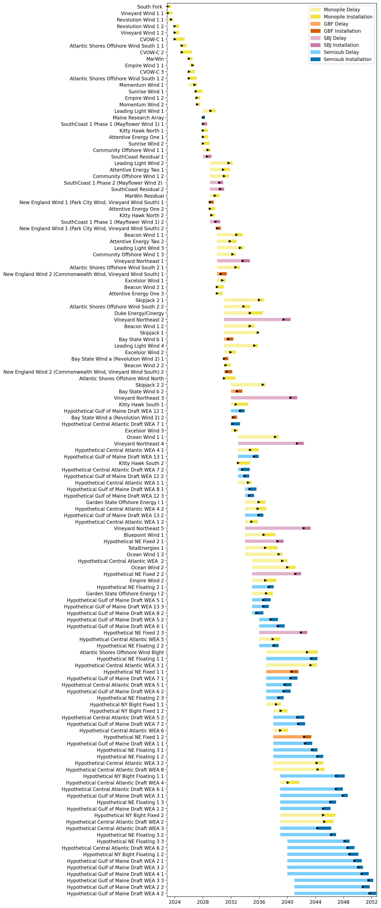
Sorted Full Gantt

Slide 4
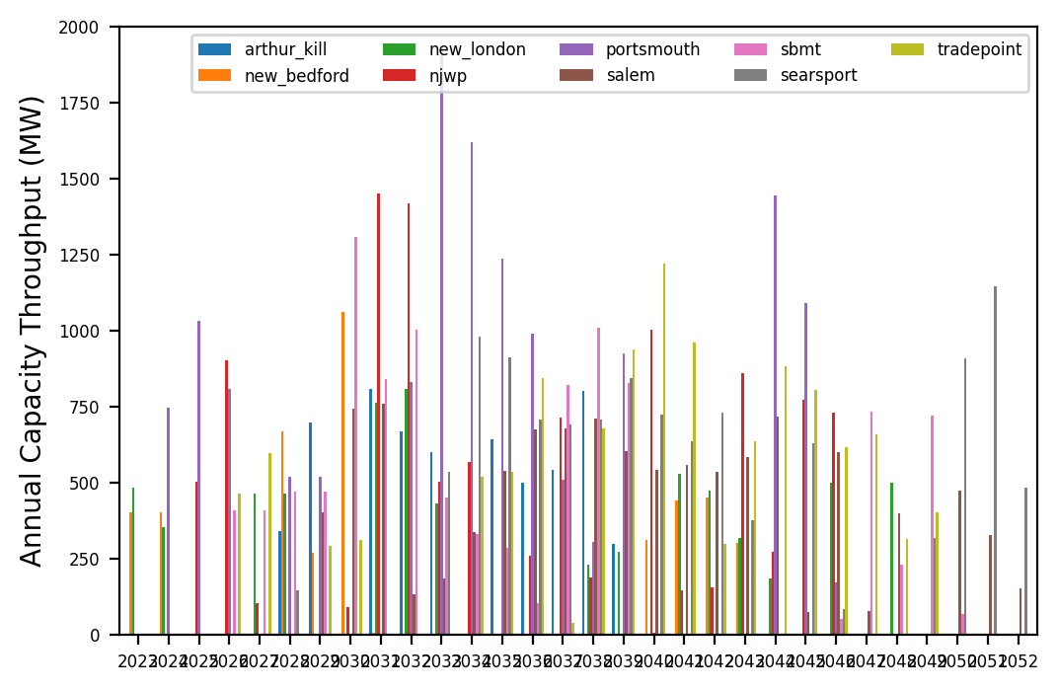
Port Throughput

Slide 5
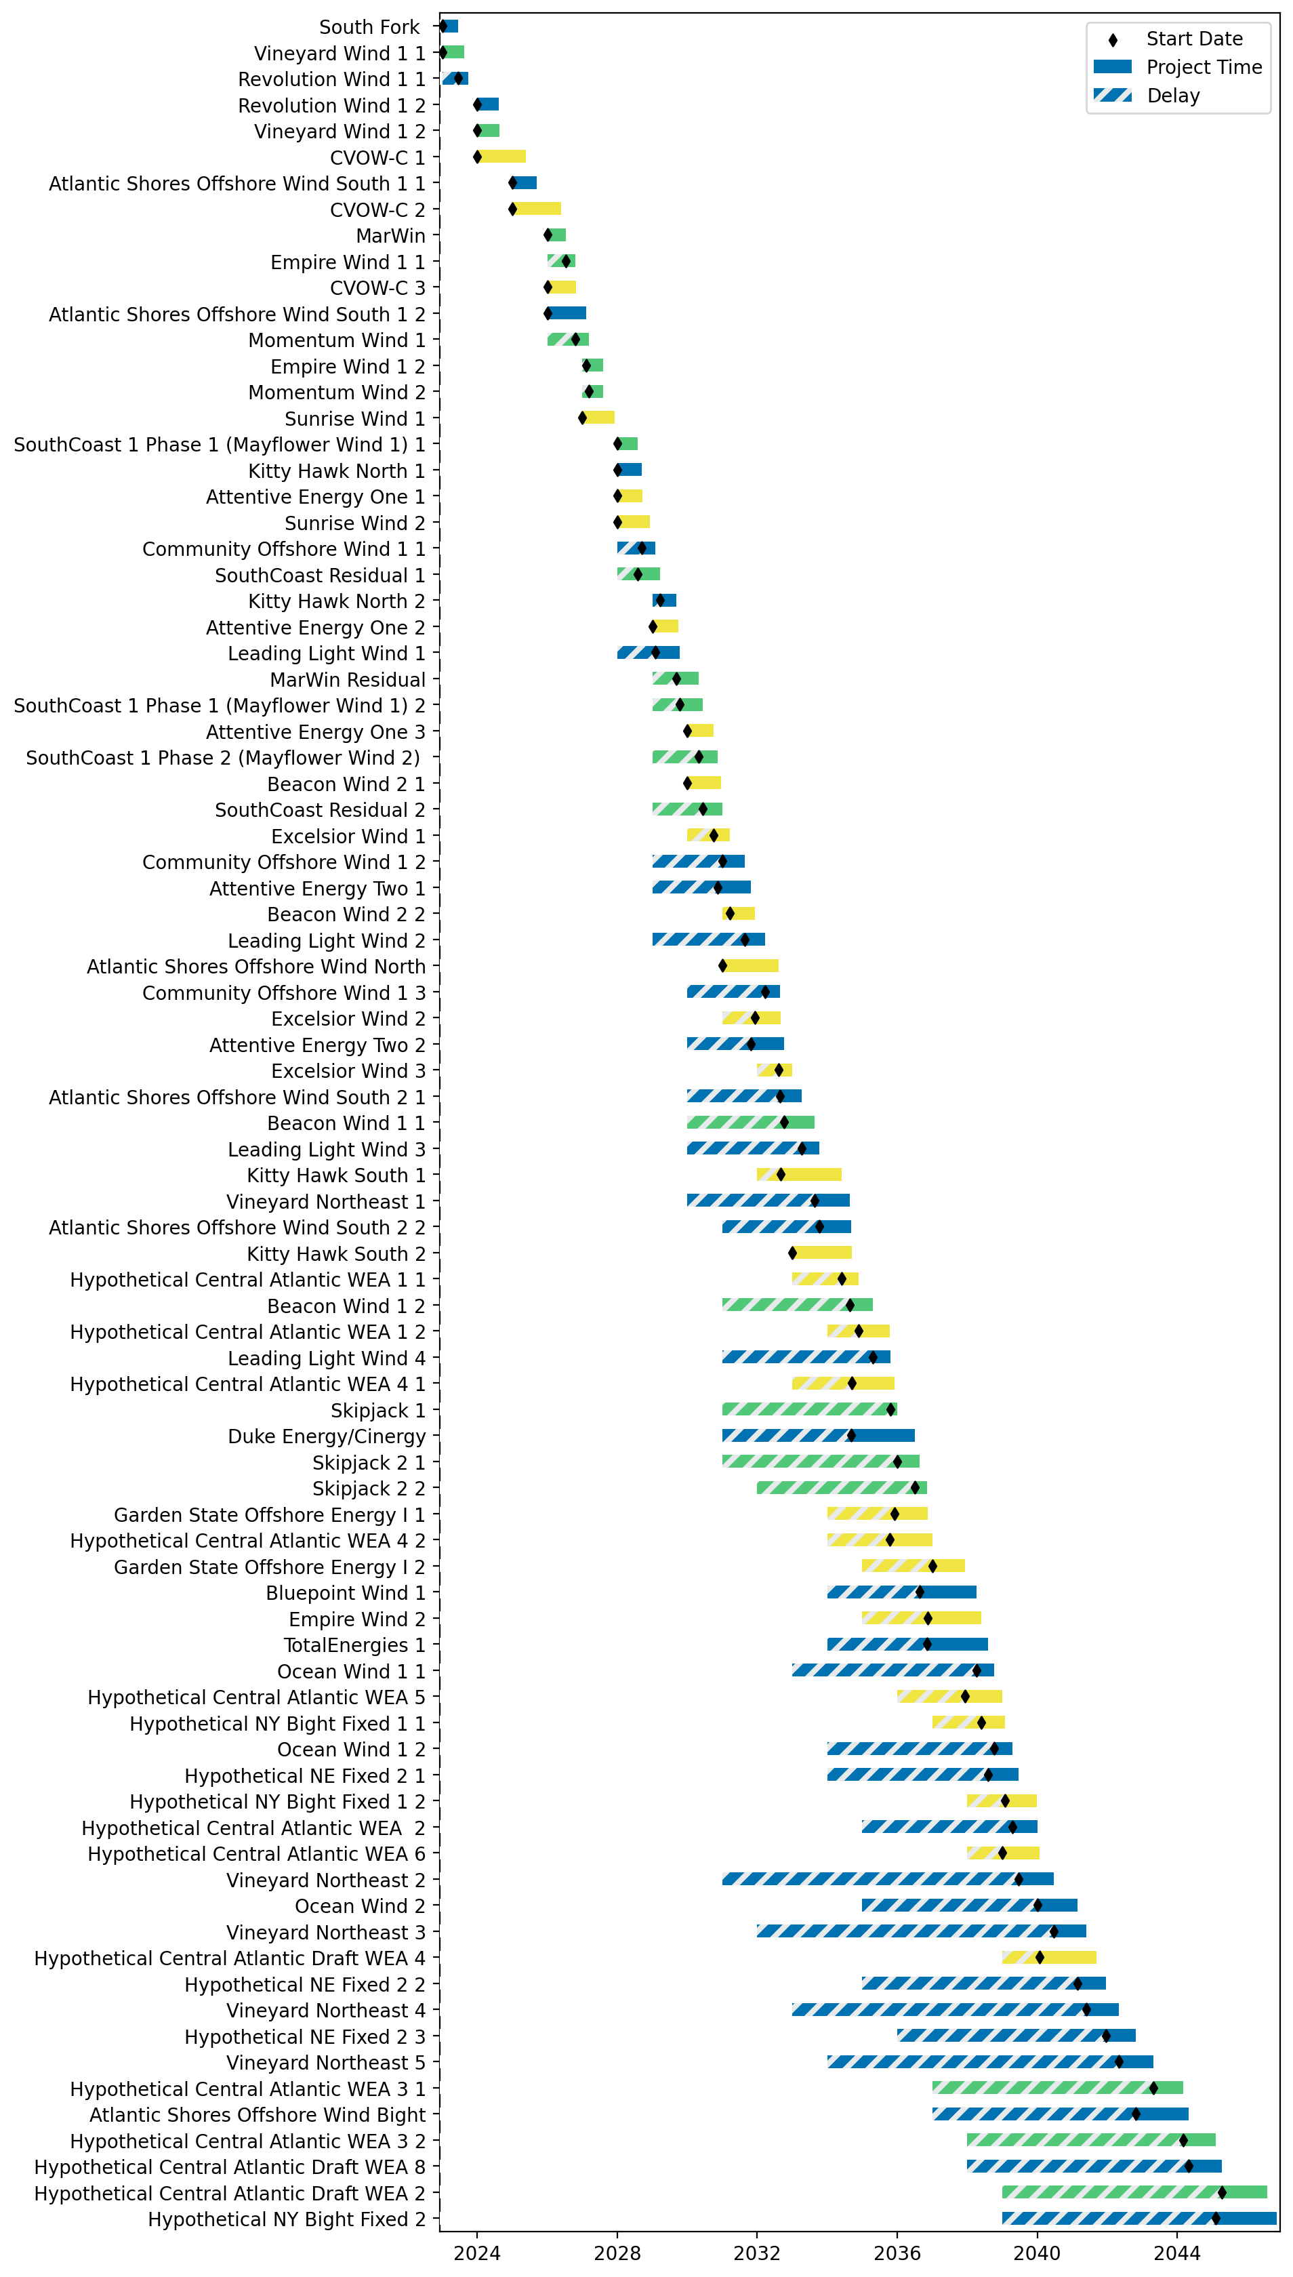
Fixed Gantt

Slide 6
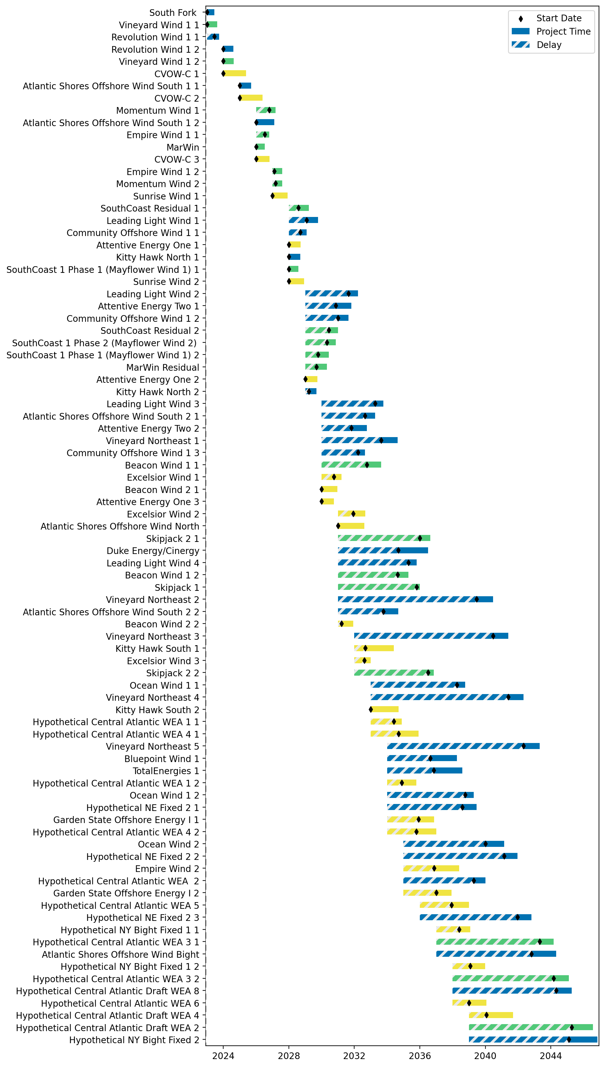
Sorted Fixed Gantt

Slide 7
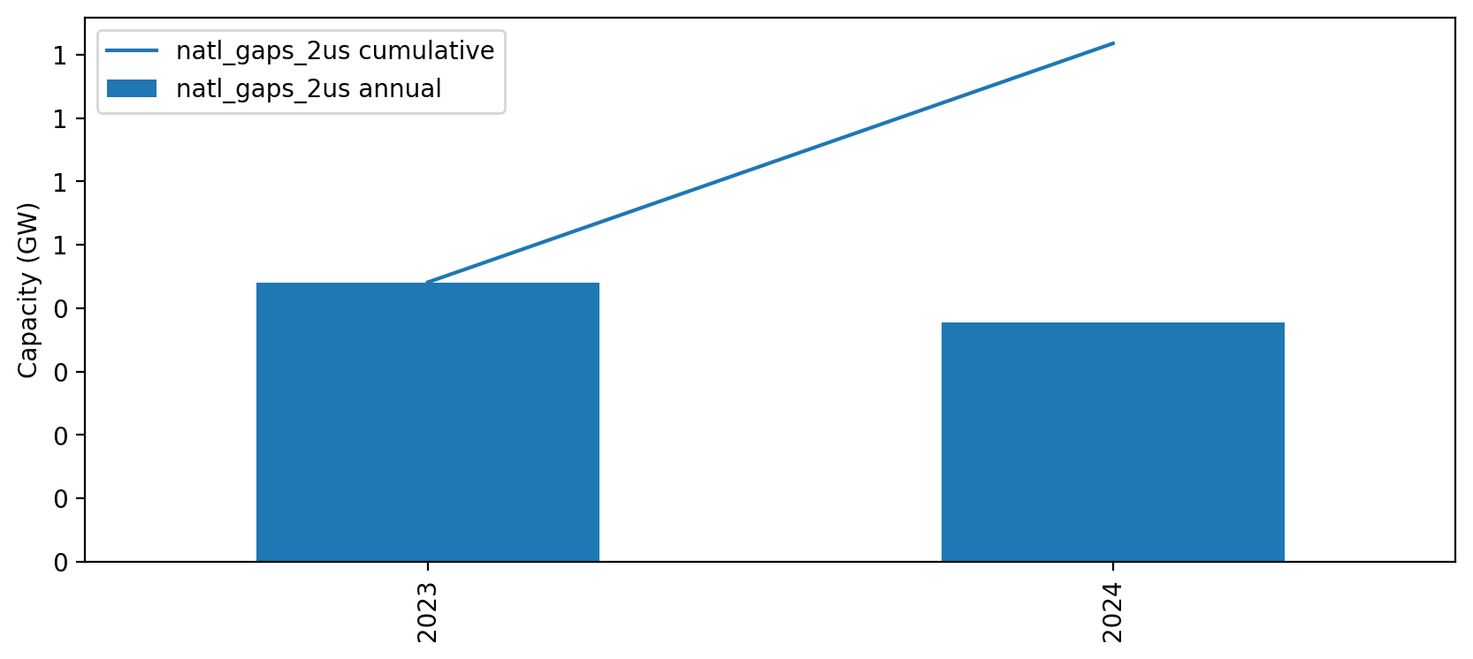
Installed Capacity

