Slide 1
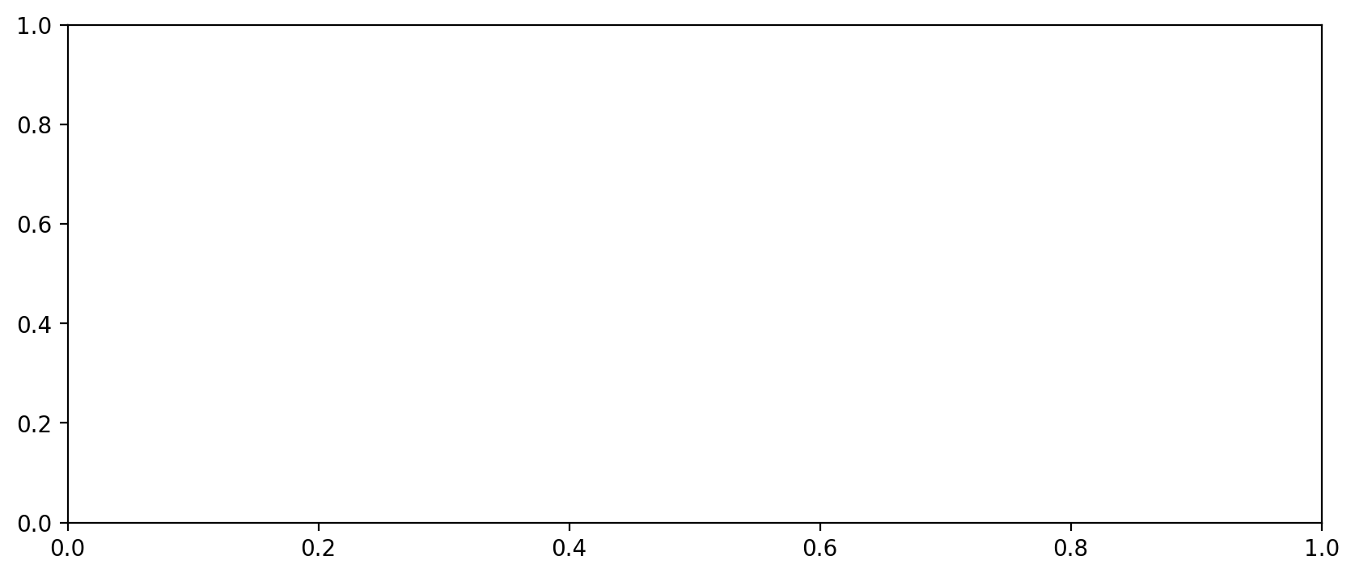
Vessel Utilization

Slide 2
Vessel Utilization

Slide 3
Vessel Utilization

Slide 4
Vessel Utilization

Slide 5
Vessel Utilization

Slide 6
Vessel Utilization

Slide 7
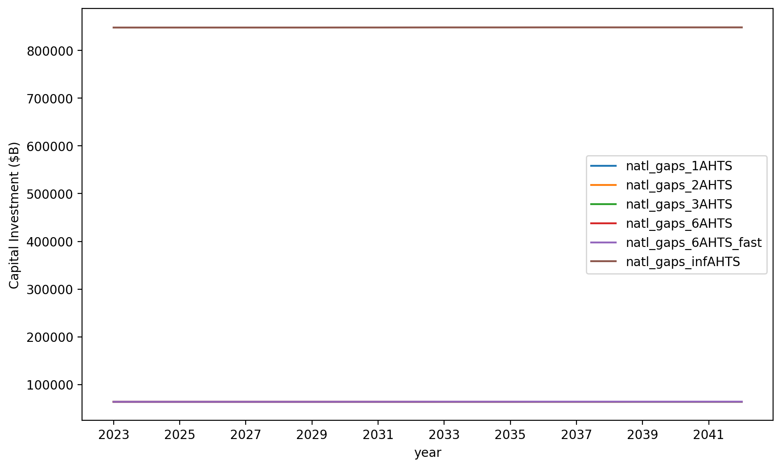
Vessel Investment

Slide 8
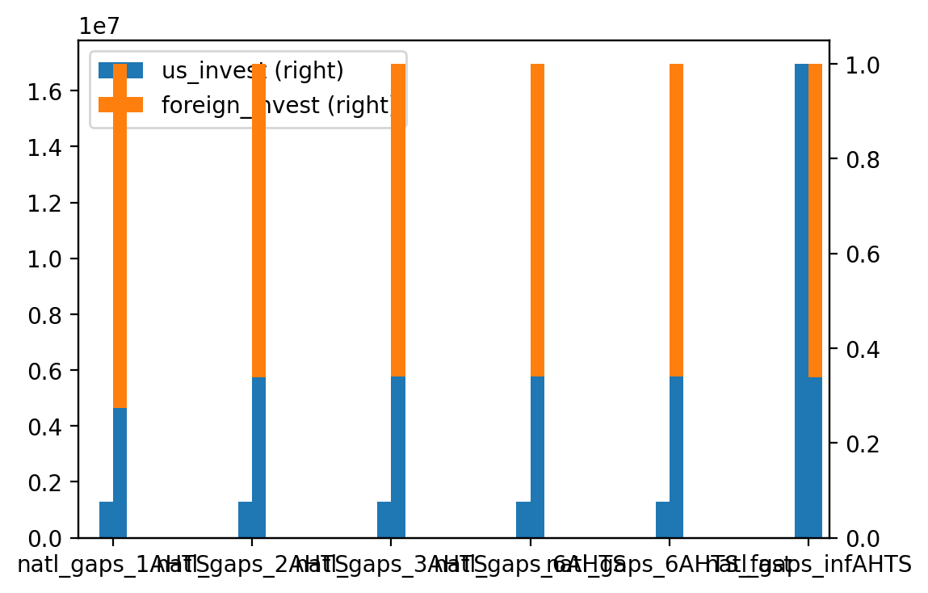
Vessel Investment Summary

Slide 9
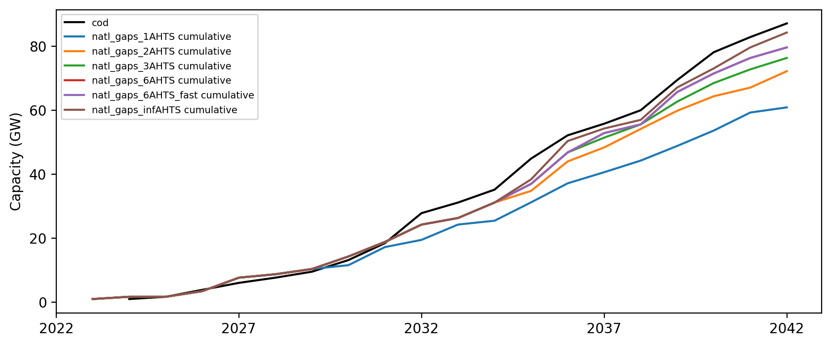
Installed Capacity

