Slide 1
example_atlantic_1
Example Altantic pipeline 1

Slide 2
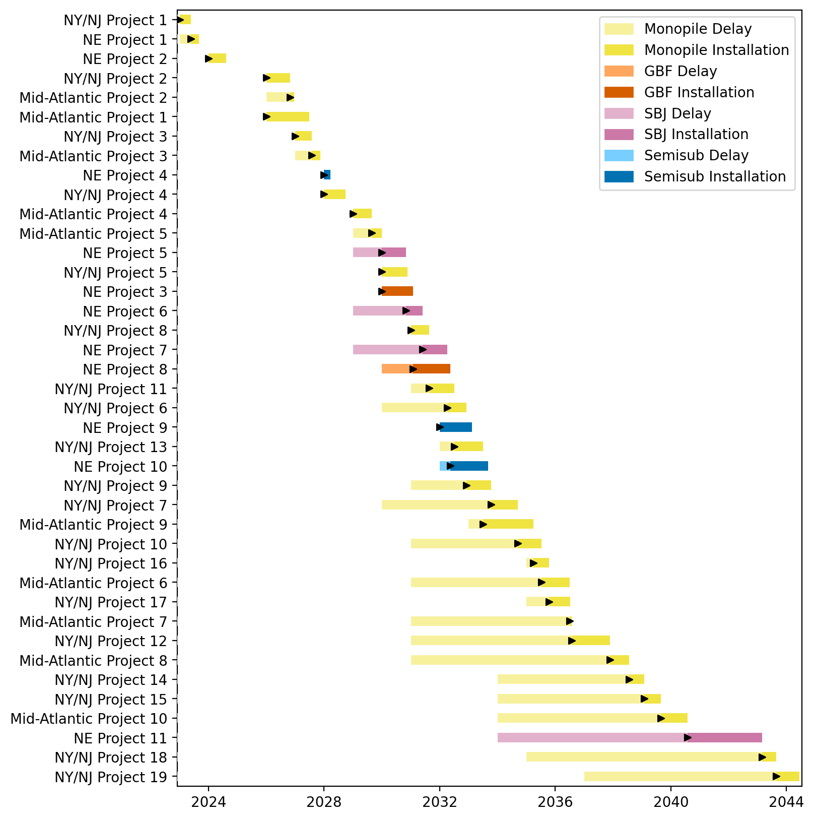
Full Gantt

Slide 3
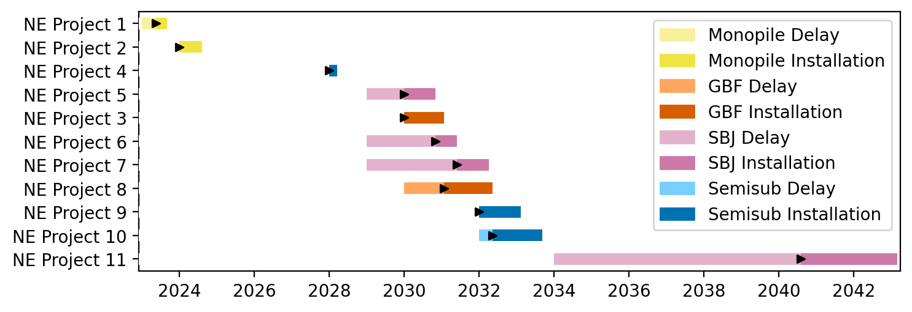
New England Gantt

Slide 4
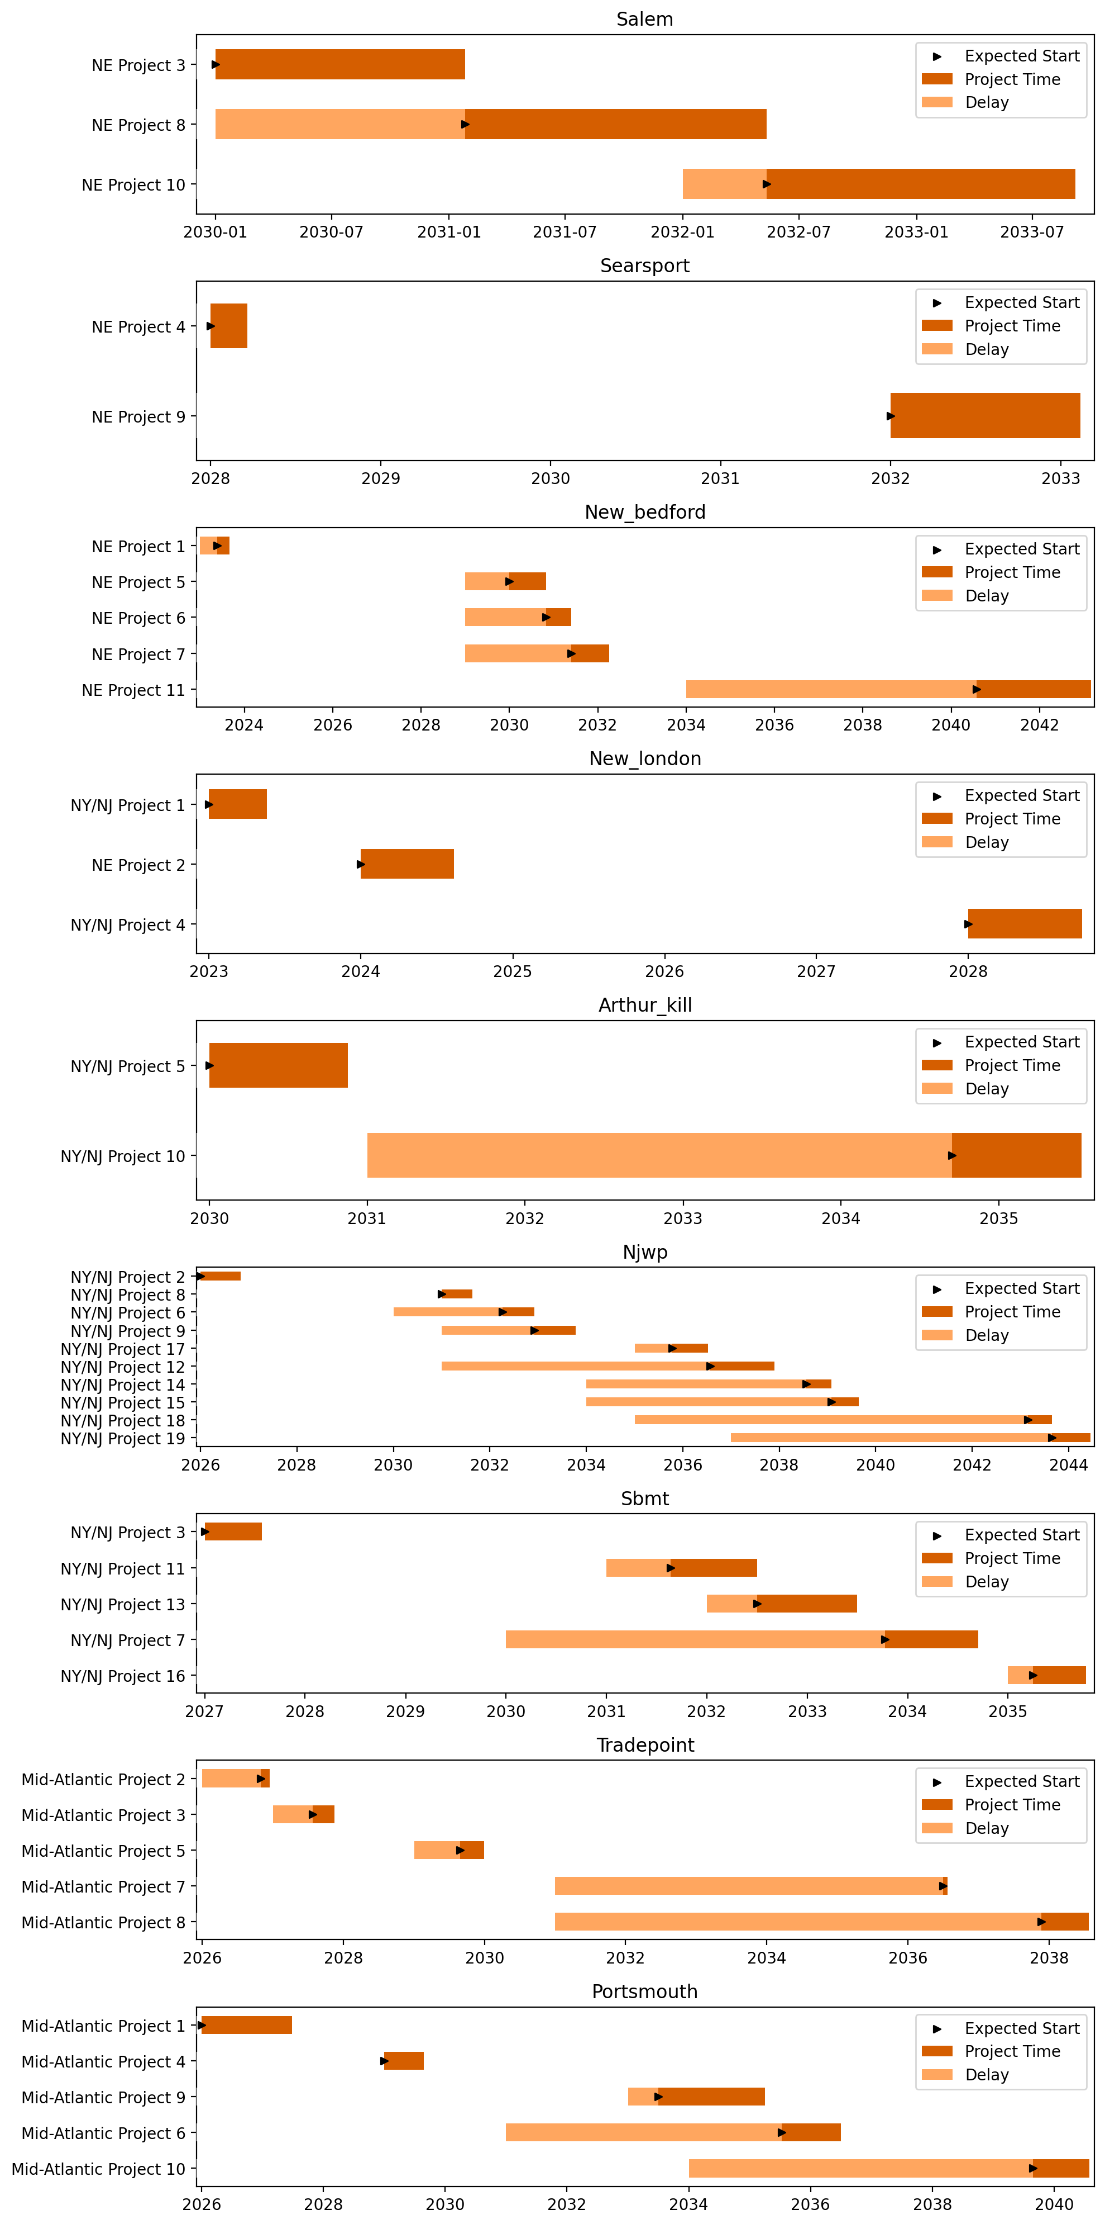
Port Gantts

Slide 5
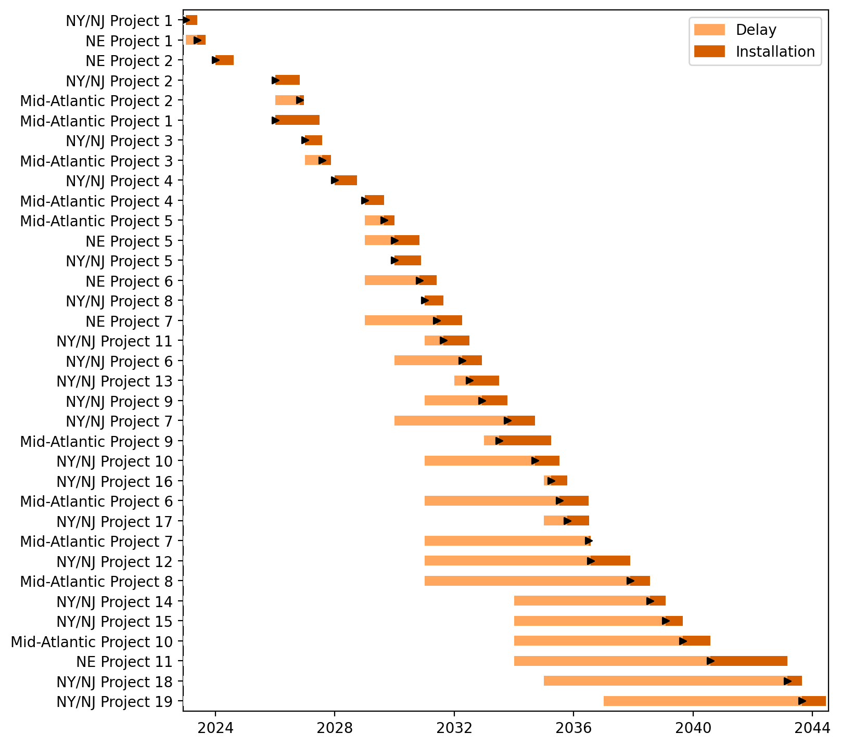
Fixed Gantt

Slide 6
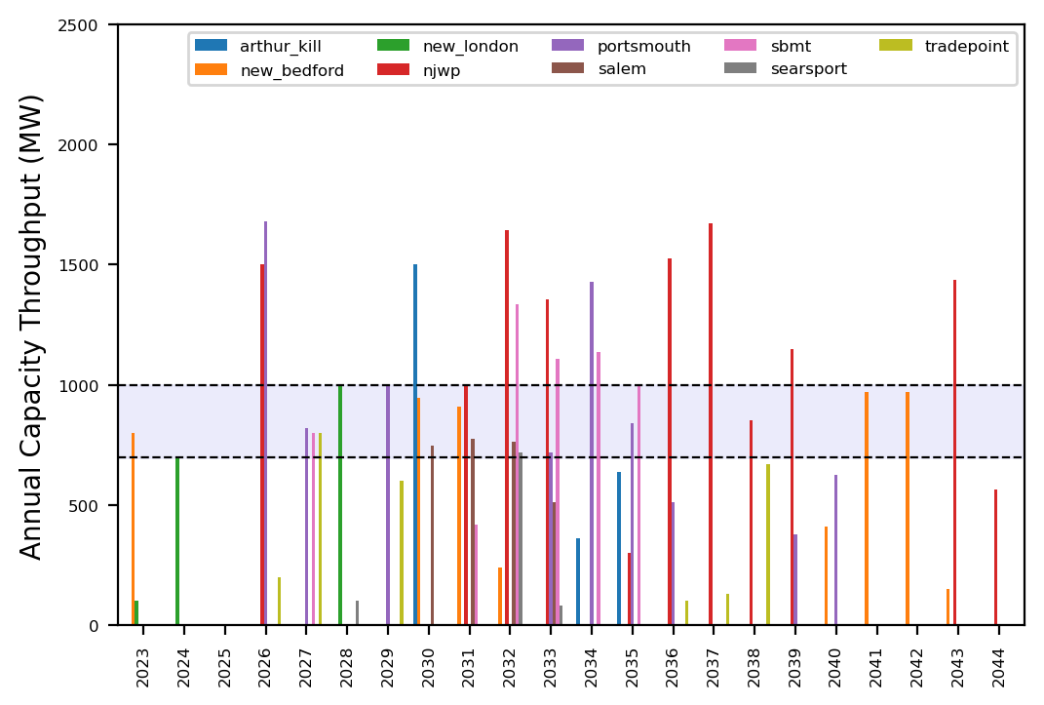
Port Throughput

Slide 7
example_atlantic_2
Example Altantic pipeline 2

Slide 8
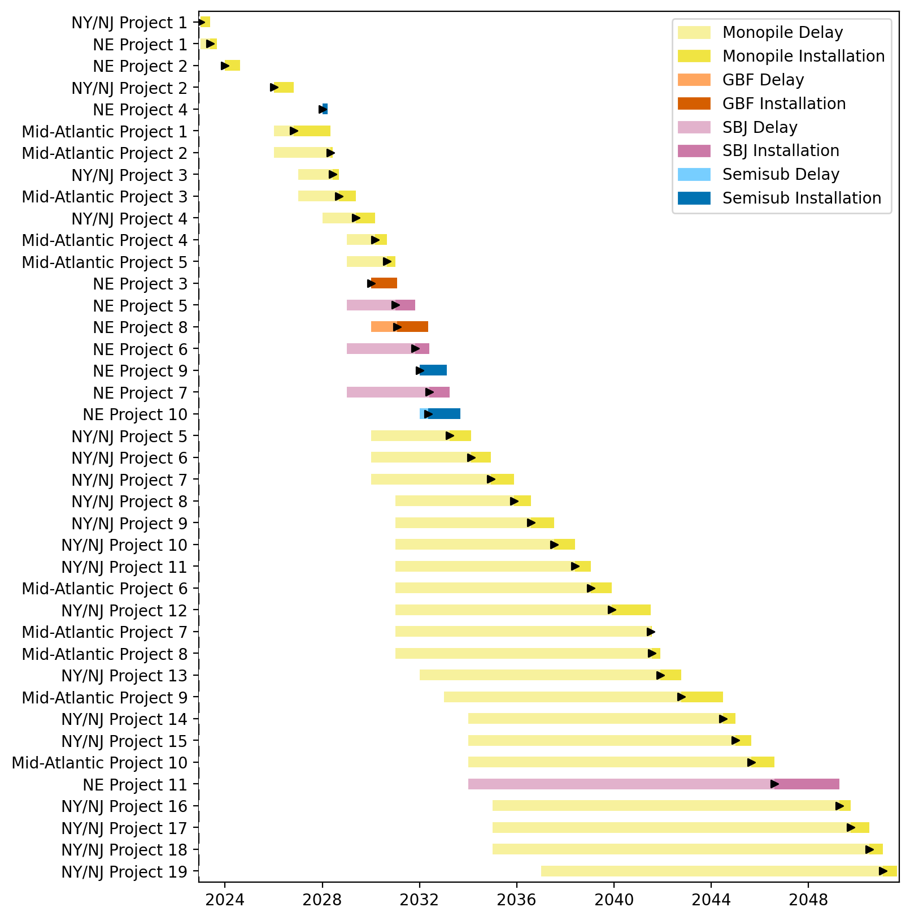
Full Gantt

Slide 9
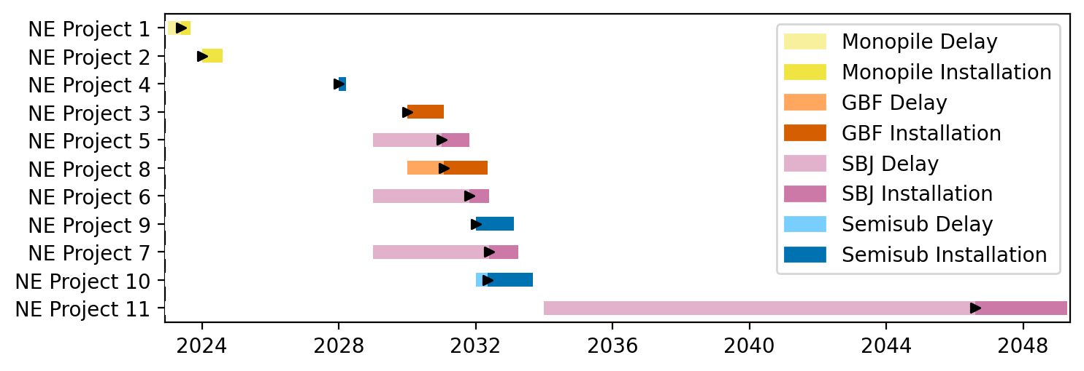
New England Gantt

Slide 10
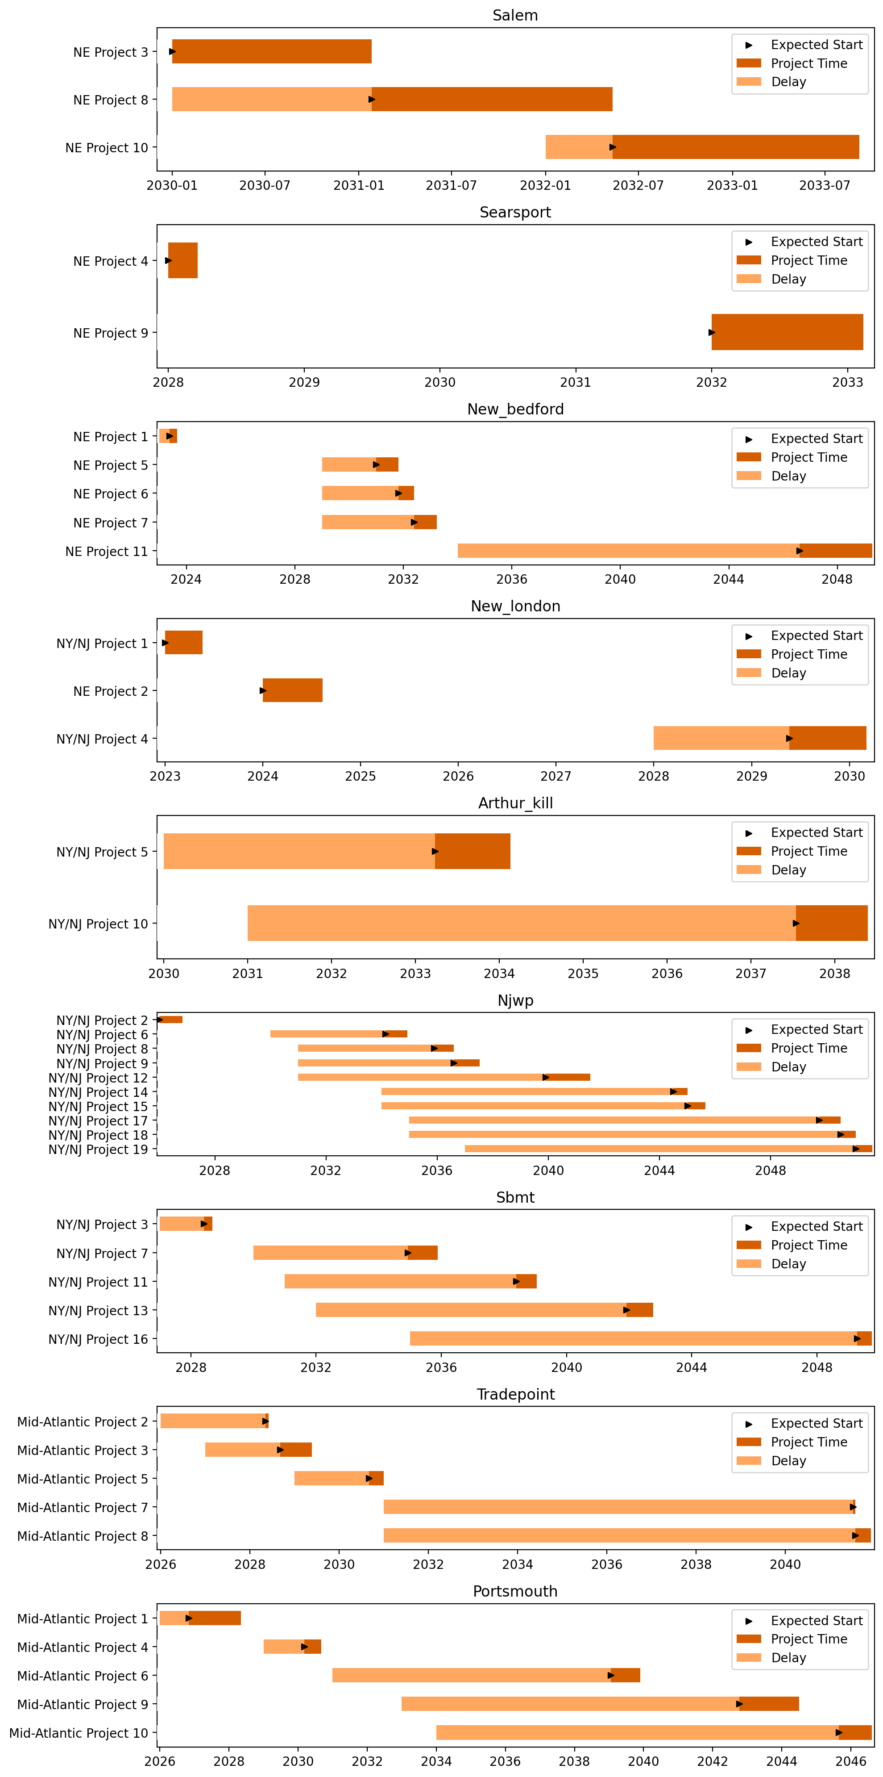
Port Gantts

Slide 11
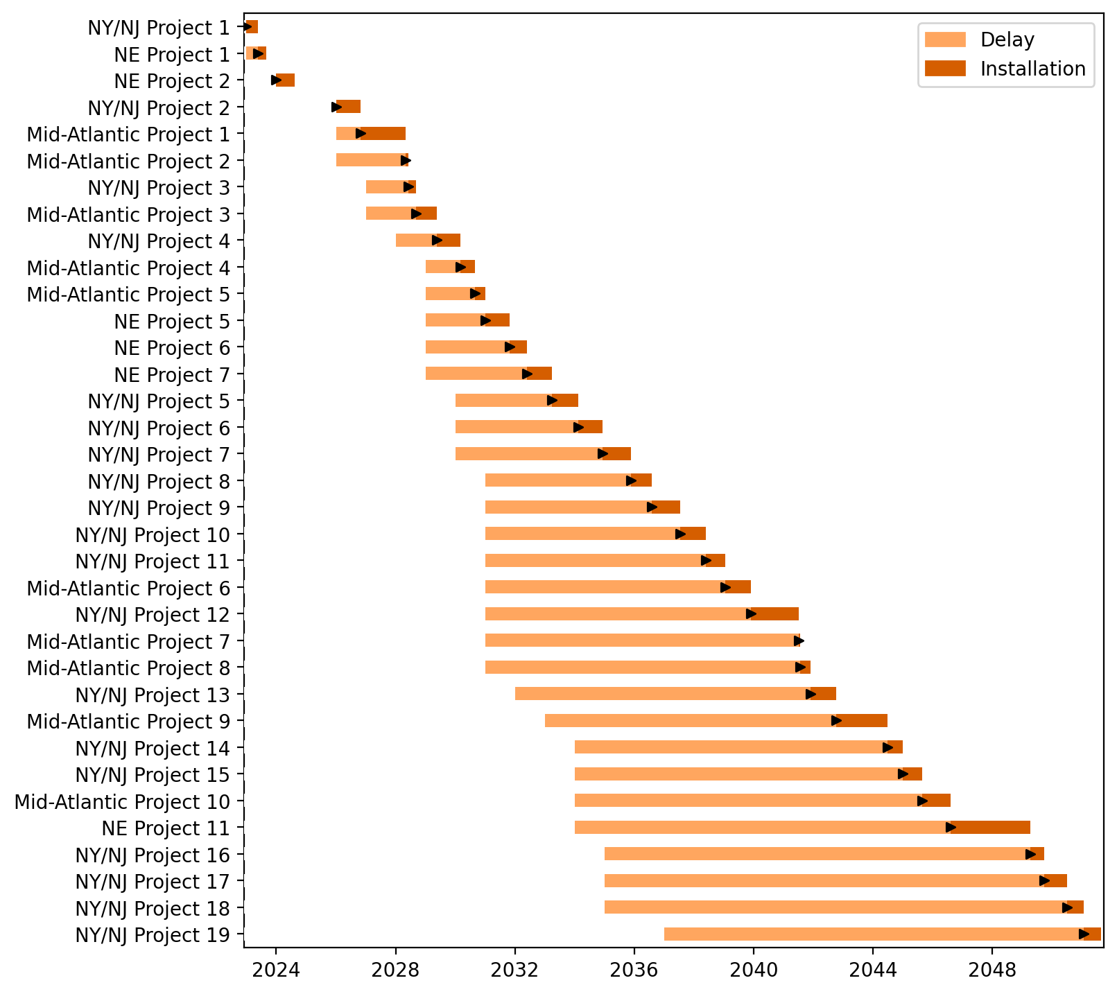
Fixed Gantt

Slide 12
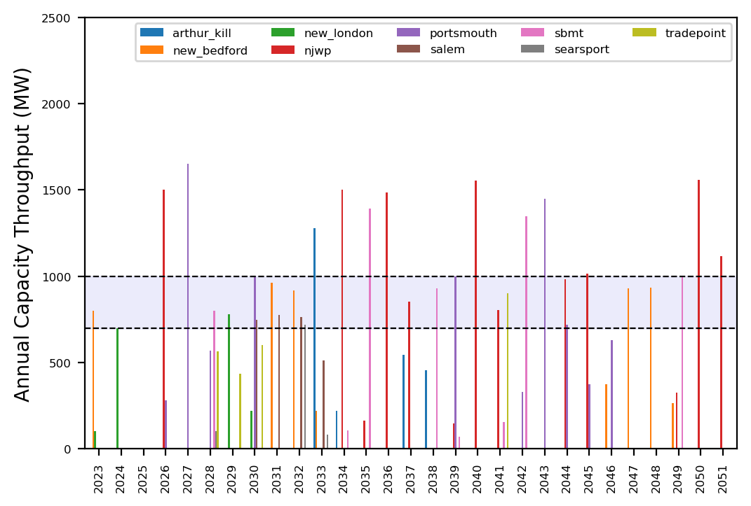
Port Throughput

Slide 13
example_atlantic_3
Example Altantic pipeline 3

Slide 14
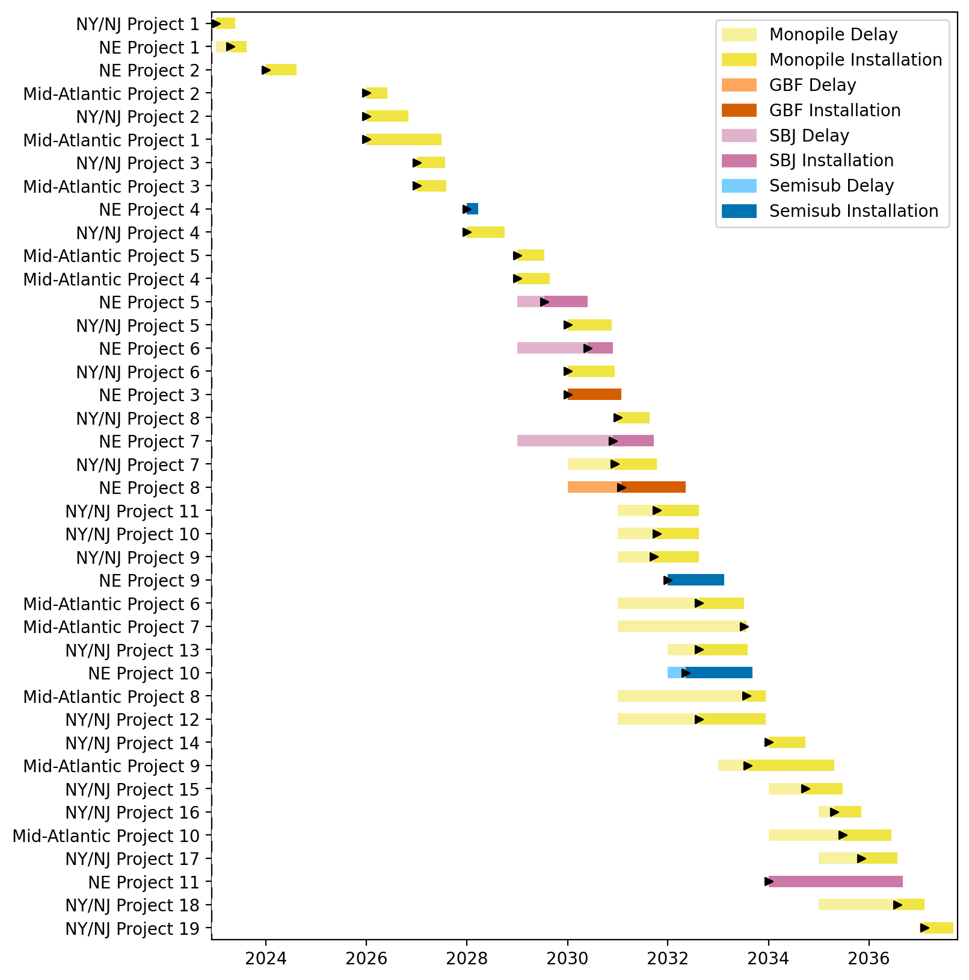
Full Gantt

Slide 15
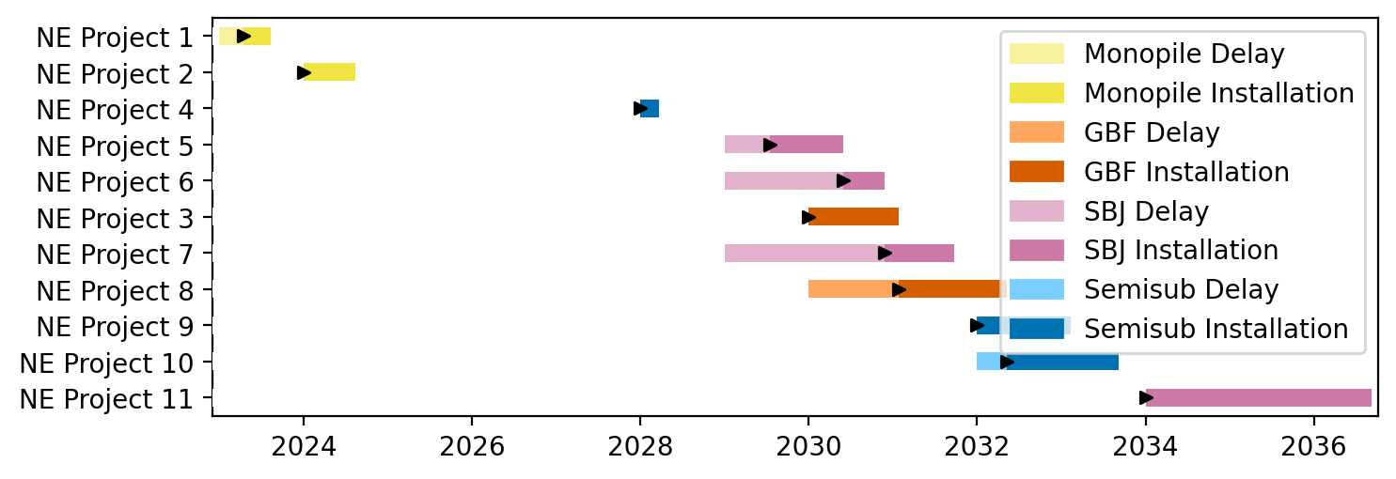
New England Gantt

Slide 16
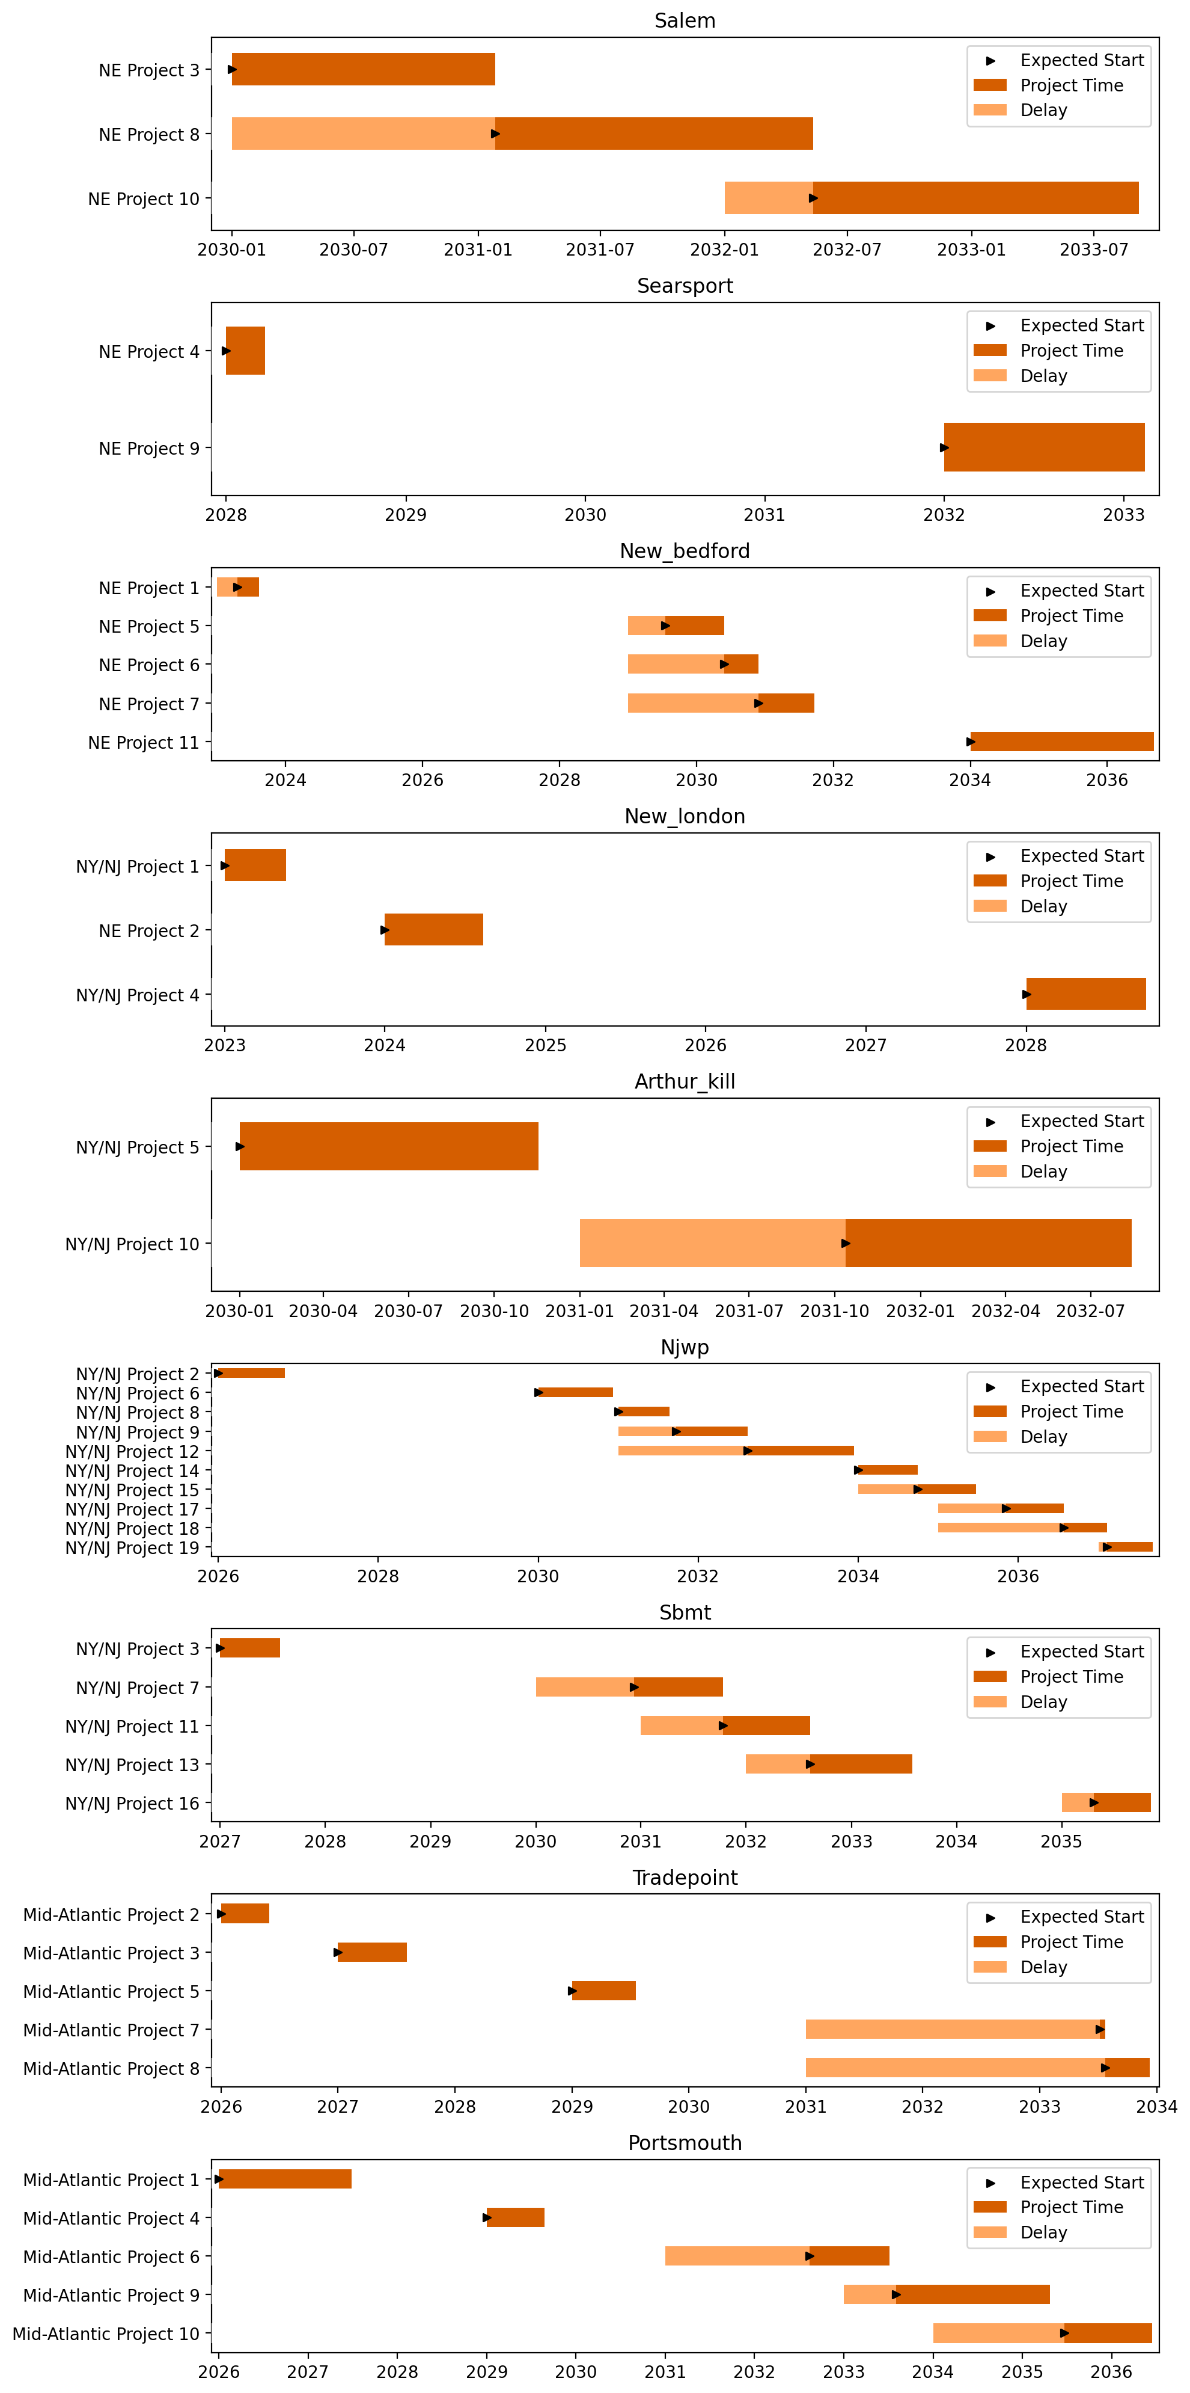
Port Gantts

Slide 17
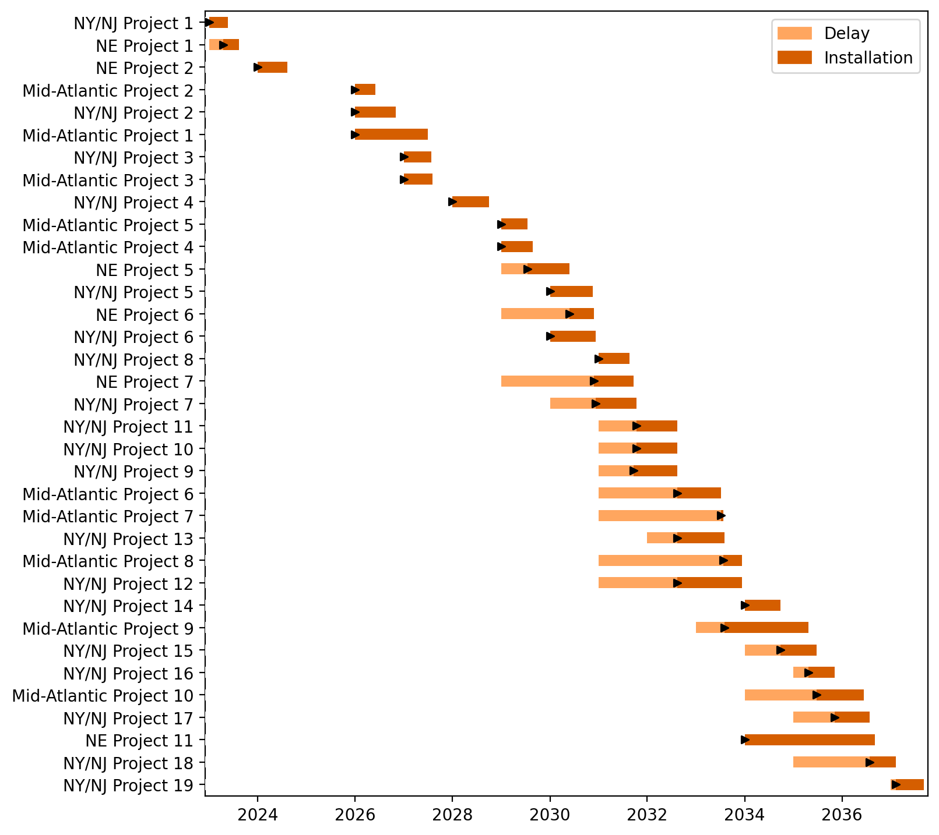
Fixed Gantt

Slide 18
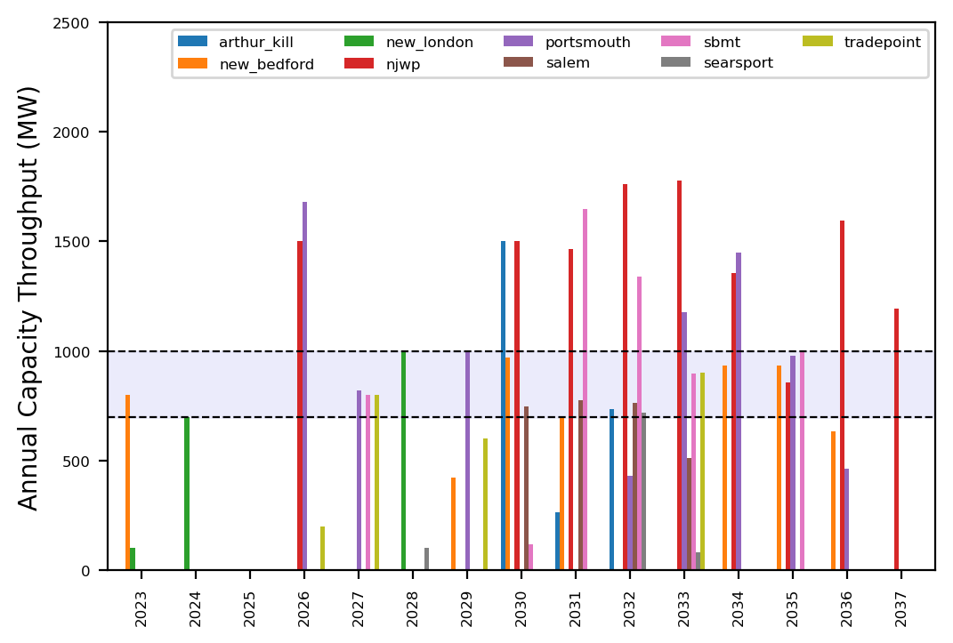
Port Throughput

Slide 19
Summary Plots
Plots comparing runs

Slide 20
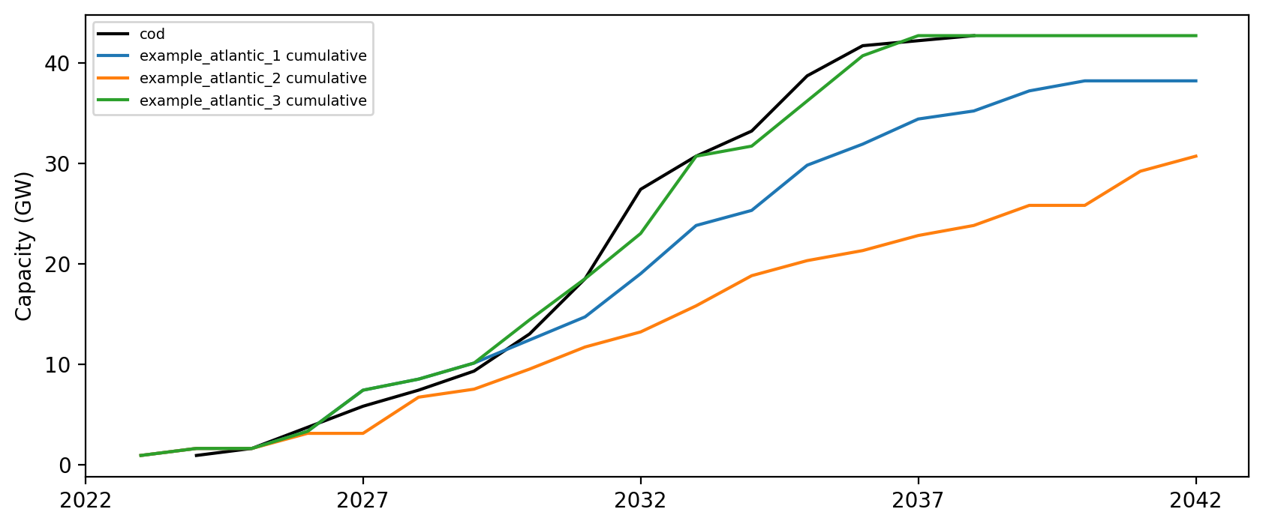
Cumulative Installed Capacity

Slide 21
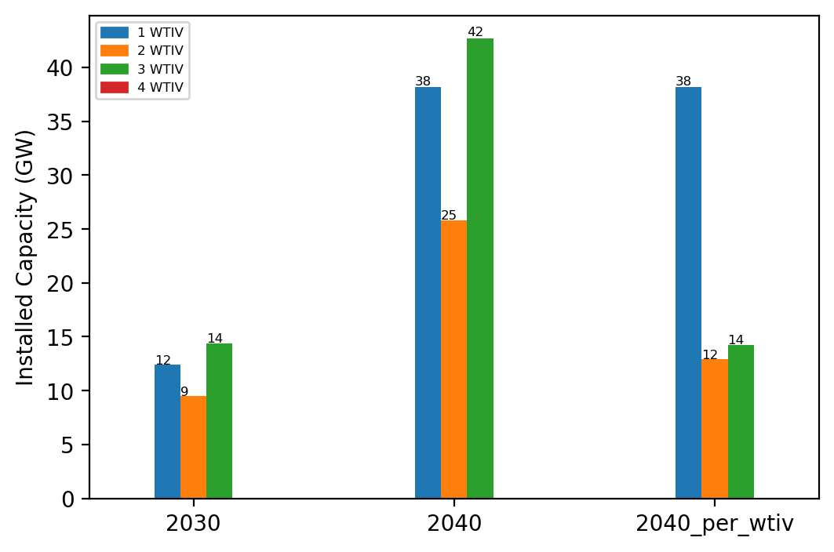
Summary Installed Capacity

