Slide 1
natl_gaps_core_scenario
Pipeline: Natl Vessel Core Scenario
Vessel Pathway: Common
Port Pathway: Common

Slide 2
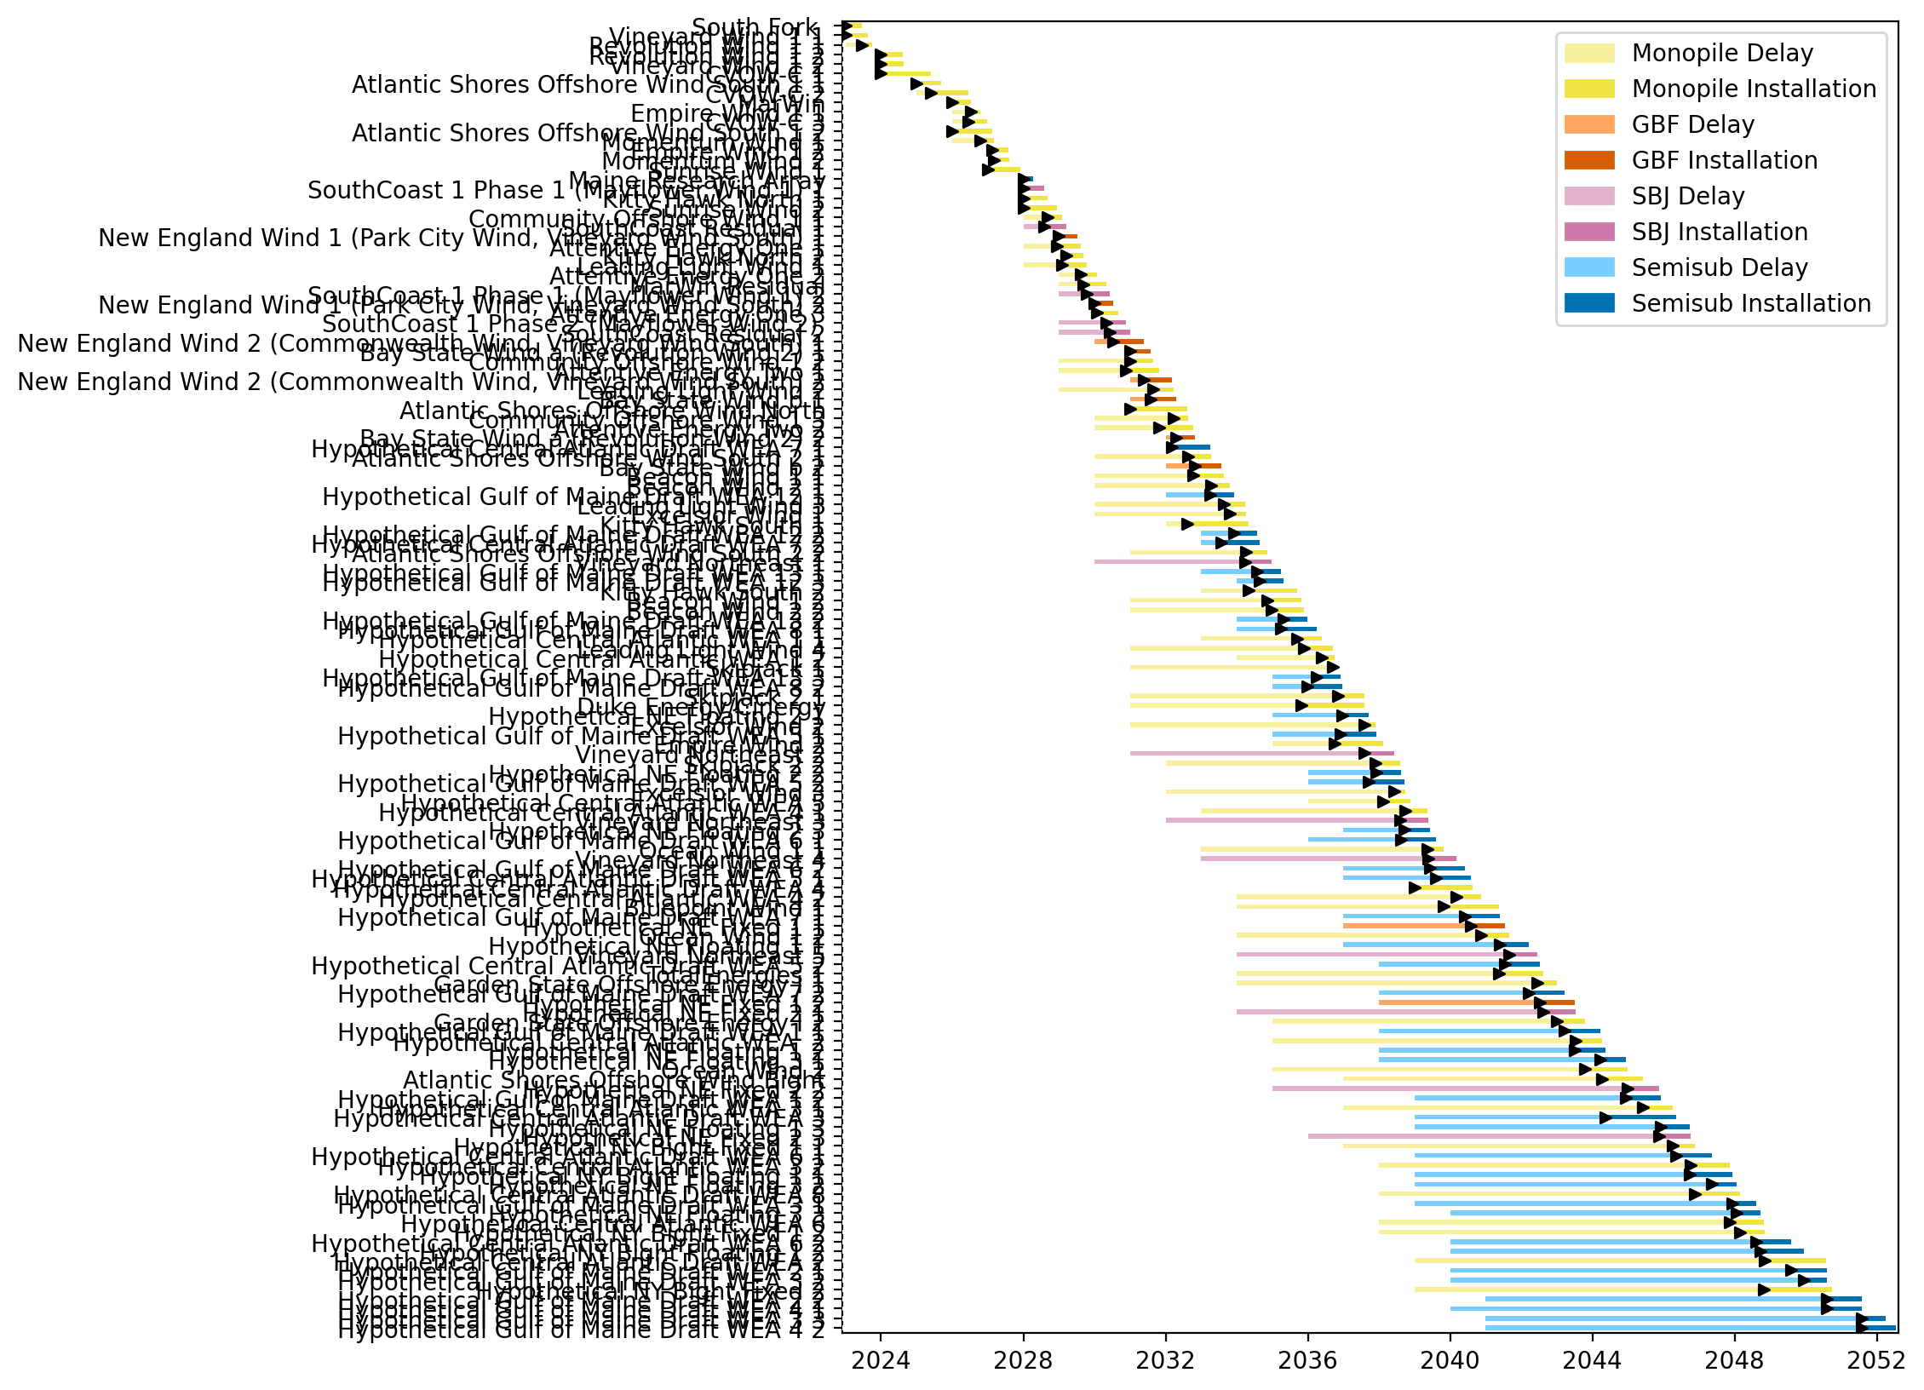
Full Gantt

Slide 3
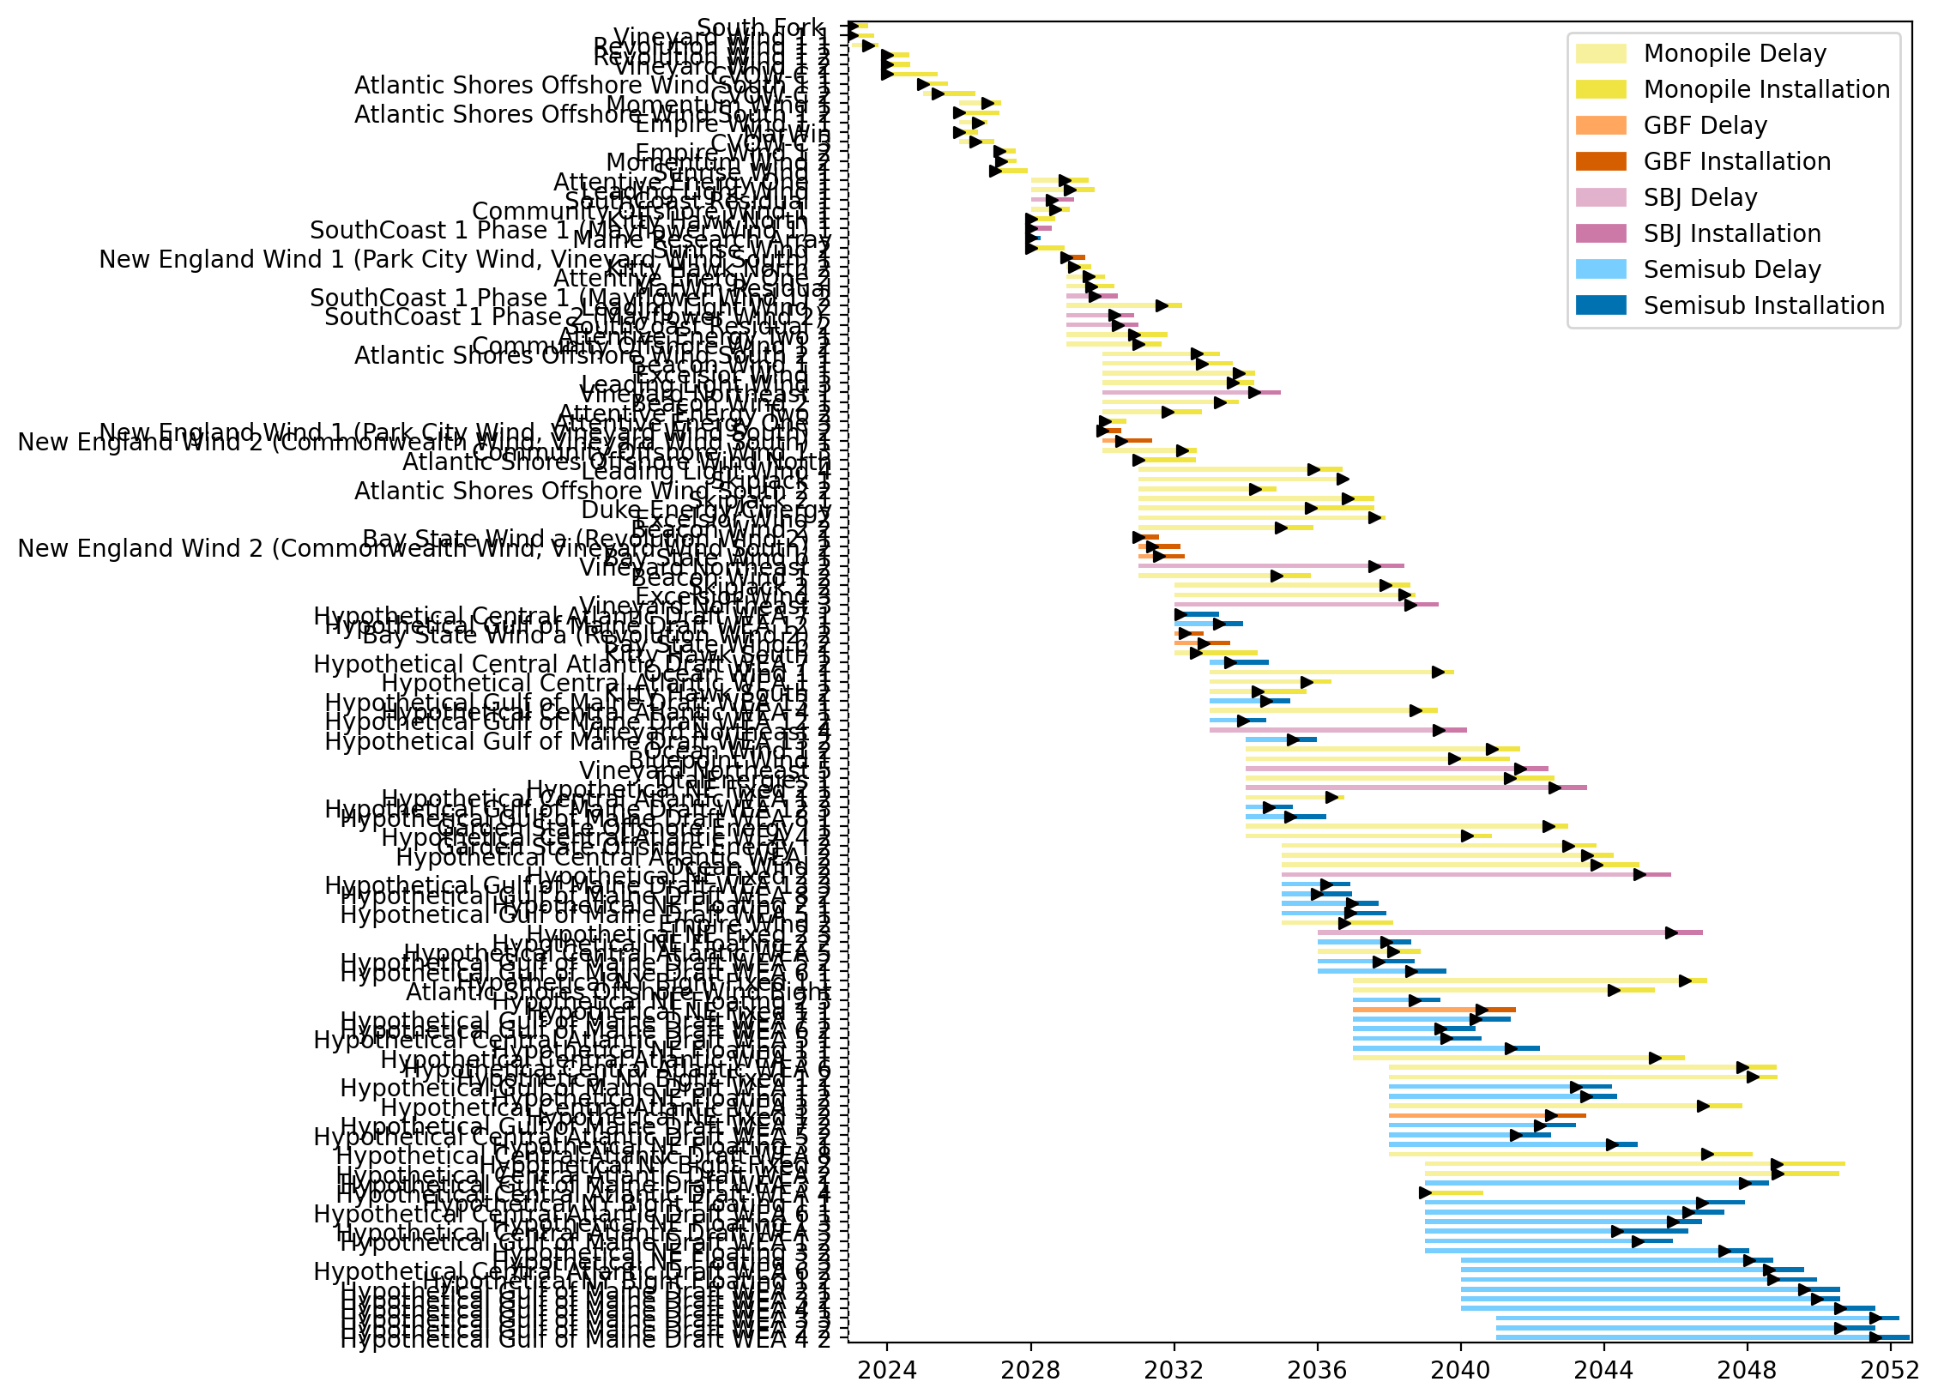
Sorted Full Gantt

Slide 4
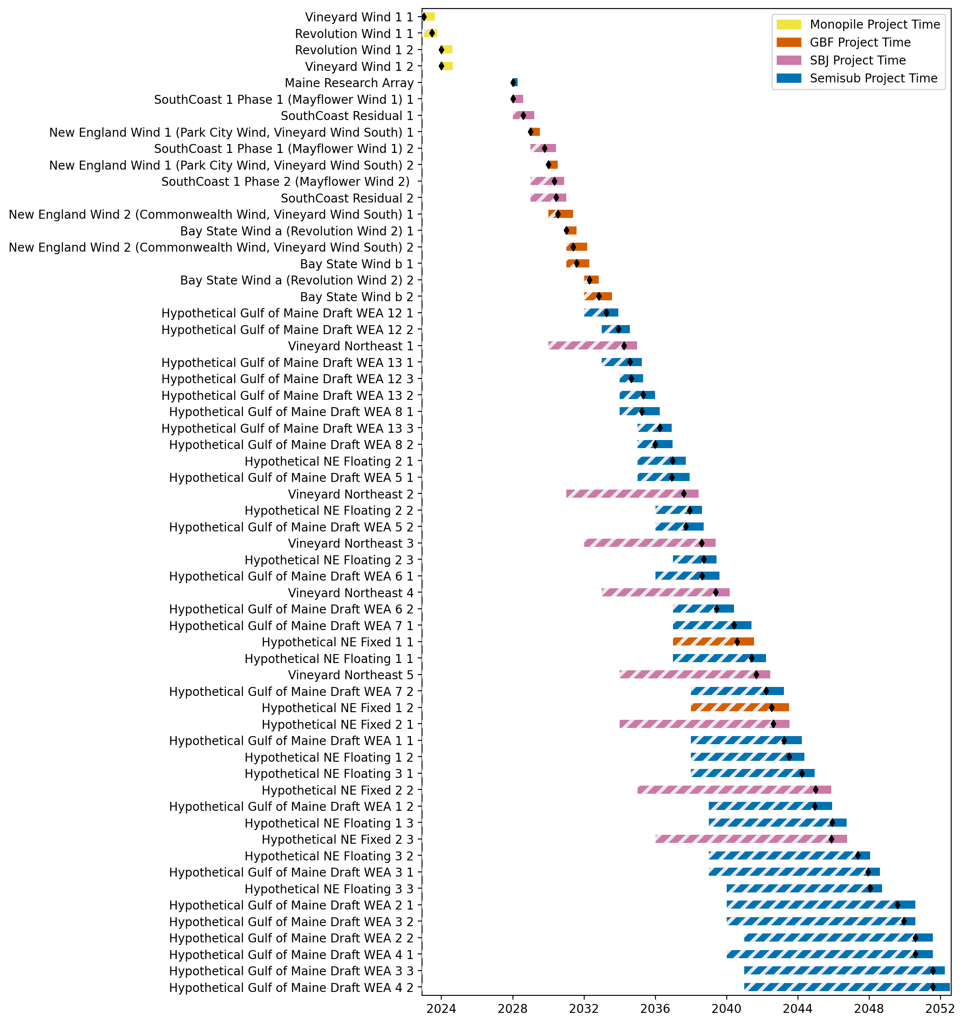
New England Gantt

Slide 5
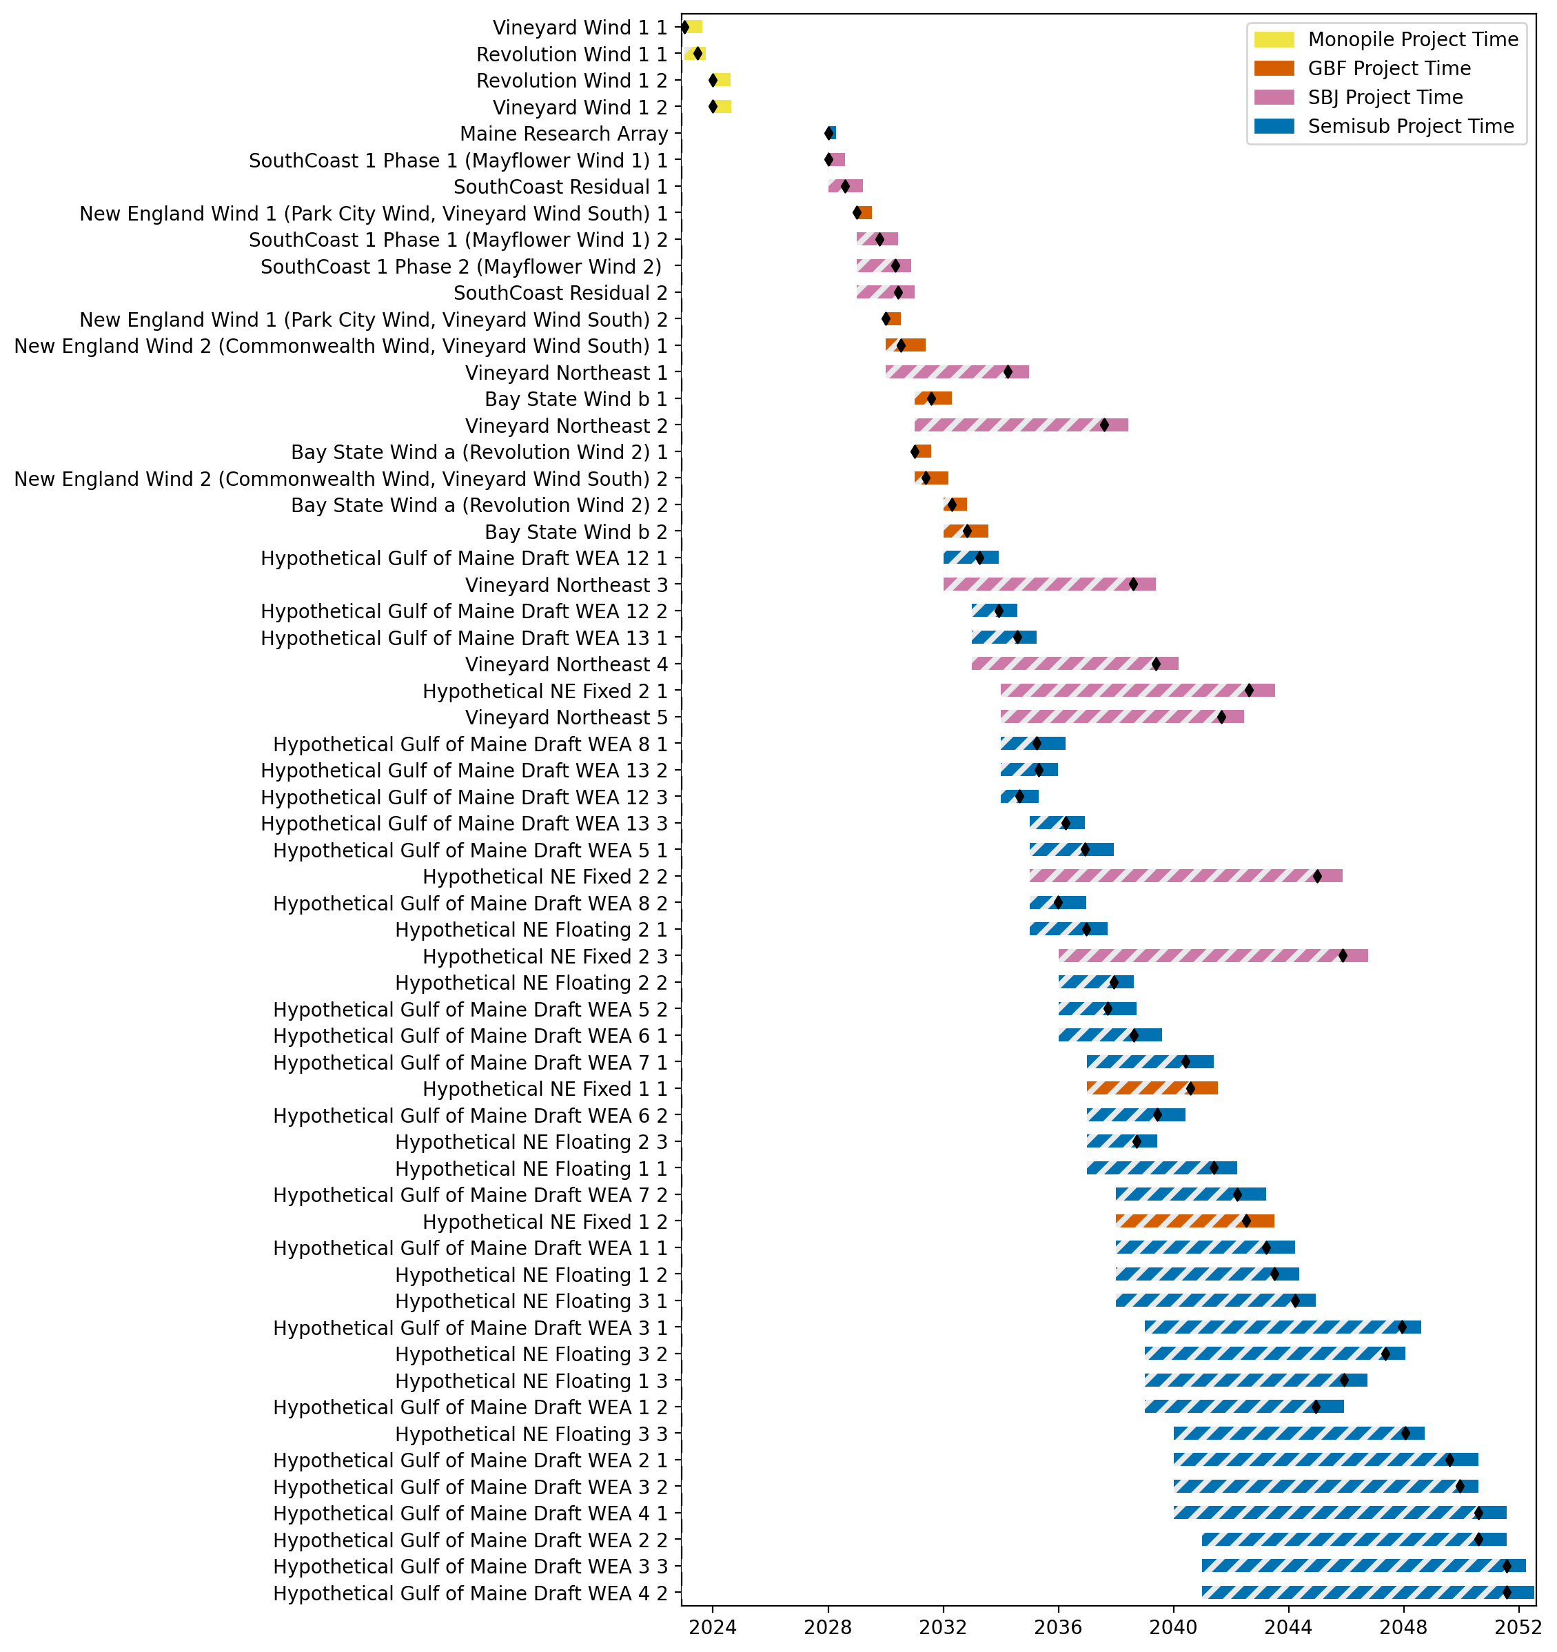
Sorted New England Gantt

Slide 6
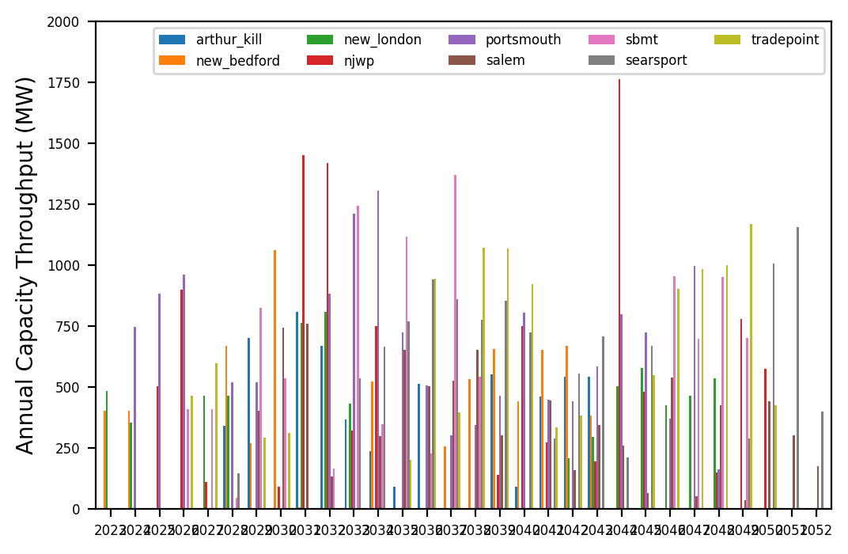
Port Throughput

Slide 7
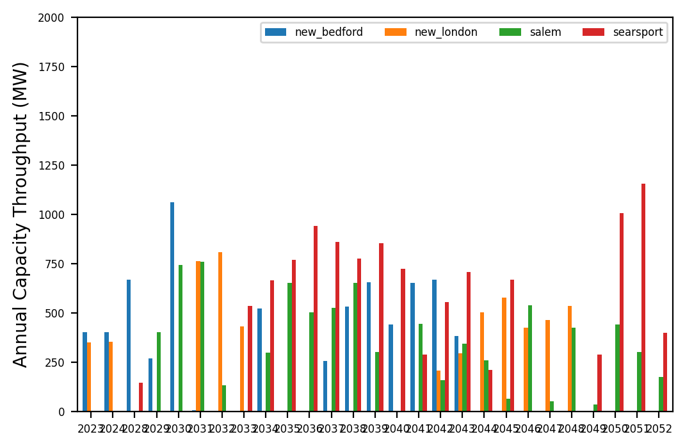
Port Throughput

Slide 8
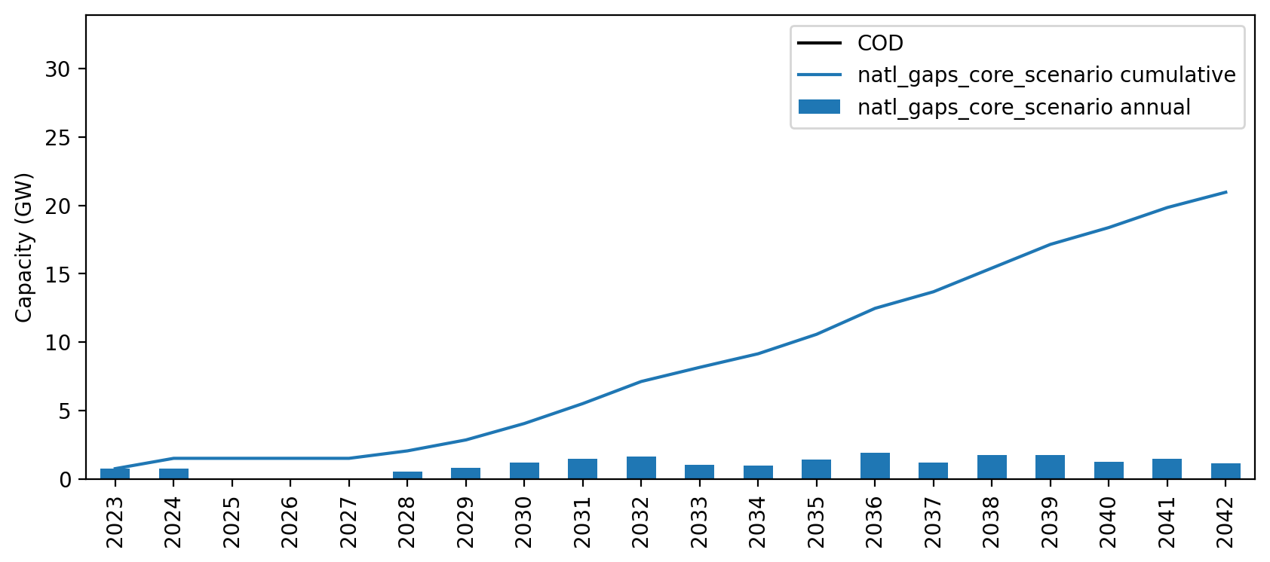
Installed Capacity

Slide 9
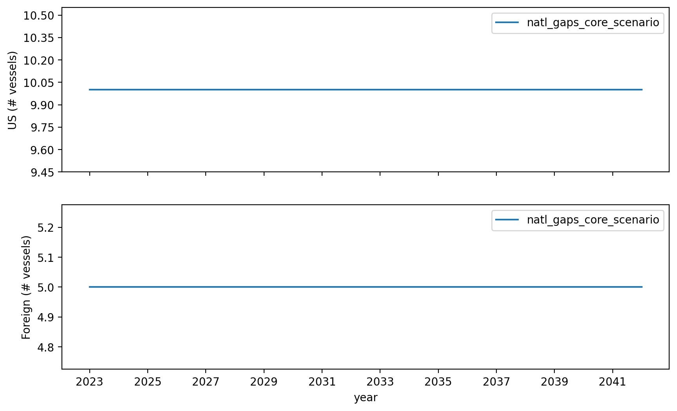
Vessel Investment

Slide 10
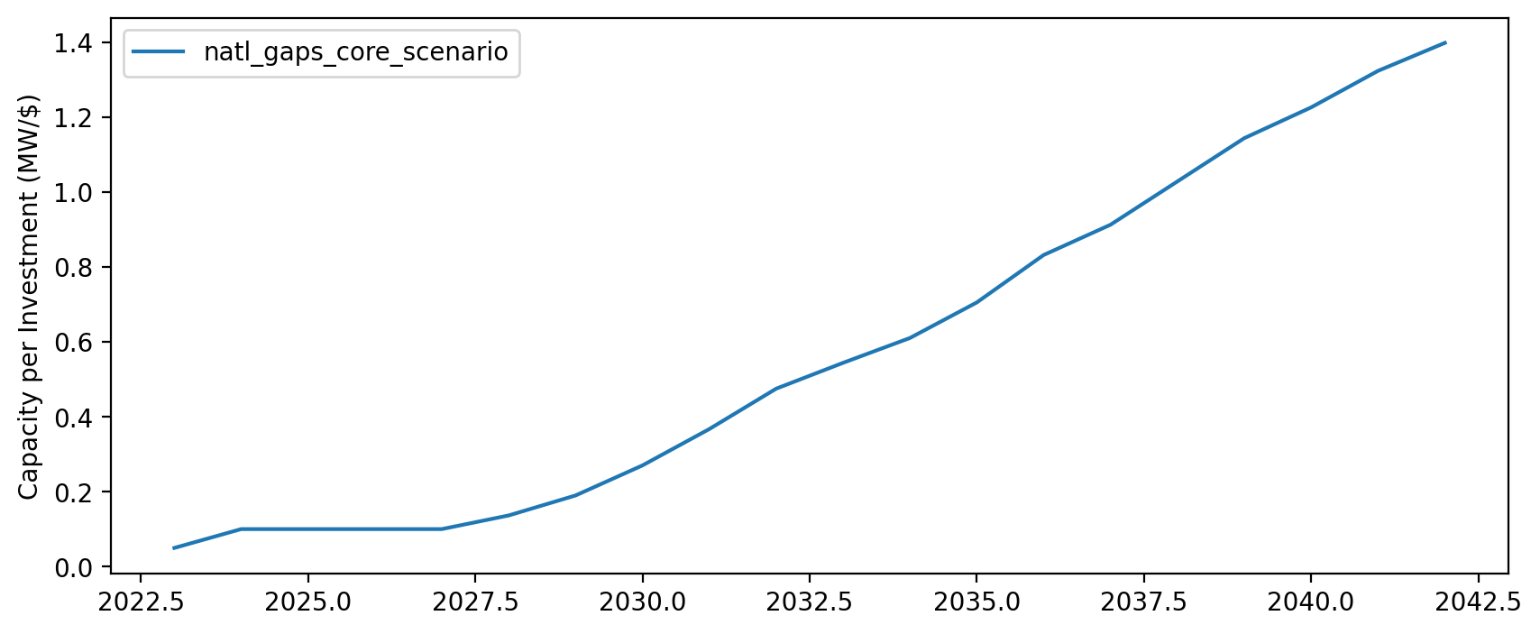
Capacity per Investment (MW/$)

