Slide 1
3_WTIV_removal
1 US WTIV starting with CVOW, then 1 in 2030, 2033. Foreign WTIV removed from pool in 2030

Slide 2
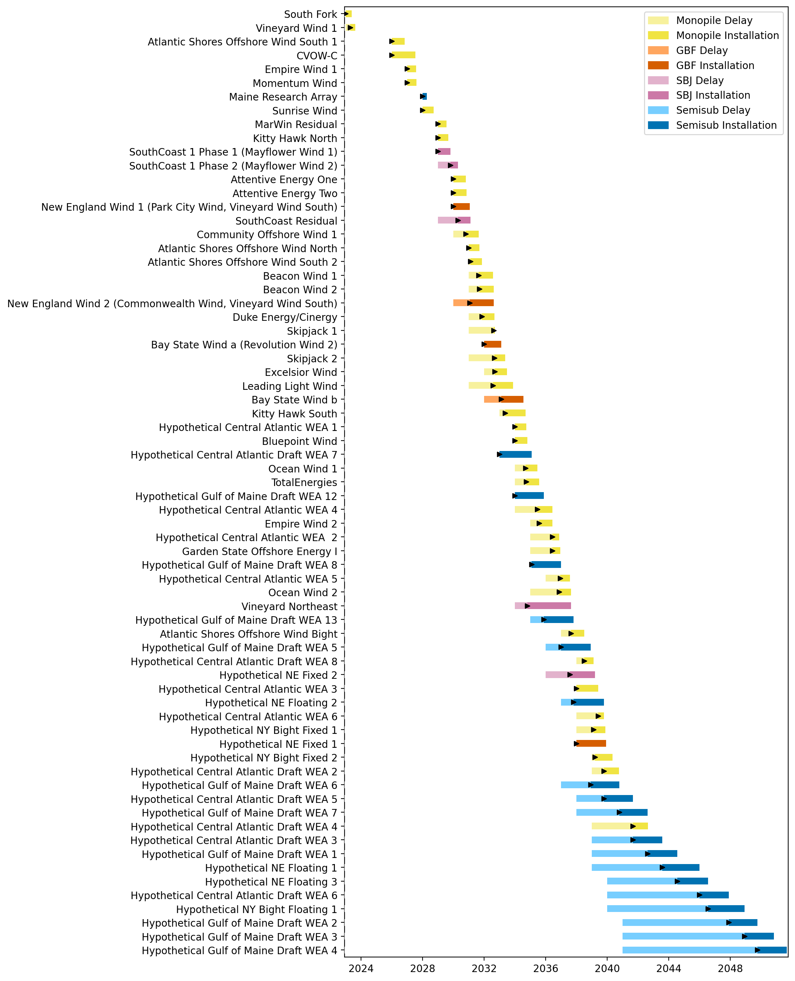
Full Gantt

Slide 3
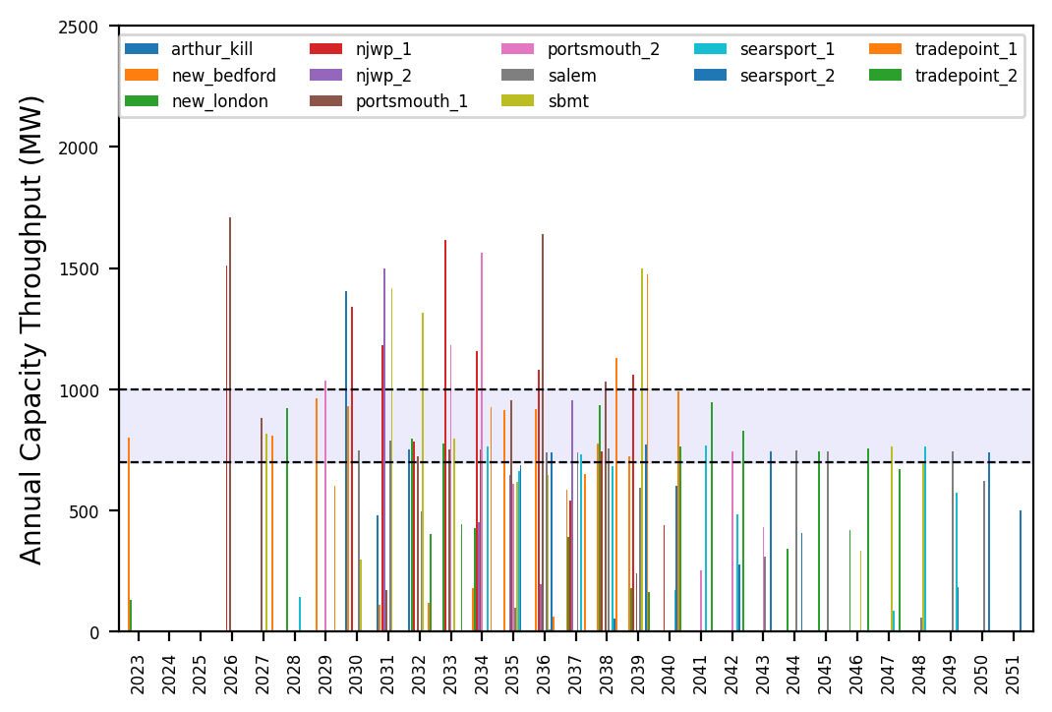
Port Throughput

Slide 4
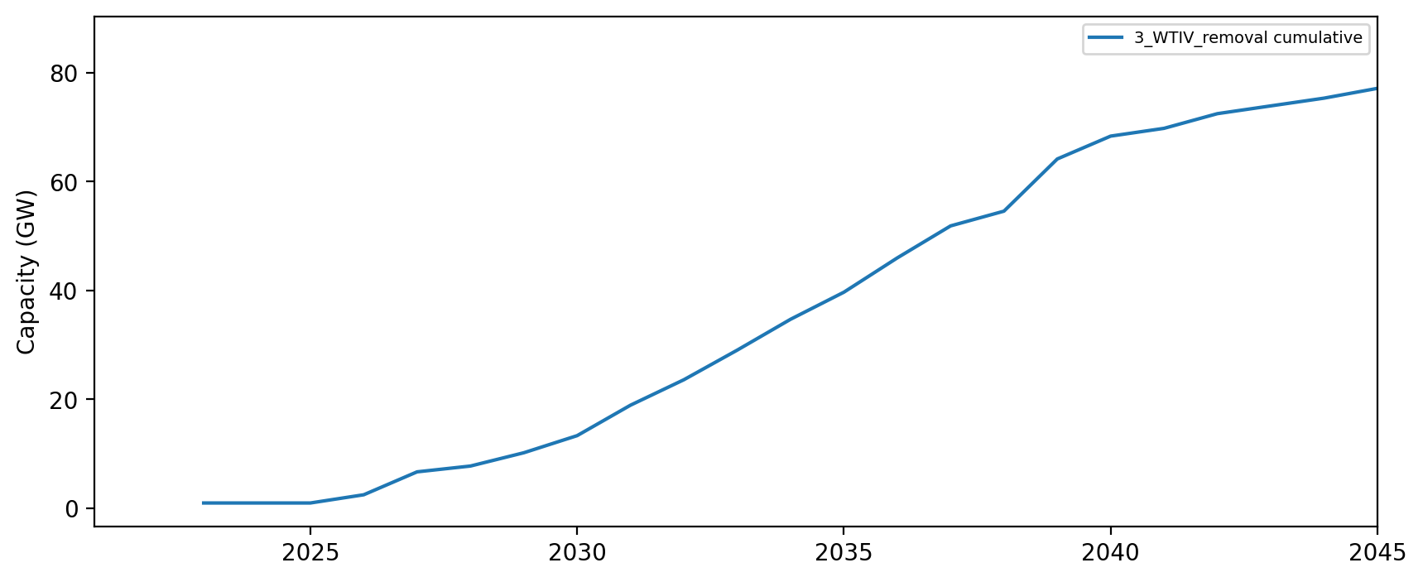
Installed Capacity

