Slide 1
no_action
1 US WTIV starting with CVOW

Slide 2
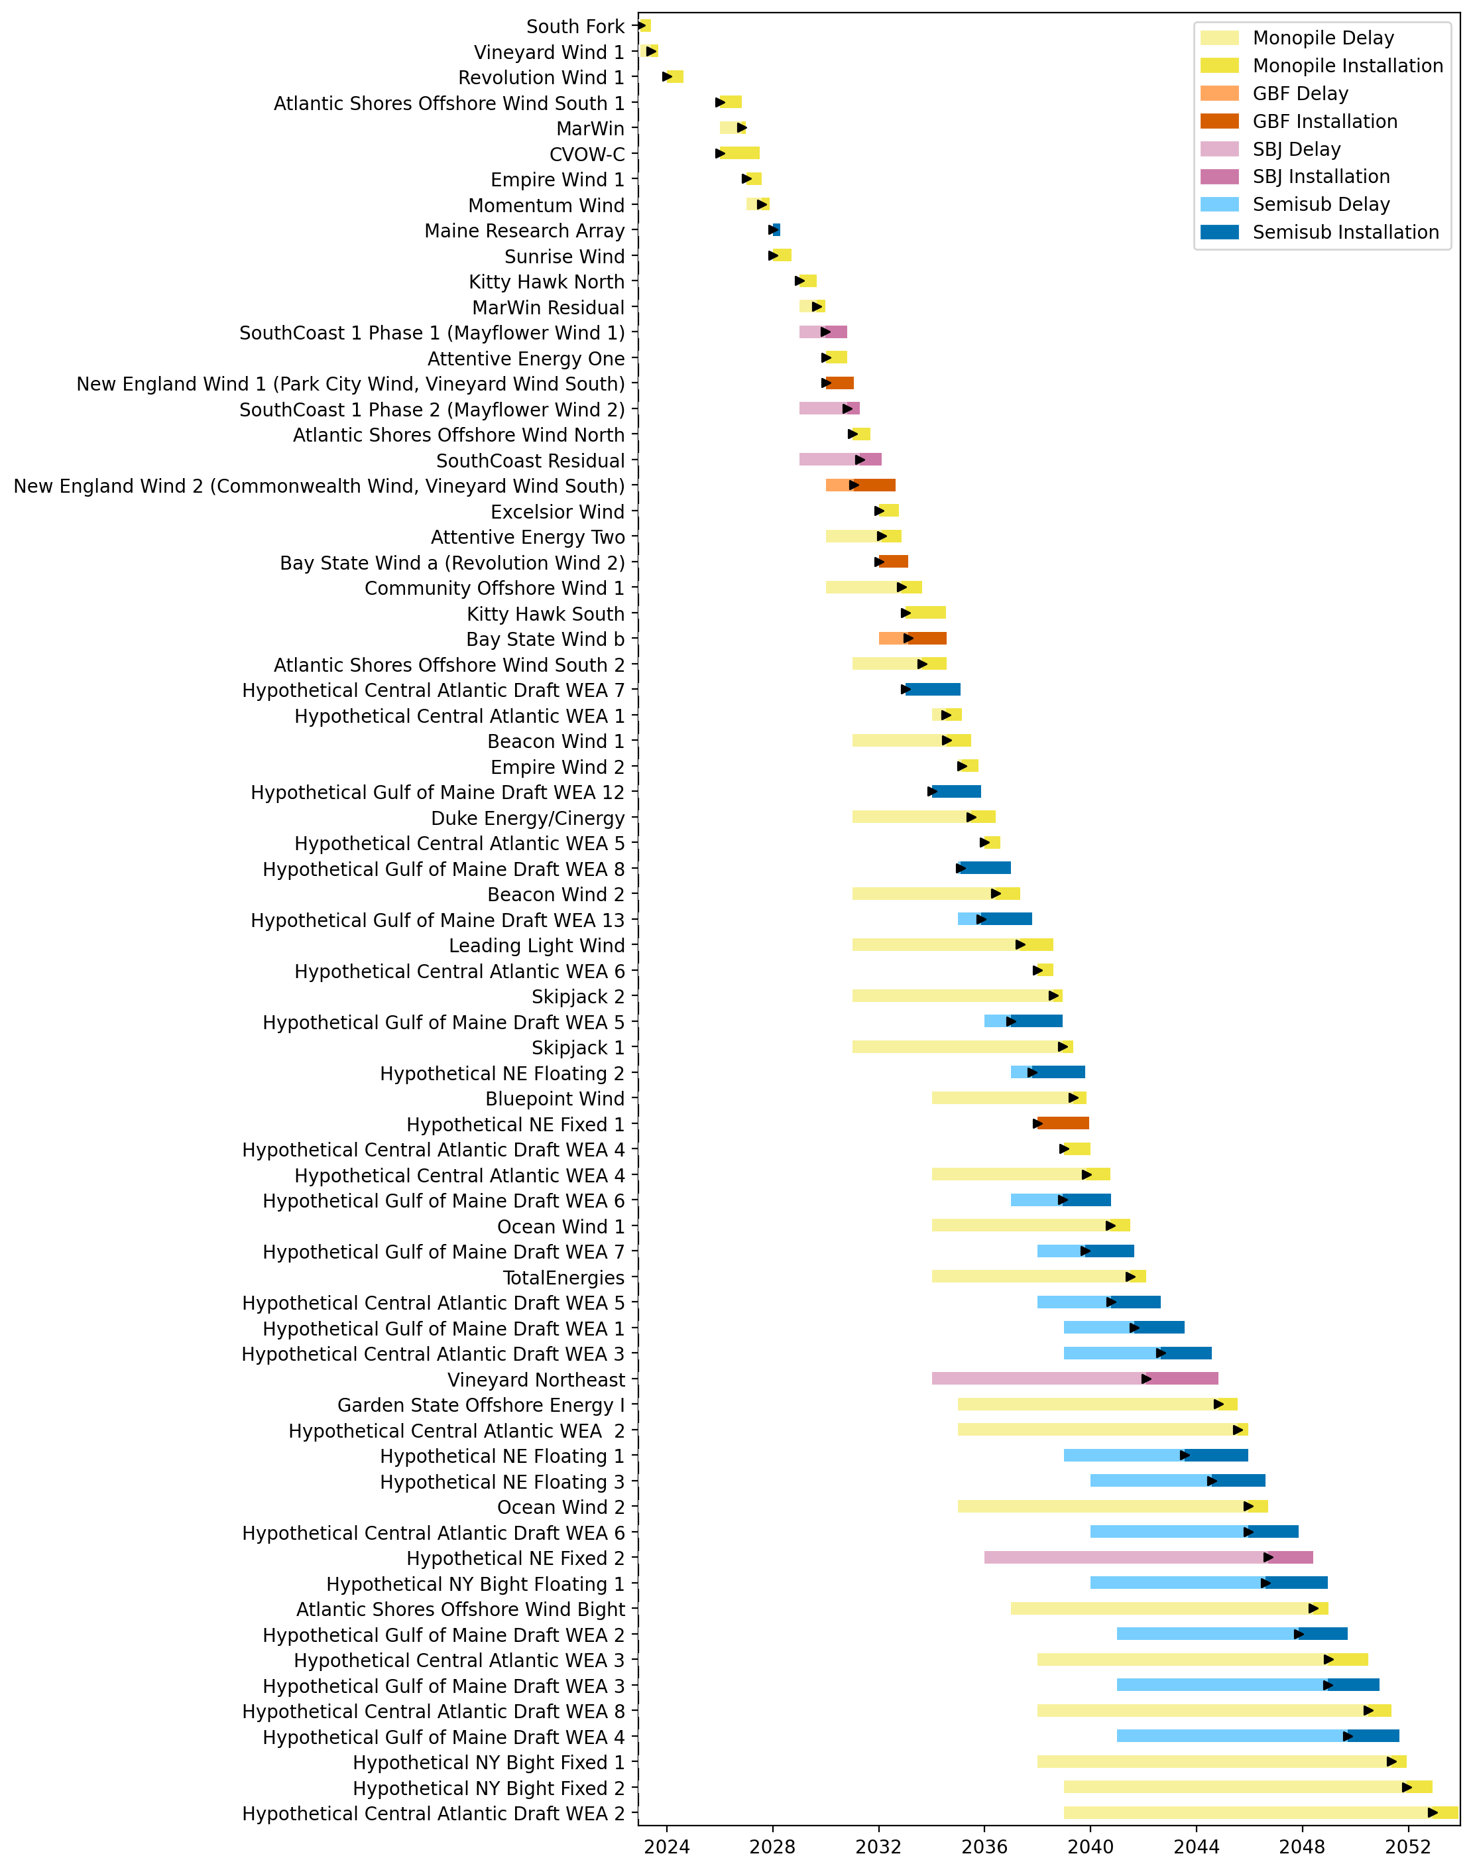
Full Gantt

Slide 3
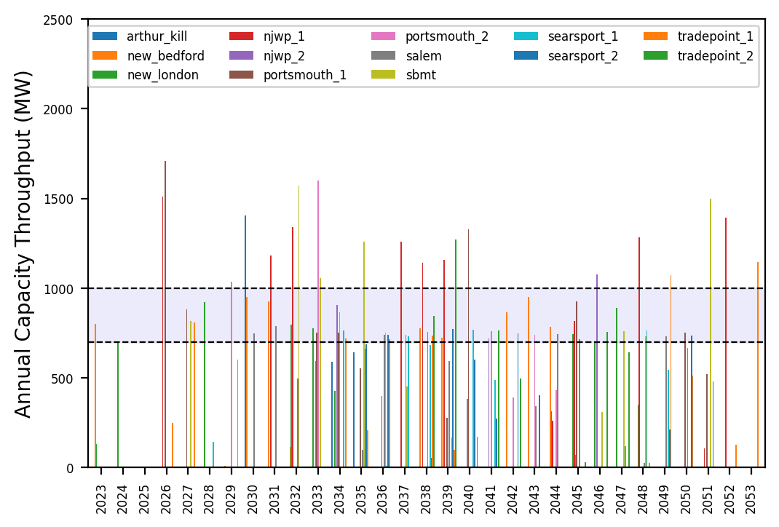
Port Throughput

Slide 4
3_WTIV
1 US WTIV starting with CVOW, then 1 in 2030, 2033. Foreign WTIV removed from pool in 2030

Slide 5
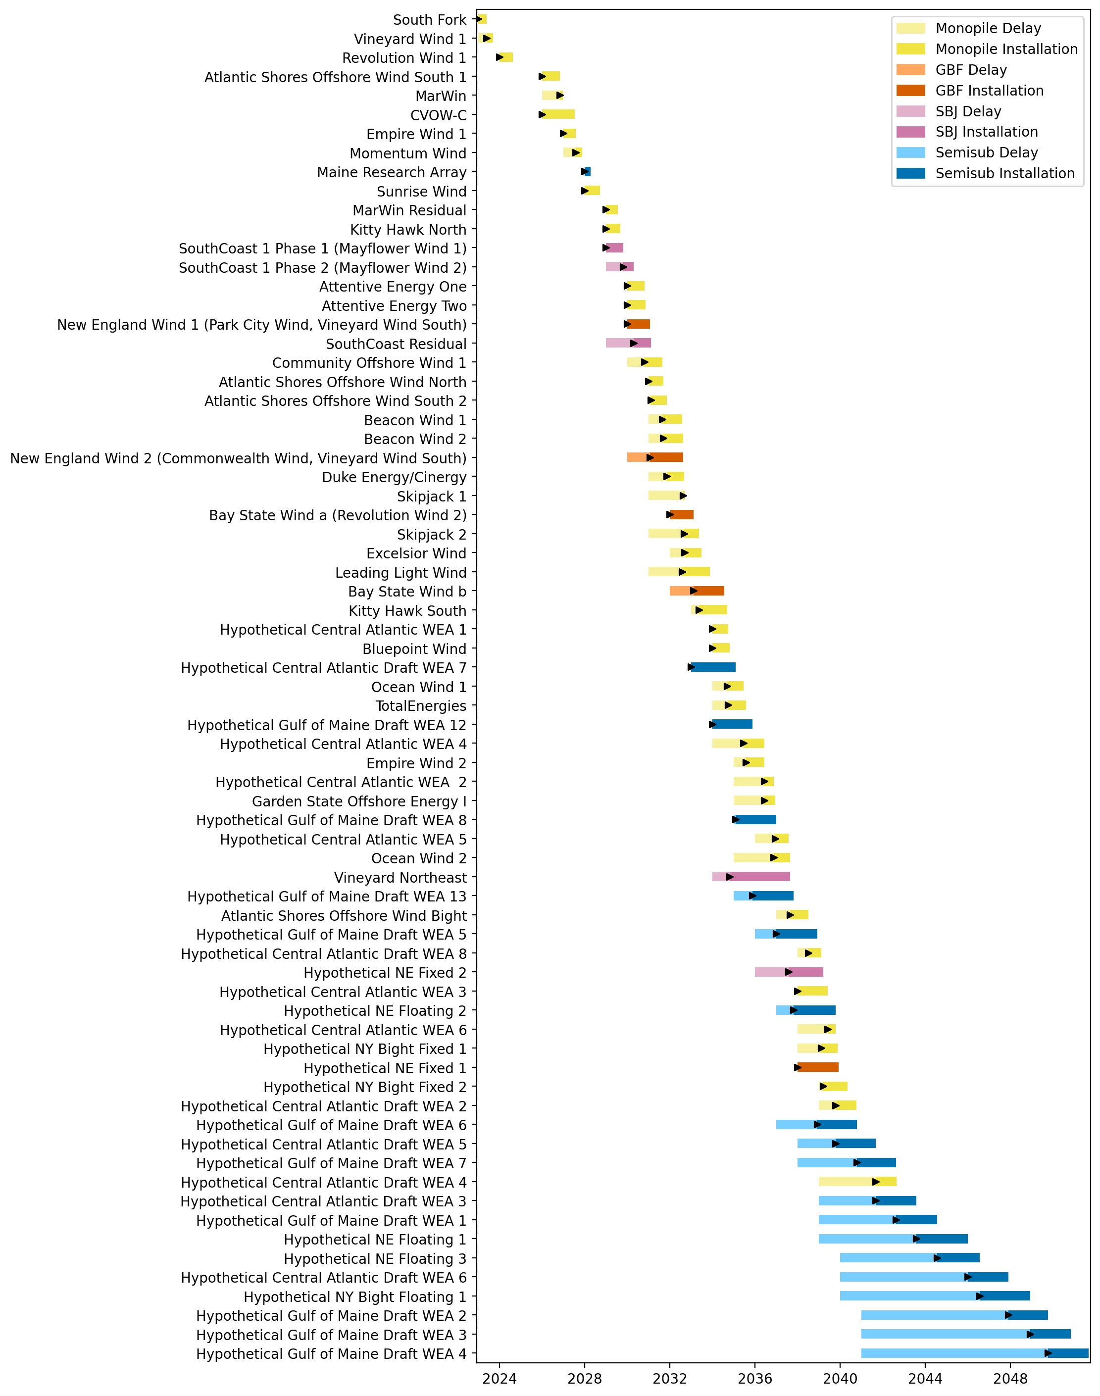
Full Gantt

Slide 6
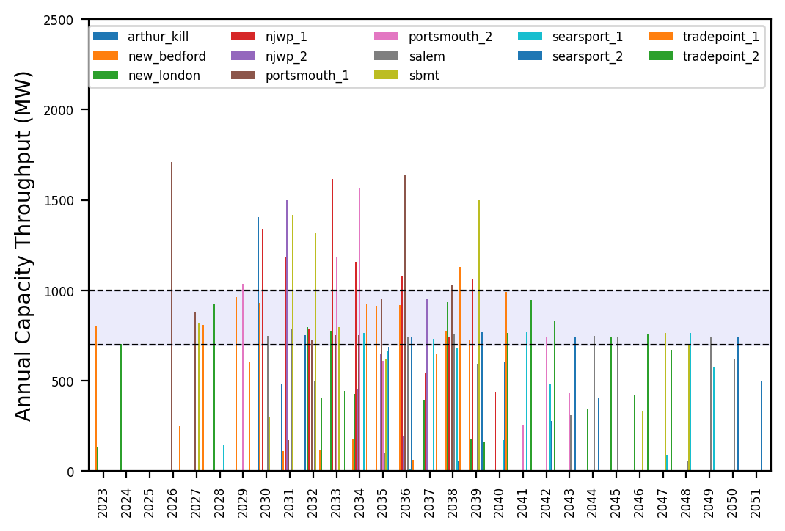
Port Throughput

Slide 7
10_Feeders
2 Feeders added every 2 years from 2026-2030. 1 Foreign WTIV and FFIV is recruited for every 2 feeders built

Slide 8
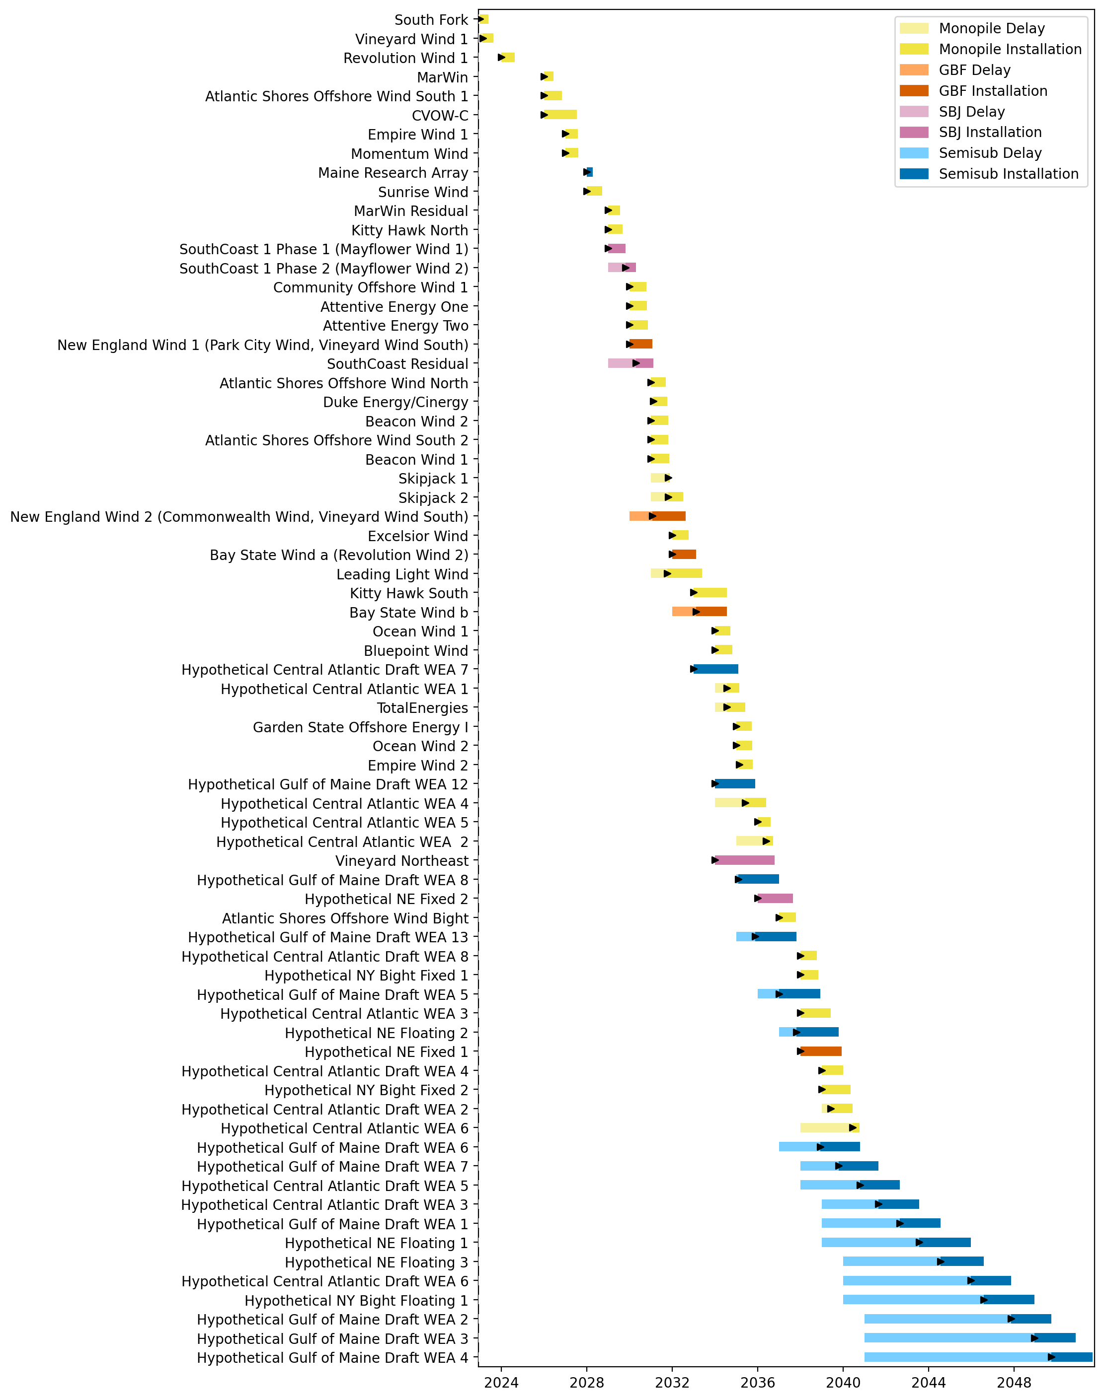
Full Gantt

Slide 9
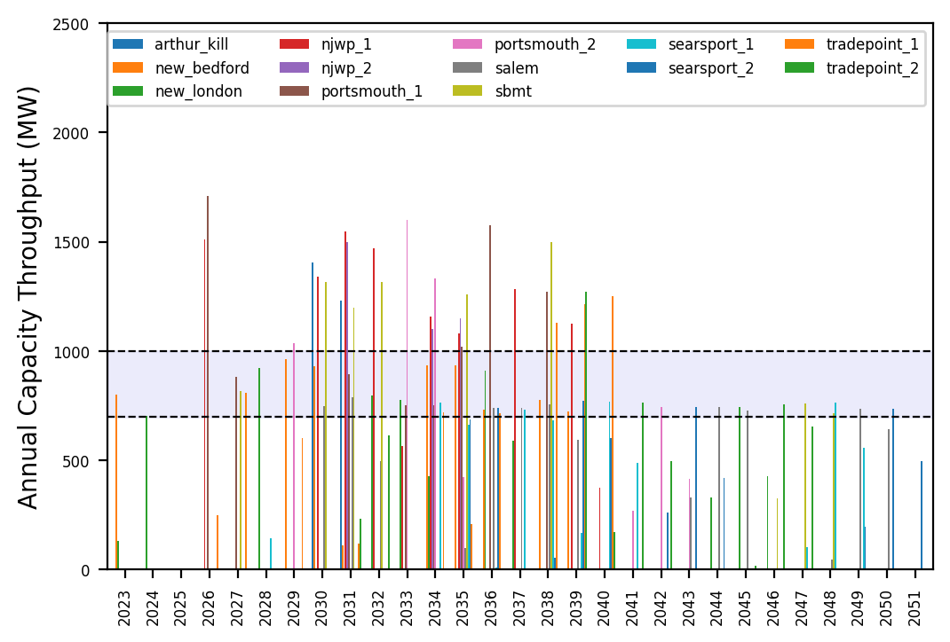
Port Throughput

Slide 10
10_Feeders_No_Foreign_WTIVs
2 Feeders added every 2 years from 2026-2030. 0 Foreign WTIVs and 1 Foreign FFIV is recruited throughout the pipeline.

Slide 11
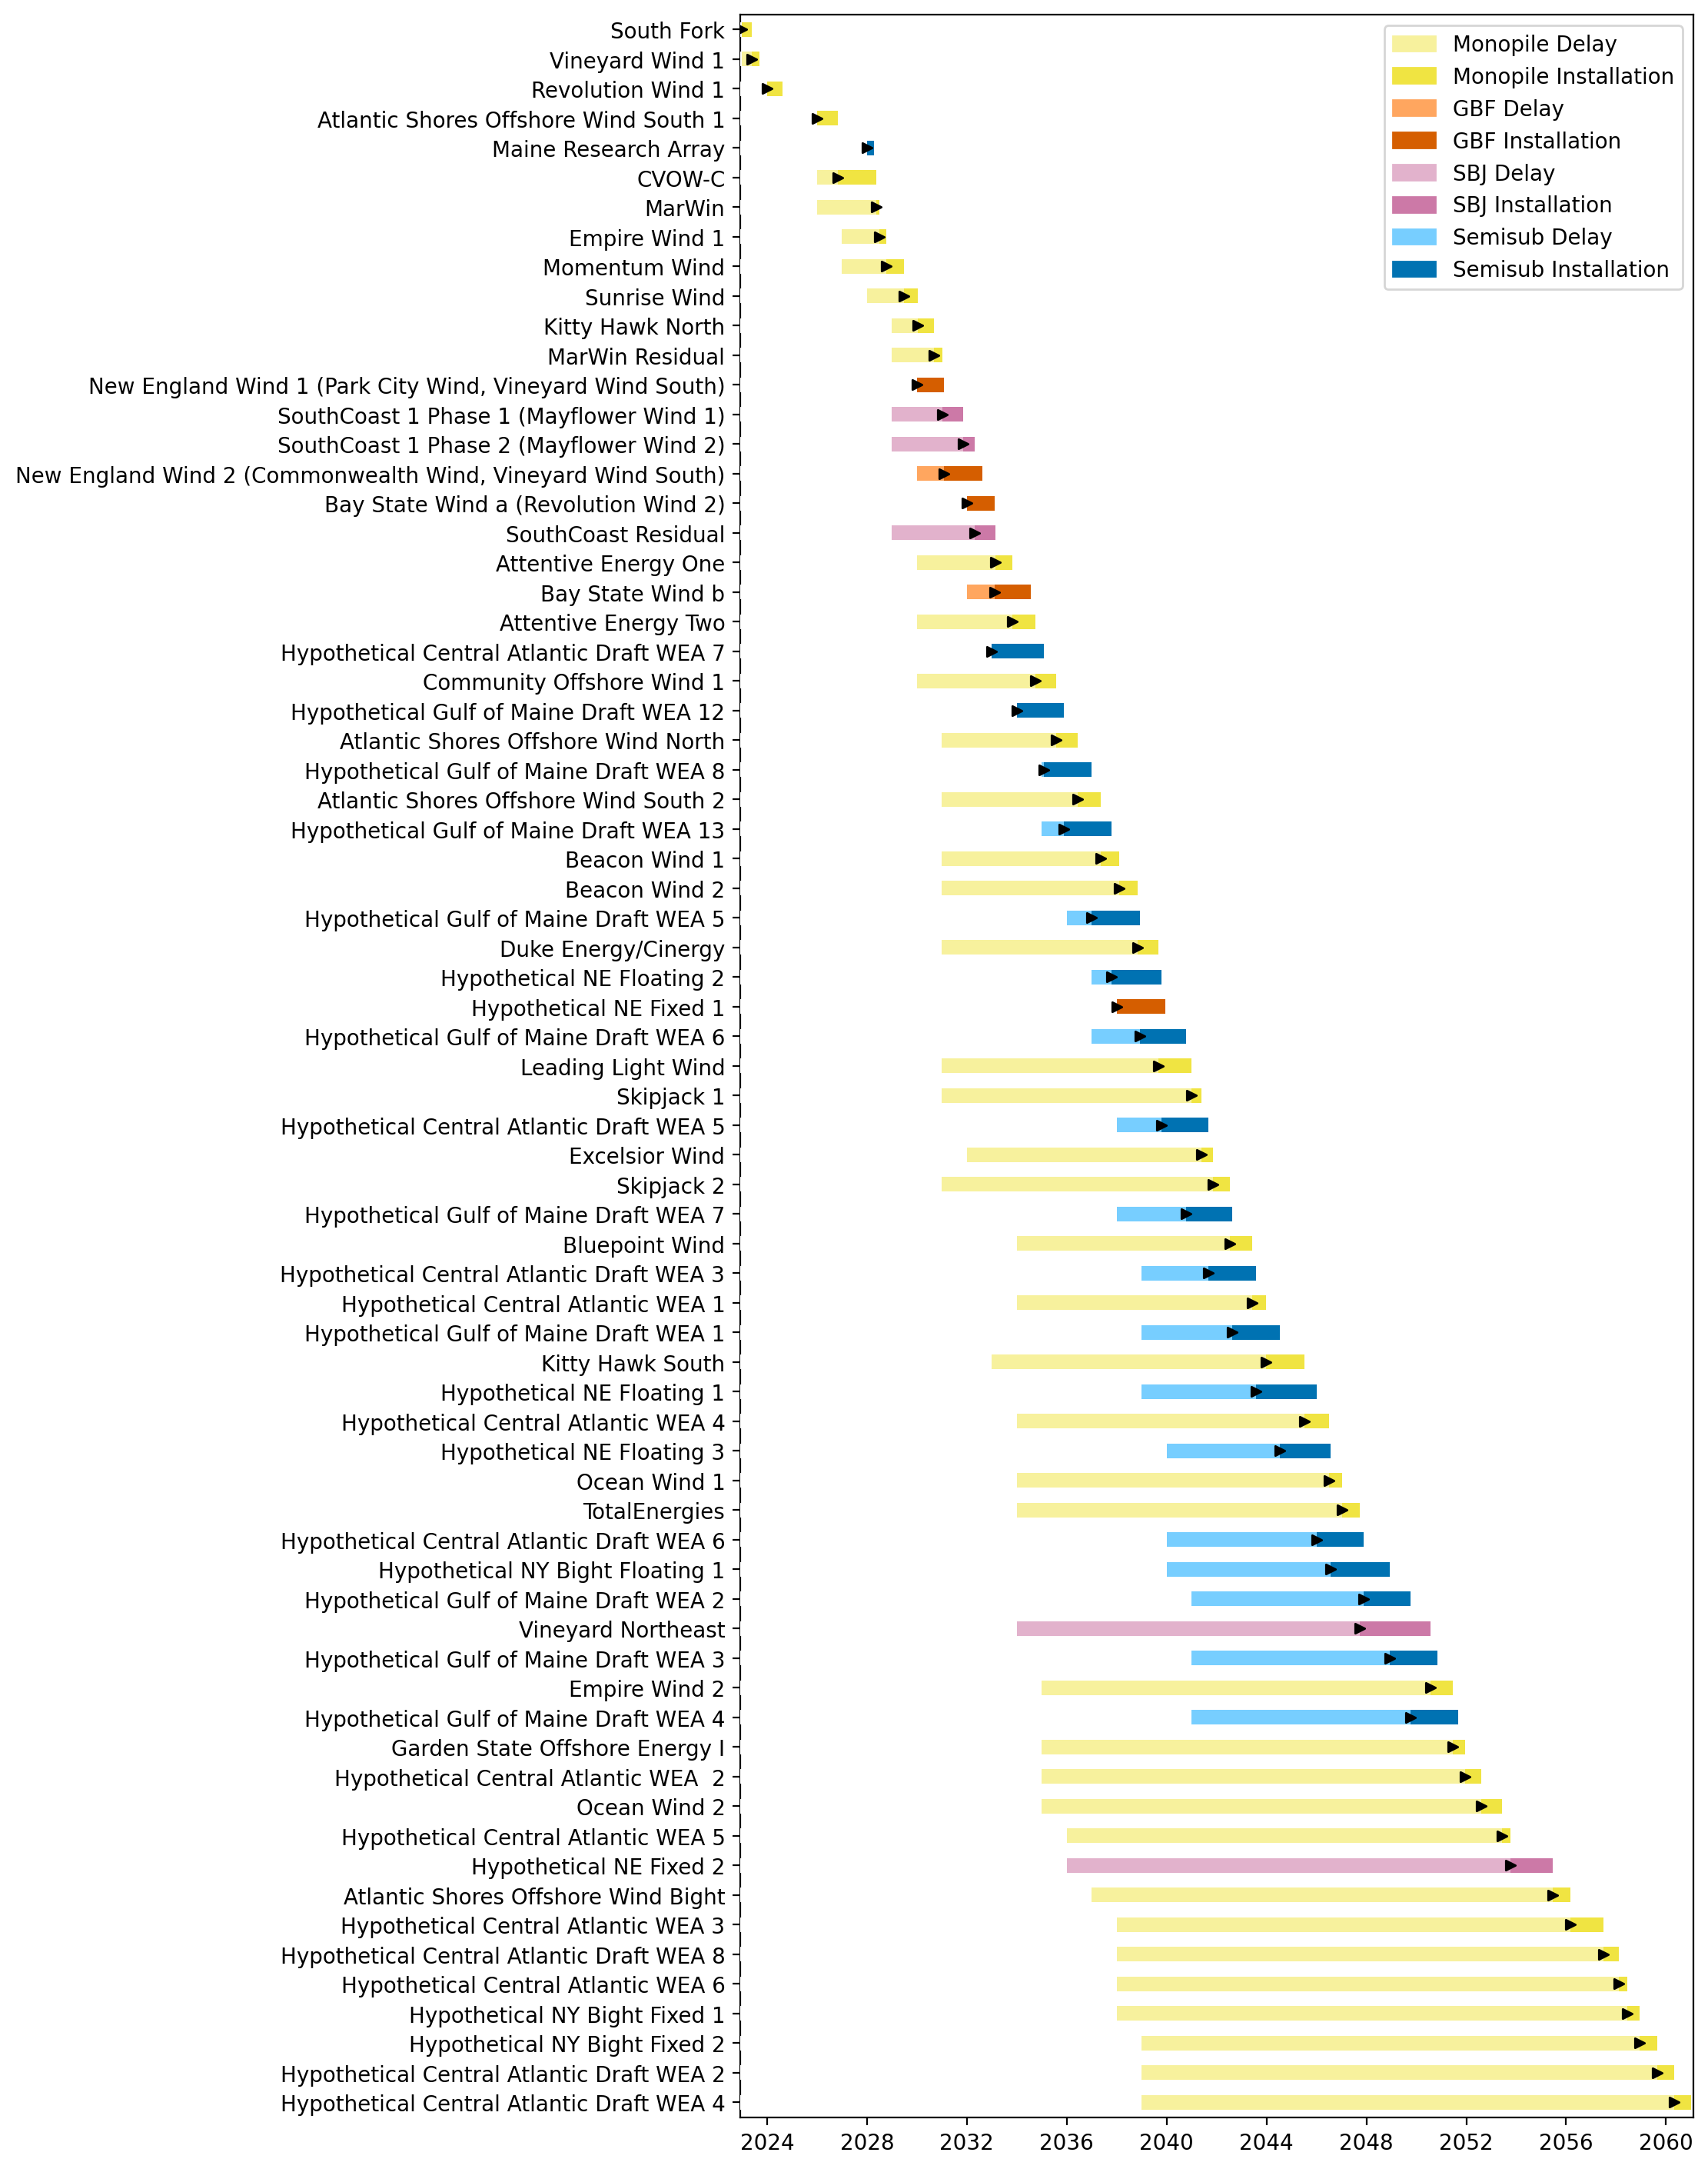
Full Gantt

Slide 12
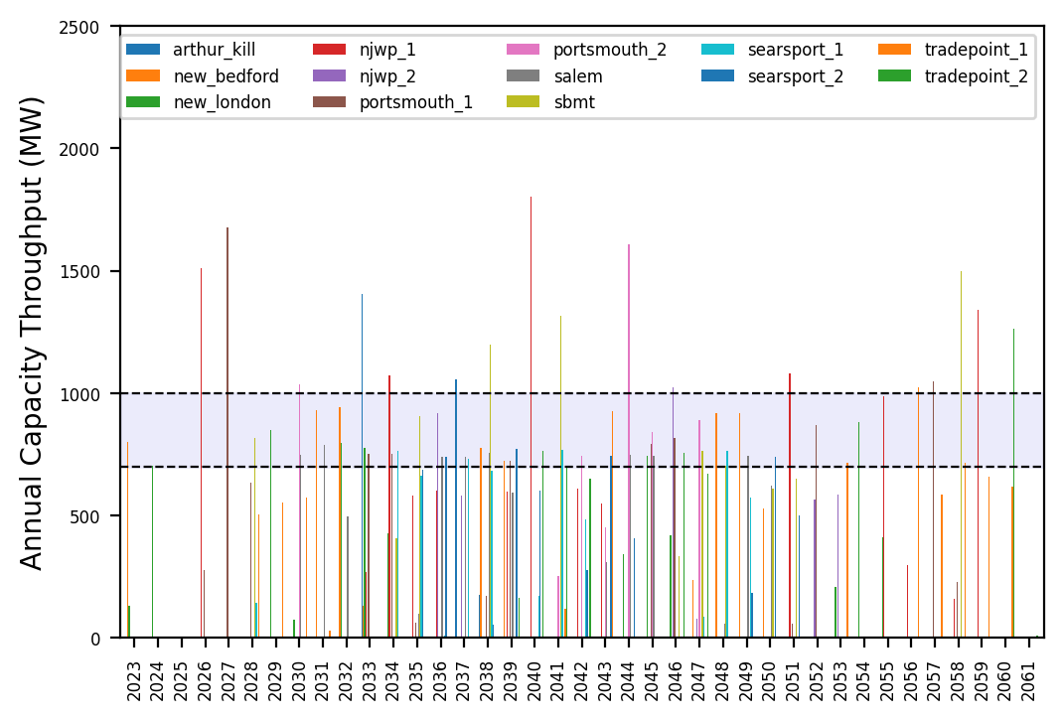
Port Throughput

Slide 13
6_AHTS
4 additional AHTS vessels, with 2 AHTS built every 3 years starting in 2033

Slide 14
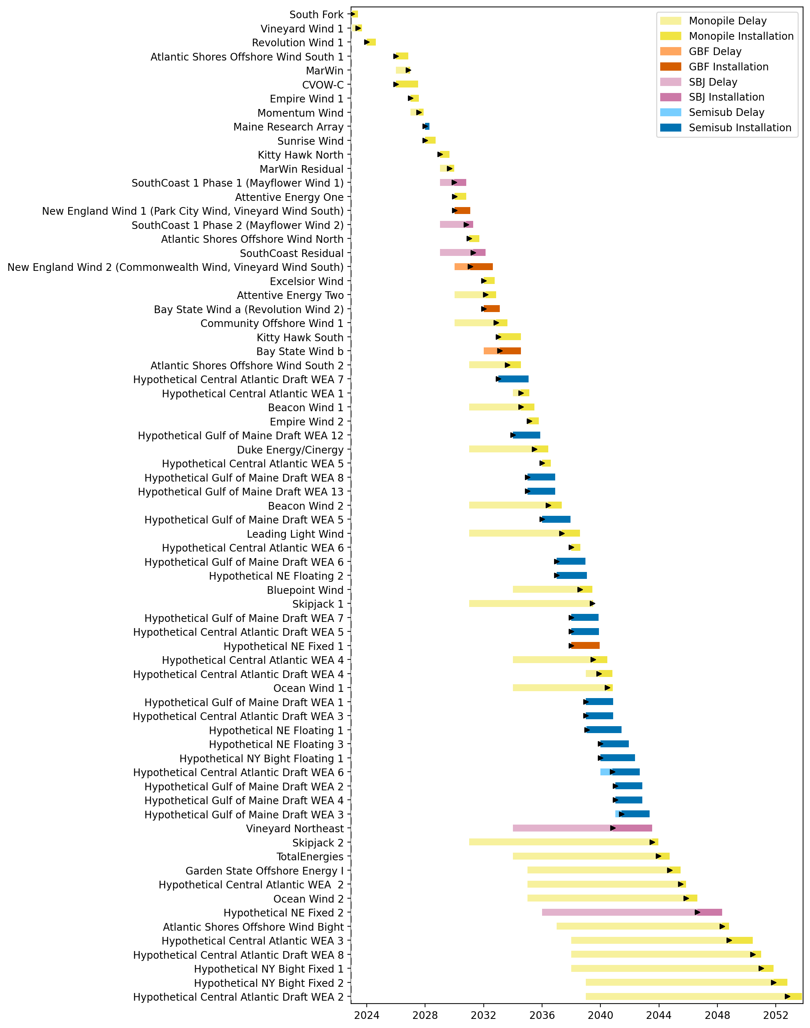
Full Gantt

Slide 15
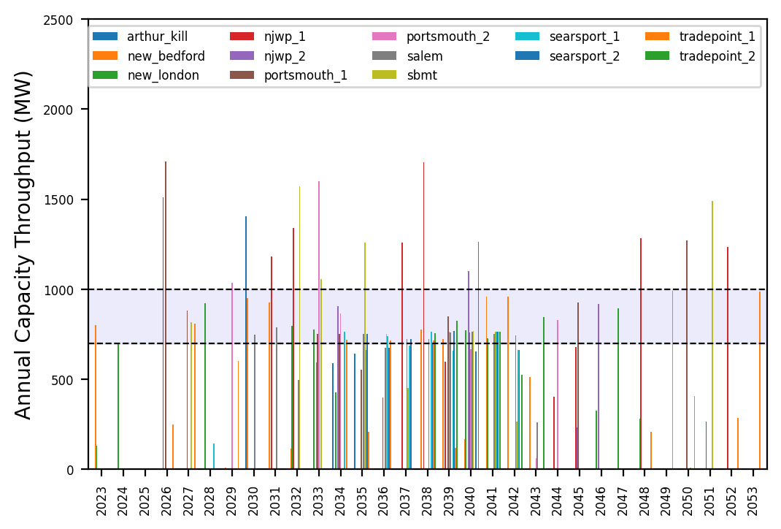
Port Throughput

Slide 16
Hybrid_3_WTIV_6_AHTS_6_Feeders
1 Foreign WTIV and 1 FFIV recruited in 2026, 2 feeders built in 2026, US WTIV built in 2030, Foreign WTIV leaves pipeline in 2030, 2 AHTS built every 3 years starting in 2033

Slide 17
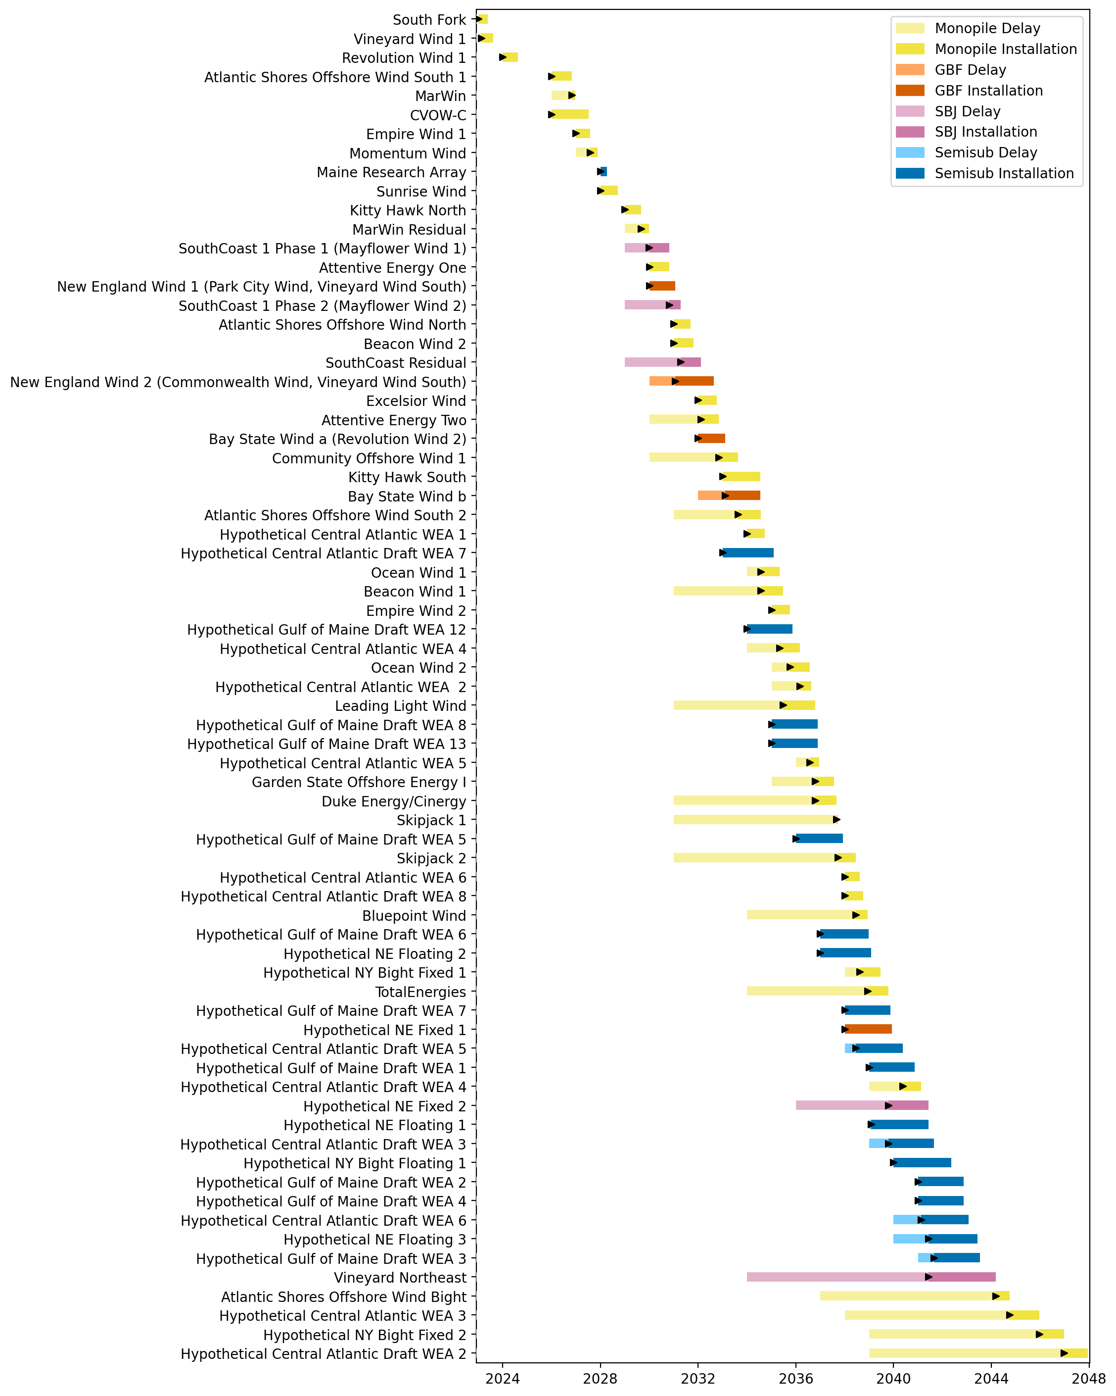
Full Gantt

Slide 18
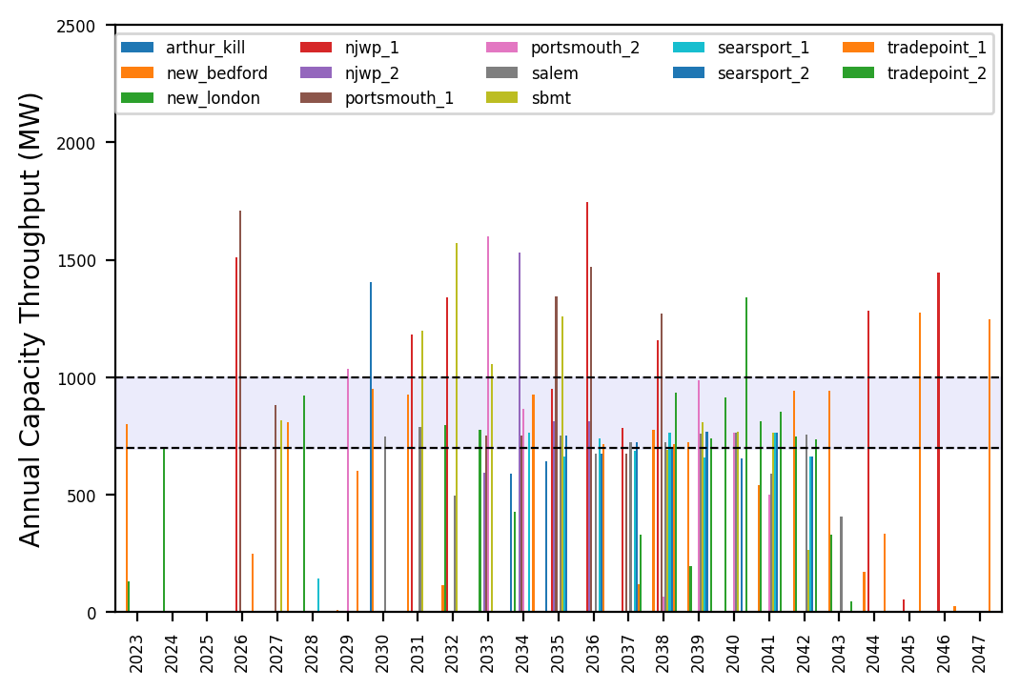
Port Throughput

Slide 19
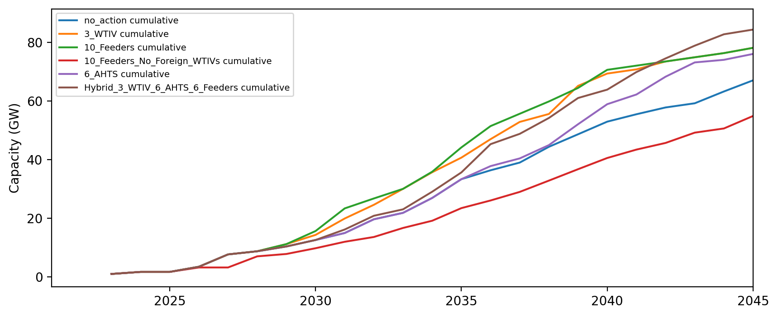
Installed Capacity

