Slide 1
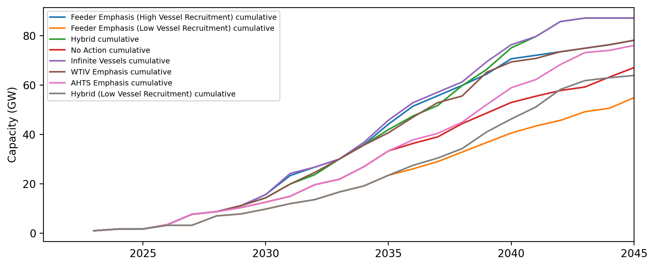
Installed Capacity

Slide 2
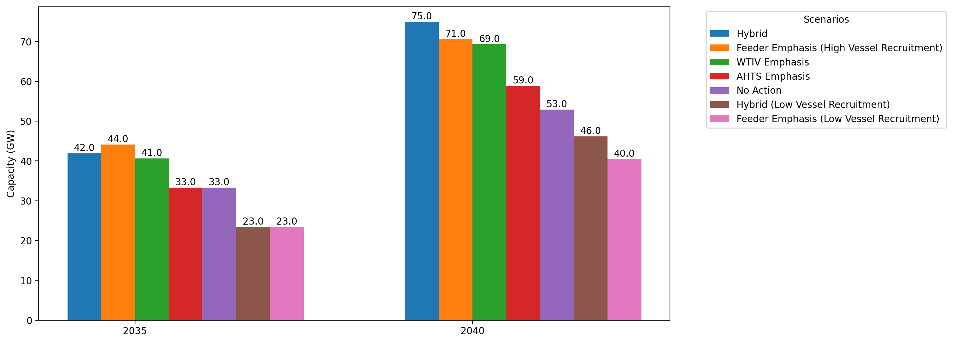
Cumulative Capacity by 2035 and 2040

Slide 3
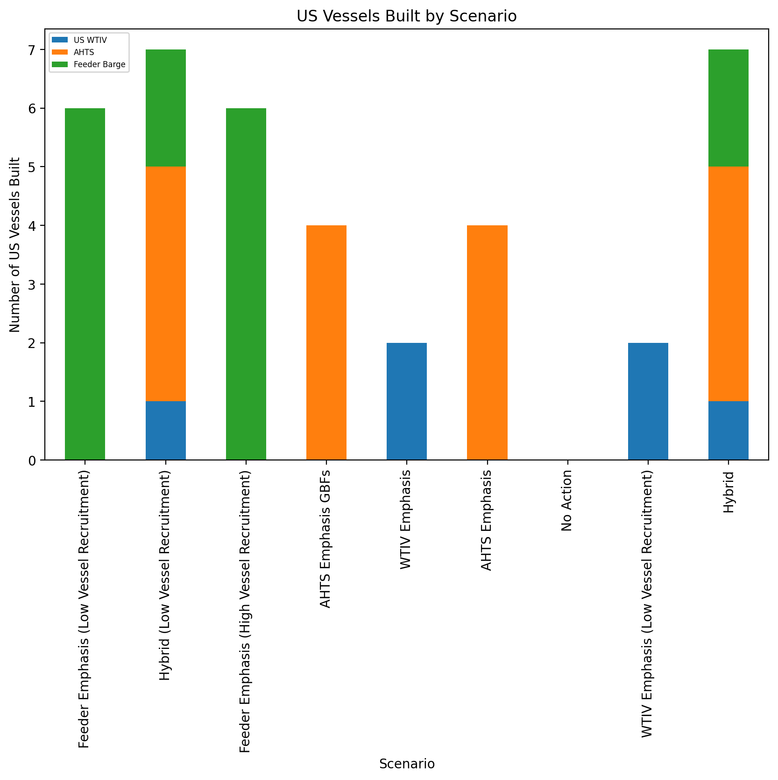
US Vessels Built

Slide 4
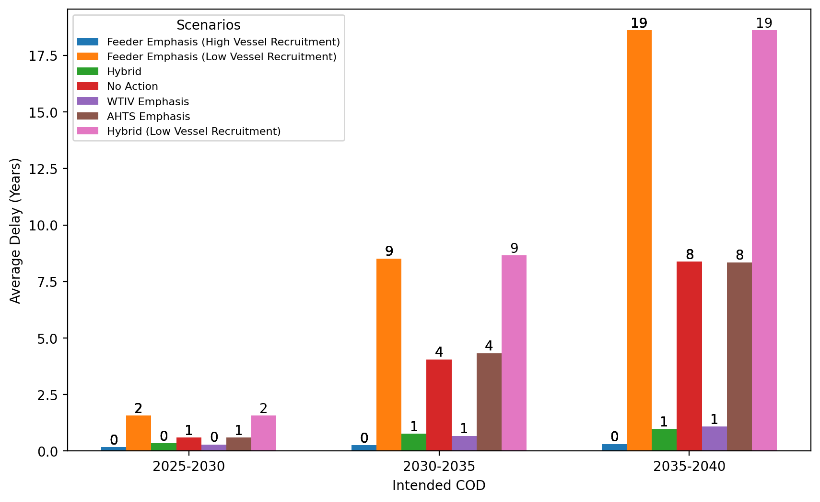
Average Delay Per Project by COD - All Regions

Slide 5
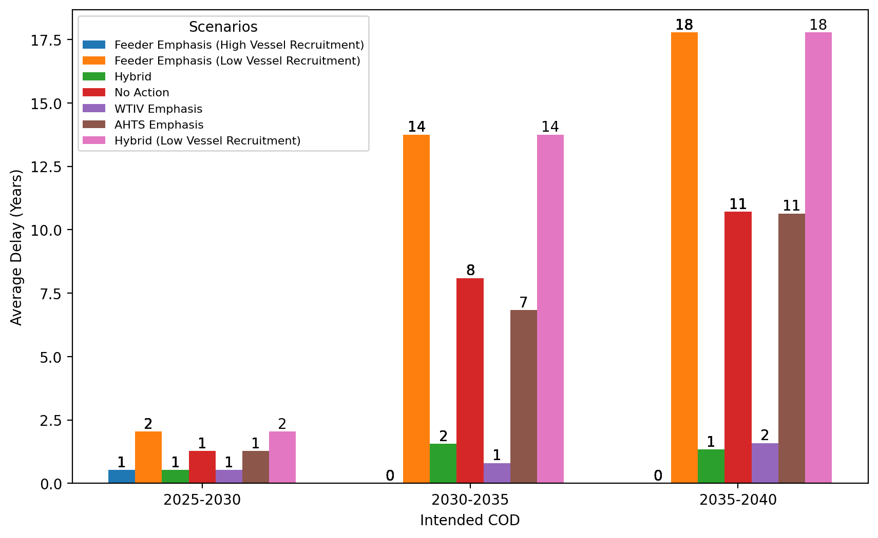
Average Delay Per Project by COD - NE

Slide 6
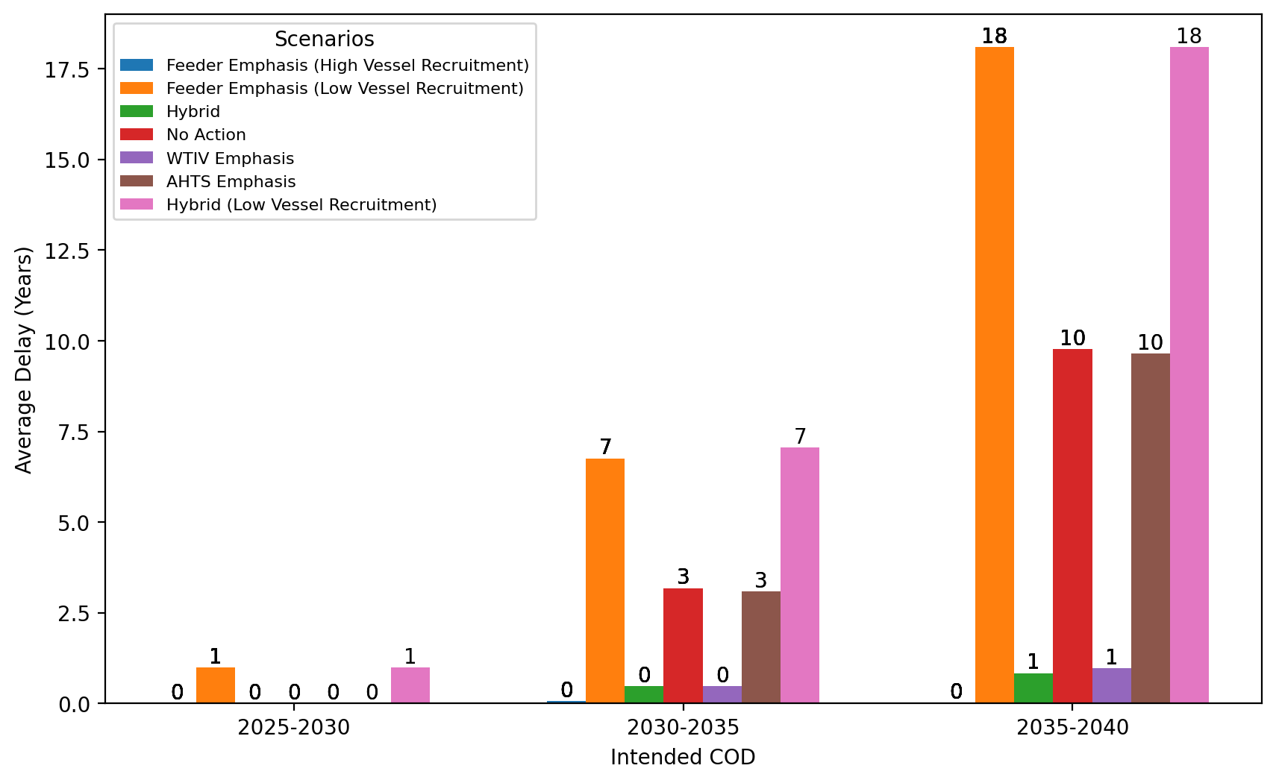
Average Delay Per Project by COD - NYNJ

Slide 7
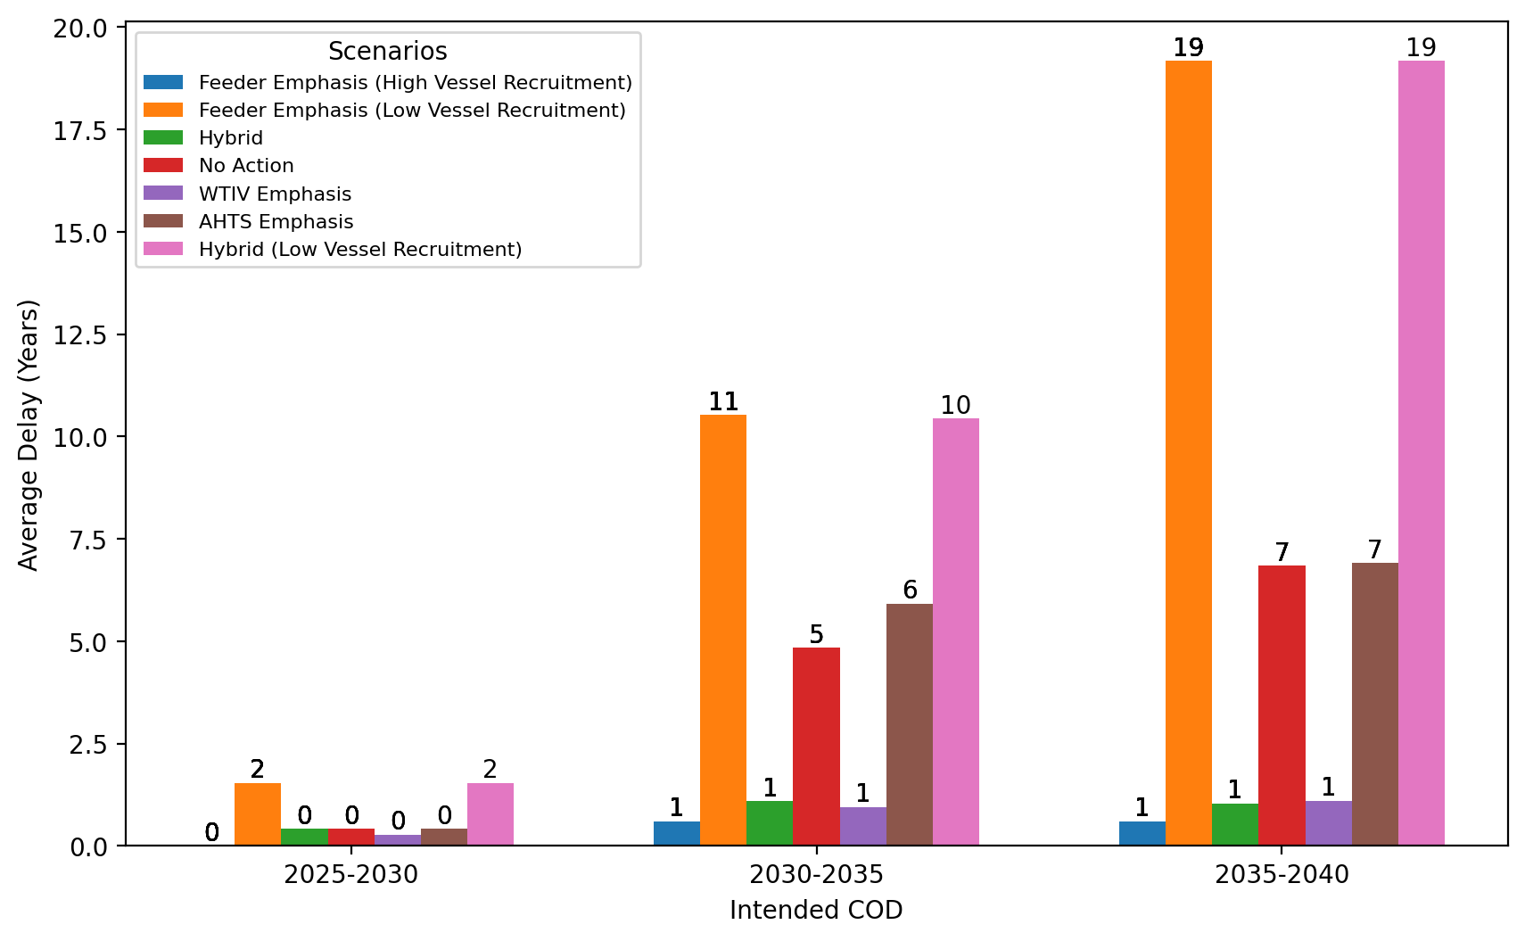
Average Delay Per Project by COD - Mid-Atlantic

Slide 8
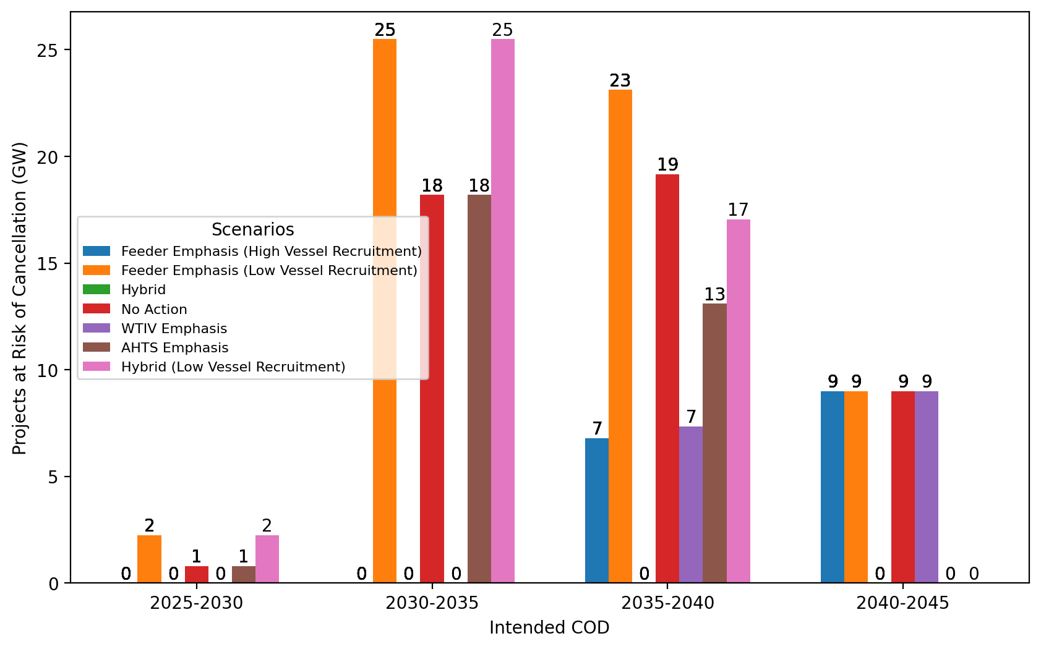
Total Capacity at Risk by COD - All Regions

Slide 9
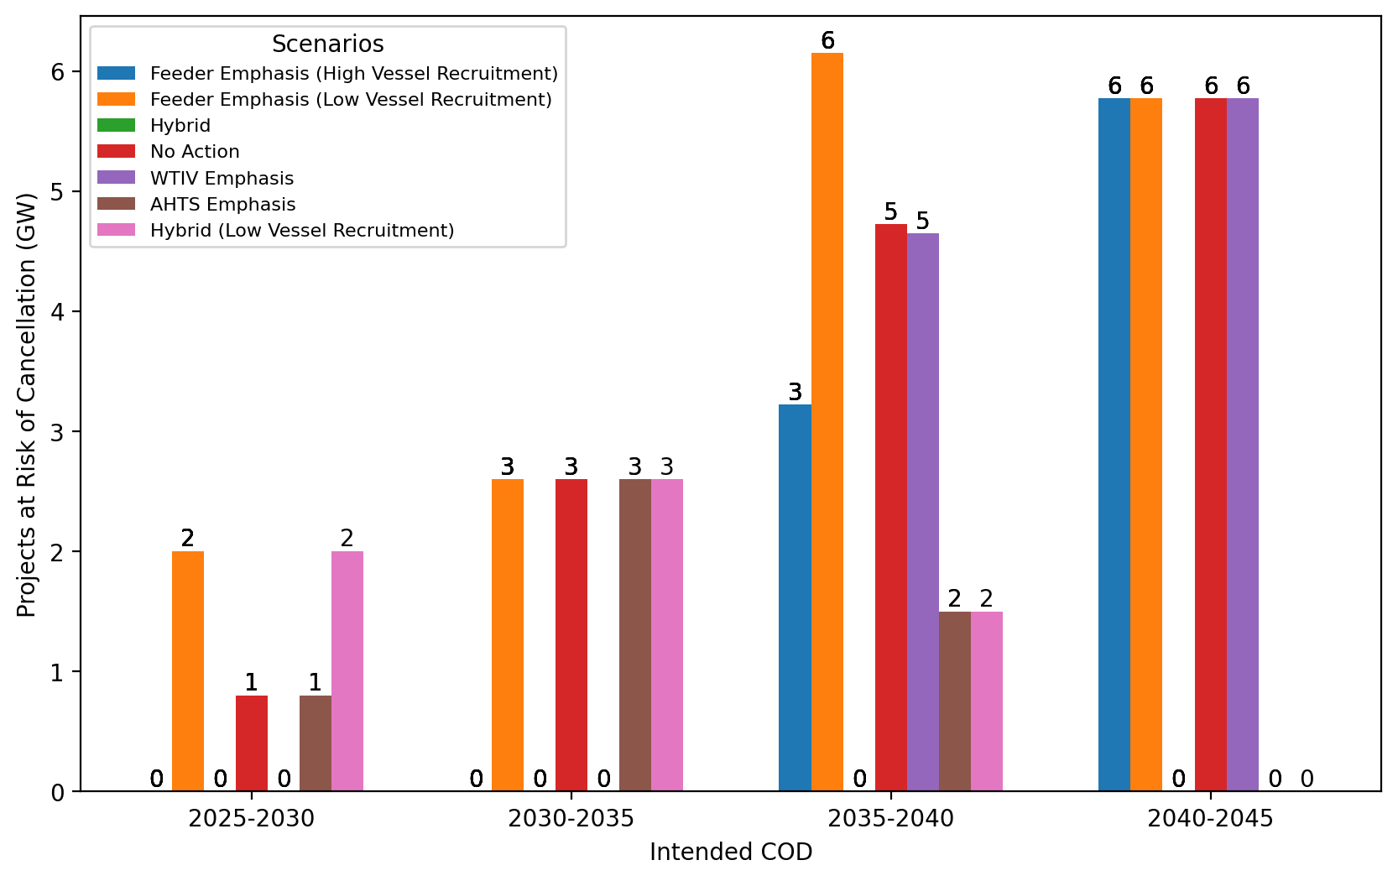
Total Capacity at Risk by COD - NE

Slide 10
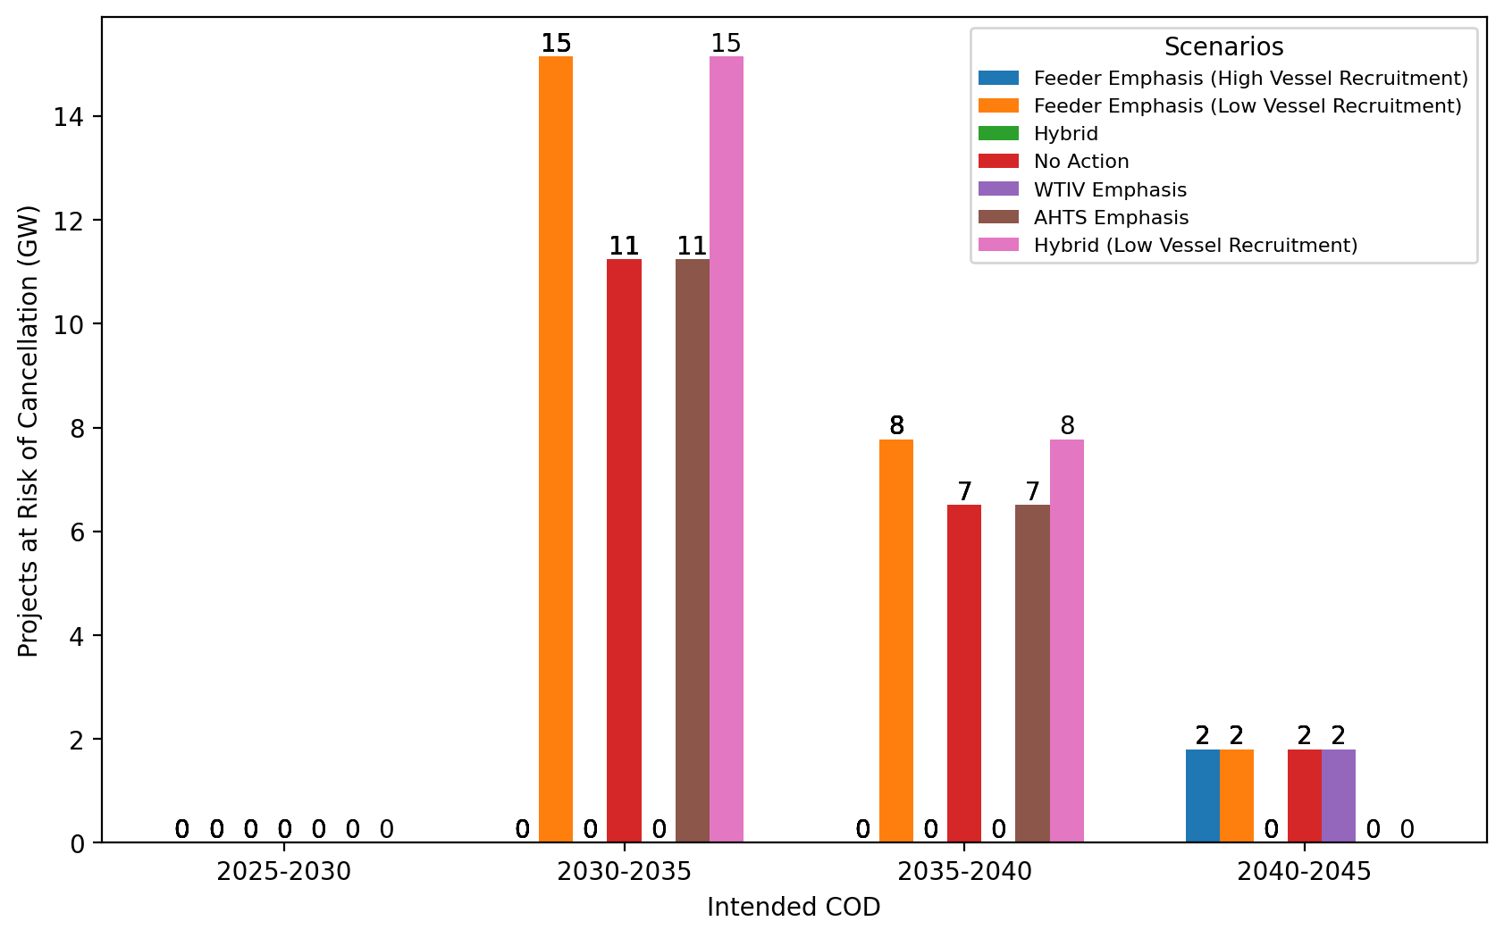
Total Capacity at Risk by COD - NYNJ

Slide 11
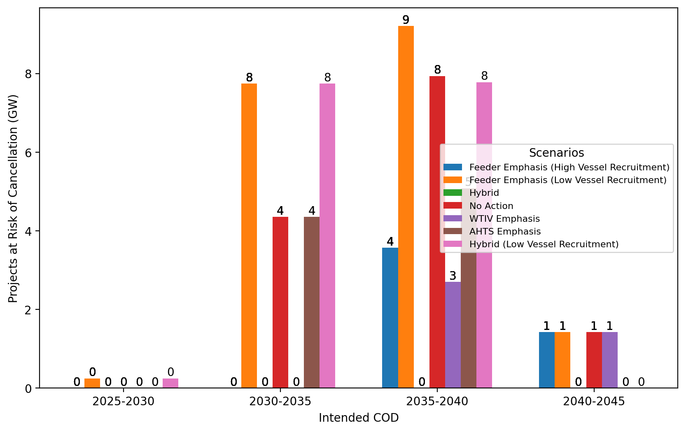
Total Capacity at Risk by COD - Mid-Atlantic

Slide 12
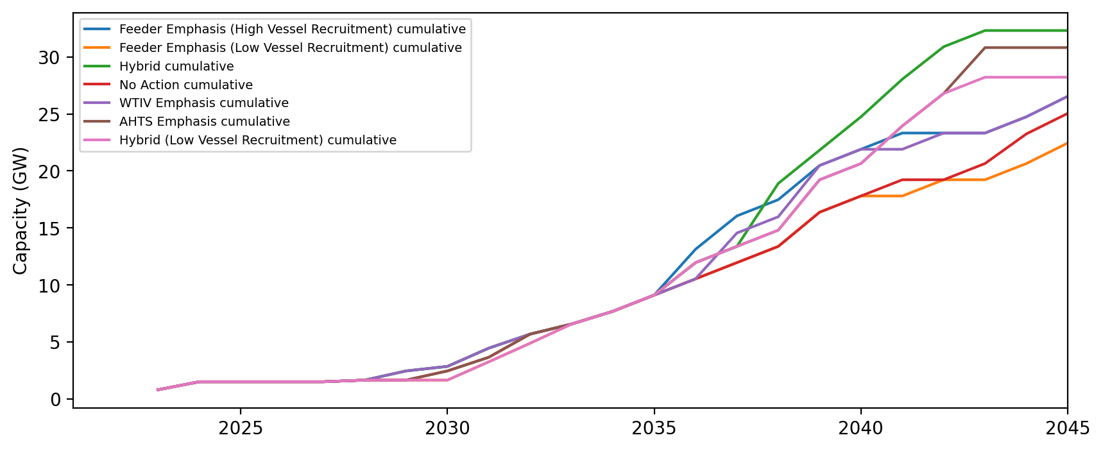
Installed Capacity - NE

Slide 13
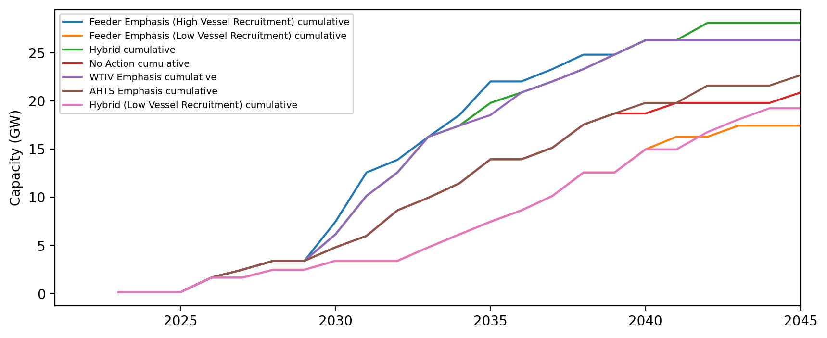
Installed Capacity - NYNJ

Slide 14
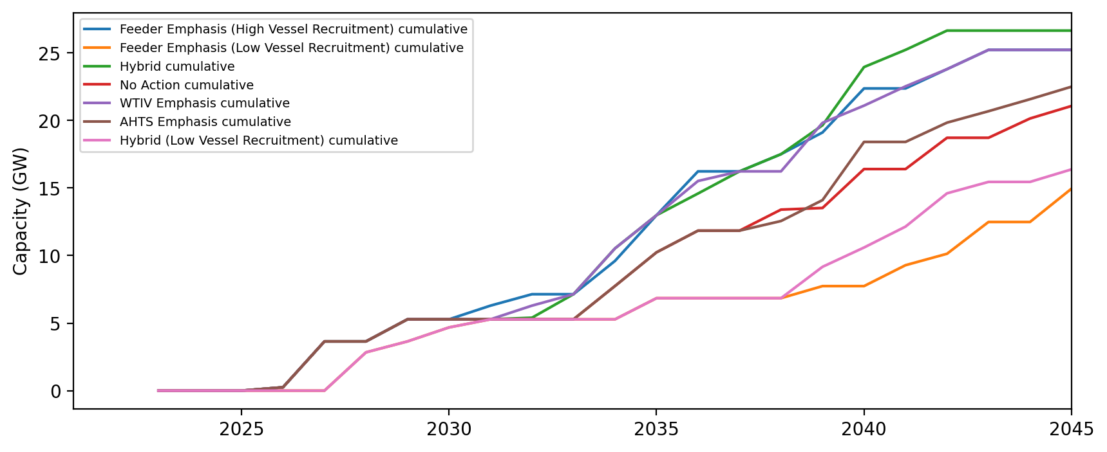
Installed Capacity - Mid-Atlantic

Slide 15
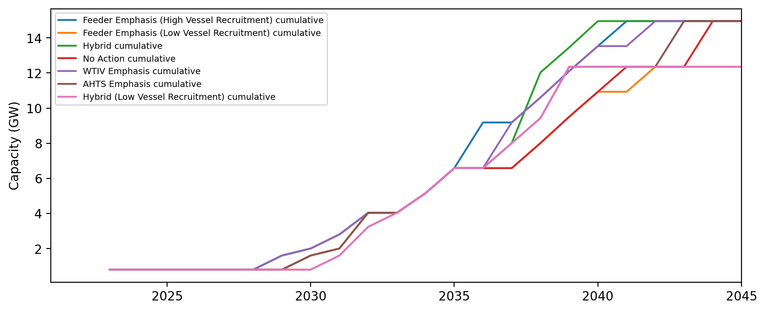
Installed Capacity - MA

Slide 16
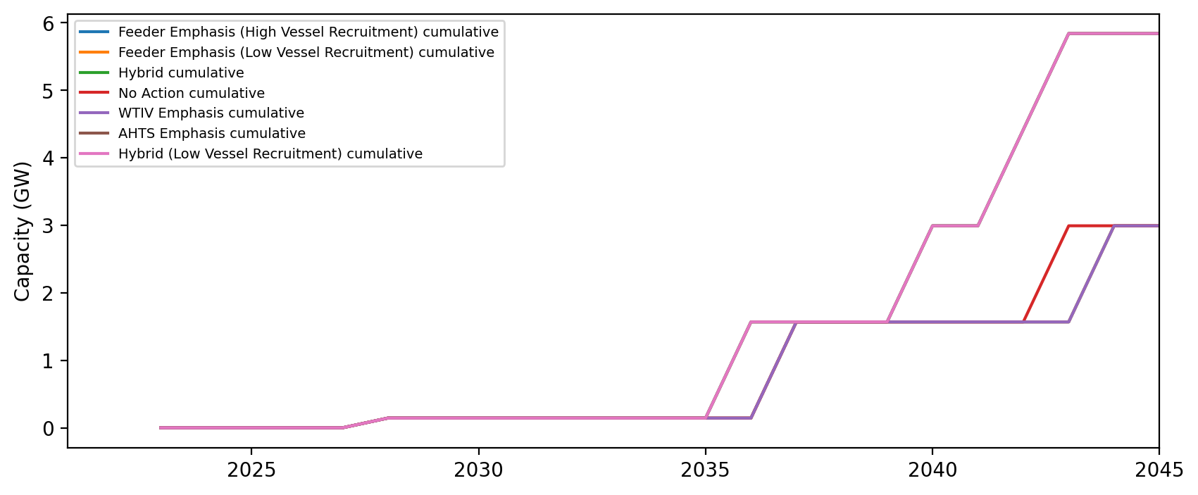
Installed Capacity - ME

Slide 17
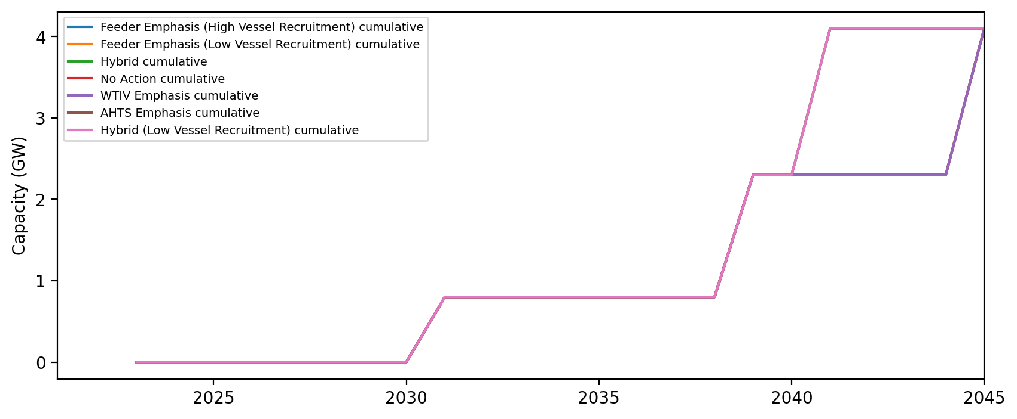
Installed Capacity - CT

Slide 18
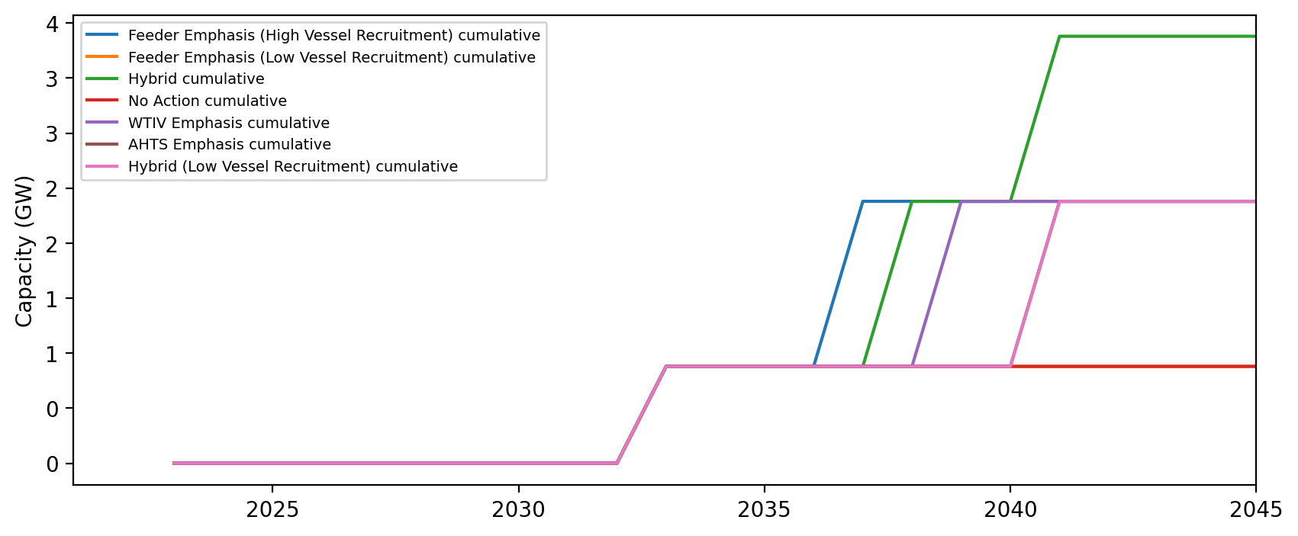
Installed Capacity - RI

Slide 19
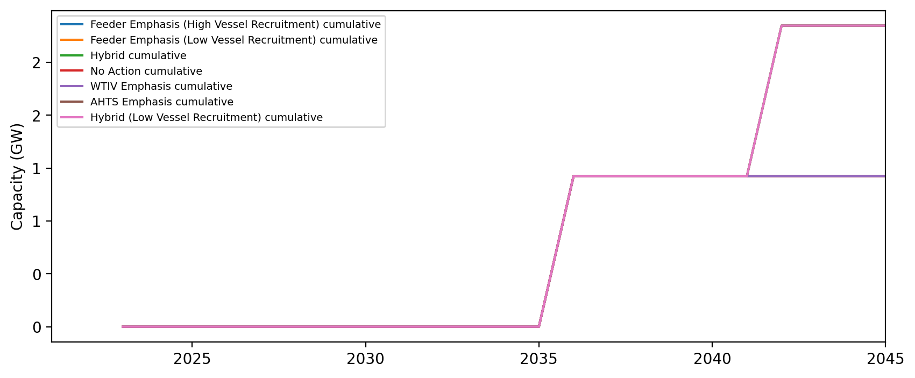
Installed Capacity - NH

Slide 20
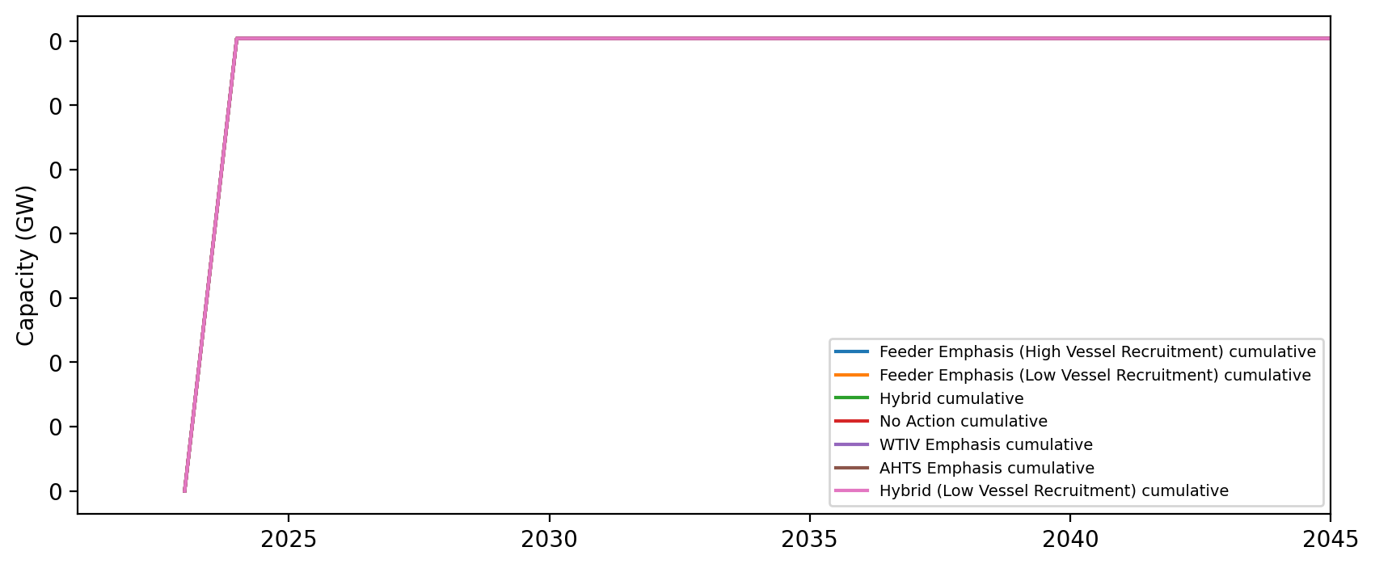
Installed Capacity - RI/CT

Slide 21
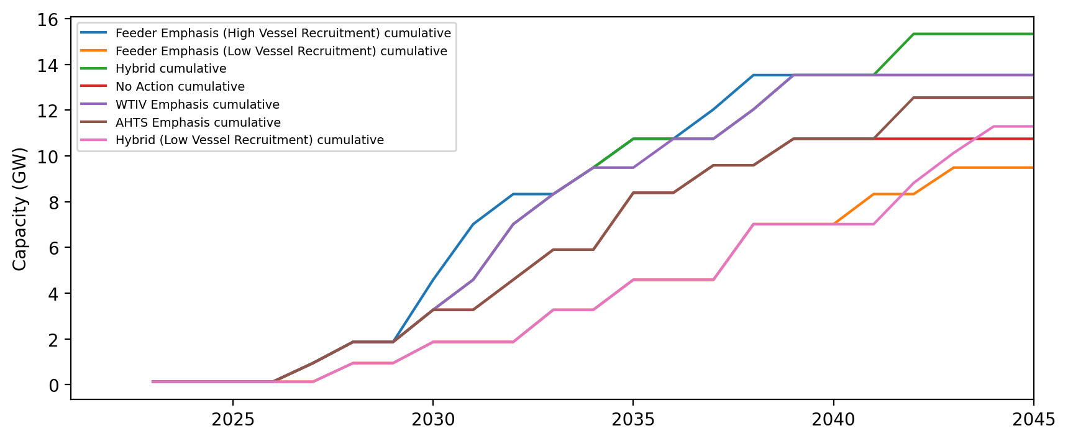
Installed Capacity - NY

Slide 22
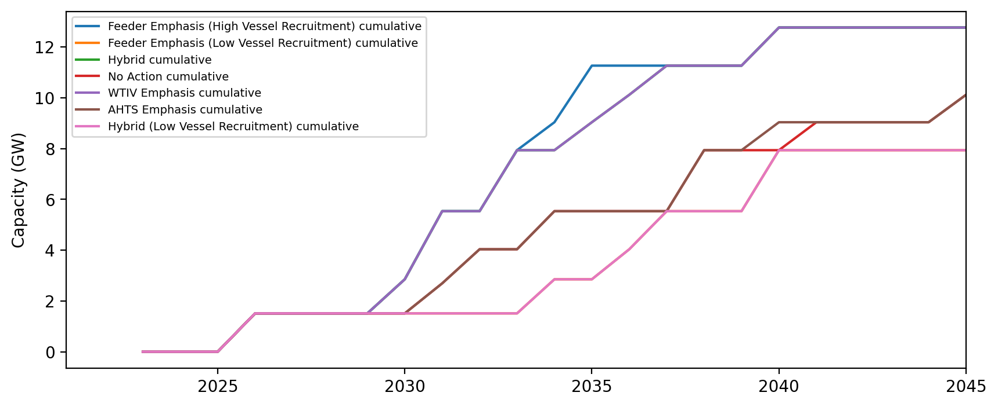
Installed Capacity - NJ

Slide 23
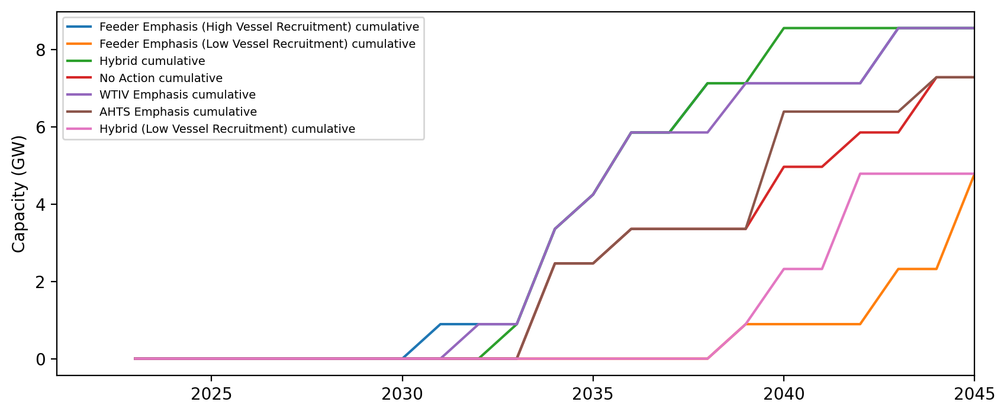
Installed Capacity - NC

Slide 24
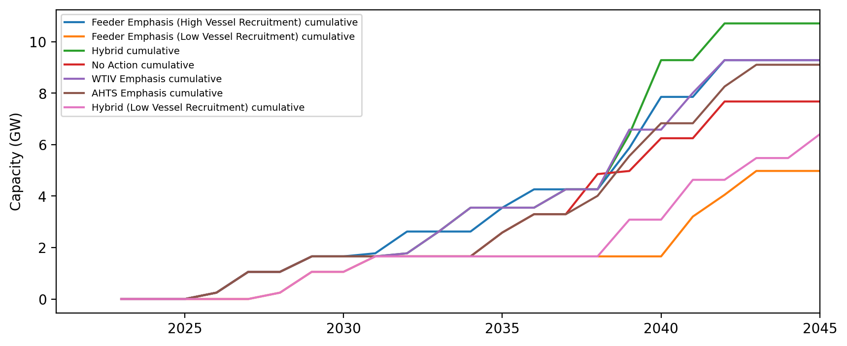
Installed Capacity - MD

Slide 25
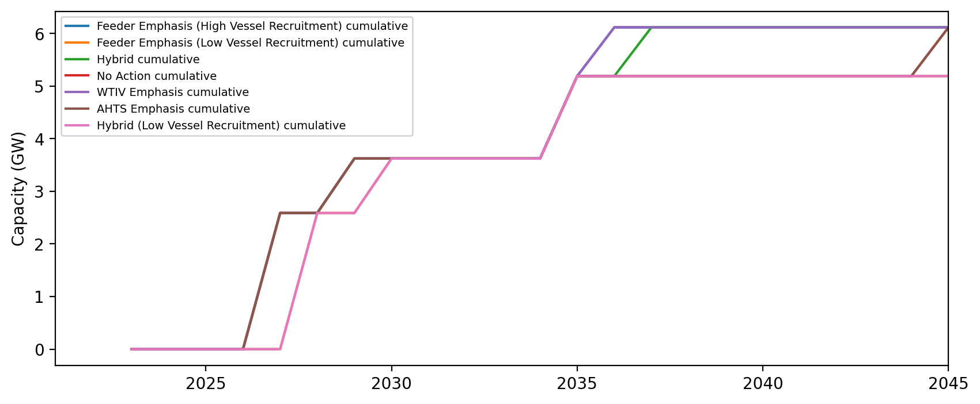
Installed Capacity - VA

Slide 26
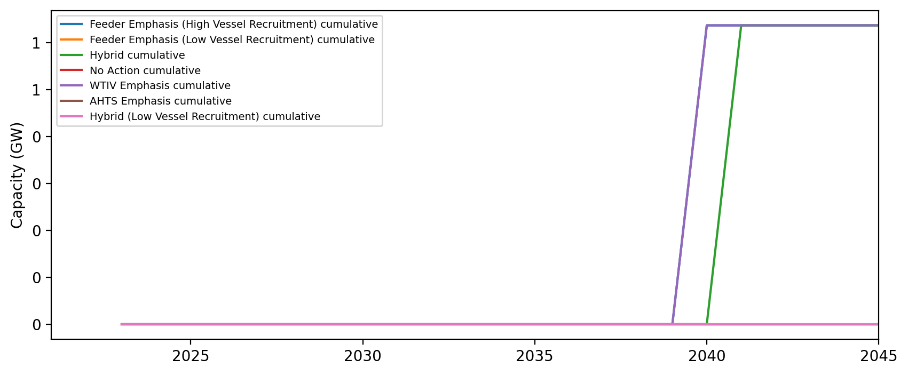
Installed Capacity - DE

