Slide 1
10_Feeders
t
e
x
t

Slide 2
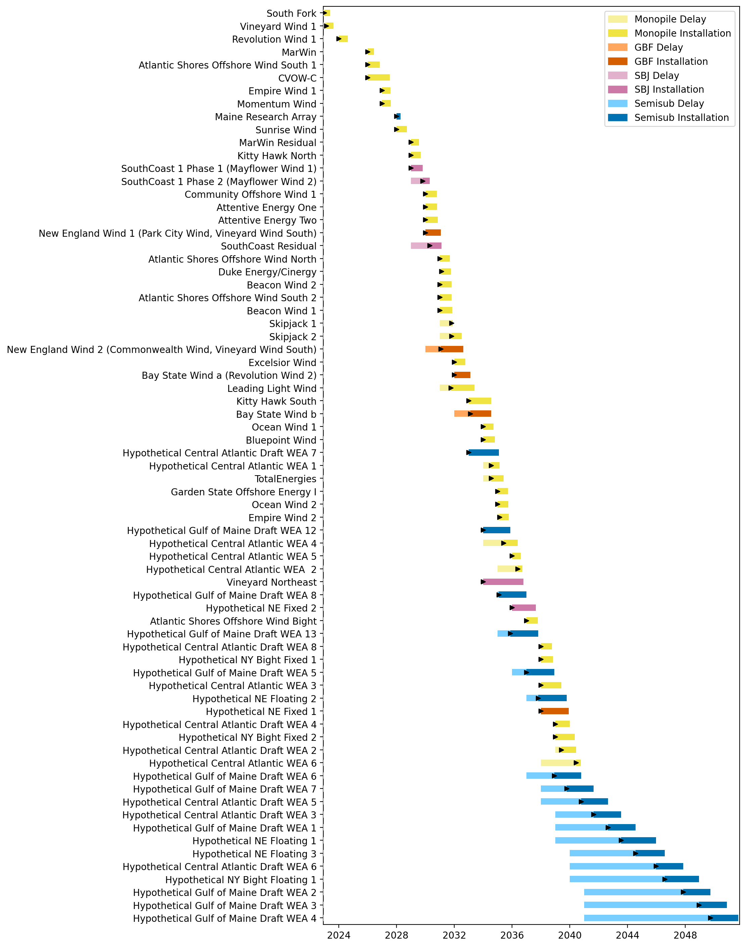
Full Gantt

Slide 3
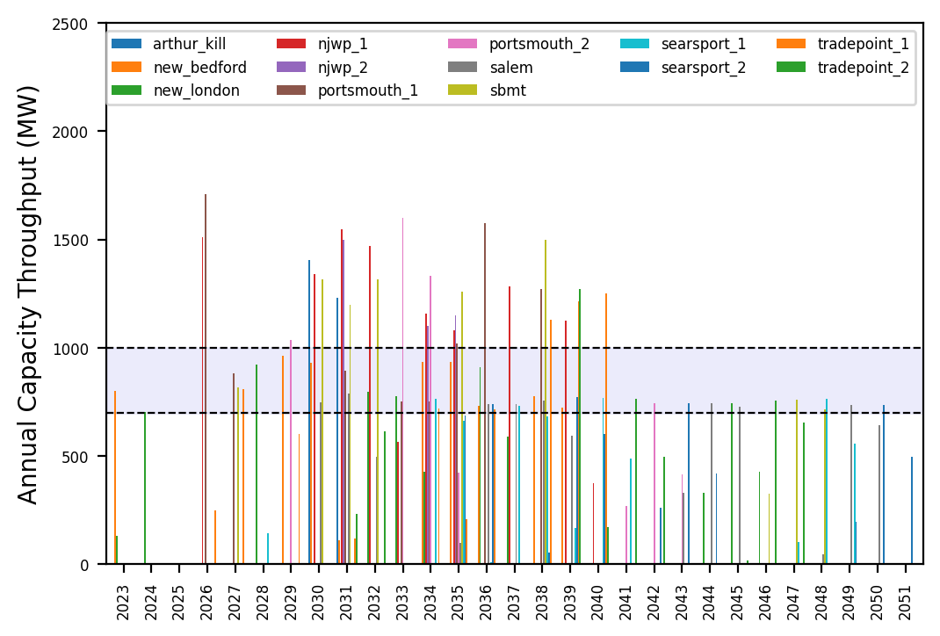
Port Throughput

Slide 4
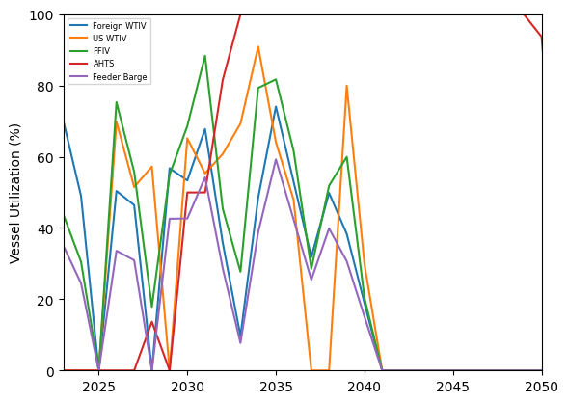
Vessel Utilization

Slide 5
6_AHTS_GBF_Pipeline
t
e
x
t

Slide 6
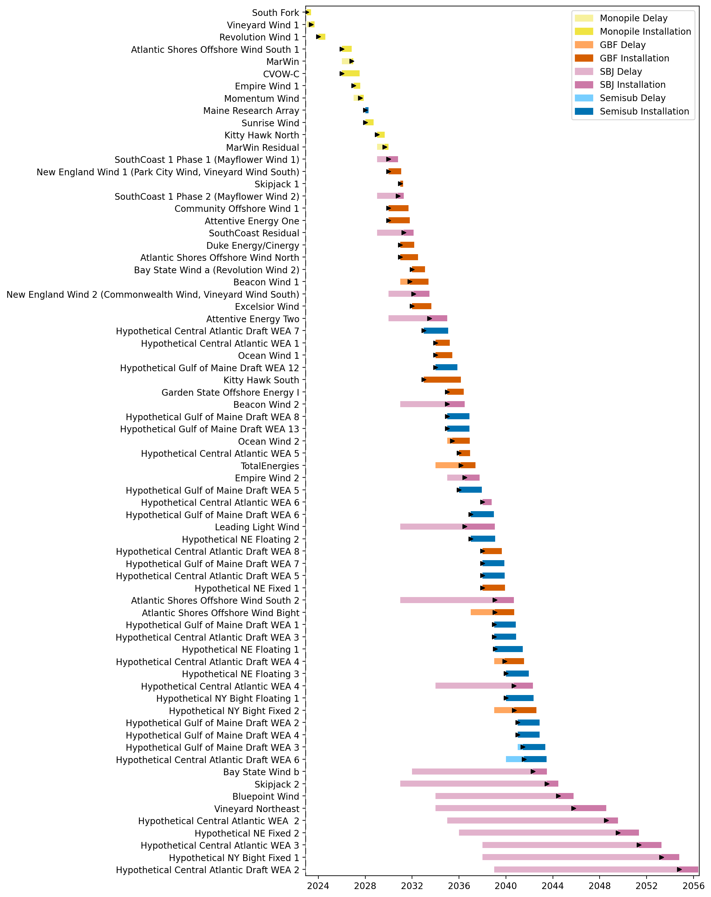
Full Gantt

Slide 7
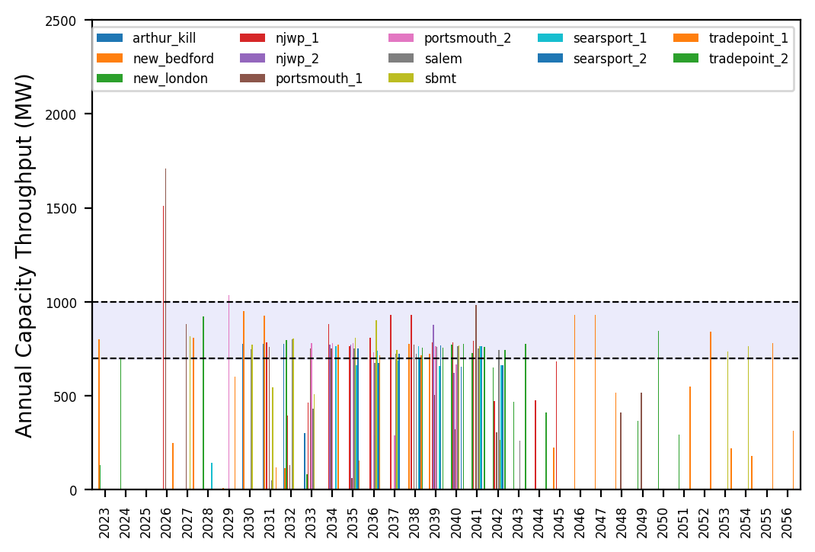
Port Throughput

Slide 8
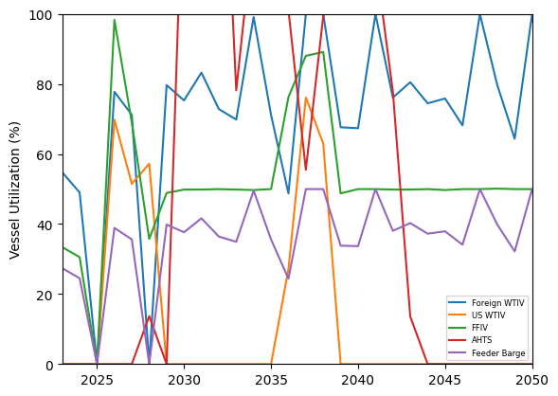
Vessel Utilization

Slide 9
3_WTIV
t
e
x
t

Slide 10
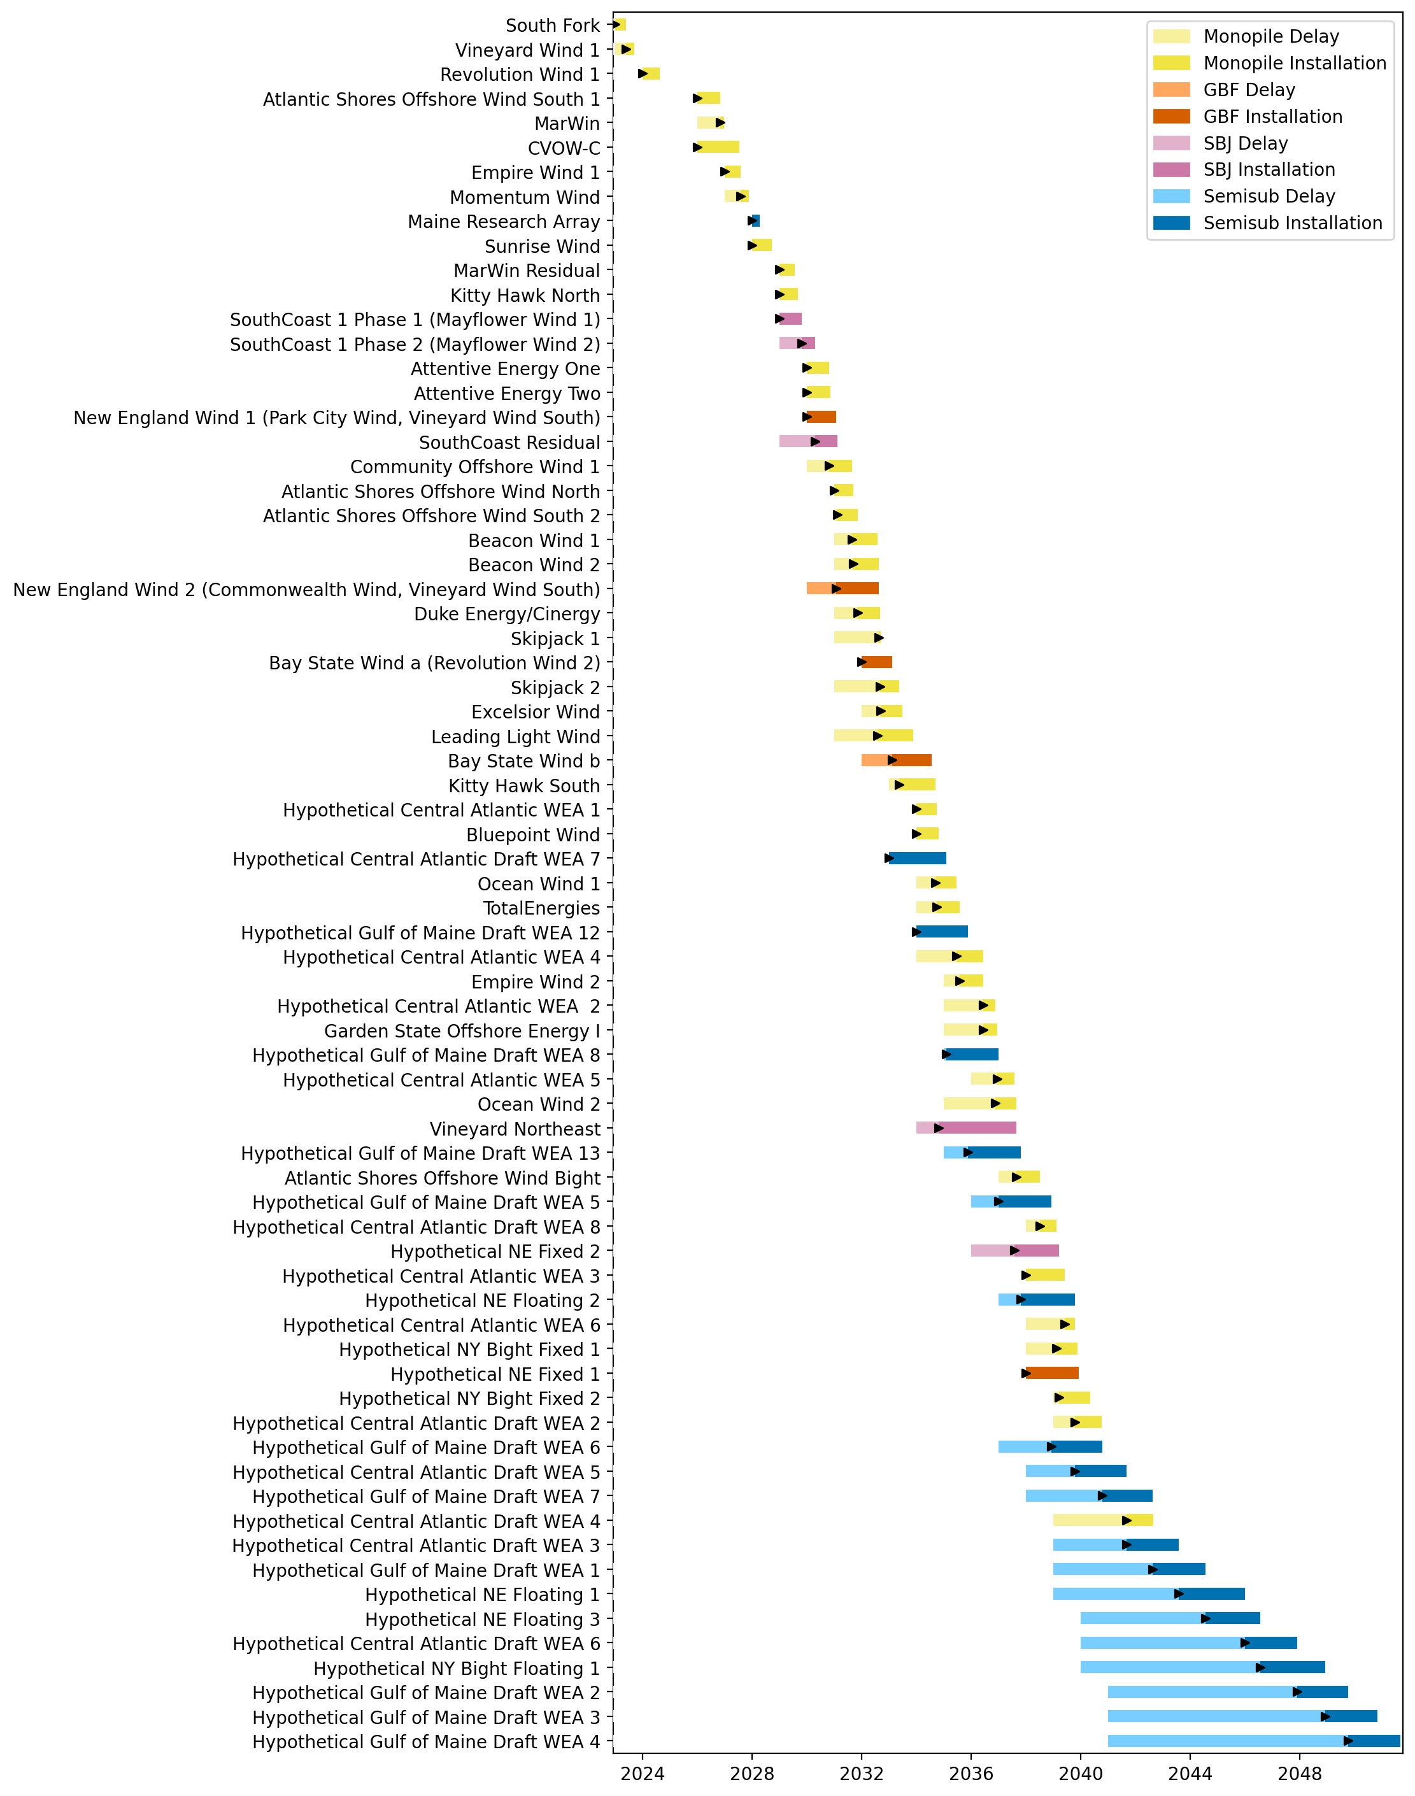
Full Gantt

Slide 11
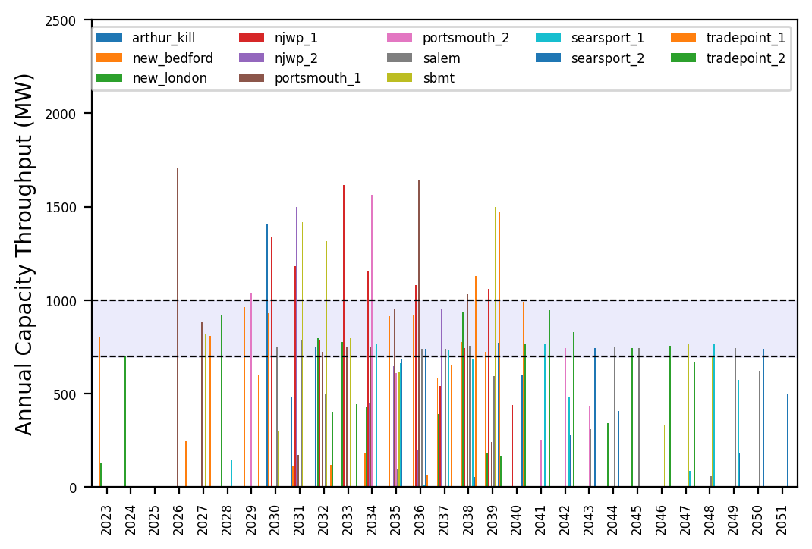
Port Throughput

Slide 12
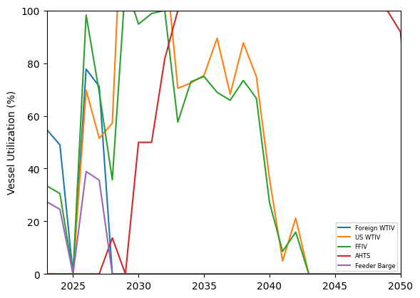
Vessel Utilization

Slide 13
6_AHTS
t
e
x
t

Slide 14
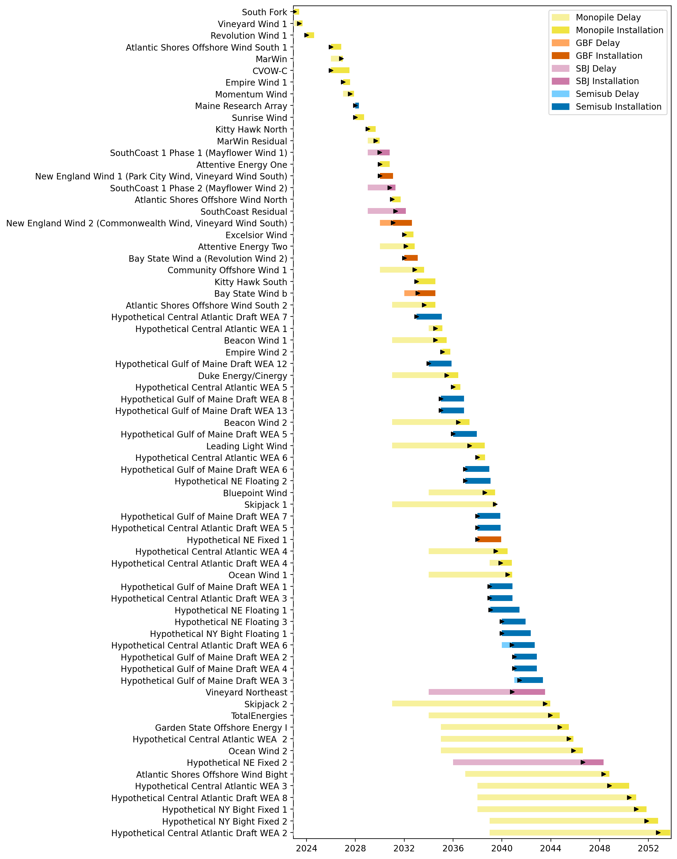
Full Gantt

Slide 15
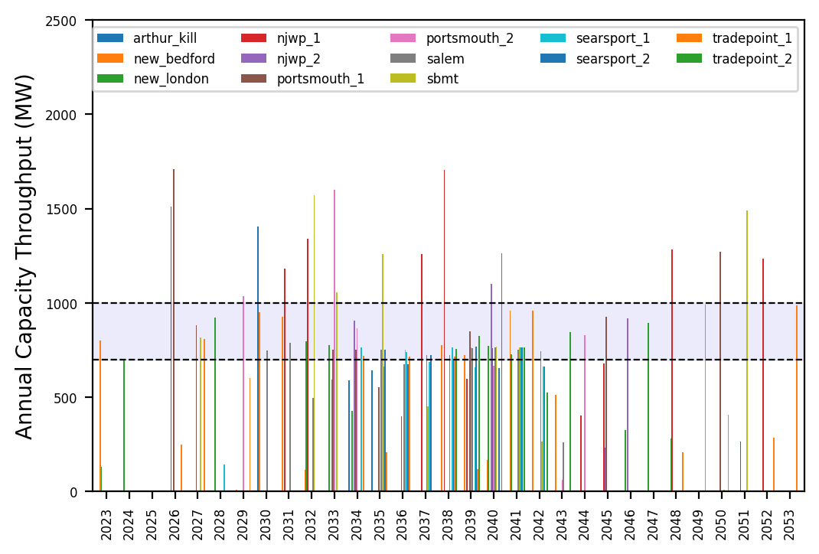
Port Throughput

Slide 16
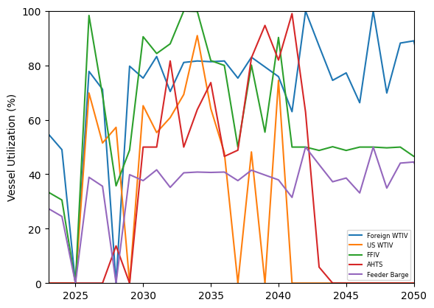
Vessel Utilization

Slide 17
no_action
t
e
x
t

Slide 18
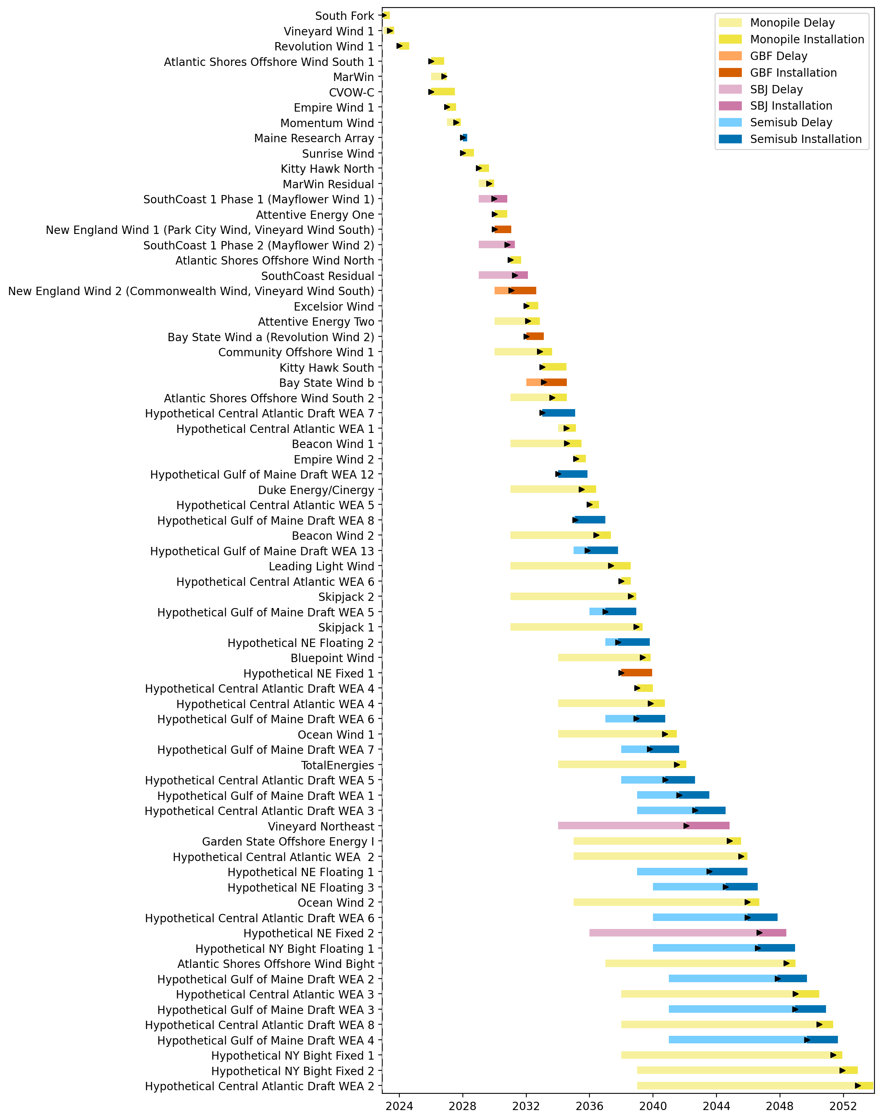
Full Gantt

Slide 19
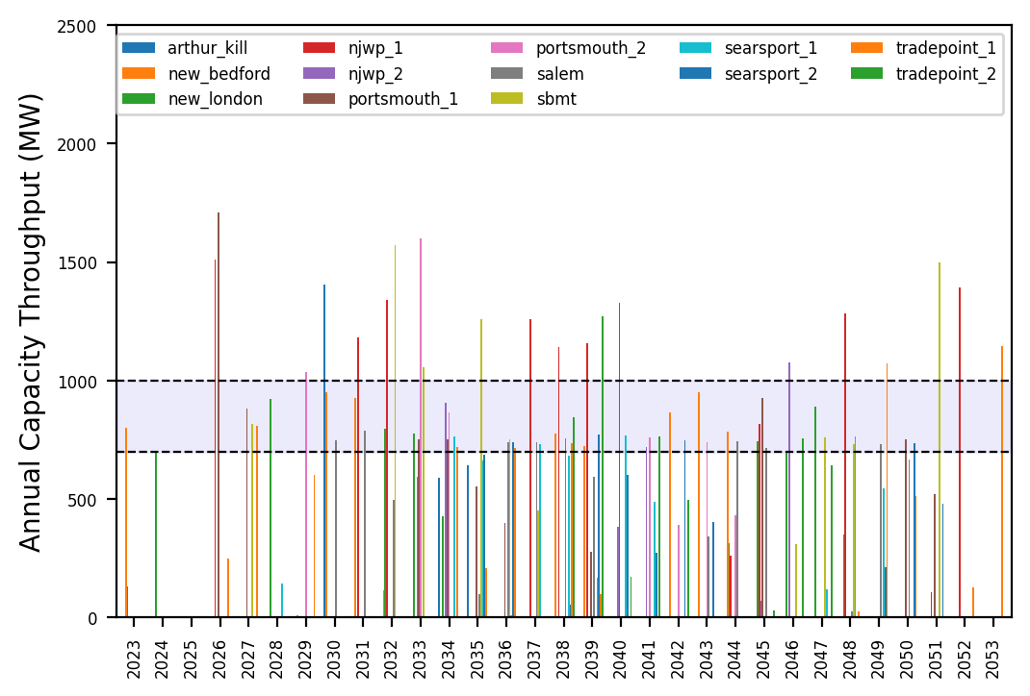
Port Throughput

Slide 20
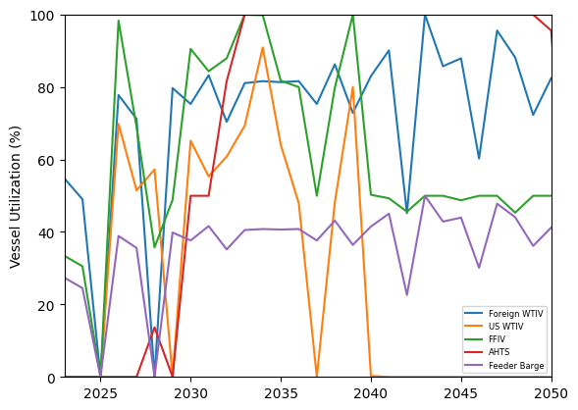
Vessel Utilization

Slide 21
Hybrid_Optimized_Pipeline
t
e
x
t

Slide 22
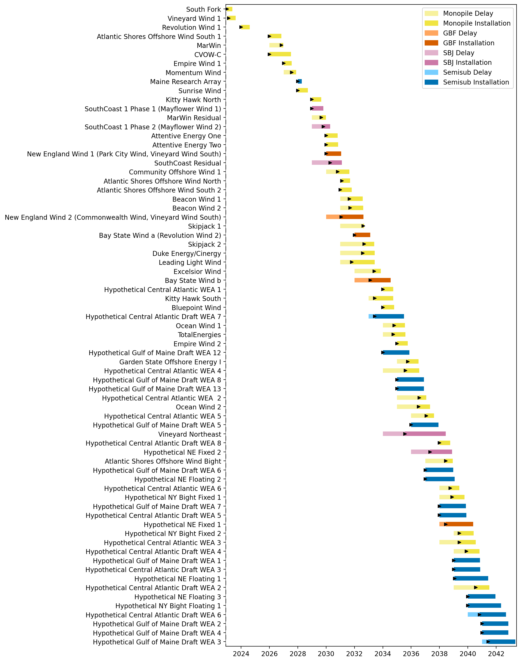
Full Gantt

Slide 23
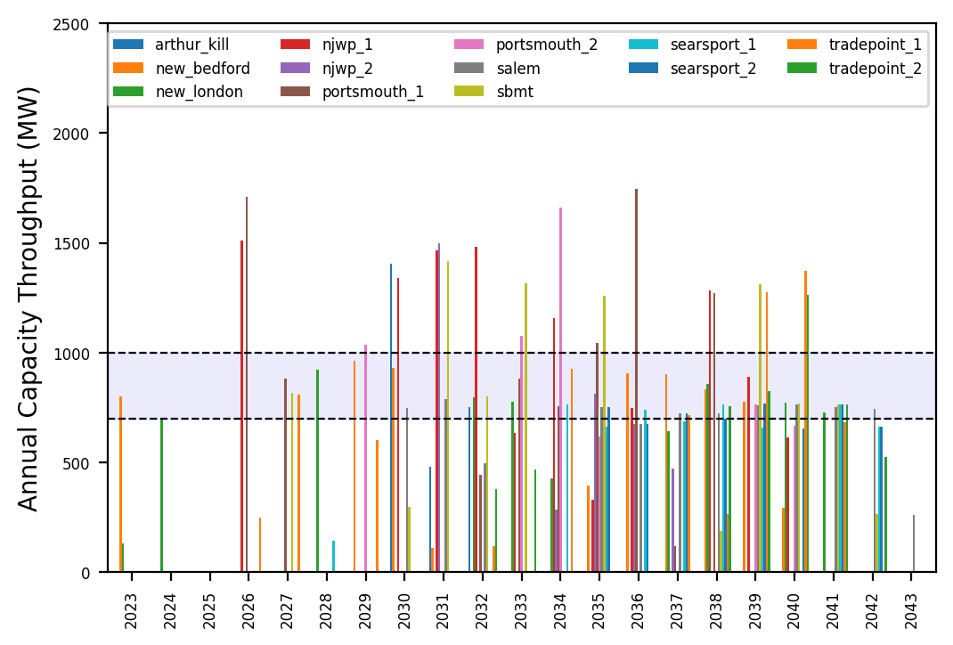
Port Throughput

Slide 24
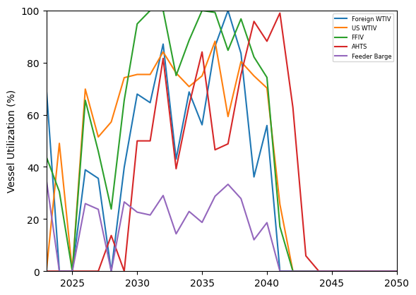
Vessel Utilization

Slide 25
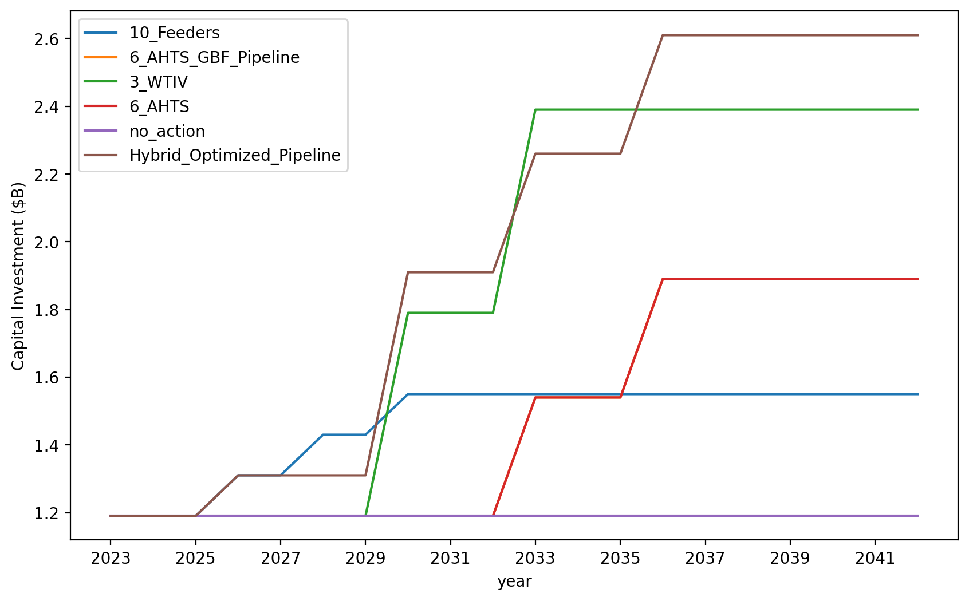
Vessel Investment

Slide 26
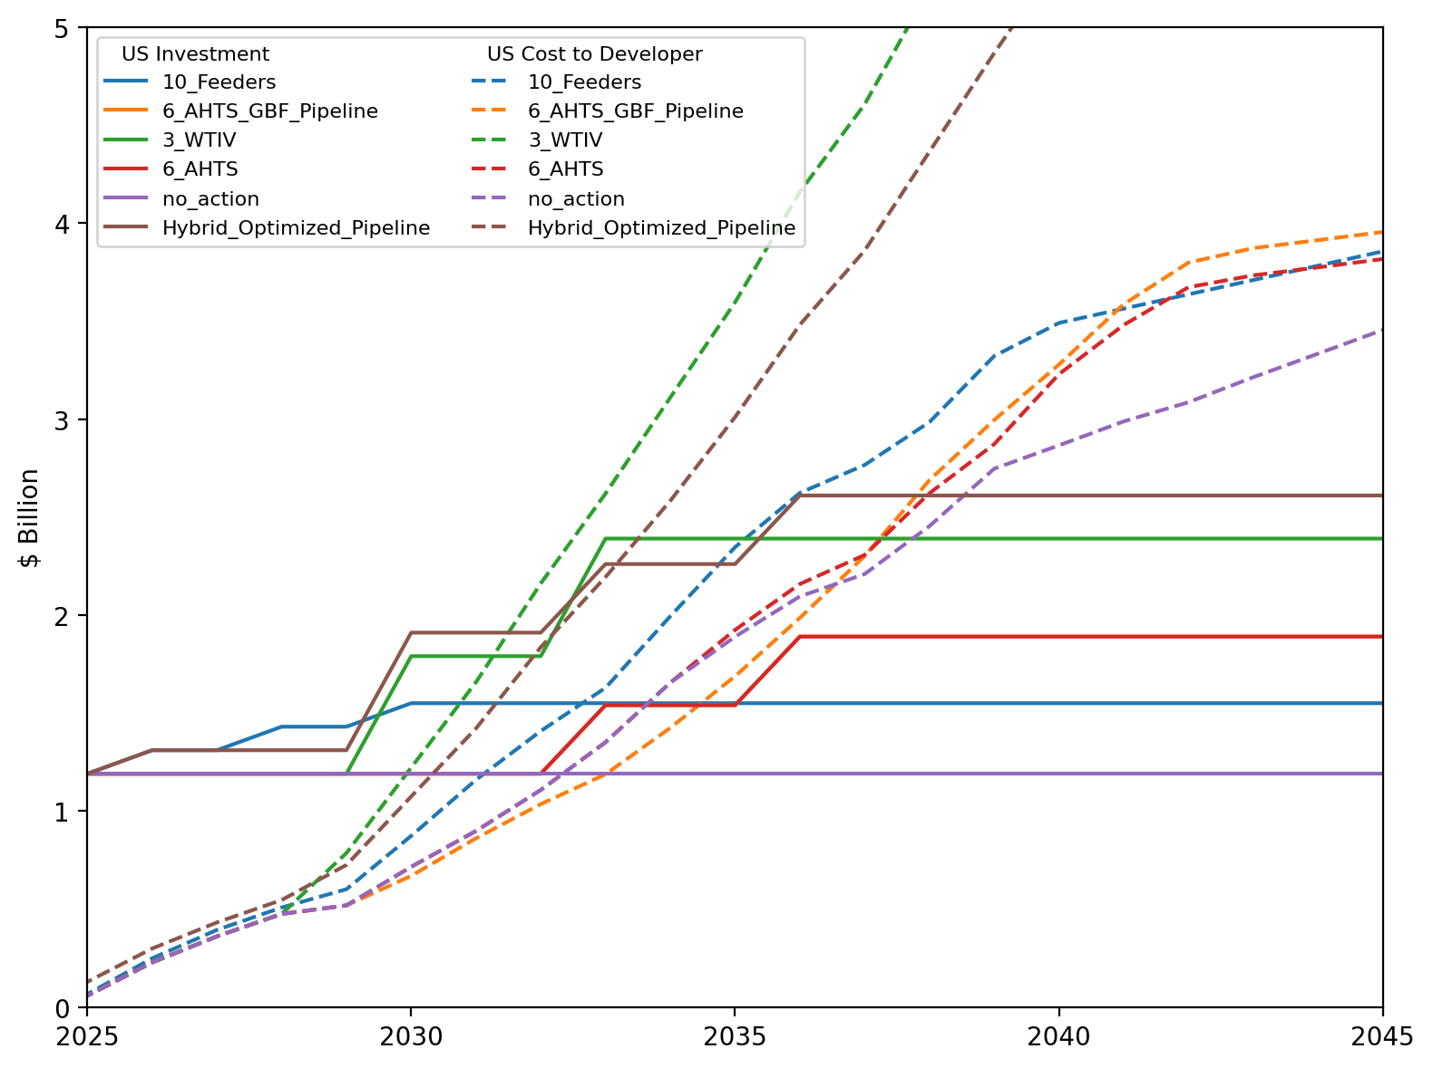
US Investment Summary

