Slide 1
4_WTIV
t
e
x
t

Slide 2
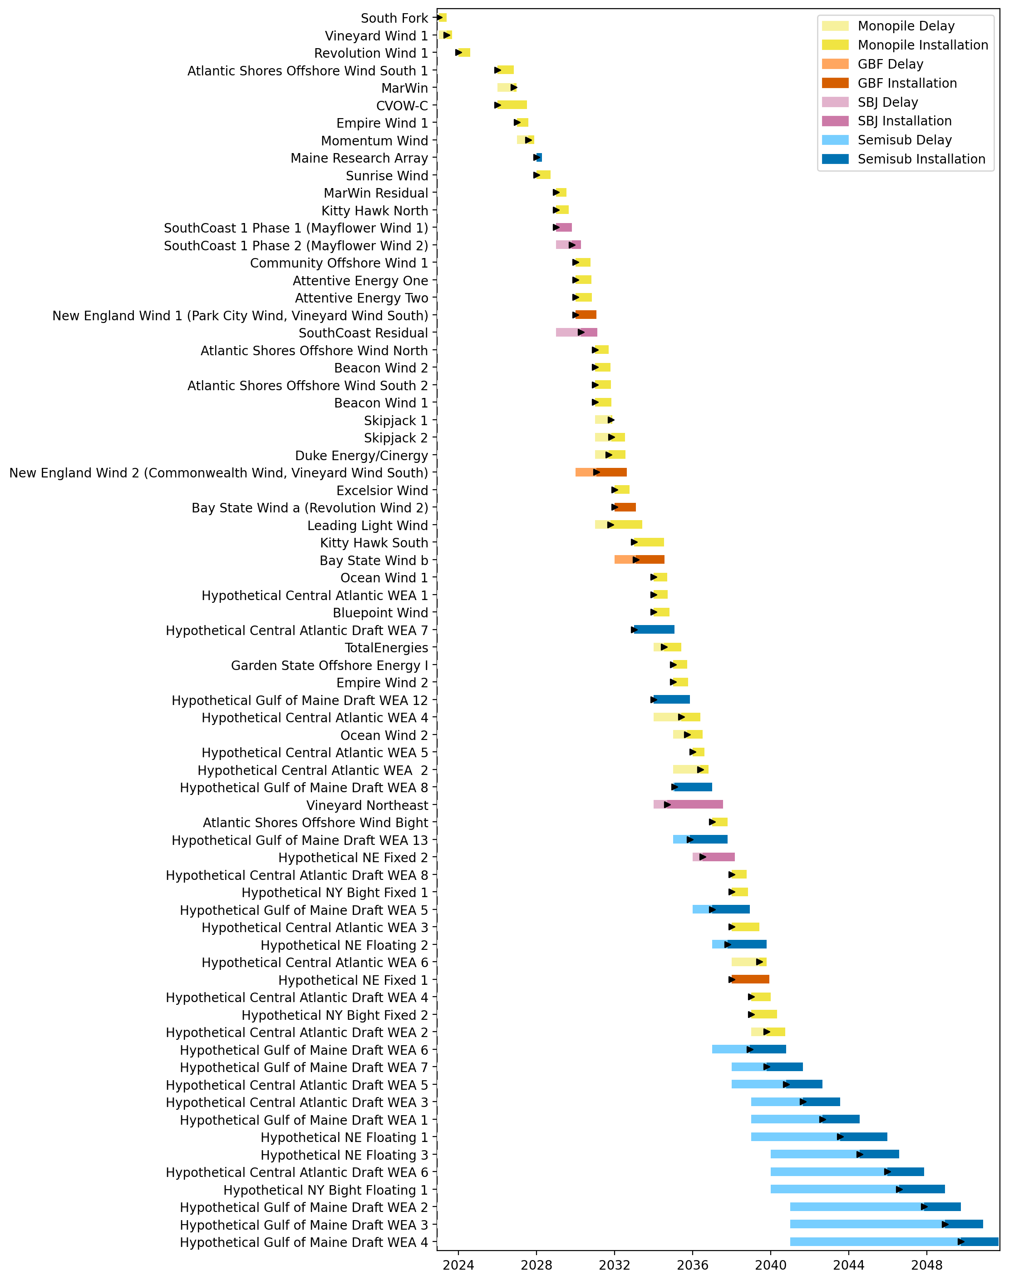
Full Gantt

Slide 3
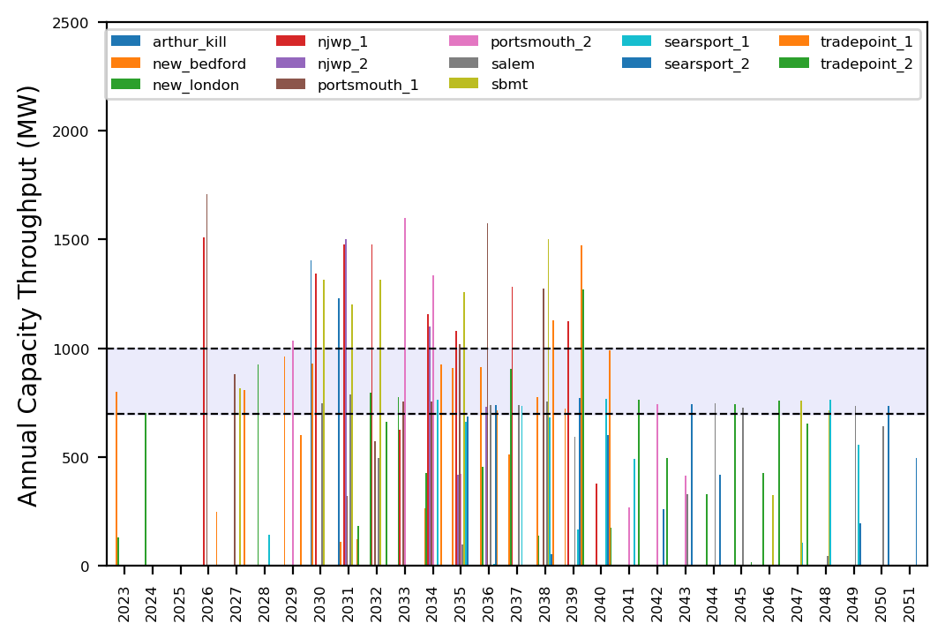
Port Throughput

Slide 4
3_WTIV
t
e
x
t

Slide 5
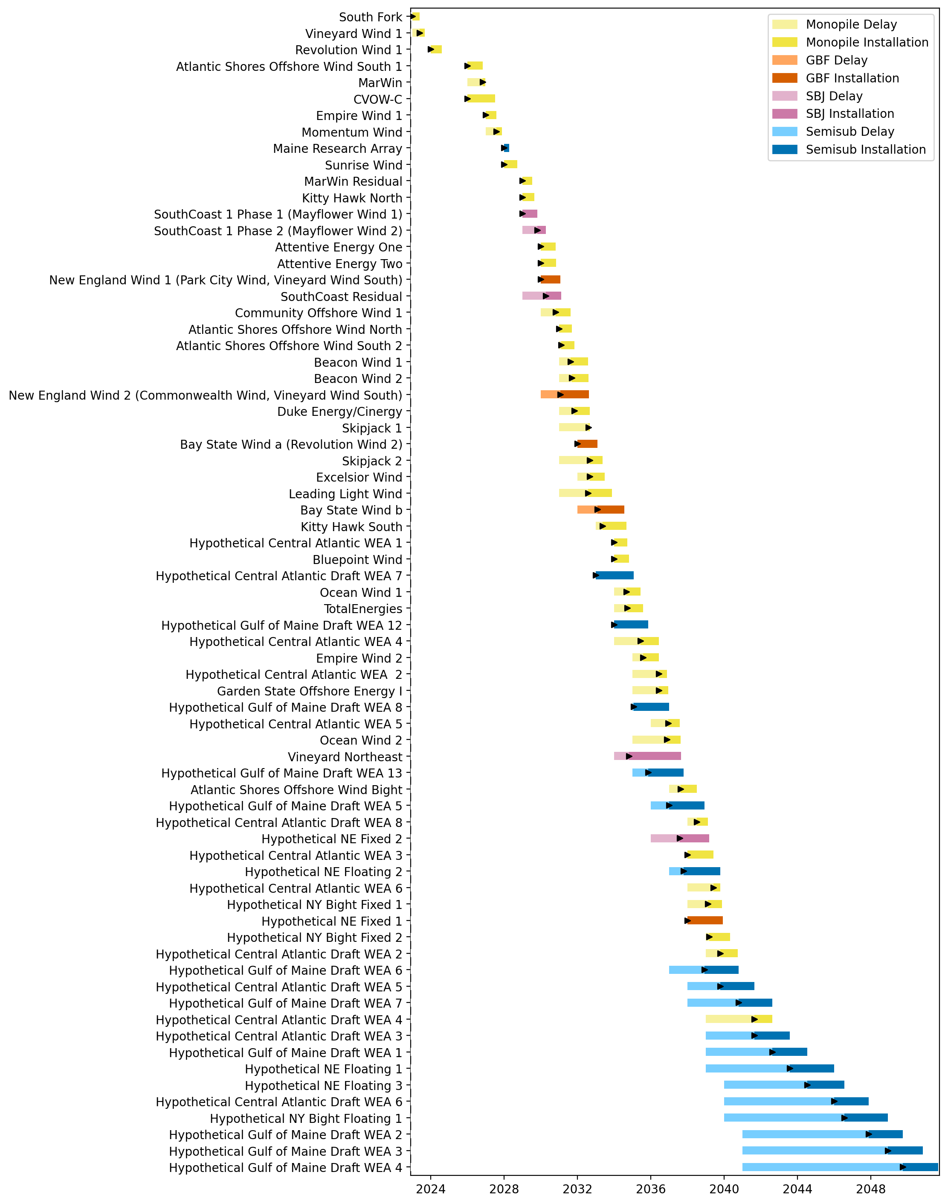
Full Gantt

Slide 6
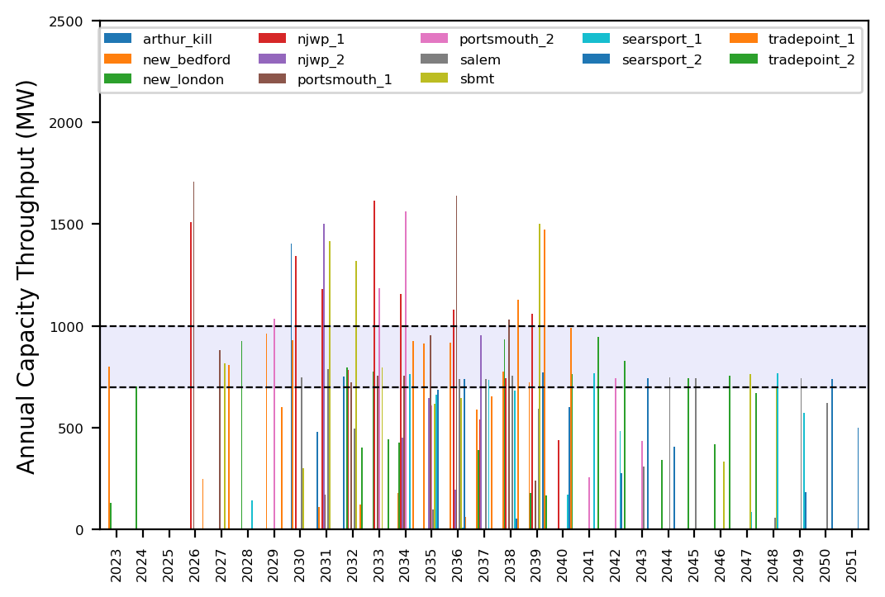
Port Throughput

Slide 7
2_WTIV
t
e
x
t

Slide 8
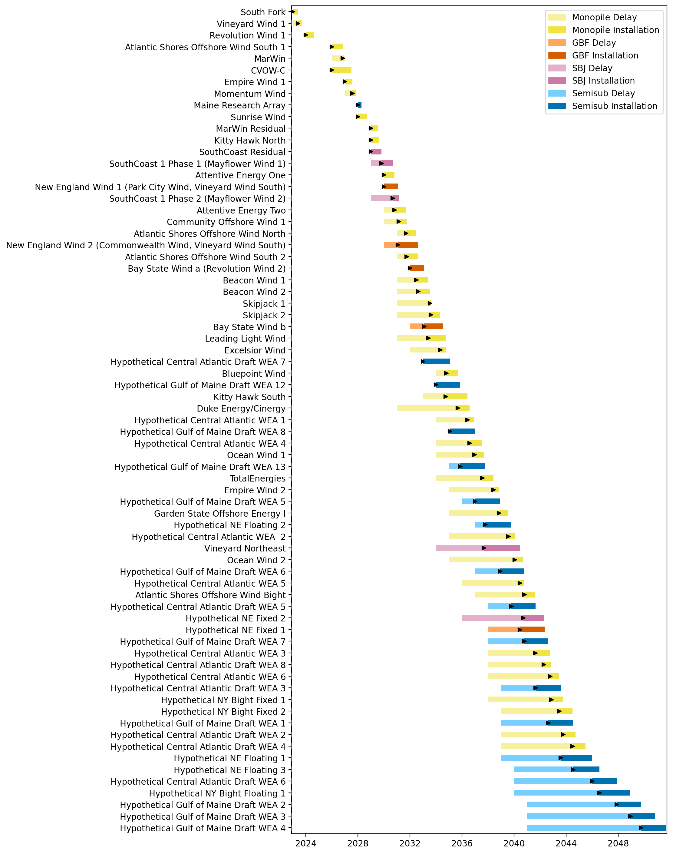
Full Gantt

Slide 9
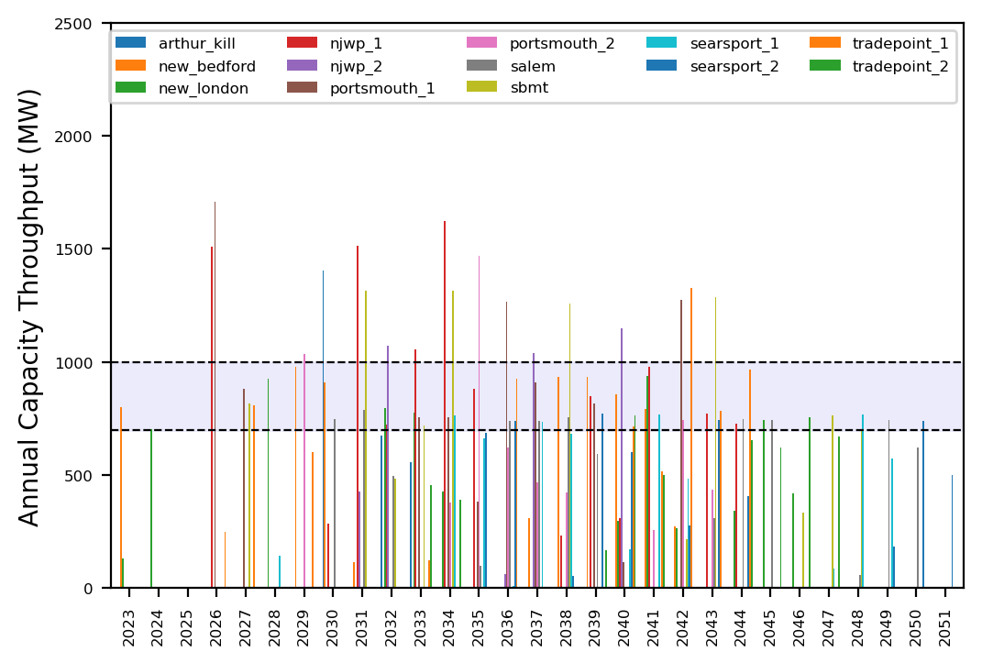
Port Throughput

Slide 10
1_WTIV
t
e
x
t

Slide 11
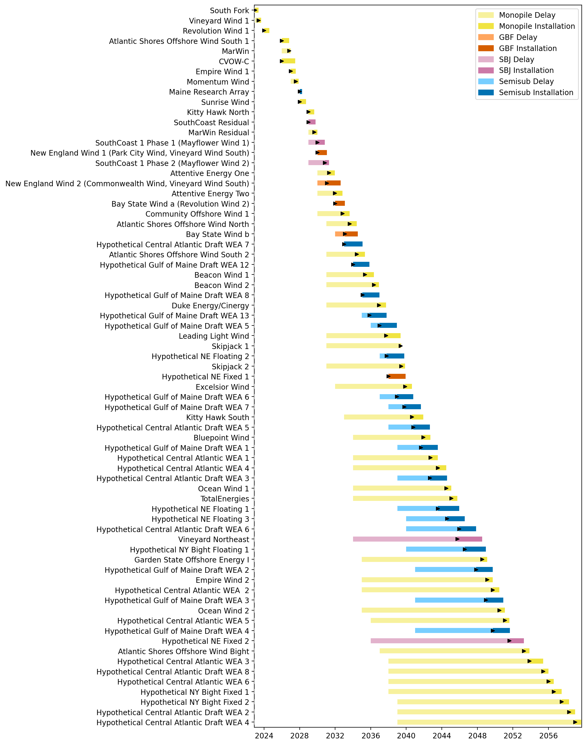
Full Gantt

Slide 12
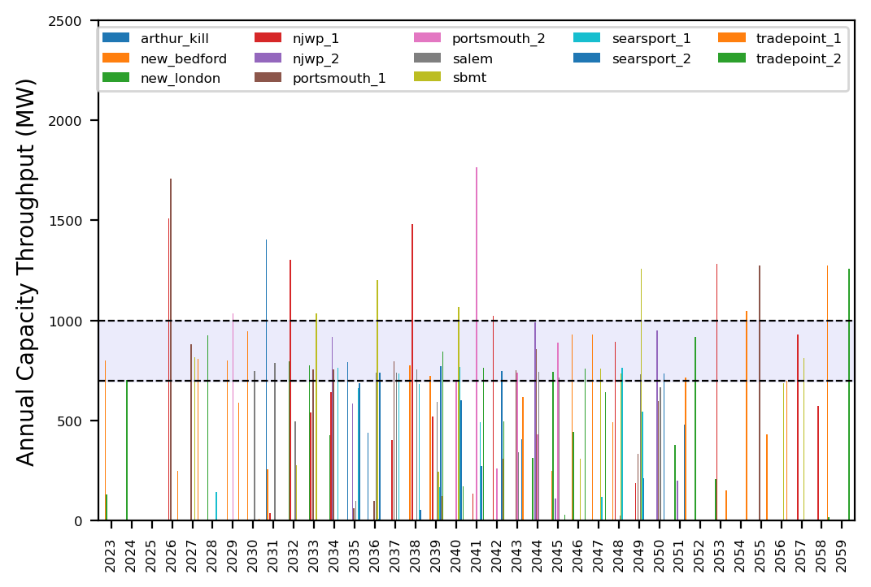
Port Throughput

Slide 13
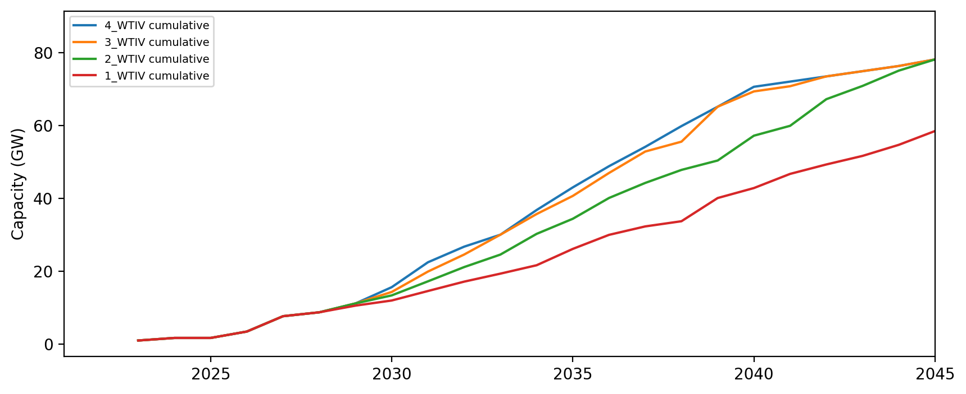
Installed Capacity

Slide 14
Installed Capacity - All Regions

Slide 15
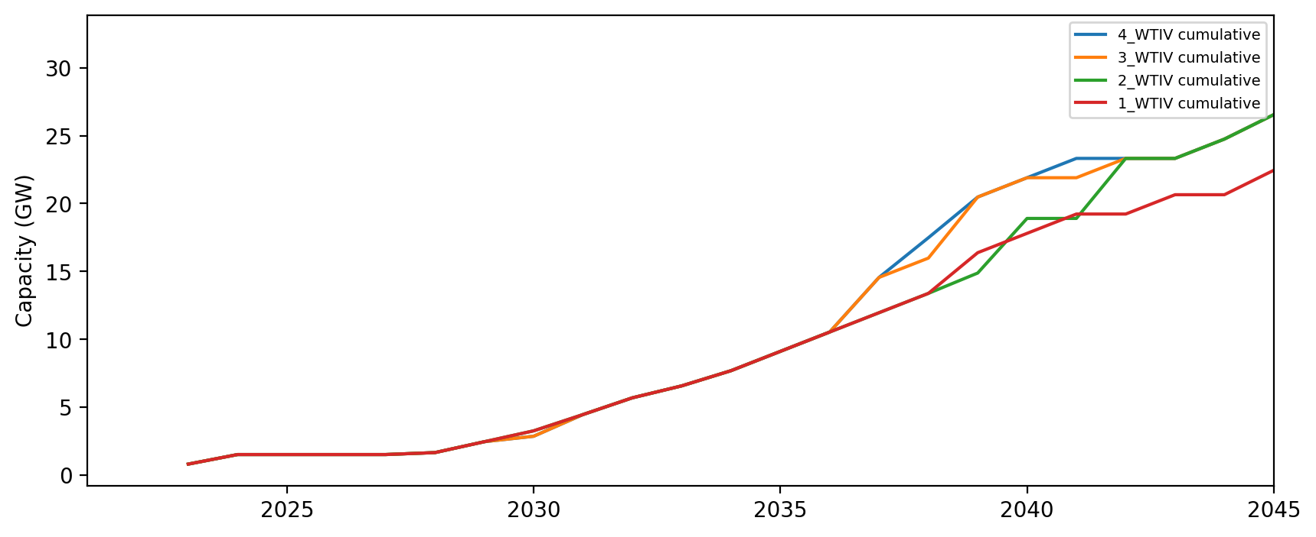
Installed Capacity - NE

Slide 16
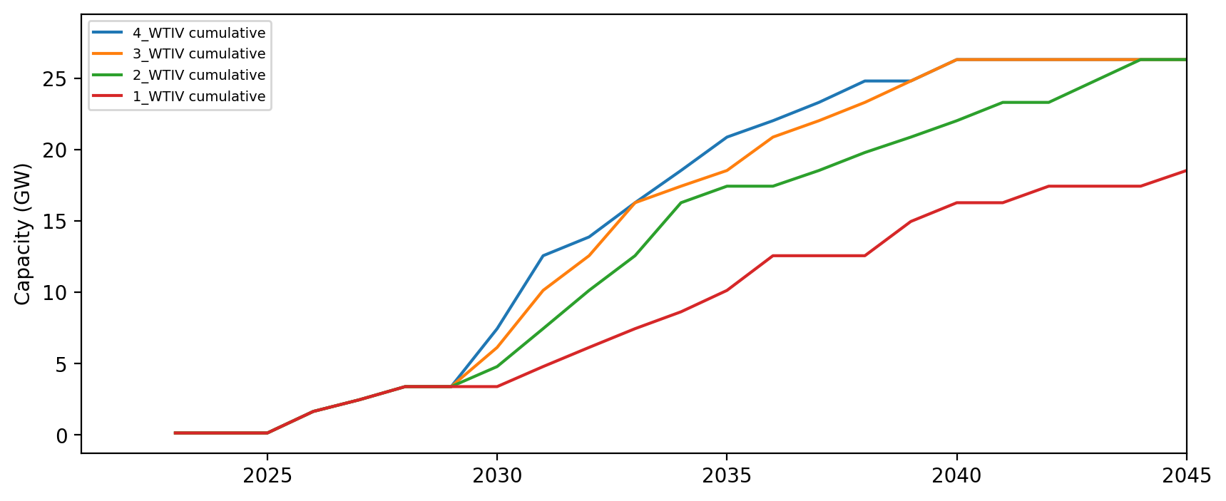
Installed Capacity - NYNJ

Slide 17
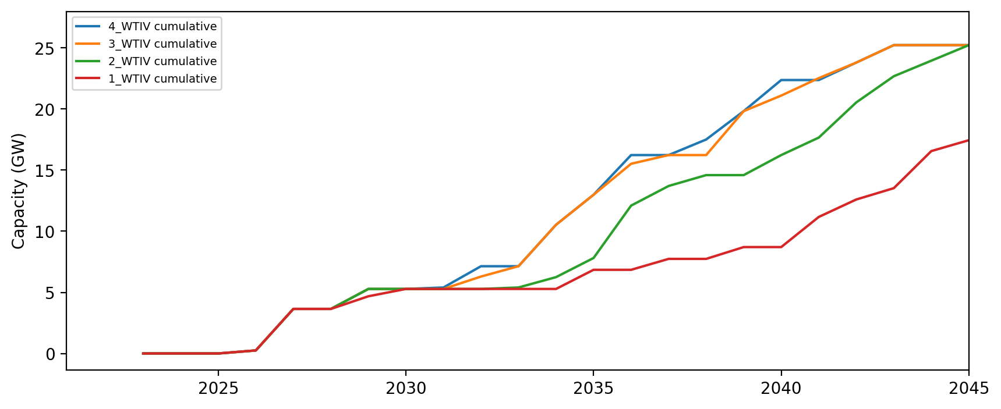
Installed Capacity - Mid-Atlantic

Slide 18
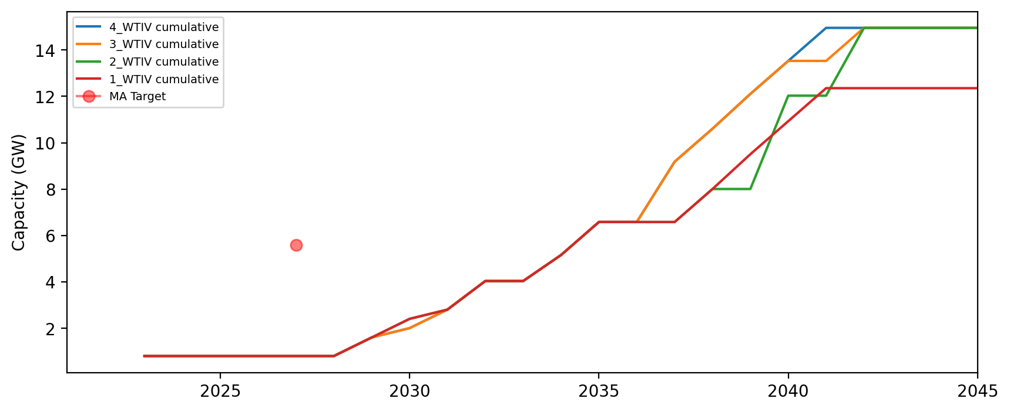
Installed Capacity - MA

Slide 19
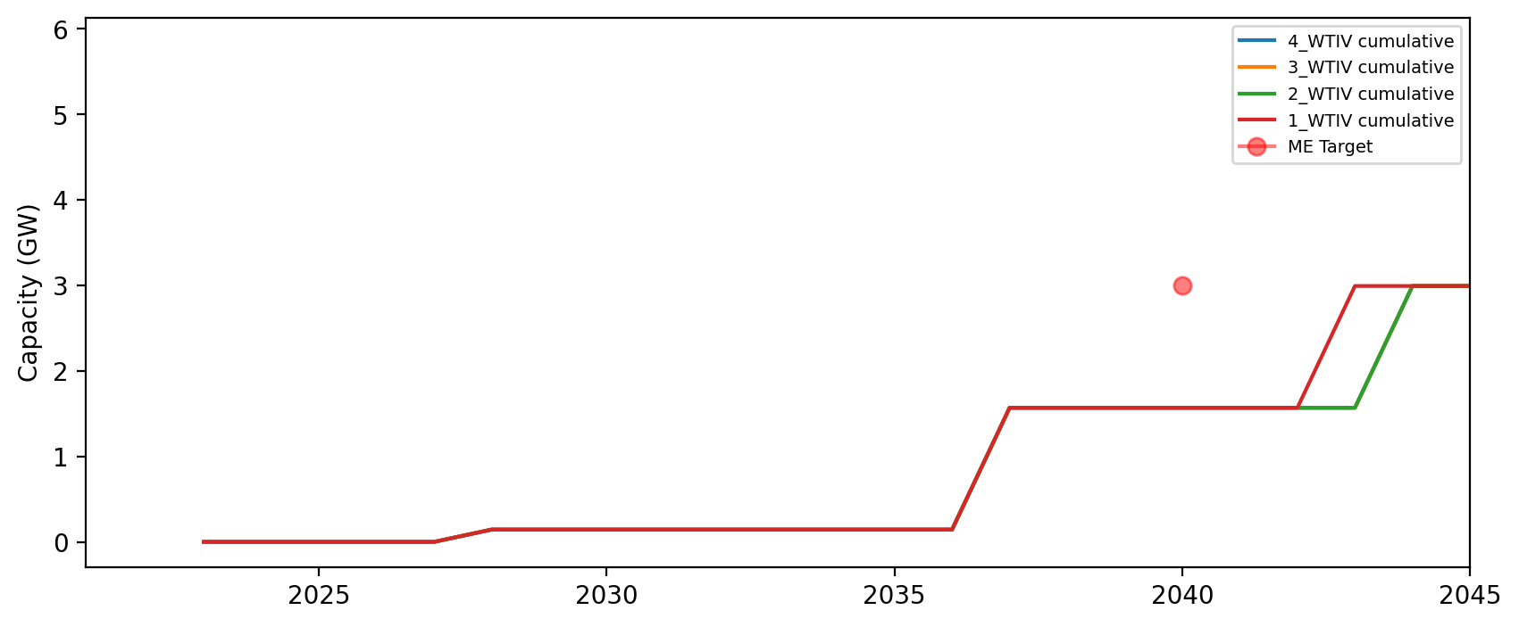
Installed Capacity - ME

Slide 20
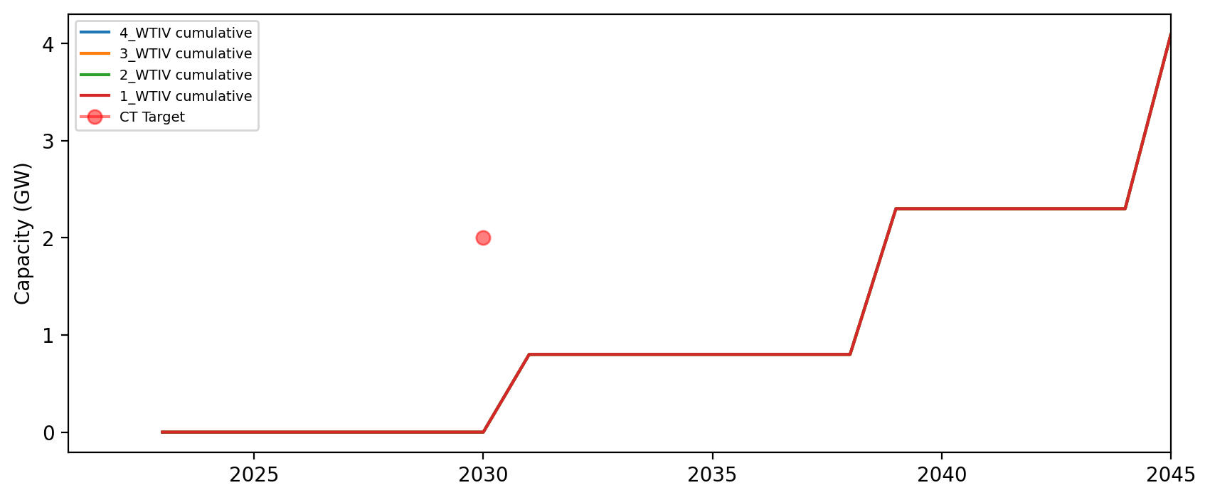
Installed Capacity - CT

Slide 21
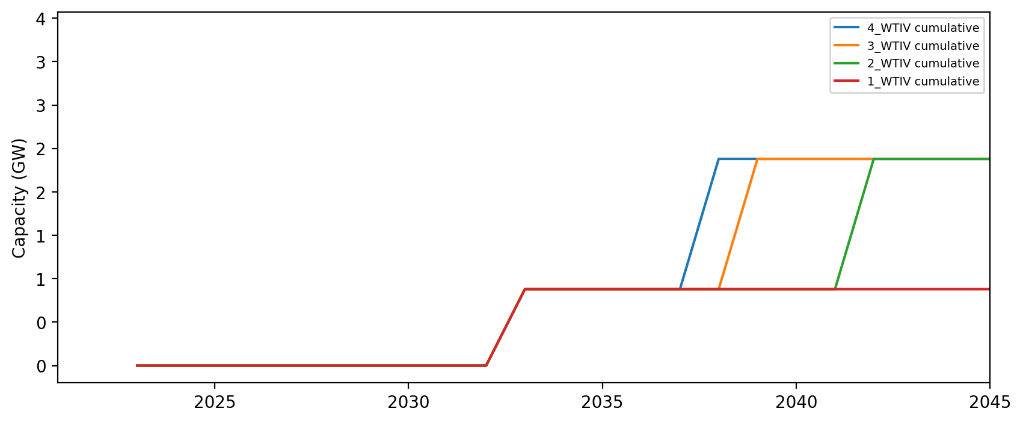
Installed Capacity - RI

Slide 22
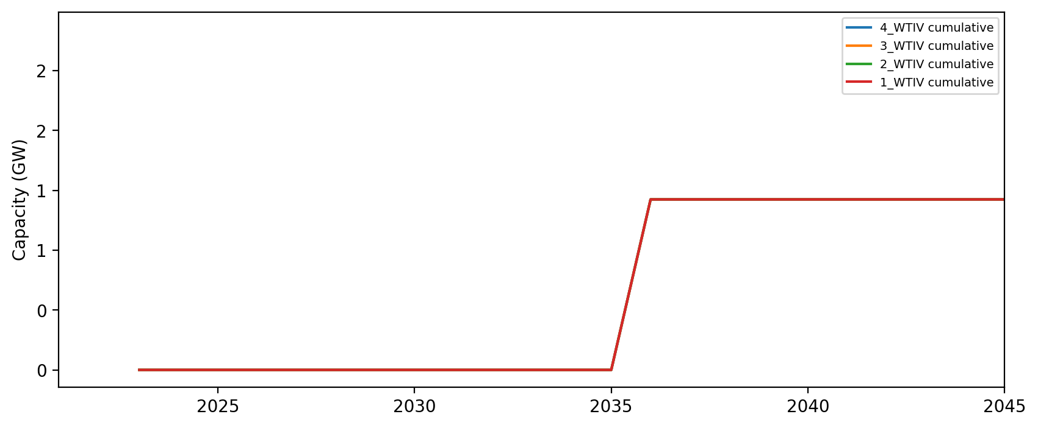
Installed Capacity - NH

Slide 23
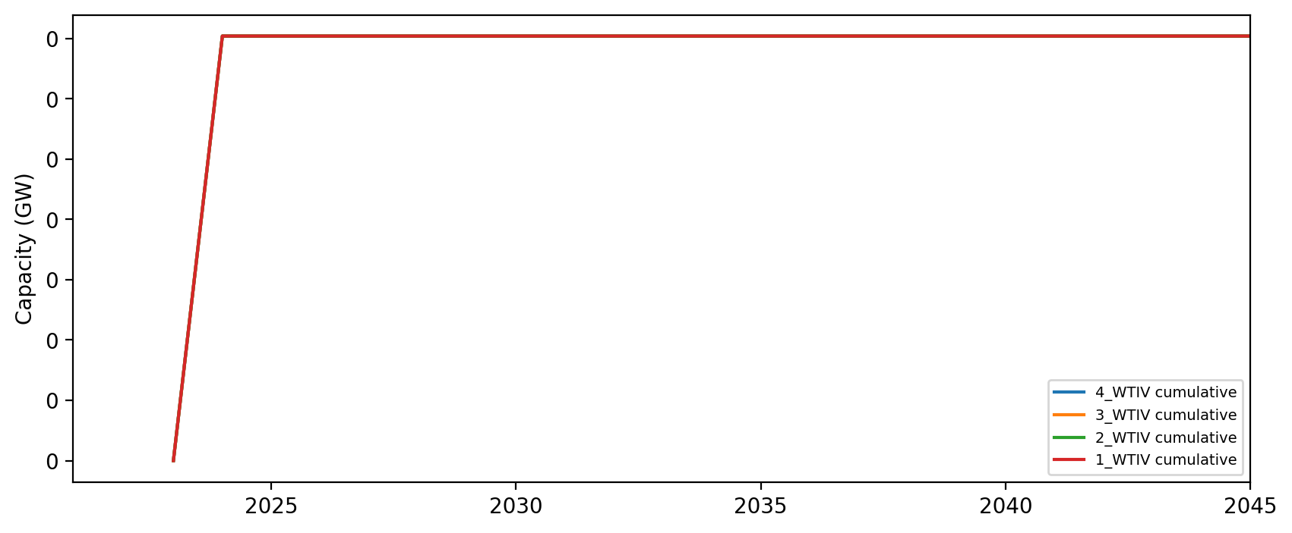
Installed Capacity - RI/CT

Slide 24
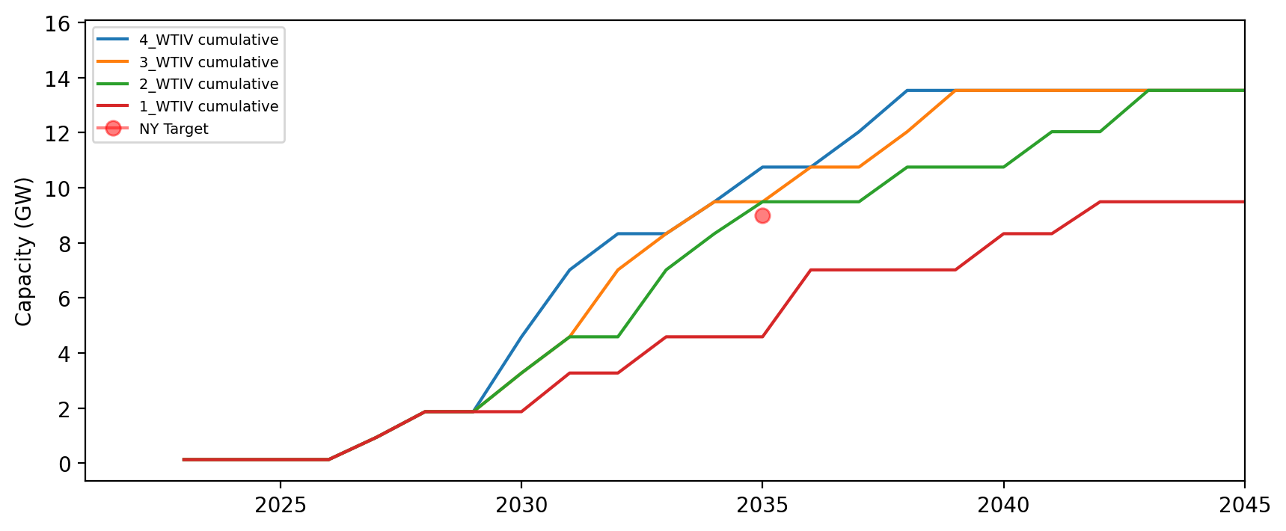
Installed Capacity - NY

Slide 25
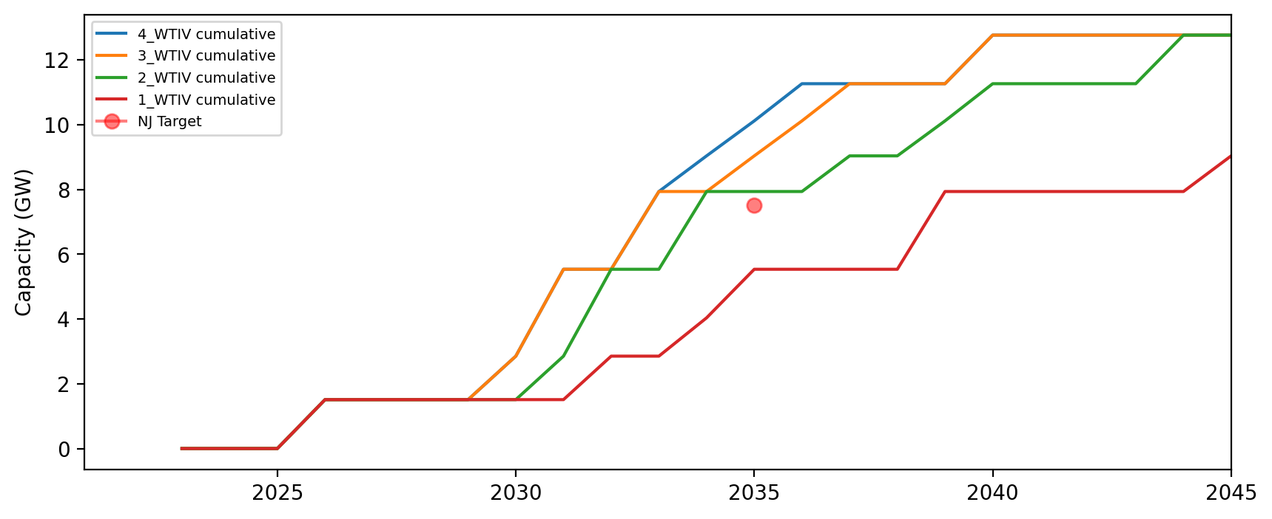
Installed Capacity - NJ

Slide 26
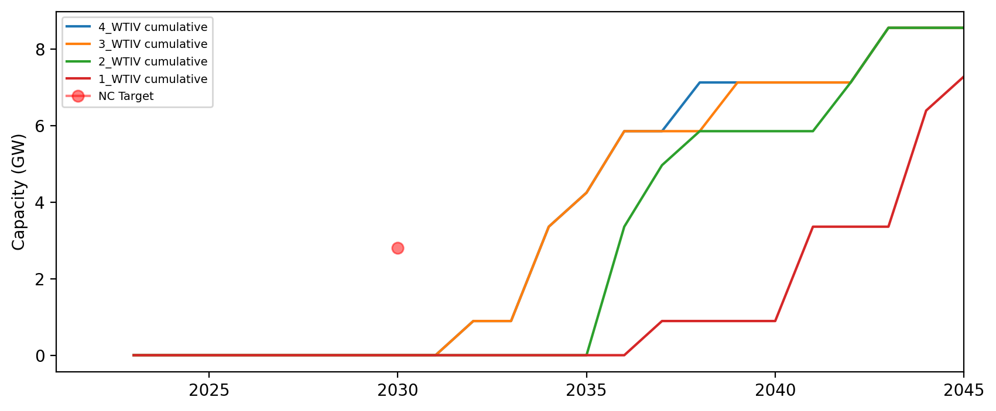
Installed Capacity - NC

Slide 27
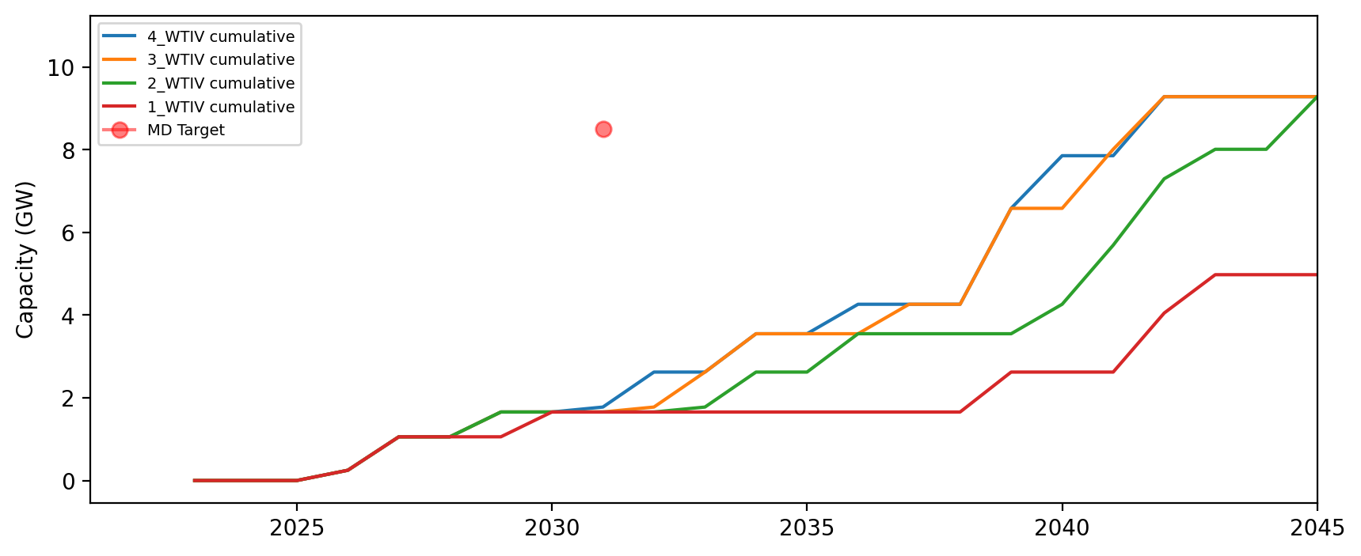
Installed Capacity - MD

Slide 28
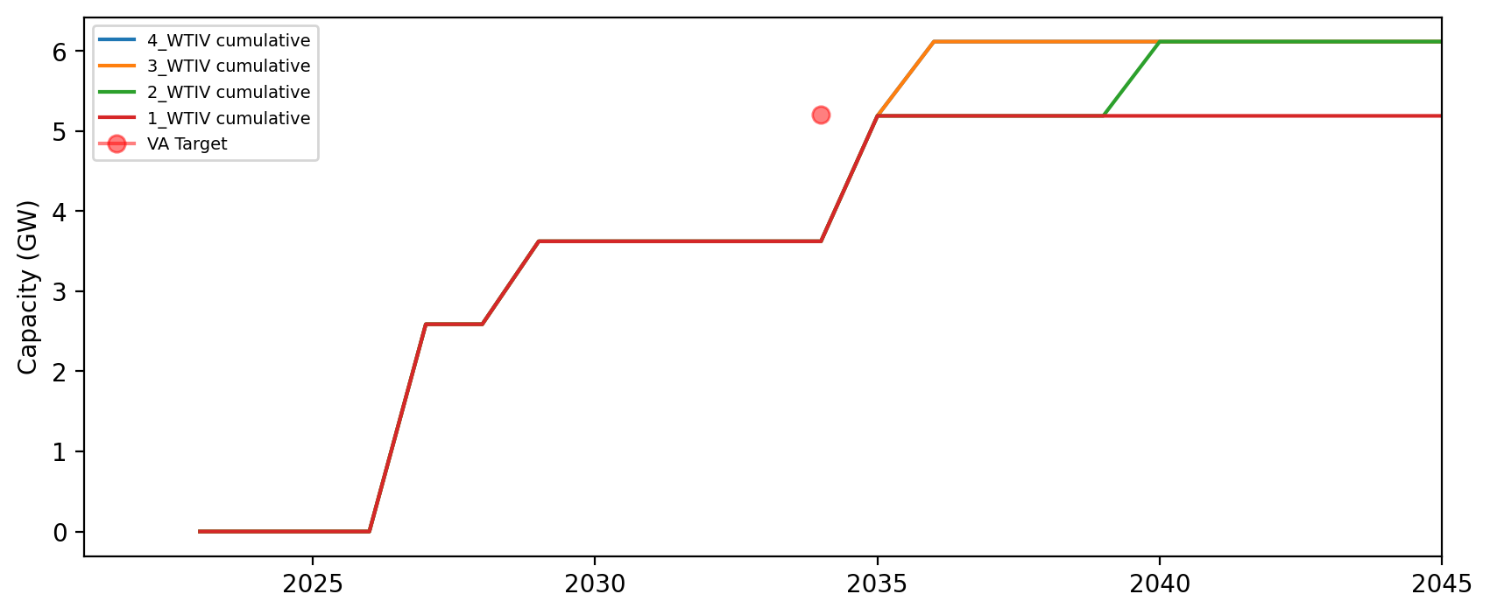
Installed Capacity - VA

Slide 29
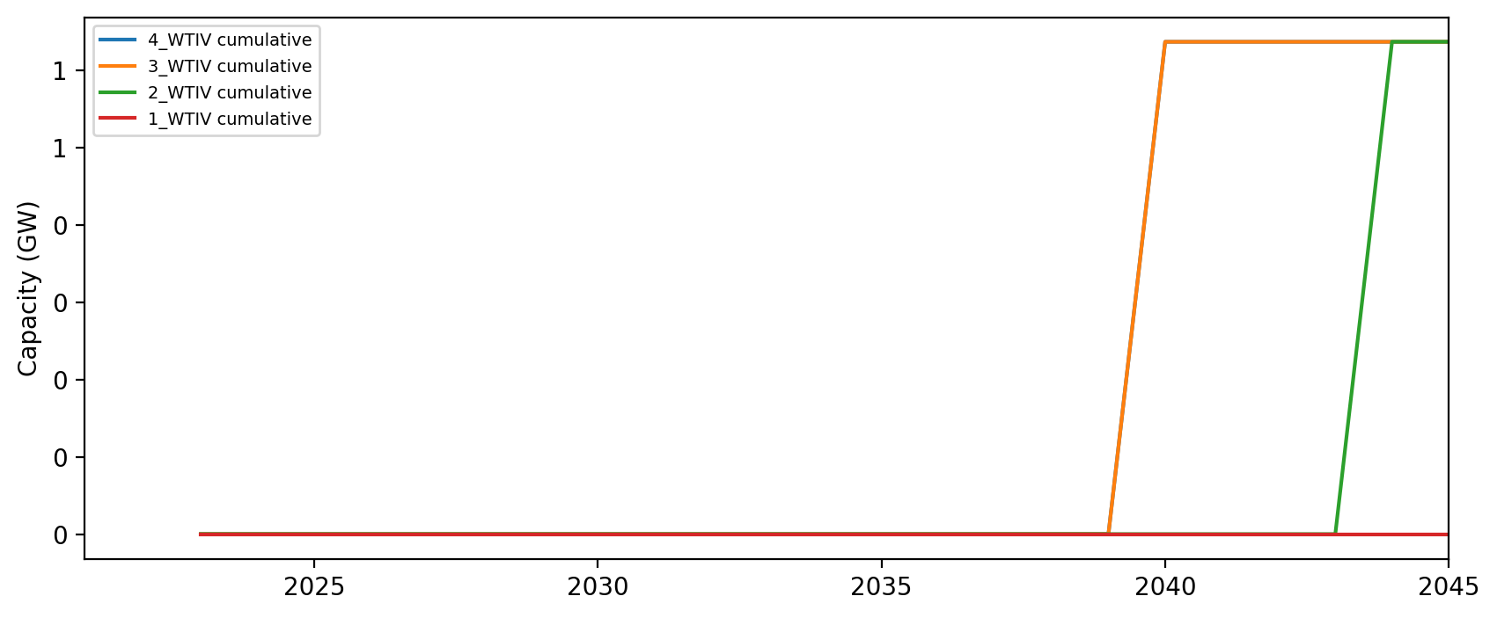
Installed Capacity - DE

Slide 30
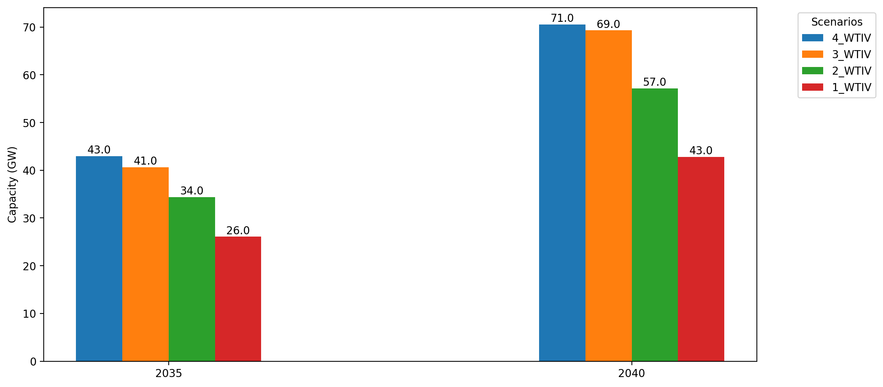
Cumulative Capacity by 2035 and 2040

Slide 31
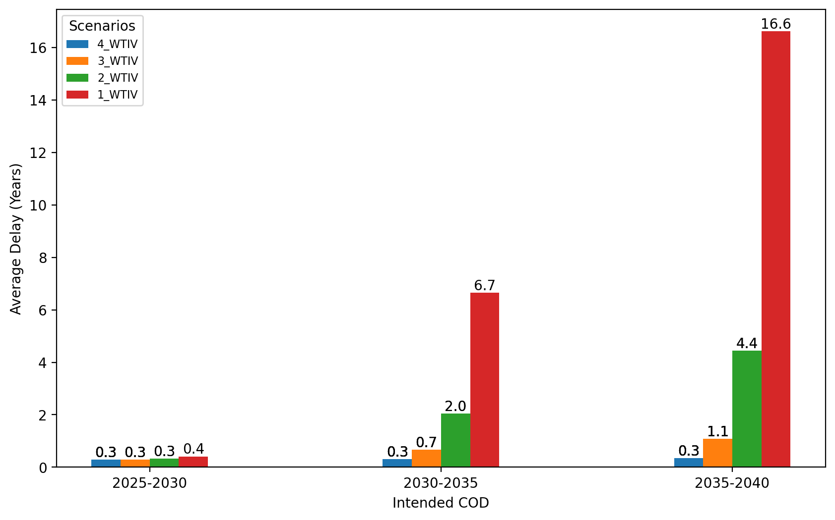
Average Delay Per Project by COD - All Regions

Slide 32
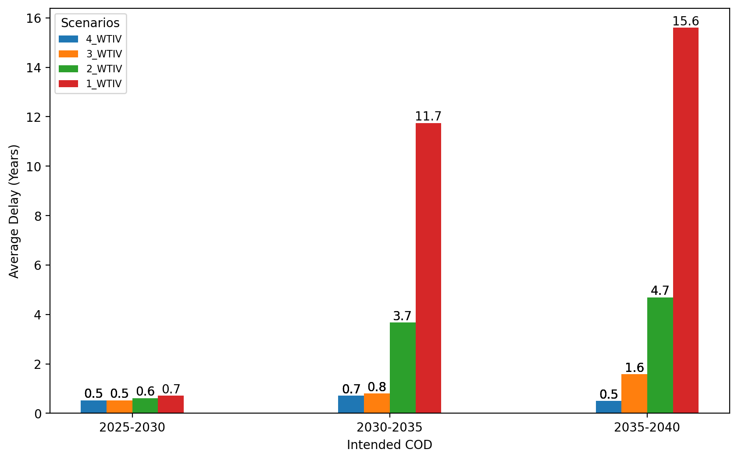
Average Delay Per Project by COD - NE

Slide 33
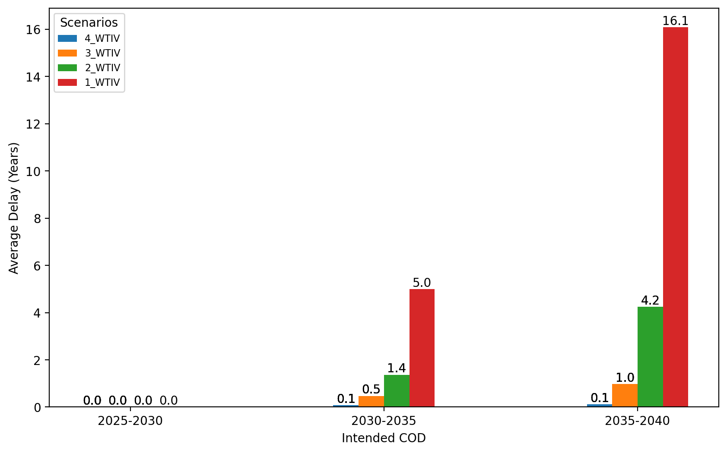
Average Delay Per Project by COD - NYNJ

Slide 34
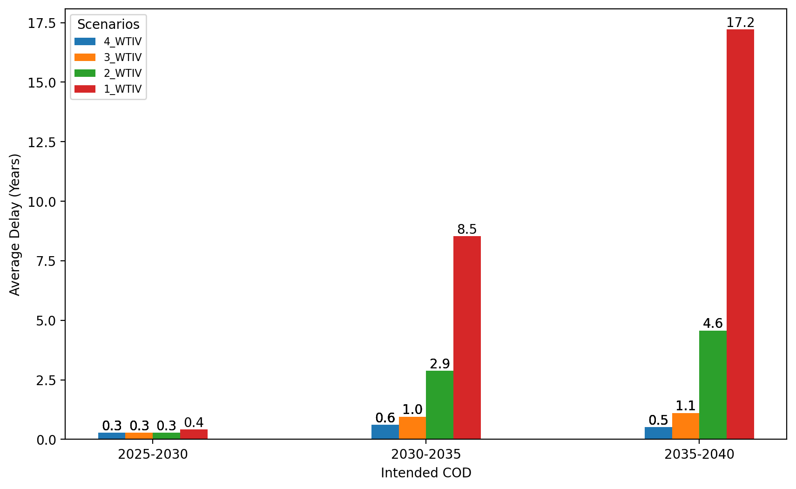
Average Delay Per Project by COD - Mid-Atlantic

Slide 35
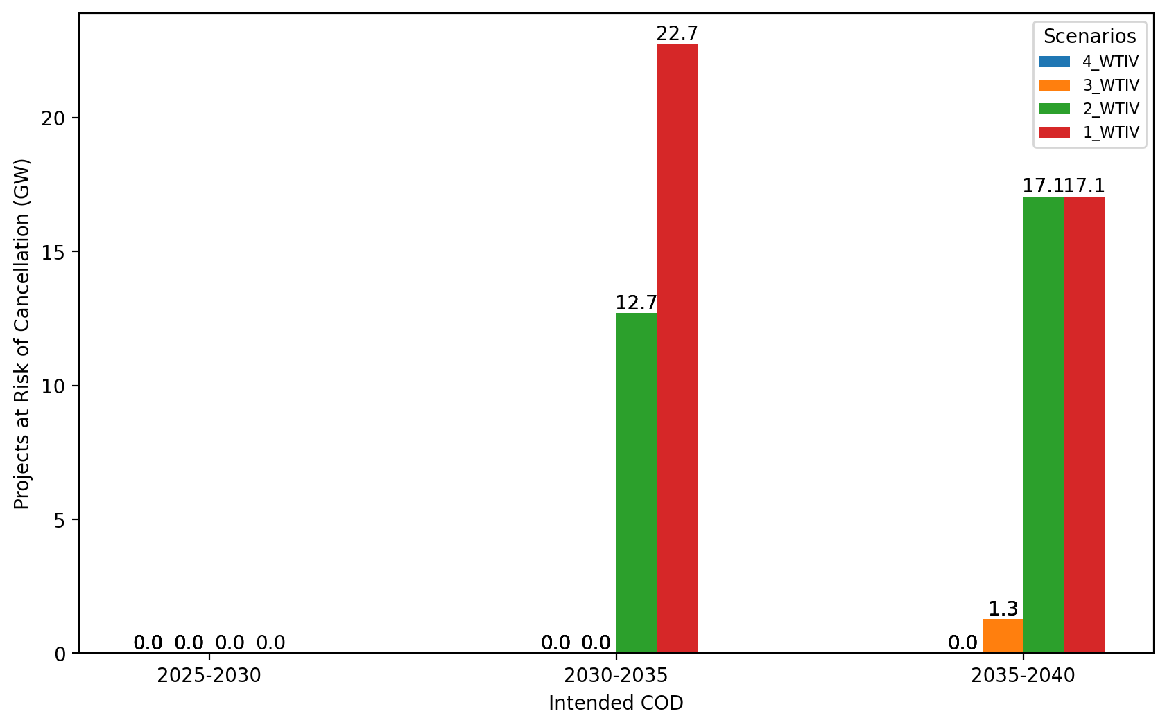
Total Capacity at Risk by COD - All Regions

Slide 36
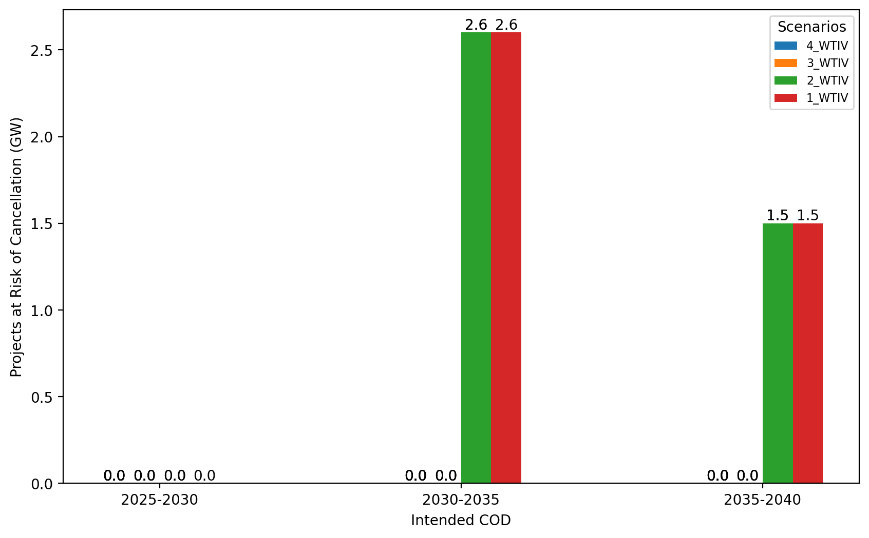
Total Capacity at Risk by COD - NE

Slide 37
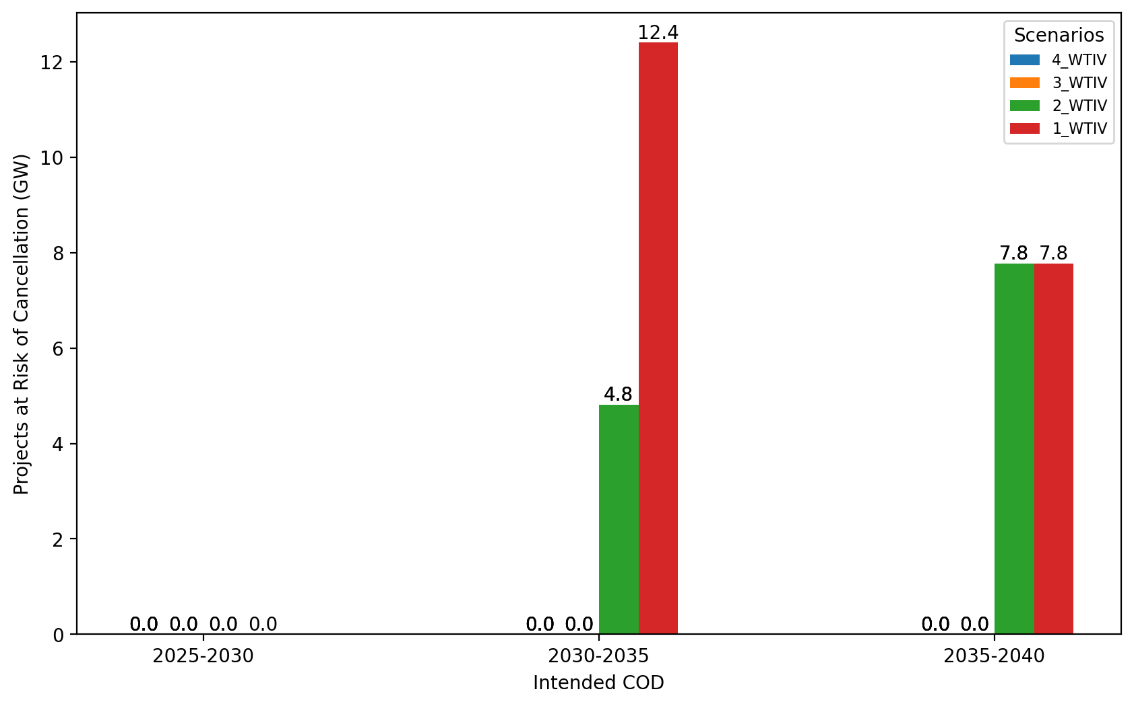
Total Capacity at Risk by COD - NYNJ

Slide 38
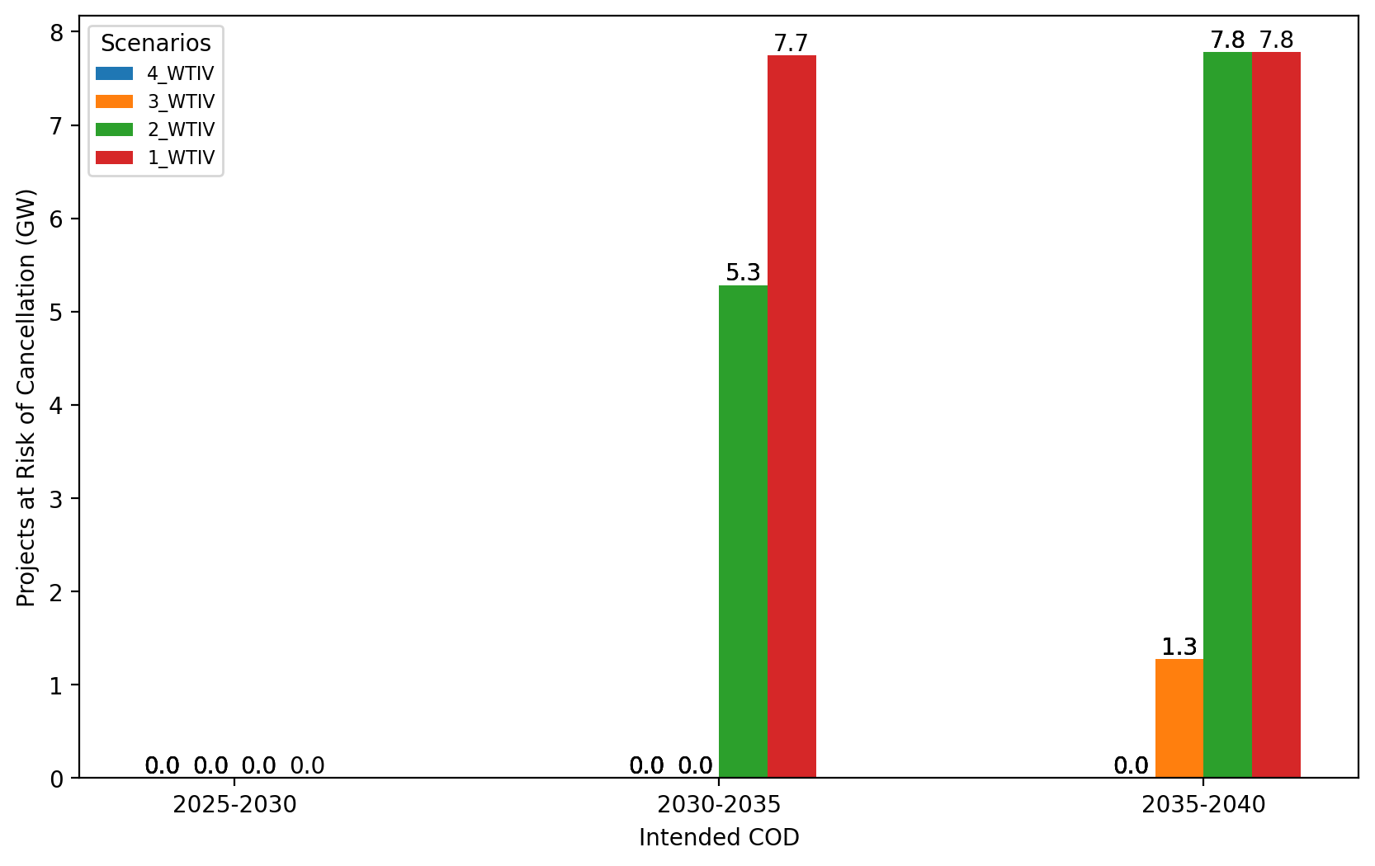
Total Capacity at Risk by COD - Mid-Atlantic

