Slide 1
natl_gaps_no_action_2_1
t
e
x
t

Slide 2
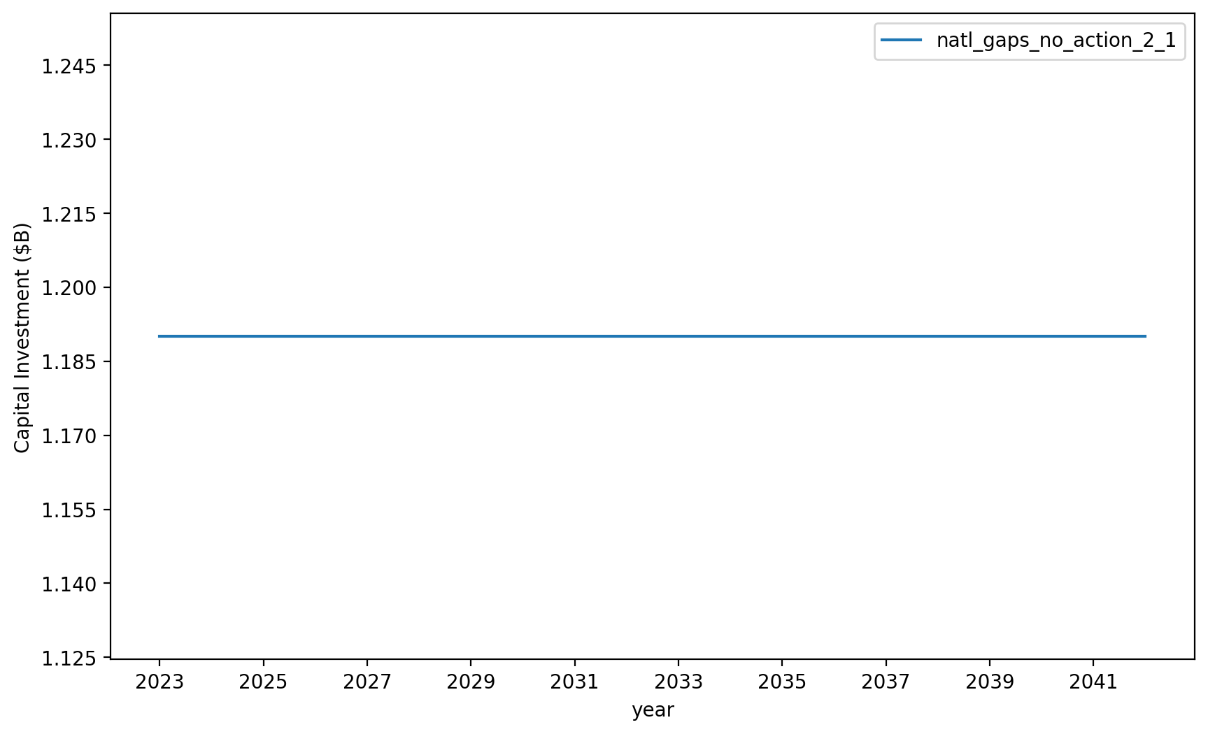
Vessel Investment

Slide 3
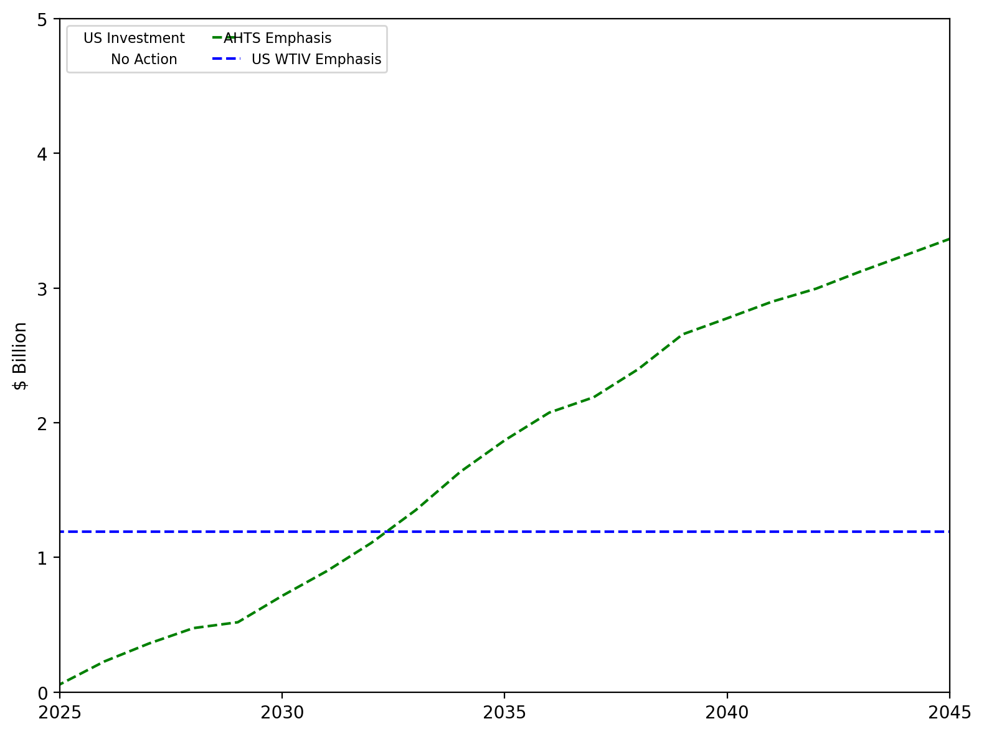
US Investment Summary

Slide 4
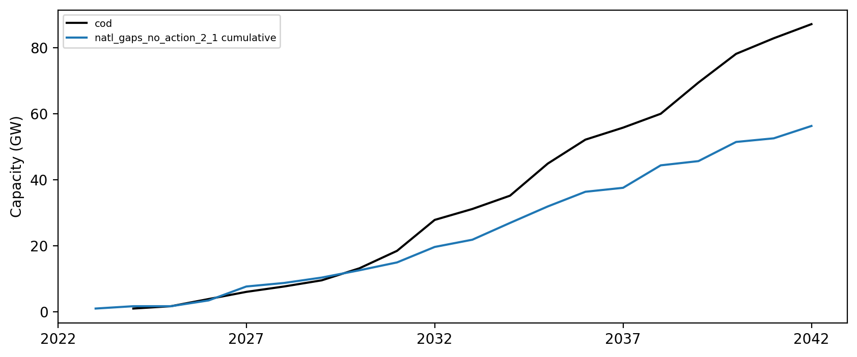
Installed Capacity

Slide 5
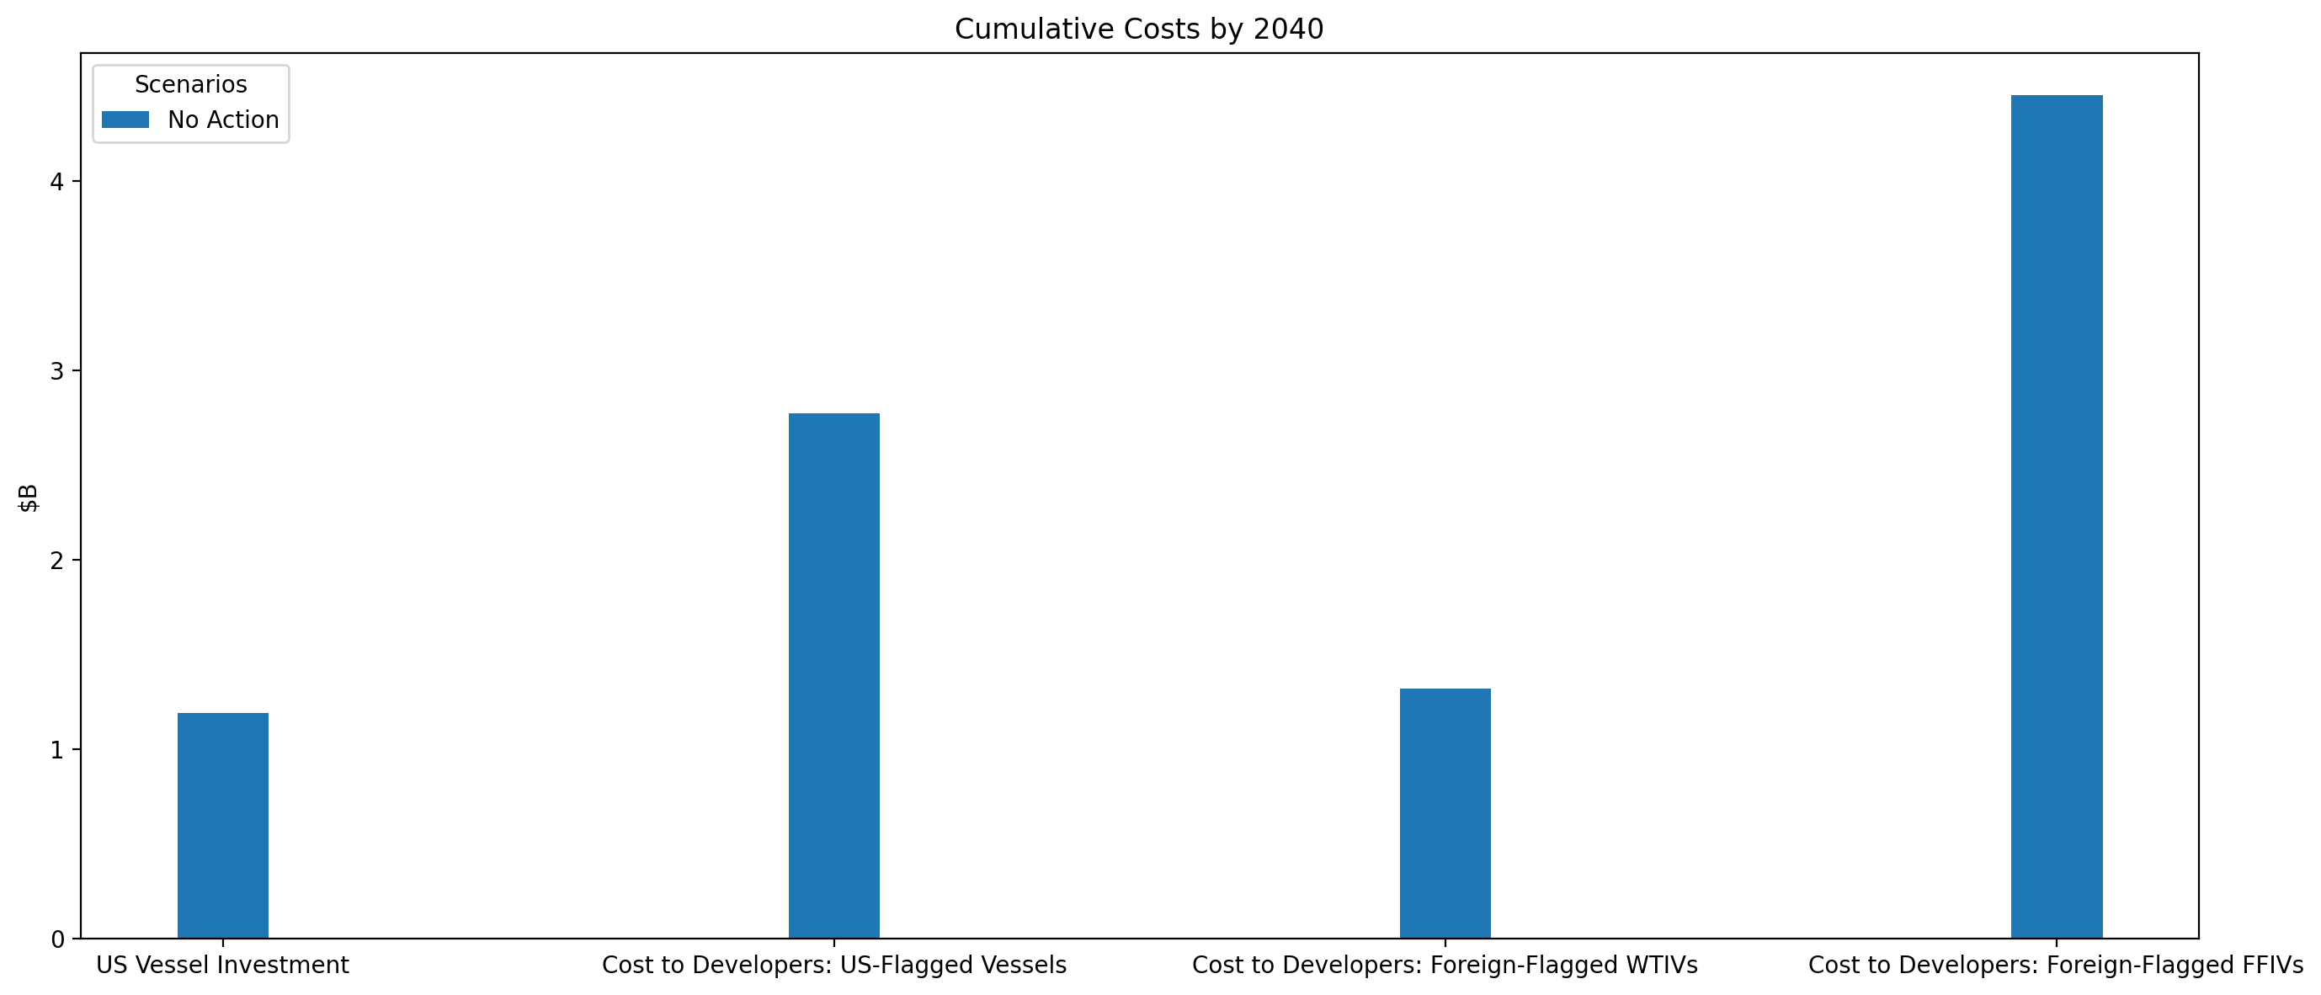
Cumulative Investment and Costs by Scenario (Up to 2040)

Slide 6
Installed Capacity

Slide 7
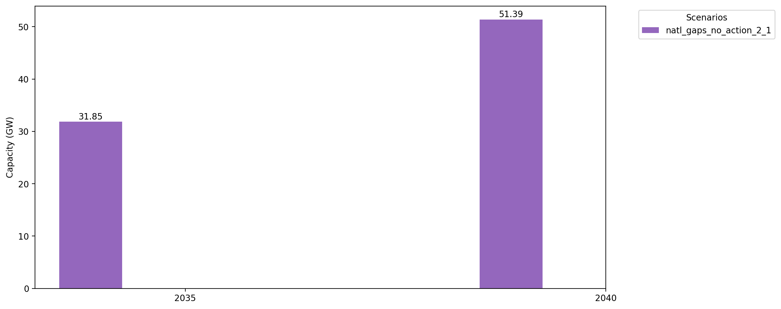
Cumulative Capacity by 2035 and 2040

