Slide 1
natl_gaps_no_action_2_1
t
e
x
t

Slide 2
natl_gaps_4AHTS_2_1
t
e
x
t

Slide 3
natl_gaps_infv
t
e
x
t

Slide 4
natl_gaps_3us_2_1
t
e
x
t

Slide 5
natl_gaps_4foreign_2_1
t
e
x
t

Slide 6
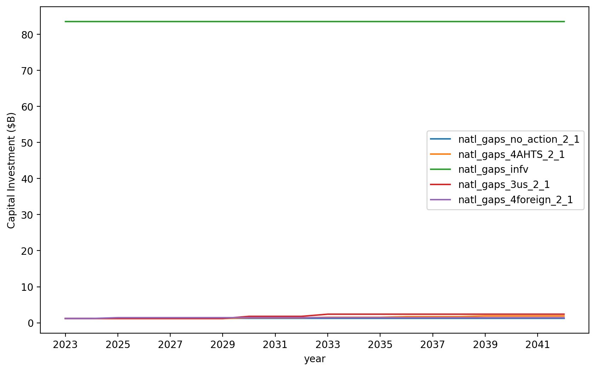
Vessel Investment

Slide 7
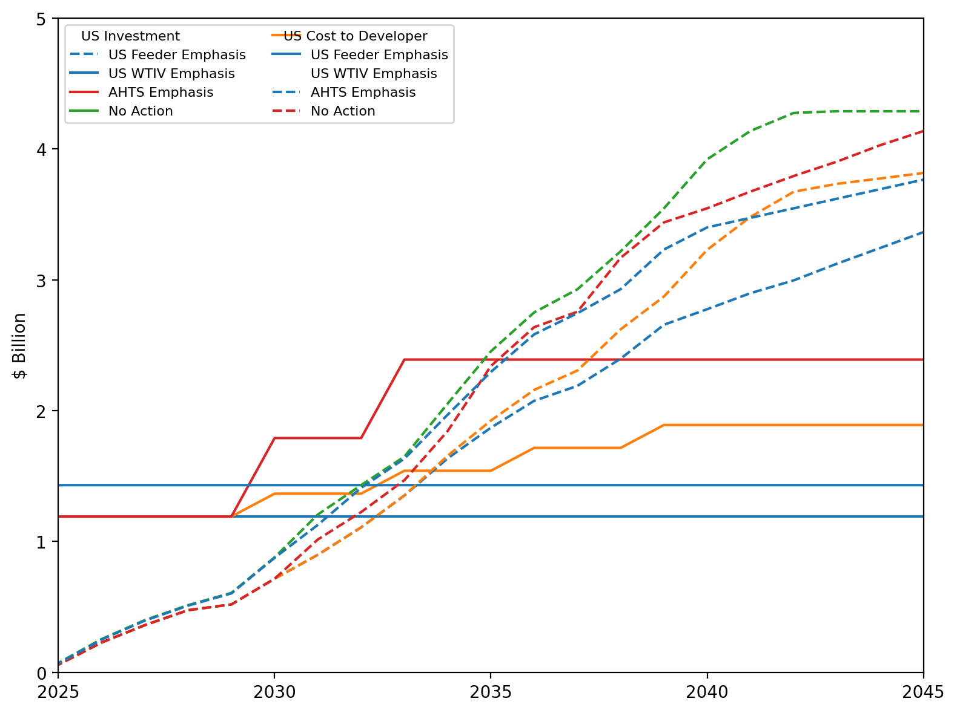
US Investment Summary

Slide 8
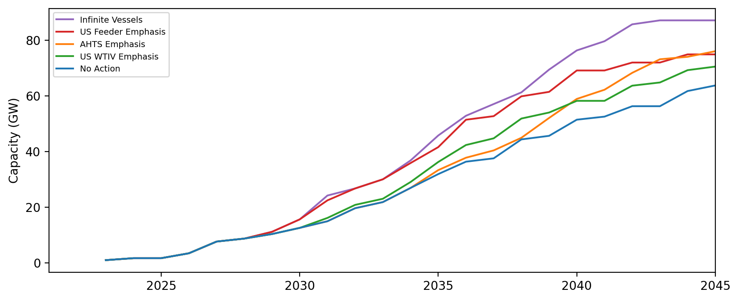
Installed Capacity

Slide 9
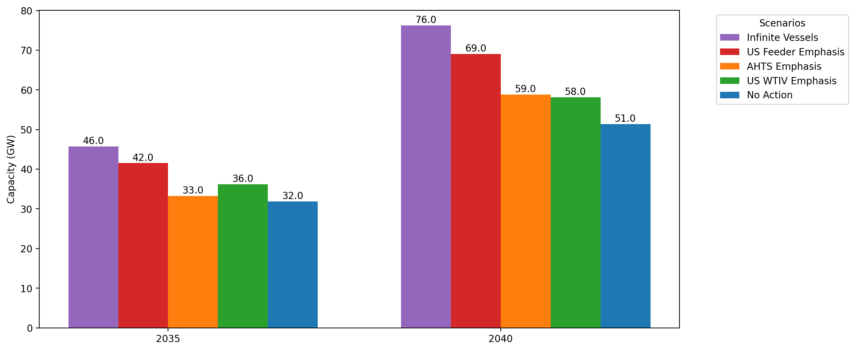
Cumulative Capacity by 2035 and 2040

Slide 10
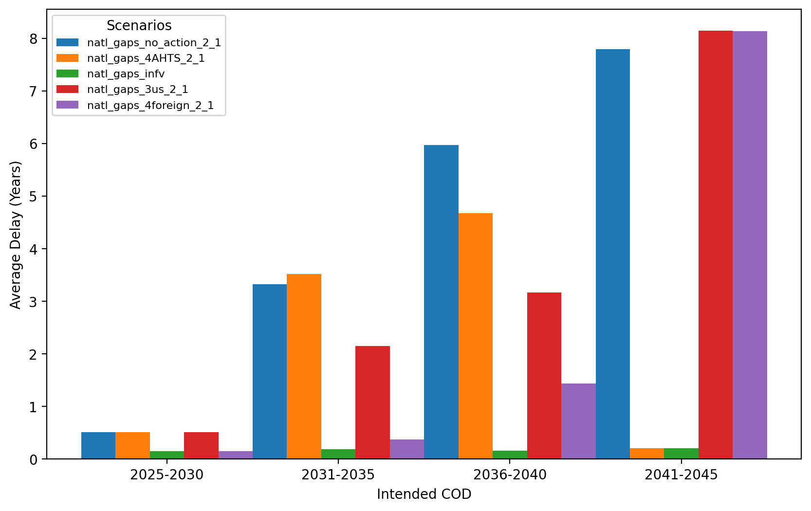
Average Delay Per Project by COD

