Slide 1
natl_gaps_no_action_2_1
1 US WTIV starting with CVOW

Slide 2
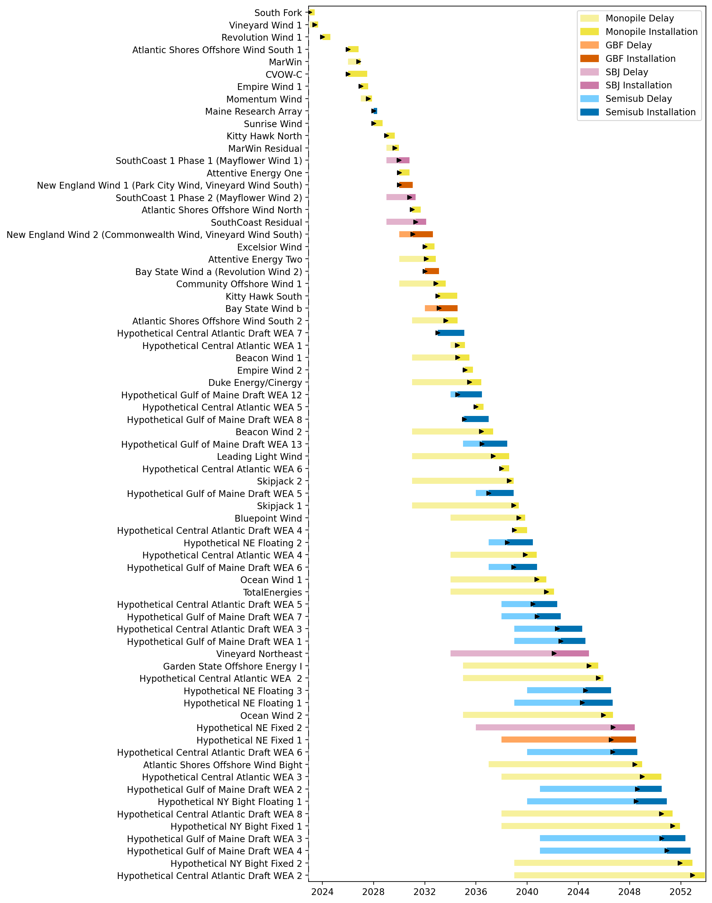
Full Gantt

Slide 3
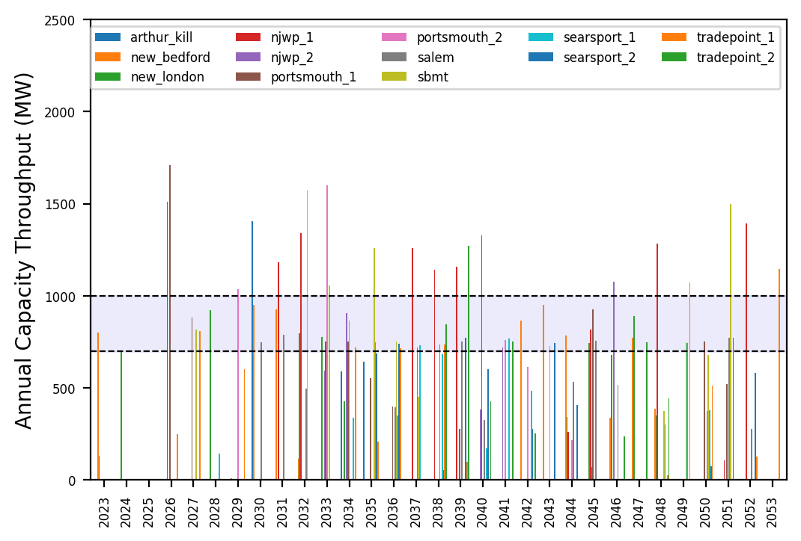
Port Throughput

Slide 4
natl_gaps_2us_2_1
1 US WTIV starting with CVOW, then 1 in 2030

Slide 5
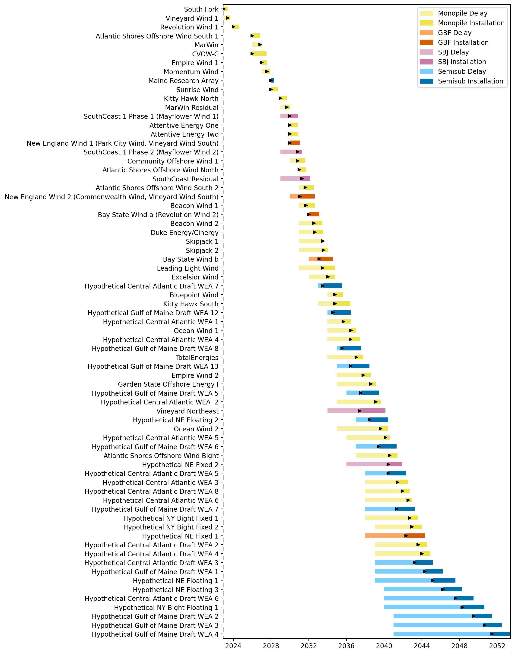
Full Gantt

Slide 6
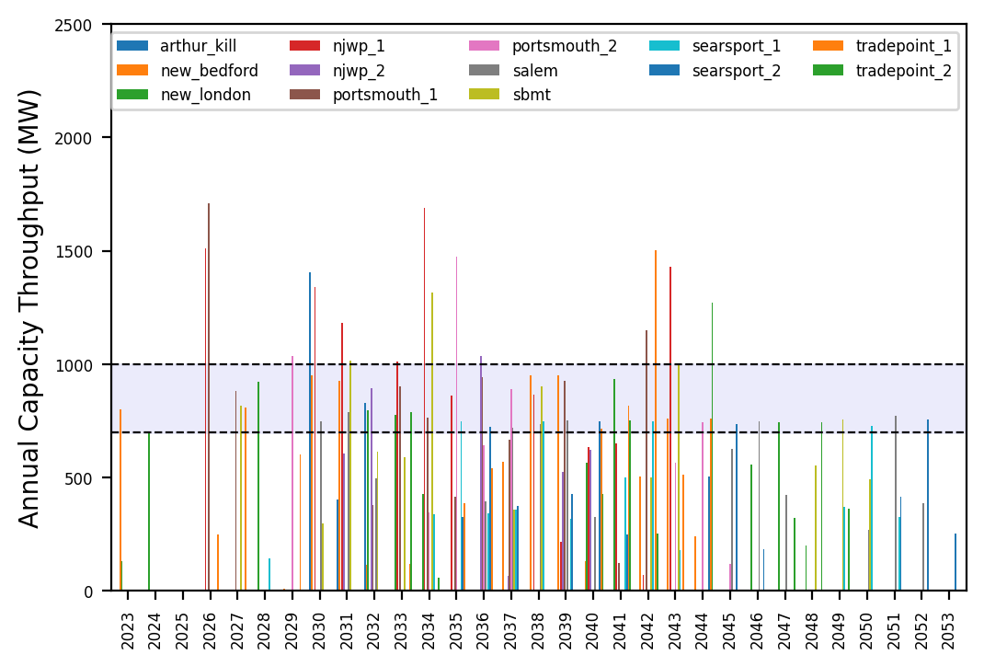
Port Throughput

Slide 7
natl_gaps_3us_2_1
1 US WTIV starting with CVOW, then 1 in 2030, 2033

Slide 8
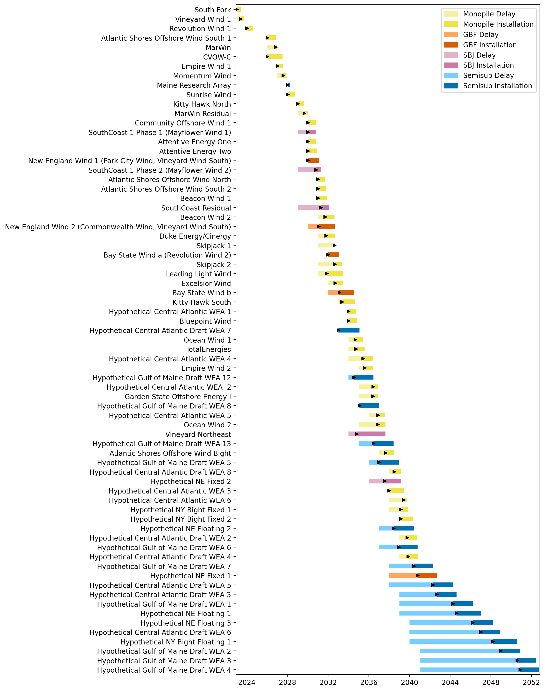
Full Gantt

Slide 9
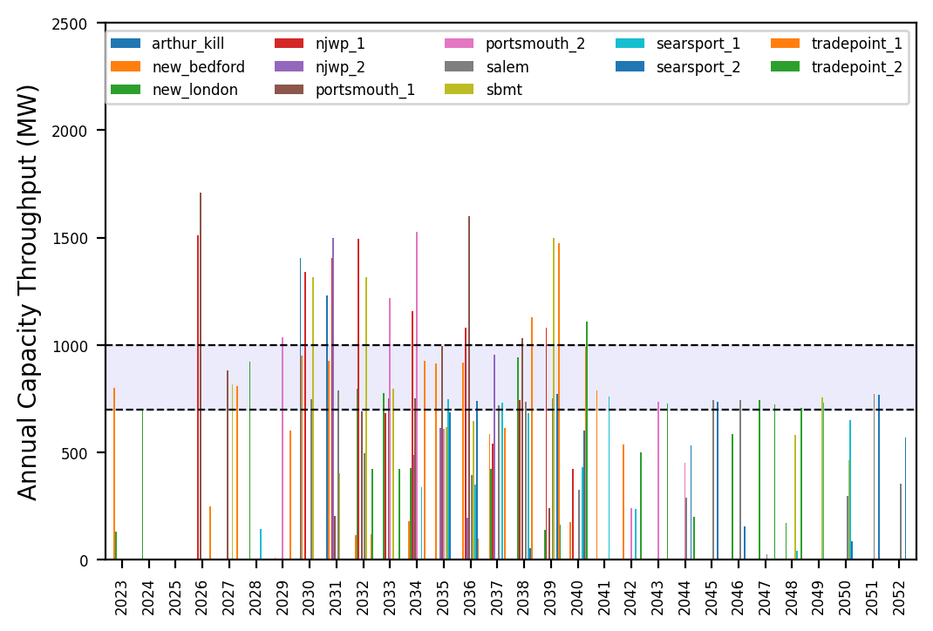
Port Throughput

Slide 10
natl_gaps_4us_2_1
1 US WTIV starting with CVOW, then 1 in 2030, 2033, 2036

Slide 11
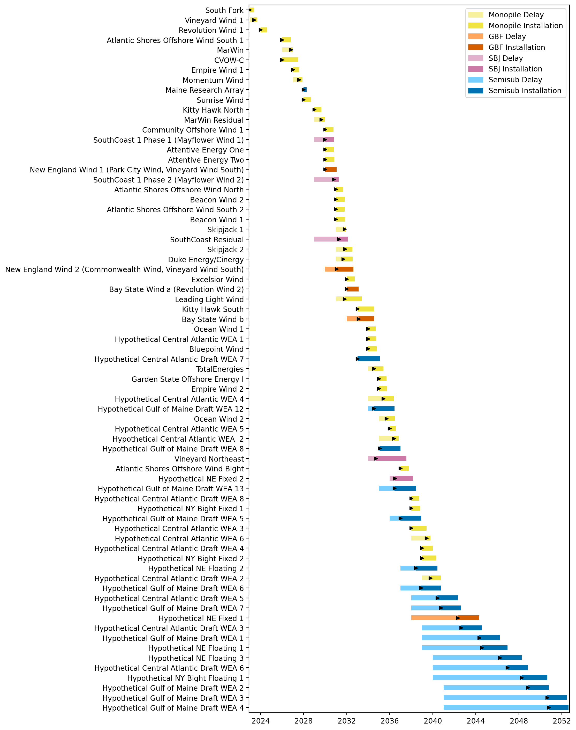
Full Gantt

Slide 12
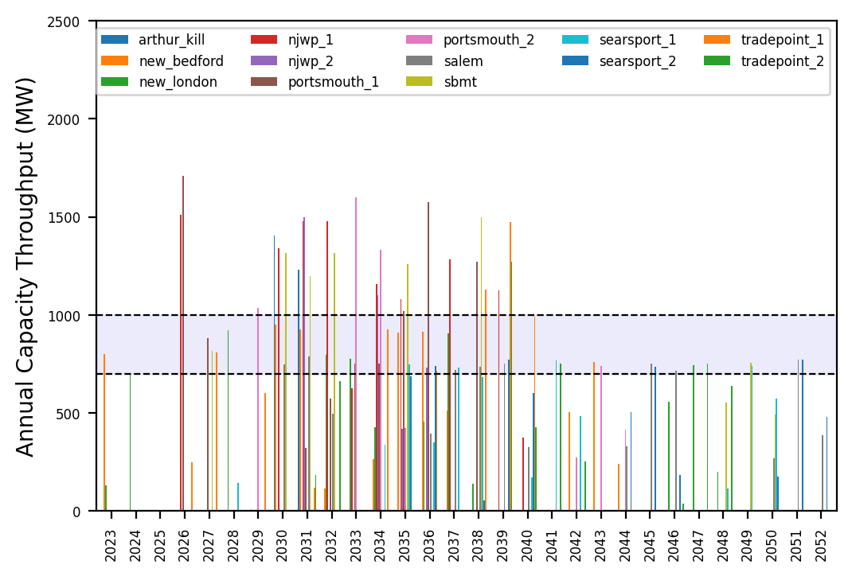
Port Throughput

Slide 13
natl_gaps_4us_infp_2_1
1 US WTIV starting with CVOW, then 1 in 2030, 2033, 2036

Slide 14
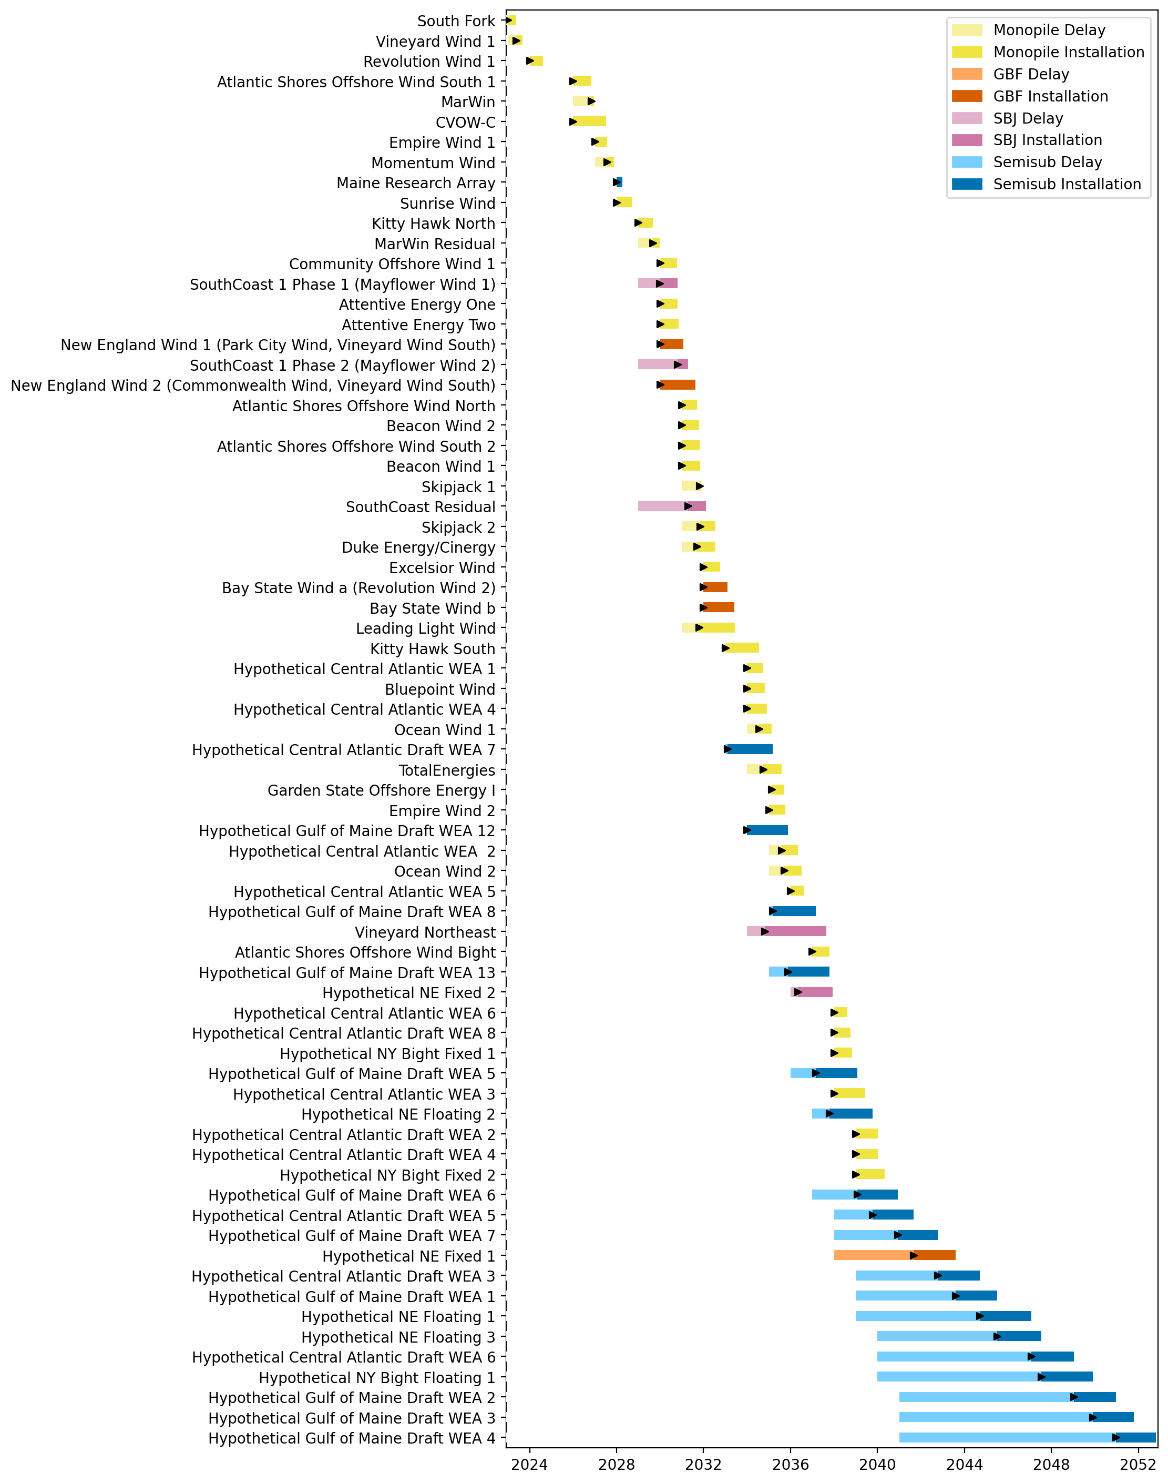
Full Gantt

Slide 15
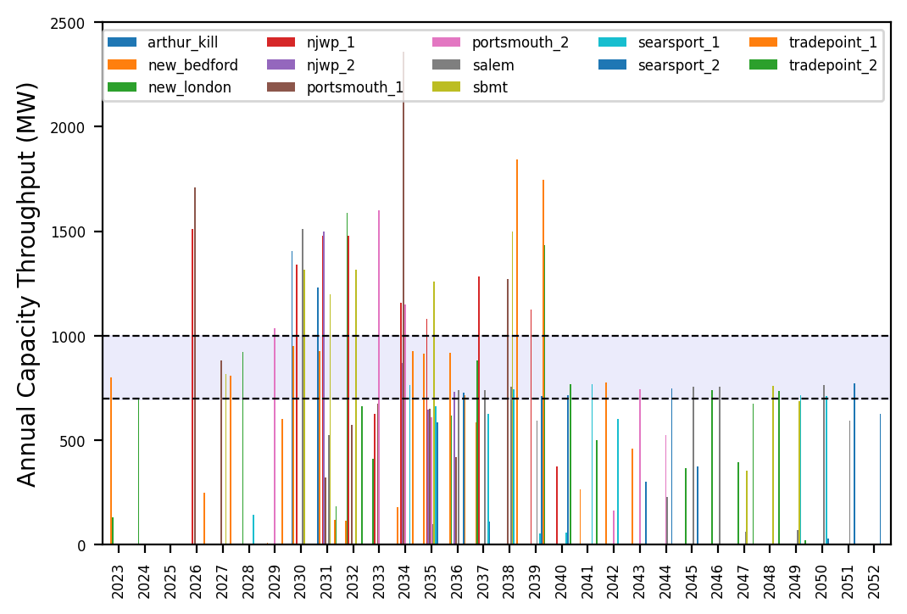
Port Throughput

Slide 16
natl_gaps_infv
Default ports, unconstrained vessels

Slide 17
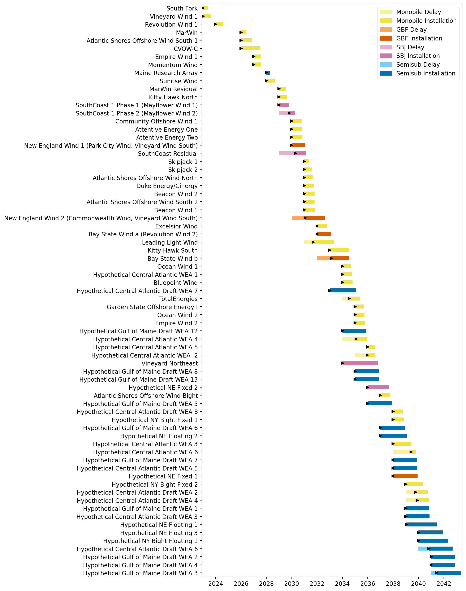
Full Gantt

Slide 18
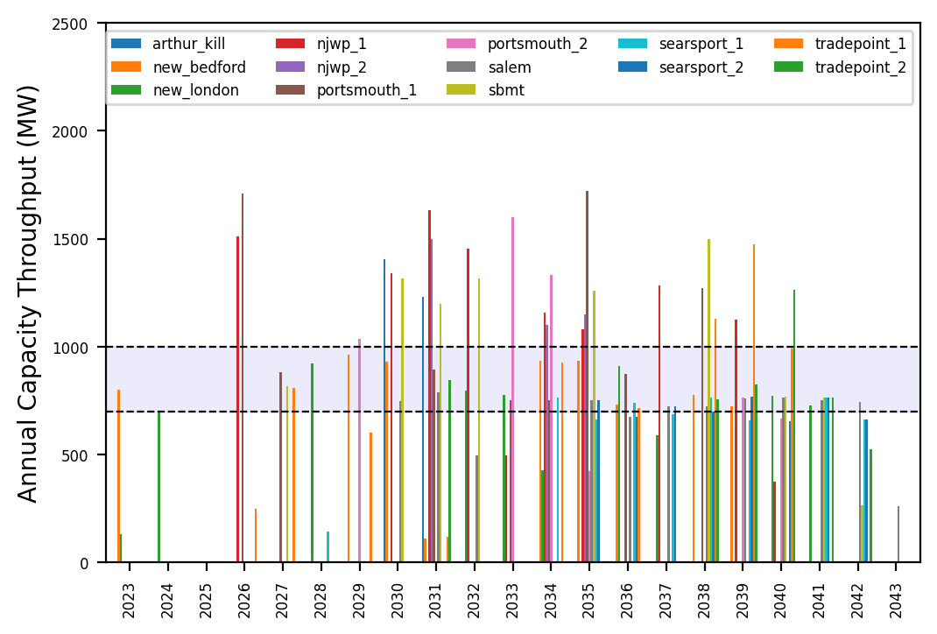
Port Throughput

Slide 19
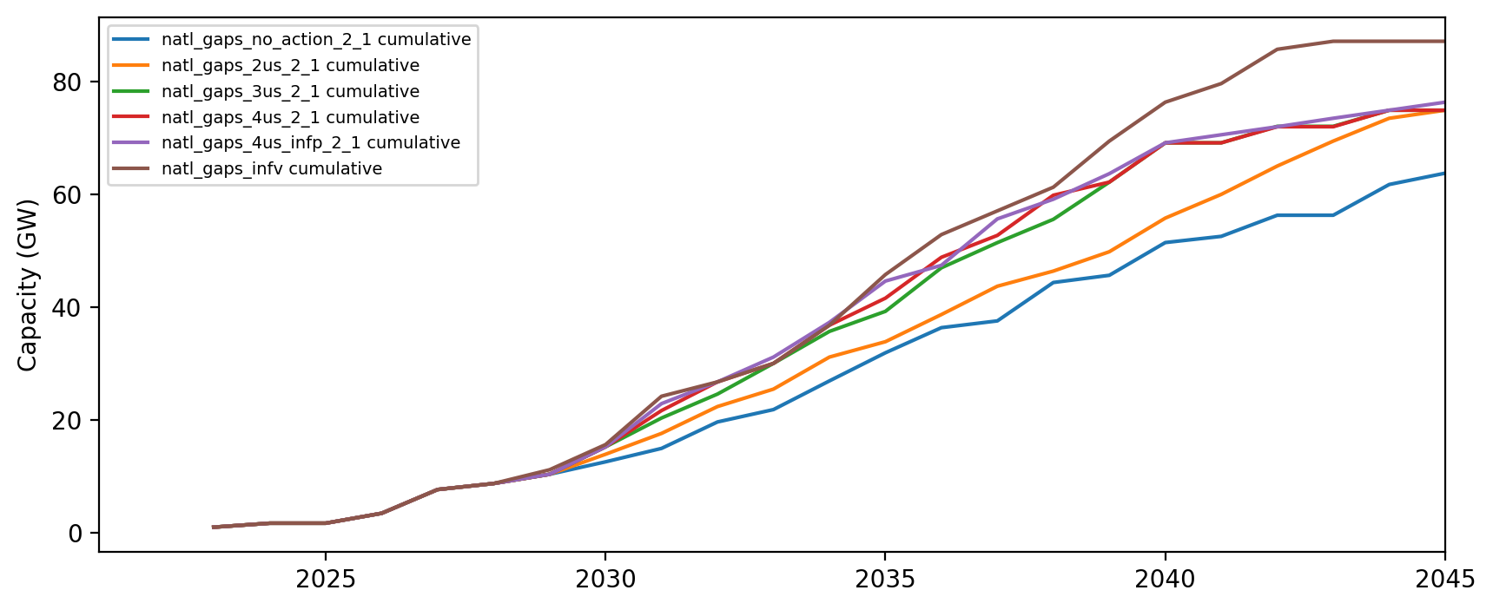
Installed Capacity

