Slide 1
natl_gaps_no_action_2_1
t
e
x
t

Slide 2
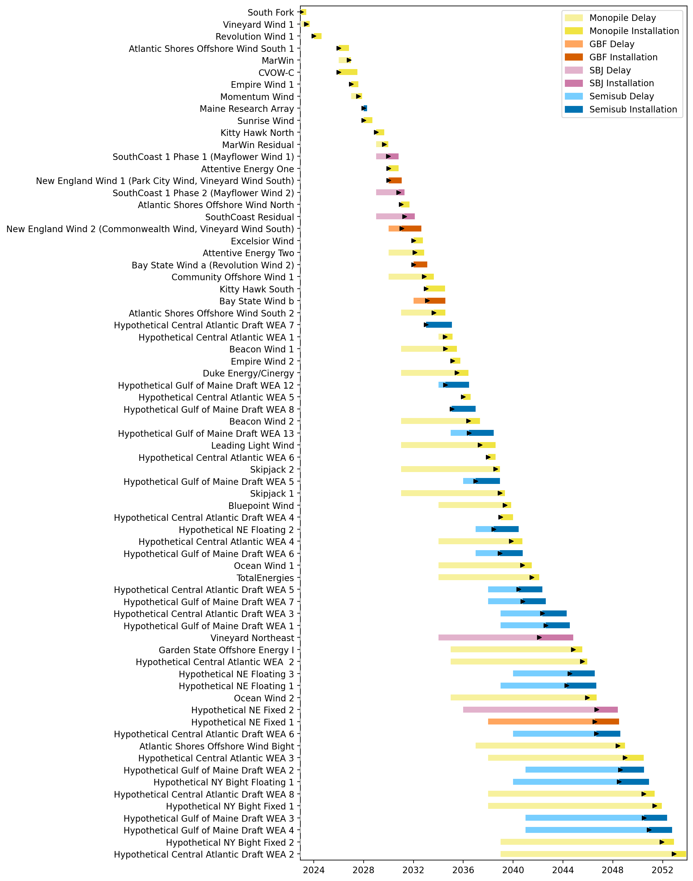
Full Gantt

Slide 3
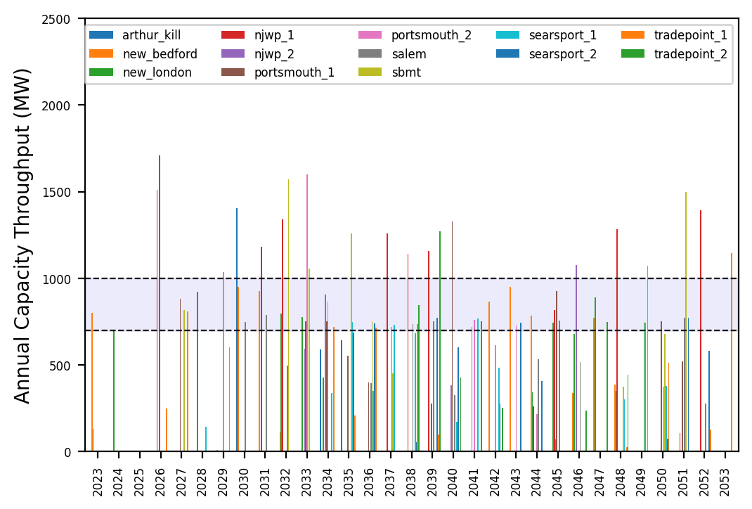
Port Throughput

Slide 4
natl_gaps_4us_2_1
t
e
x
t

Slide 5
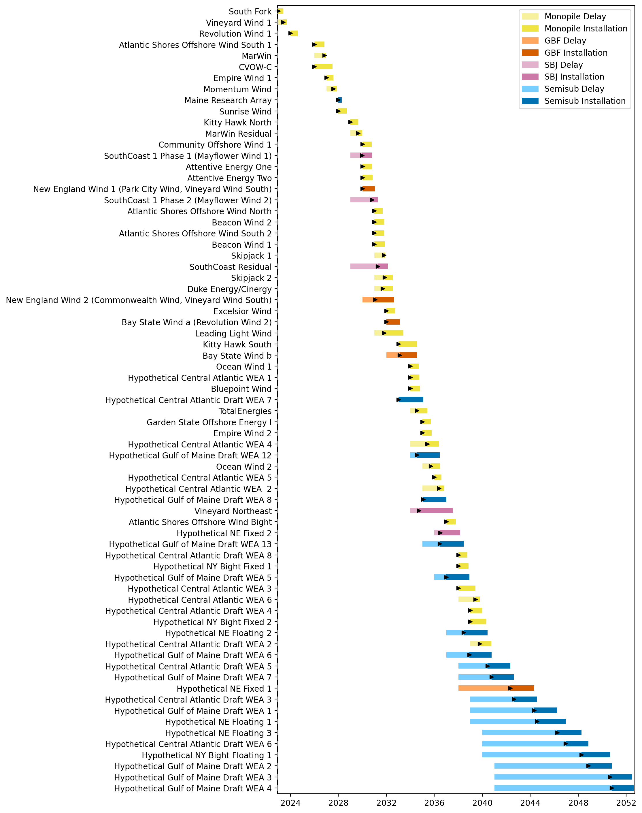
Full Gantt

Slide 6
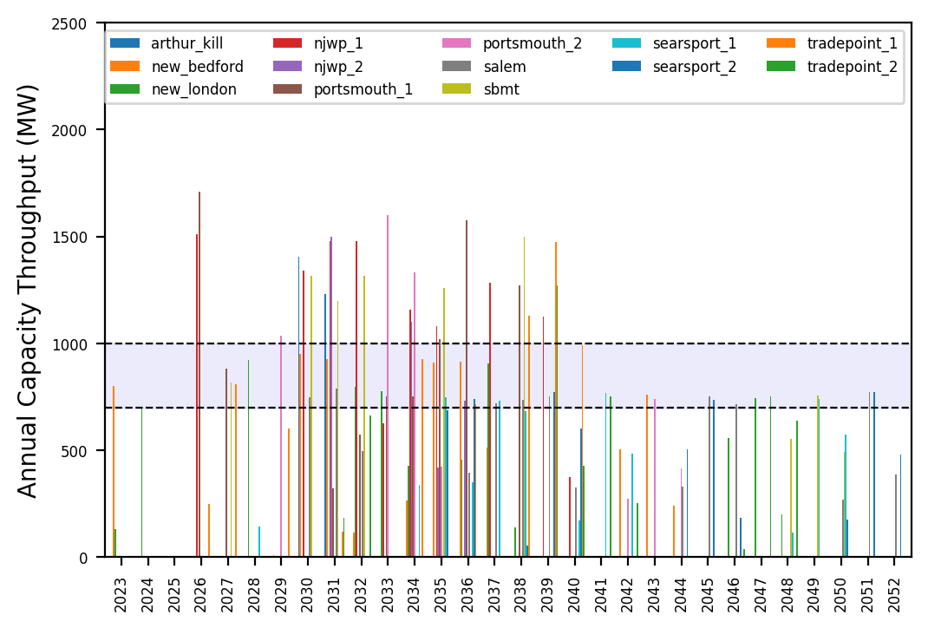
Port Throughput

Slide 7
natl_gaps_2us_2_1
t
e
x
t

Slide 8
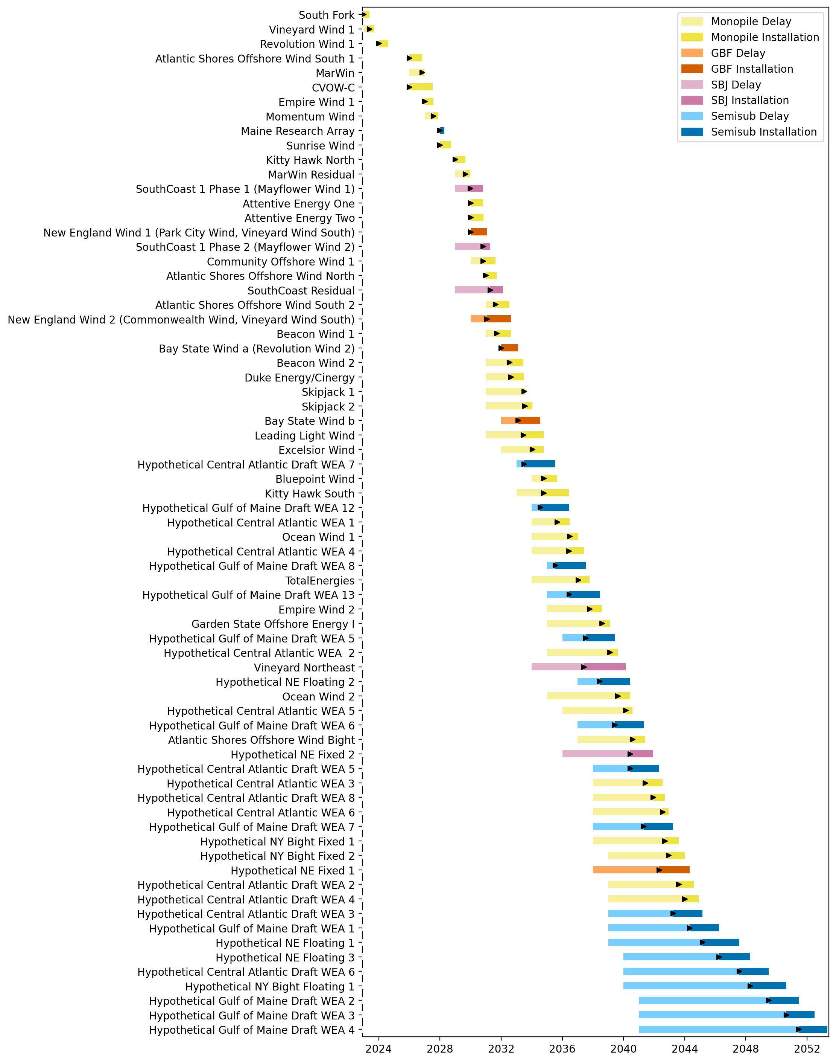
Full Gantt

Slide 9
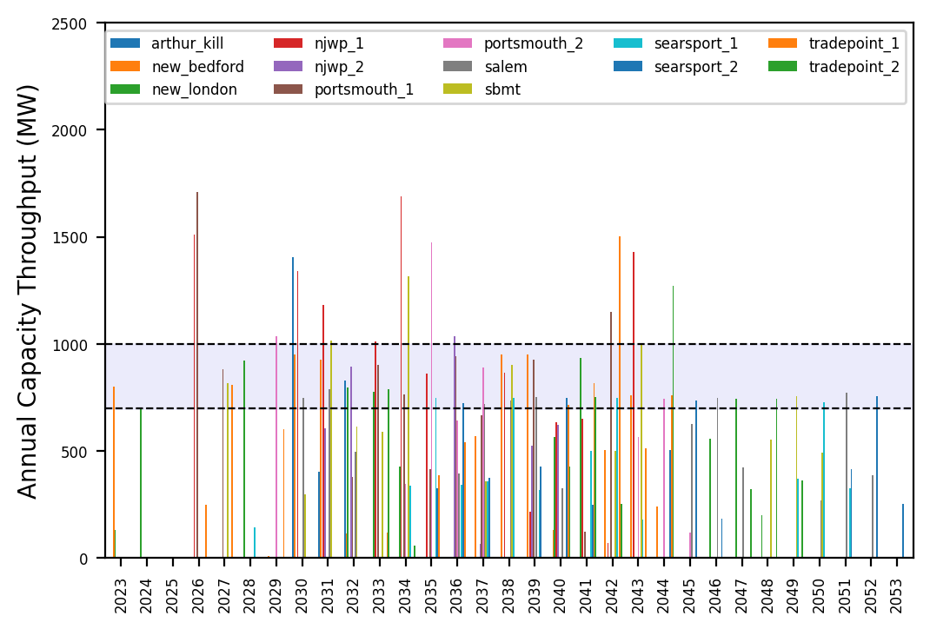
Port Throughput

Slide 10
natl_gaps_3us_2_1
t
e
x
t

Slide 11
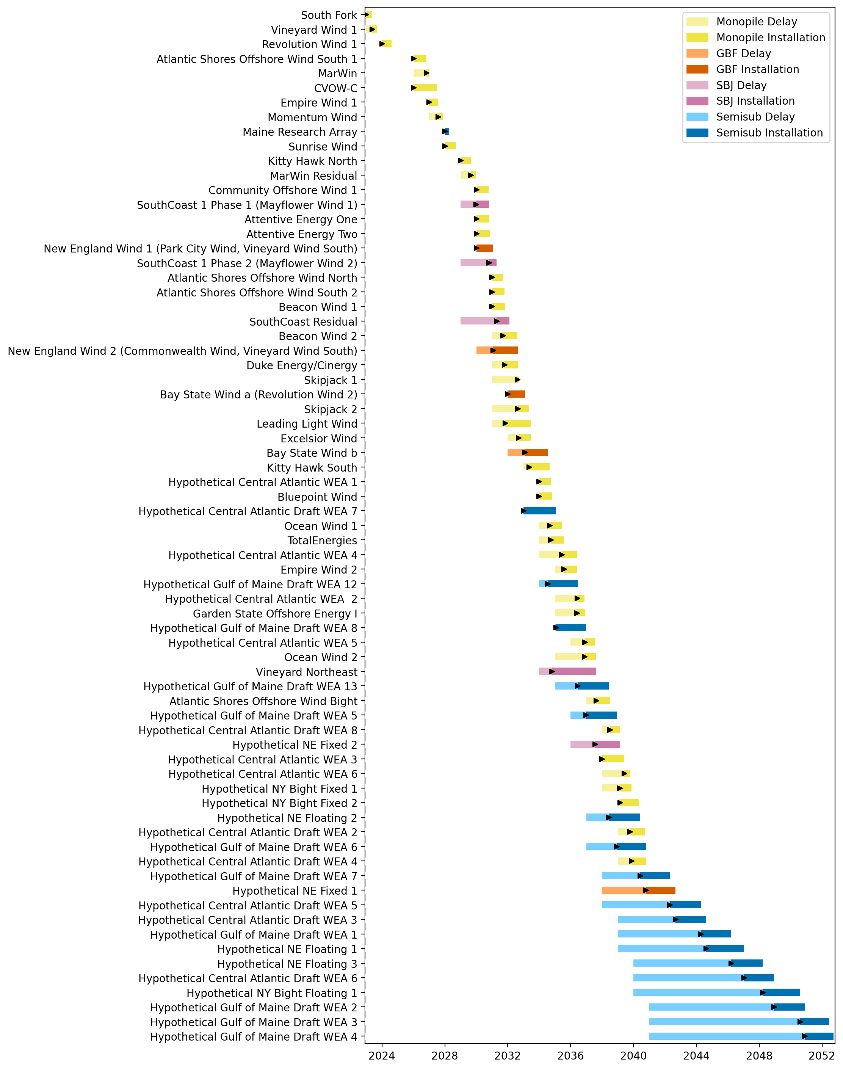
Full Gantt

Slide 12
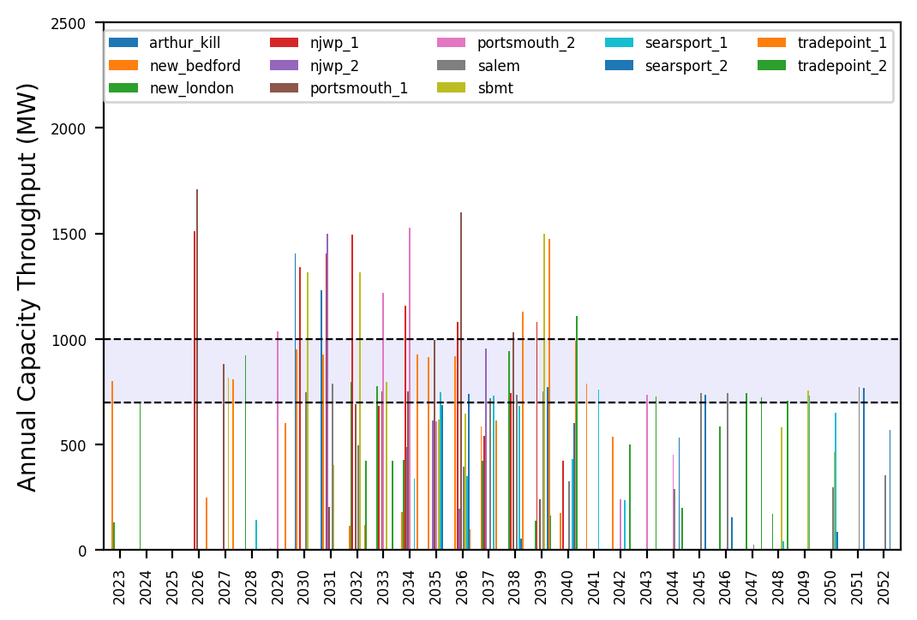
Port Throughput

Slide 13
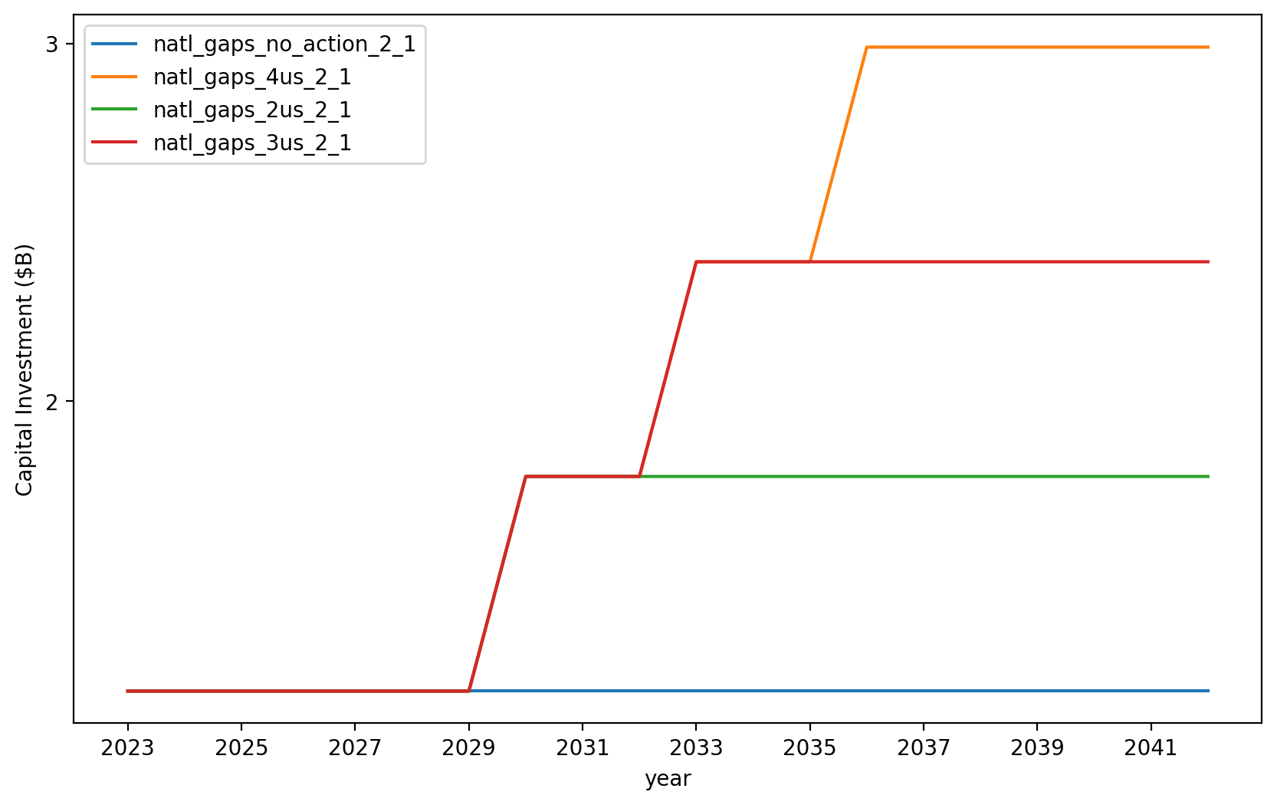
Vessel Investment

Slide 14
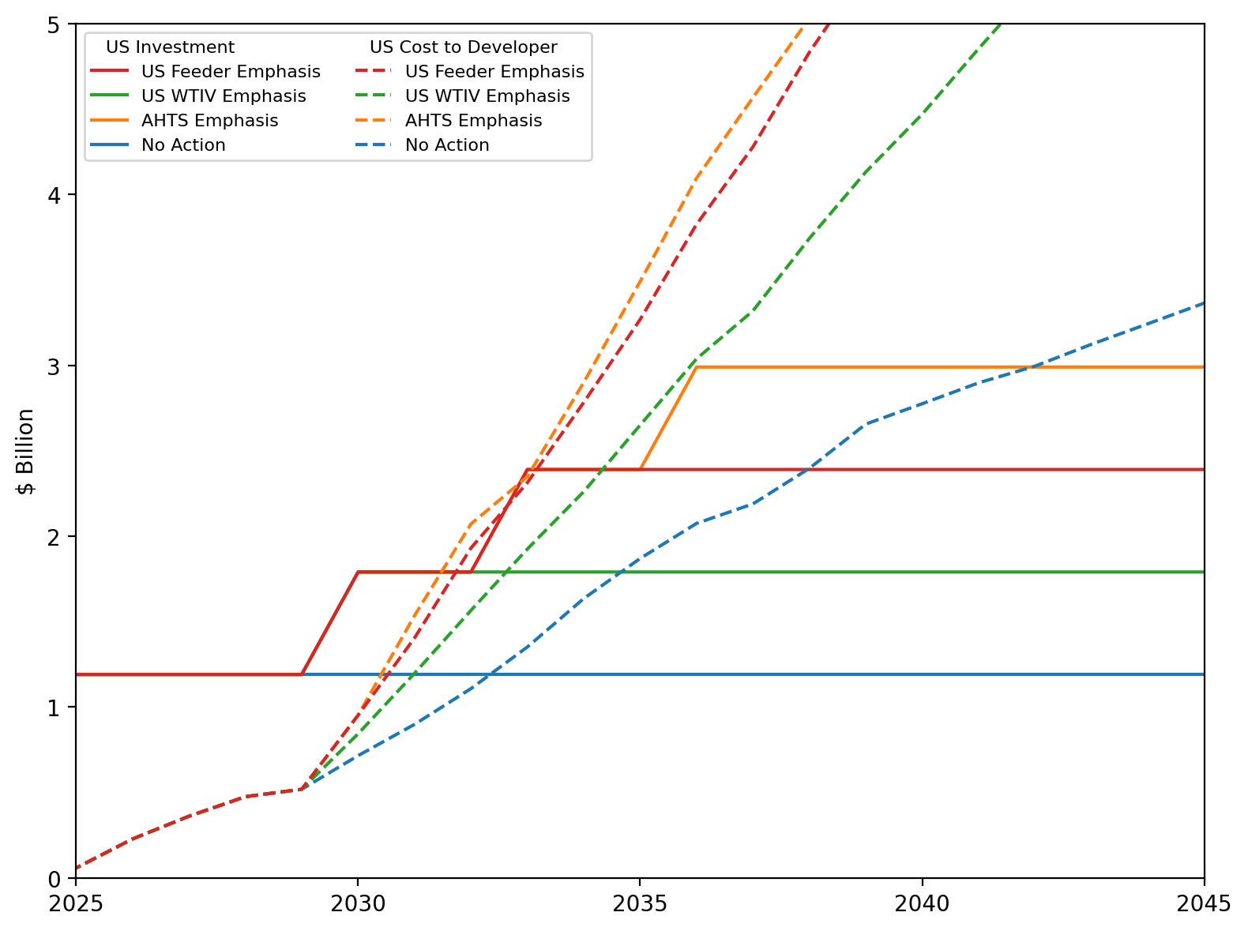
US Investment Summary

Slide 15
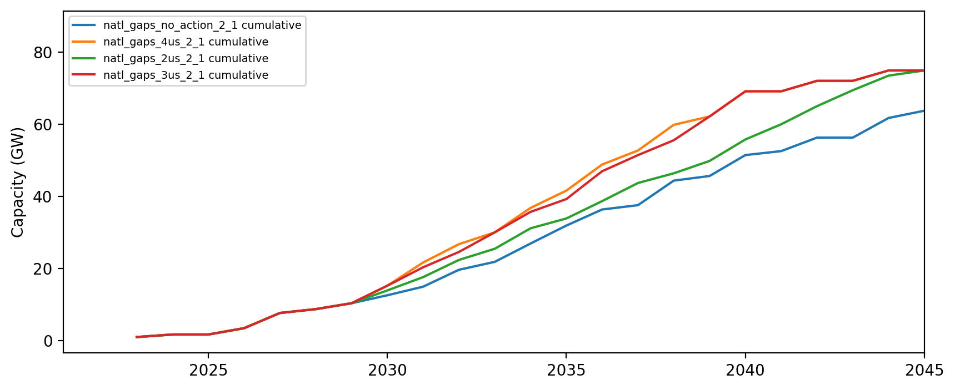
Installed Capacity

Slide 16
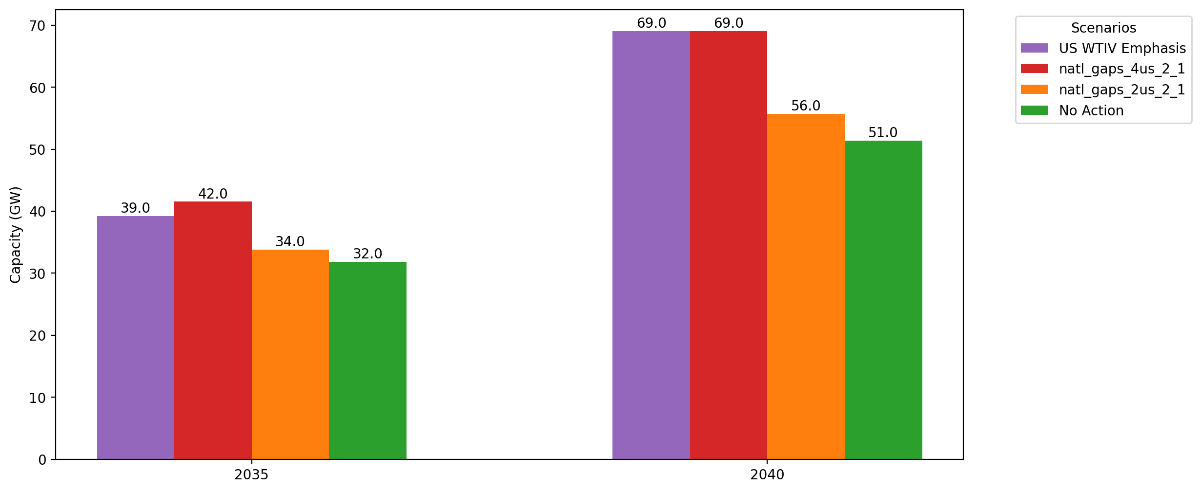
Cumulative Capacity by 2035 and 2040

Slide 17
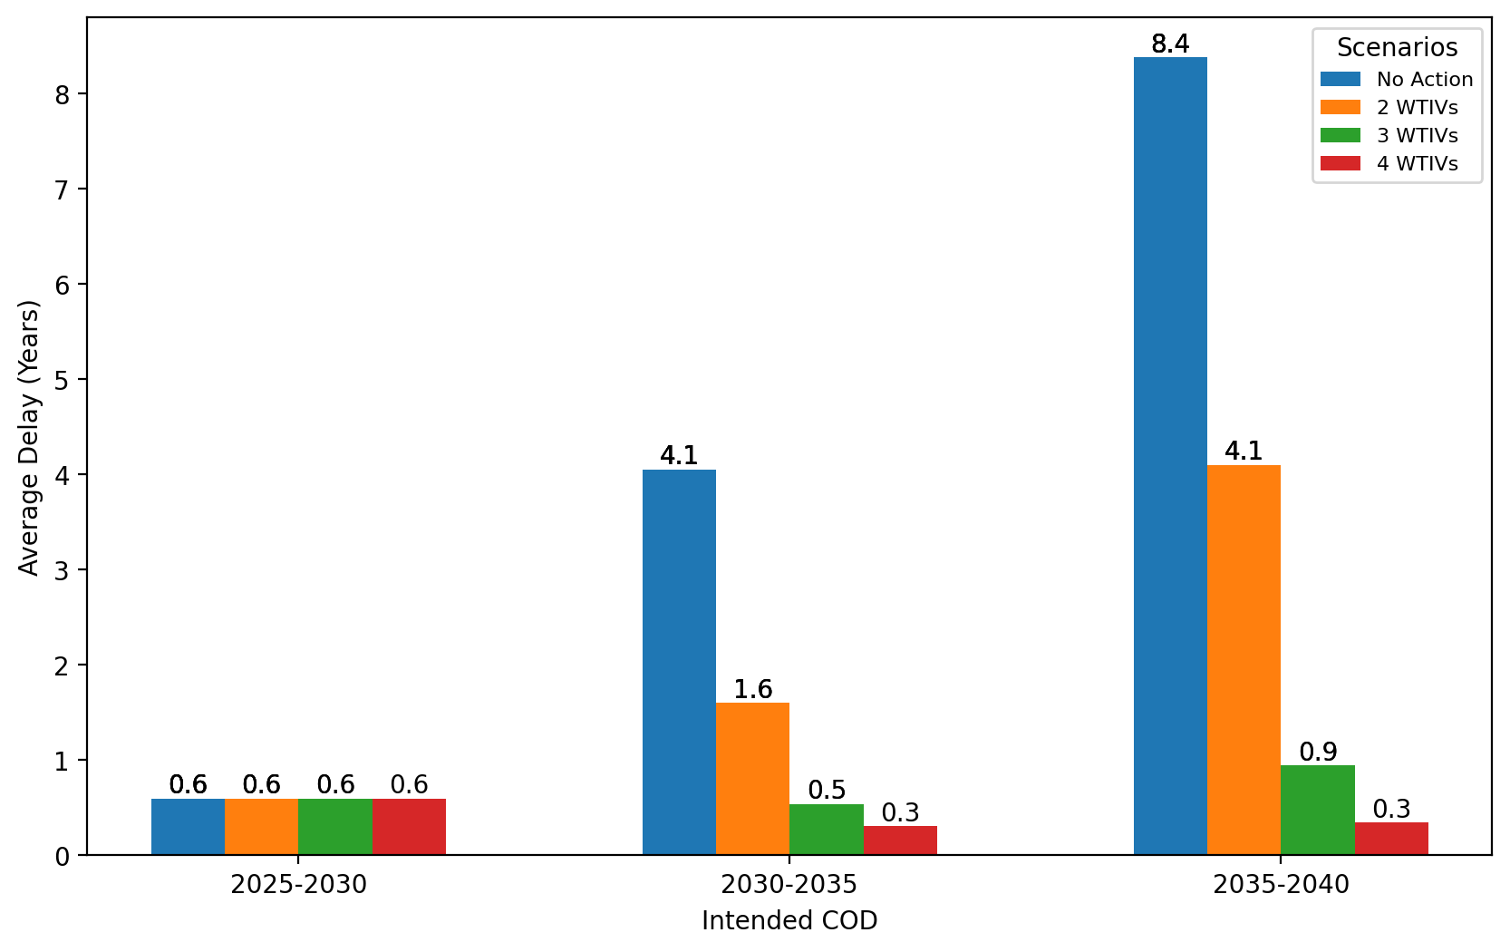
Average Delay Per Project by COD - All Regions

Slide 18
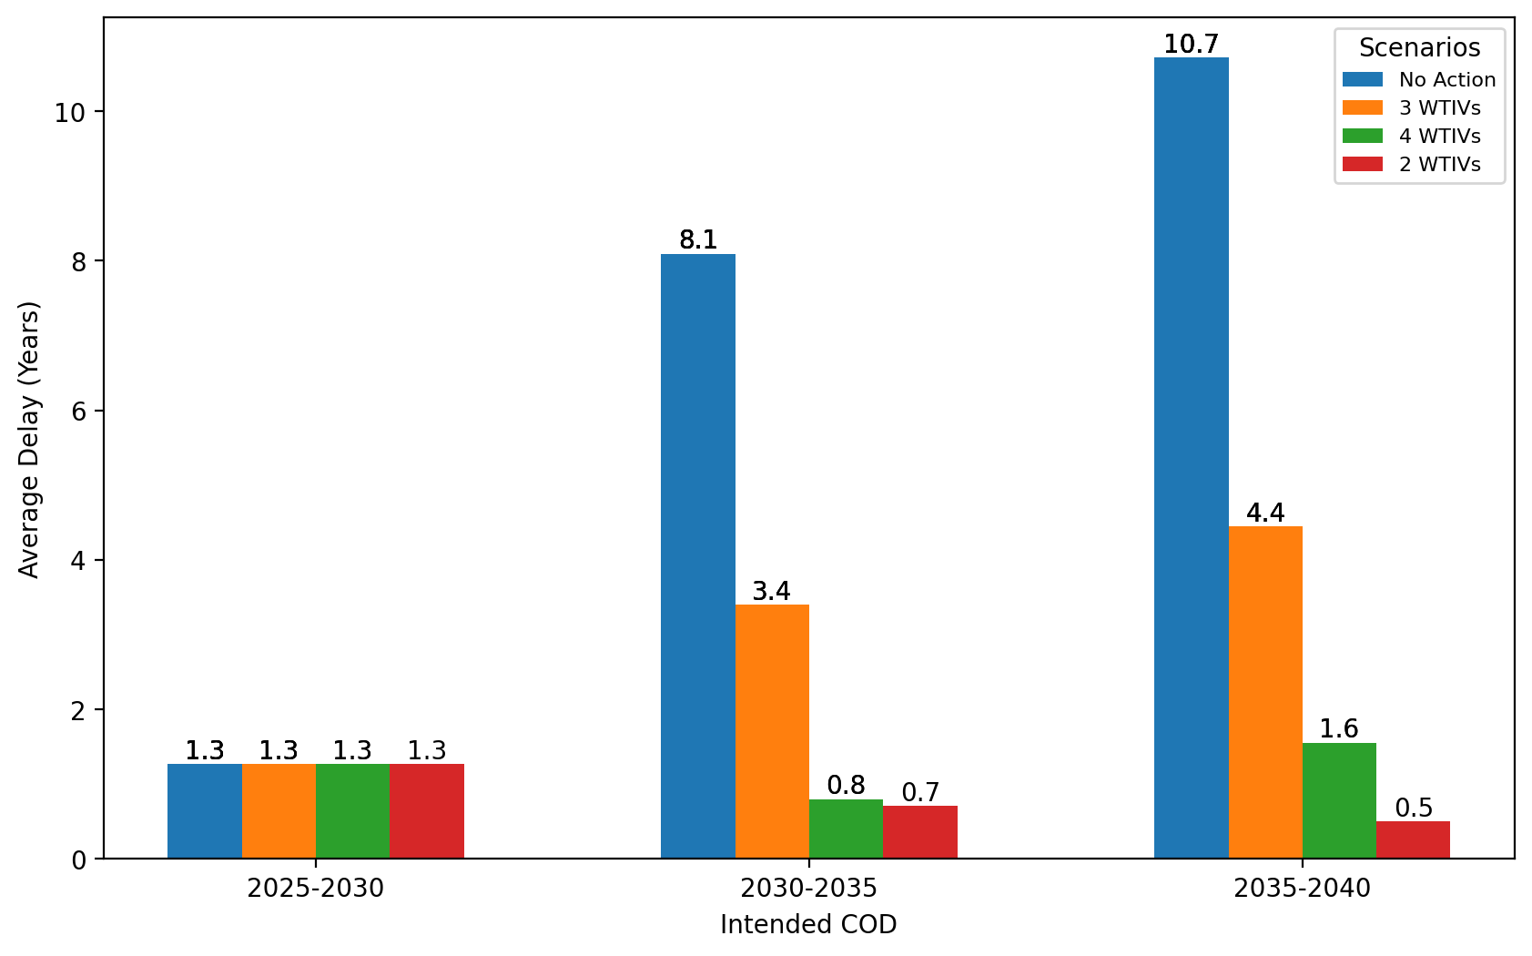
Average Delay Per Project by COD - NE

Slide 19
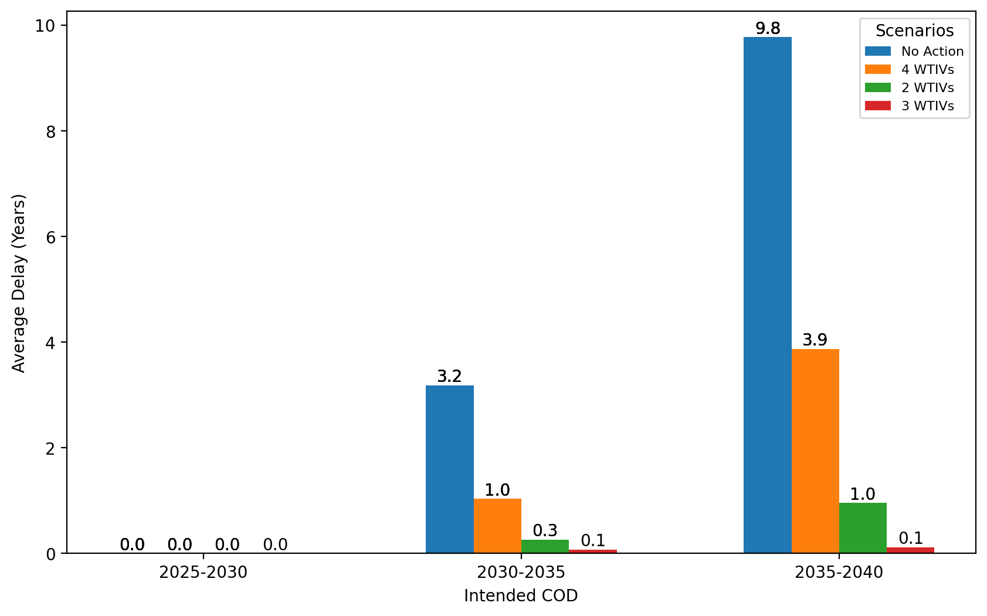
Average Delay Per Project by COD - NYNJ

Slide 20
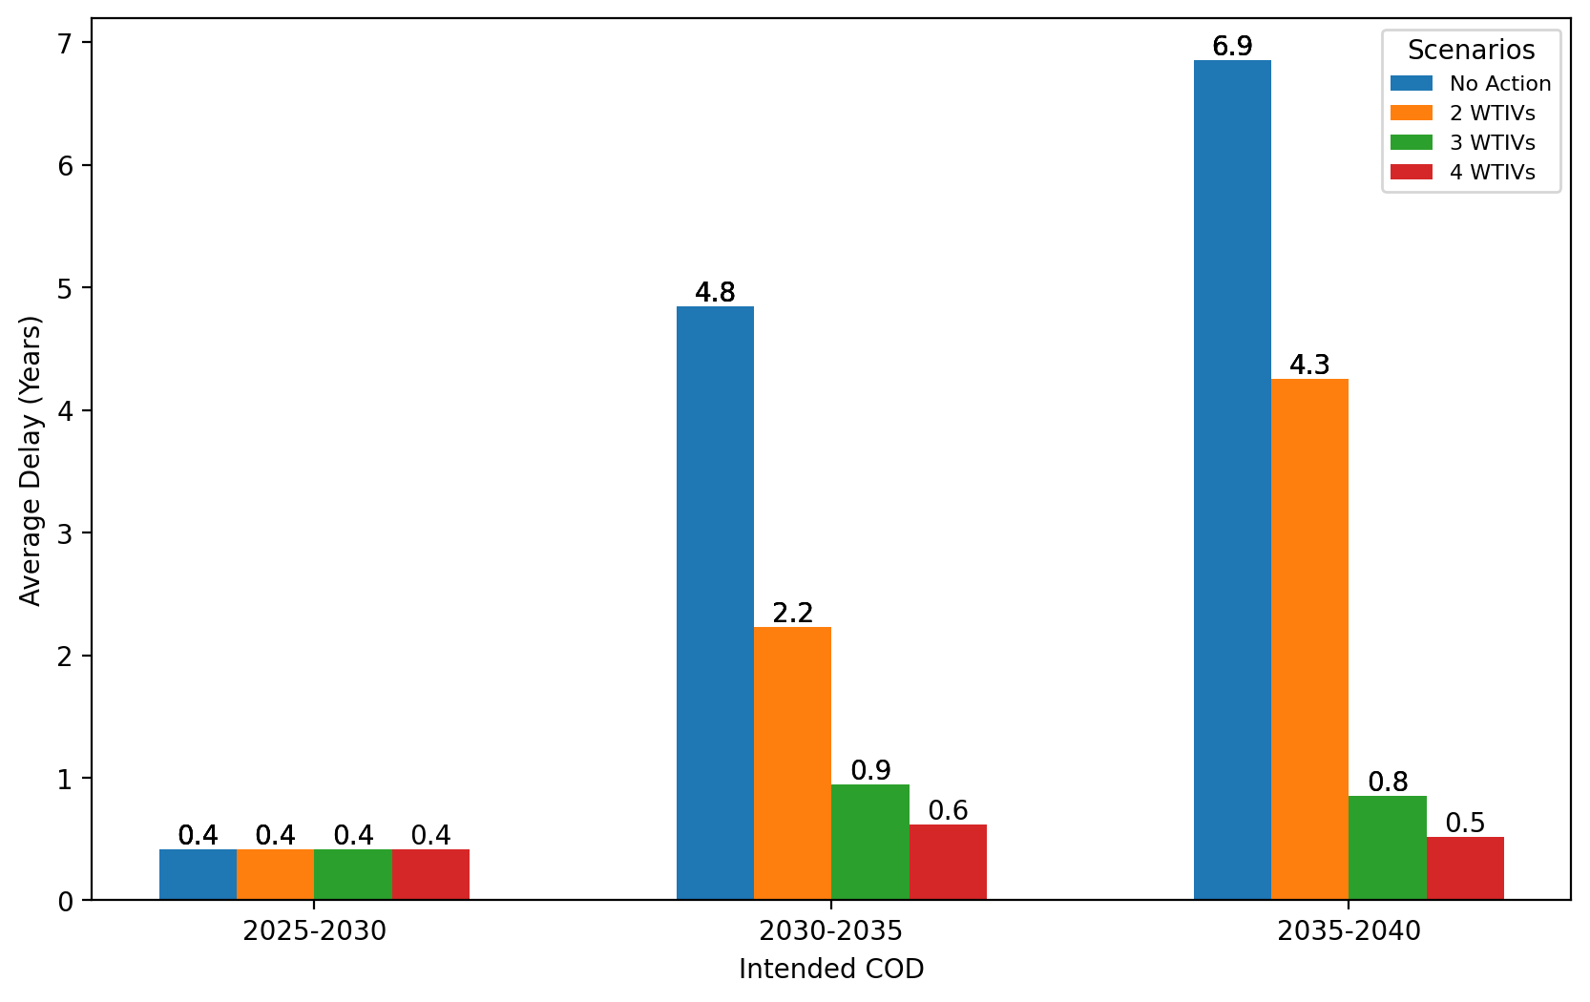
Average Delay Per Project by COD - Mid-Atlantic

Slide 21
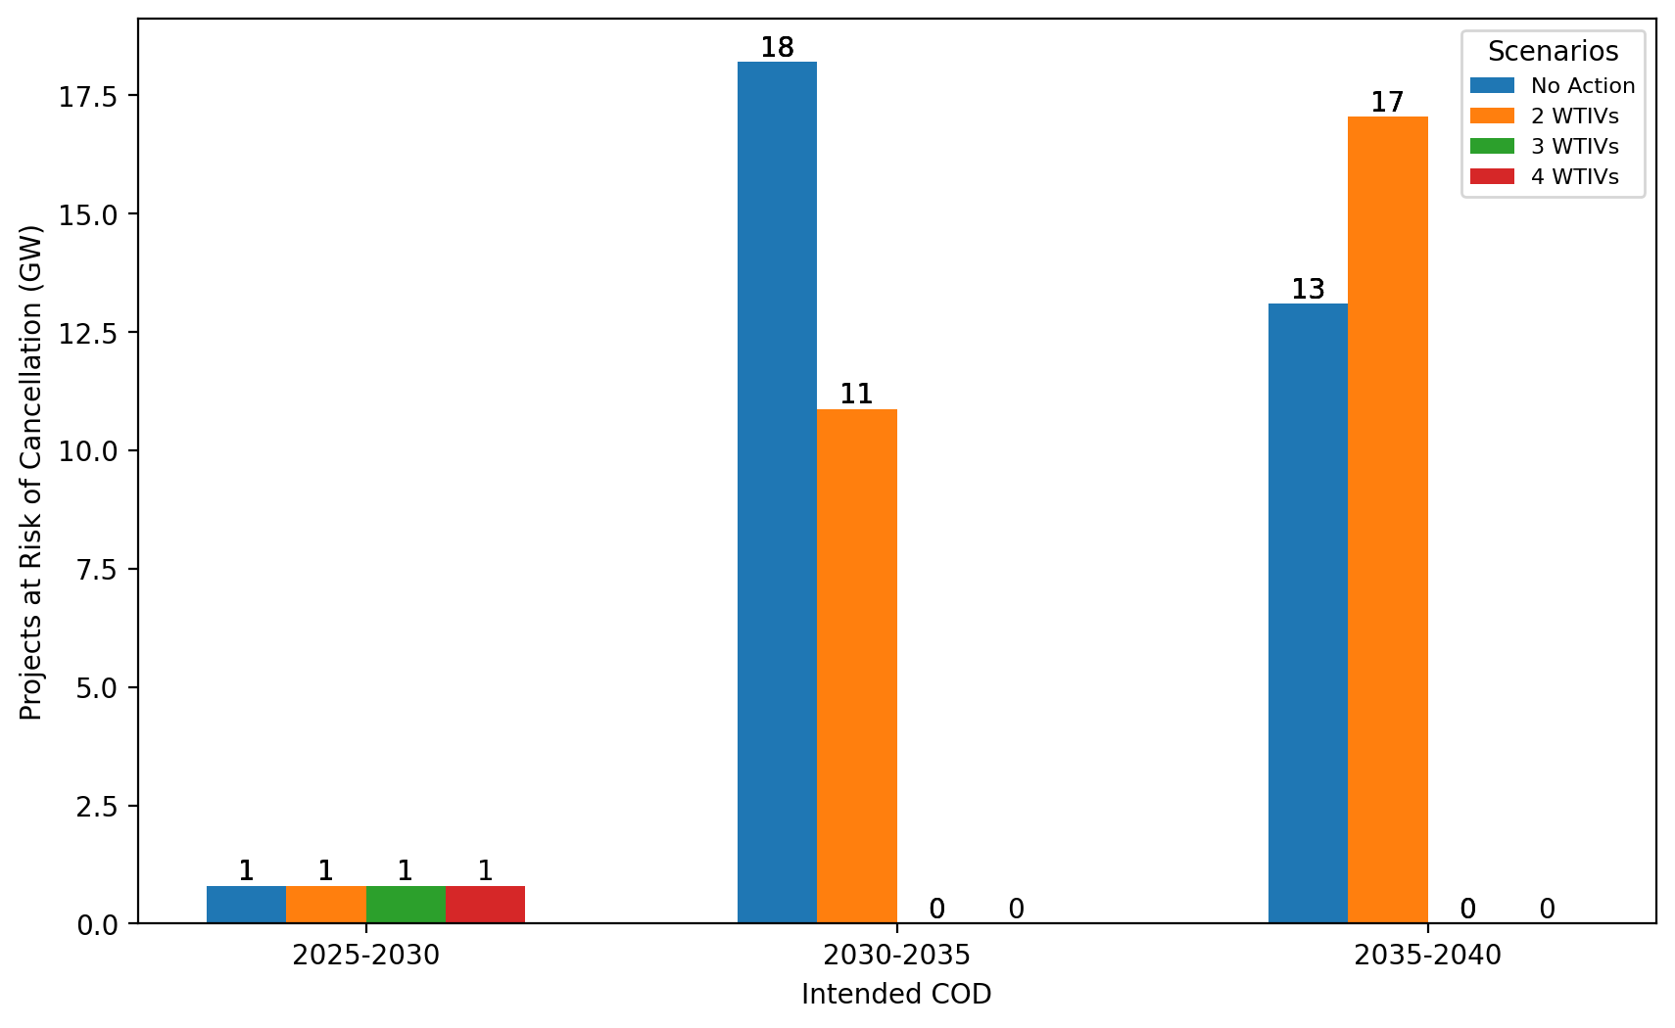
Total Capacity at Risk by COD - All Regions

Slide 22
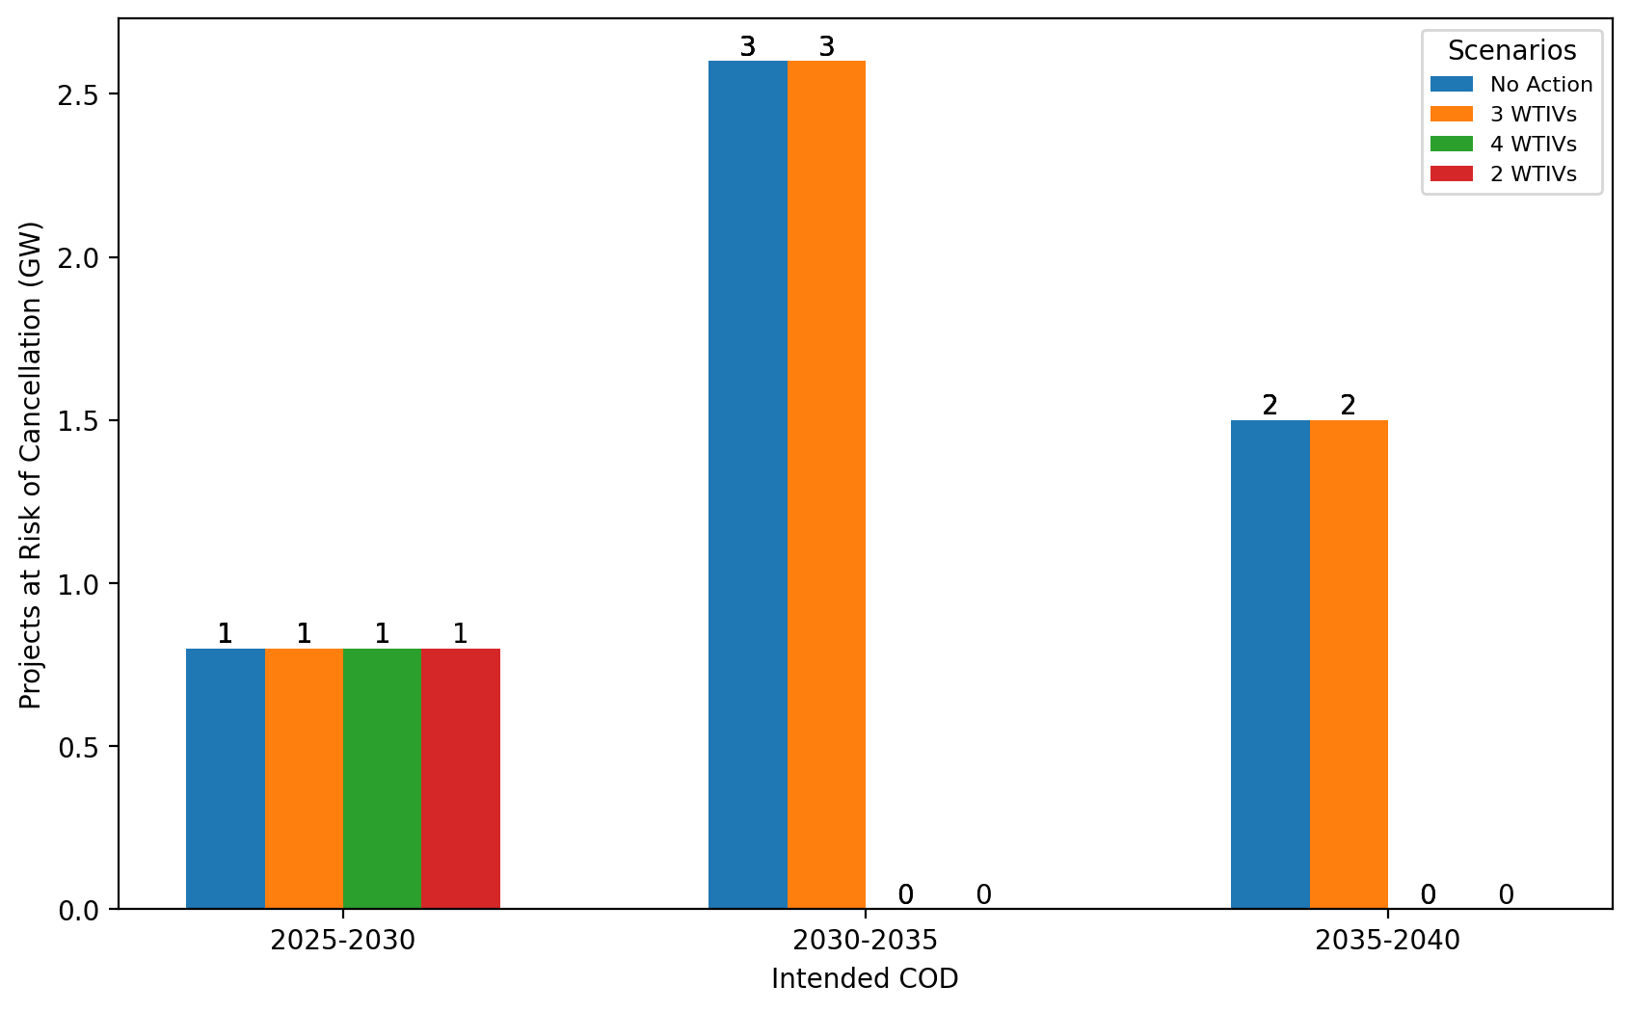
Total Capacity at Risk by COD - NE

Slide 23
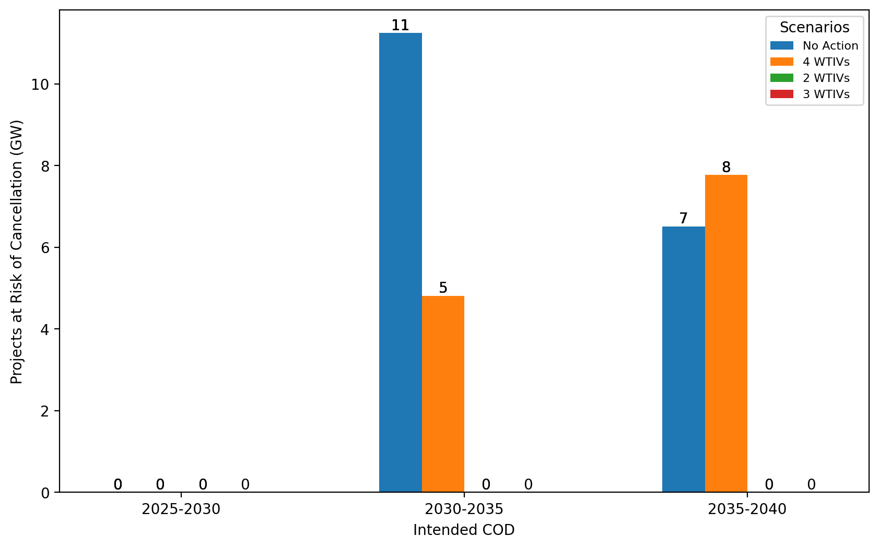
Total Capacity at Risk by COD - NYNJ

Slide 24
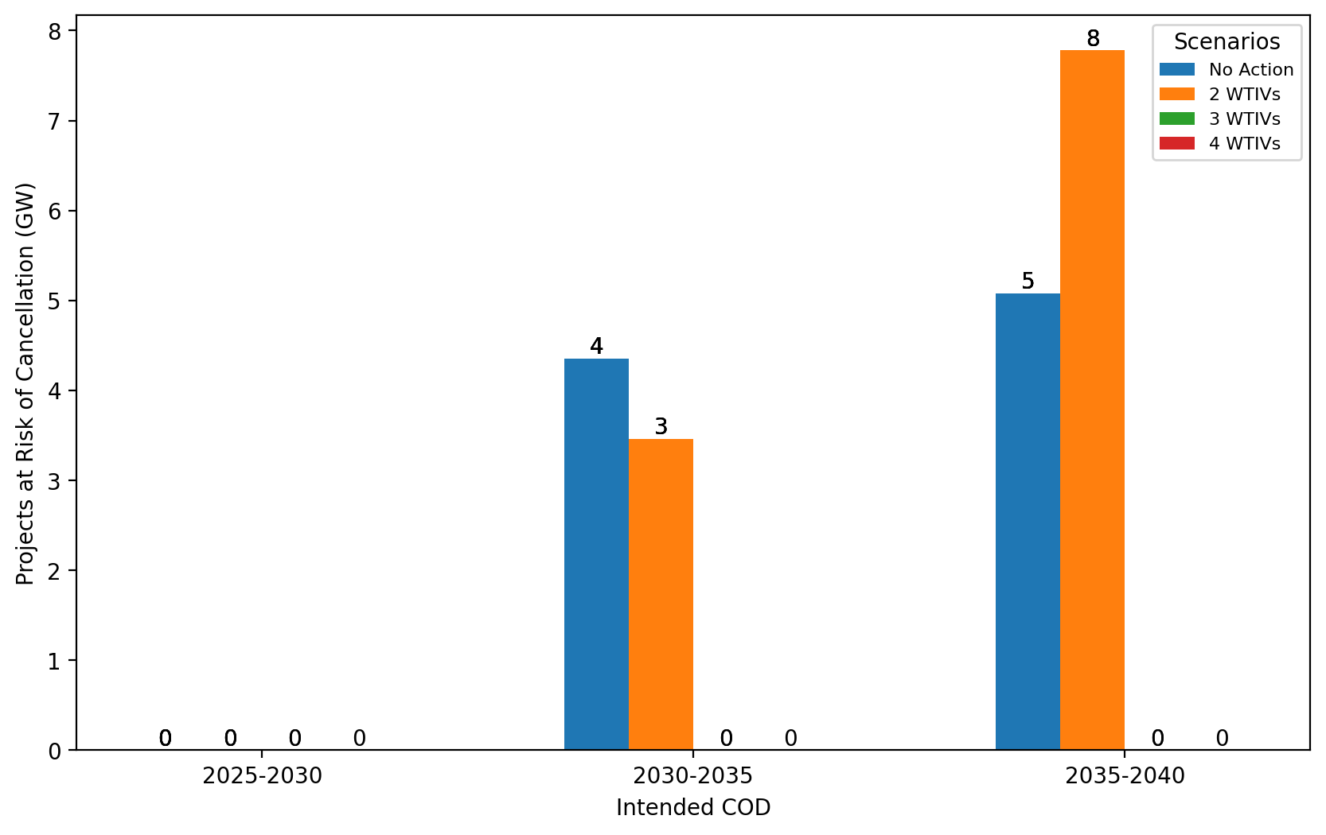
Total Capacity at Risk by COD - Mid-Atlantic

