Slide 1
natl_gaps_infAHTS
4 additional AHTS vessels, built every 3 years starting in 2030

Slide 2
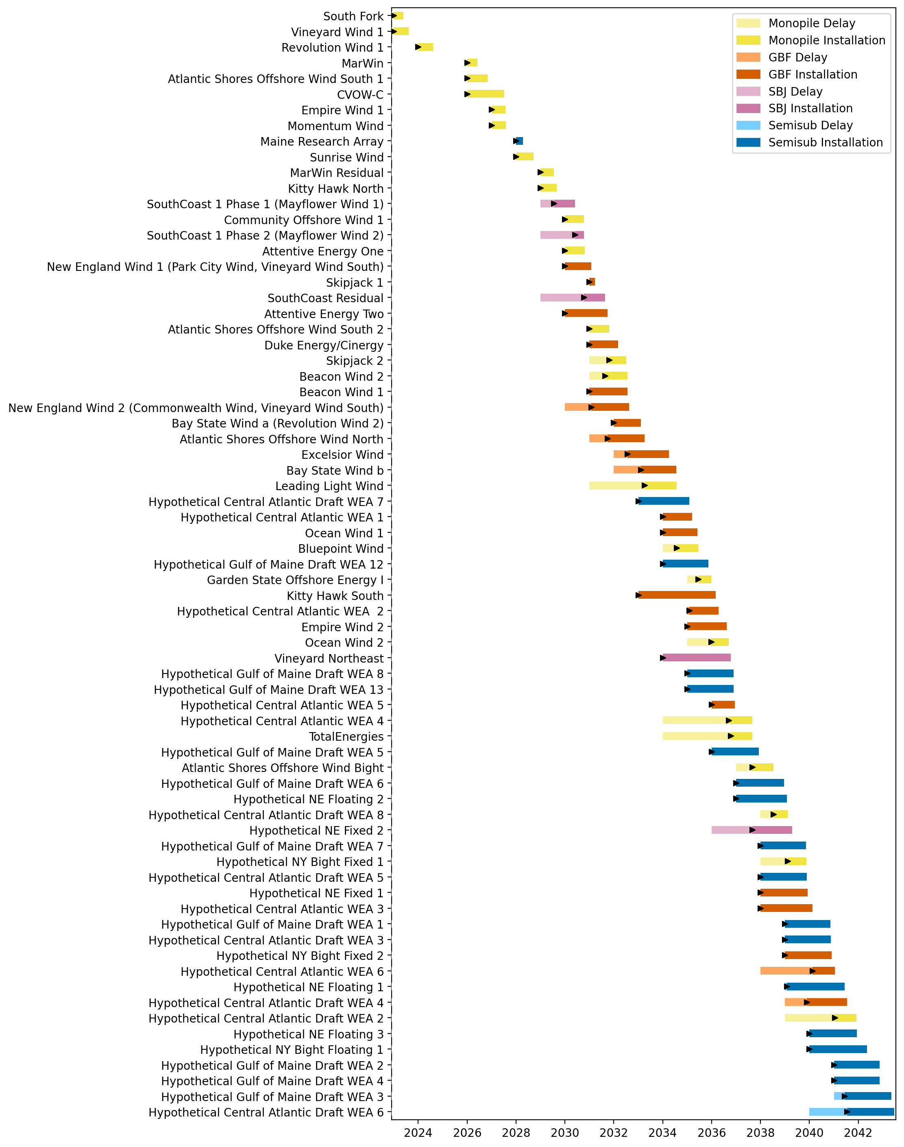
Full Gantt

Slide 3
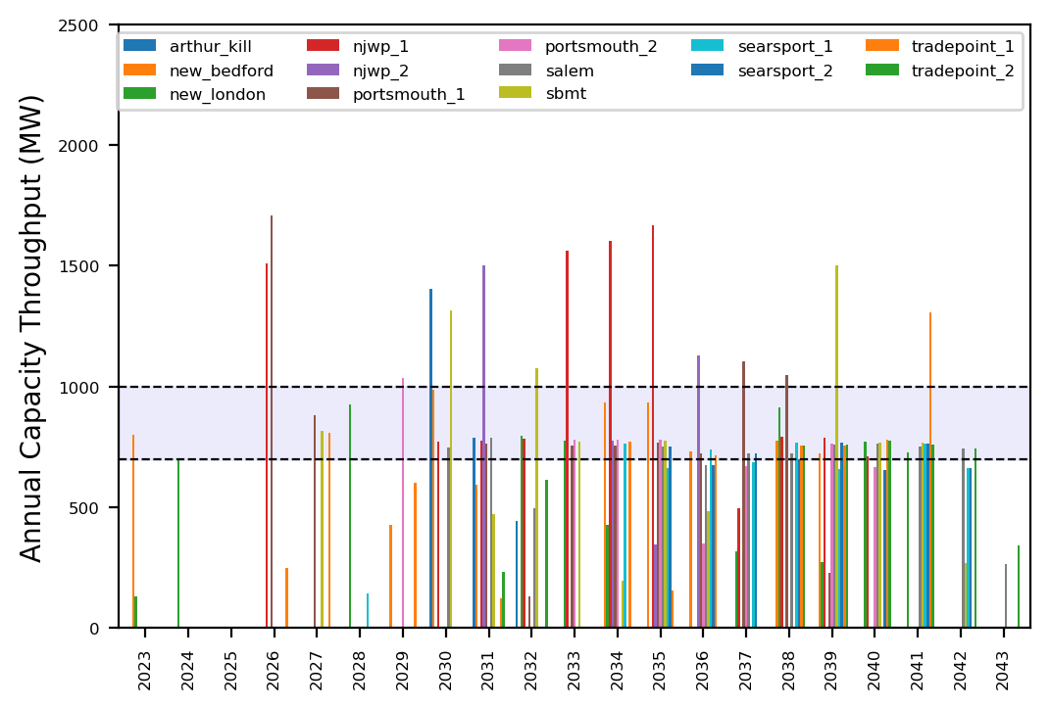
Port Throughput

Slide 4
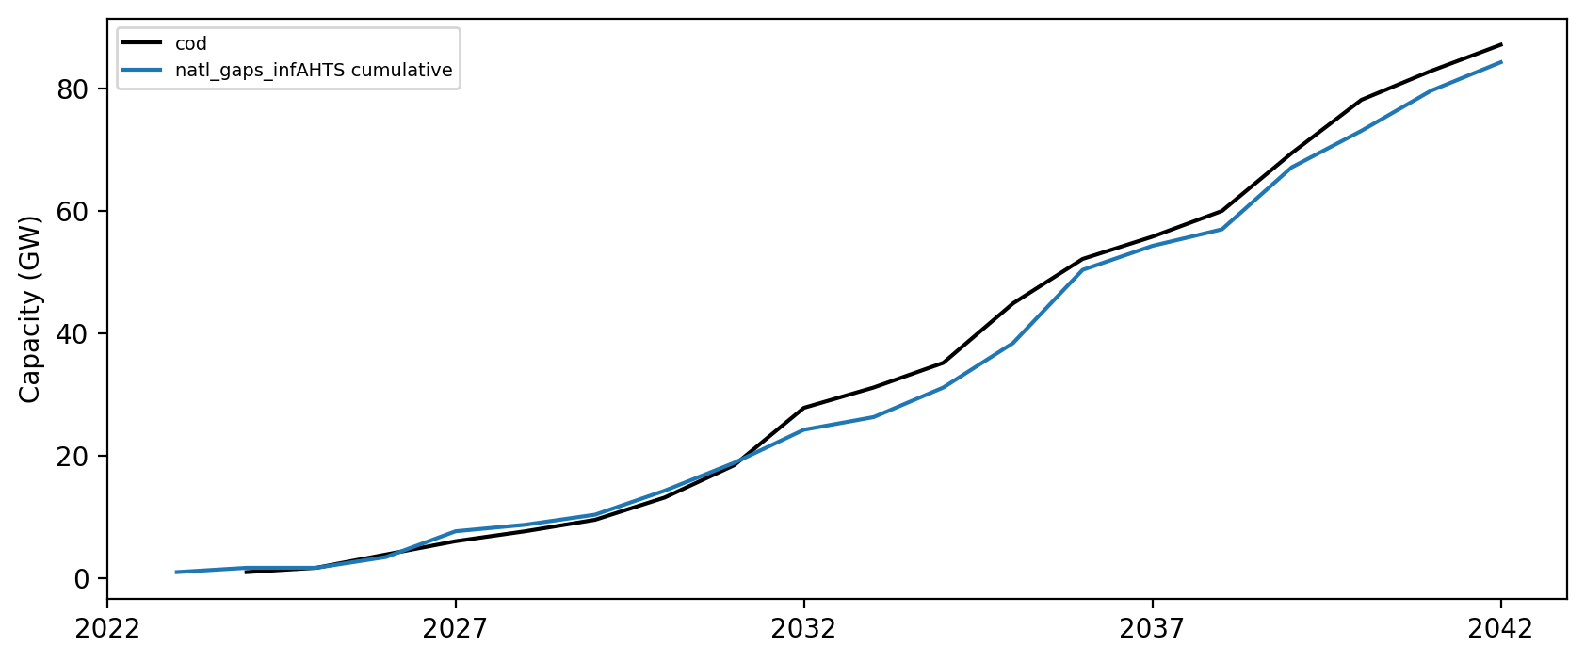
Installed Capacity

