Slide 1
natl_gaps_2us
t
e
x
t

Slide 2
natl_gaps_3foreign
t
e
x
t

Slide 3
natl_gaps_6AHTS
t
e
x
t

Slide 4
natl_gaps_no_action
t
e
x
t

Slide 5
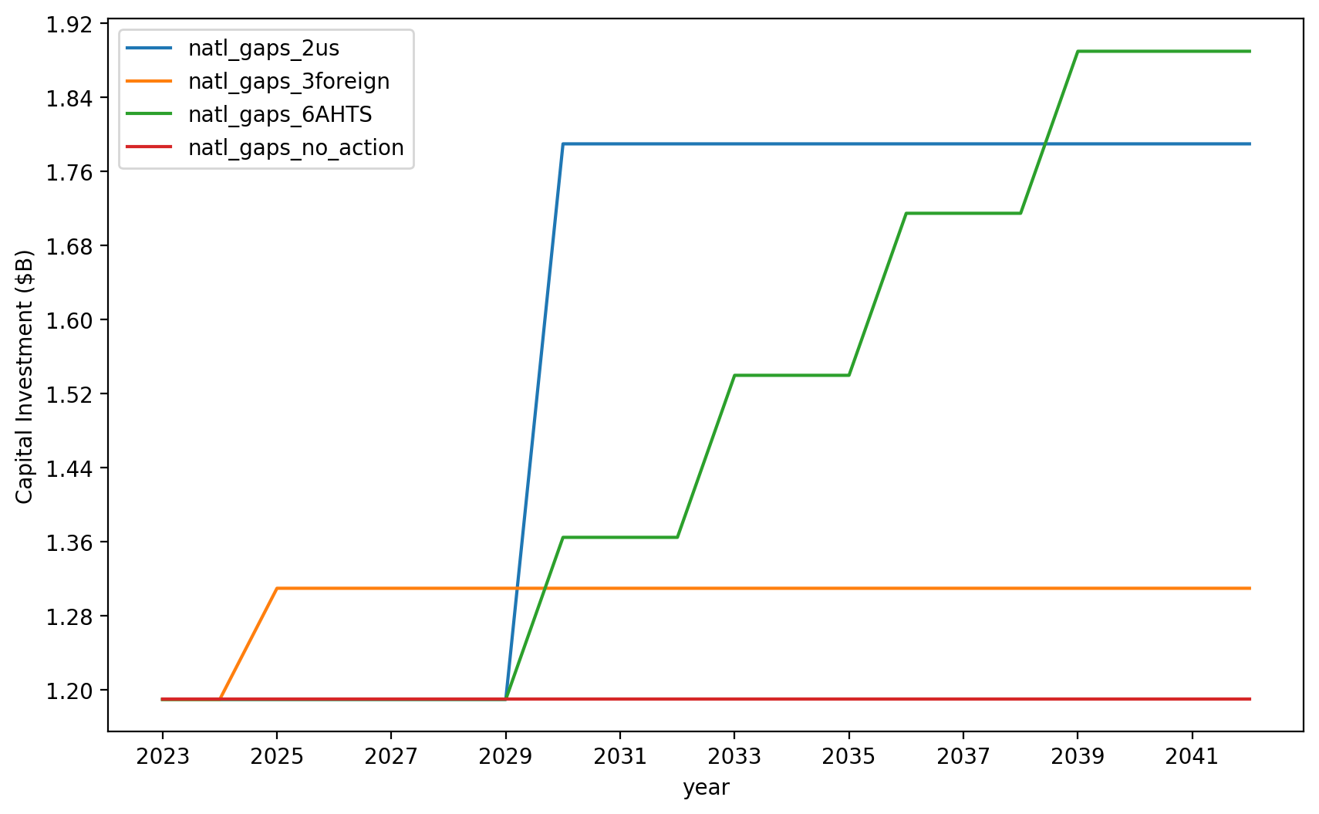
Vessel Investment

Slide 6
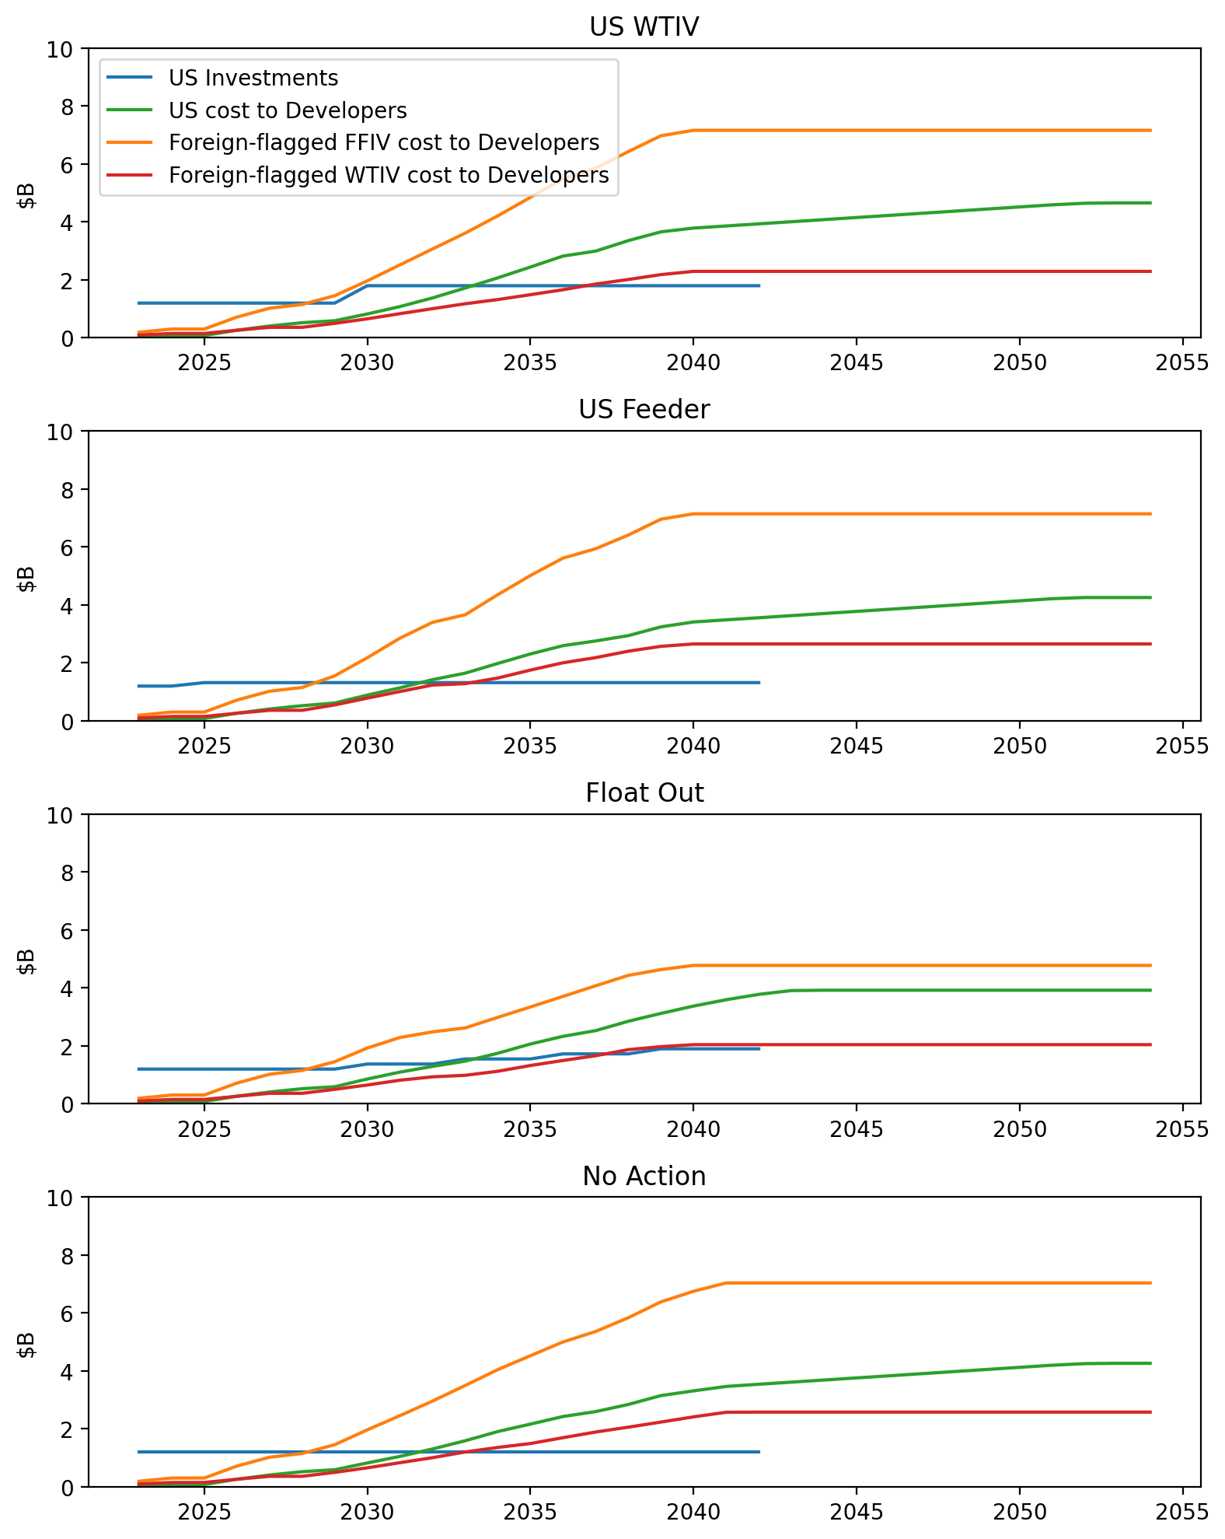
Vessel Investment Summary

Slide 7
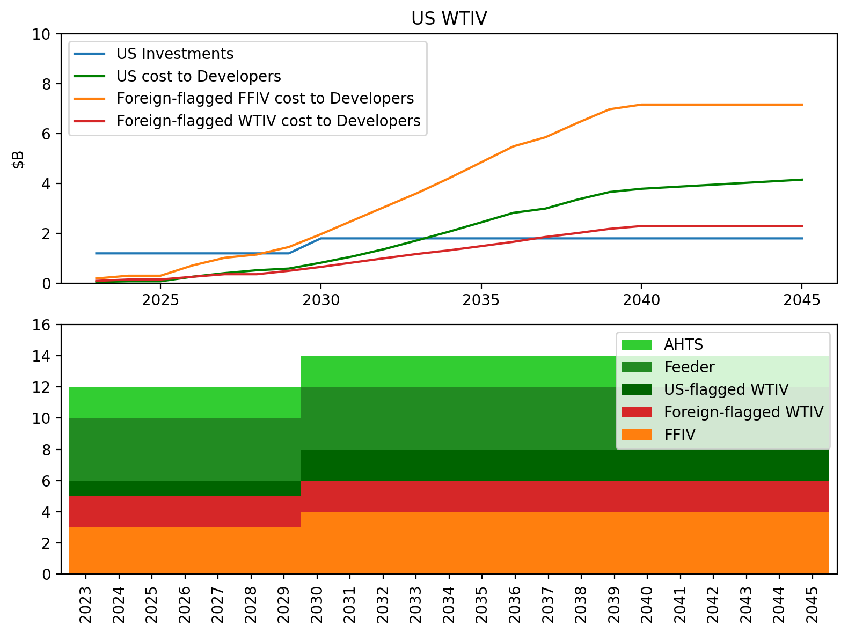
Vessel Investment Summary for US WTIV

Slide 8
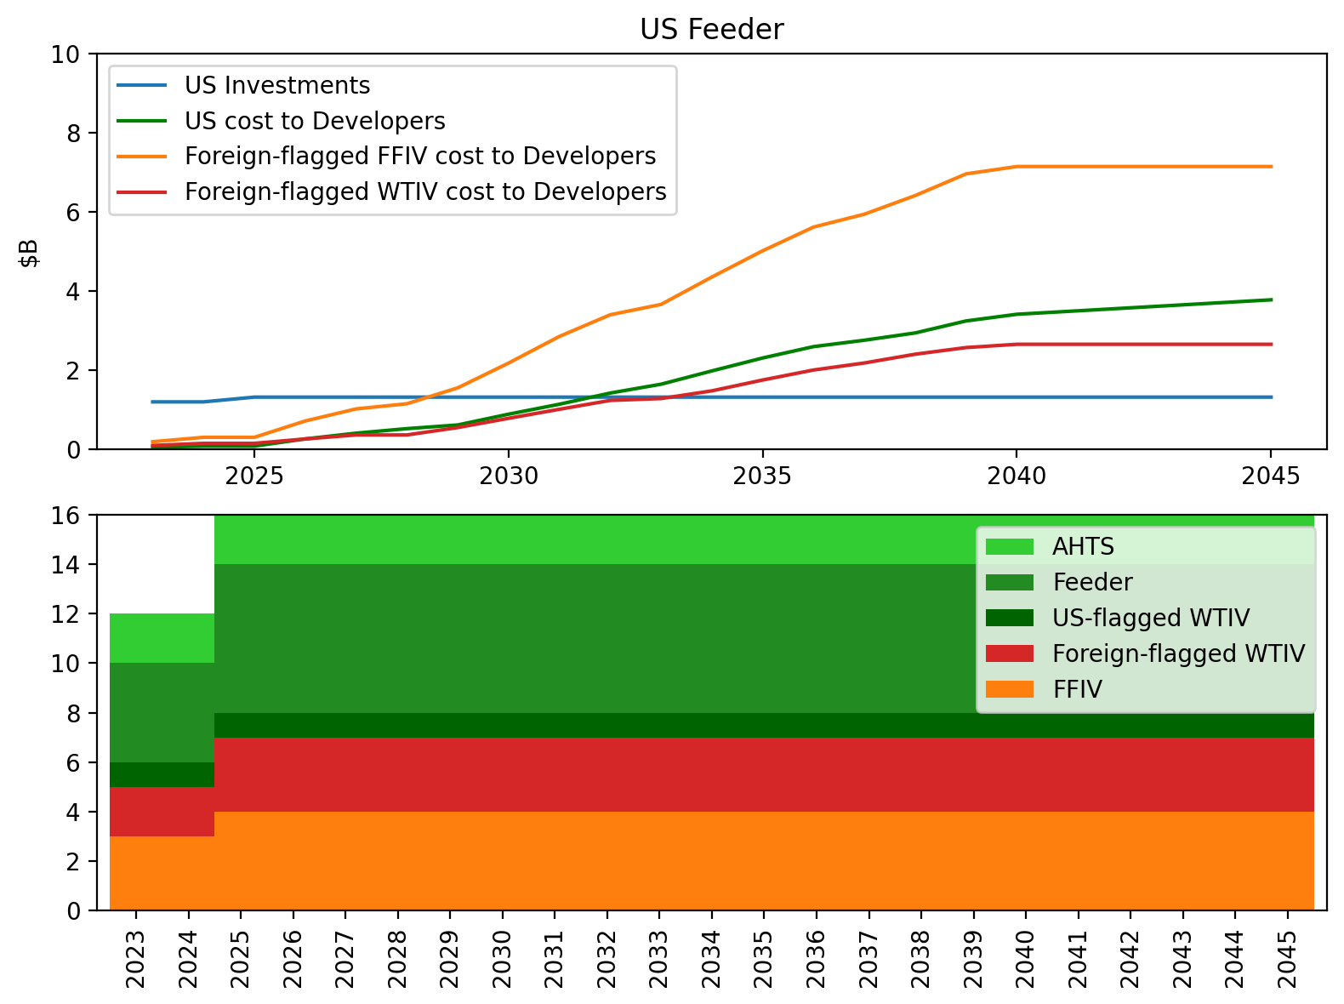
Vessel Investment Summary for US Feeder

Slide 9
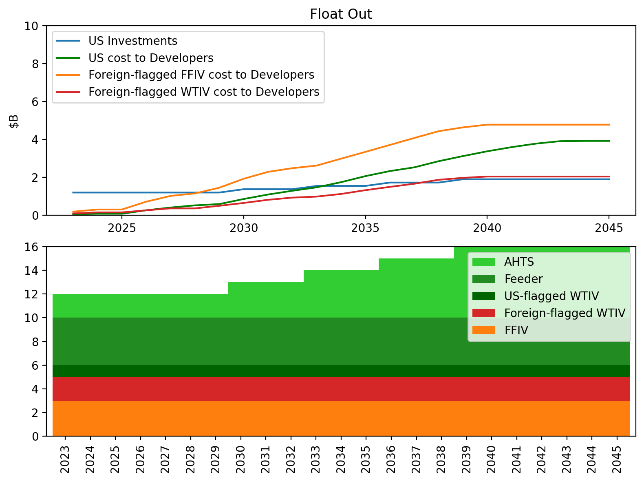
Vessel Investment Summary for Float Out

Slide 10
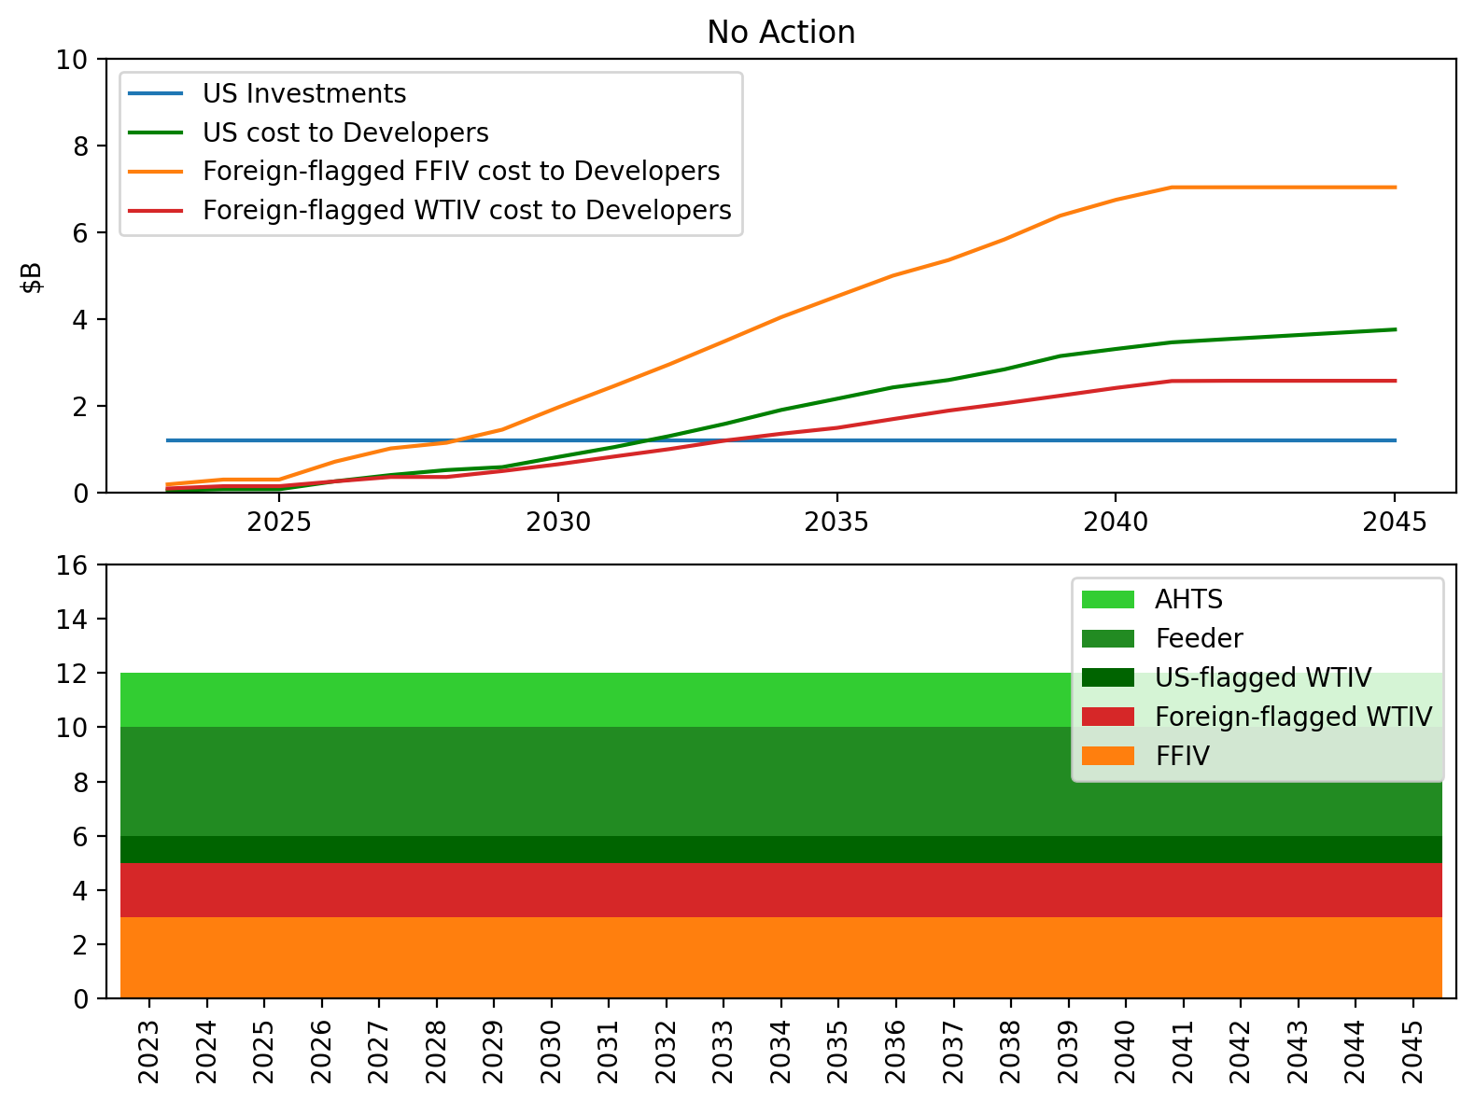
Vessel Investment Summary for No Action

Slide 11
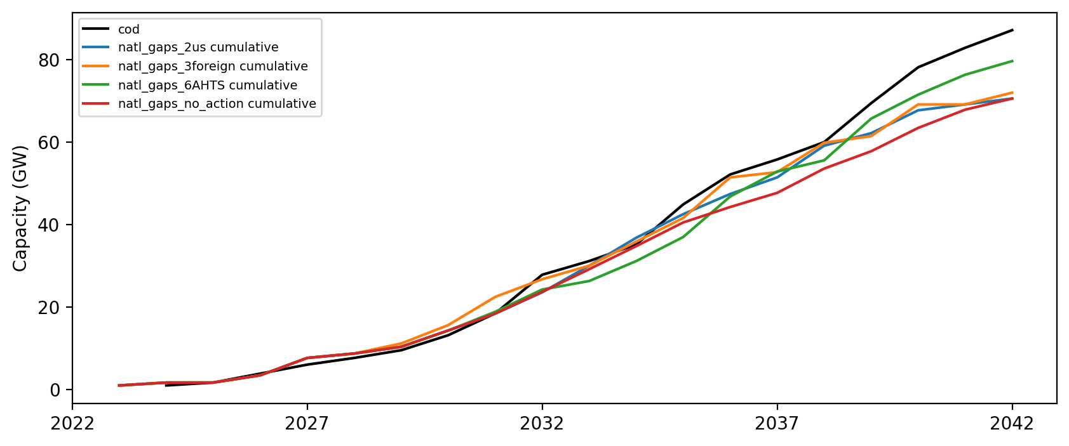
Installed Capacity

