Slide 1
natl_gaps_2us
t
e
x
t

Slide 2
natl_gaps_3foreign
t
e
x
t

Slide 3
natl_gaps_6AHTS
t
e
x
t

Slide 4
natl_gaps_no_action
t
e
x
t

Slide 5
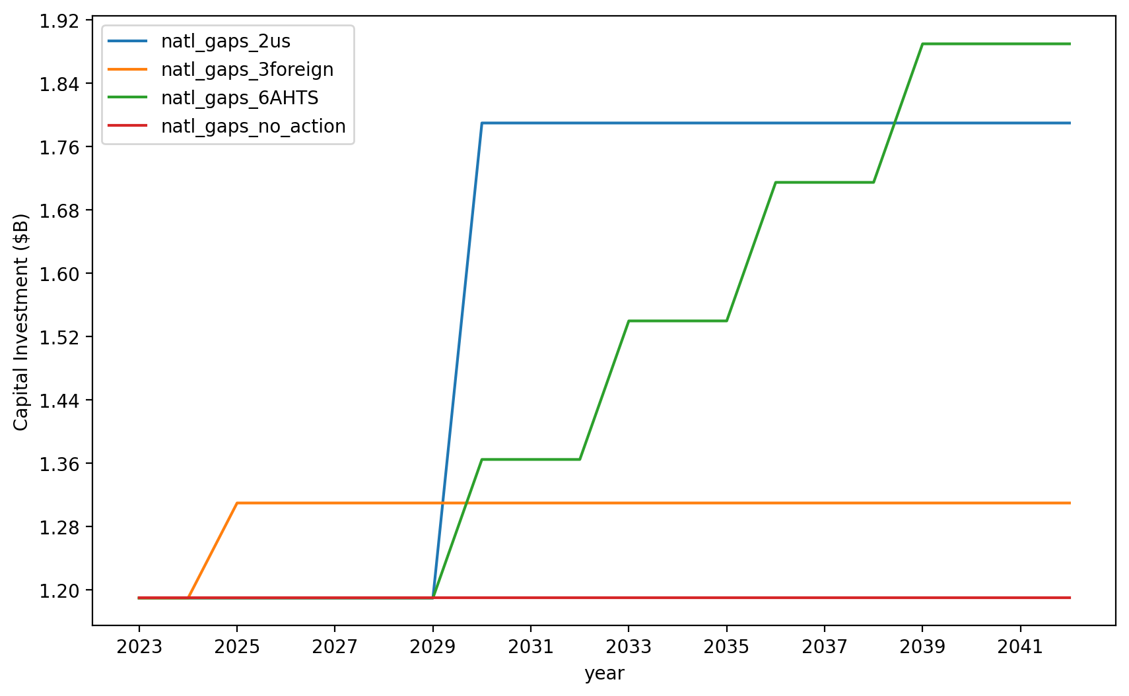
Vessel Investment

Slide 6
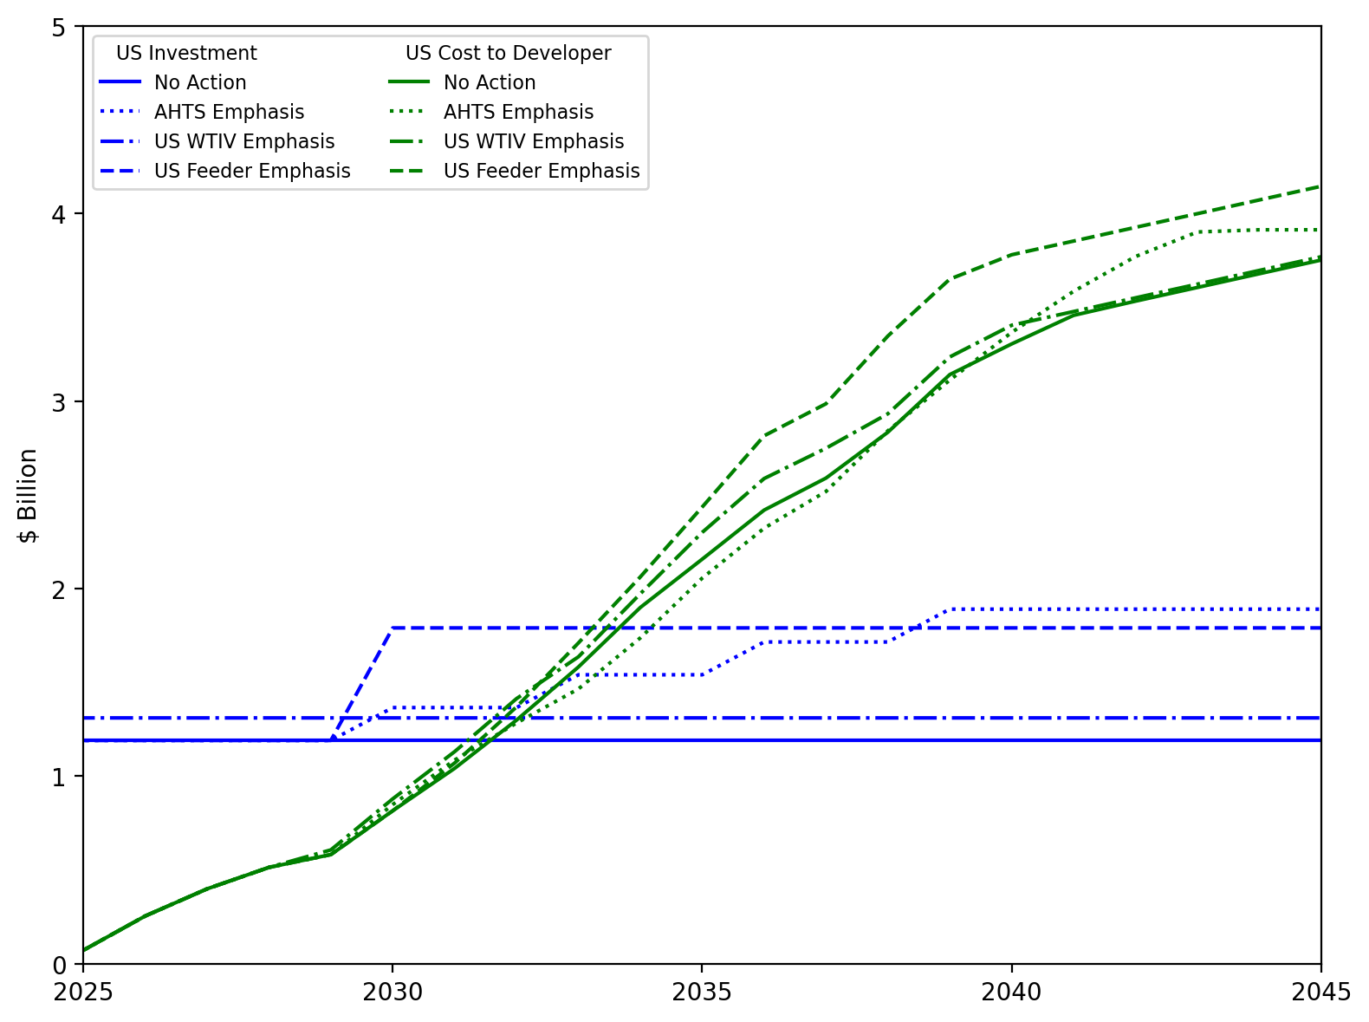
US Investment Summary

Slide 7
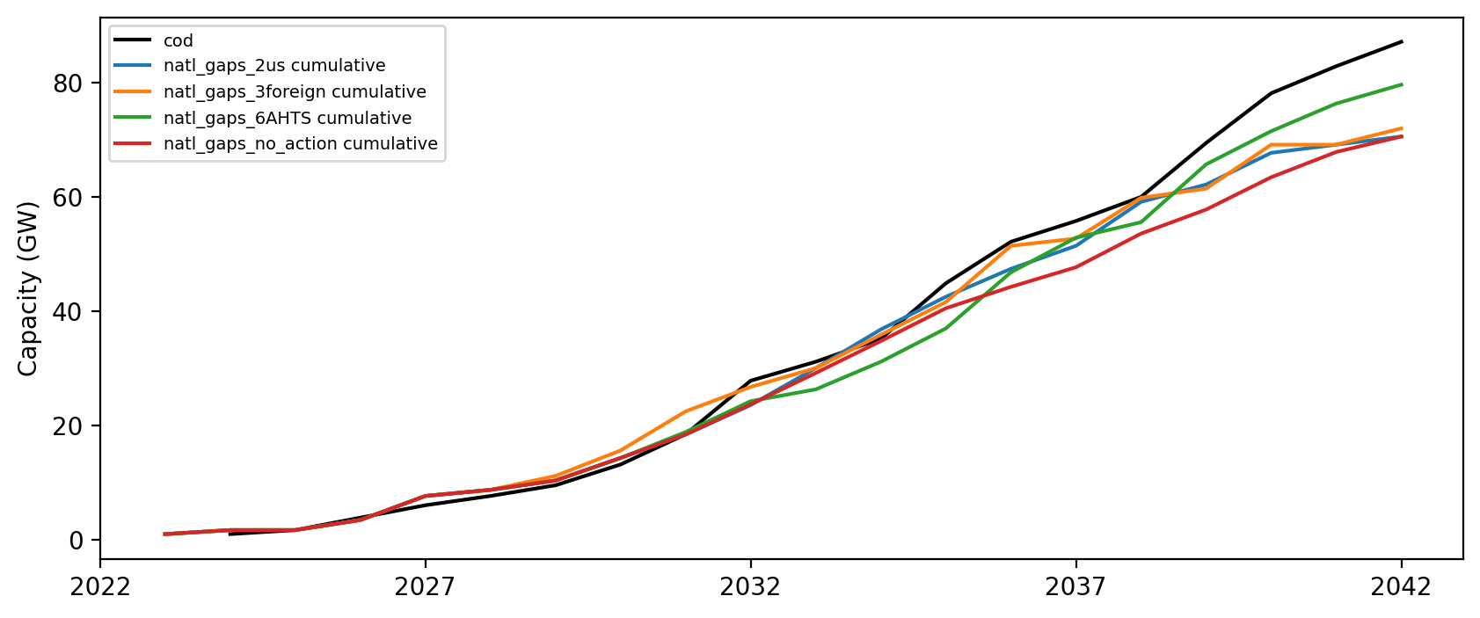
Installed Capacity

