Slide 1
natl_gaps_3foreign_2_1
1 more foreign WTIV 2025

Slide 2
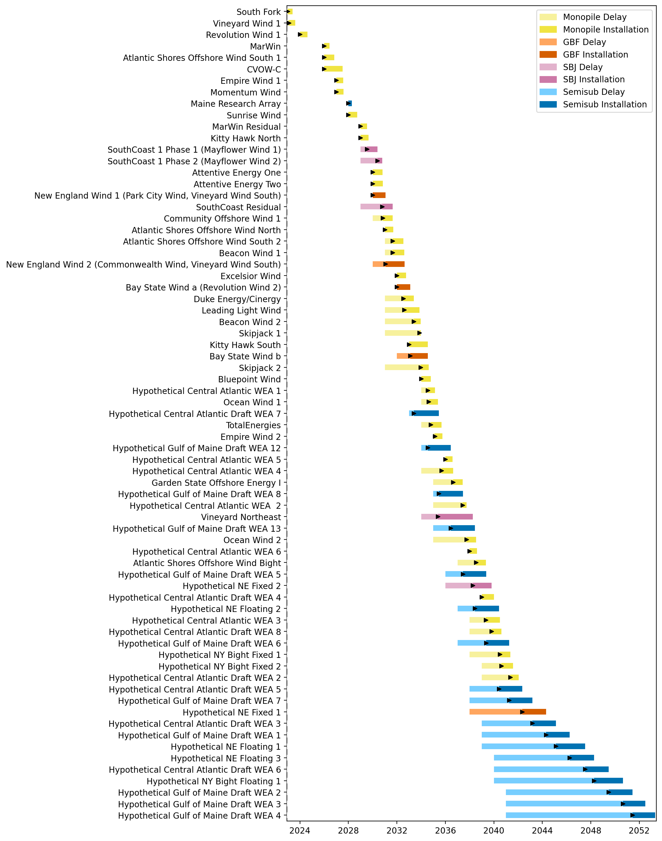
Full Gantt

Slide 3
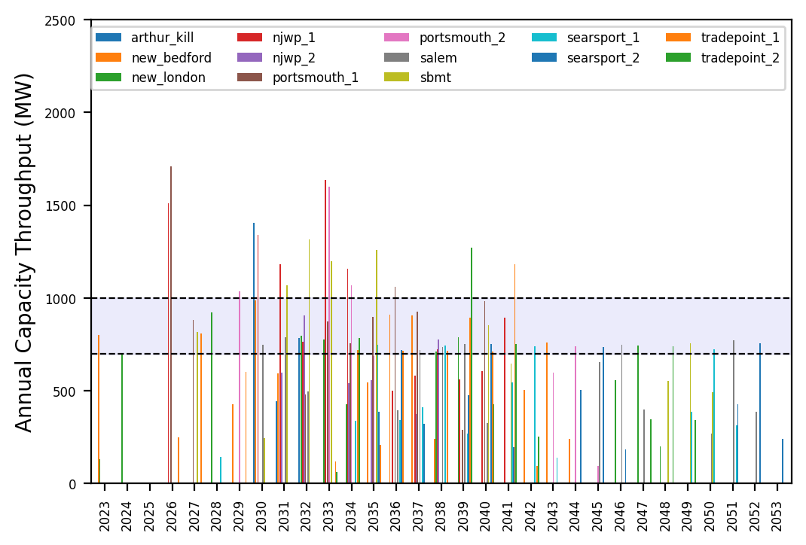
Port Throughput

Slide 4
natl_gaps_4foreign_2_1
1 more foreign WTIV 2025

Slide 5
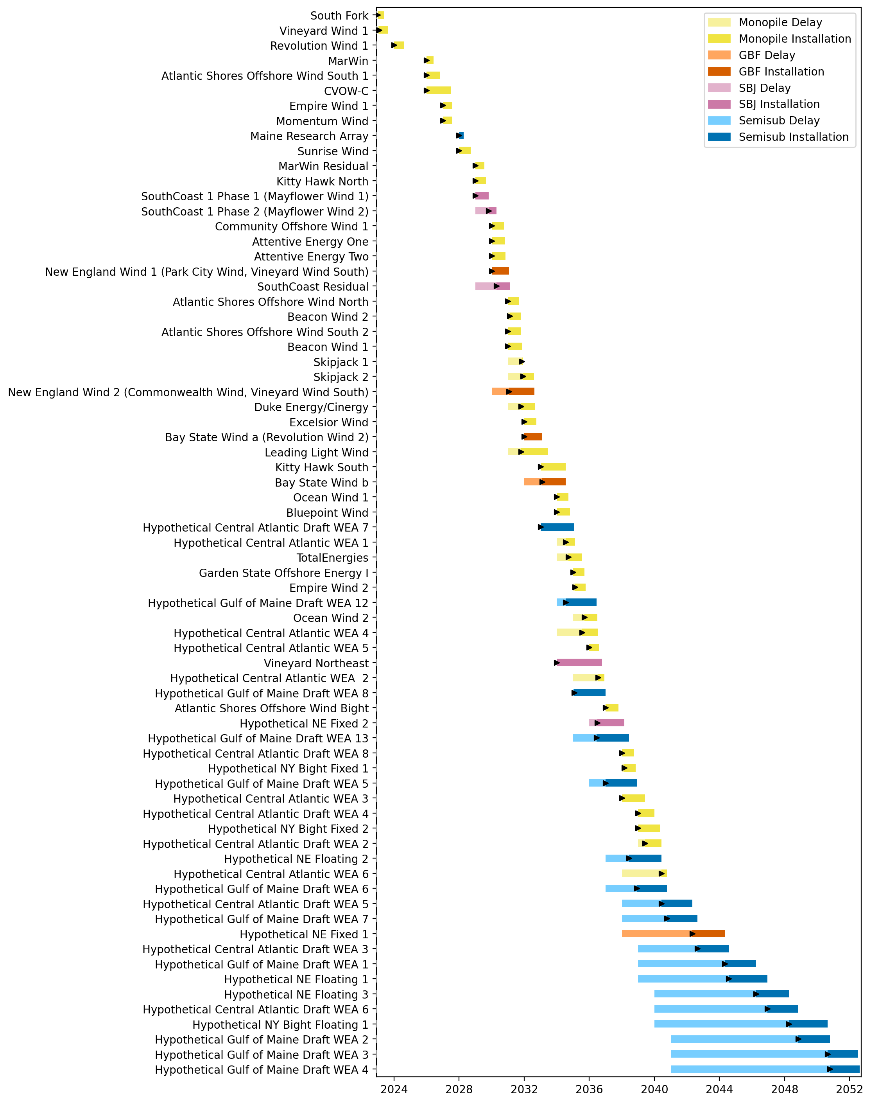
Full Gantt

Slide 6
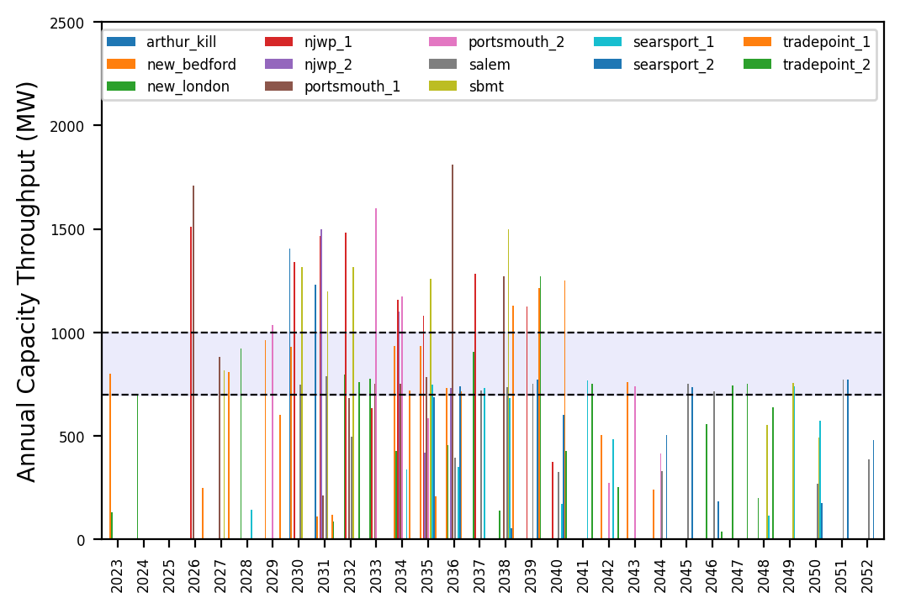
Port Throughput

Slide 7
natl_gaps_5foreign_2_1
1 more foreign WTIV 2025

Slide 8
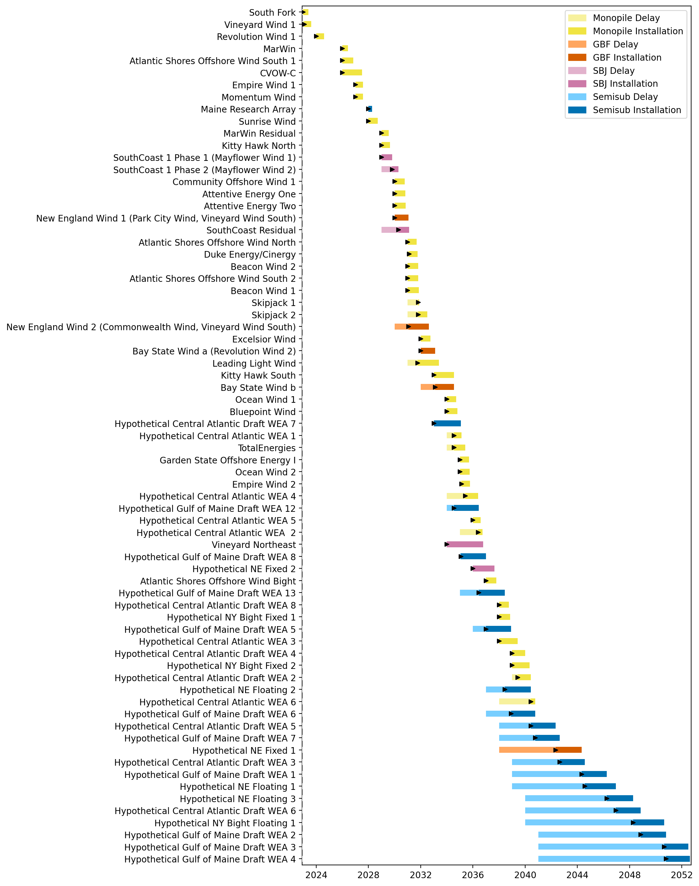
Full Gantt

Slide 9
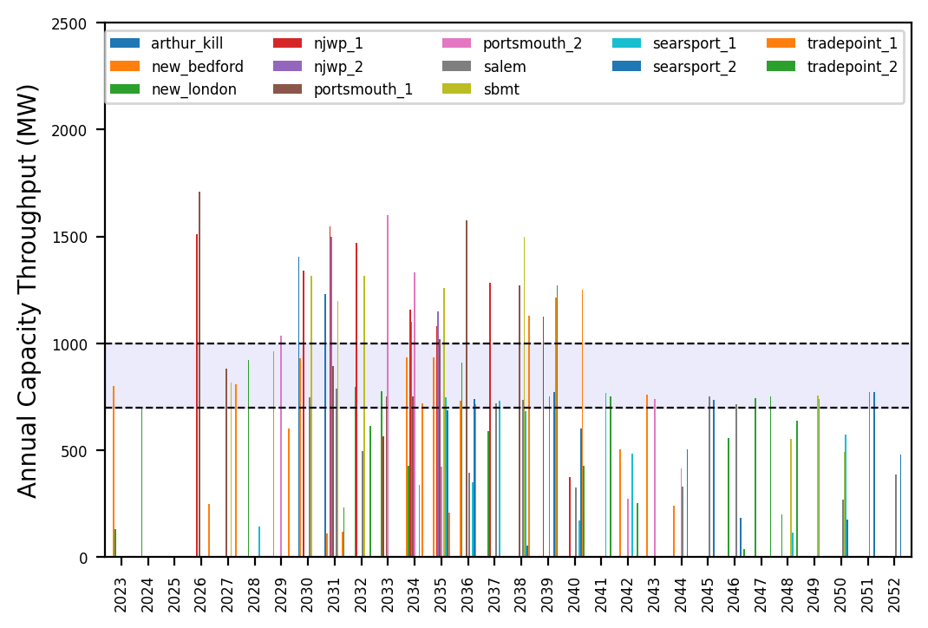
Port Throughput

Slide 10
natl_gaps_6foreign_2_1
1 more foreign WTIV 2025

Slide 11
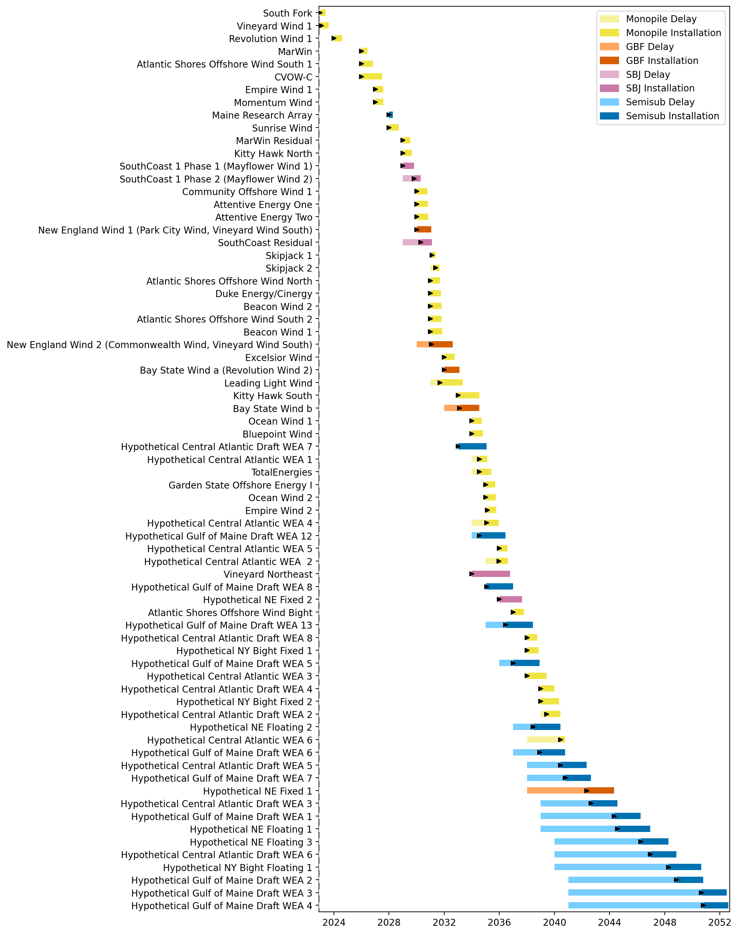
Full Gantt

Slide 12

Port Throughput

Slide 13
natl_gaps_6foreign_infp_2_1
1 more foreign WTIV 2025

Slide 14
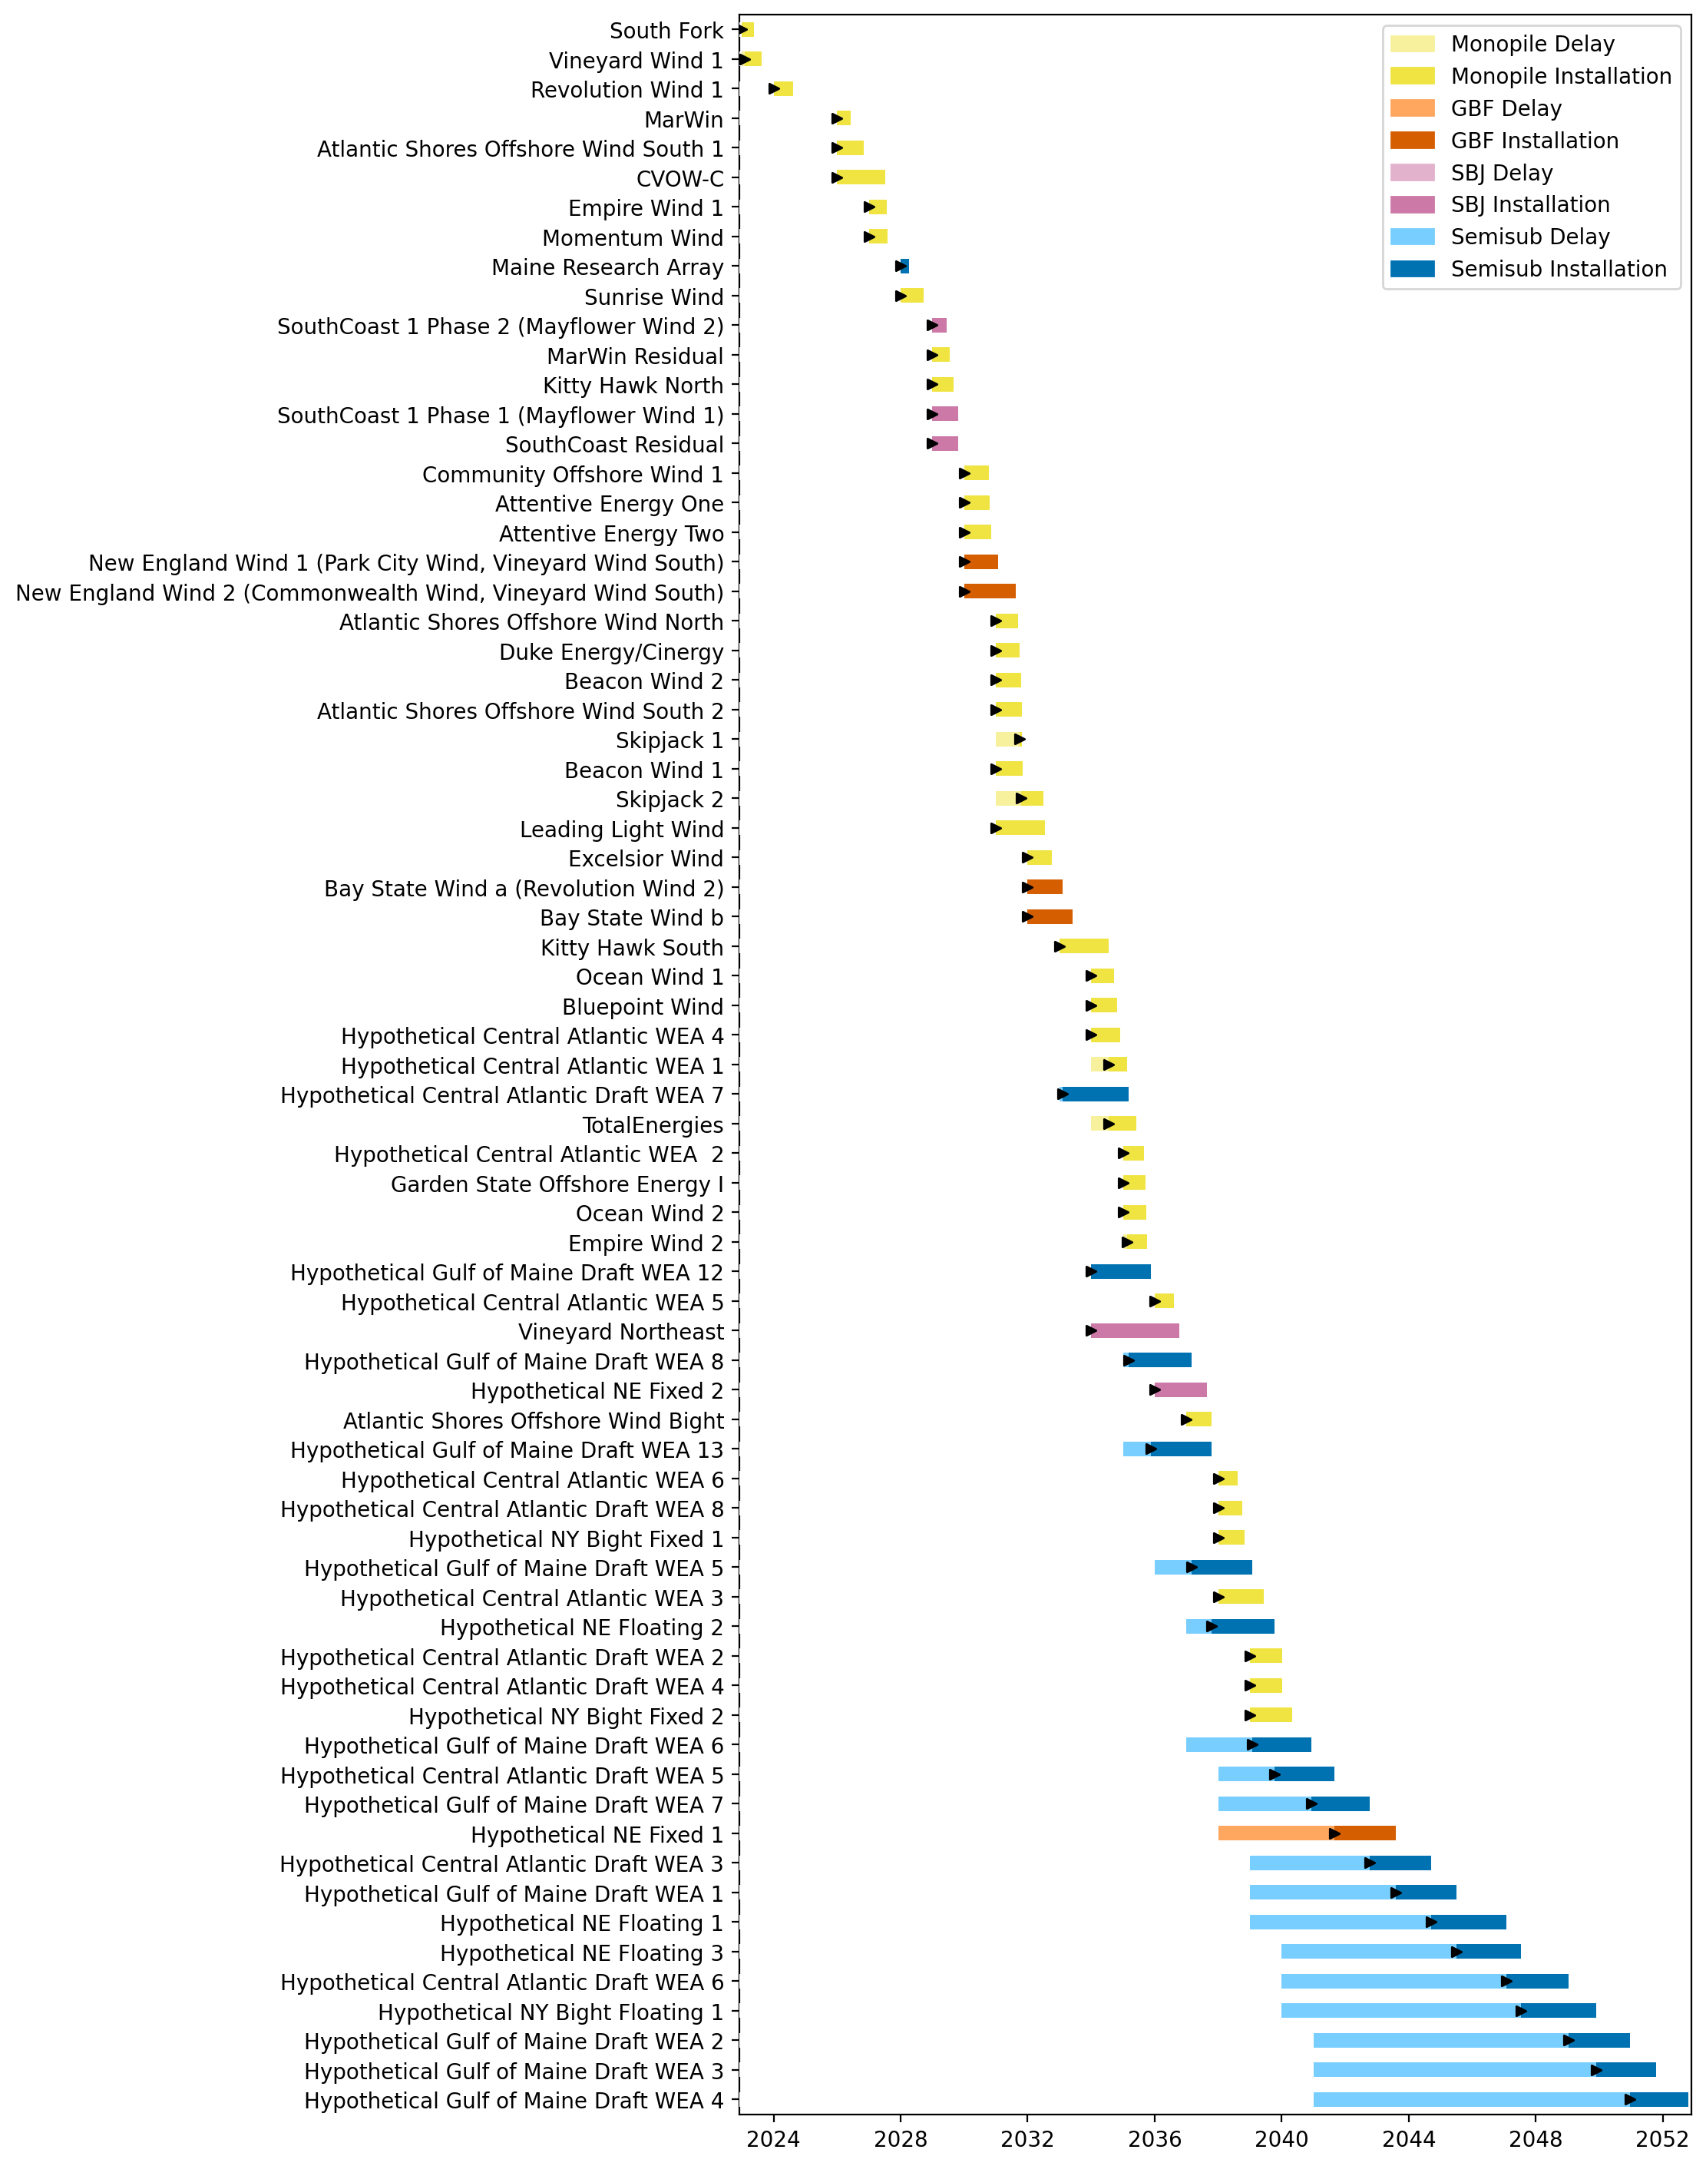
Full Gantt

Slide 15
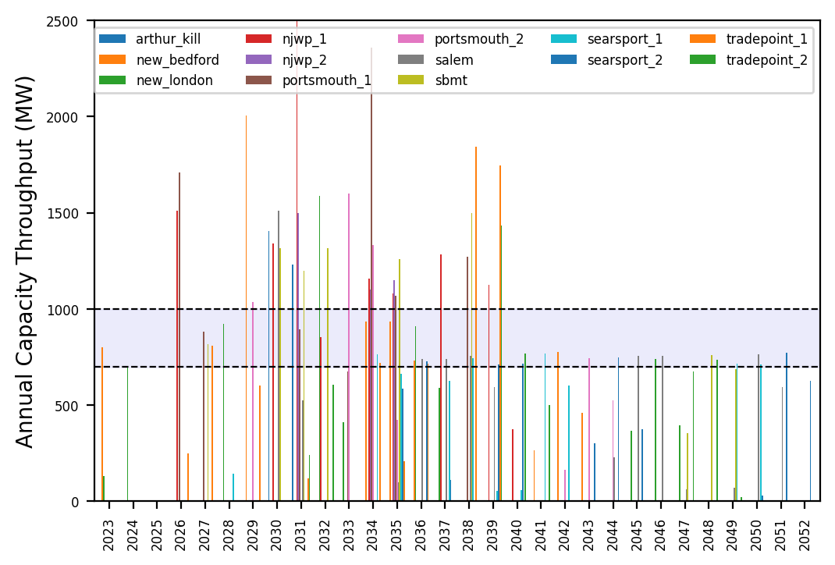
Port Throughput

Slide 16
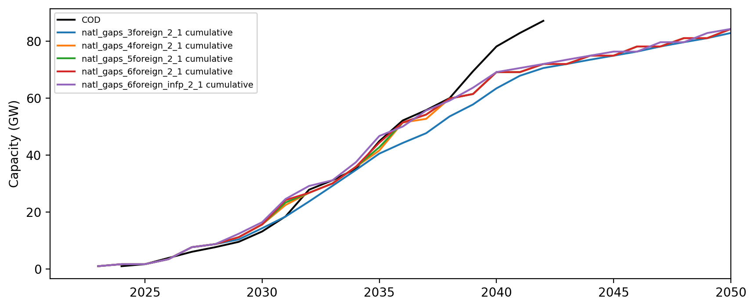
Installed Capacity

