Slide 1
natl_gaps_no_action_alt_policy
Foreign FFIVs cannot shuttle, no additional vessels added to pipeline

Slide 2
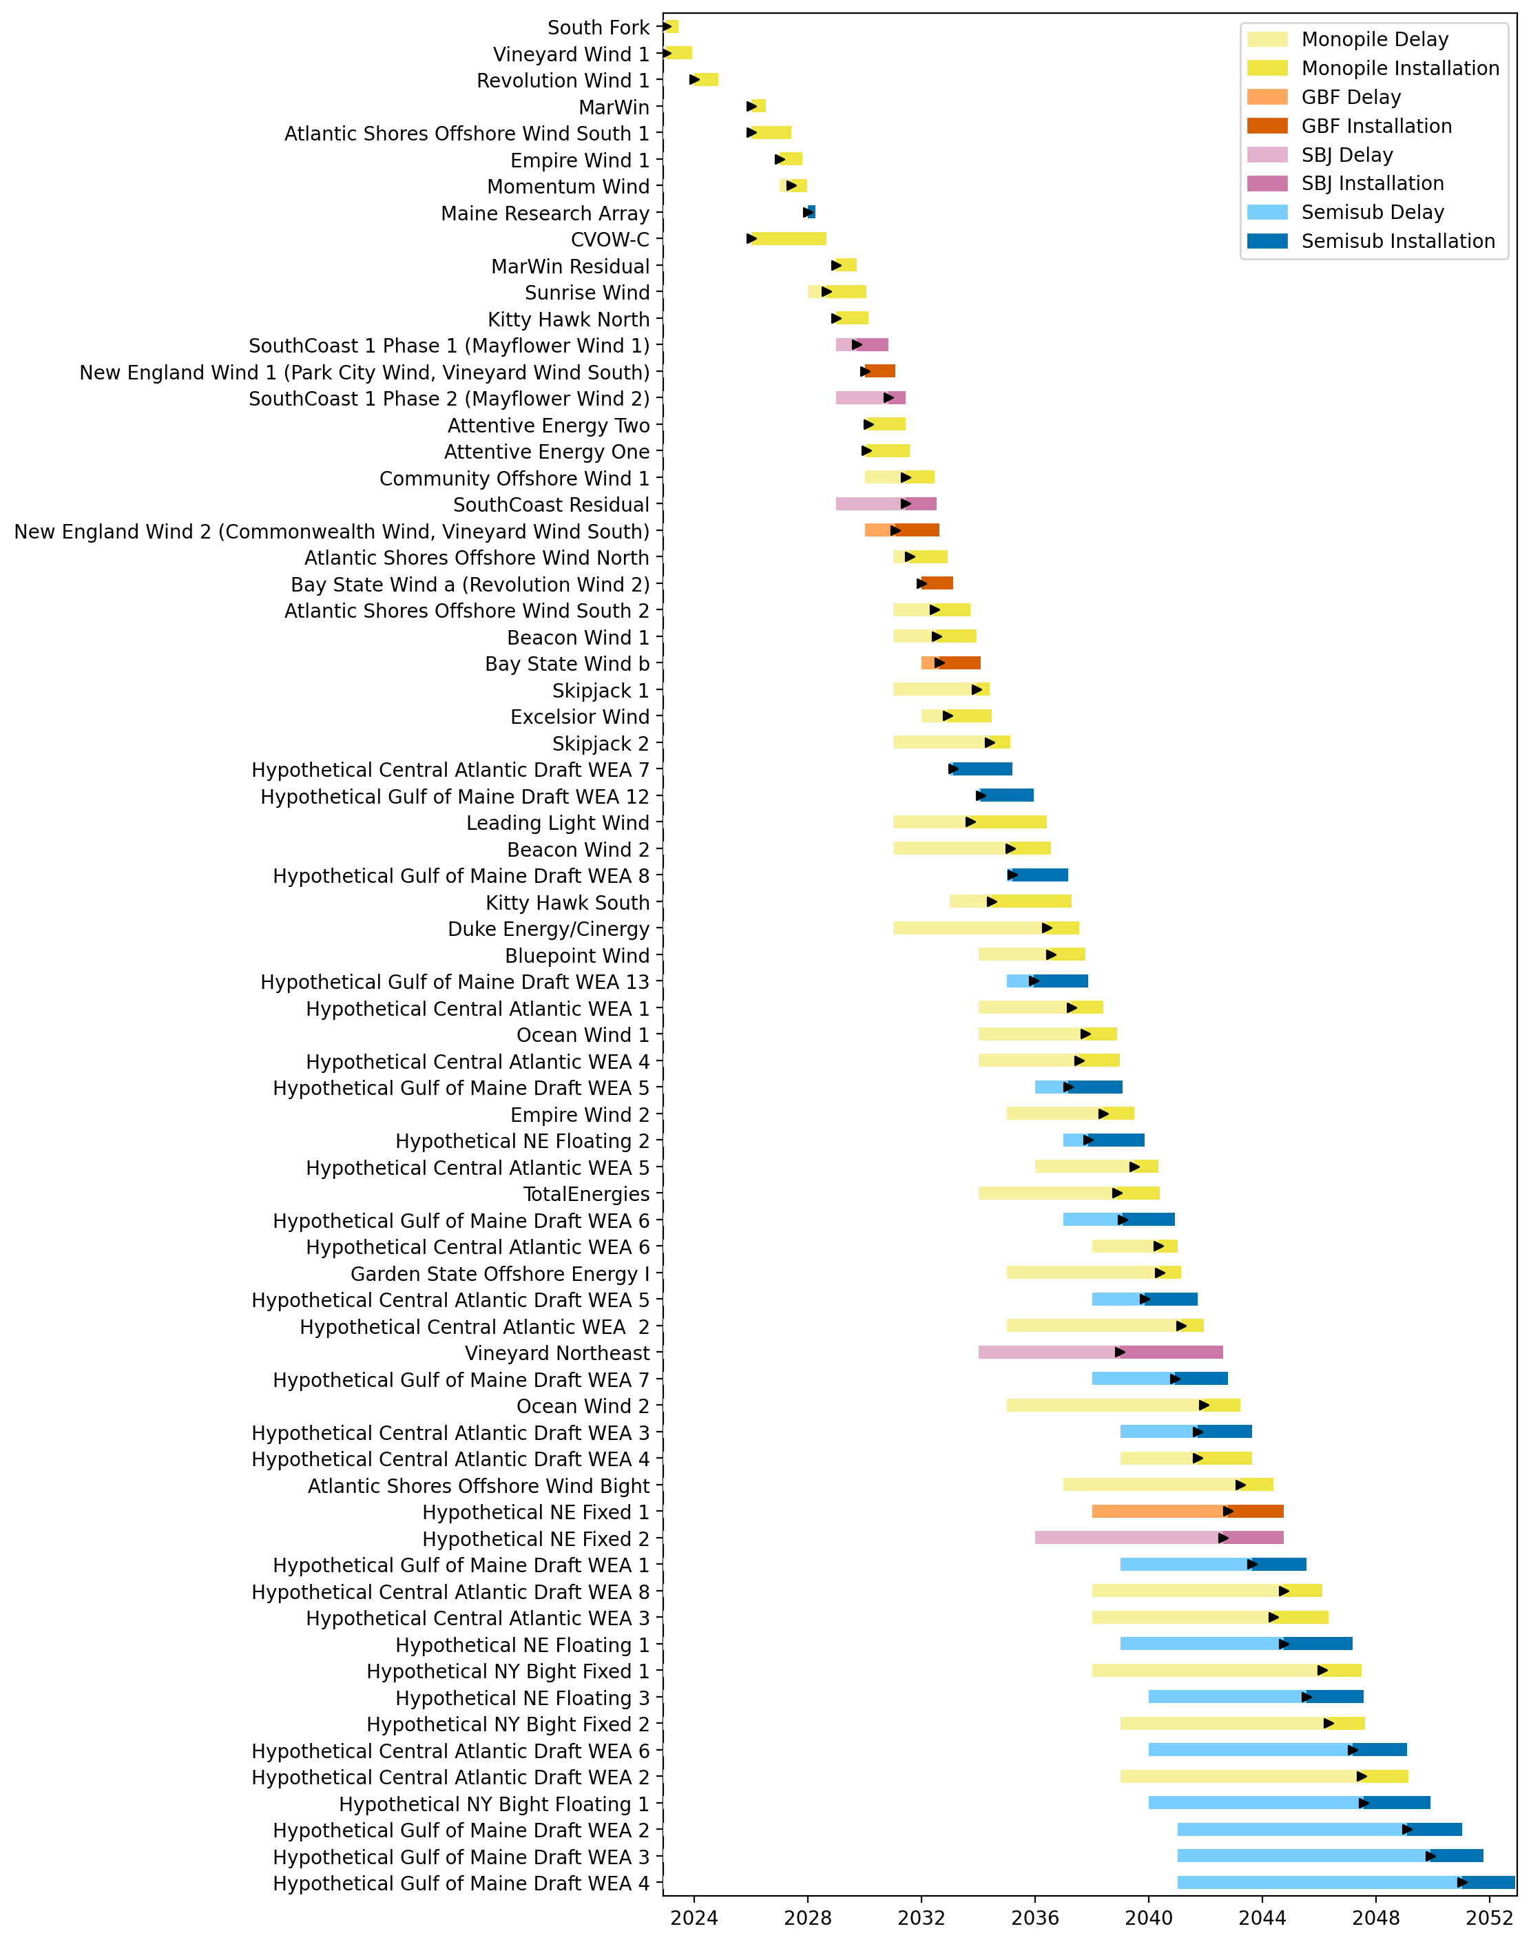
Full Gantt

Slide 3
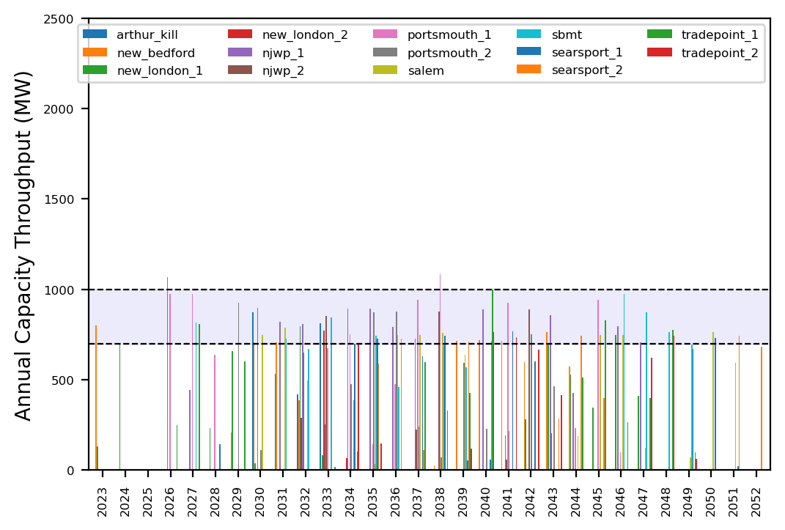
Port Throughput

Slide 4
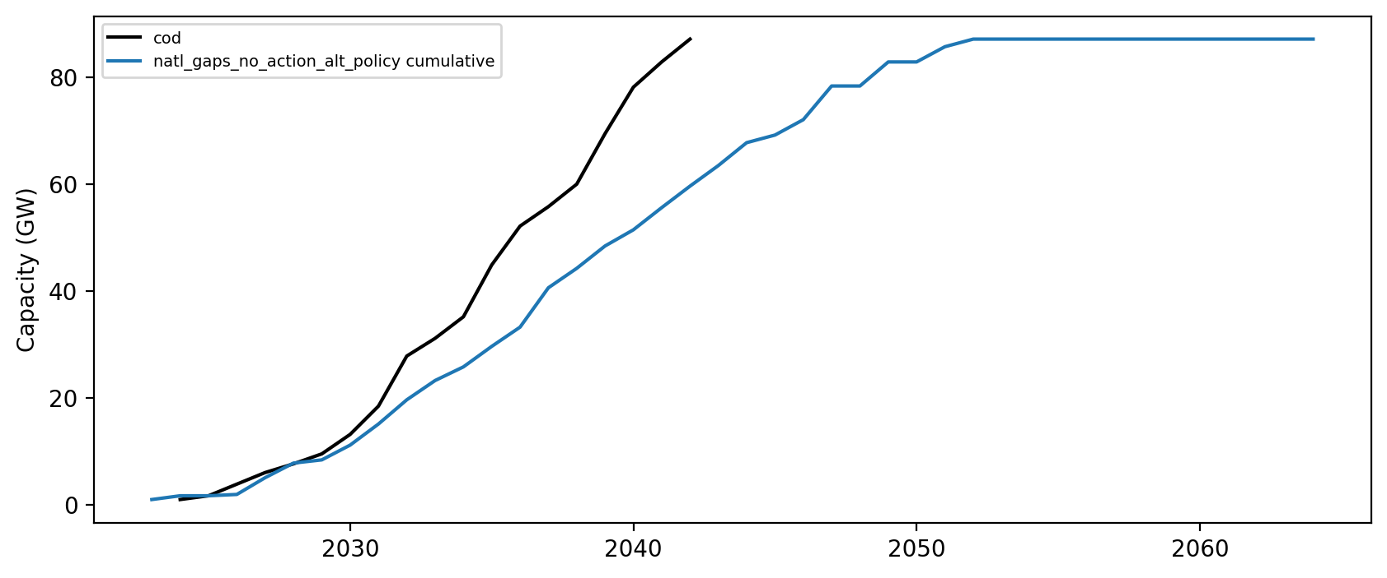
Installed Capacity

