Slide 1
example_atlantic_3
Example Altantic pipeline 3

Slide 2
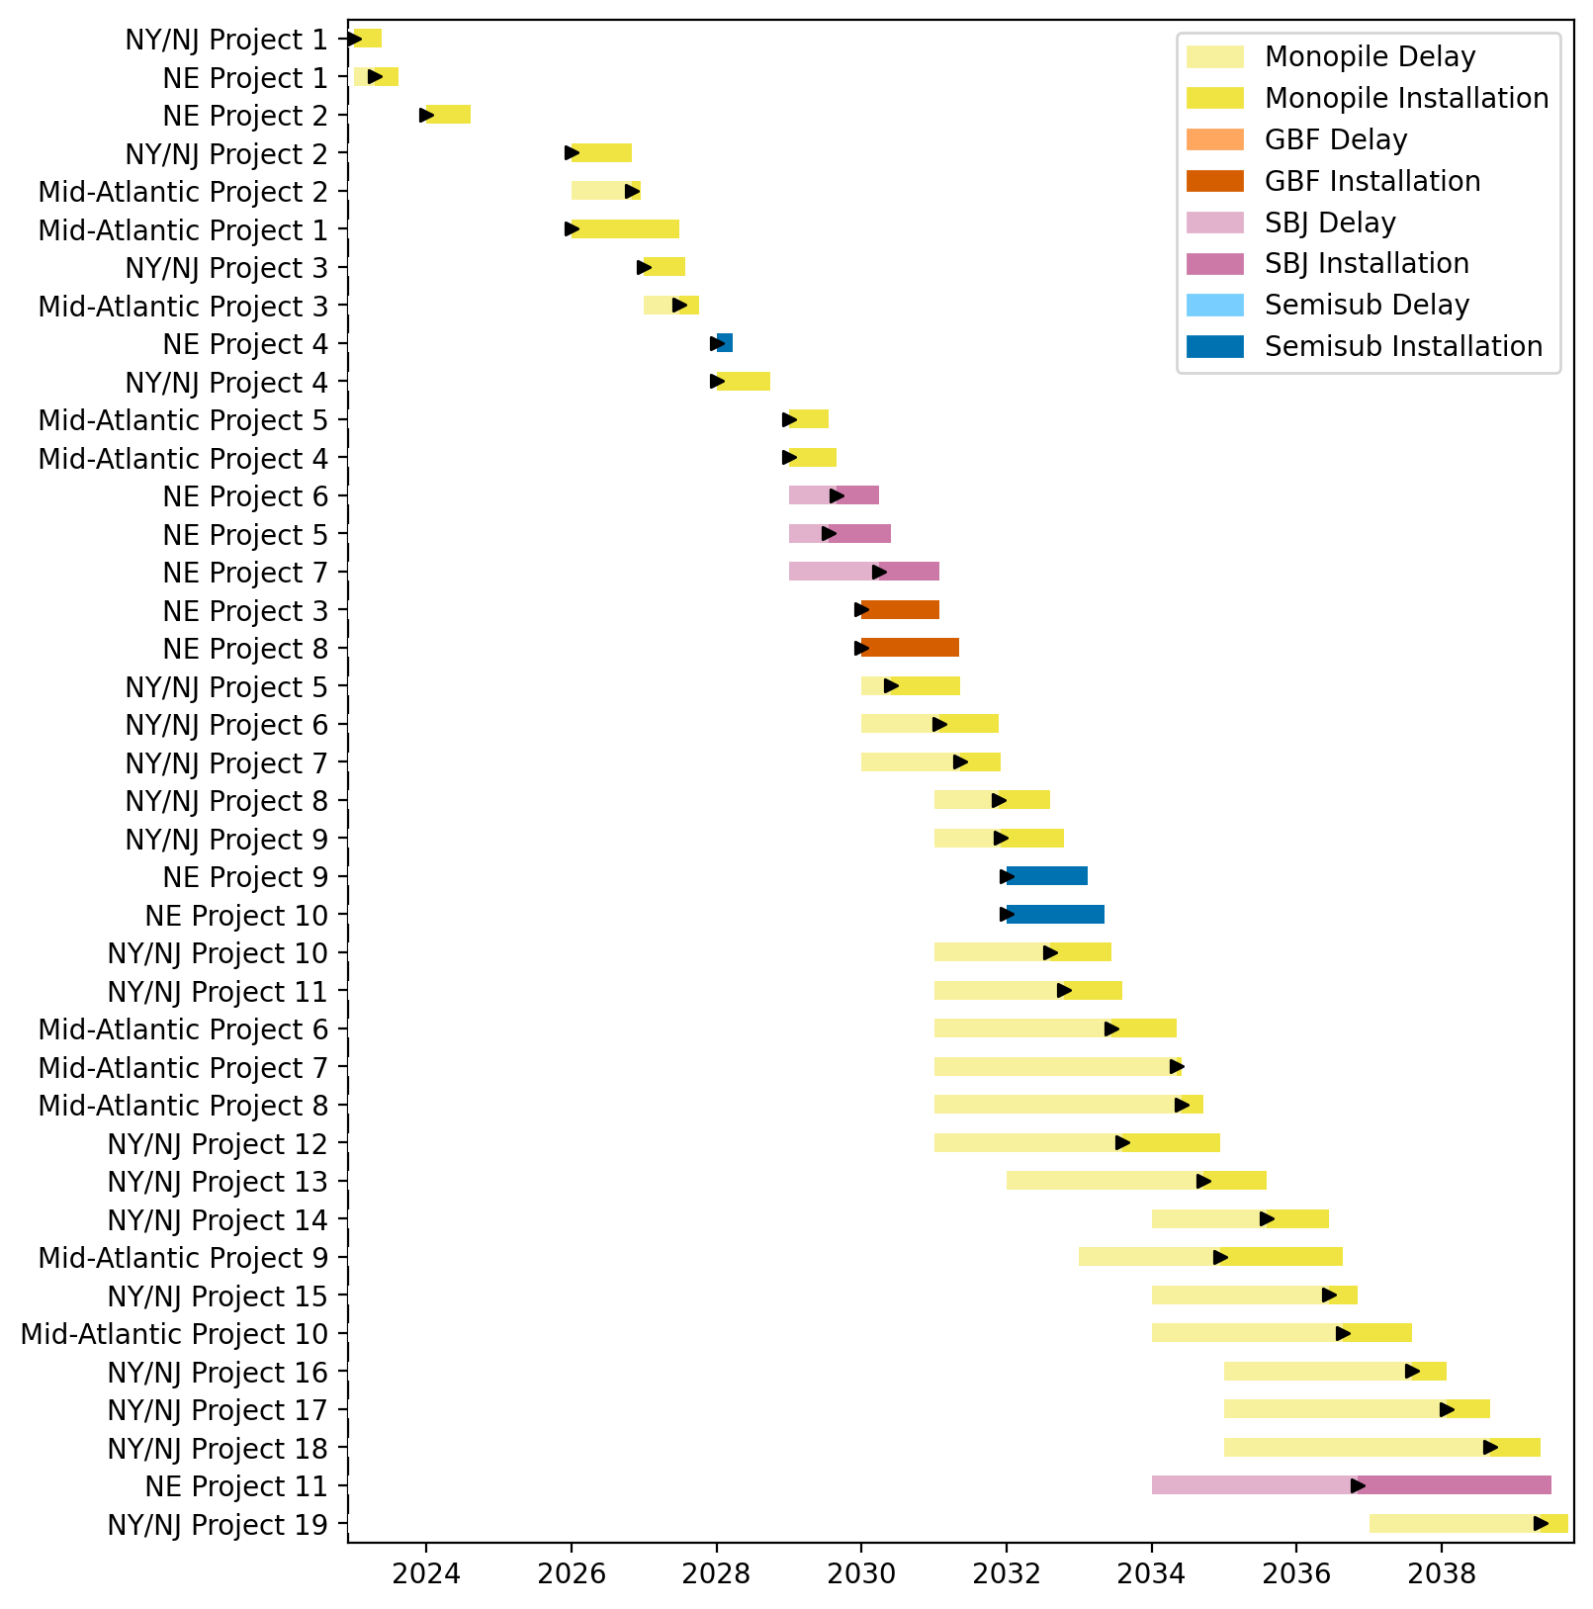
Full Gantt

Slide 3
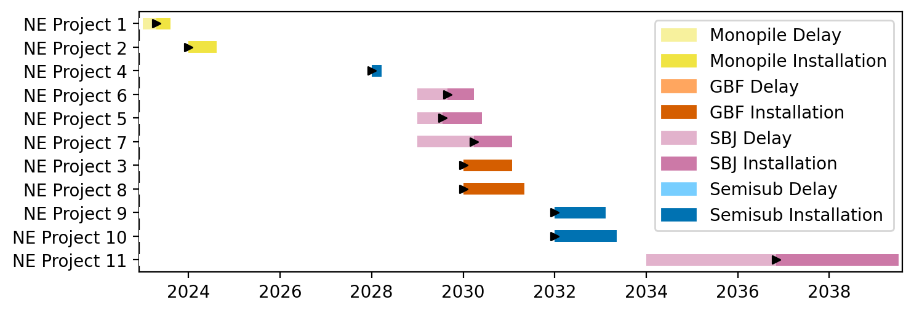
New England Gantt

Slide 4
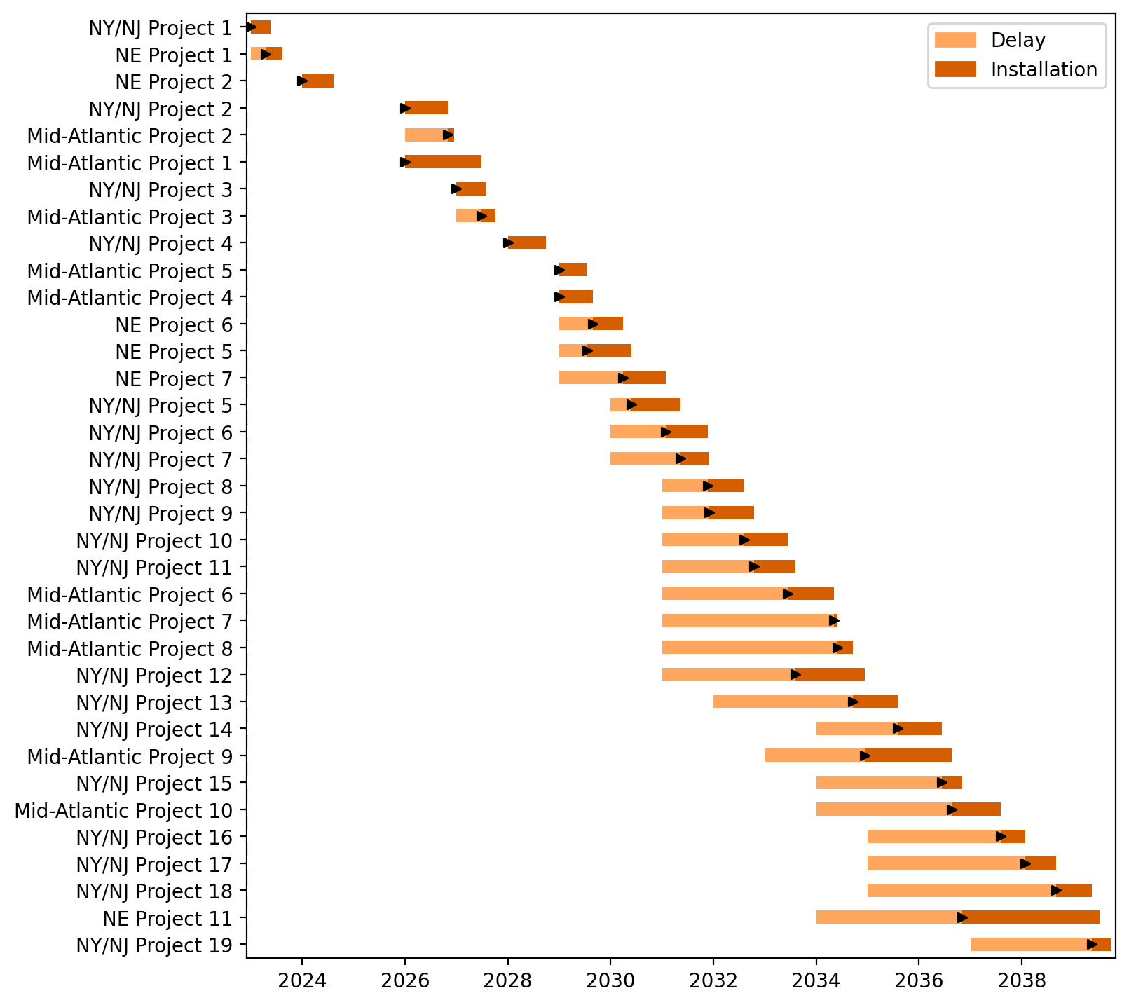
Fixed Gantt

Slide 5
example_atlantic_canada
Example Altantic w/ Canadian Port

Slide 6
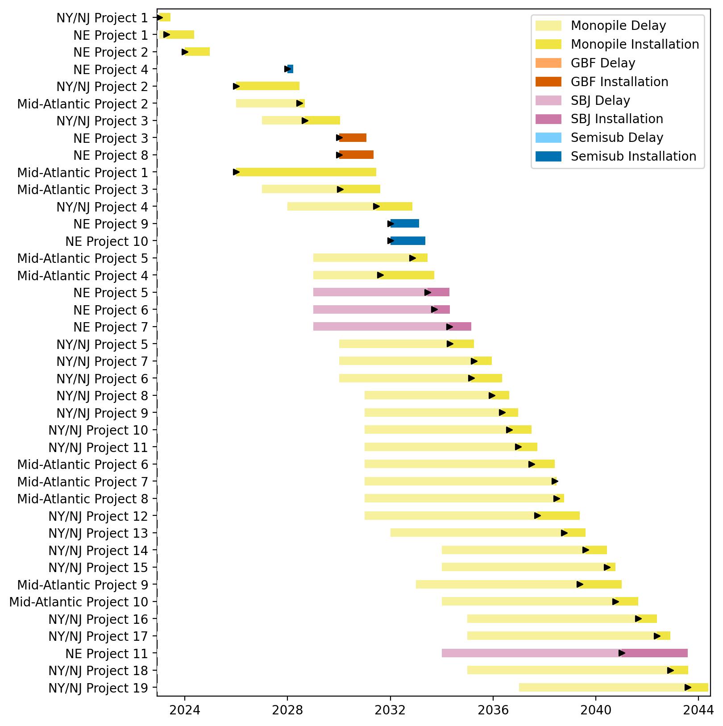
Full Gantt

Slide 7
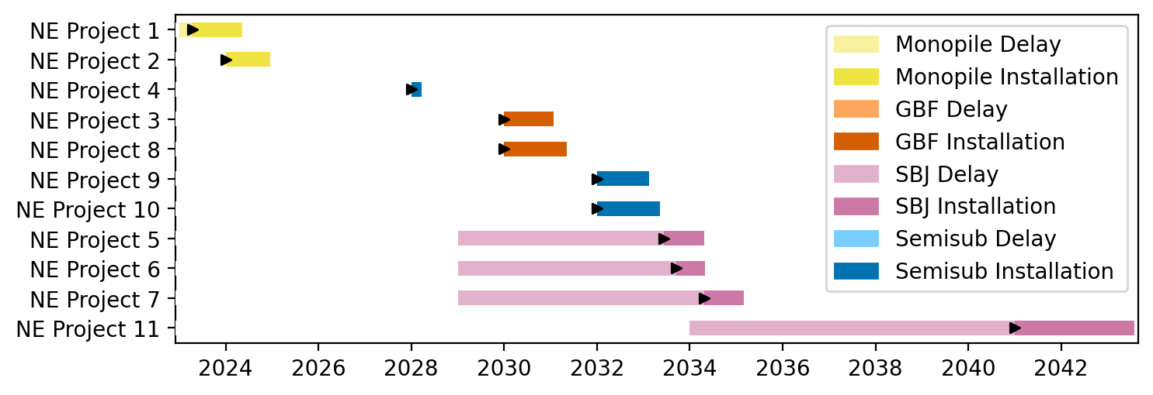
New England Gantt

Slide 8
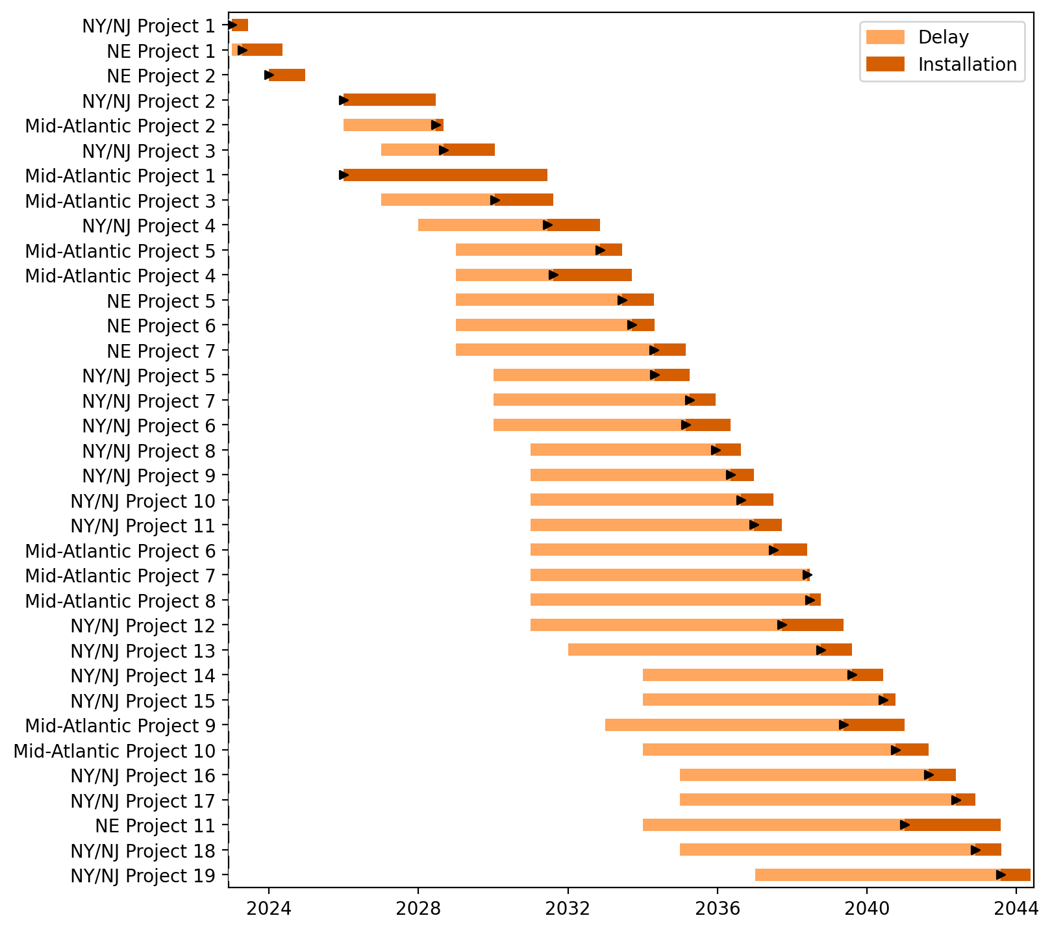
Fixed Gantt

Slide 9
Summary Plots
Plots comparing runs

Slide 10
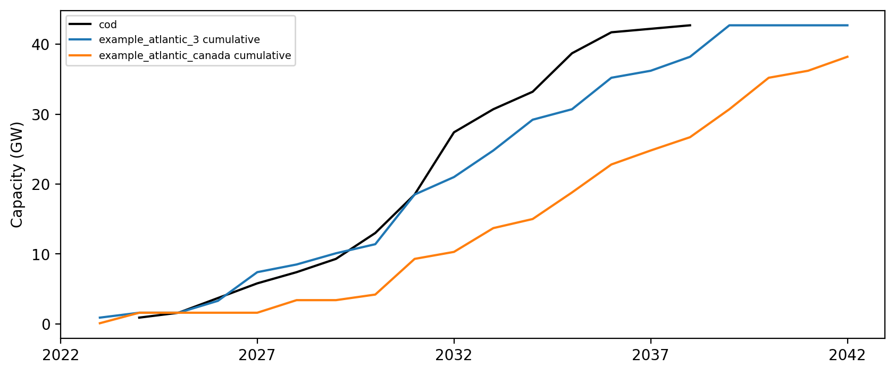
Cumulative Installed Capacity

Slide 11
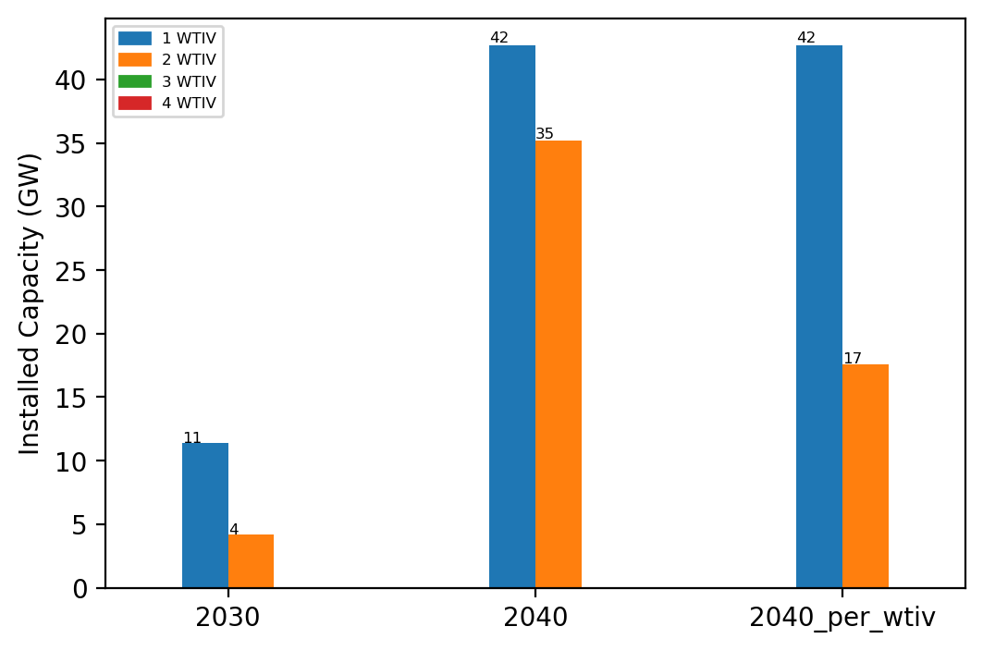
Summary Installed Capacity

