Slide 1
natl_gaps_no_action_alternate_policy
Foreign FFIVs cannot shuttle, no additional vessels added to pipeline

Slide 2
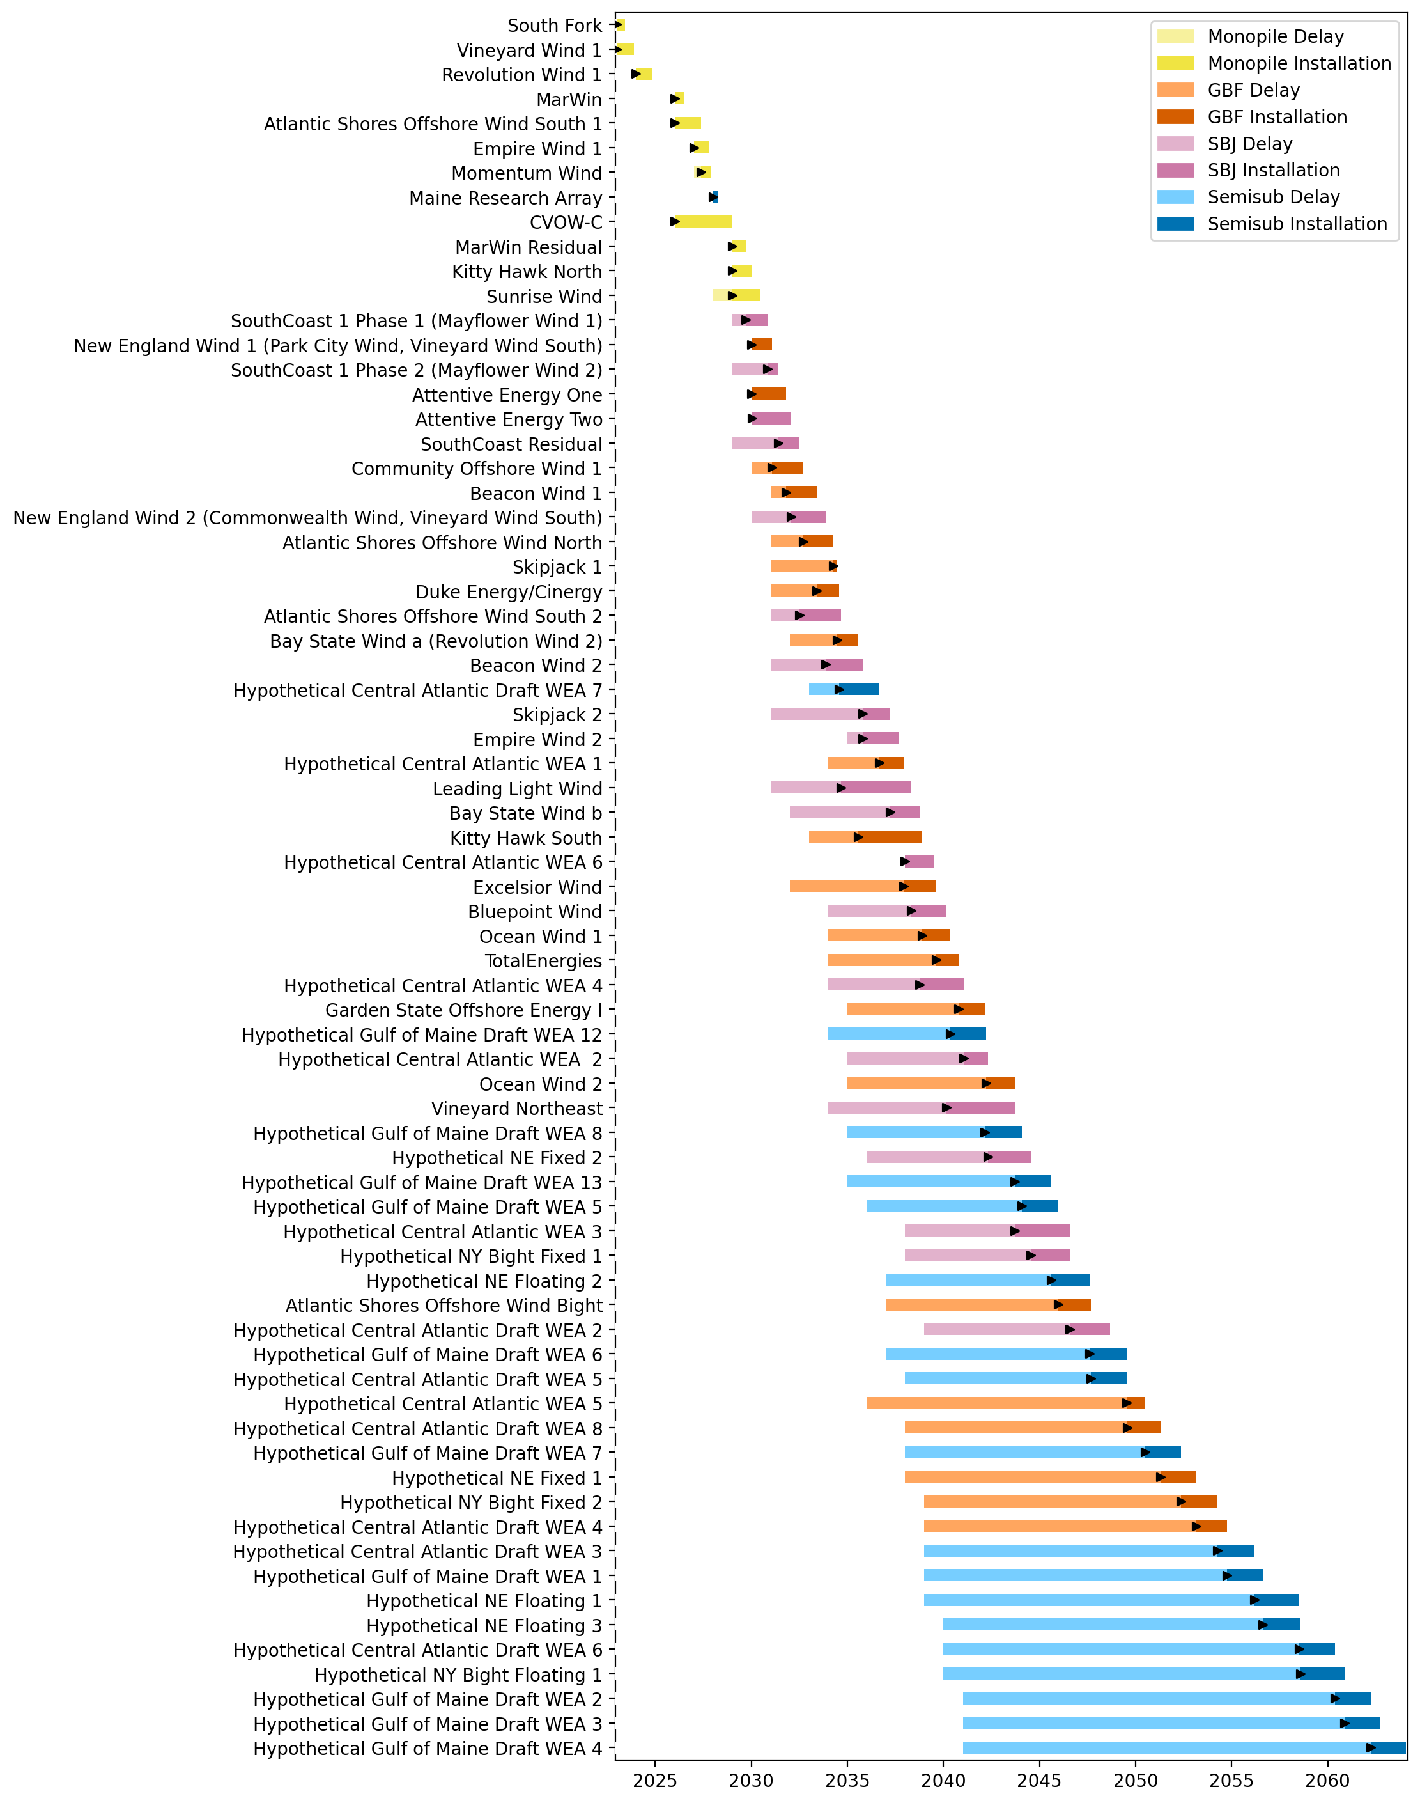
Full Gantt

Slide 3
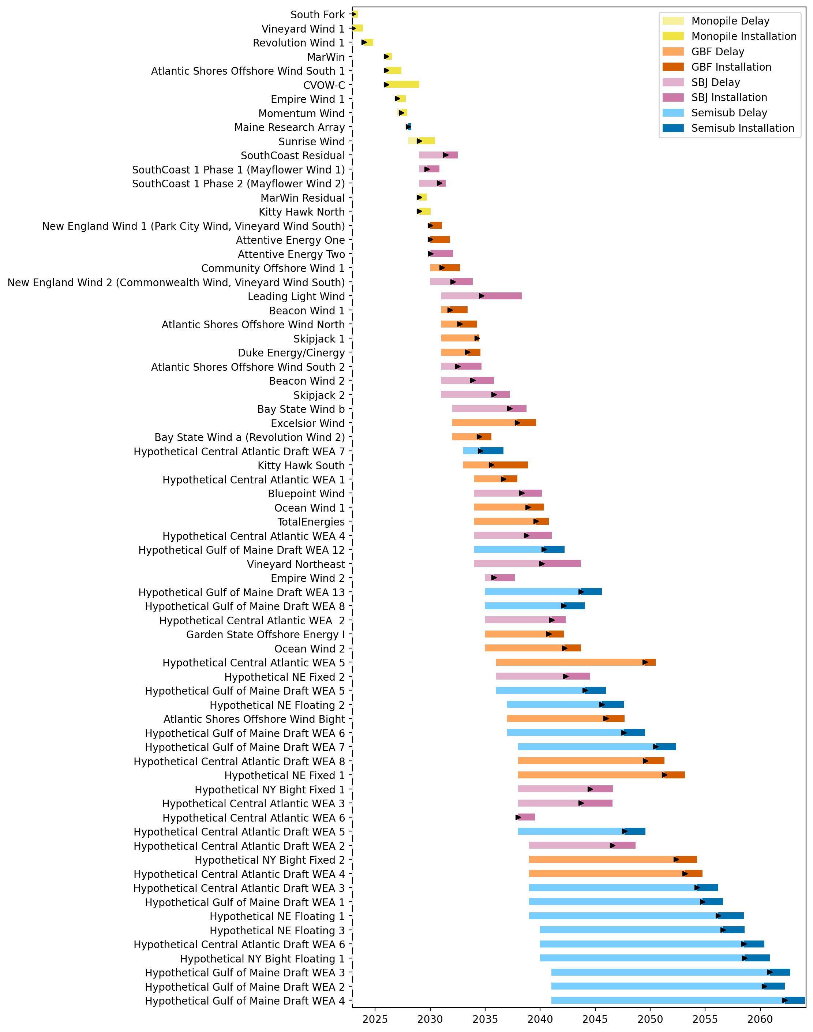
Sorted Full Gantt

Slide 4
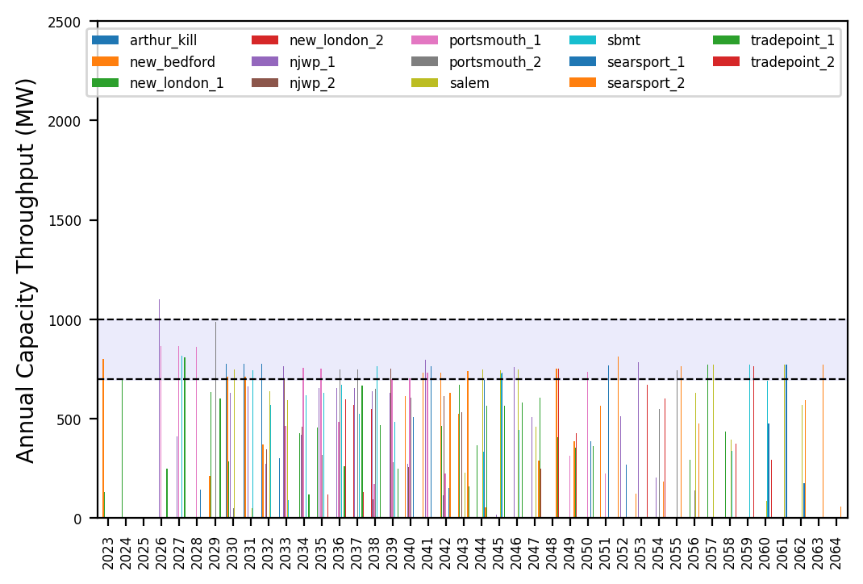
Port Throughput

Slide 5
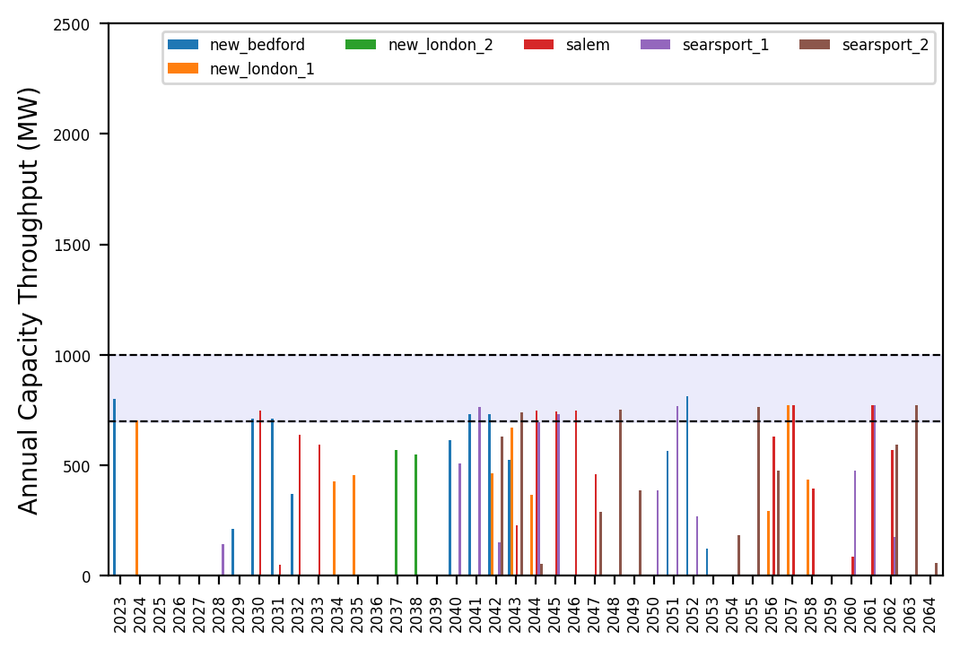
Port Throughput

Slide 6
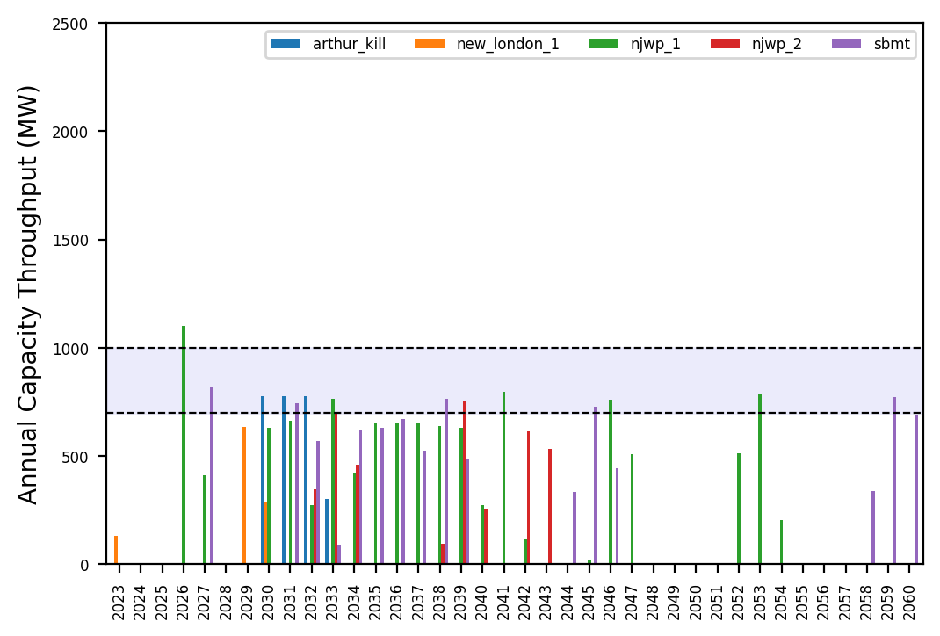
Port Throughput

Slide 7
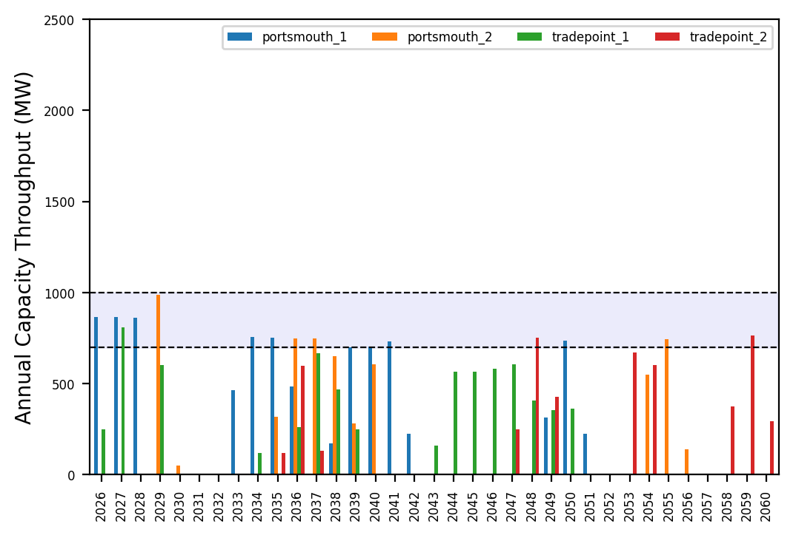
Port Throughput

Slide 8
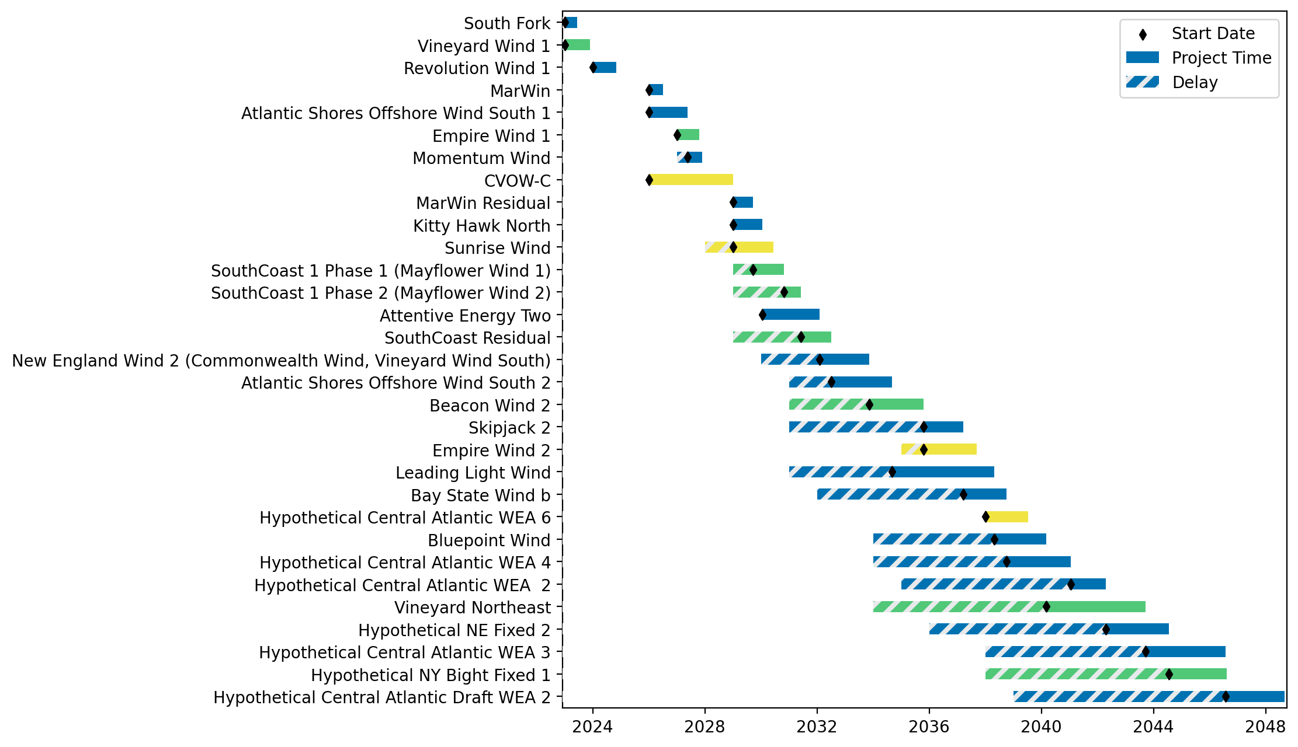
Fixed Gantt

Slide 9
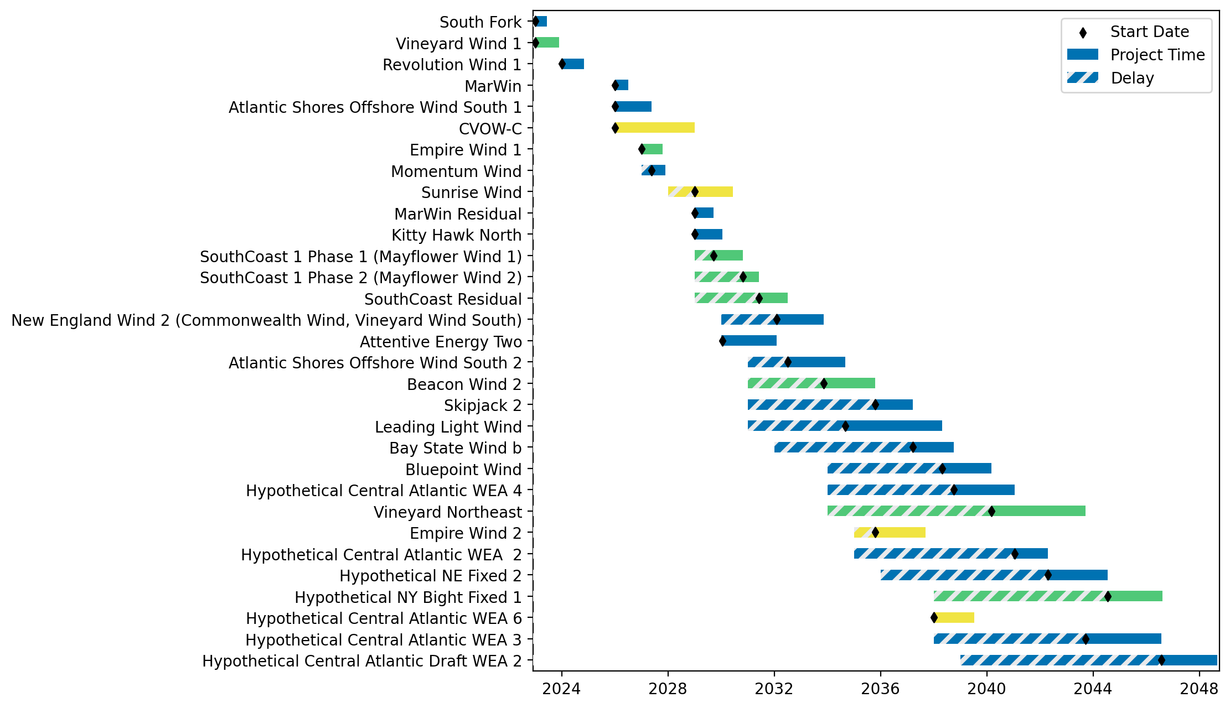
Sorted Fixed Gantt

Slide 10
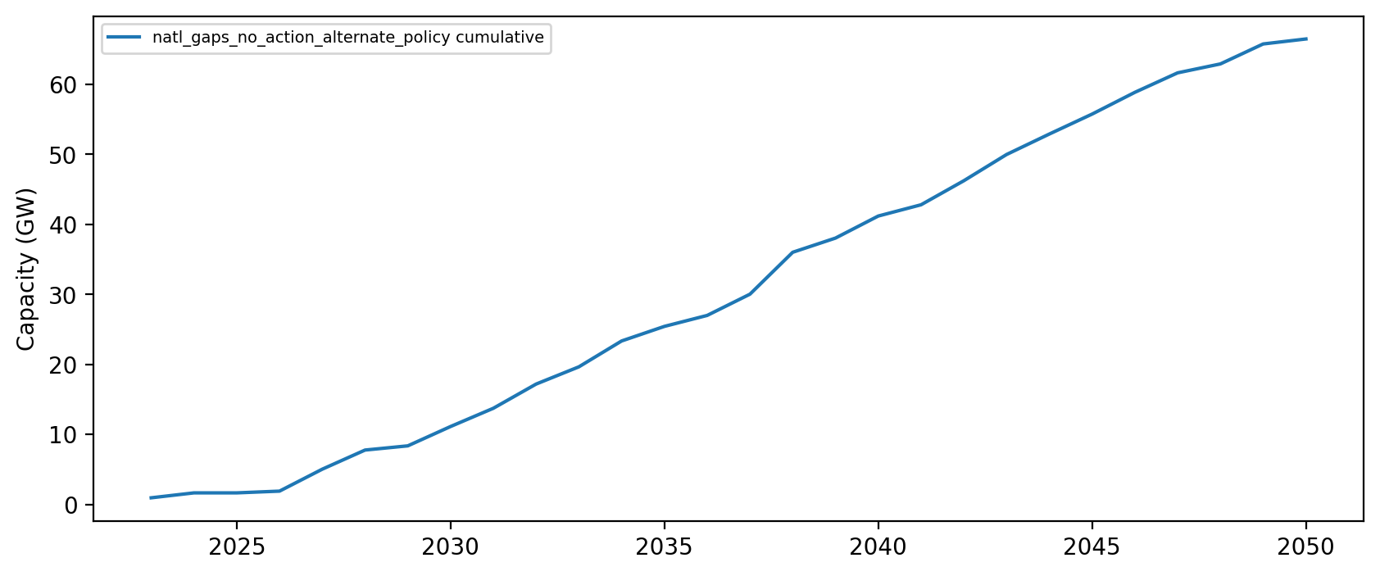
Installed Capacity

