Slide 1
natl_gaps_no_action
1 US WTIV starting with CVOW

Slide 2
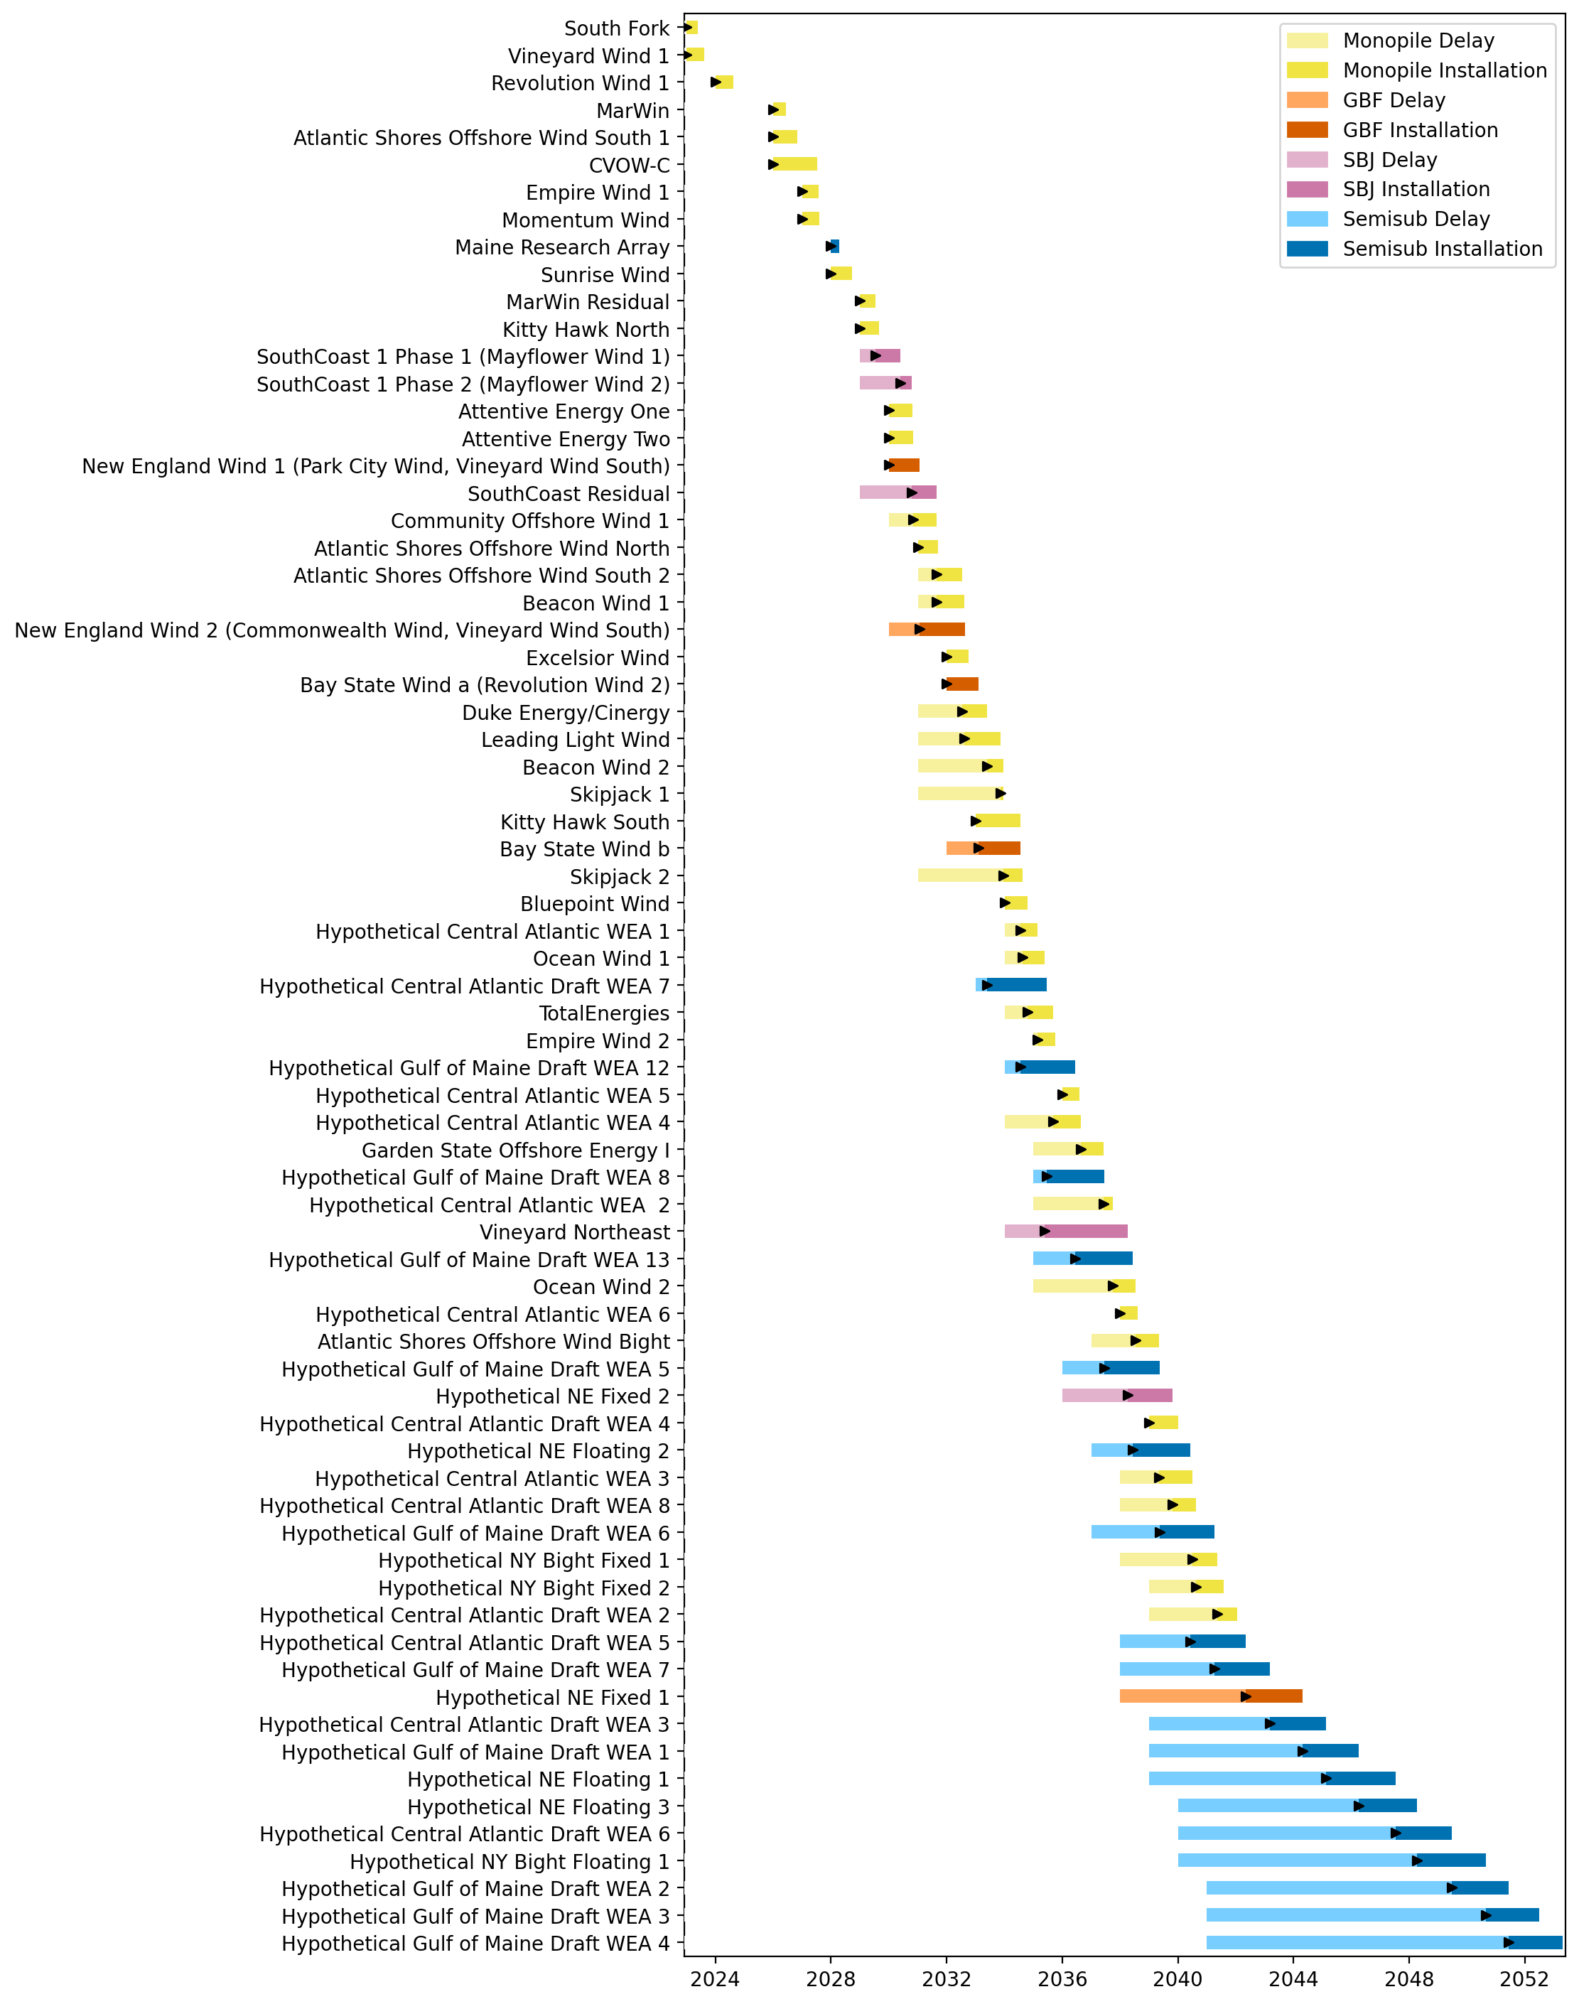
Full Gantt

Slide 3
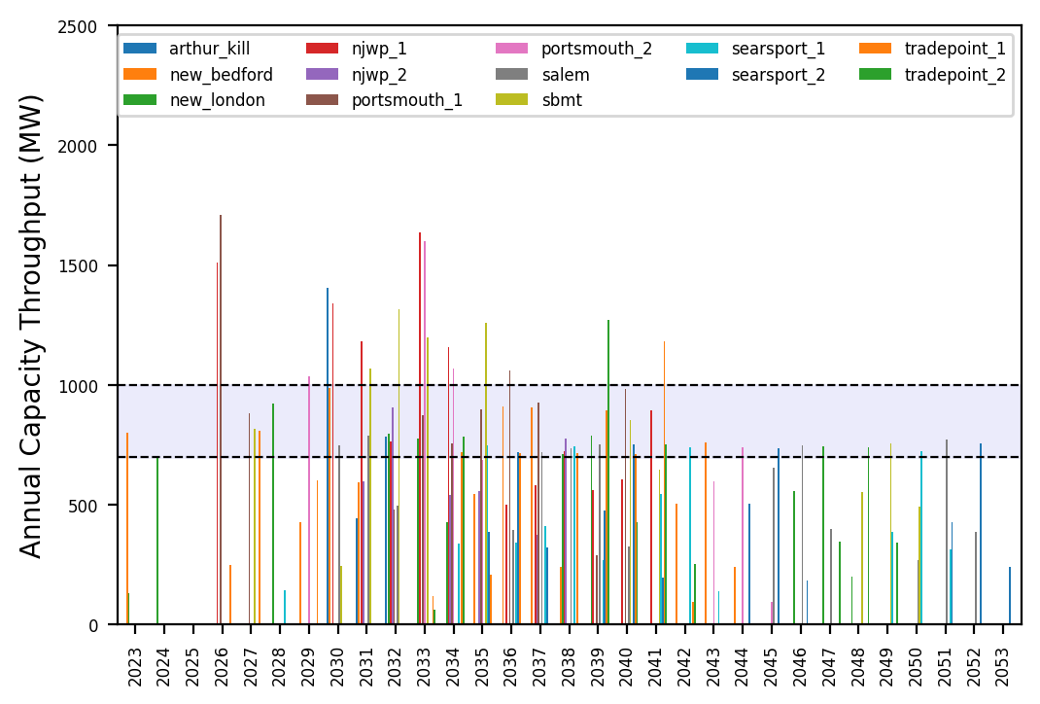
Port Throughput

Slide 4
natl_gaps_3foreign
1 more foreign WTIV 2025

Slide 5
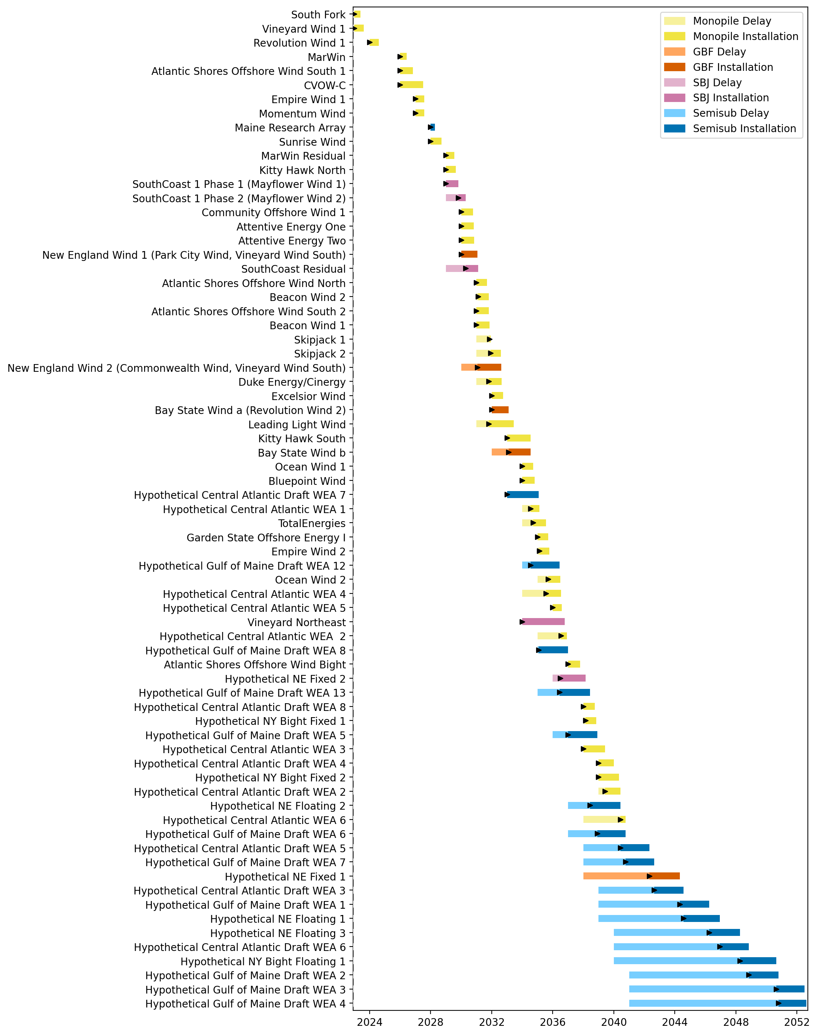
Full Gantt

Slide 6
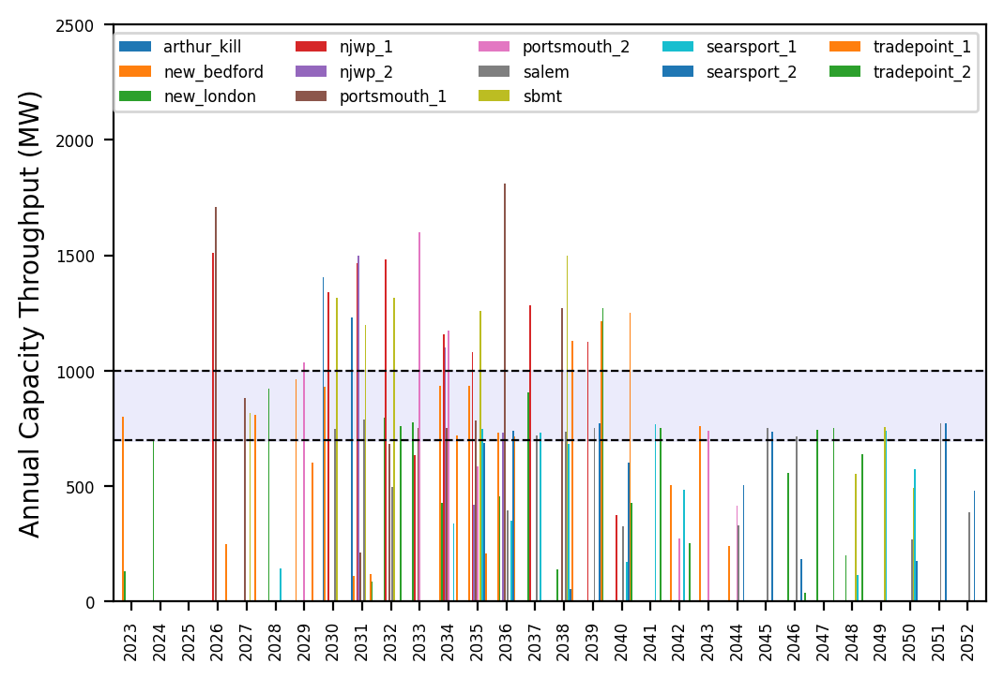
Port Throughput

Slide 7
natl_gaps_4foreign
1 more foreign WTIV 2025

Slide 8
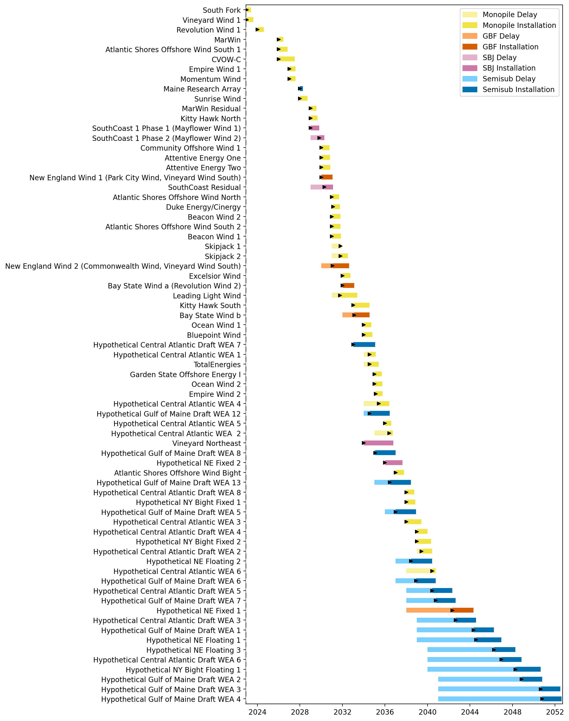
Full Gantt

Slide 9
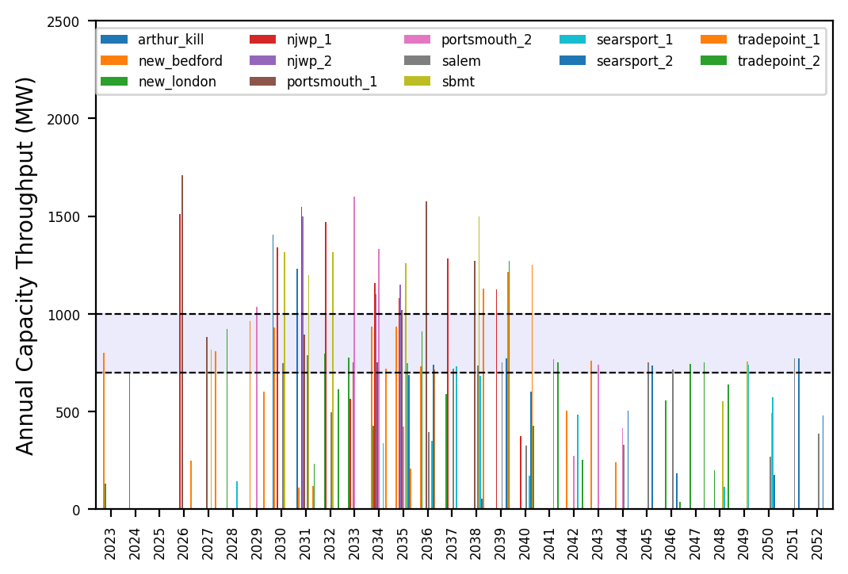
Port Throughput

Slide 10
natl_gaps_5foreign
1 more foreign WTIV 2025

Slide 11
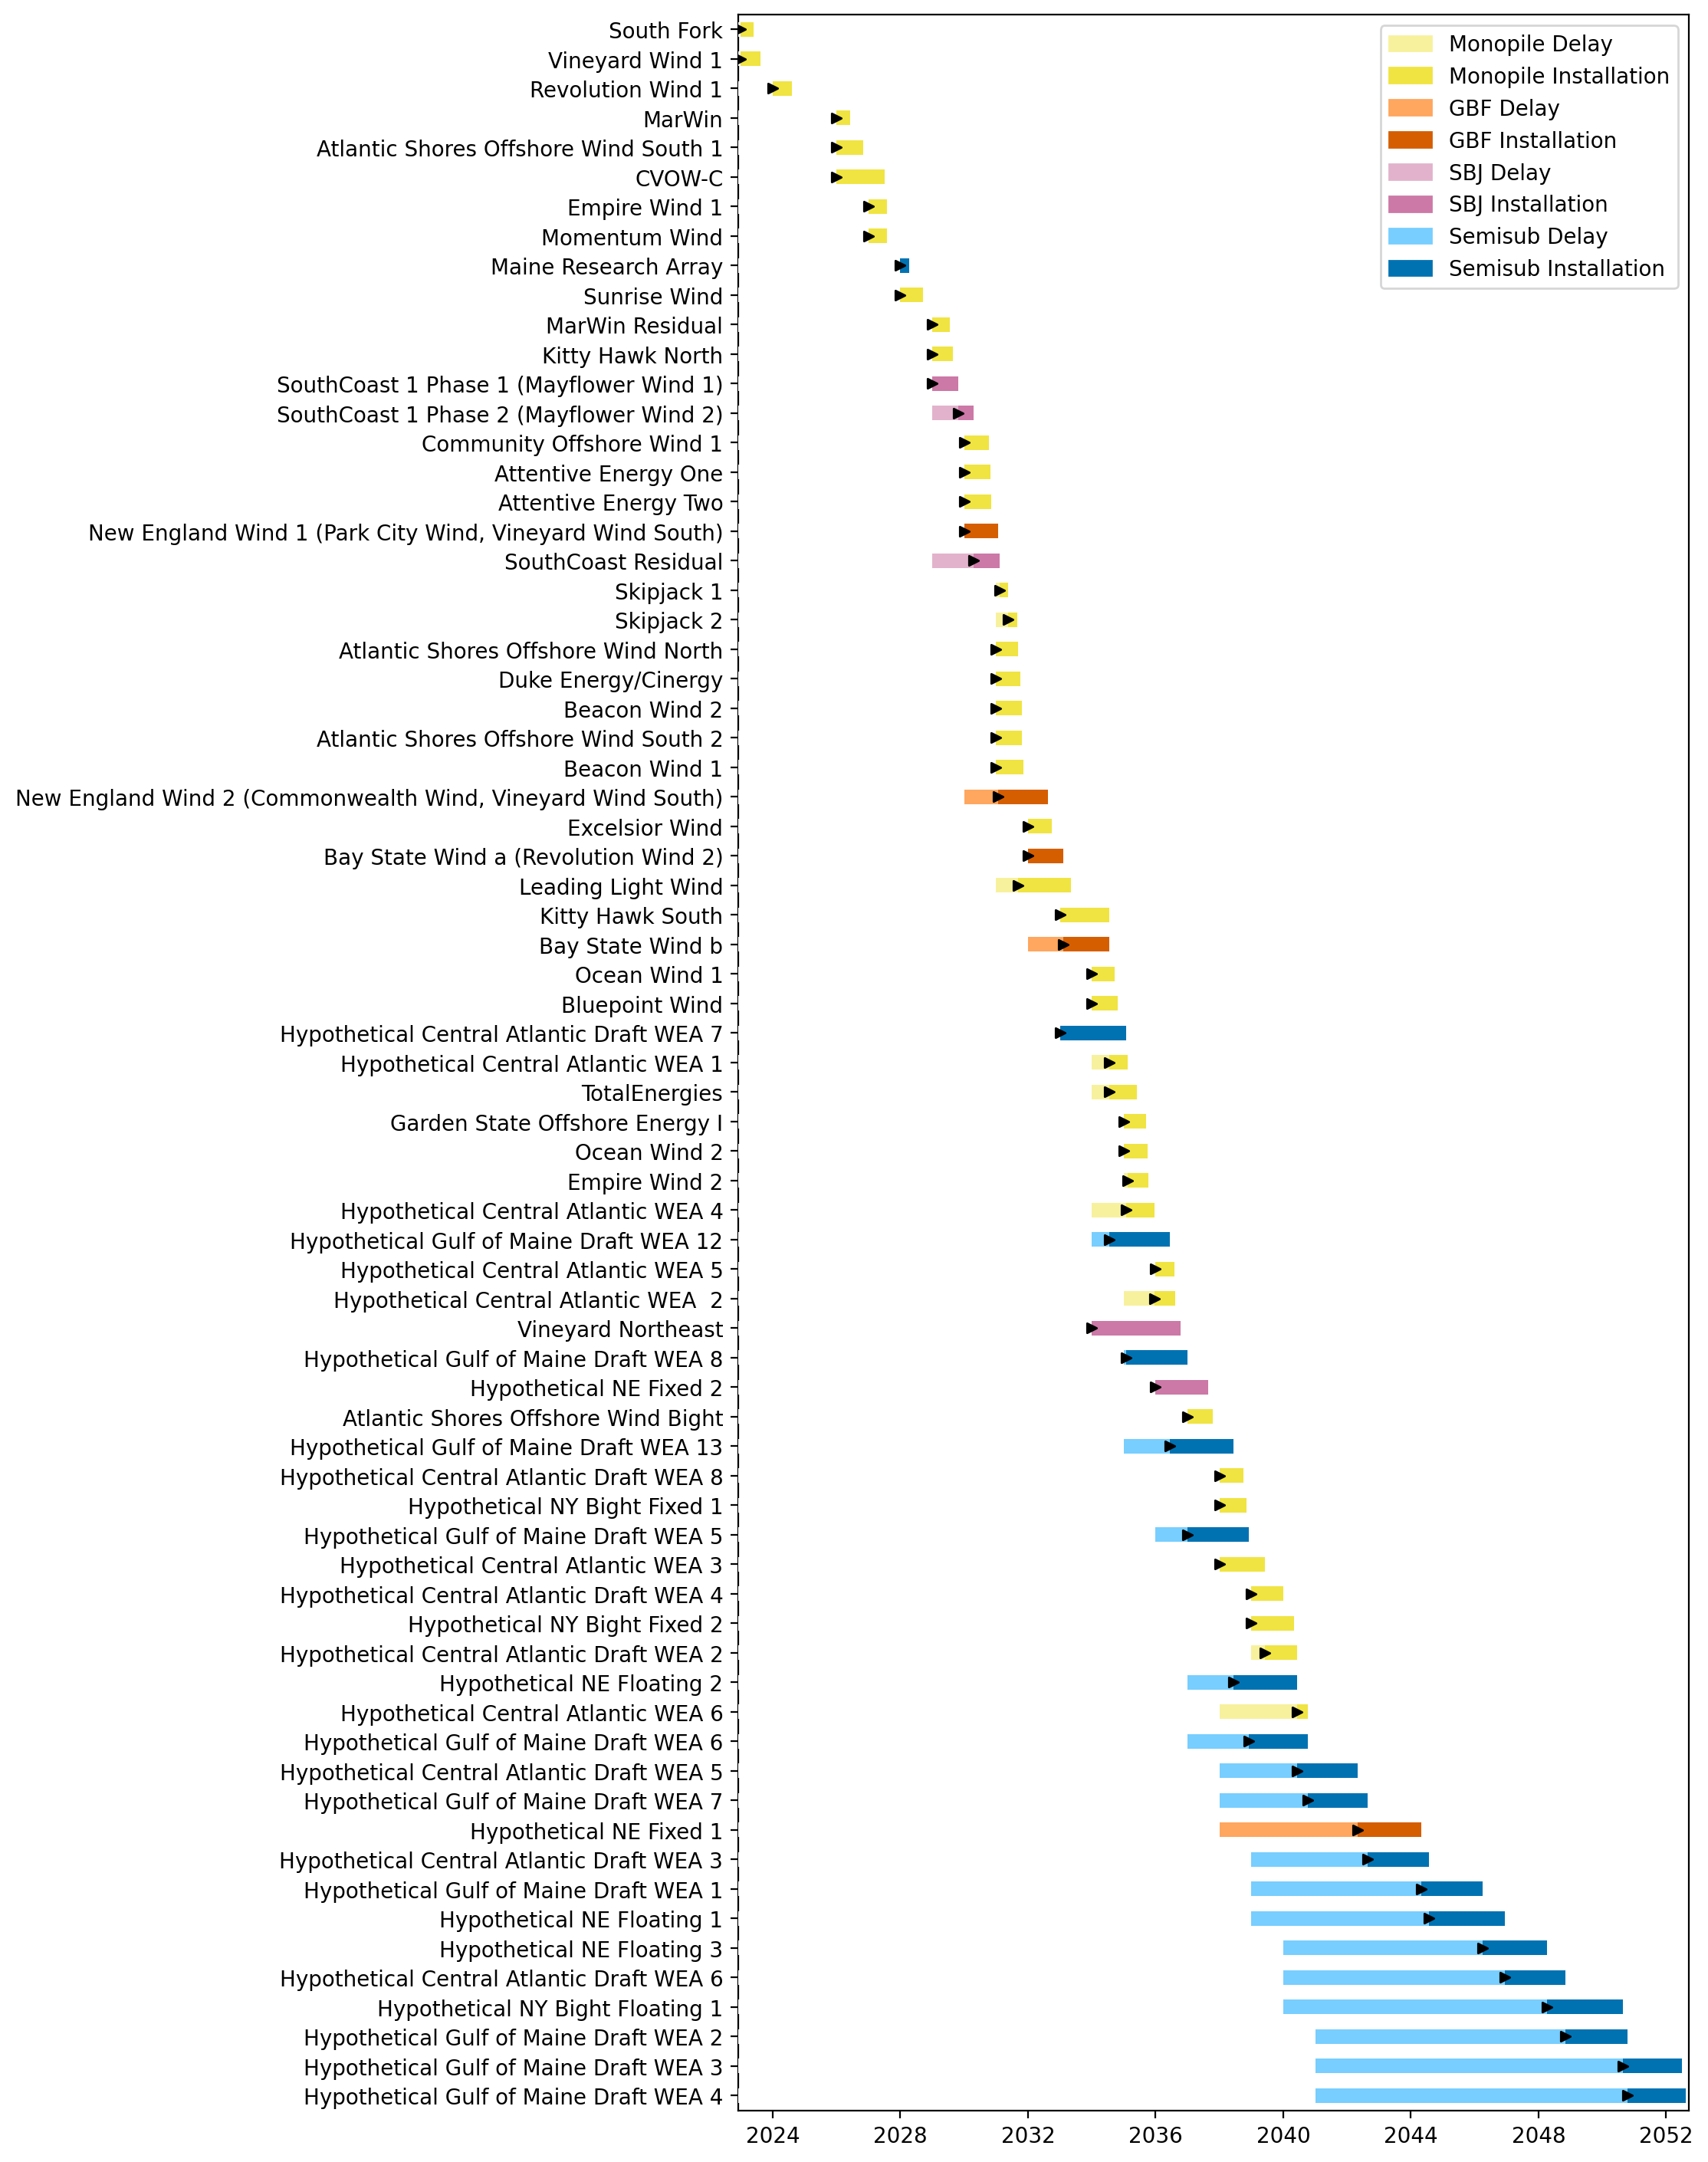
Full Gantt

Slide 12

Port Throughput

Slide 13
natl_gaps_6foreign
1 more foreign WTIV 2025

Slide 14
Full Gantt

Slide 15
Port Throughput

Slide 16
natl_gaps_6foreign_infp
1 more foreign WTIV 2025

Slide 17
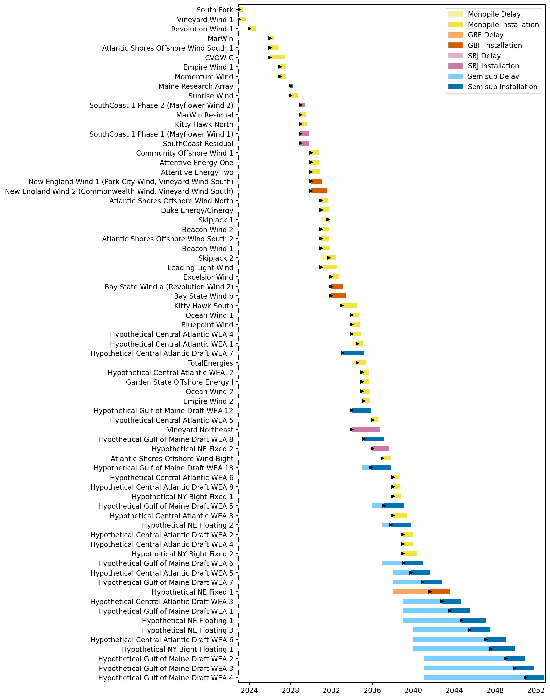
Full Gantt

Slide 18
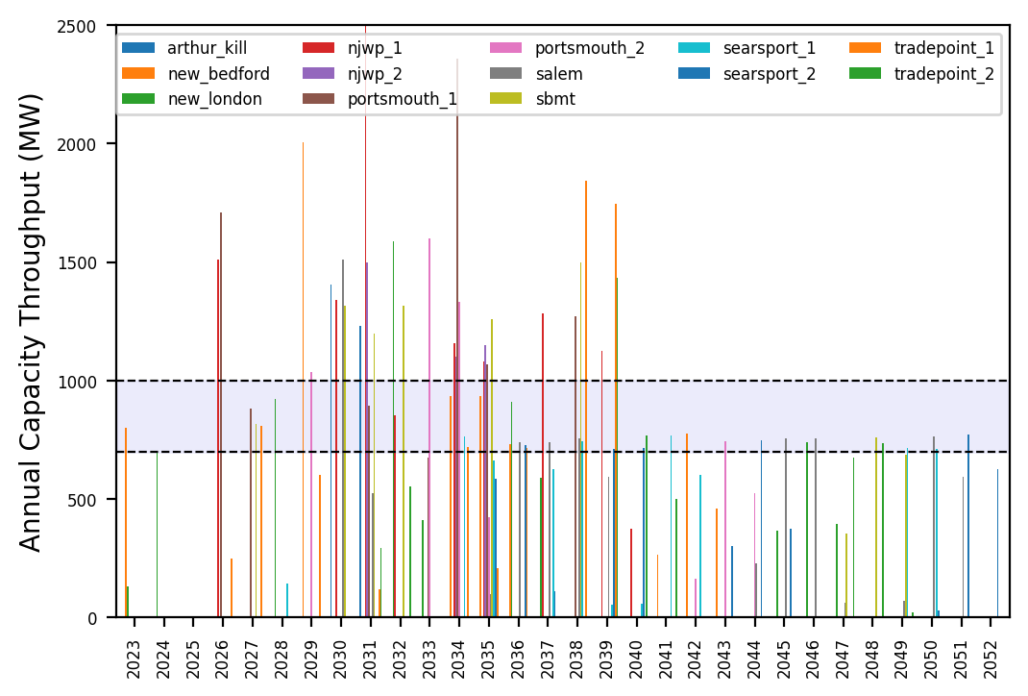
Port Throughput

Slide 19
natl_gaps_infp_infv
1 US WTIV starting with CVOW, then 1 in 2030, 2033, 2036

Slide 20
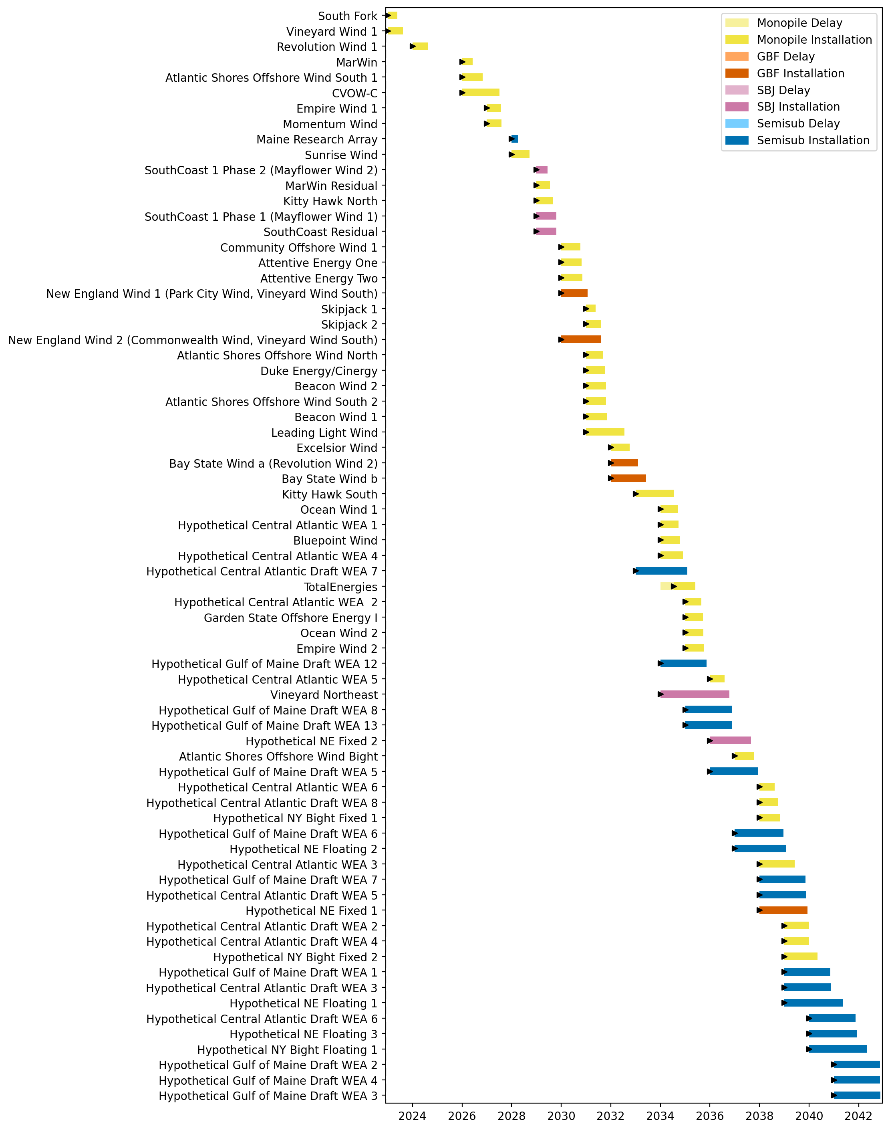
Full Gantt

Slide 21
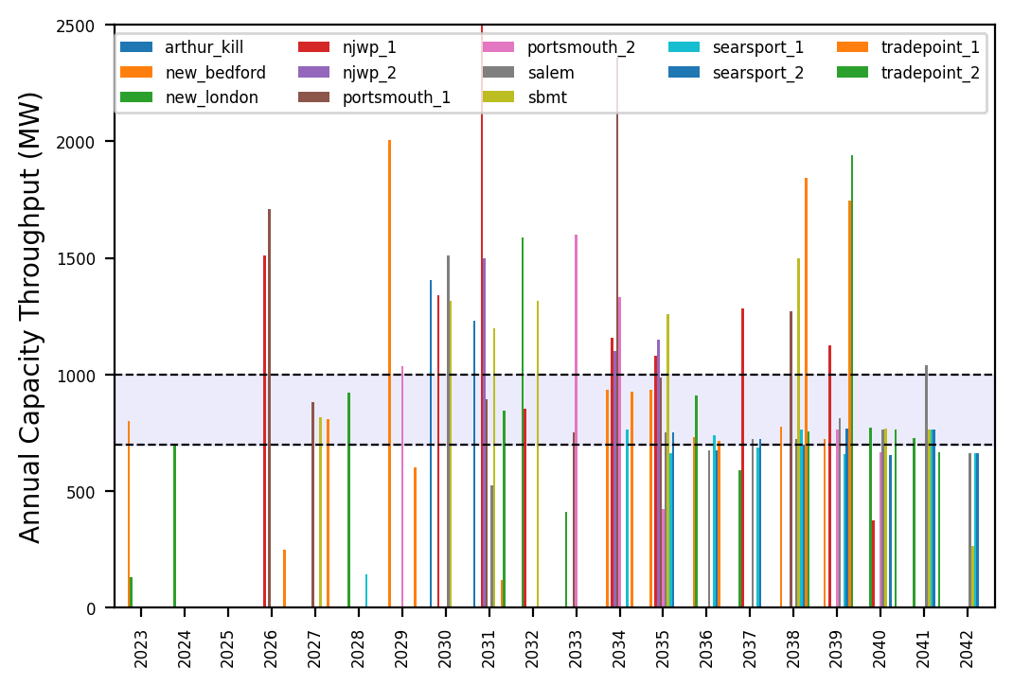
Port Throughput

Slide 22
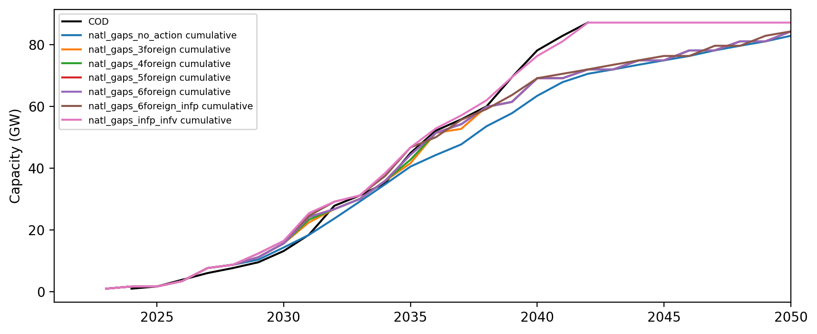
Installed Capacity

