Slide 1
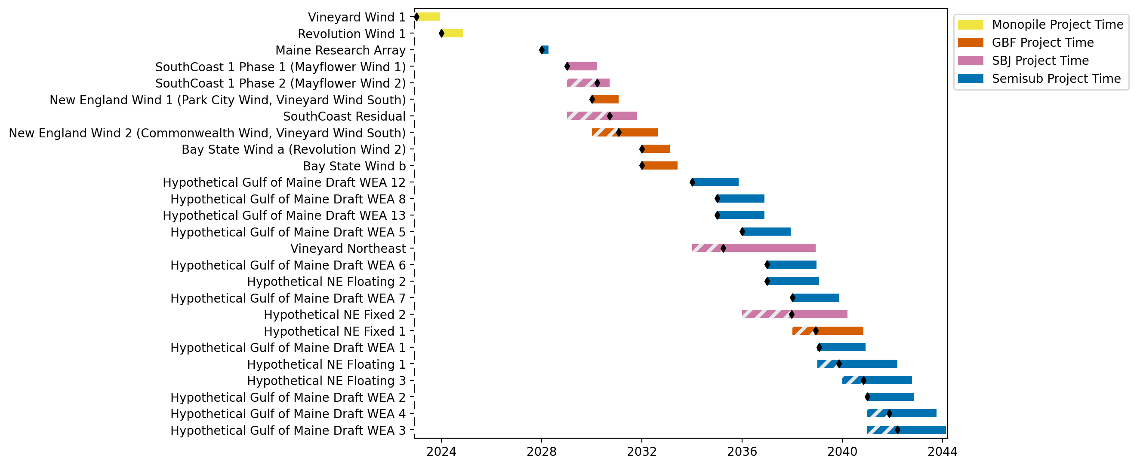
New England Gantt

Slide 2
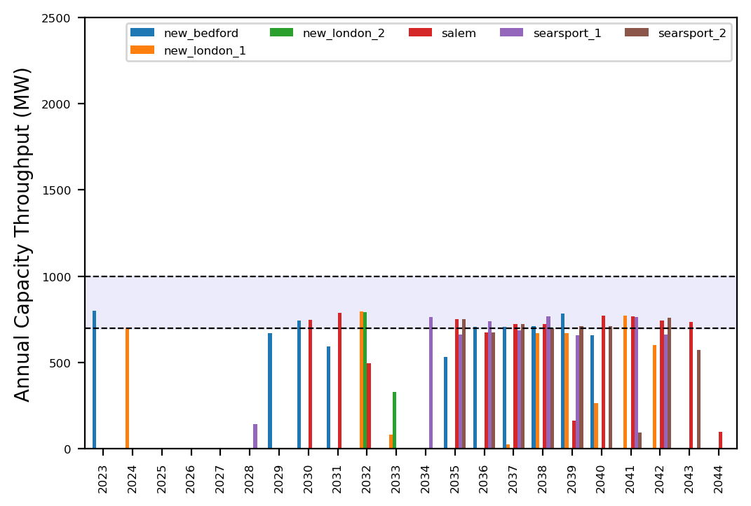
Port Throughput

Slide 3
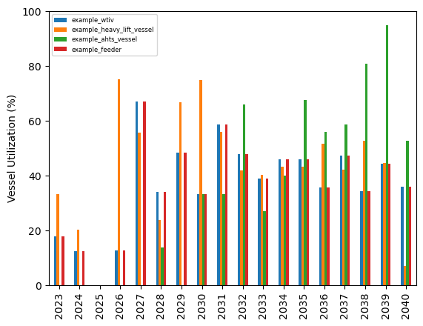
Vessel Utilization

Slide 4

New England Gantt

Slide 5
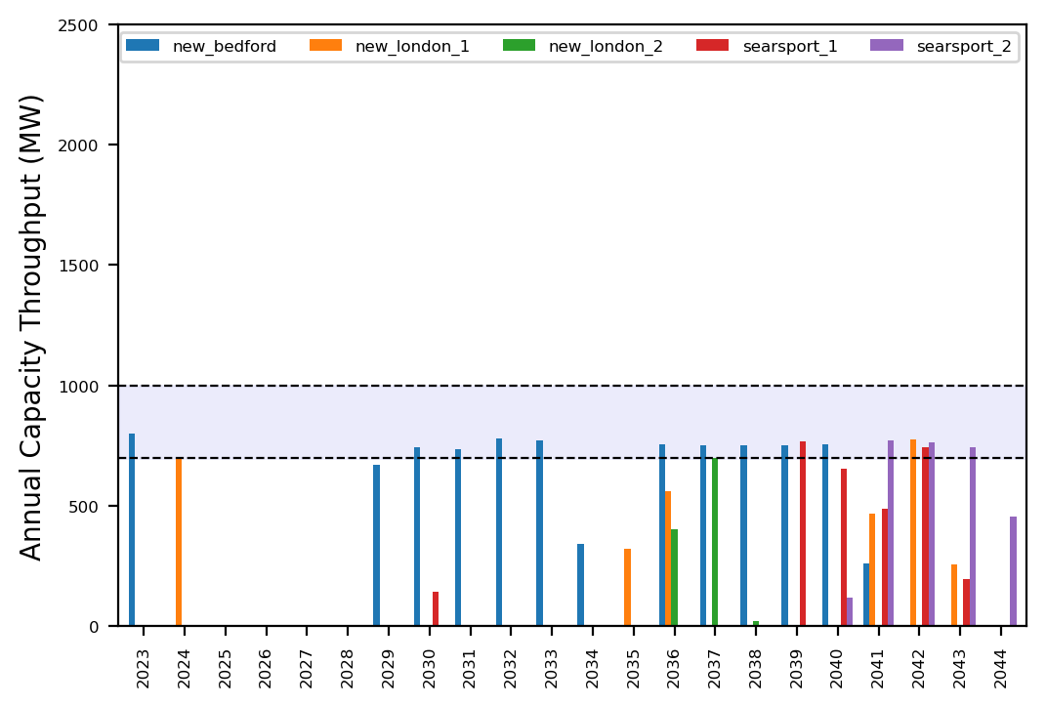
Port Throughput

Slide 6
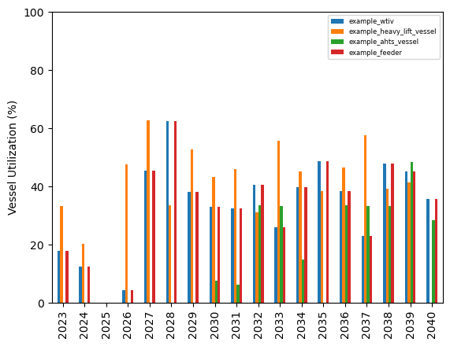
Vessel Utilization

Slide 7
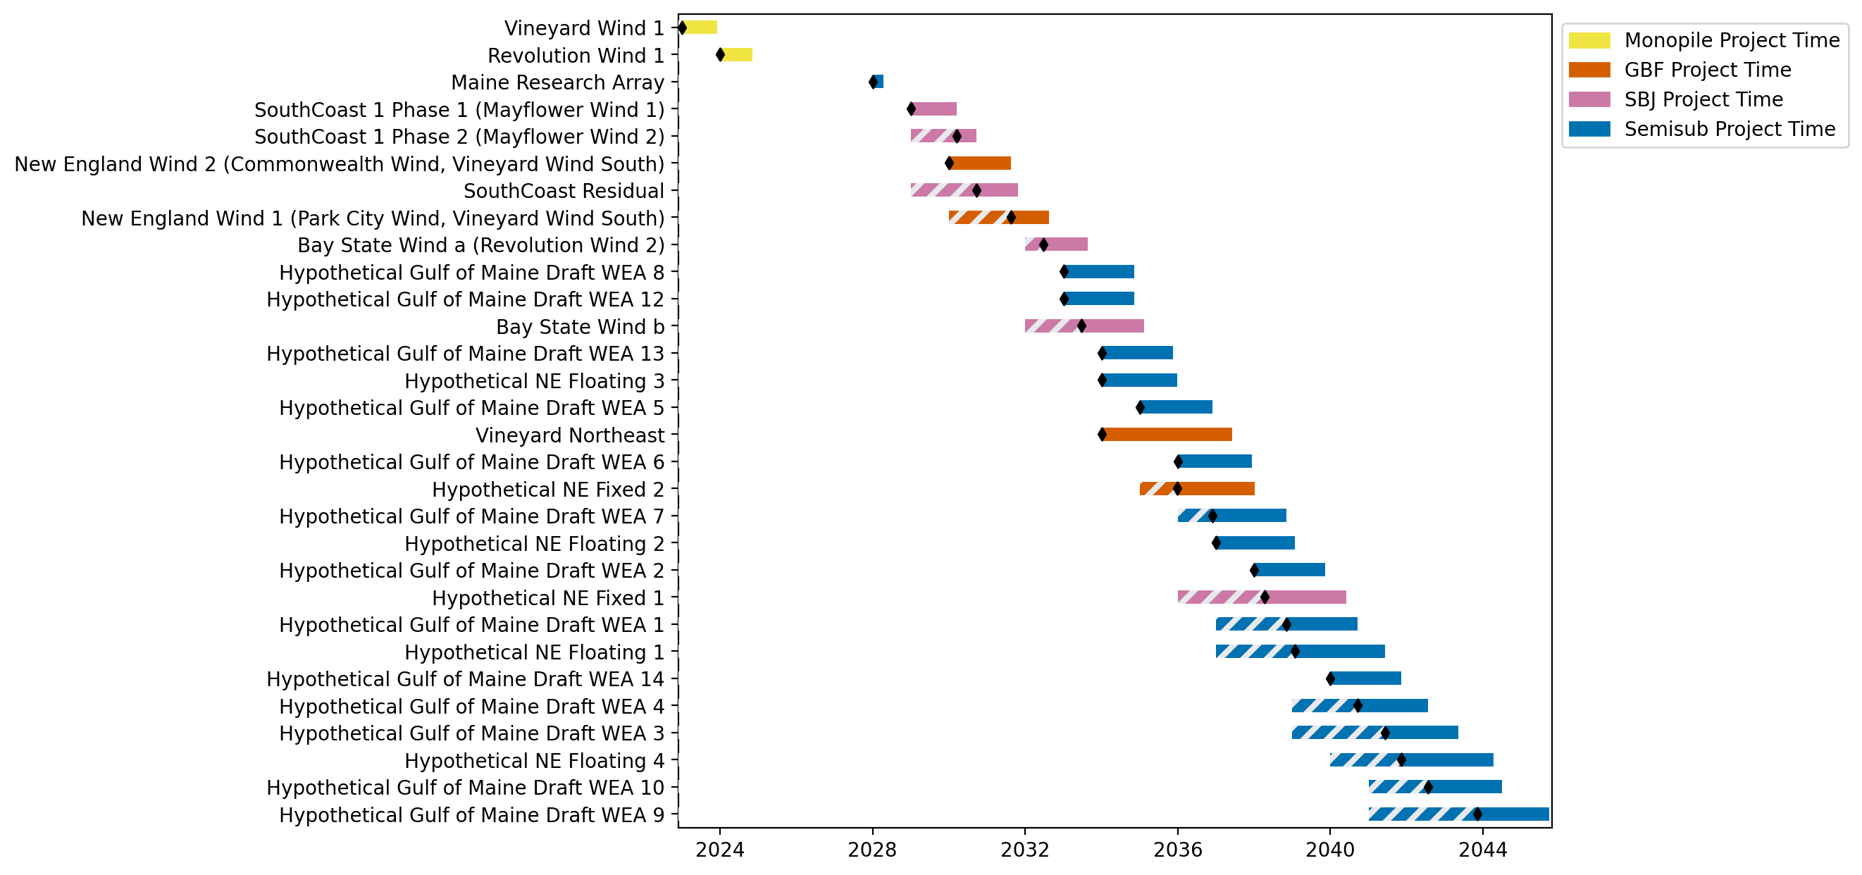
New England Gantt

Slide 8
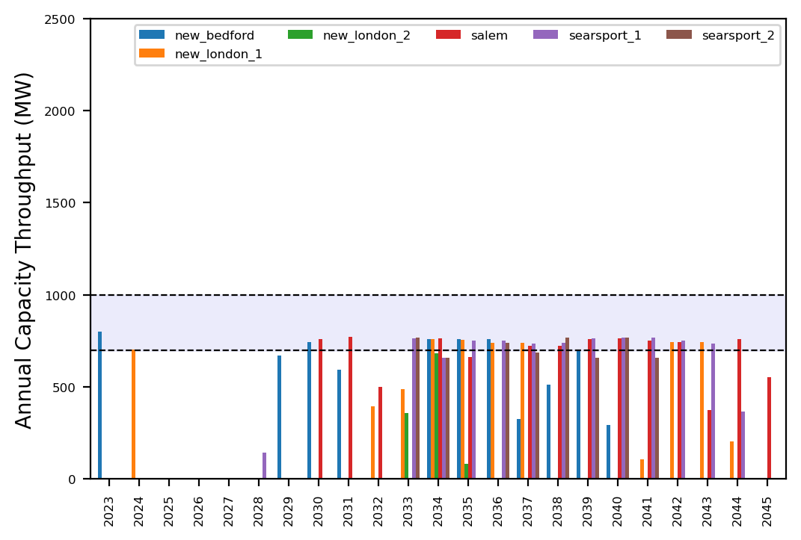
Port Throughput

Slide 9
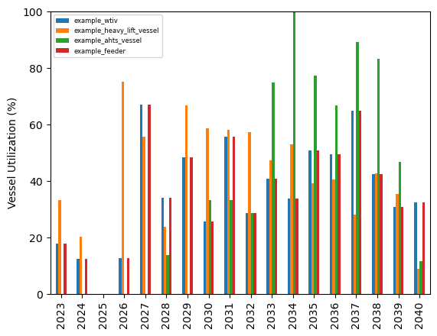
Vessel Utilization

Slide 10
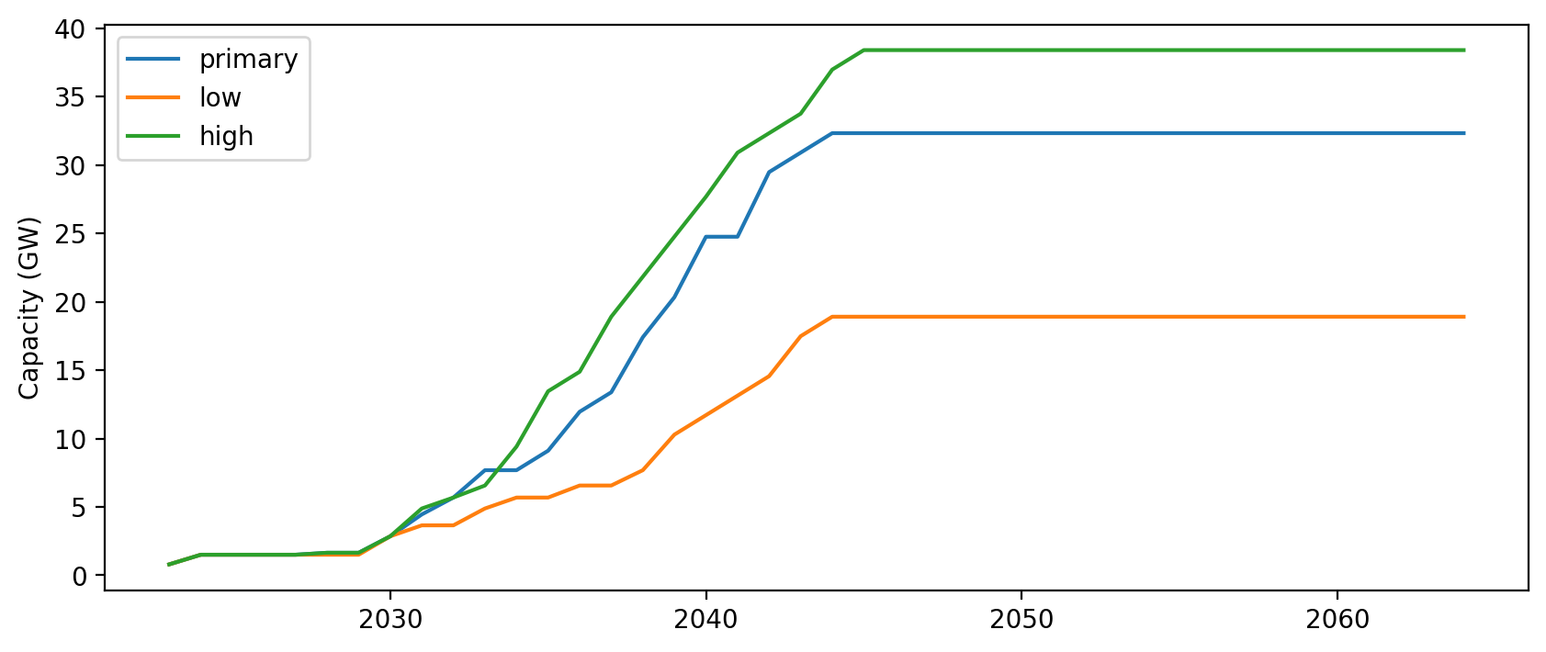
Installed Capacity

Slide 11
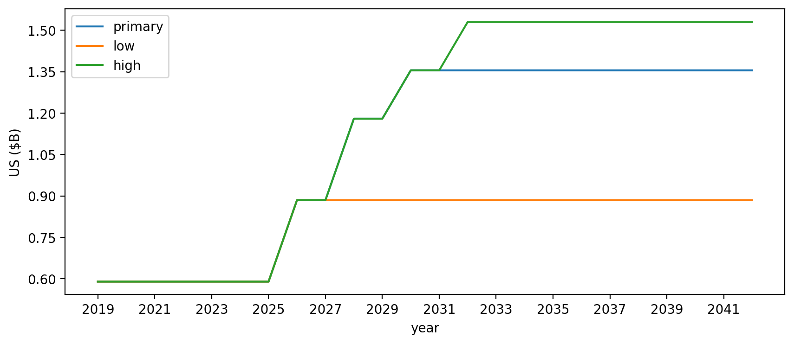
Vessel investment

Slide 12
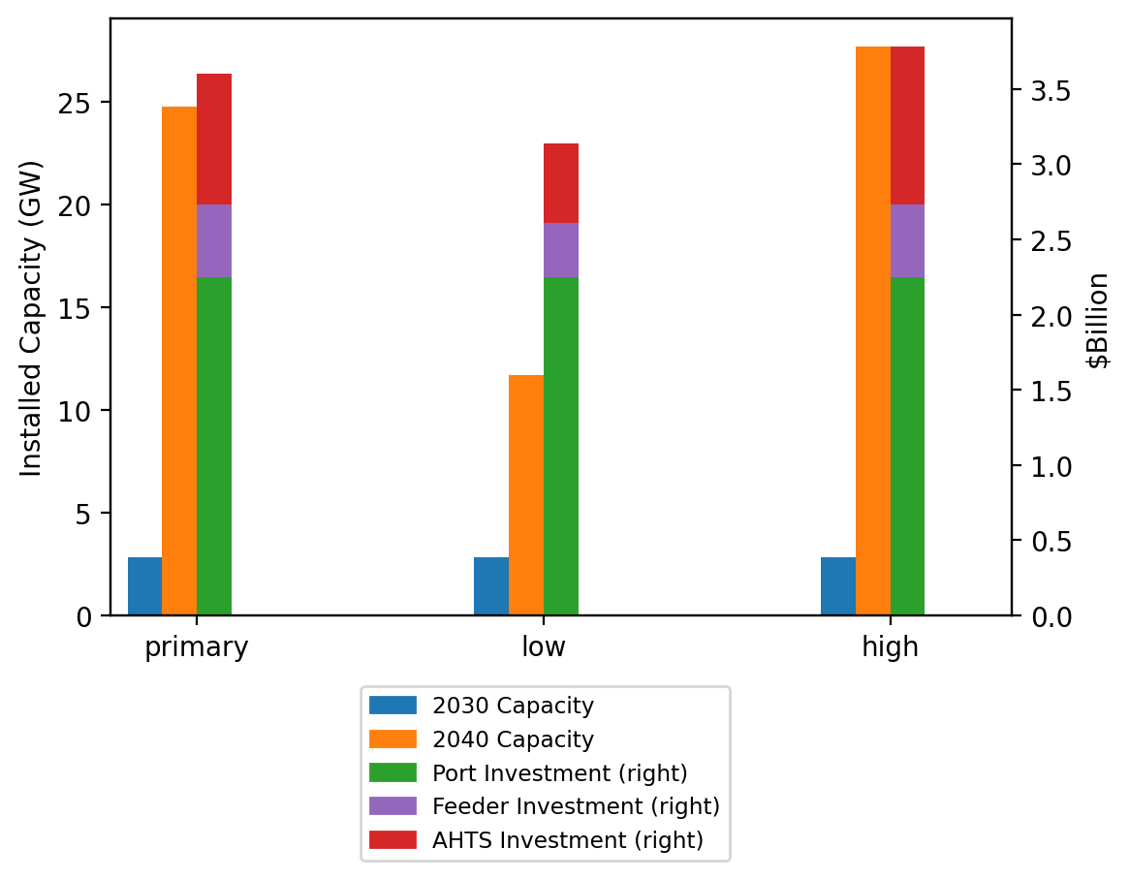
Summary Installed Cap/Investment

