Slide 1
20MW_turbine
Turbine Upsizing Scenario
Add 2 WTIV

Slide 2
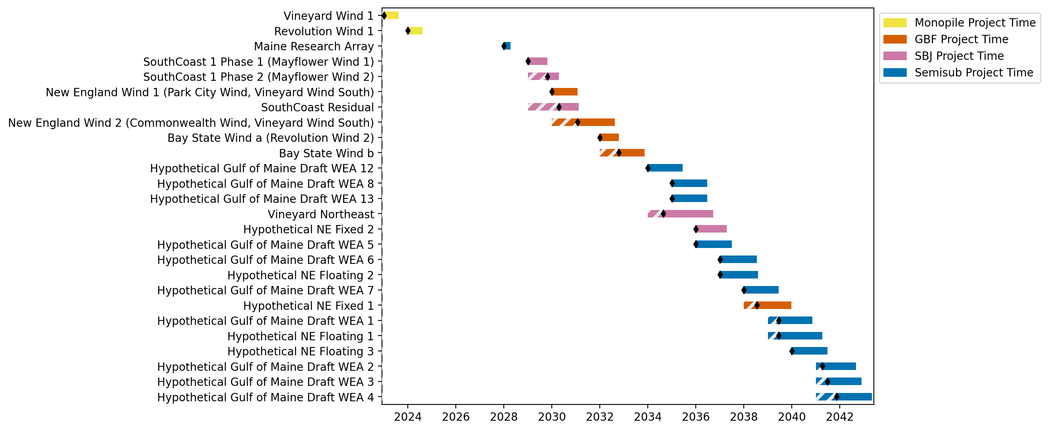
New England Gantt

Slide 3
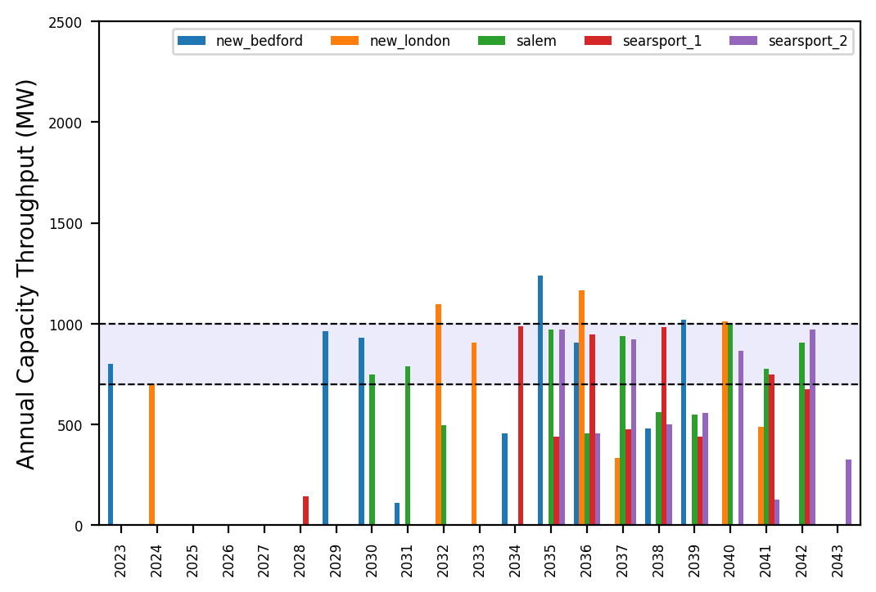
Port Throughput

Slide 4
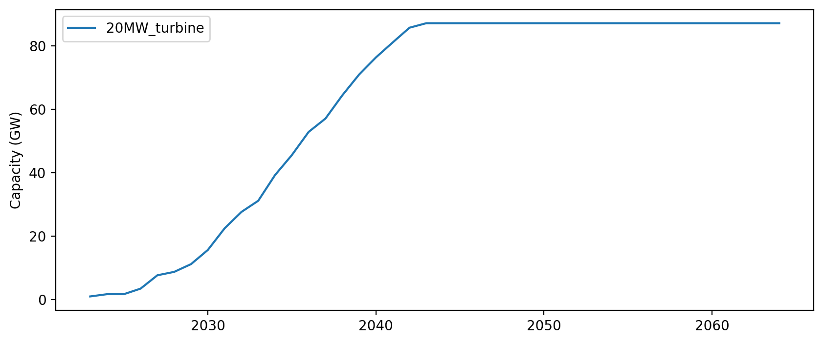
Installed Capacity

