Slide 1
gbf
All GBF Pipeline
Add 4 AHTS

Slide 2
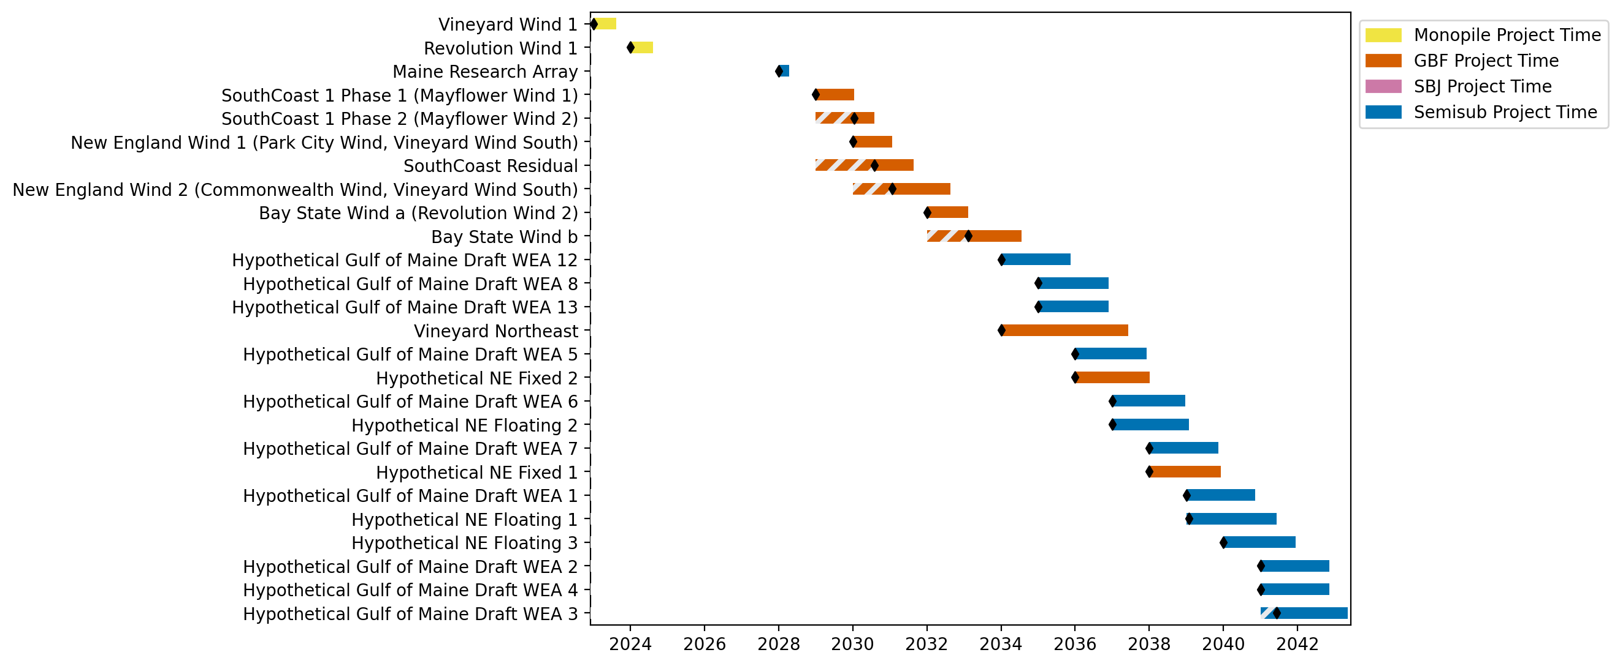
New England Gantt

Slide 3
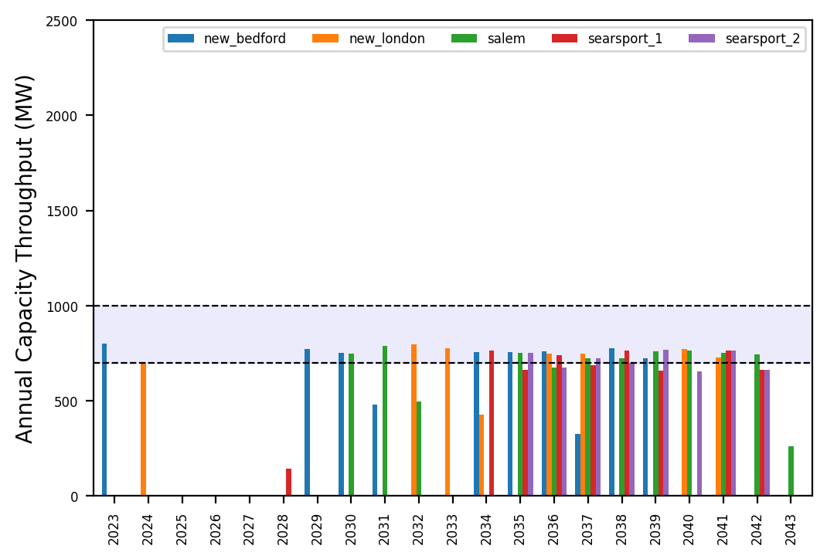
Port Throughput

Slide 4
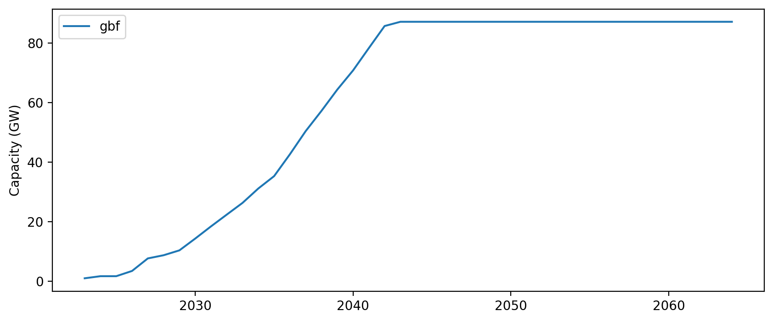
Installed Capacity

