Slide 1
limited_vessels
NE Core Scenario

Slide 2
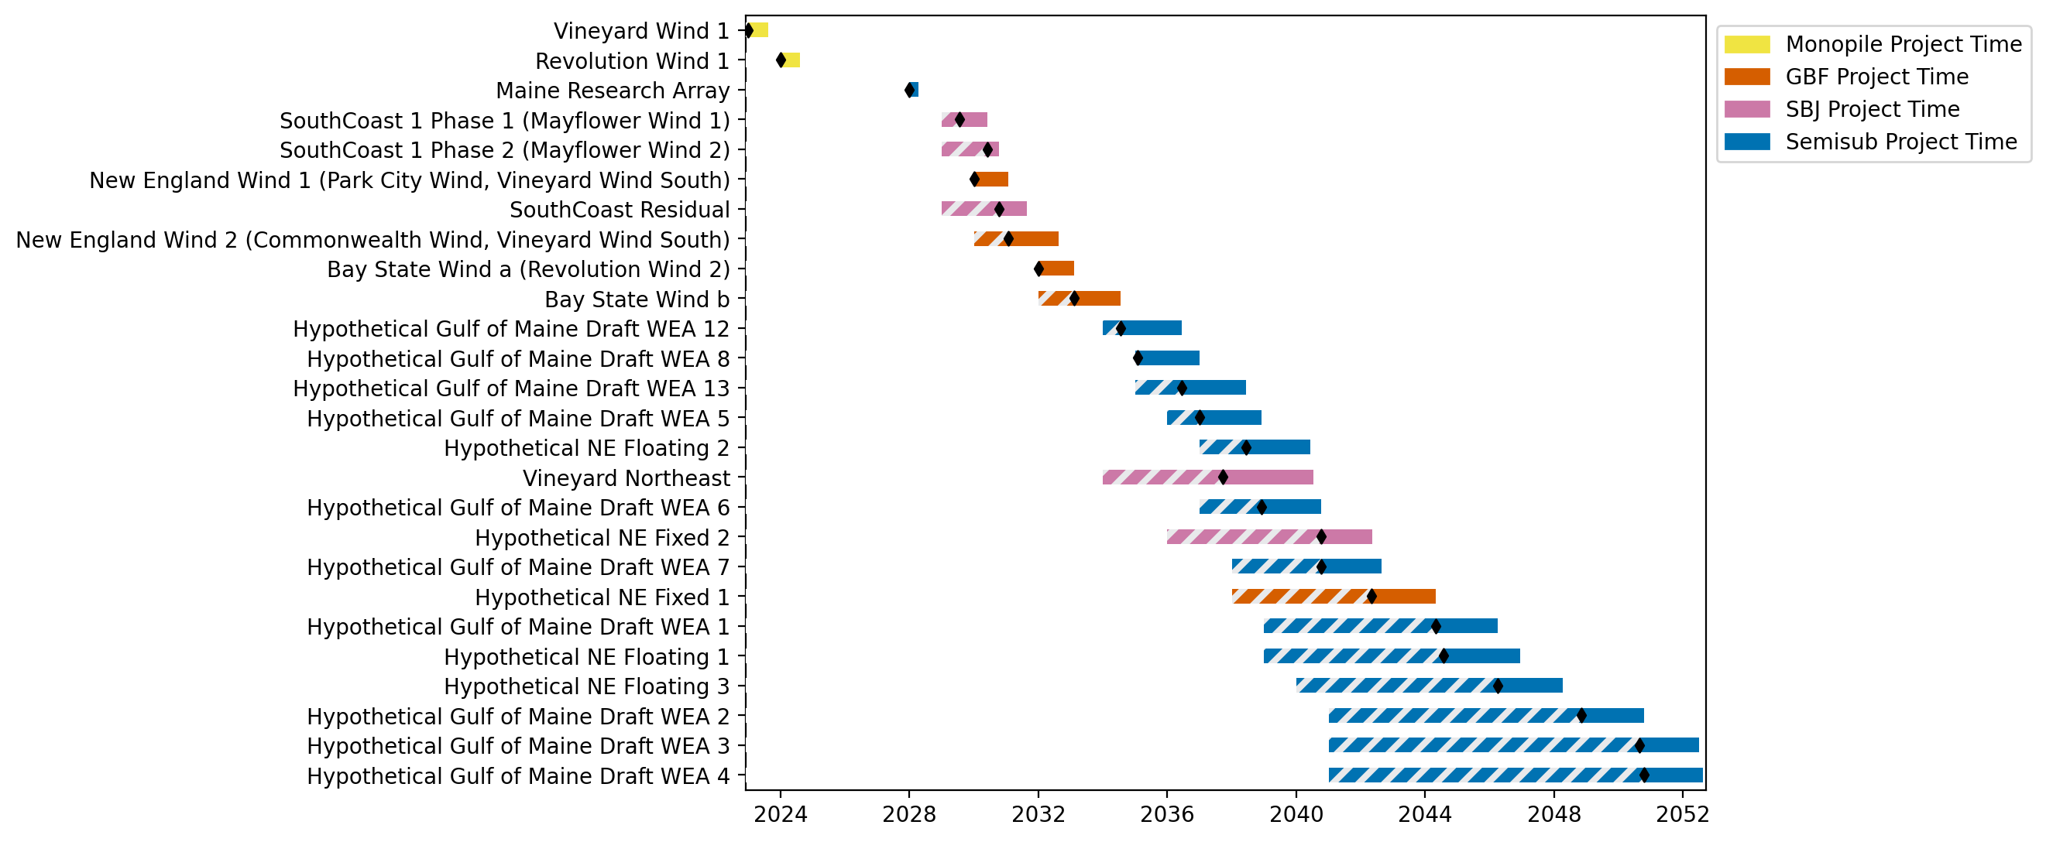
New England Gantt

Slide 3
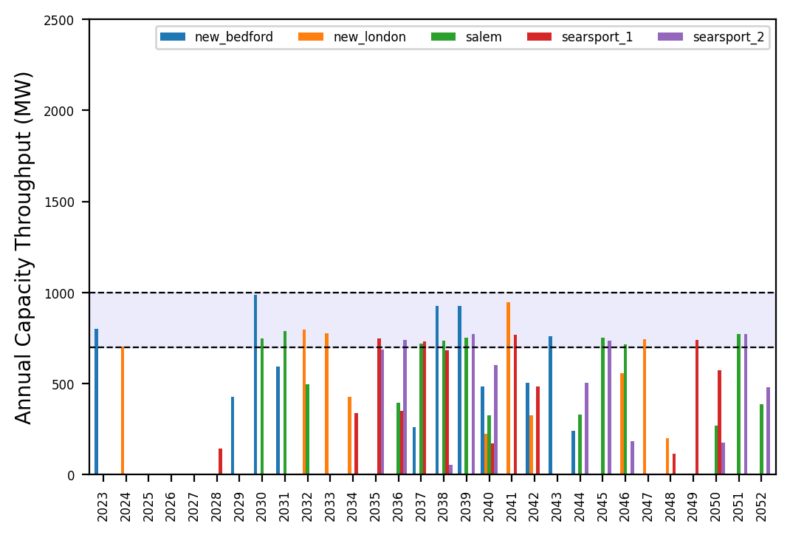
Port Throughput

Slide 4
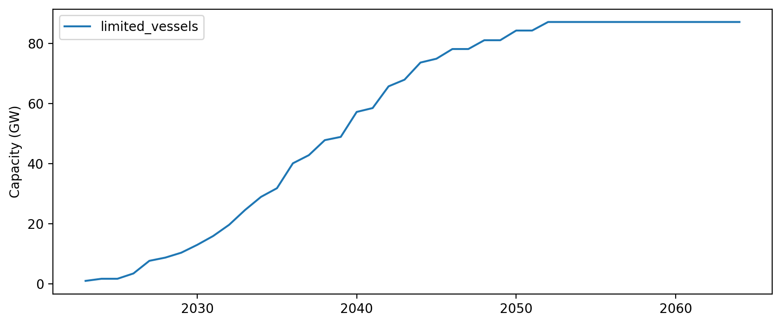
Installed Capacity

